Slide 1
Optimizing Openness in Human Subjects Research: Balancing Transparency and Human Research Protections
Julie Goldman, Dessi Kirilova, Diana Kapiszewski, Anna M. Mitchell

Slide 2
Disclosure: All presenters declare
“I have no relevant personal/professional/financial relationship(s) with respect to this educational activity.”

Slide 3
Learning Objectives
Review new developments and challenges in expectations for data sharing (DS) and research transparency
Examine the interaction between data repositories and IRBs in protecting research subjects while facilitating data availability; summarize results from an empirical study of IRBs on DS
Share model study documents (template consent language that enables appropriate data sharing under different scenarios, data management plan insert) for endorsement and/or adoption

Slide 4
Recent Developments
HIPAA
HIPAA (Health Insurance Portability and Accountability Act) provides data privacy and security provisions for safeguarding medical information.
NSF: Data Management Plan
All proposals must include a 2 page supplementary "Data Management Plan" (DMP), describing how the proposal will conform to NSF policy on the dissemination and sharing of research results.
PLOS: Data Availability Policy
Make all data underlying the findings described in the manuscript fully available without restrictions at the time of publication.
2003
2013
2019
1996
2011
2014
NIH: Data Sharing Plan
Research application requesting $500,000 or more are expected to include a plan for sharing final research data for research purposes.
OSTP: Public Access Plan
Executive Office of the President’s Office of Science and Technology Policy (OSTP) memo directed Federal agencies with more than $100M develop plans to make the results of federally funded research freely available to the public.
NIH: Revised Common Rule
The federal policies mandating the protection of human subjects are known as the “Common Rule.” The revised rule is meant to ease some researcher burden while enhancing the protection of human subjects.

Slide 5
Data Sharing Drivers
Funder and publisher requirements → enforcers
Multiplying benefits of resources spent
Transparency and better evaluation of publications
Technological and infrastructure advances → enablers
A lot of contemporary data are born digital
Professional repositories (domain and institutional) develop processes and tools to store, make findable, preserve for the long run
Researchers → implementers

Slide 6
Research Data Lifecycle
“[A] high level overview of the stages involved in successful management and preservation of data for use and reuse” (DataONE)
PLAN
COLLECT, GENERATE & STORE
CLEAN, ANALYZE & VISUALIZE
PUBLISH & SHARE
ARCHIVE & PRESERVE
REUSE
Plan for research data needs
Acquire, organize & store data
Process data for current use
Organize & share data in repository
Appraise & steward data
Discover & reuse data
Notes:
For this talk, I have divided the research data lifecycle into six stages:
Planning - Plan for research data needs
Collectioning, generating, and storing data - Acquire, organize and store data
Cleaning, analyzing, and visualizing data - Process data for current uses
Publishing and sharing data - Organize and share data in a repository
Archiving and preserving data - Appraise and steward data
Data reuse - Discover and reuse data
In each box, I have provided a summary of the activities in the stage and a few common elements, such as resources or activities.
As you can see, the research data lifecycle is long and complex.
Next, let’s look at some of the many stakeholders who are involved in these processes.

Slide 7
Services Throughout the Lifecycle
PLAN
COLLECT, GENERATE & STORE
CLEAN, ANALYZE & VISUALIZE
PUBLISH & SHARE
ARCHIVE & PRESERVE
REUSE
Plan for research data needs
Acquire, organize & store data
Process data for current use
Organize & share data in repository
Appraise & steward data
Discover & reuse data
Data cleaning, processing & visualization services & support
Consultations, referrals & best practices
Dataverse data repository & DASH
Data curation services
Consultations & referrals
Digital & data preservation services
Consultations, referrals & best practices
Data reference services
Consultations & referrals
DMPTool
Data Management Plans (DMPs)
Digitization services
Data acquisitions
Consultations & best practices
Notes:
For this talk, I have divided the research data lifecycle into six stages:
Planning - Plan for research data needs
Collectioning, generating, and storing data - Acquire, organize and store data
Cleaning, analyzing, and visualizing data - Process data for current uses
Publishing and sharing data - Organize and share data in a repository
Archiving and preserving data - Appraise and steward data
Data reuse - Discover and reuse data
In each box, I have provided a summary of the activities in the stage and a few common elements, such as resources or activities.

Slide 8
Research Data
“material commonly accepted in the scientific community as necessary to validate research findings.”
- Federal Office of Management & Budget Circular A-110
“any representations of the social world relevant to a particular type of inquiry and rendered in a form suited to the analysis to be undertaken.”
- Kapiszewski and Karcher forthcoming
Notes:
Surprisingly, data itself is a bit difficult to define.
If you get too specific in your definition, such as saying that data must be digital, then you end up leaving out important categories of data, such as physical samples like ice cores.
Also, science is constantly changing, and so what is not considered to be data today, might one day become data due to new methods of research.
I like Christine Borgman’s definition, show here because it is broad enough to encompass the sciences, social sciences, and humanities:
Data refers to entities used as evidence of phenomena for the purposes of research or scholarship

Slide 9
Research Data Across the Disciplines
 | Sciences | Social Sciences | Humanities
Evidence | Observations Measurements | Observations Measurements | Primary sources Trace information
Source | Instruments Field observations | Surveys, Interviews Field observations | Art, artefacts Documents
Format | Binary data Images Lab notebooks Samples, specimens Tabular data | Audio recordings Diaries Images Spreadsheets Transcripts | Audio recordings Books, paper Images Maps, GIS Text files
Notes:
Let’s take a look at some examples of data, by discipline.
Remember here that data can be digital or non-digital, too.
In this workshop, we will be seeing how digital data can be stored in the Dataverse data repository.
Much of that data is in tabular form, such as spreadsheets.
However it is good to remember that not all data takes that shape, not all data is numerical, and not all data is digital

Slide 10
Data Management
“Research data management concerns the organization of data, from its entry to the research cycle through the dissemination and archiving of valuable results. It aims to ensure reliable verification of results, and permits new and innovative research built on existing information.”
Whyte, A., Tedds, J. 2011. ‘Making the Case for Research Data Management’. DCC Briefing Papers. Edinburgh: Digital Curation Centre. http://www.dcc.ac.uk/resources/briefing-papers
Notes:
"Research data management concerns the organization of data, from its entry to the research cycle through the dissemination and archiving of valuable results. It aims to ensure reliable verification of results, and permits new and innovative research built on existing information."
Managing your data is common sense organization across a project and/ or a team that allows for accurate communication about that project. You can trace every change and outcome. This is necessary for study reproduction and integrity and it is helpful when you are just coming into a project.

Slide 11
Data Management Planning
Which datasets will be generated in your research?
How will your datasets be named and referenced?
Which file formats will be used for each dataset?
What data standards and metadata standards will each dataset follow?
Who will have access to your datasets?
How and when will you share your datasets, if applicable?
How will you archive and preserve your datasets?
How will you license your datasets?
How will you deal with privacy or confidentiality, if applicable?

Slide 12
Data Management & Ethics
Ethical component remains primary for all research involving human participants
Legal statutes and regulations
Funders, but also individual institutions, might require formal DMPs
Effective research data management is vital to managing risk and the potential for ethical and legal data publication and sharing
Reuse reduces societal cost and participant fatigue

Slide 13
Data curation for sharing & reuse
PLAN
COLLECT, GENERATE & STORE
CLEAN, ANALYZE & VISUALIZE
PUBLISH & SHARE
ARCHIVE & PRESERVE
REUSE
Plan for research data needs
Acquire, organize & store data
Process data for current use
Organize & share data in repository
Appraise & steward data
Discover & reuse data
Data Management Plans (DMPs)
DMPTool
Instruments, Researchers
Subscriptions, Licenses
Asset management
R, Python, OpenRefine
Statistical software
Tableau, d3.js
Data curation
Data citations, DOIs
Data use agreements (DUAs)
Appraise for enduring value
Migrate data to preservation repository
Locate data for new project
Data repository
Notes:
If you remember, it was one of the richest areas of services that librarians can offer.

Slide 14
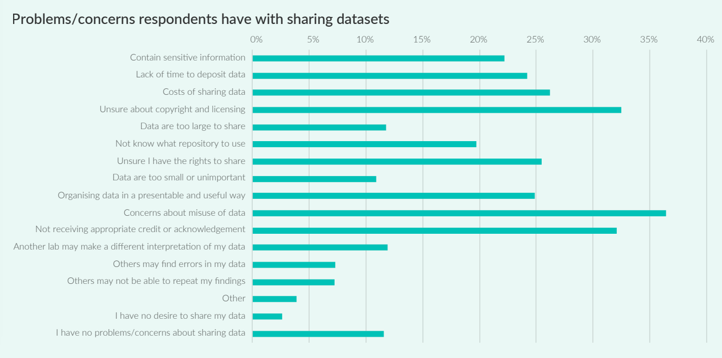
Data Sharing Concerns
Science, Digital, Briony Fane, Paul Ayris, Mark Hahnel, Iain Hrynaszkiewicz, Grace Baynes, and Emily Farrell. 2019. “The State of Open Data Report 2019.” figshare. https://doi.org/10.6084/m9.figshare.9980783.v2
Notes:
Sensitive information

Slide 15
Data Sharing Benefits
Data Generator / Scholarly Community
Data collection is expensive
Others can learn from shared data or (re)analyze them from new perspectives and for new purposes
Teaching of research methods is enhanced as students can practice using analytic techniques on actual (or sample) research data
One’s work can be improved when a plan to share data and documentation about the production and analytical processes used in a project exists and is followed from the beginning
Research Participants
Benefits to research participants/the public also exist!
Maximizes the use of their contributions / information
Allows them to have their voices / stories heard more widely
Minimizes repeated data collection efforts
Especially for hard-to-reach, oversampled, over-studied groups

Slide 16
Achieving Data Sharing
Data need to be managed properly to be effectively published and shared
Publishing does not necessarily equal full sharing and even less “open access”
Data underlying just results reported in a paper
Data underlying publication + information about other variables collected
Data underlying publication + embargo on full dataset
All data collected for that study
Metadata can be published for discoverability regardless of specific access conditions to the mediated actual data
Publication and sharing might happen on different timelines
Notes:
“NOT ALL OR NOTHING” POINT

Slide 17
Options for Data Sharing
Public-Public (Open access) | Public-Private (Mediated open access) | Private-Private (Closed access)
Metadata is fully discoverable | Metadata is fully discoverable | Metadata is not publicly available
Data are accessible and immediately downloadable | Mediated access to data via data custodian | Data not discoverable or available to third parties
Preferred option for non-sensitive data from completed projects | Good option for sensitive or confidential data | Safest option for highly-sensitive data
Table originally from Curtin University, Research Data Team. http://libguides.library.curtin.edu.au
Notes:
Table originally from http://libguides.library.curtin.edu.au/, via Olesen, Sarah. “Ethics of Data Publication: Same same or different?”. Committee on Publication Ethics. Available at https://publicationethics.org/files/COPE%20presentation_S%20Olesen_for%20distribution%20%281%29.pdf
Publication: makes the data discoverable (via findable metadata; might lead immediately to actual data assets or not)
Access: the actual dissemination to others (might be fully open or mediated, i.e., have various conditions/restrictions/limitations)

Slide 18
Repositories
Provide a persistent identifier (and url) and a citation for your data
Archive your data in a trusted place for long-term access
Provide a framework for you to describe your data using metadata standards
Provide access control, in case you need to restrict your data
Are compliant with funders’ and journals’ requirements

Slide 19
Repository Services
Workflow-based
Assistance by repository staff in data collection methods decision-making and DM planning
Technology-assisted
Access controls (incl. timed embargos, secure downloads, virtual enclaves, physical enclaves=offline access, etc.)
Policy-based
User agreements for both depositor and end-user of the data

Slide 20
Disciplinary Repositories

Slide 21
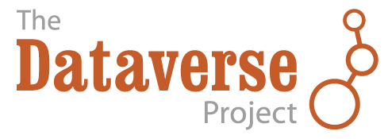
General Repositories

Slide 22
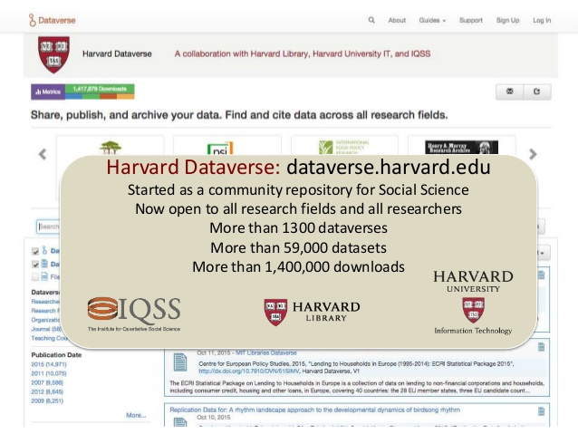
Institutional Repositories
Harvard DASH https://dash.harvard.edu
Harvard Dataverse https://dataverse.harvard.edu

Slide 23
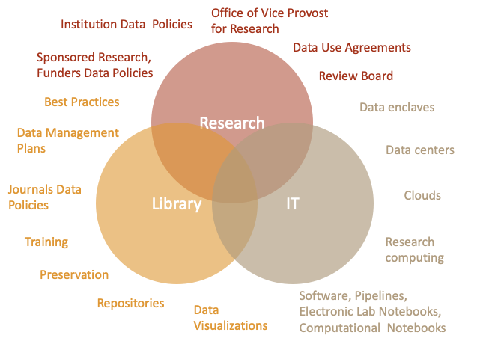
RDM is a Collaborative Effort
(IRB)

Slide 24
Collective Management of Tensions
All of these actors can help researchers to manage the assumed tensions between data sharing imperatives and ethical and legal responsibilities to protect human participants in research.
Notes:
different communities, overlapping goals

Slide 25
Considerations for data sharing
How much risk do the data carry? Is there any additional risk that their sharing might present? Is one sharing scenario or another able of minimizing the additional risk?
How likely are any of the risks?
How much benefit does collecting the data bring? Are there additional benefits that data sharing might provide? Is one sharing scenario or another best able to maximize benefits?
Were the participants asked for their permission to share the data? Were they willing to share the data / under certain conditions only?
Notes:
- Sounds like the questions IRBs would consider, but these are also the factors repos care about and would help a researcher think through

Slide 26
Nexus of DMP and IRB Mandates
Sample narrative replies to a survey of NSF awardees
Notes:
Curty, R., Kim Y., & Qin, J. (2013). “What have Scientists Planned for Data Sharing and Reuse? A Content Analysis of NSF Awardees’ Data Management Plans [presentation slides].” Research Data Access & Preservation Summit. Baltimore, 4-5 April 2013. Retrieved from http://www.slideshare.net/asist_org/rdap13-curty-what-have-scientists-planned-for-data-sharing-and-reuse-a-content-analysis-of-nsf-awardees-data-management-plans.

Slide 27
Motivation for QDR’s Empirical Studies
Researchers come to repositories wishing to share data but sometimes present restrictive consent forms
Reveals little awareness of the need for DMP choices and IC scripts to align
No habit of planning for sharing

Slide 28
2017 IRB Public Guidance Language Study
50 universities with top amounts of NSF SBE funding in 2016 (114 SBE guidance documents)
0.1% of docs referenced data sharing
3 docs – “sharing”
4 docs – “archive”
5 docs – “repository”
Notes:
SBE = Social, Behavioral and Economic Sciences Directorate

Slide 29
2019 IRBs and Data Sharing Study
17 universities in individual interviews
12 universities in focus groups (Chicago; DC)
Primarily R1 universities (due both to sample selection and self-selection):
Highest NSF SBE funding amounts
Most relevant pressures from federal funders and journal requirements on researchers
Often trend-setters for others

Slide 30
Where IRBs First Learn about Data Sharing
(more predictably)
Understandably: from researchers’ protocols
Suggests need for new knowledge by IRBs
Some staff research further on their own (typically better resourced institutions)
Most have to rely on researchers’ own understanding
Due to legal considerations, must involve other depts
No institutional (internal or external) guidance mentioned as an initiating driver
Notes:
- Some local “freedom of information” (ex: Commonwealth of VA) and minimum retention requirements have necessitated data sharing too

Slide 31
Where IRBs First Learn about Data Sharing
(more unexpected)
From various data use agreements (DUAs) researchers sign as secondary users of data
From need to cooperate internally on a team or with researchers at other institutions or to take “their” data with them to other universities
more limited type of data sharing but still necessitates detailed plans
Sometimes even from media reports about science fraud scandals

Slide 32
Policy Development Follows Practice
Might reflect idiosyncrasies of studies
Might lead to ad hoc solutions
Might nonetheless be the right approach
BUT all respondents wished for a centralized source of more uniform information / standardized forms
Notes:
- Wish might be unrealistic

Slide 33
Impact of Revised Common Rule?
“Even though the regulations have been updated I don't think they've really … been adequately updated to provide guidance for institution in terms of how to do this in a way that protects human subjects. I think there is recognition that we are in a very different realm in terms of our ability to share data, but we haven't really sort of matched that in terms of guidance for researchers or for IRB folks.”

Slide 34
Impact of Revised Common Rule
Addresses SBE data sharing tangentially
ONE BIG CHANGE: new requirement to say whether even de-identified data will be shared (in the past, often automatically treated as not HSR) has forced researchers to put more thought into what their plans are / should be
* highlights importance of data management planning, even informally
Notes:
Sidenote re: the logistical nightmare of broad consent, which should have / could have been a boon for data sharing; most uni’s not implementing
Ref. Kathleen Murphy’s take on the “spirit of broad consent” vs. “the reality of broad consent”

Slide 35
Common Reactions – Change Forms
Typically, questions about data storage (during course of project) and disposition have existed
Recently (last 18-24 months on average) – new Qs
🡪 will the data be shared in any form
🡪 will shared data be de-identified or not
🡪 what will be the period of retention
Notes:
- Our recommendation: review the questions your form asks and think whether they lead researchers to think that a certain default is expected (for example, 5-yr retention minimum rule sometimes is misinterpreted to mean data need to be destroyed after 5 years)

Slide 36
Less Common – Proactive IRBing
Being alert to funder requirements generally
Discouraging PIs from promising that they / their team will be the only ones with access to the data
Inquiring about data sharing plans if none are addressed in IRB application
Notes:
interestingly, some of the more proactive IRBs have encountered pushback, typically from more established researchers who are used to the default “we’ll just keep the data and we don’t need to say anything about data sharing”
Respondents shared that their IRB staff is thinking whether the IRB actually should have a role in raising data sharing when not mentioned and including the topic in trainings

Slide 37
Even Less Common – Shift in Mindset
Rare examples of thinking about data sharing as a benefit, not just a risk
“In submissions, people will say…’This might lead to increased knowledge about X’… and we take that on faith, but if that data never gets out into the scientific community and is never shared, that benefit can’t be realized.”

Slide 38
Need for intra-campus coordination
Issues are complex and solutions require multifaceted expertise
Reorganizations of activities in past 7-10 years: trend toward expanding scope of human participant protections programs to become broader research integrity programs
Most typically also involve sponsored programs, local libraries, IT departments, legal counsel
Notes:
As illustrated in the Venn diagram above

Slide 39
Relevant campus entities
Existing institutional repositories (typically for non-sensitive / non-identifiable data only, so little use for SBE researchers)
Data stewardship / security policies – developed for other reasons, but direct impact on DM planning and possibility of data sharing
In some places, campus privacy officers and cyber-infrastructure groups can provide expertise

Slide 40
ADVICE FROM REPOSITORIES
PIs must consider post-study life of their data
Human participants must be informed of the plans and given options
Data sharing allows for nuance – find the appropriate choices for a given study and a given population
Suggested consent script inserts for data sharing: https://qdr.syr.edu/guidance/templates
Notes:
https://qdr.syr.edu/guidance/templates

Slide 41
BCH IRB Perspective
Many academic hospitals are also doing behavioral research and because they are HIPAA covered entities also have to adhere to the HIPAA privacy rule
The BCH IRB reviews both behavioral as well as biomedical research, including specimen registries / data repositories
Submissions are submitted through a specific registry/repository form
Notes:
General discussion of what Boston Children’s Hospital (BCH) process for reviewing research protocols including data repositories
Types of information typically included in data repository/ registry submissions as well as typical informed consent content
General comments on information learned from the Qualitative Data Repository’s (QDR) work with data repository and IRB communities

Slide 42
Data Registry Protocols
IRB review information that is requested is the following:
Repository Details: Where repository will be located, the types of subjects (minors and/or adults)
Purpose of Registry: State the objectives, justification of why collection of data is warranted scientifically
Registry Information: What sources the data will be obtained from, the time period these data will be reviewed, what type of data will be collected, data collected or list of data elements

Slide 43
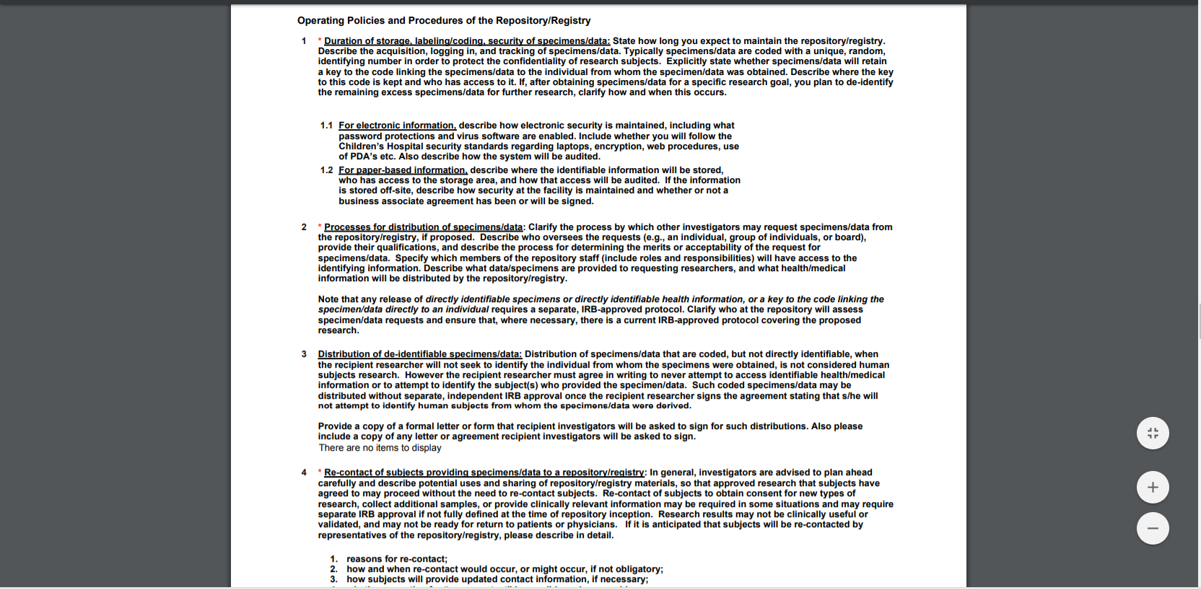
Registry/Repository From

Slide 44
Data Registry Protocols
Recruitment Details: Patient population, inclusion and exclusion criteria, methodology that will be used to recruit subjects
Operating Policies and Procedures: Duration of storage, labeling/coding, security of data, for electronic information how security will be maintained, for paper based where it will be stored and who has access, who will the data be shared with
Risks/Benefits: Benefits, risks, process how events will be reported to the IRB
HIPAA/Privacy/Confidentiality: Methods to protect privacy and maintain confidentiality, coded data where the key to the code is accessible researchers
Informed Consent and Authorization: Explain how, when, where and by whom consent will be obtained, explain how consent is discussed for the data repository, documentation of consent , process for when subject turns 18

Slide 45
Informed Consent Forms
In addition, to the typical elements of informed consent the IRB would want to see the following information for a repository protocol:
Discussion what data is being collected
How data will be labeled and how it will be protected
Who will the data be shared with and how will it be shared
Standard wording whether information/samples will be used for research in the future

Slide 46
BCH Example
Pulled information from one of the repository questions (informally) focusing on how many of the protocols were sending outside or keeping data within the institution and how data would be distributed
Total of Data Registry/Specimen Repository protocols 147
# sending data outside the institution: Yes/ 60
No/ 41 Unclear*/ 46
How was data distributed? De-identified 74
Aggregate 4 Unclear* 69
Notes:
Informal review of data of one particular question in the data registry/specimen repository protocols.
Outside of the institution - Unclear - this could be that the question was addressed elsewhere in the submission through edits to the submission form, data was only being used by the study team and not sent out, etc.
Data distribution - unclear, data was not being sent outside the study team, the questions was more specifically answered in another question of the submission with edits to whole submission form, etc.

Slide 47
Beyond BCH IRB Review
BCH IRB also utilizes other departments within the research enterprise if agreements are necessary for data to be sent outside the institution and when data is coming into the institution (Data Use Agreements)
Working with BCH IT and added questions to make sure it gets appropriate reviews by security and IT professionals as we are seeing more data stored in the cloud and transferred this way as well
Notes:
We request that the researchers contact these departments and make sure the appropriate process is followed before data is released or received
More IT related questions to make sure it gets appropriate reviews by security and IT professionals . Maybe we are extra careful because we are a HIPAA covered entity but there are more things being stored in cloud transferred etc

Slide 48
Challenges
Providing clear language in ICFs for participants so they know how their data will be shared
Individualized data requests – for example, BCH recipients of large external data sets. Institutionally, BCH has an institutional sign off that researchers will not try to re-identify, often in addition to DUAs.
Notes:
Providing clear consent language is always a challenge, IRBs are always working on this
Challenge - This is a challenge for the IRB on how to best protect this information and DUAs are one way but because of the size of the datasets institution feels it is important to add additional protections. This becomes an additional step for the researchers to take but also for the institution.

Slide 49
Overall Conclusions
Orchestrating the ethical sharing of research is a collaborative enterprise (e.g., also involving repositories and libraries).
IRBs are in a unique position to provide guidance before, during, and after IRB submission / at various points in research lifecycle.
Develop and offer to researchers guidelines and templates so appropriate information is described in protocol submitted to the IRB
Engage in preliminary discussion about protocol submission and post-project life of data
Discuss consent and how information can be presented to better inform the participant
Researchers have a lot of responsibility too, of course.
Consult expert resources (IRBs, IT offices, data librarians, repository curators)
Develop proactive plans for managing and sharing data
Generate clear consent language for participants so they have an understanding of how their data will be used

Slide 50
Questions?

Slide 51
Thank You

