Slide 1
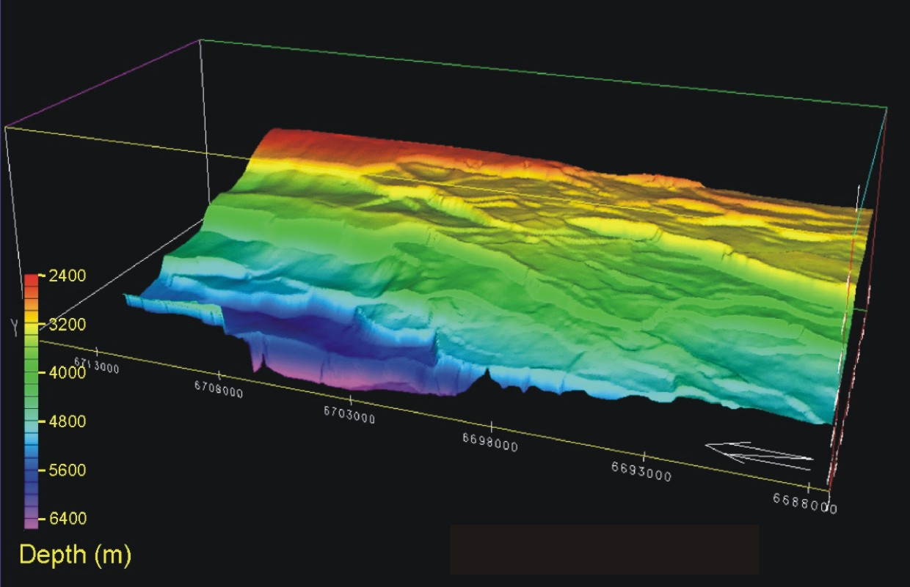
How Do Normal Faults Grow?
Christopher A-L. Jackson¹, Atle Rotevatn²,
Rebecca E. Bell¹, Sophie Pan¹, Anette B.M. Tvedt²
¹Basins Research Group (BRG), Department of Earth Science & Engineering, Imperial College, LONDON, SW7 2BP, UK
²Department of Earth Science, University of Bergen, Allégaten 41, 5007 Bergen, Norway
Data:
Software:
@seis_matters

Slide 2
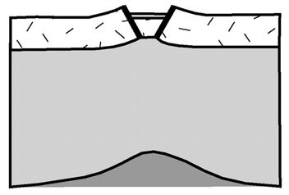
Continental Rifting
upper crust
lower crust
time
modified from Armitage & Allen (2010)
time
modified from Gawthorpe & Leeder (2000)

Slide 3
Continental Rifting
North Sea rift system, offshore Norway
https://www.fault-analysis-group.ucd.ie/gallery/Normal_faults_plan.htm
c. 5 km

Slide 4
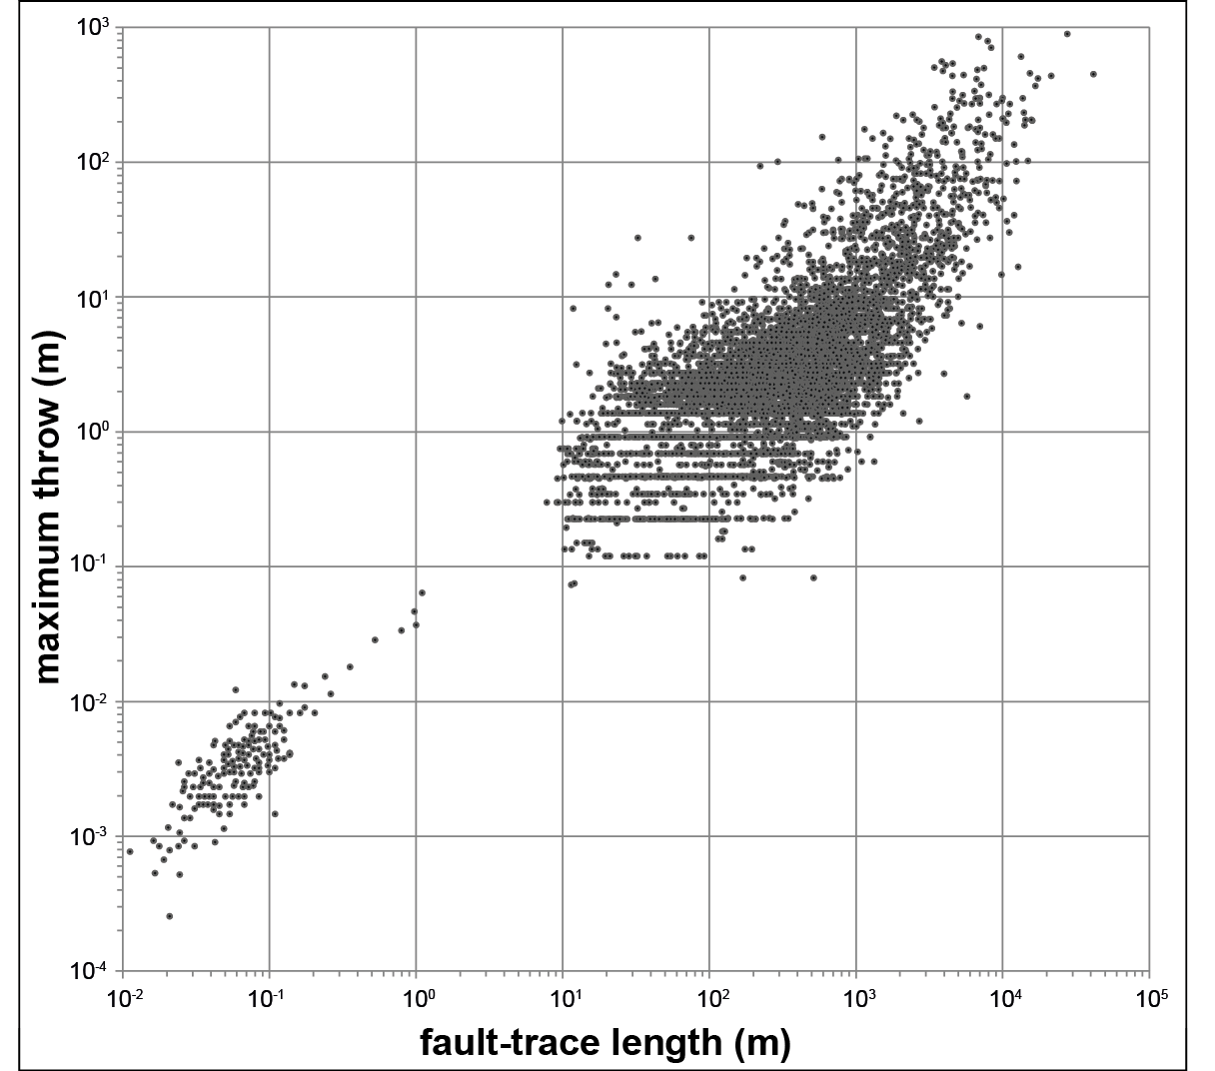
Normal Fault Growth
T1
T2
T3
T4
‘Propagating’ model
data provided by Badley Geoscience; with additional data from Kim & Sanderson (2005)
Nicol et al. (2016)
Underpinned by global D-L datasets and physical models
Explains: (i) displacement variations; (ii) folds; (iii) fault-strike variability
Widely applied…

Slide 5
Normal Fault Growth
initial nucleation of many isolated faults…
…enhanced growth optimally located faults…
fault growth by segment linkage…
…strain localisation onto a few through-
going faults; other faults die
Cowie et al. (2000)

Slide 6
Normal Fault Growth
T1
T2
T3
T4
‘Constant-length’ model
data provided by Badley Geoscience; with additional data from Kim & Sanderson (2005)
Nicol et al. (2016)
(Partly) explains: (i) scatter in D-L; (ii) disparity with earthquake scaling relationships; and (iii) physical modelling results
Rarely tested…

Slide 7
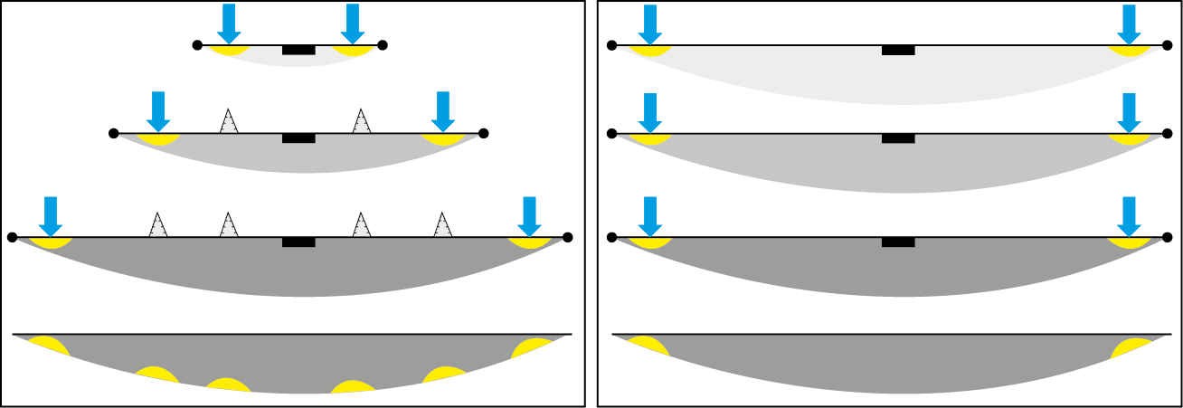
Why are normal faults important?
Kinematics control sediment dispersal and reservoir deposition...
‘Isolated’ model
‘Constant-length’ model
time
...so, how do faults grow and how do
we test these models?

Slide 8
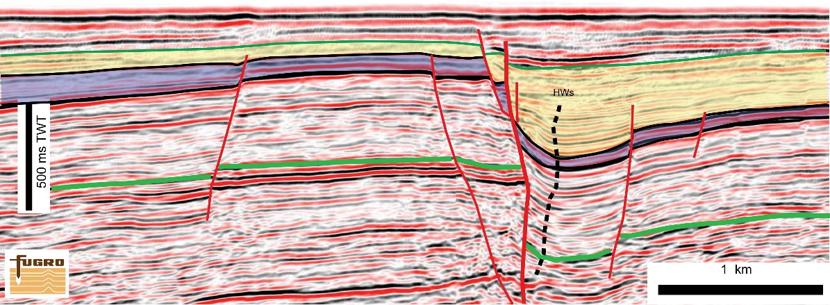
Growth Strata – 2D
Inner Moray Firth, offshore UK
http://see-vsa.leeds.ac.uk/uploaded/image/201108/ca85f9a7-c0ad-4278-9b55-8ab6a732061f.jpg
post-kinematic strata
syn-kinematic (growth) strata
pre-kinematic strata

Slide 9
Displacement Backstripping
Original Method (e.g. Chapman & Meneilly, 1991)
Jackson et al. (2017)

Slide 10
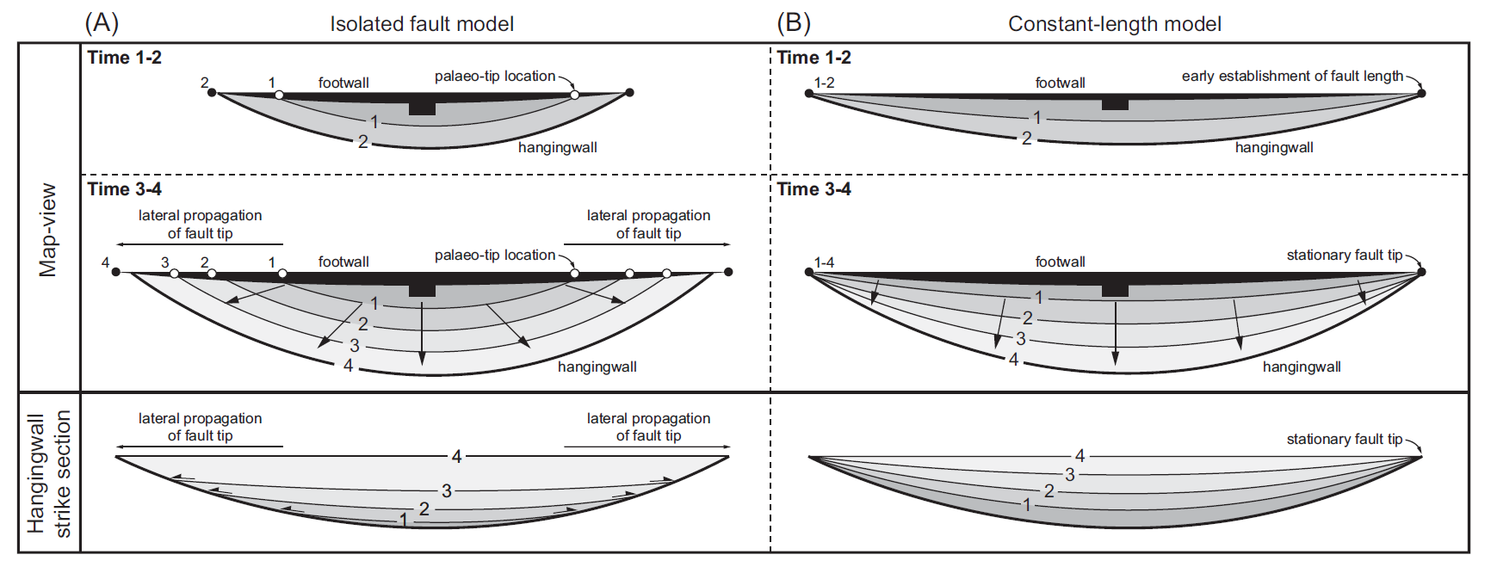
Growth Strata – 3D (Isopachs)
‘Isolated’ model
‘Constant-length’ model
Jackson et al. (2017)

Slide 11
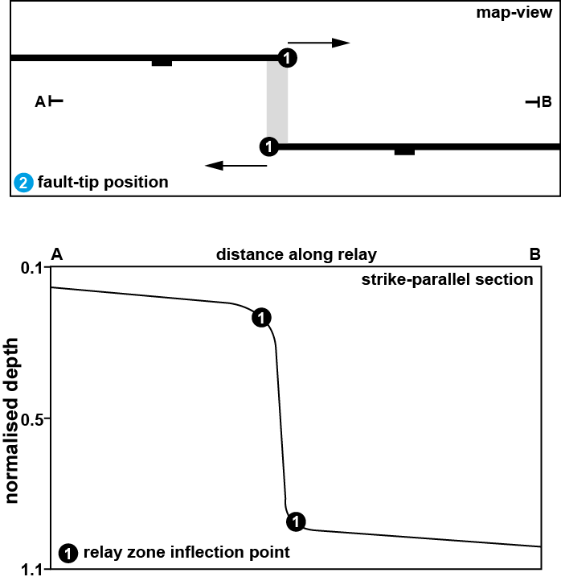
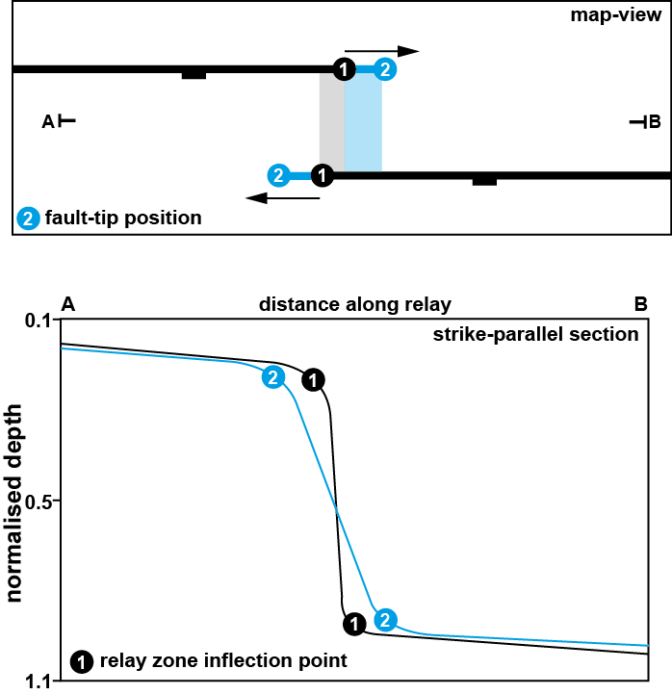
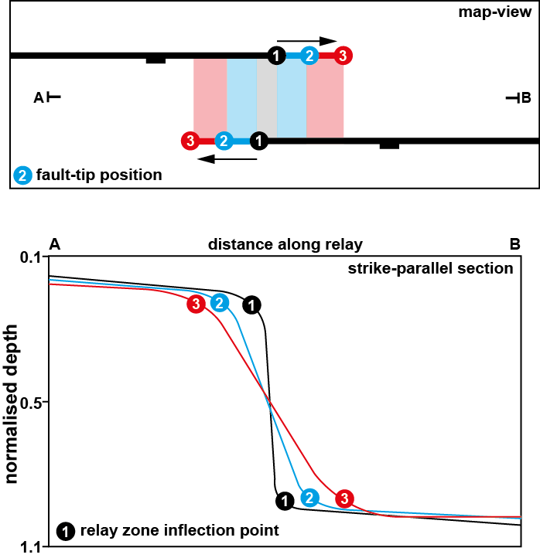
Relay Zone Kinematics
‘Isolated’ model
‘Constant-length’ model
...now lets go play...!
modified from Giba et al. (2012)

Slide 12
October Fault Zone - Geometry
Base synkinematic sequence (H5) depth map
Jackson & Rotevatn (2014)

Slide 13
October Fault Zone - Growth
Base synkinematic sequence (H5) depth map
Input data
H5
H6
throw (m)
H7
Original method
H5
Jackson & Rotevatn (2014)

Slide 14
October Fault Zone - Growth
H9
H8
H7
H6
Jackson & Rotevatn (2014)

Slide 15
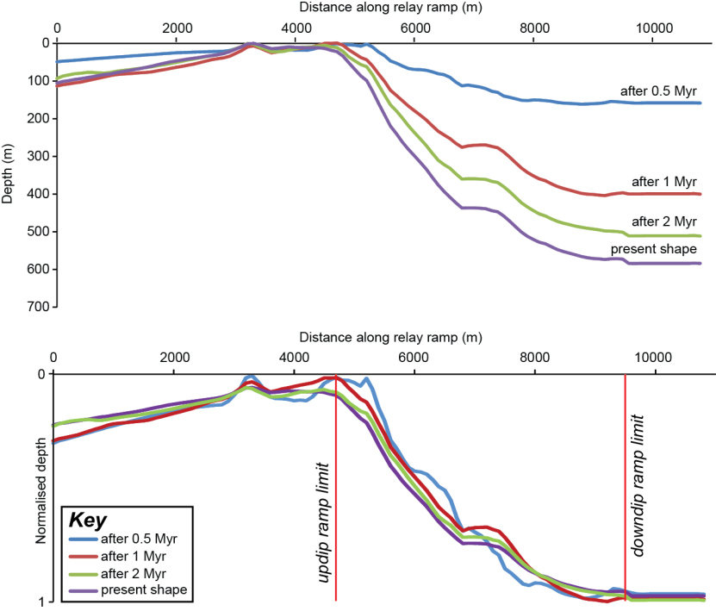
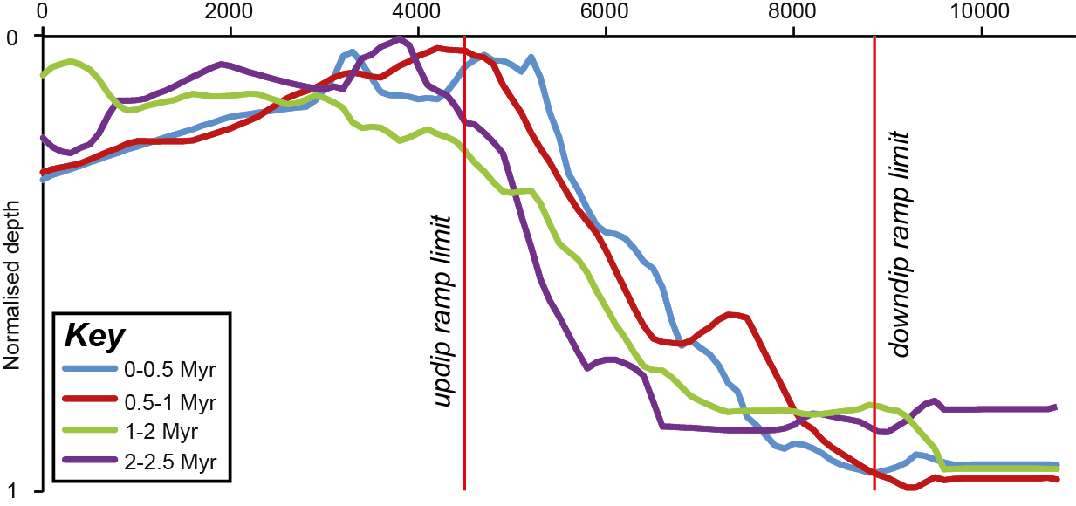
October Fault Zone - Growth
Relay Zone Backstripping – Application
Jackson & Rotevatn (2014)

Slide 16
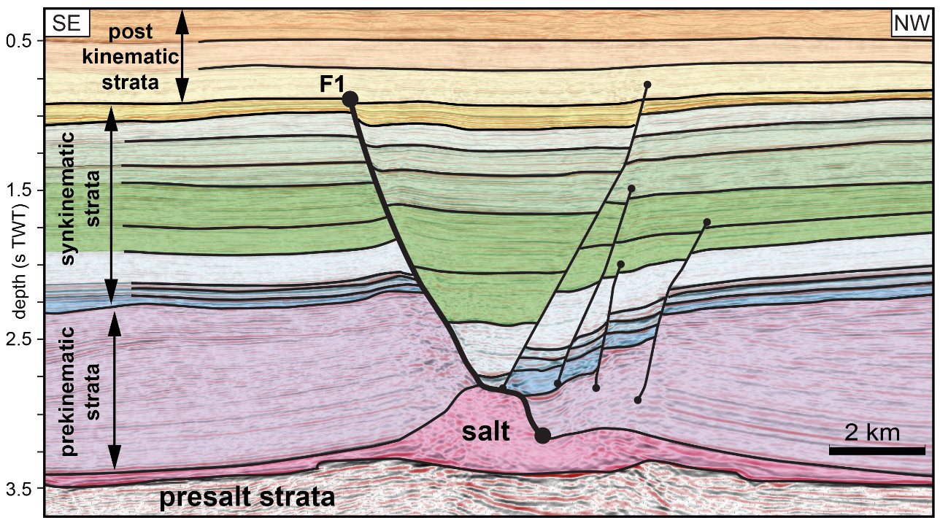
Fault 1, Egersund Basin - Geometry
SU5-6 isochron map
Tvedt et al. (2016)

Slide 17
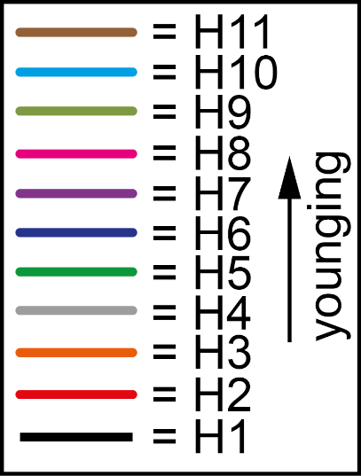
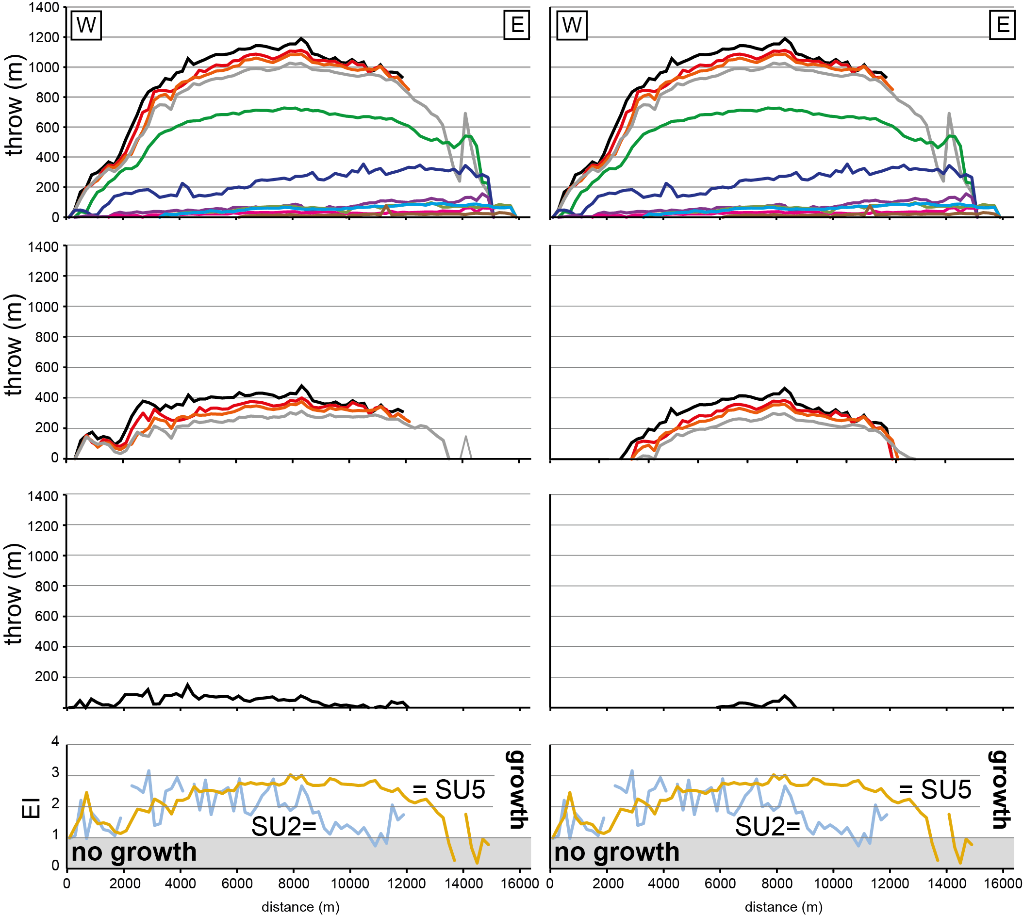
Fault 1, Egersund Basin - Kinematics
Original Method
Modified Method
H1
H6
Backstripped to H5
Backstripped to H5
H4
Backstripped to H2
Backstripped to H2
H1
Expansion Index
Expansion Index
Jackson et al. (2017)

Slide 18
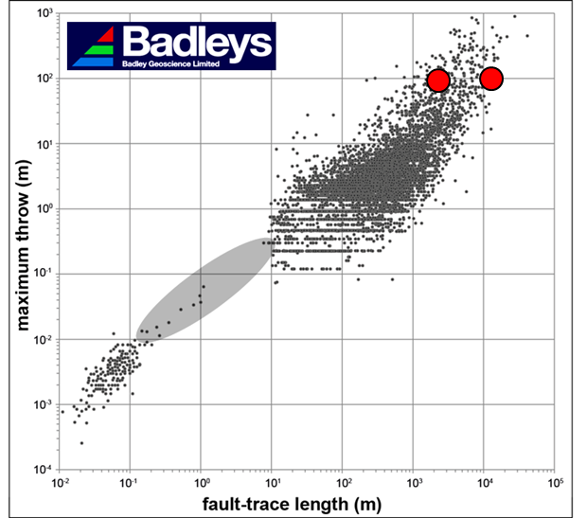
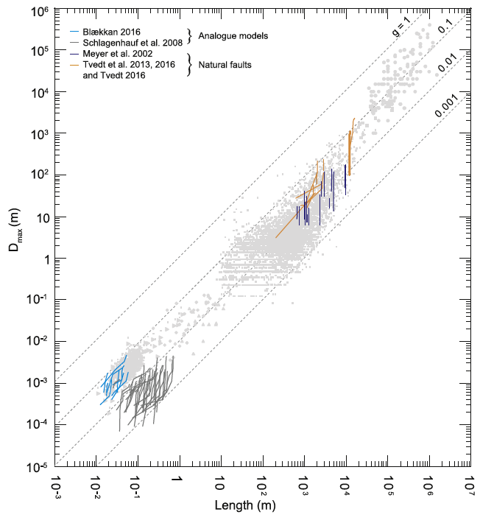
Discussion
present geometry
100 m
backtripped using
Modified Method
backstripped using
Original Method
1 km
Rotevatn et al. (2019)

Slide 19
Thebe, Exmouth Plateau
We assess the entire fault population in the Thebe field area, Exmouth Plateau, NW Shelf, Australia
Protracted extension (Late Triassic to Early Cretaceous)
Large areal extent (1300 km²)
Comparable to areas of active continental extension (e.g. the Afar, Corinth, and Suez rifts, etc.)
High-quality 3D seismic data with well borehole to date horizon ages and timing of fault activity
Pan et al. (in prep)

Slide 20
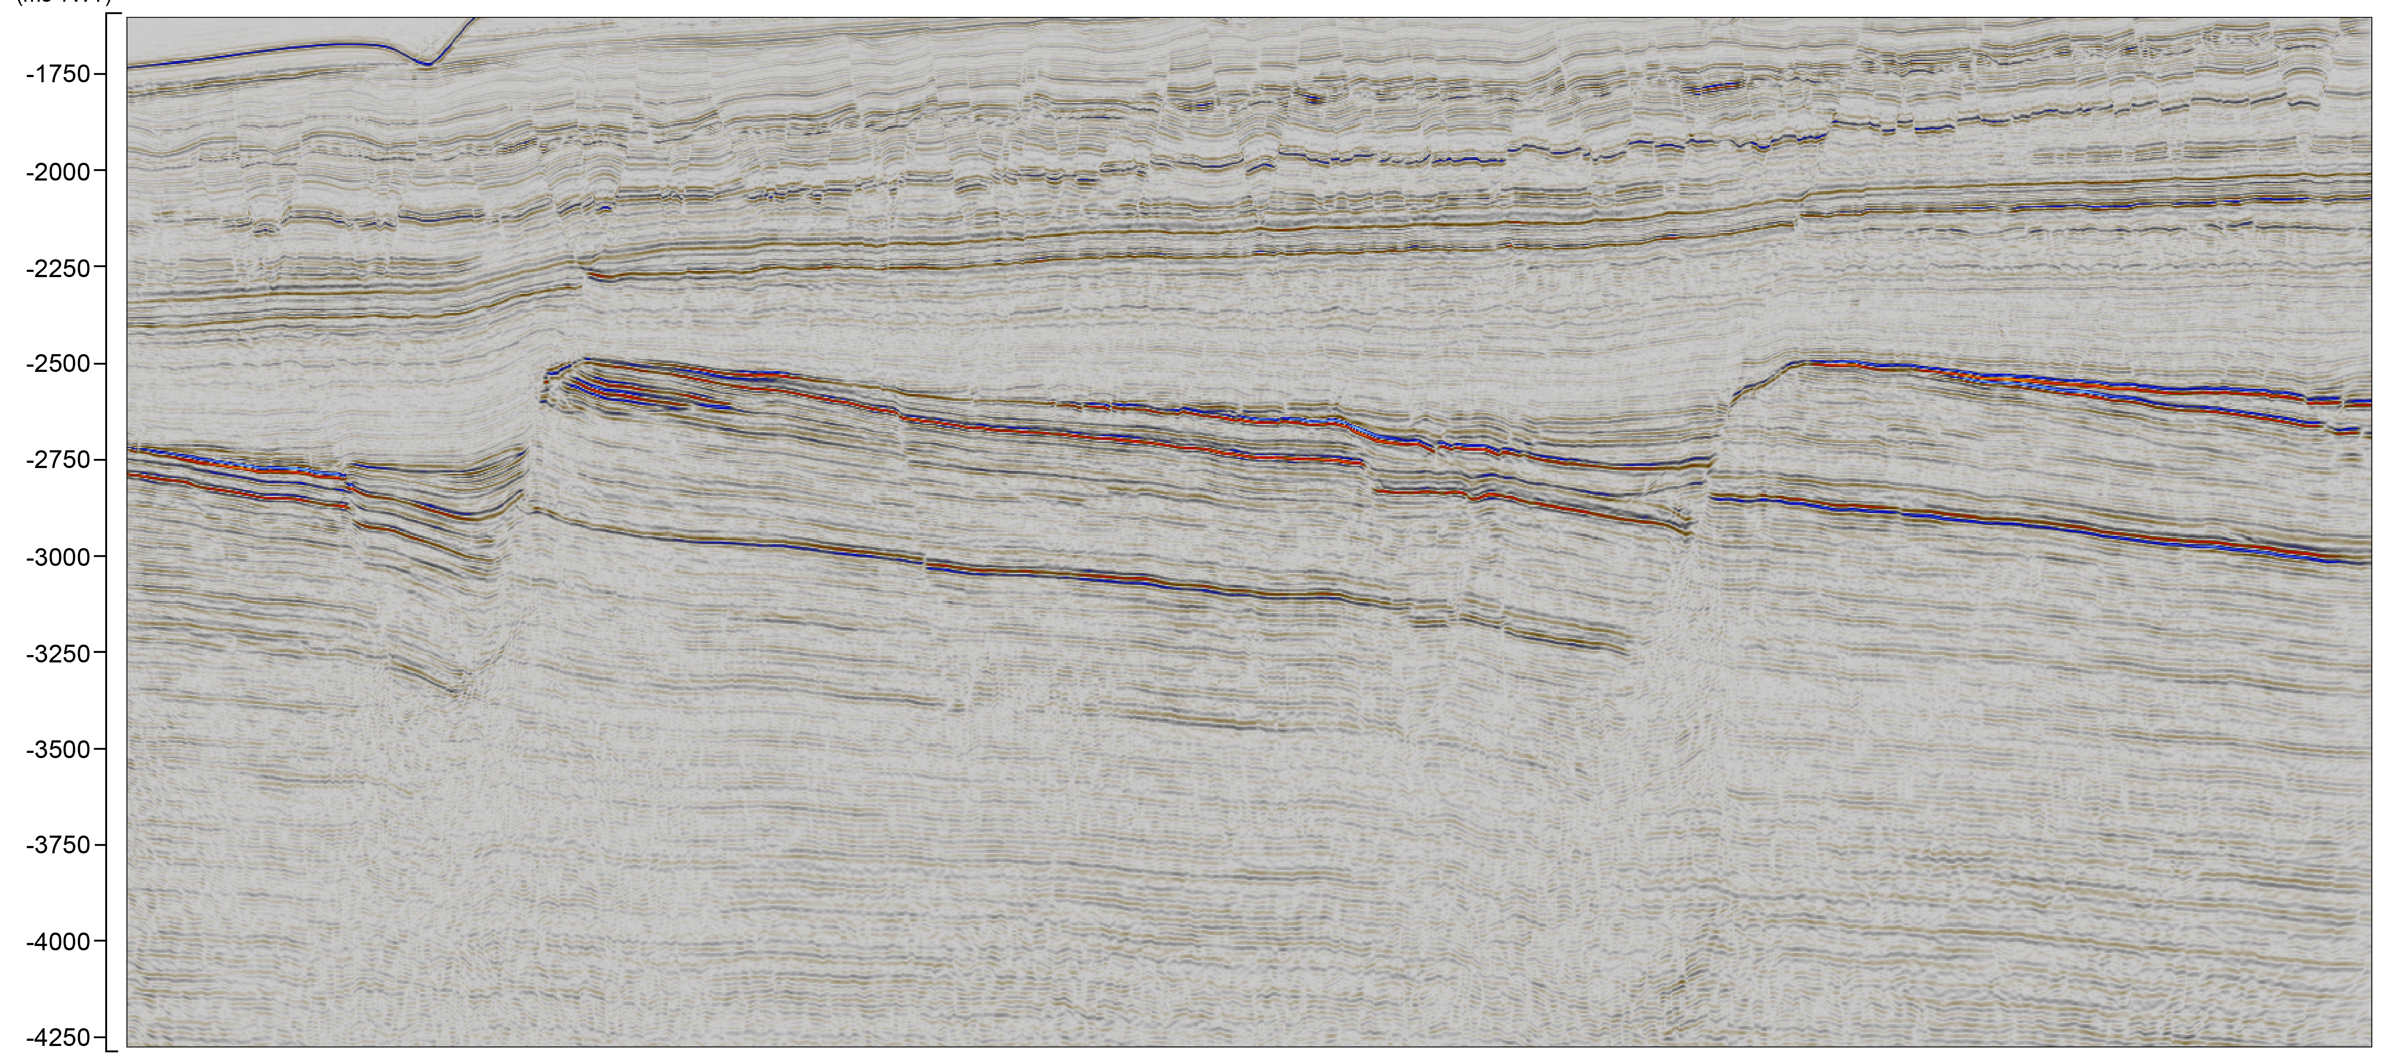
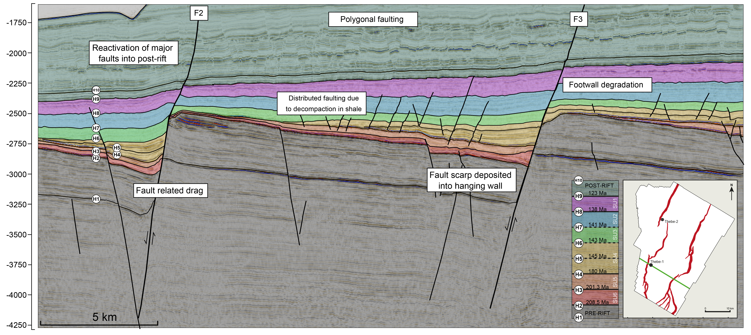
Geological Setting
NW
SE

Slide 21
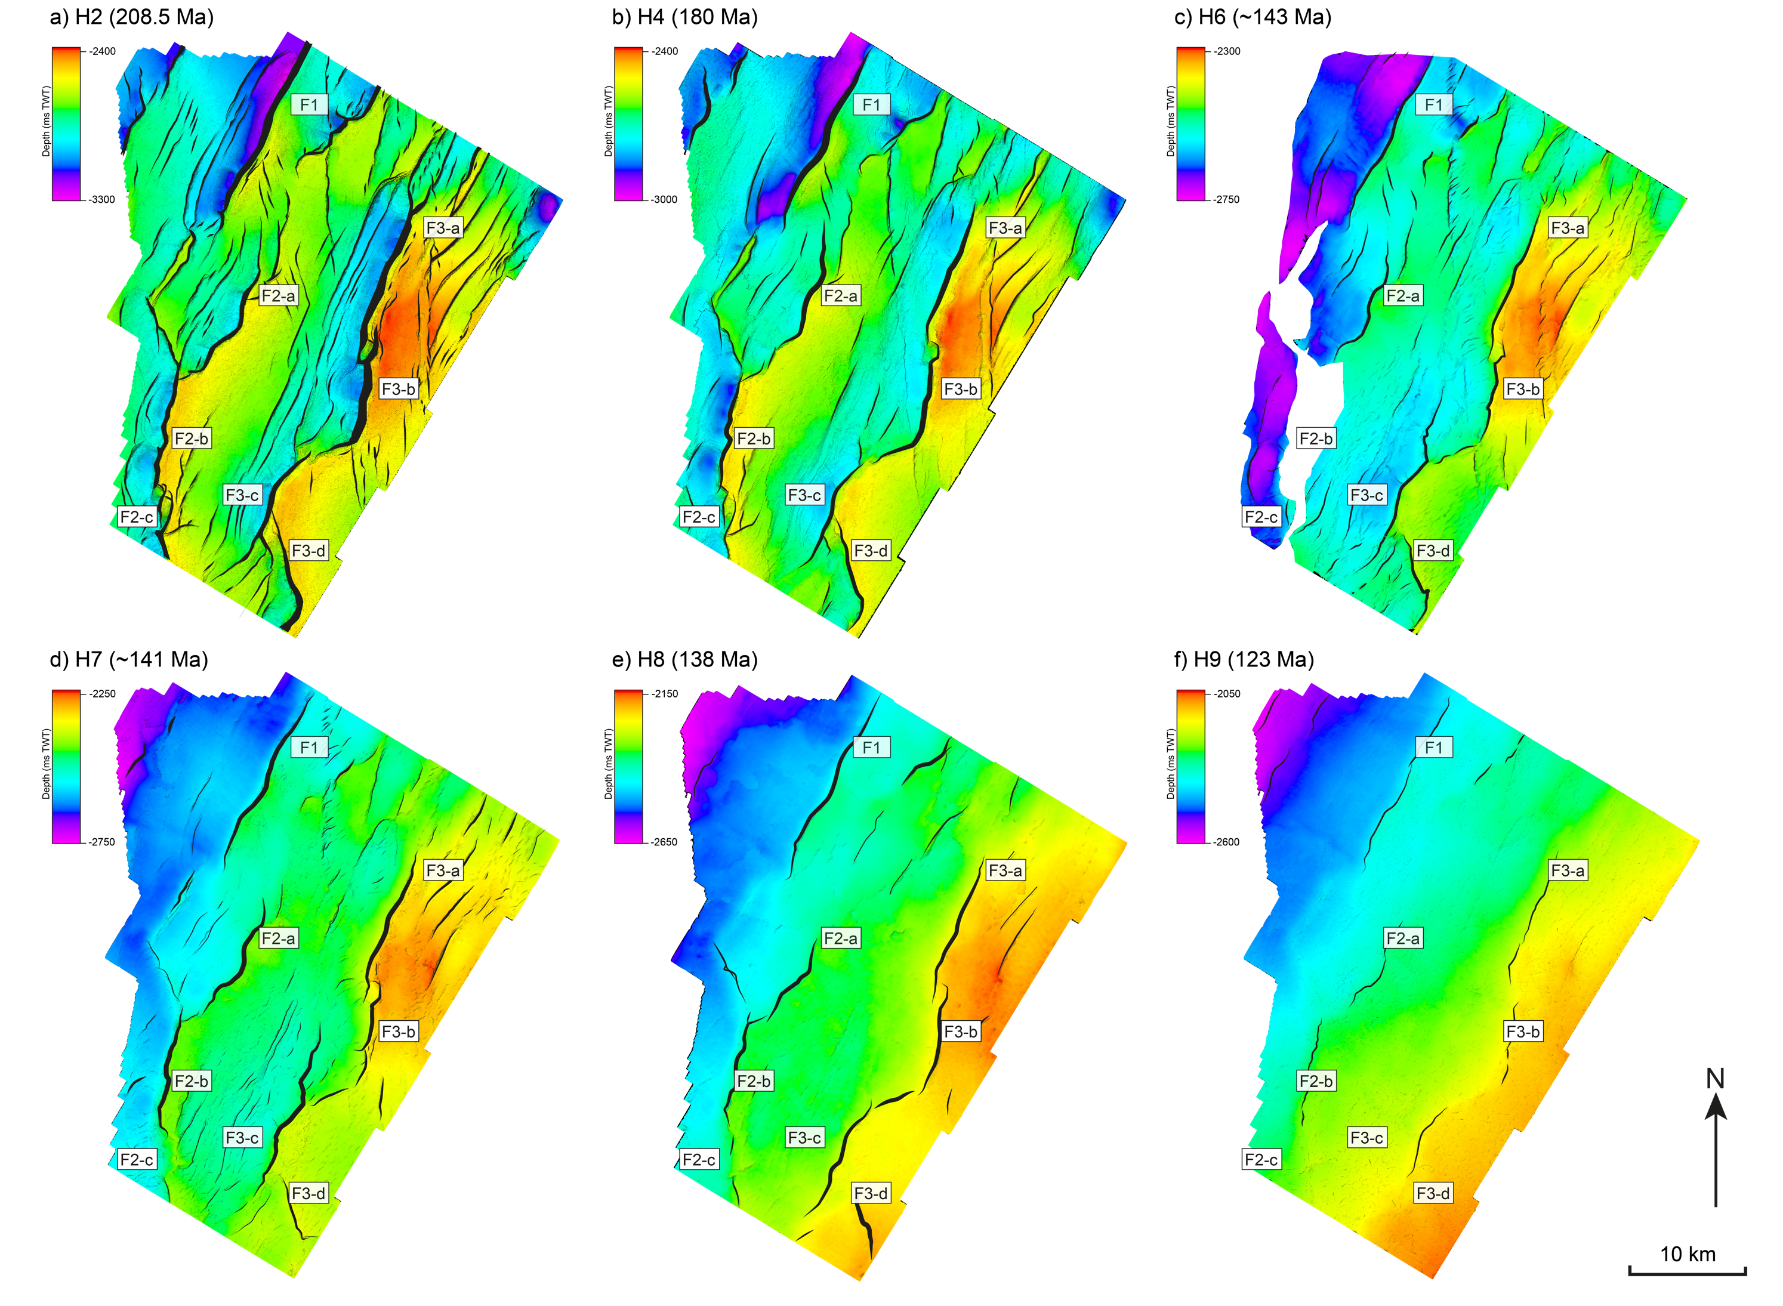
Structural Framework
oldest…
Time-surface maps define structural framework:
Dominant NE-SW- striking fault population
Base syn-rift (top Mungeroo) most faulted; faults die-out upwards towards the top syn-rift (top Muderong)
Overall total rift duration of c. 85.5 Myrs
…youngest

Slide 22
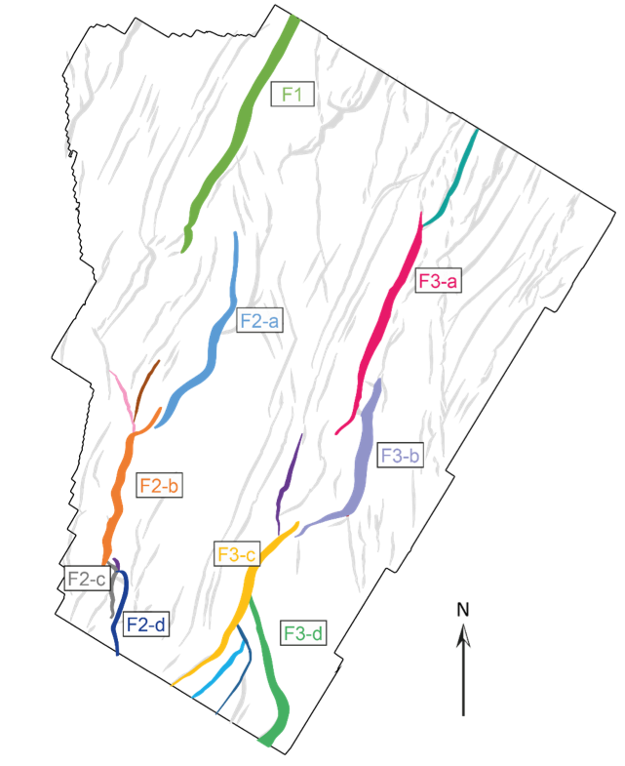
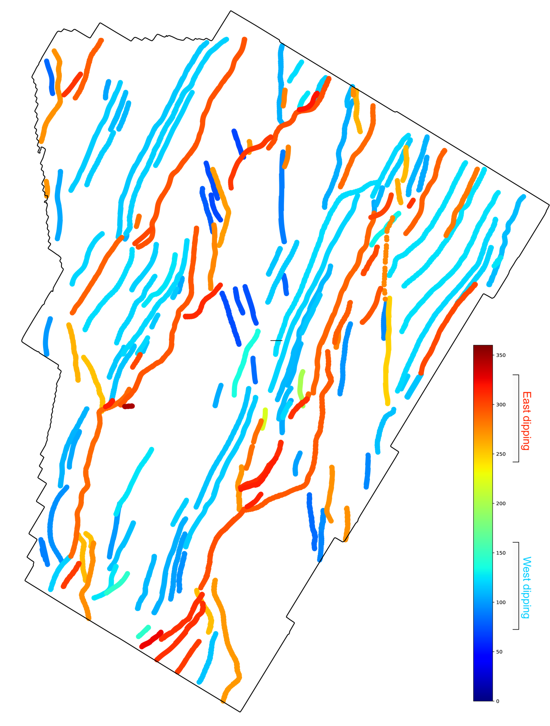
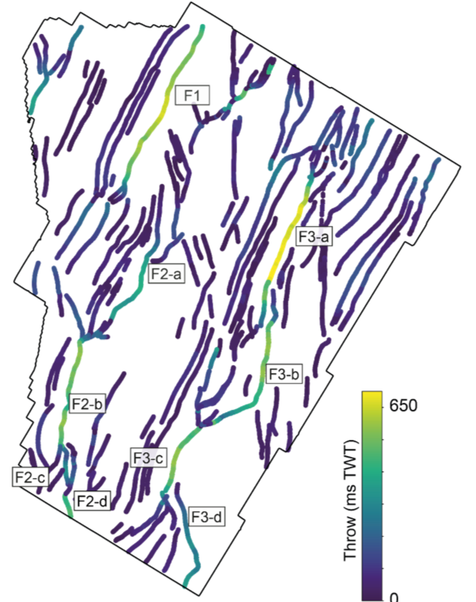
Structural Framework
Map view of the fault array
Dip direction
Throw distribution
East
West

Slide 23
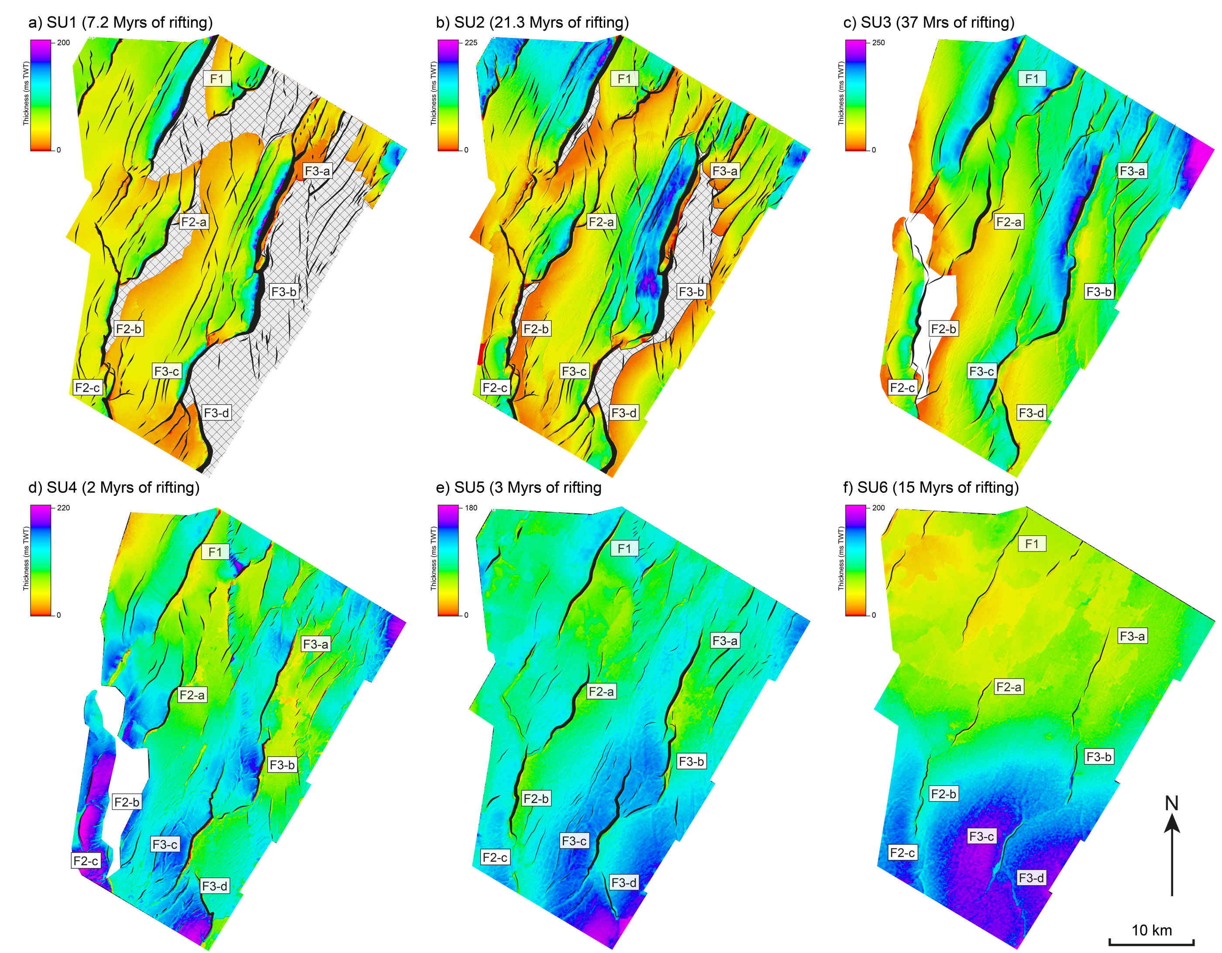
Rift Development
oldest…
Thickness patterns on isochron maps reveal periods of active faulting
First slip interval shows that most faults had established their final lengths in the first c. 7.2 Myrs (c. 8% of the c. 85.5 Myr rift event)
Faults are fully linked by SU3 (i.e. after c. 28.5 Myrs (c. 33% of the c. 85.5 Myr rifting event)
…youngest

Slide 24
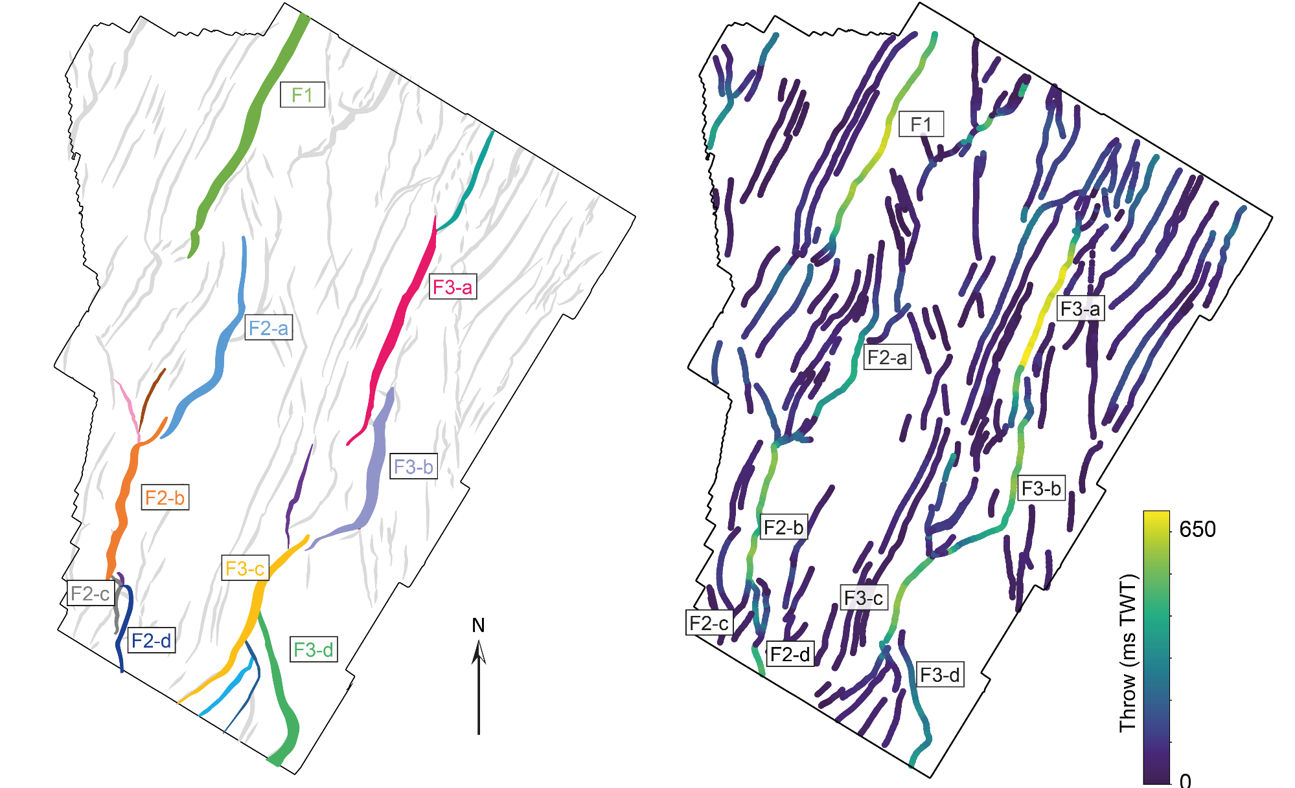
Rift Development
Map view of the fault array
Present day throw
Symmetrical
throw profiles

Slide 25
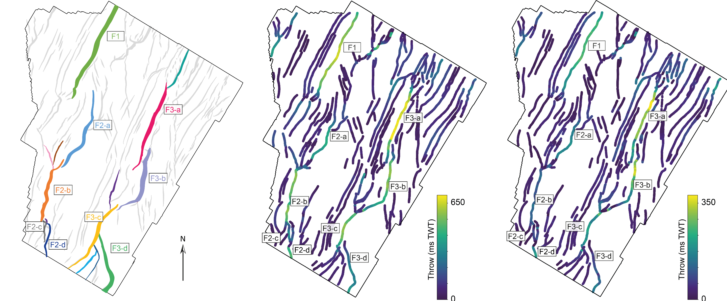
Rift Development
Map view of the fault array
Present day throw
Reconstructed throw
Symmetrical
throw profiles
Asymmetrical, irregular throw

Slide 26
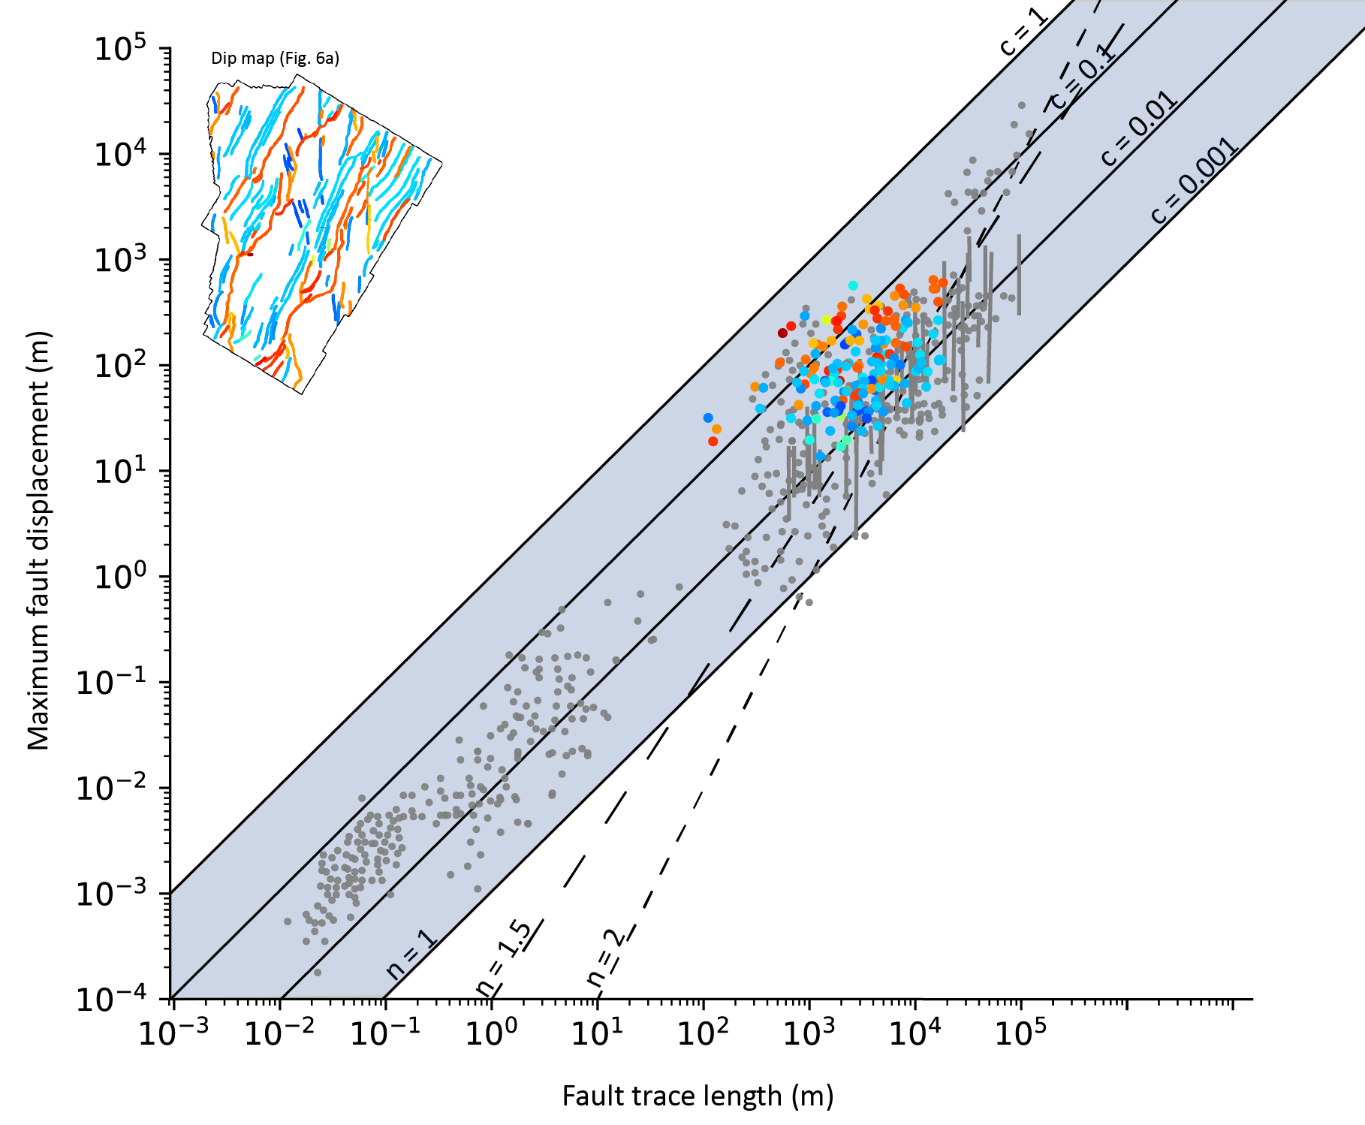
Fault Evolution
Large, W-dipping fault systems have greater displacement ratios (c ~ 0.1) compared to antithetic minor faults (c ~ 0.01)

Slide 27
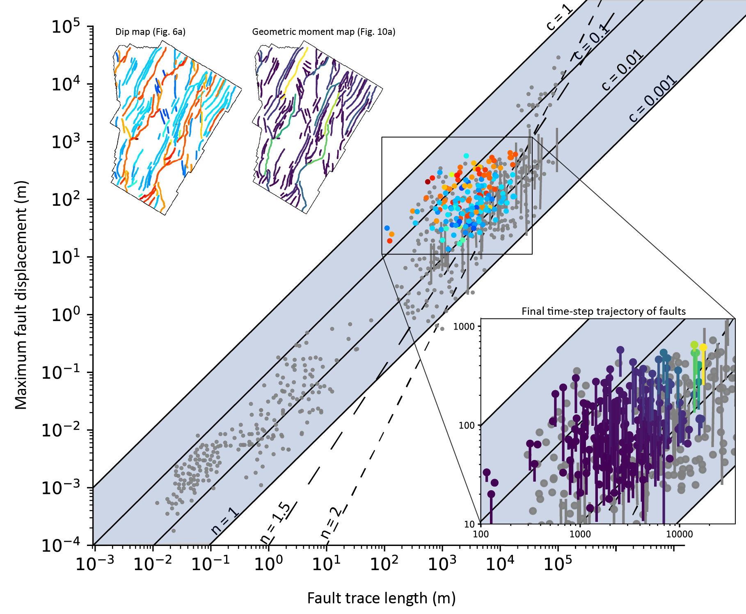
Fault Evolution
Large, W-dipping fault systems have greater displacement ratios (c ~ 0.1) compared to antithetic minor faults (c ~ 0.01)
The last time step trajectory on a D-L plot is of displacement accrual (i.e. constant model)
Antithetic faults remain static in the last time-step due to strain localising on major faults (i.e. stress shadows)
Overall, faults following the constant-length model do not extend outside of the range defined by global data…

Slide 28
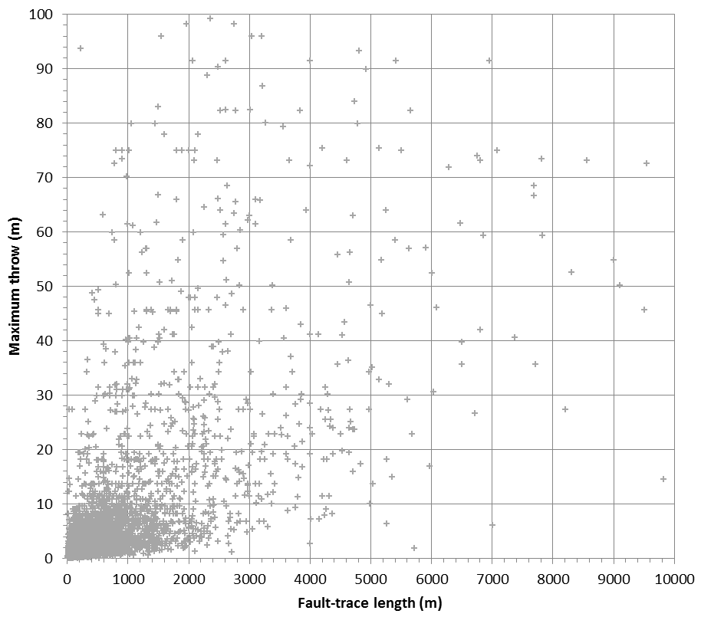
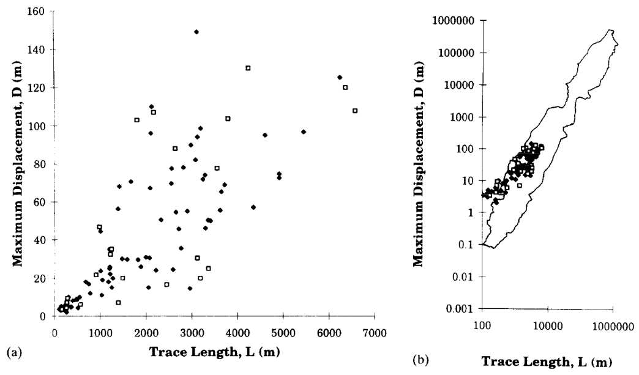
So, How Do Normal Faults Grow?
Fault growth likely messier than implied by ‘global’ D-L dataset…
Couple backstripping with independent kinematic constraints
Test constant-length model with 3D seismic (long-term) and trench-scale (short-term) data
Is constant-length model always associated with fault reactivation?
Do geomorphic data support the constant-length model?
Can anyone demonstrate a fault grew in accordance with the isolated fault model on geological timescales?!
data courtesy of Badley Geoscience
Cartwright & Trudgill (1994)

Slide 29
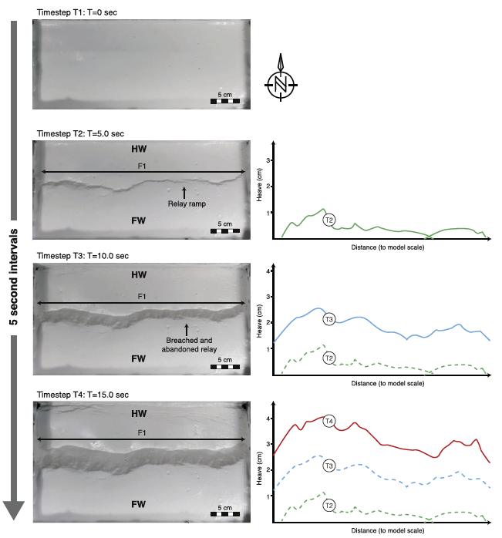
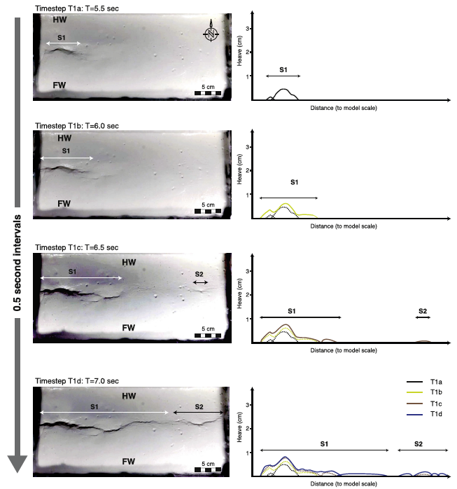
The Answer…?
Time-steps=5 seconds
Time-steps=1.5 seconds
Rotevatn et al. (2019)

