Slide 1
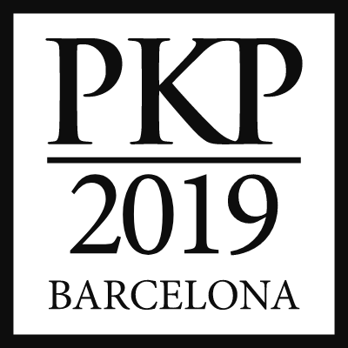
Organizational Structures and Digital Skills Regarding OJS Adoption in Mexican Humanities Journals
Ivonne Lujano-Vilchis (Arizona State University, USA) @ivonnelujano
Néstor Daniel Martínez-Domínguez (Universidad Autónoma Metropolitana-Azcapotzalco, Mexico) @nesdaniel
Bárbara Rivera-López (Universidad de Las Américas, Chile) @barb_rivera
November 20th-22nd 2019

Slide 2
Context

Slide 3
Economic crisis and research policies
Fiscal austerity: Budget cuts in Higher Education and R & D
Brain drain
Content and infrastructure owned by commercial publishers
Big publishers are commercial enterprises that are driven by profit (Larivière, Haustein & Mongeon, 2015)
Reed-Elsevier profit more than 2 billion USD in 2012 and 2013
Springer Science+Business Media 35% profit margin in 2012
John Wiley & Sons’ Scientific, Technical, Medical and Scholarly division 28.3% in 2013
Taylor and Francis 35.7% in 2013
Scholarly infrastructure owned by big publishers (Posada, Chen & Chan, 2019)
Acquisition and integration of scholarly infrastructure: the tools and services that underpin the scholarly research life cycle.
Notes:
Servicios Editoriales Tercerizados para Revistas Científicas Electrónicas Latinoamericanas

Slide 4
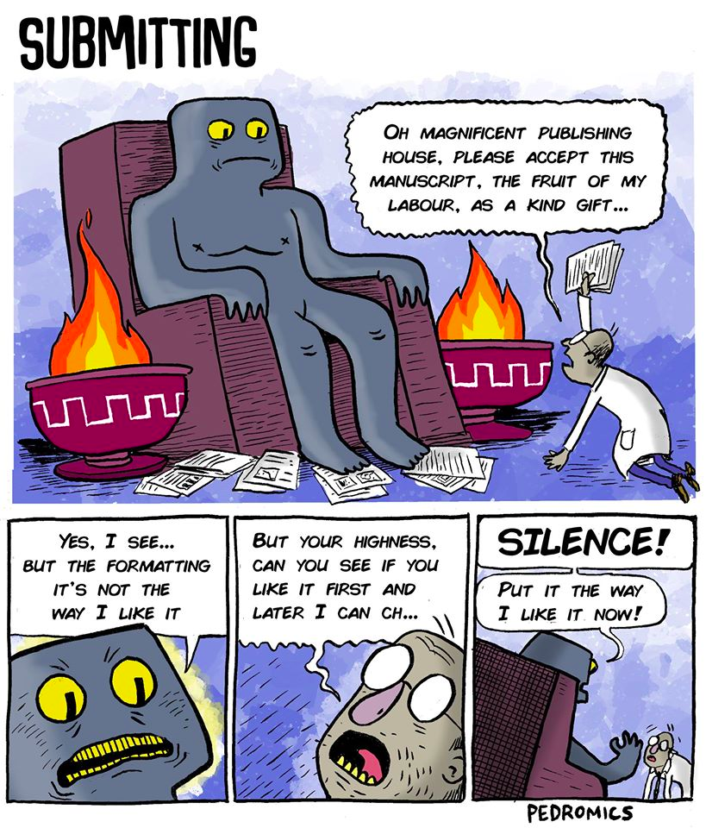
Power dynamics at play
Authors: Pressure and copyrights
System: Unequal scholarly communications landscape

Slide 5
PKP Community building
“The PKP community consists of a diverse group of users, contributors, partners, and staff. This track will celebrate the editors, developers, scholars, librarians, service providers and many more who work together to make knowledge public. We’ll network, share stories, and provide updates to learn more about how we are - or could be - working better together.
OJS is open source software made freely available to journals worldwide for the purpose of making open access publishing a viable option for more journals, as open access can increase a journal’s readership as well as its contribution to the public good on a global scale”
Notes:
In this context, PKP’s role in community building have been key on making knowledge public worldwide. Values such as diversity, public good and global scale are essential for the creation of community-driven digital tools and software as OJS.

Slide 6
Mexican journals
Around 450 open access journals (Latindex)
Published by scholarly institutions —universities, research centers, scholarly associations
Funded directly or indirectly by the federal government or the state-level governments
131 journals using OJS

Slide 7
Research question

Slide 8
What is the process of sociotechnical appropriation of an open technology (OJS) in editorial teams of humanities journals in Mexico?

Slide 9
Theoretical framework

Slide 11
Methods

Slide 12
Sample
10 Mexican Humanities journals
5 Philosophy journals
3 History journals
2 Linguistics journals
All of them use OJS as a publication platform

Slide 13
Interviews
Dimensions of the interview script
Knowledge production processes
Writing knowledge communication (editorial policy)
Contributions’ value
Humanities at the University
2.8 Could you describe a contribution editorial flow from its submission until it gets published?
2.9 What are the challenges to improve the journal’s editorial workflow?
2.15 What is your Editorial staff composition? What are the challenges around this aspect?
Notes:
We performed extensive interviews to executive and academic editors. These were performed face to face, through Skype or email; and later transcribed for further analysis.

Slide 14
Results

Slide 15
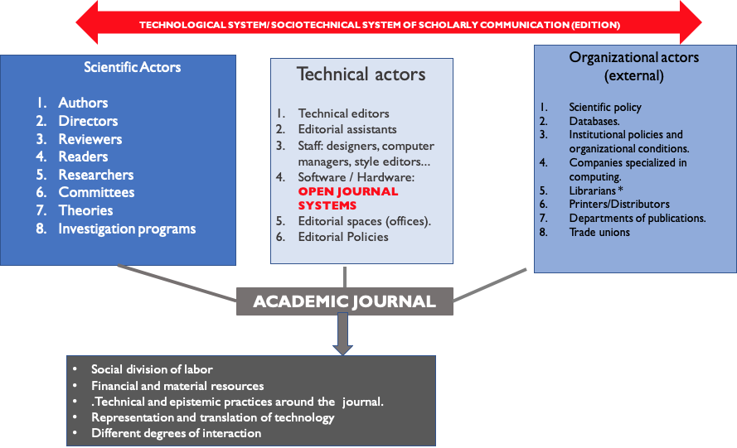

Slide 16
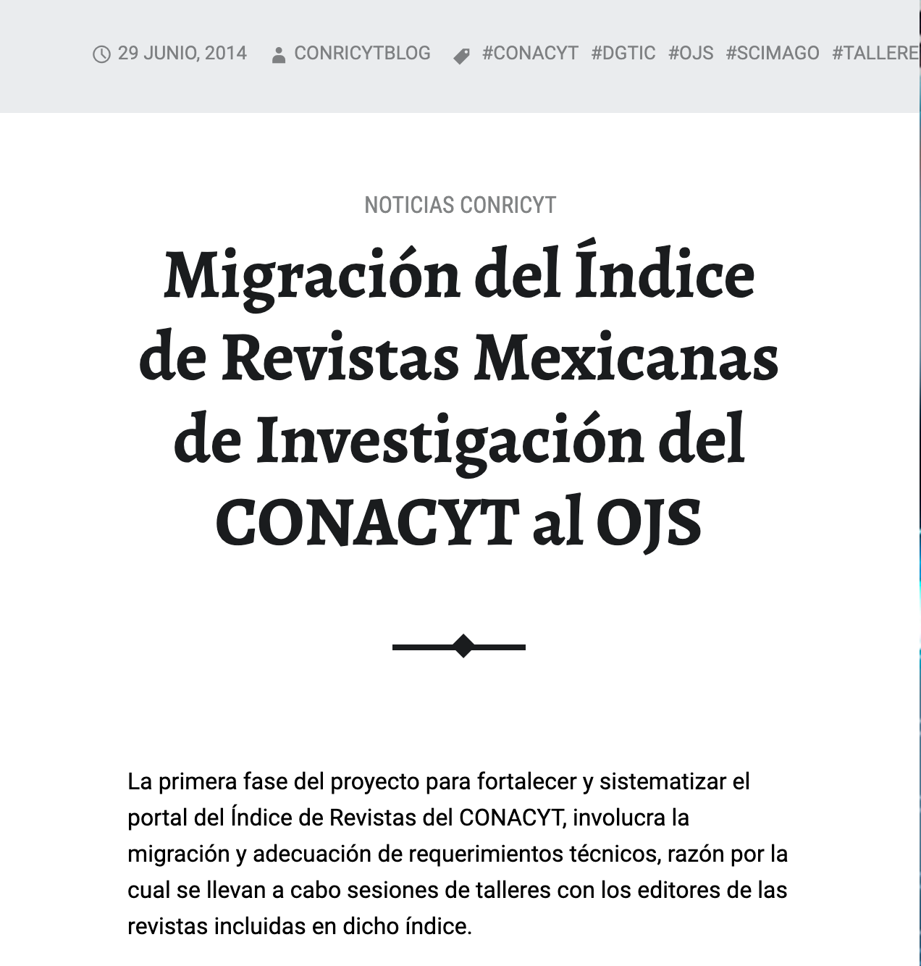

Slide 17
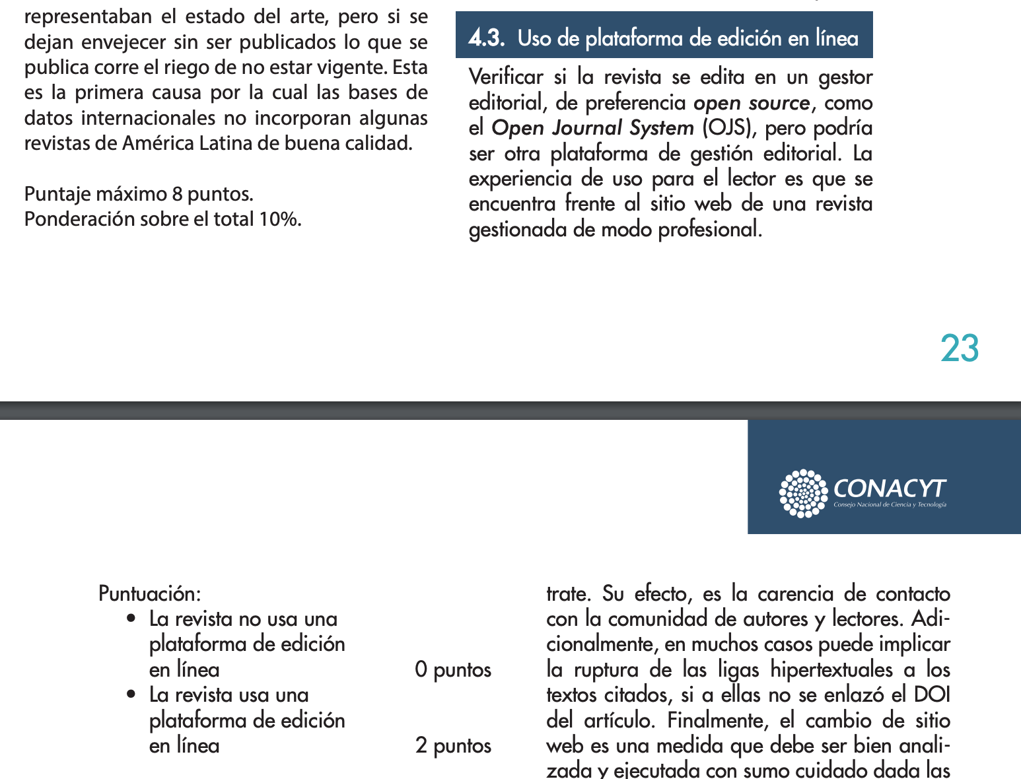

Slide 19
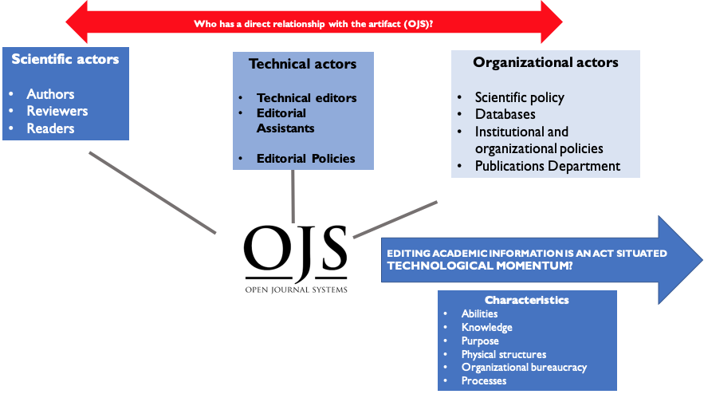

Slide 20
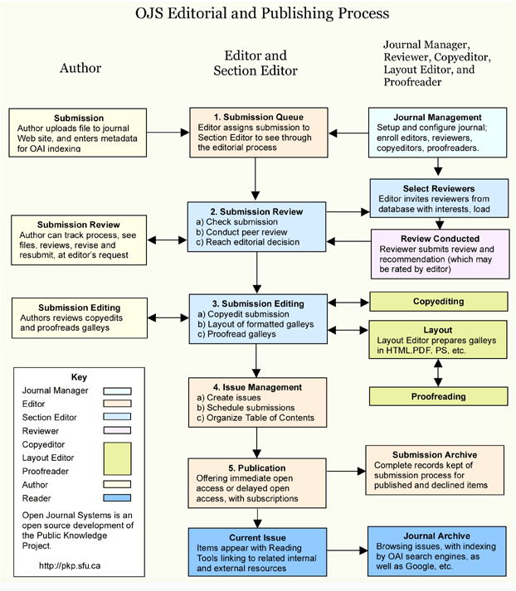
⚠
⚠
⚠
⚠

Slide 21
Editors’ voices
“[Desde que se cayó el OJS] ahorita tuvimos que regresar al correo en lo que están viendo [el personal de sistemas] si se recuperan las cosas del OJS, yo ya lo veo complicado; tenemos ahora ya otro OJS, pero ahora solo tenemos PDF´s, pero toda la información se perdió, de hecho ese fue nuestro enojo, …. nos agilizaba el trabajo…” (Editor A)
“Todo lo hacemos vía OJS. Nosotros empezamos a usar OJS desde 2014… [aunque]nosotros trabajamos mucho en papel por las correcciones...pero todo lo de los autores lo hacemos en la plataforma”. (Editor B)
“El problema del OJS es que [los mensajes] se van mucho al spam, no llegan a los mensajes, eso no nos funciona bien, temenos muchos problemas, entonces se manda del correo directamente”. (Editor C)

Slide 22
Conclusions
We cannot look at this artifact without looking at the political context in which it is designed and used.
OJS is seen as a panacea by editors
Tension point: the paradox that OJS is a free system made to be a viable option for journals, but it is outsourced in its use or in its appropriation (customization; technical know-how).
What is the process of appropriation of an open technology in contexts where knowledge production is being privatized?
How do you dialogue with the neoliberal processes of knowledge production? For example: privatization and outsourcing of services

Slide 23
CHILE VIOLATES HUMAN RIGHTS
223 injured in their eyes
2,535 injured
74 criminal complaints for sexual abuse
341 criminal complaints for torture
22 deaths
© INDH report

Slide 24
References
Chen, G., Posada, A. and Chan, L. (2019). Vertical Integration in Academic Publishing: Implications for Knowledge Inequality. In Chan, L., & Mounier, P. (Eds.), Connecting the Knowledge Commons — From Projects to Sustainable Infrastructure: The 22nd International Conference on Electronic Publishing – Revised Selected Papers. Marseille: OpenEdition Press. doi:10.4000/books.oep.9068
Darat, N. & Tello, A. M. (2016). Desobediencia intelectual: resistencias a la privatización del conocimiento. Polis, 15(43), 313-329.
Eve, M. P. (2013, March 10). Open Access, "Neoliberalism", "Impact" and the Privatisation of Knowledge [Blog post]. Retrieved from https://eve.gd/2013/03/10/open-access-neoliberalism-impact-and-the-privatisation-of-knowledge/
Flannery, M. E. (2019, September 11). ‘Nobody is Talking About This’: The Sorry State of Higher Ed Funding [Blog post]. Retrieved from http://neatoday.org/2019/09/11/the-sorry-state-of-higher-ed-funding/
Frosio, Giancarlo, Open Access Publishing: A Literature Review (January 1, 2014). CREATe Working Paper 2014/1. doi: 10.5281/zenodo.8381
Izsak, K., Markianidou, P., Lukach, R. and Wastyn, A. (2013). The impact of the crisis on research and innovation policies. Study for the European Commission DG Research by Technopolis Group Belgium and Idea Consult.
Larivière, V., Haustein, S. and Mongeon, P. (2015). The Oligopoly of Academic Publishers in the Digital Era. Plos One ,(10)6. doi:10.1371/journal.pone.0127502
Tennant, J.P.; Crane, H.; Crick, T.; Davila, J.; Enkhbayar, A.; Havemann, J.; Kramer, B.; Martin, R.; Masuzzo, P.; Nobes, A.; Rice, C.; Rivera-López, B.; Ross-Hellauer, T.; Sattler, S.; Thacker, P.D.; Vanholsbeeck, M. Ten Hot Topics around Scholarly Publishing. Publications 2019, 7, 34
Smith, S. (2002). The Open Access (Open Journal Systems) paradigm and the production of scholarly journals in developing countries.

Slide 25
Thank you Gracias

