Slide 1
Effects of Bitter Crab Disease on the gene expression of Alaska Tanner Crabs
Grace Crandall
Roberts Lab, UW SAFS
GSS 2019

Slide 2
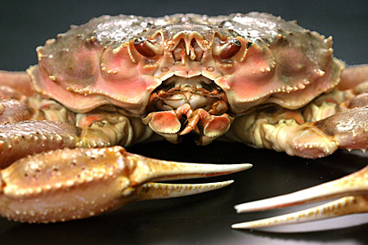
Tanner Crab (Chionoecetes bairdi )

Slide 3
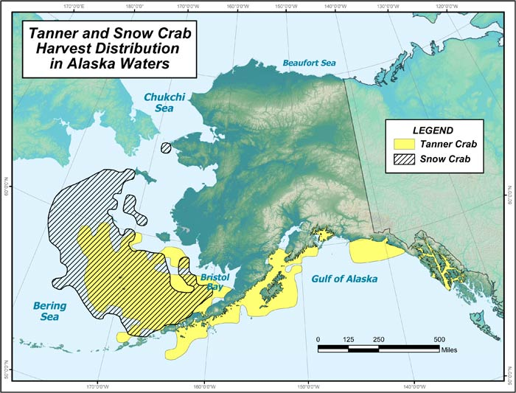
Range and economic importance
SE population: $21million fishery (2014)
Often marketed under “snow crab”
Market sized males: 7-9 years old, 2-4 lbs
Image: ADF&G
Notes:
https://www.adfg.alaska.gov/index.cfm?adfg=tannercrab.main
Range AK-OR

Slide 4
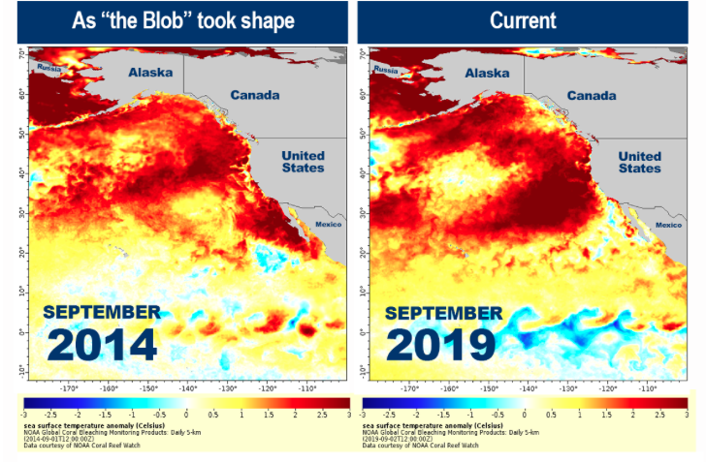
Threats to fishery
Bitter Crab Disease (“Principle Threat” - ADF&G)
Prevalence ( SE Alaska vs. Bering Sea)
2. Warming oceans
Increase BCD prevalence?
NOAA Fisheries
Notes:
https://www.fisheries.noaa.gov/feature-story/new-marine-heatwave-emerges-west-coast-resembles-blob

Slide 5
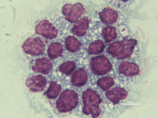
What is bitter crab disease?
Parasitic dinoflagellate Hematodinium spp.
Takes over hemol spaces in crab
Outcompetes host for nutrients + oxygen
Transmission: unknown
Molting?
Ingestion? (water column; cannibalism)
Hemolymph smear: Hematodinium → purple
Notes:
What hematodinium is
Transmission unknown

Slide 6
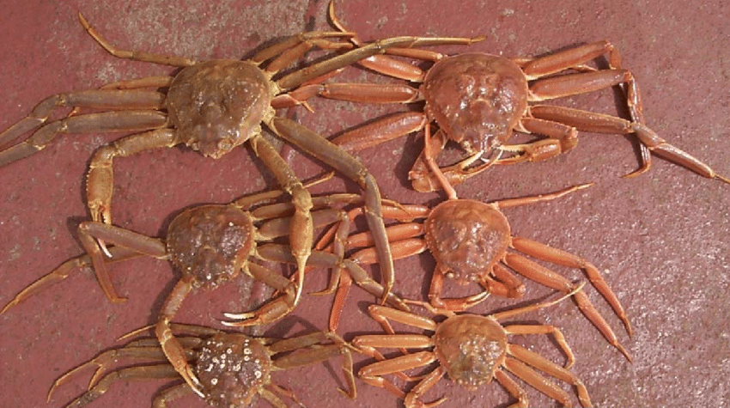
Bitter Crab Disease signs
red/cooked-looking carapace

Slide 7
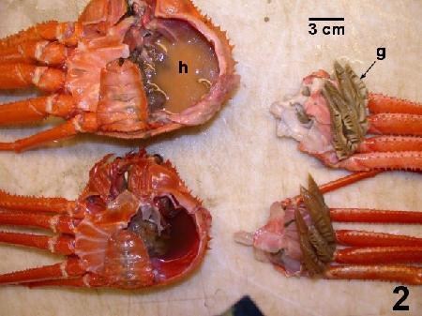
Bitter Crab Disease signs
Milky hemolymph

Slide 8
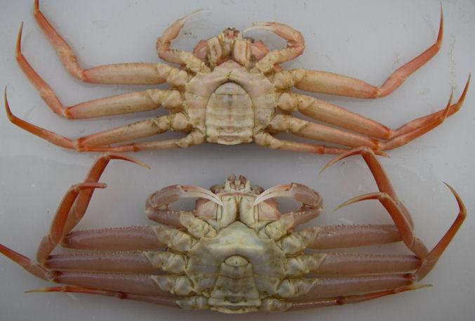
Bitter Crab Disease signs
Opaque legs

Slide 9
Bitter Crab Disease signs
Lethargy

Slide 10
Bitter Crab Disease signs
Bitter, chalky meat
Notes:
When cooked

Slide 11
Diagnosis
Gross signs
PCR
Hemolymph smears
Histology

Slide 12
Diagnosis Prognosis
Gross signs
PCR
Hemolymph smears
Histology
Death…?
Chronic…?
Death from secondary factors…?
Suffocation; starvation; etc.

Slide 13
Goals of project
Understand unknowns
Mortality; transmission
Understand interactions between temperature, infection, and crab physiology
Notes:
Unknowns: mortality, transmission
Help inform fishery management
Look into these by looking at expressed genes

Slide 14
Genes
Unbiased
Basic functionality in organism
Differential abundance → how conditions affect organism
Notes:
Unbiased: either genes are present or not; the ones that are present will tell us what biological processes are taking place

Slide 15
Transcriptomics

Slide 16
Transcriptomics
DNA → RNA → Protein
transcribe
translate
Collection of mRNA sequence = transcriptome
Notes:
Up next: experimental design
Just say i’m looking at what’s in box. Looking at genes.
I AM NOT LOOKING AT PROTEINS!

Slide 17
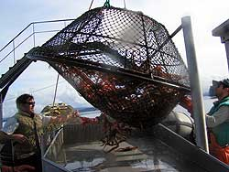
Sampling and acclimation
~400 immature, male crabs sampled from Juneau by ADF&G fall 2017
cPCR at NOAA lab for initial infection status
Crabs acclimate for 9 days to tanks
Notes:
Immature males because thought that intermediate age are most susceptible - especially during molting when they are most vulnerable
Mature determined by some ratio of carapace to cheliped length

Slide 18
Experimental Design
1 → infected
0 →uninfected
Cold → 4˚C
Ambient → 6˚C
Warm → 10˚C
Hemolymph sampled pre-temp. trtmnts
Hemolymph sampled from all treatments
Hemolymph sampled from all treatments
1 cold
1 ambient
1 warm
1 cold
1 ambient
1 warm
1 cold
1 ambient
1 warm
Crabs brought into lab
cPCR: infection status
0 cold
0 ambient
0 warm
0 cold
0 ambient
0 warm
0 cold
0 ambient
0 warm
Day 0
Day 9
Day 12
Day 26
Notes:
design helps us to look into the interactions between infection and temperature
We would expect that crabs in warmer temperatures might be physiologically stressed, and so we may see more stress genes expressed.
180 crabs chosen to continue
Hemolymph sampled: RNA extraction
Separated into 3 temps → 10 infected, 10 uninfected per tank

Slide 19
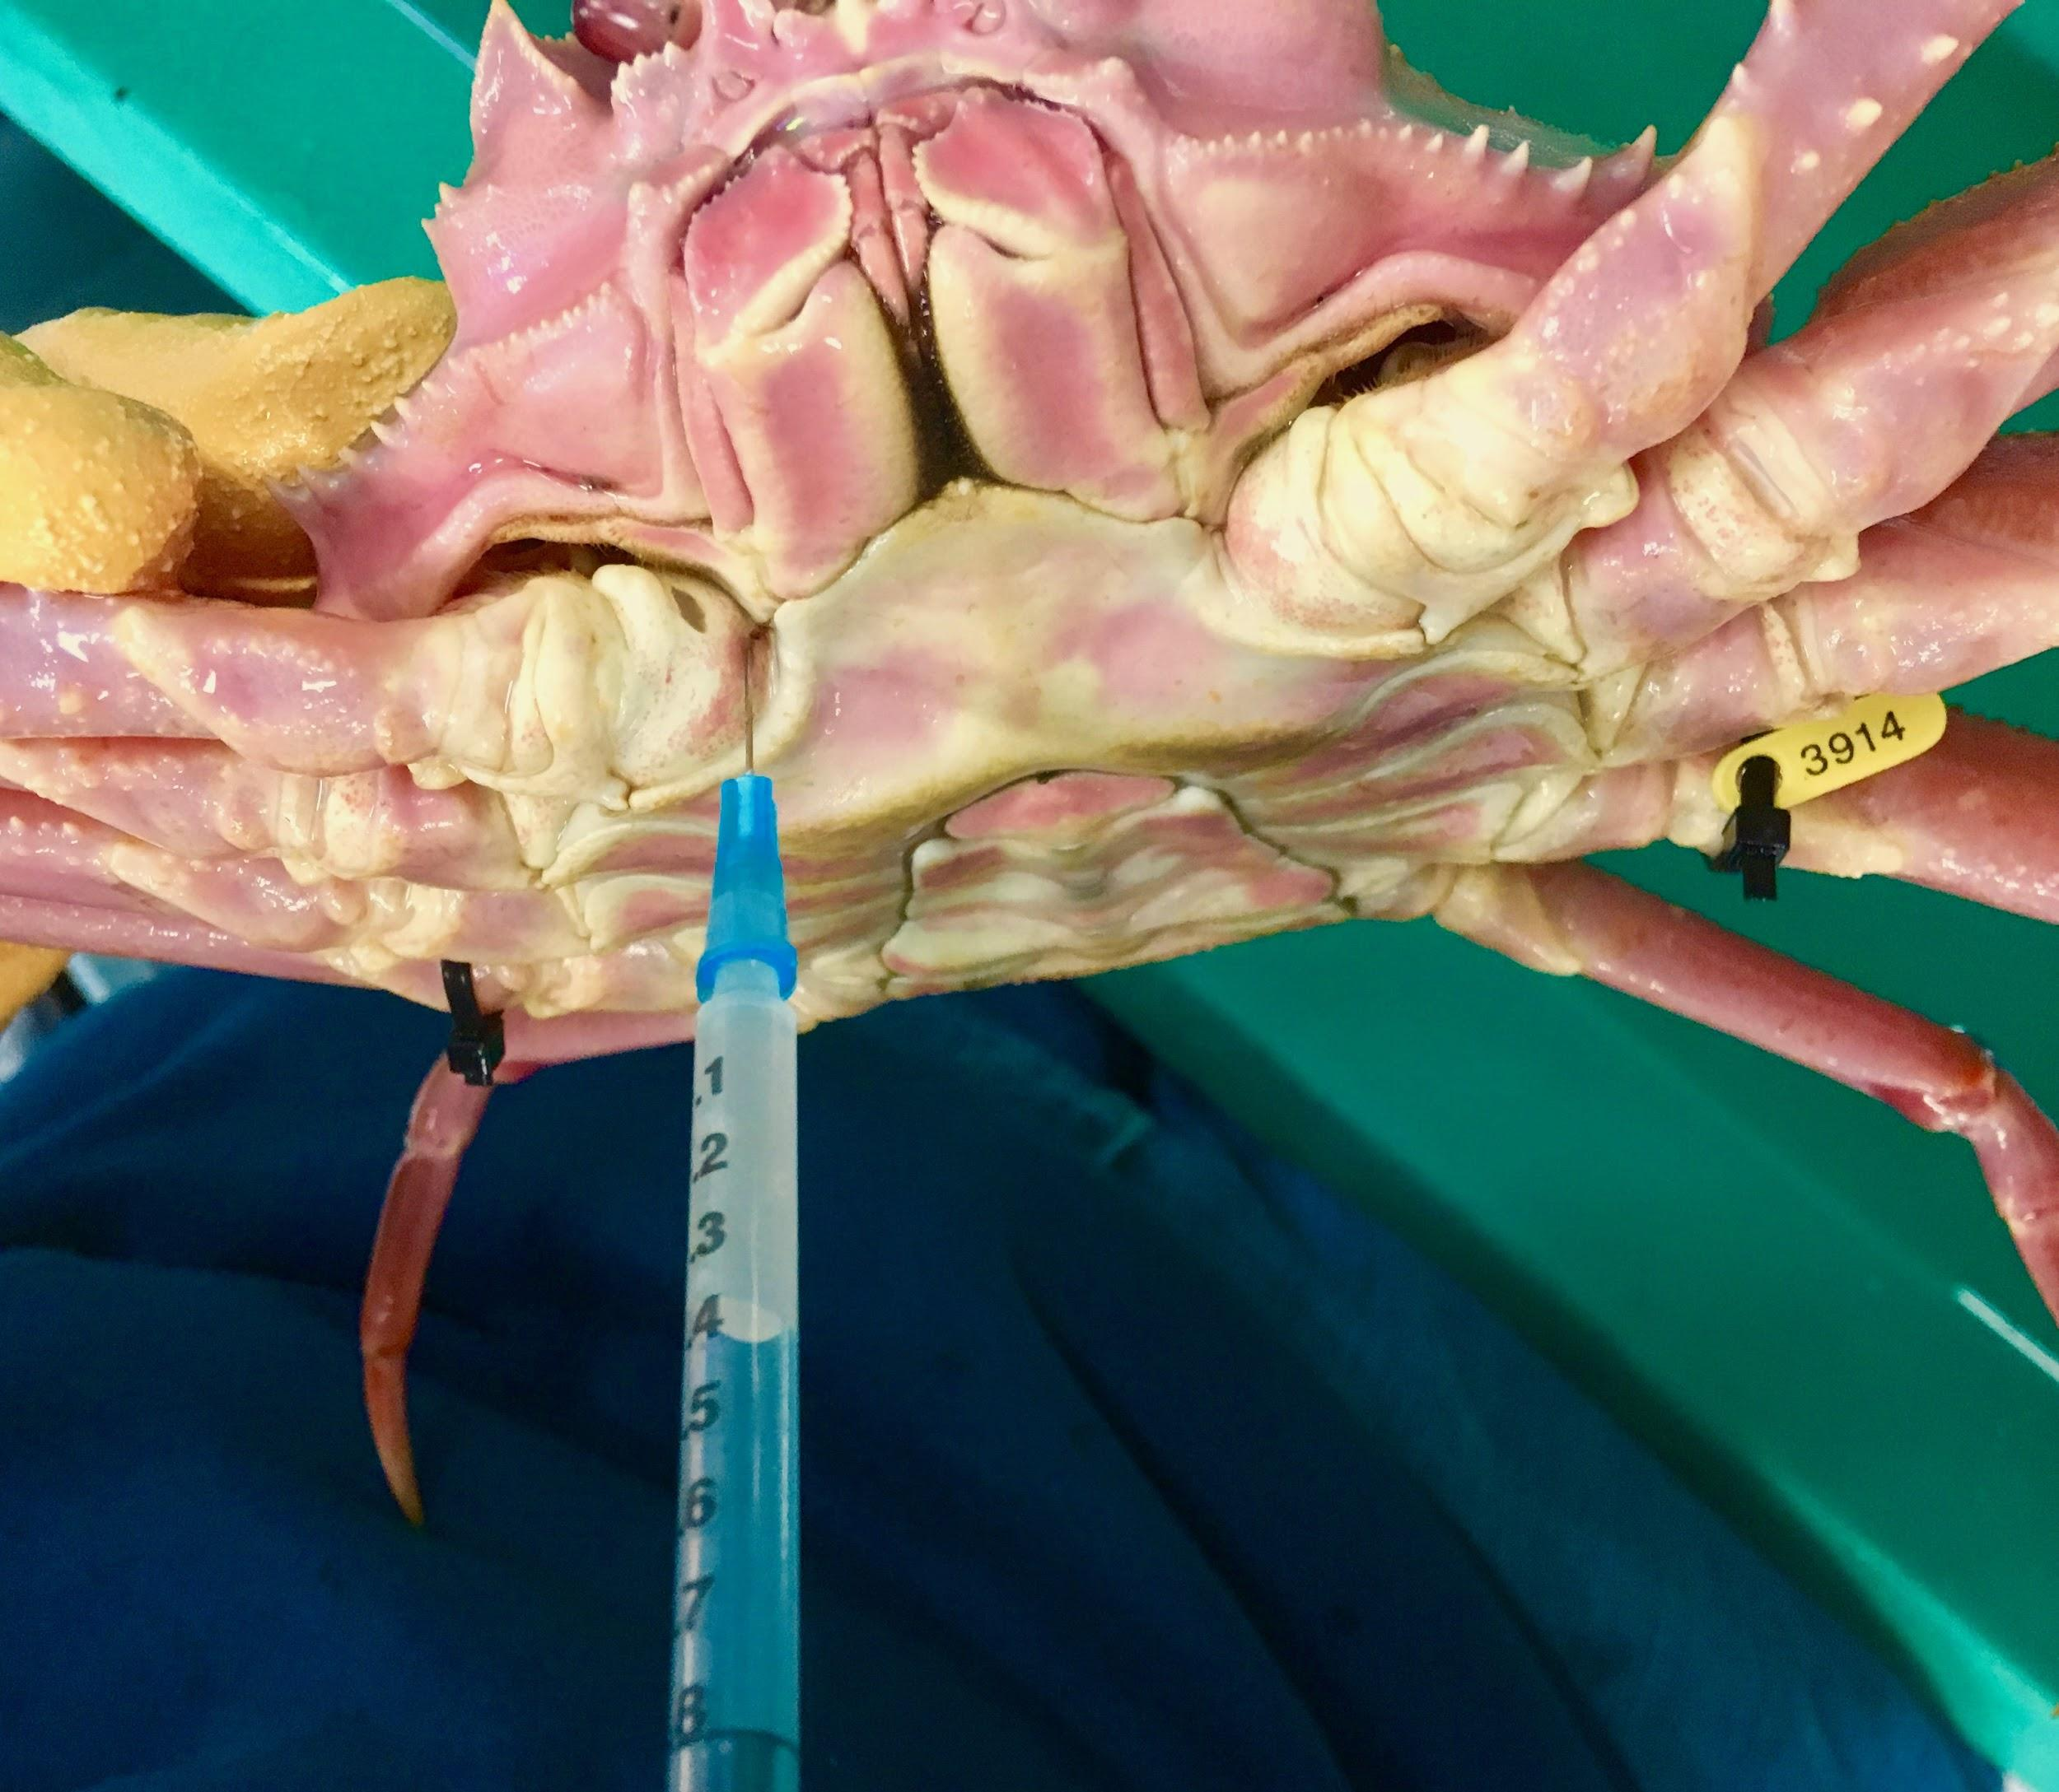
How did we sample hemolymph?
Stored in RNAlater for RNA extraction

Slide 20
1 cold
1 ambient
1 warm
1 cold
1 ambient
1 warm
0 cold
0 ambient
0 warm
0 cold
0 ambient
0 warm
Day 12
Day 26
Notes:
Data I’ll be presenting today
New data

Slide 21
1, cold
1, ambient
1, warm
1, cold
1, ambient
1, warm
INFECTED
UNINFECTED
Day 12
Day 26
Notes:
Just comparing infected and uninfected
NEW DATA: not final results.

Slide 22
How are the infected and uninfected crabs different?
Notes:
What is the difference between the infected and uninfected crabs?

Slide 23
How are the infected and uninfected crabs different?
What genes are differentially expressed in the infected crabs compared to the uninfected crabs?
Notes:
DEG = differentially expressed gene
Only possible in comparisons
Either more or less abundant in one group than in another (others)
How conditions affect an organism

Slide 24
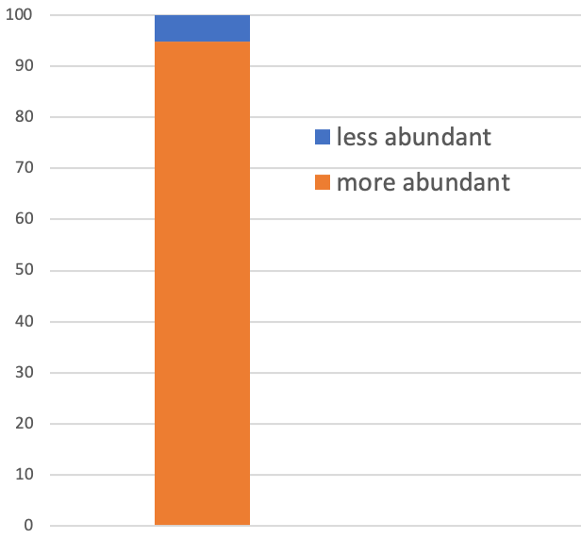
How many DEGs did we find?
58468 DEGs total
3062 less abundant in infected
55406 more abundance in infected
Notes:
EXCITING! Talk about how there are a lot more of the more abundant genes than less abundant. This is exciting because it might mean that we’re getting some Hematodinium RNA in our samples
In order to attempt to figure out if we do indeed have Hemat. In our samples we want to know
http://htmlpreview.github.io/?https://github.com/sr320/nb-2019/blob/master/C_bairdi/11-Deseq2.html
Positive (“up”) are in uninfected
Negative (“down”) are in infected
https://www.bioconductor.org/packages/devel/bioc/vignettes/DESeq2/inst/doc/DESeq2.html#standard-workflow

Slide 25
What are these DEGs doing?

Slide 26
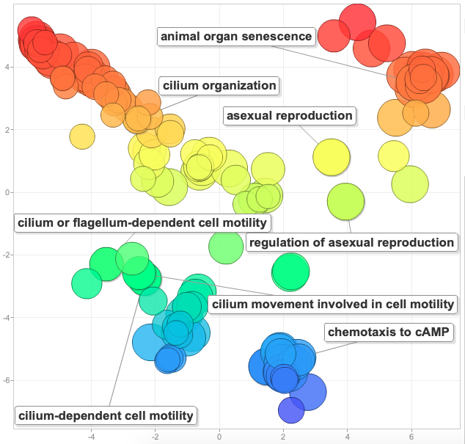
High abundance in infected group
Notes:
Larger the dot, the more abundant process is in the infected
298 enriched genes
Talk about some cool things:
Cilia (dinoflagellates move with flagella/cilia)
Asexual reproduction (dinoflagellates reproduce asexually)

Slide 27
High abundance in infected group
Some crab immune genes:
- Interleukin-1 receptor associated kinase 4 (IRAK-4)
- Serine protease persephone
- Leukocyte elastase inhibitor A (Serpine B1a)
Notes:
Interleukin-1 receptor-associated kinase 4 (IRAK-4) (EC 2.7.11.1) → plays a critical role in initiating innate immune response against foreign pathogens
Serine protease persephone (EC 3.4.21.-) → role in innate immunity in response
Leukocyte elastase inhibitor A (Serine protease inhibitor EIA) (Serpin B1a) → innate immunity
Others:
High mobility group protein DSP1 (Protein dorsal switch 1)
Toll-like receptor Tollo (Toll-like receptor 8)
Matrix metalloproteinase-2 (Dm2-MMP) (EC 3.4.24.-)
Autophagy protein 5 (APG5-like)
Leukocyte elastase inhibitor A (Serine protease inhibitor EIA) (Serpin B1a)
Serine protease persephone (EC 3.4.21.-)
Toll-interacting protein
Complement component 1 Q subcomponent-binding protein,
Interleukin-1 receptor-associated kinase 4 (IRAK-4) (EC 2.7.11.1)
Putative serine protease K12H4.7 (EC 3.4.-.-)
Protein toll
Interleukin enhancer-binding factor 2 homolog

Slide 28
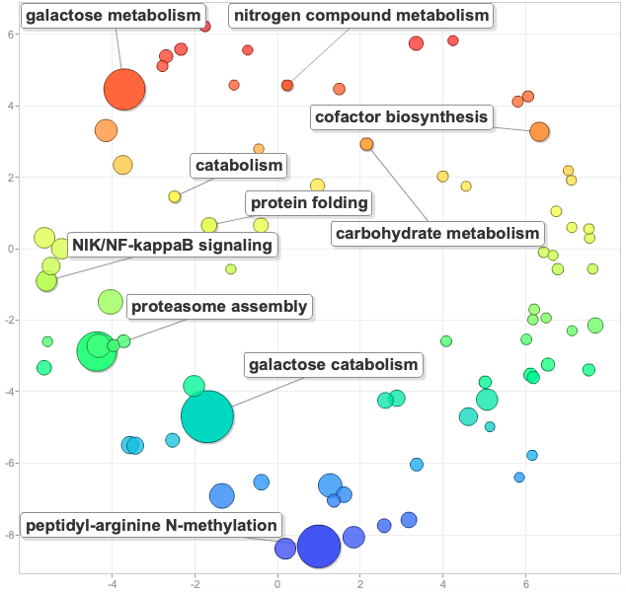
Low abundance
in infected group
Notes:
Less abundant genes involved in normal metabolism.
Tells us that the crabs normal metabolic functioning are negatively impacted by Hematodinium.
That they are stressed by the infection.
Makes sense since it’s known that the parasite takes over the crabs hemol spaces and outcompetes the host for nutrients and oxygen

Slide 29
Summary
Identified genes in crab immune response
Identified genes in Hematodinium
Motility; reproduction
Saw negative impact on general crab metabolism
Lower abundance of metabolic functions in infected crabs
Notes:
Have markers of neg. Impact on metabolism and of infection
Can look for them in samples

Slide 30
Next steps
1 → infected
0 →uninfected
Cold → 4˚C
Ambient → 6˚C
Warm → 10˚C
1 cold
1 ambient
1 warm
1 cold
1 ambient
1 warm
Infected
Uninfected
0 cold
0 ambient
0 warm
0 cold
0 ambient
0 warm
Day 9
Day 12
Day 26
Notes:
Look at temperatures, sampling days → look into connections deeper

Slide 31
Next steps
1 → infected
0 →uninfected
Cold → 4˚C
Ambient → 6˚C
Warm → 10˚C
Infected
Infected
Uninfected
Uninfected
Day 9
Day 12
Day 26
Notes:
Dig deeper into what I currently have
infection status and day 12 and day 26 → want to look deeper into those interactions

Slide 32
Next steps
1 → infected
0 →uninfected
Cold → 4˚C
Ambient → 6˚C
Warm → 10˚C
1 cold
1 ambient
1 warm
1 cold
1 ambient
1 warm
Infected
Uninfected
0 cold
0 ambient
0 warm
0 cold
0 ambient
0 warm
Day 9
Day 12
Day 26
Notes:
Coming up:
I’ll have data accounting for infection status pre-temperature treatment
Comparing infection status and cold and warm conditions

Slide 33
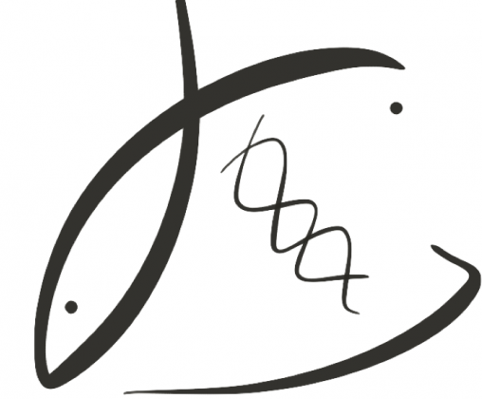
THANK YOU!
P.I.s:
Dr. Steven Roberts
Dr. Pam Jensen
Roberts Lab:
Jay Dimond
Laura Spencer
Shelly Trigg
Brent Vadopalas
Yaamini Venkataraman
Sam White
UW NWGC
bittercrab.science
grace-ac.github.io
Podcast: DecaPod

Slide 34
High abundance Low abundance
Notes:
Talk about size of dots
A lot more upregulated in high vs low abundance

