Slide 1
2019 European Meeting of ISMPP
Scientific Communications in a Fast-Paced World:
Fighting Fit for the Future

Slide 2
Maximising the impact of data: Curation and communication
Tom Rees
Oxford PharmaGenesis

Slide 3
Publications: convey data to clinicians

Slide 4
Publications in the changing communications environment

Slide 5
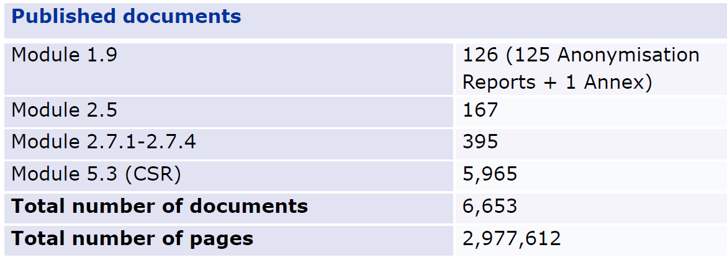
The volume of clinical information is enormous
An average of 450 pages per document
Henry-Eude, AS. European Medicines Agency. Presented at the DIA Global Clinical Trials Transparency Conference, 19-20 September 2018

Slide 6
Clinical trials are increasingly complex
86%
increase in endpoints per clinical trial
2001-2005
2010-2015
Tufts CSDD Impact report. July/August 2018. Vol, 20 No 4.

Slide 7
Functions of a publication beyond data disclosure
Select what’s important
Contextualise
Explain

Slide 8
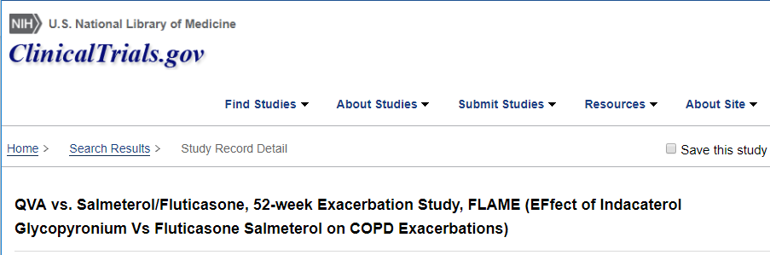
Linking the web to provide the full picture
Select what’s important. Resolved by providing the complete picture through links

Slide 9
And provide further context

Slide 10
Increasing volume of publications

Slide 11
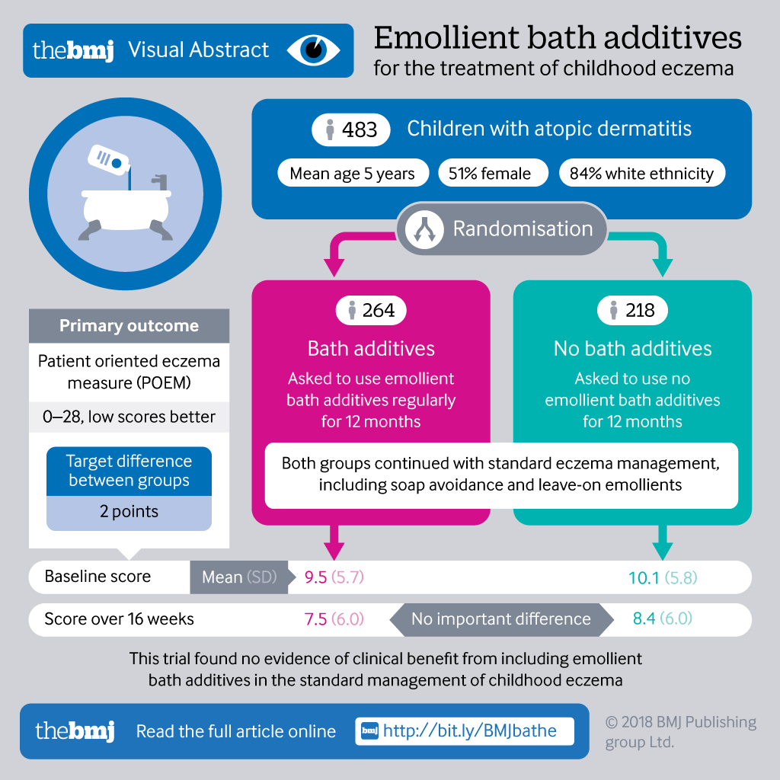
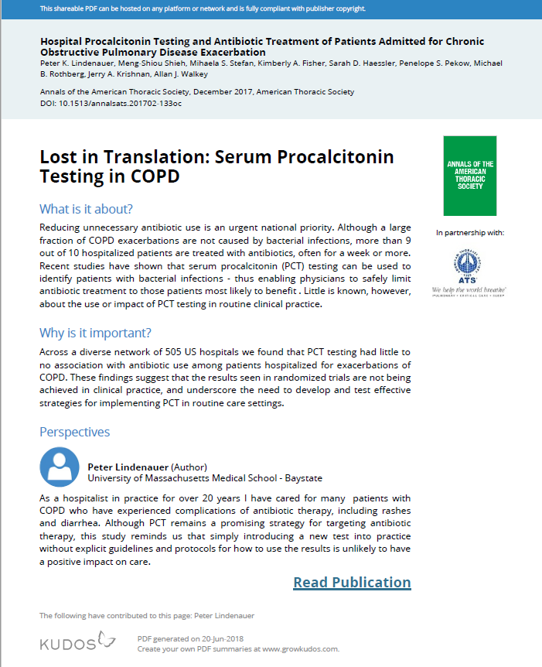
Summarise, simplify, and explain
Explanatory videos
Infographics
Plain Language Summaries

Slide 12
People love to share pictures
Title only
Visual abstract + title
11
92
retweets
3,000
24,000
tweet views
66
175
article views
Ibrahim AM, et al. Annals of Surgery. 2017 Dec 1;266(6):e46-8.

Slide 13
The importance of visual communication
Google Images currently accounts for 23% of all internet searches
Share of web searches February 2018 (via Jumpshot’s US clickstream panel)
Available at: https://sparktoro.com/blog/new-jumpshot-2018-data-where-searches-happen-on-the-web-google-amazon-facebook-beyond/

Slide 14
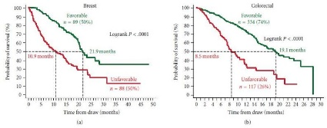
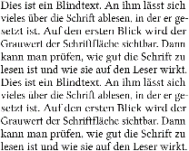
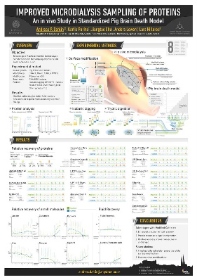
In the future, publications will be part of an ecosystem
Trialists’ perspective
Clinical Trial
Full results
Protocol
Data
Layperson summary
Third party commentary

Slide 15
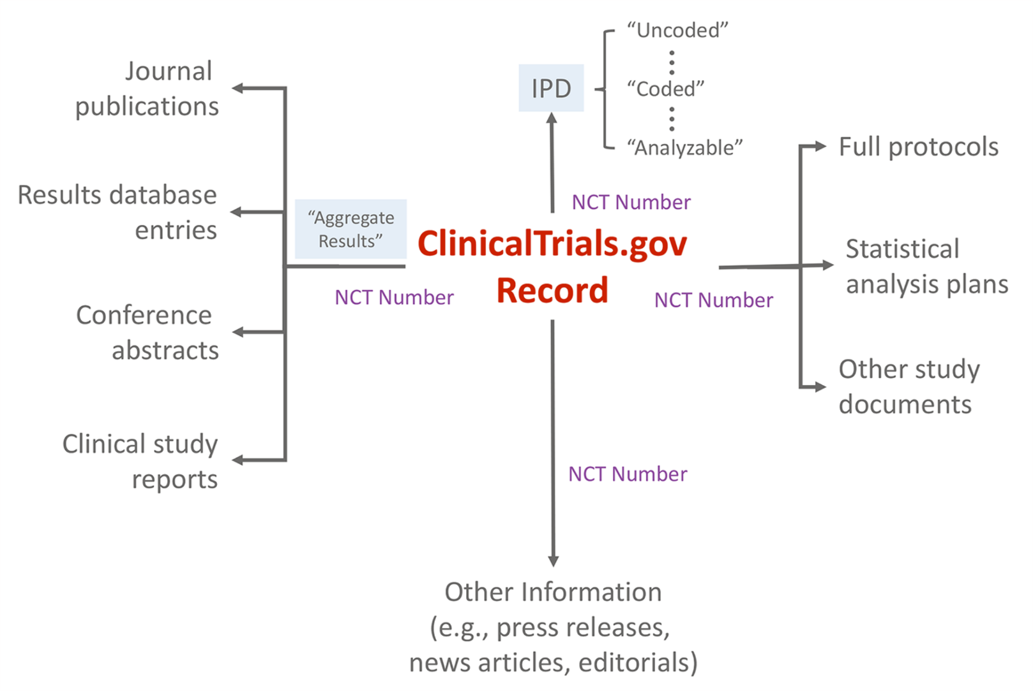
Medical communications can be connected through the clinical study identifier
Zarin DA, Tse T. PLoS medicine. 2016;13(1):e1001946.

Slide 16
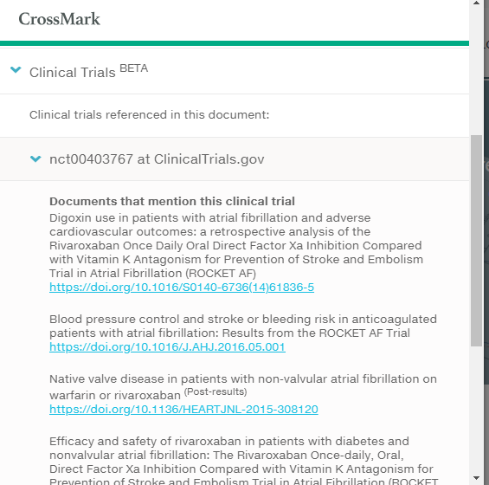
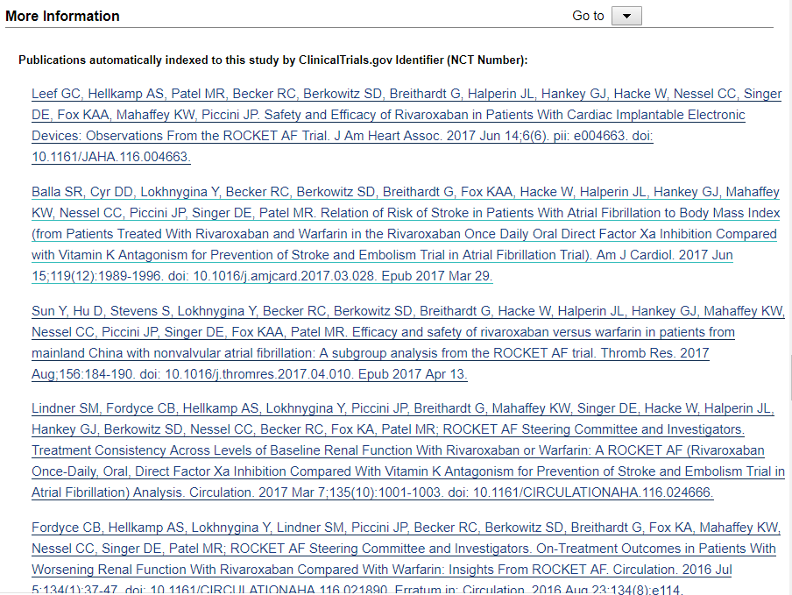
Finding publications linked to a clinical trial: Metadata versus content mining
Metadata
(Crossmark)
Automatic indexing
(PubMed)
Actual number
?
5 publications
22 publications
Number of publications linked to the Rocket-AF trial

Slide 17
Improving the link through deep learning
Matching article and clinical trial characteristics can find around 50% more trials
Goodwin TR. AMIA Summits on Translational Science Proceedings. 2018;2017:54.

Slide 18
Metadata is crucial to make this happen
Illustration by Jørgen Stamp digitalbevaring.dk CC BY 2.5 Denmark

Slide 19
“Metadata is a love note to the future”
Jason Scott, internet archivist

Slide 20
How does this talk of a publications ecosystem make you feel?
Excited – I can’t wait to explore the opportunities
Nervous – I’m not sure what to do next
Confused – I don’t really know what you’re talking about
Bored – It’s all hype
Something else

