Slide 1
Getting Big Data: Social scientists must strive to be autonomous from corporate charity
Dr. David Stillwell
Lecturer in Big Data Analytics and Quantitative Social Science
Academic Director of the Psychometrics Centre
Cambridge University Judge Business School

Slide 2
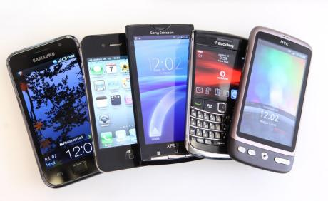
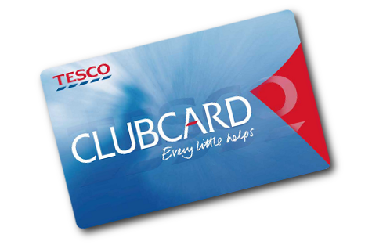
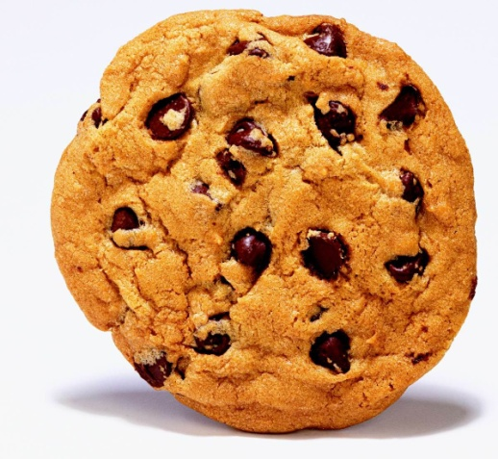
Notes:
What do all of these have in common? They’re data owned by corporations.

Slide 3
Corporations have lots of data We’d love to use it for research!
Notes:
In the past researchers had all the ‘big data’ e.g. from censuses or government surveys.

Slide 4
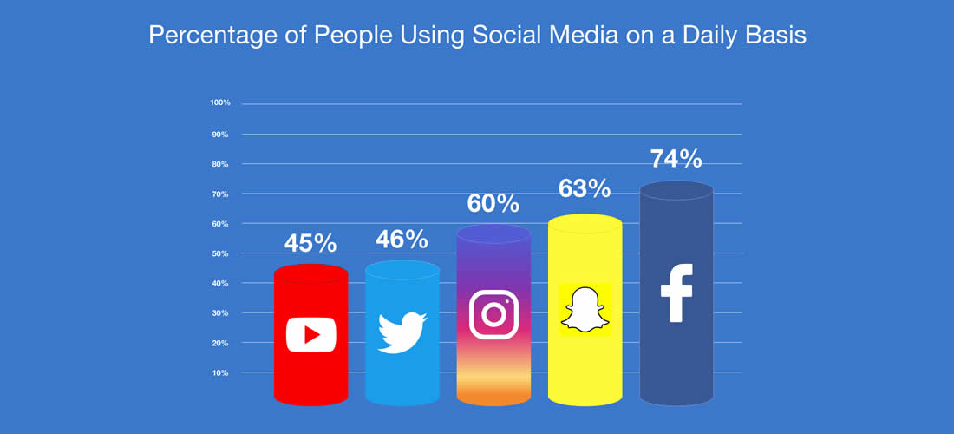
(Of those who use the platform)
http://www.pewinternet.org/2018/03/01/social-media-use-in-2018/
Notes:
Sometimes we want the data for pure research, and sometimes we want it to examine the effect of the company itself.
Warning: I use lots of FB examples, it just happens to be what I know!

Slide 5
Sometimes corporations can be persuaded to share their data
What do happy people buy?
Matz, Gladstone & Stillwell (2016) Psych. Sci.
Notes:
865 clients of a UK multinational bank
Shared 6 months of bank transactions (160,000 transactions)
Took Big Five personality test and Satisfaction with Life Scale.
In multiple regression, after controlling for age, gender, personality, total income, and total spend…
People spend more money on products that match their personality.
A person with an extraversion score in the 84th percentile spends about £52 ($77) more annually on nights out drinking than a person with an extraversion score in the 16th percentile.
A person with a conscientiousness score in the 84th percentile spends £124 ($183) more annually on ‘Health and fitness’ than a person with a conscientiousness score in the 16th percentile.
We calculated a match between each individual’s personality and the weighted average personality of their shopping basket.
People who spend more on products that match their personality have higher satisfaction with life.
This effect is ~4 times stronger than the effect of total income or total spend.

Slide 6
But companies have their own incentives
They’d rather just not know about certain things.
Or, at least, they’d rather the public didn’t know about them
So there’s limits to their data sharing
We get glimpses about these things in other ways, like from journalists, but not systematic studies.

Slide 7
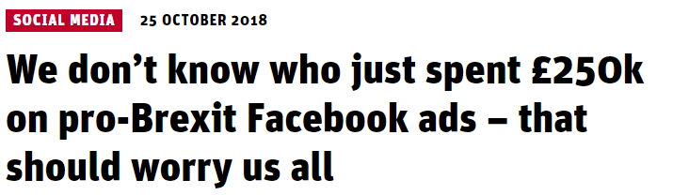
“The site, called the ‘Mainstream Network’, has no known named organisation, UK address, group or individuals publicly connected with it, and this information cannot be found. The campaign is estimated to have reached between 10 and 11 million people”
https://www.theguardian.com/politics/2019/apr/03/grassroots-facebook-brexit-ads-secretly-run-by-staff-of-lynton-crosby-firm
https://www.parliament.uk/business/committees/committees-a-z/commons-select/digital-culture-media-and-sport-committee/news/fake-news-89up-evidence-17-19/
https://www.newstatesman.com/politics/elections/2018/10/we-don-t-know-who-just-spent-250k-pro-brexit-facebook-ads-should-worry-us

Slide 8
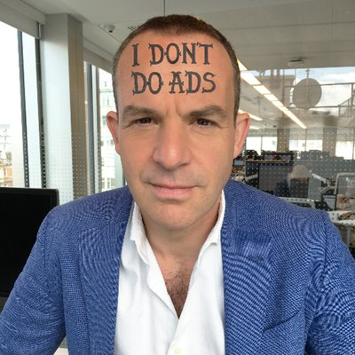
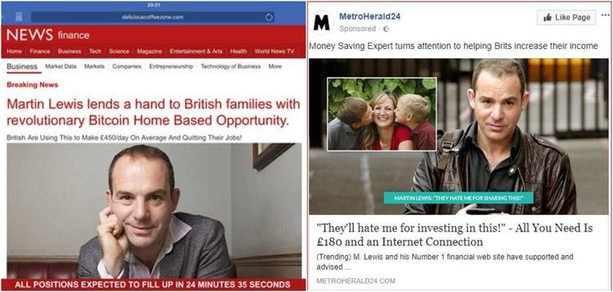
“Martin Lewis said he has been told stories of people's savings being wiped out by the scams, which he said have made some suicidal.”
https://www.businessinsider.com/martin-lewis-fake-bitcoin-ads-on-facebook-are-destroying-lives-2018-9
https://www.moneysavingexpert.com/news/2018/04/facebook-admits-its-had-to-take-down-thousands-of-fake-martin-ads/

Slide 9
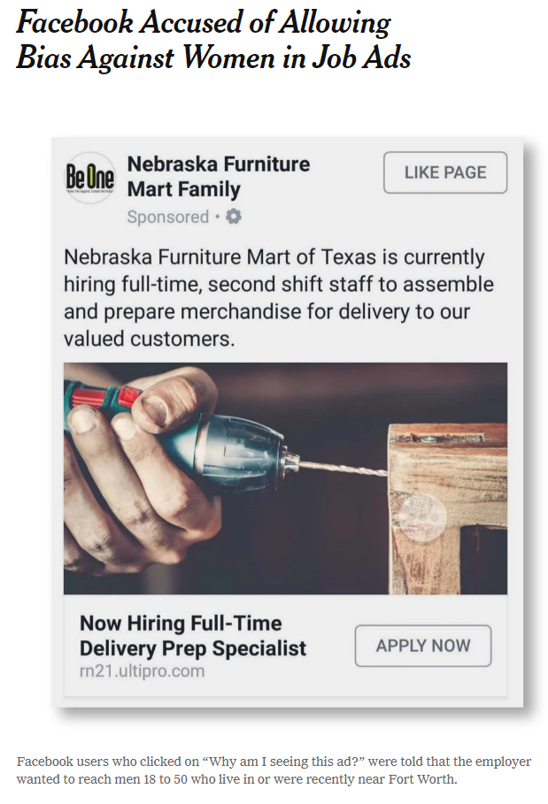
https://www.nytimes.com/2018/09/18/business/economy/facebook-job-ads.html

Slide 10
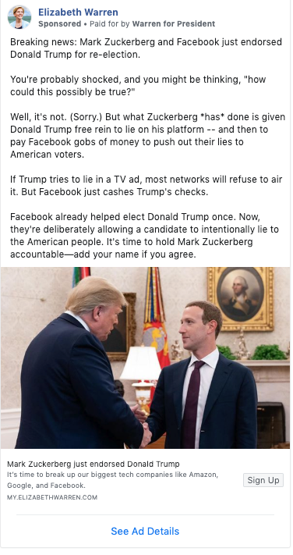
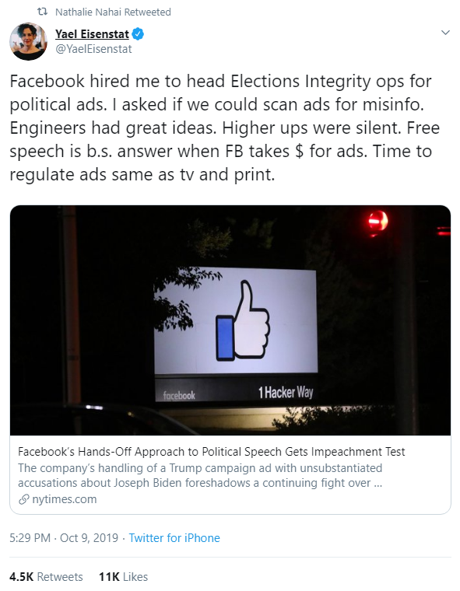
Facebook policy lets politicians lie in ads
https://www.washingtonpost.com/technology/2019/10/10/facebook-policy-political-speech-lets-politicians-lie-ads
Notes:
How much does stuff like this affect democracy?

Slide 11
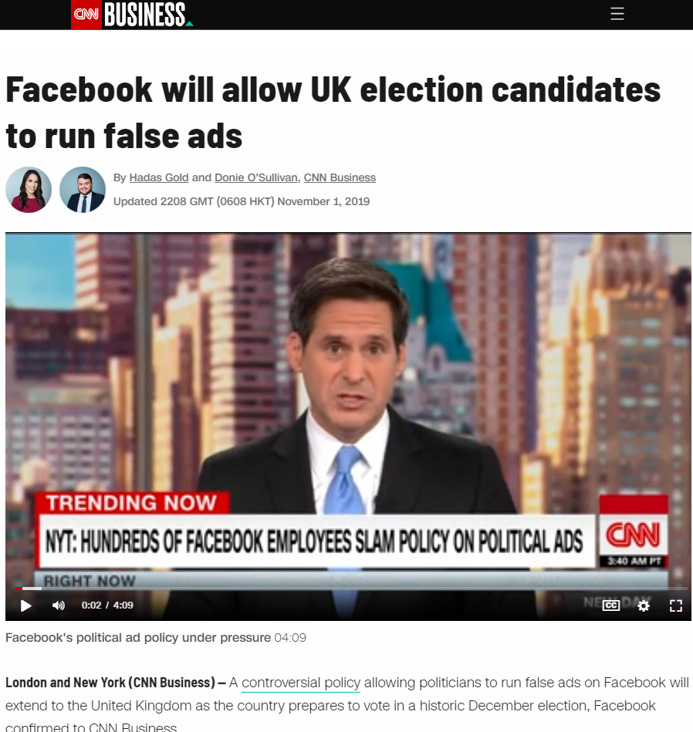

Slide 12
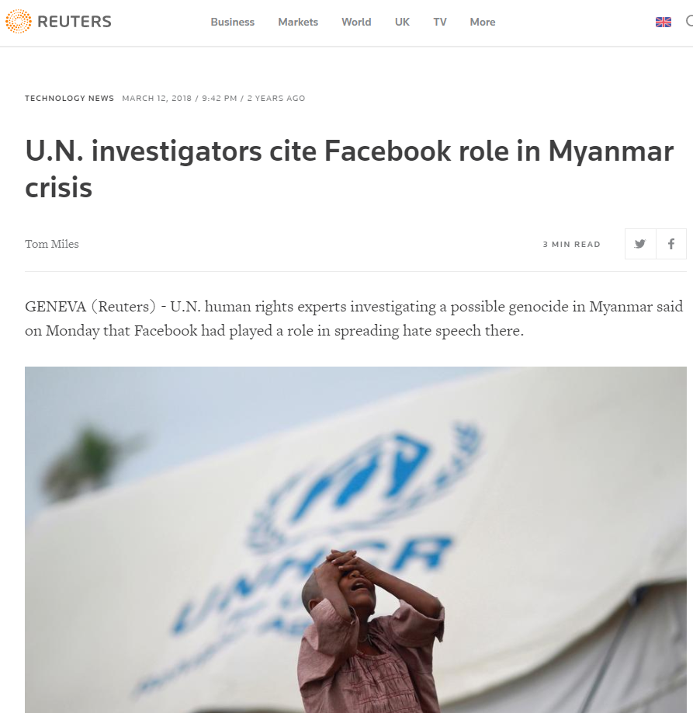
Notes:
Closed groups

Slide 13
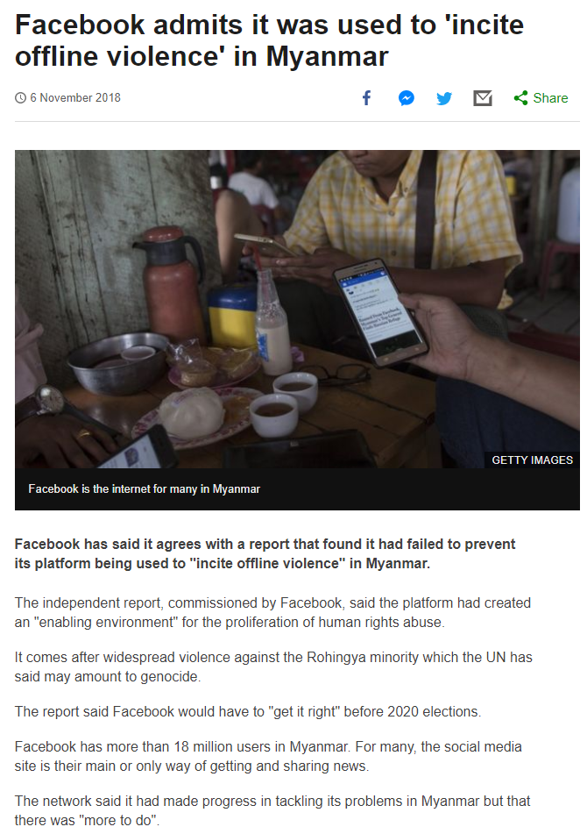

Slide 14
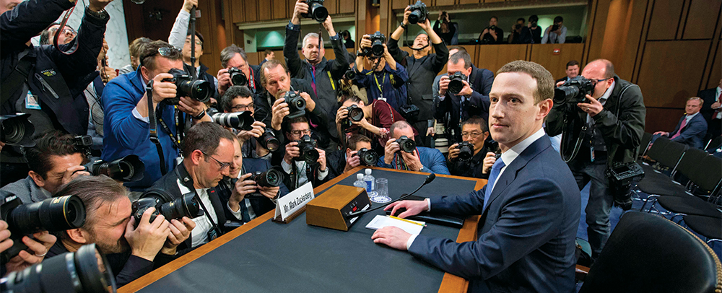
For example: Social Science One
December 2011: I, and other academics, visit FB to meet with their data team.
April 2018: (midst of Facebook Cambridge Analytica scandal) Zuckerberg tells congress that FB will share posts, links, user data with researchers around the world so they can study disinformation
He says first results will come at the end of the year
Notes:
This was an old idea: I was invited to FB HQ in 2011 where we discussed the idea of having a repository of users’ data for academic research.

Slide 15
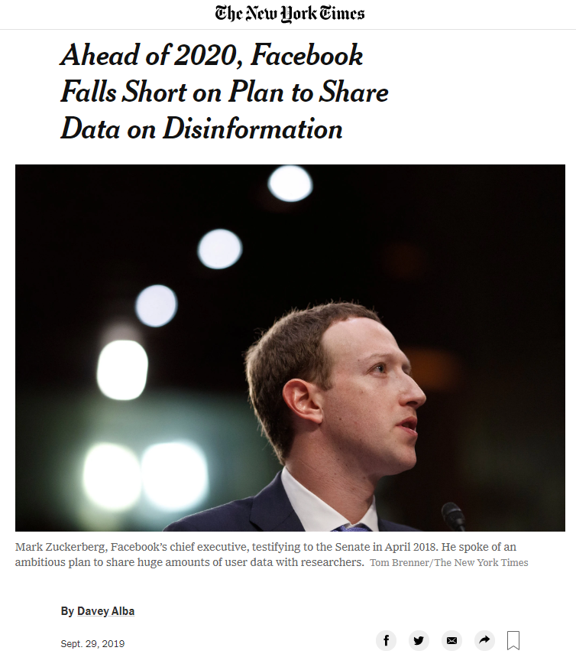

Slide 16
Social Science One
September 2019: Seven non-profit groups that funded the endeavour threaten to pull out.
Data still not provided due to privacy concerns. Working on differential privacy.
Even when data comes, it’ll be much less comprehensive than promised.

Slide 17
Social Science One
What if an academic has another research question? E.g. Does social media make people more anxious?
Social Science One says that they’ll allow other research questions to be asked in future.

Slide 18
What’s the alternative? APIs?
Notes:
APIs are the official way to get data. Instead of going to company, you go to users

Slide 19
myPersonality app (2007-12)
6mil individual psych profiles
25 validated psychometric tests
All data collected through opt-in
Data shared with >100 Universities
Feedback was the only incentive
40 journal articles since 2011

Slide 20
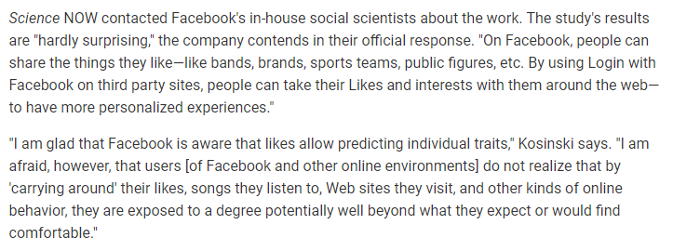
https://www.sciencemag.org/news/2013/03/facebook-preferences-predict-personality-traits
“The Likes data are public information.” -- Facebook Policy Communications

Slide 21
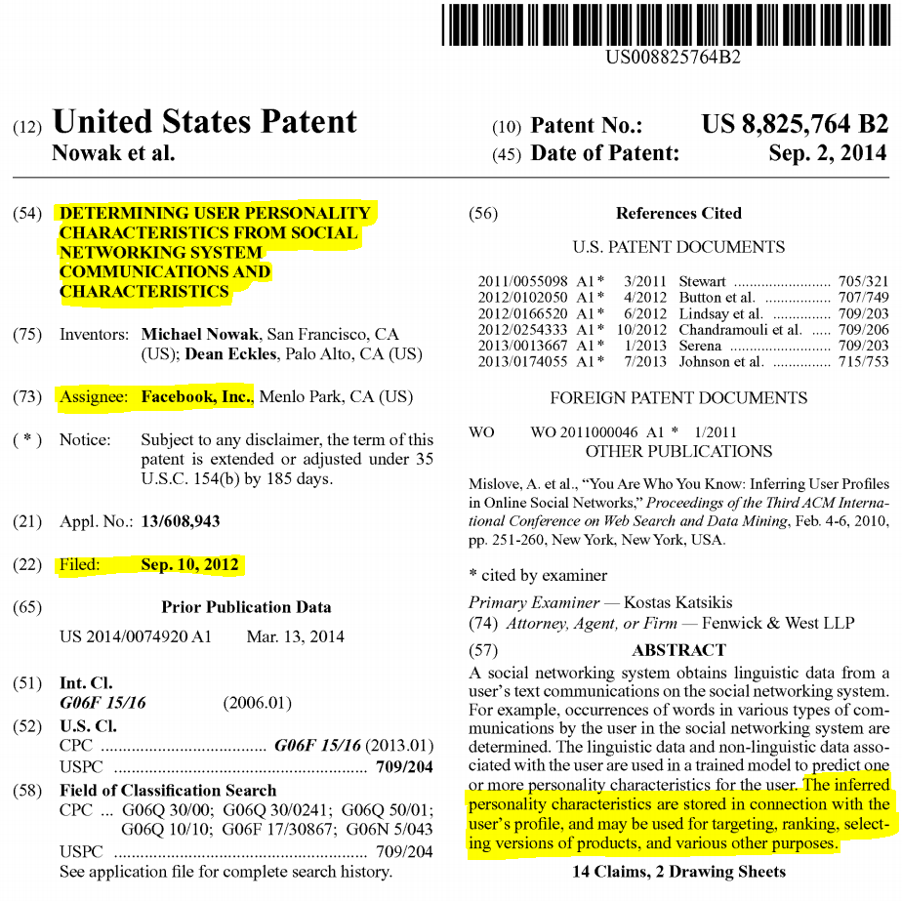
https://patents.google.com/patent/US8825764B2/en

Slide 22
“Digital records of behavior can be used to automatically and accurately predict a range of highly sensitive personal attributes”
March 2013
Kosinski, Graepel & Stillwell (2013)

Slide 23
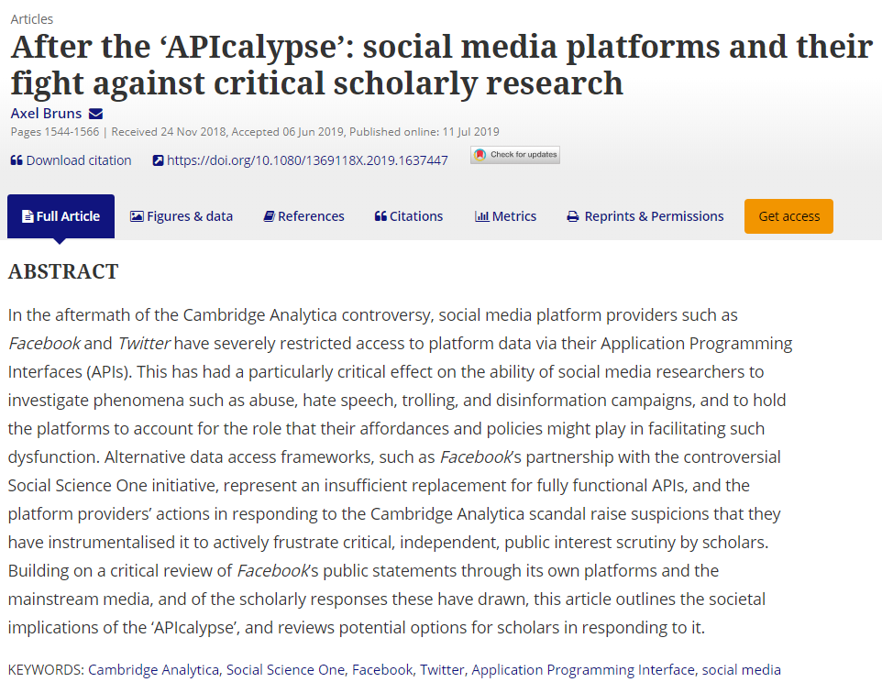
Notes:
Companies have cracked down on APIs.

Slide 24
Data flow via API
Scientist
Users
Company

Slide 25
Scientist
Users
Company decides what
scientist can do with data
Company decides what
users are allowed to share
Company

Slide 26
EU General Data Protection Regulation (GDPR)
New EU data protection regulation.
Has applied in the UK from 25th May 2018
Includes 8 broad rights
One is:
The Right to Data Portability

Slide 27
The Right to Data Portability
“The right to data portability allows individuals to obtain and reuse their personal data for their own purposes across different services.
“It allows them to move, copy or transfer personal data easily from one IT environment to another in a safe and secure way, without hindrance to usability.”
You must provide the personal data in a structured, commonly used and machine readable form. Open formats include CSV files. Machine readable means that the information is structured so that software can extract specific elements of the data. This enables other organisations to use the data.
The information must be provided free of charge.
If the individual requests it, you may be required to transmit the data directly to another organisation if this is technically feasible.

Slide 28
Volume: Right to Data Portability
www.applymagicsauce.com
https://ico.org.uk/for-organisations/guide-to-data-protection/guide-to-the-general-data-protection-regulation-gdpr/individual-rights/right-to-data-portability/
Notes:
GDPR brings opportunities too. Can ask users to export their data and then you can import it, e.g. we do it on our website www.applymagicsauce.com
How should we provide the data?
You should provide the personal data in a format that is:
structured;
commonly used; and
machine-readable.
Same kind of stuff in UK’s Open Banking regulation. Even easier for consumers via API but harder for companies because you have to register.

Slide 29
Do companies comply with legislation?
Facebook/Twitter: Fairly quick and easy
LinkedIn: Couple of days (for about 2MB of data)
Amazon: 30 days exactly (and many steps)
Reddit: Does not seem to comply

Slide 30
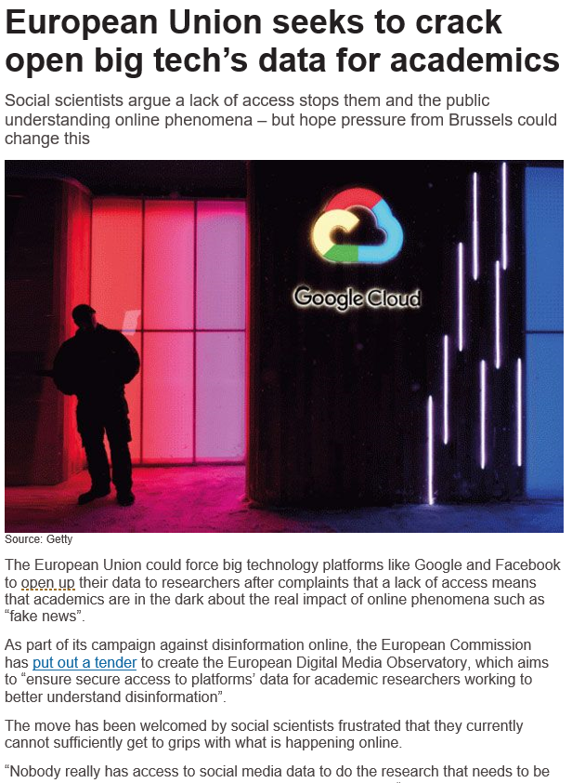
Other legislative alternatives?
But consent limitations, so only relevant under certain conditions, e.g. strong public interest.
Harder to justify for curiosity driven science.
How long will it take?

Slide 31
Companies control lots of data relevant to social science
They are not always incentivised to share it
GDPR data portability gives another alternative to researchers
Keep working towards other initiatives as well
Use your GDPR rights:
Right to data portability
Companies are required to give you a digital copy of your data that you can take elsewhere
Rights around automated decision making
Right to an explanation of any significant algorithmic decisions made about you
Dr. David Stillwell
Lecturer in Big Data Analytics and Quantitative Social Science
Academic Director of the Psychometrics Centre
Cambridge University Judge Business School

