Slide 1



SC’19 User Group Meeting
This work is supported by the National Science Foundation of the United States under the awards NSF SI2-SSE-1534949 and CSSI-Software-Frameworks-1835725.

Slide 2
User Group BoF Agenda
About Open OnDemand
Open OnDemand 2.0 Project Roadmap
Items ‘Coming Soon’ / Open Floor Discussion

Slide 3
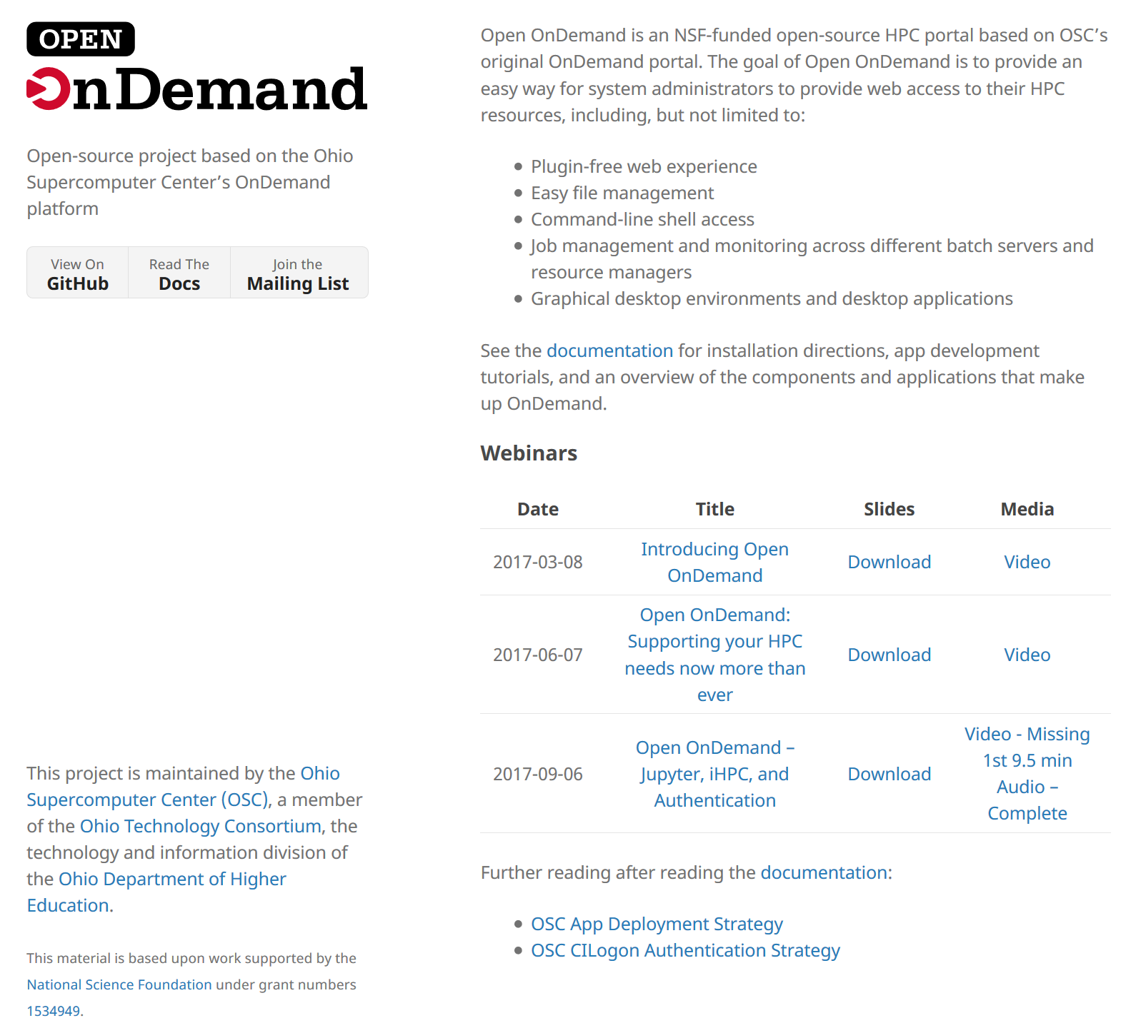
Staying in Touch
Visit our website
  http://openondemand.org
Use our Discourse
  https://discourse.osc.edu/c/open-ondemand
Join our mailing list
  https://lists.osu.edu/mailman/listinfo/ood-users
Our webinars are planned roughly quarterly
  Let us know what you’d like to learn about next

Slide 4

Supercomputing. Seamlessly.
Open OnDemand: Open, Interactive HPC Via the Web
Provides an easy to install and use, web-based access to supercomputers, resulting in intuitive, innovative support for interactive supercomputing.
Features include:
Plugin-free web experience
Easy file management
Command-line shell access
Job management and monitoring
Graphical desktop environments and applications

Slide 5
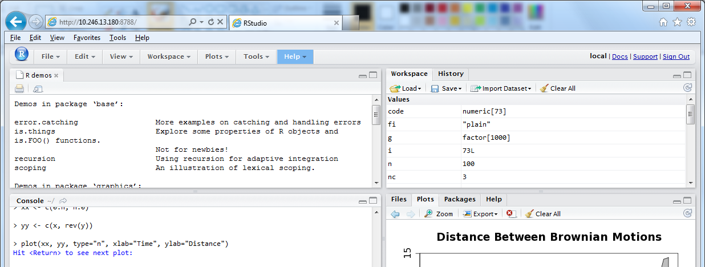
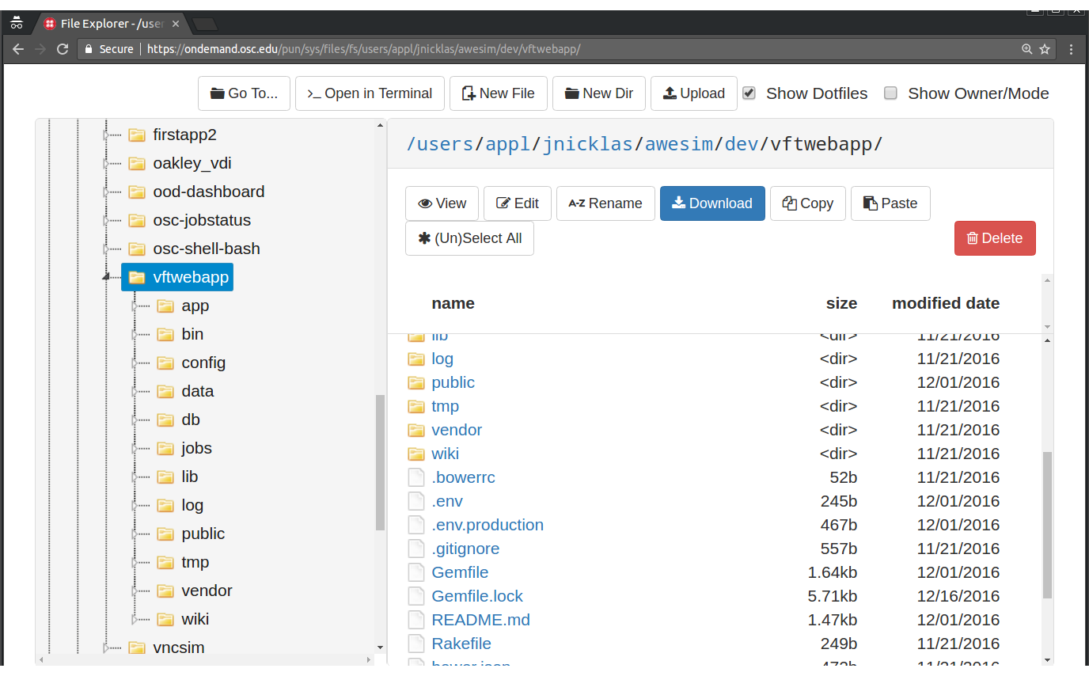
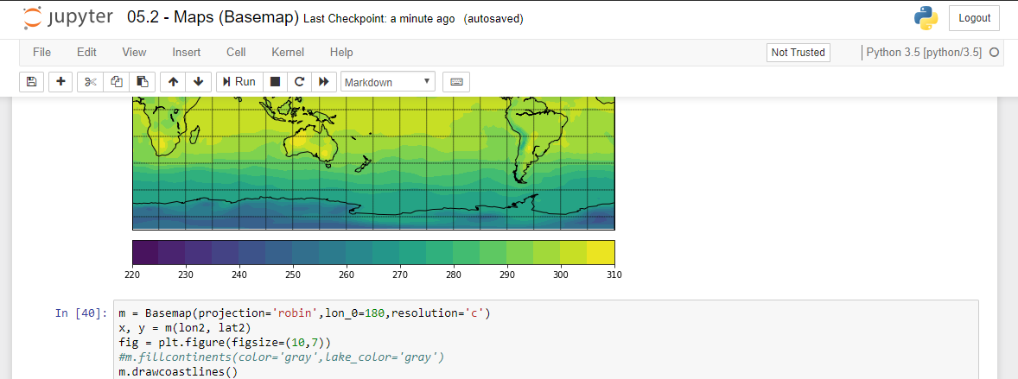
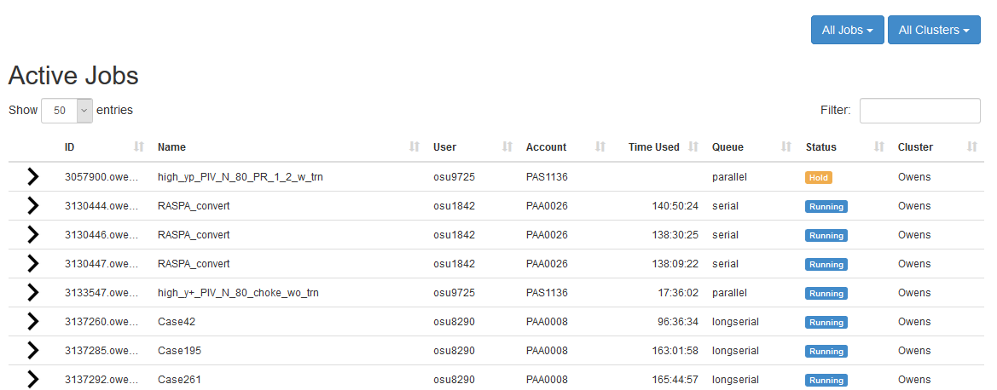
Interactive Apps & Cluster Access
RStudio Server – R IDE
File Access (browse, edit, etc)
Jupyter Notebook – Python IDE
Manage Jobs (view, submit, etc)
And many more, such as ANSYS Workbench, Abaqus/CAE, MATLAB, Paraview, COMSOL Multiphysics
And many more, such as in-browser SSH terminal, job constructors, VNC desktops

Slide 6
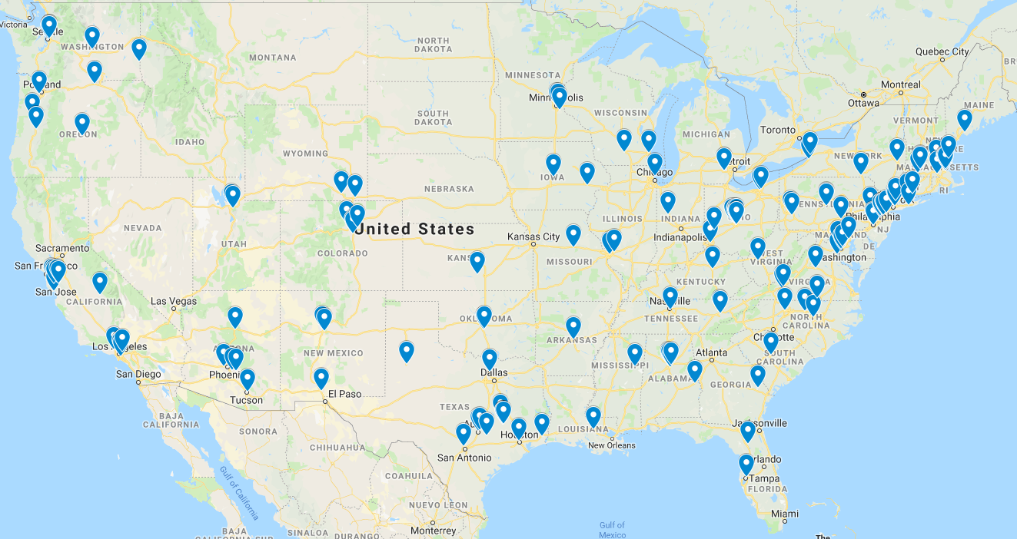


Approx Number of Institutions based on RPM logs
136 unique US locations
70 unique international locations
Map data @2019 Google, INEGI, ORION-ME

Slide 7
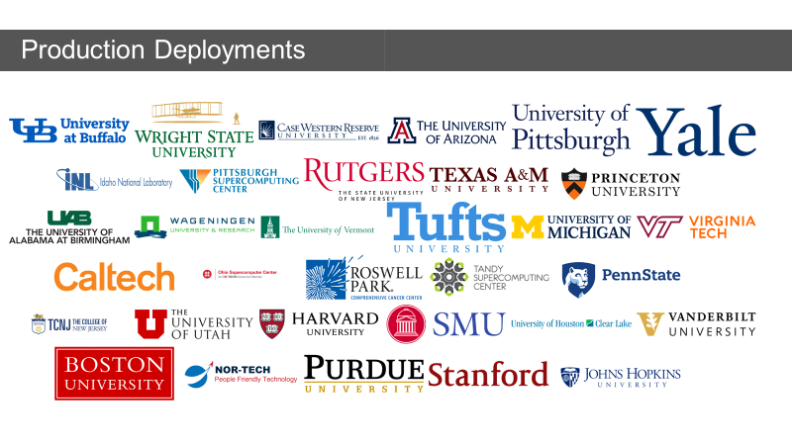
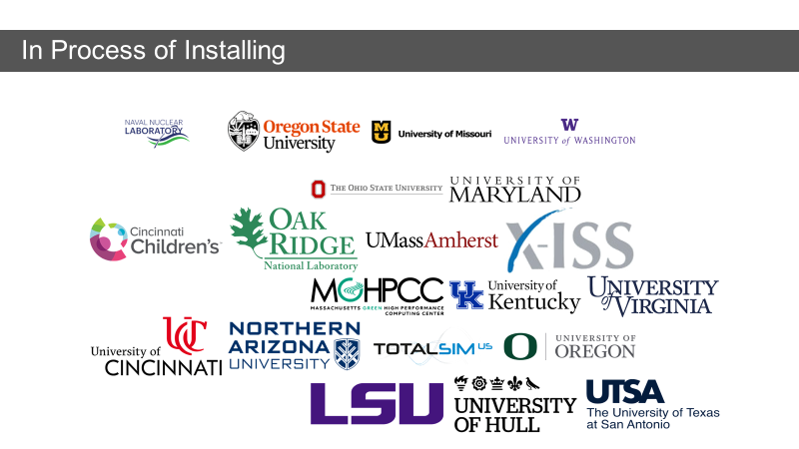
Example Current Engagements and Deployments

Slide 8
User Group BoF Agenda
About Open OnDemand
Open OnDemand 2.0 Project Roadmap
Items ‘Coming Soon’ / Open Floor Discussion

Slide 9
Open OnDemand 2.0 Project Overview
OnDemand 1.x: 3 year NSF SI2 award (#1534949)
OnDemand 2.x: 5 year NSF CSSI award (#1835725)
  Collaborators: SUNY Buffalo, Virginia Tech
Four areas
  Visibility: Enhancing resource use visibility by integrating Open XDMoD
  Scalability: support more types of computing resources and software
  Accessibility: appeal to more scientists in more fields of science
  Engagement: establish community of HPC users and administrators

Slide 10
Visibility: 5 year goals (bolded year 1 focus)
Integrate XDMoD Metrics into OnDemand
  Incorporate Job Accounting and Performance Summary
  Develop direct link capability to XDMoD from OnDemand
  Provide OnDemand usage metrics through XDMoD
  Link to XDMoD Job Viewer from Active Jobs app
Efficiency to Users
  Develop User Report Card
  Support user customization of their OOD dashboard
  Improve summary data and report card based on user feedback
  DL/ML automated detection to optimize user efficiency

Slide 11
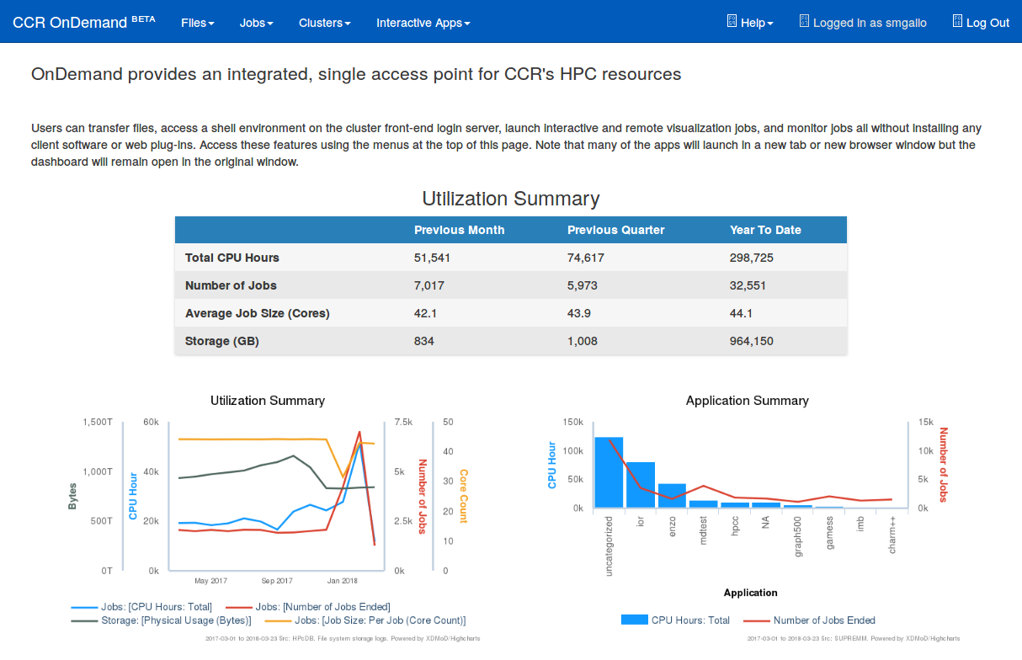
Open XDMoD and OnDemand Integration

Slide 12
Scalability: 5 year goals (bolded year 1 focus)
Extendibility
  Interactive work without a batch scheduler
  Increase number of languages to build and deploy apps in
  Support app development with REST API or ported App Kit
Performance
  Reduce response times, start up times, memory usage
  Support horizontal scaling of Per User NGINX processes
  Implement persistence options to support things like caching

Slide 13

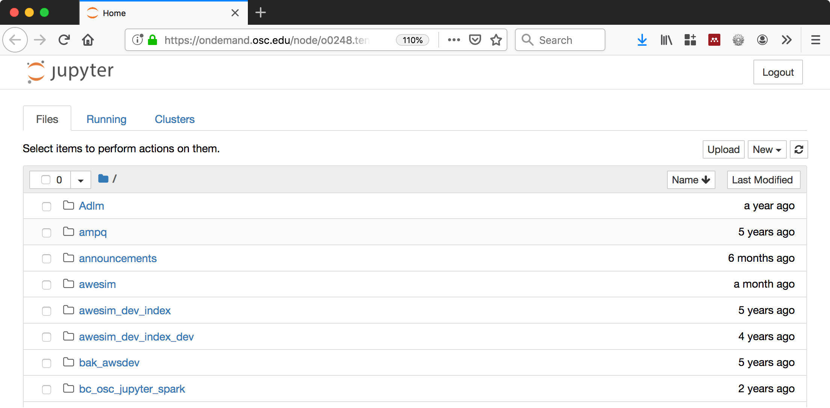



Scalability: Interactive without a batch scheduler - immediate access

Slide 14
Accessibility: 5 year goals (bolded year 1 focus)
Improve Job Management
Reduce Administrative Load (installation, config., etc)
Streamlining interface (reduce steps to accomplish a task)
Integrate Job/File Management, and App Launching interface
Integrated IDE for job and app development

Slide 15
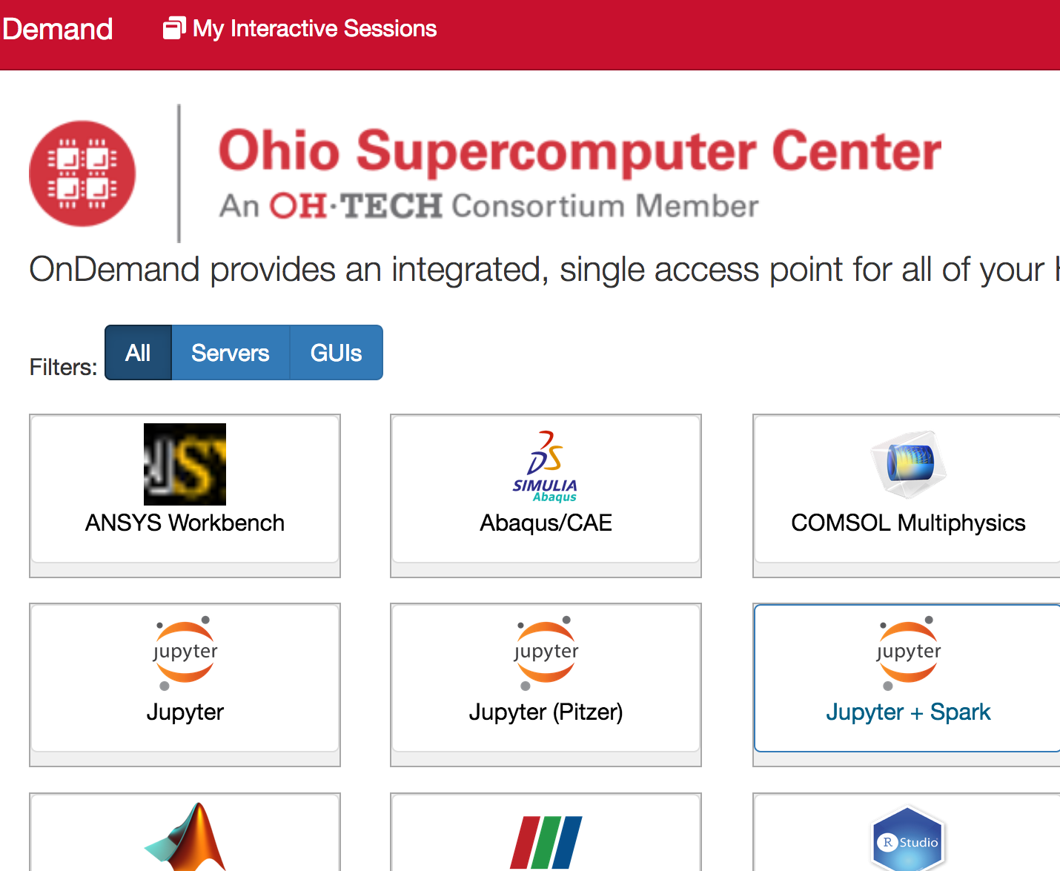
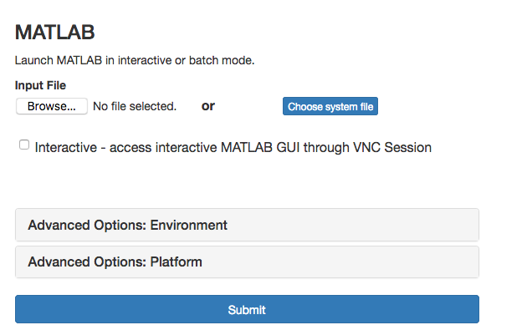
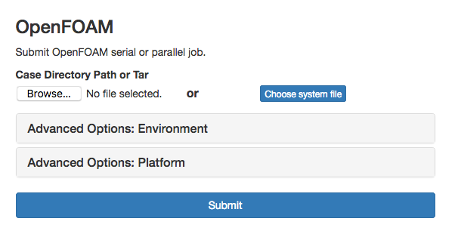
Complete Software Catalog and Integrated App Plugin

Slide 16
Engagement: 5 year goals
Targeting non traditional HPC disciplines
Advocating for the beginner user
Outreach
Ensure the project is community guided (Advisory Group)
  Members create local focus groups of users to gather feedback
  Help identify apps to expand access to non traditional domains

Slide 17
Leveraging OnDemand in Gateway Opportunities (LOGO)
National-scale Science Gateway community emerging
  Want to avoid duplication of effort
NSF is interested in the “science of cyberinfrastructure”
  OnDemand’s unique architecture is an opportunity for study
How should OnDemand integrate/extend existing Gateway solutions?
  Sandstone HPC, Galaxy, Apache Airavata

Slide 18
User Group BoF Agenda
About Open OnDemand
Open OnDemand 2.0 Project Roadmap
Items ‘Coming Soon’ / Open Floor Discussion

Slide 19
Items ‘Coming Soon’
System Stuff
Linux host adapter
Dashboard with XDMoD
Keycloak identity brokering
Kubernetes adapter
Custom classroom deployment
System status with GPUs
Globus integration
OpenHPC integration
Ansible role
OpenStack
Apps
Stata app
Tensorboard app
QGIS app
Job composer with XDMoD
Completed jobs app with XDMoD
Render app
Galaxy app
Shell reconnect
Visual Studio Code Server
New Files app

Slide 20
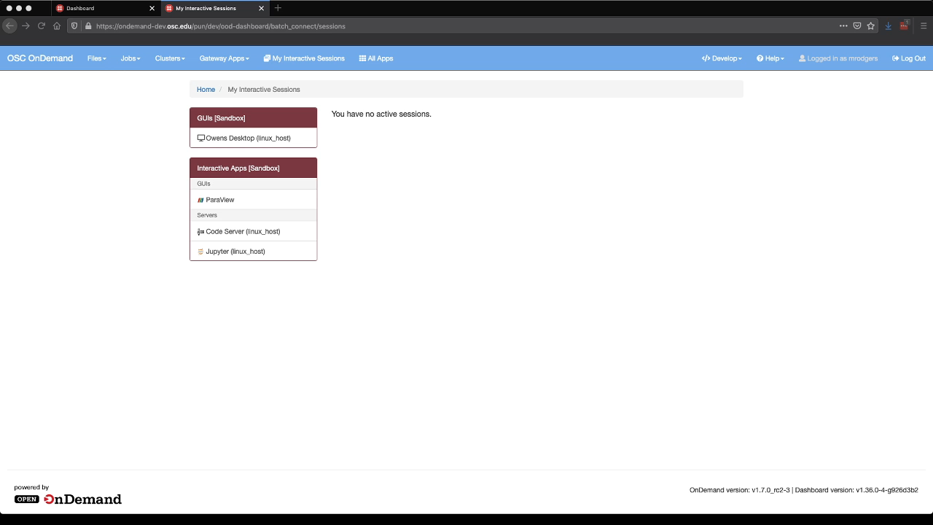
Linux Host Adapter (Video)

Slide 21
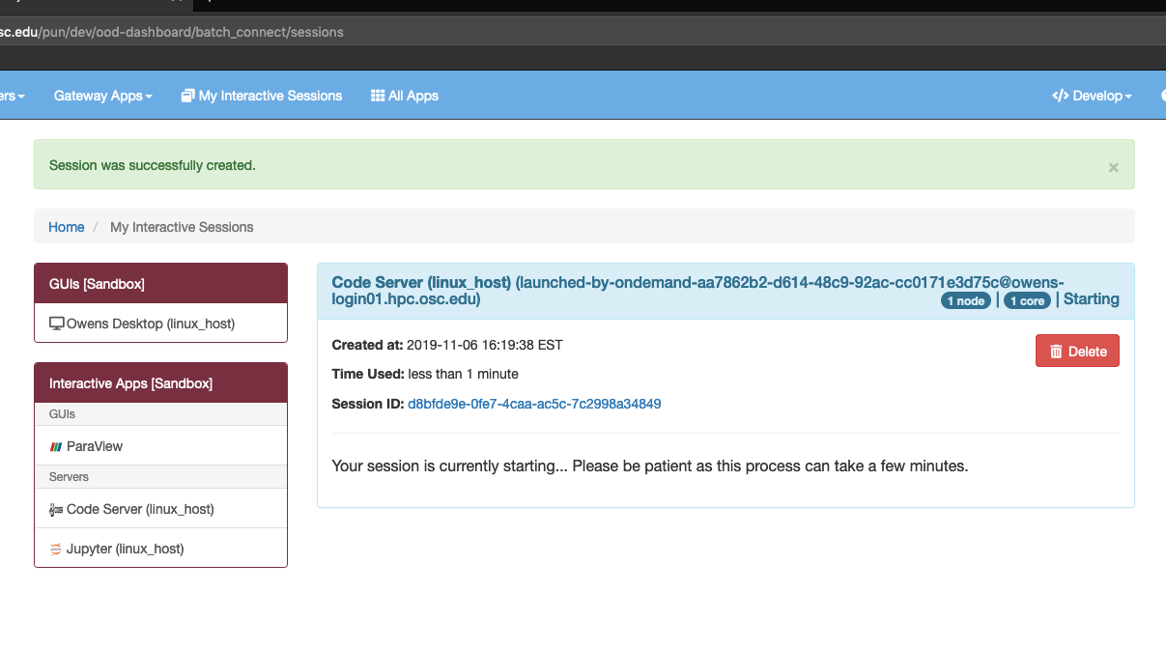
Linux Host Adapter (Screenshot)

Slide 22
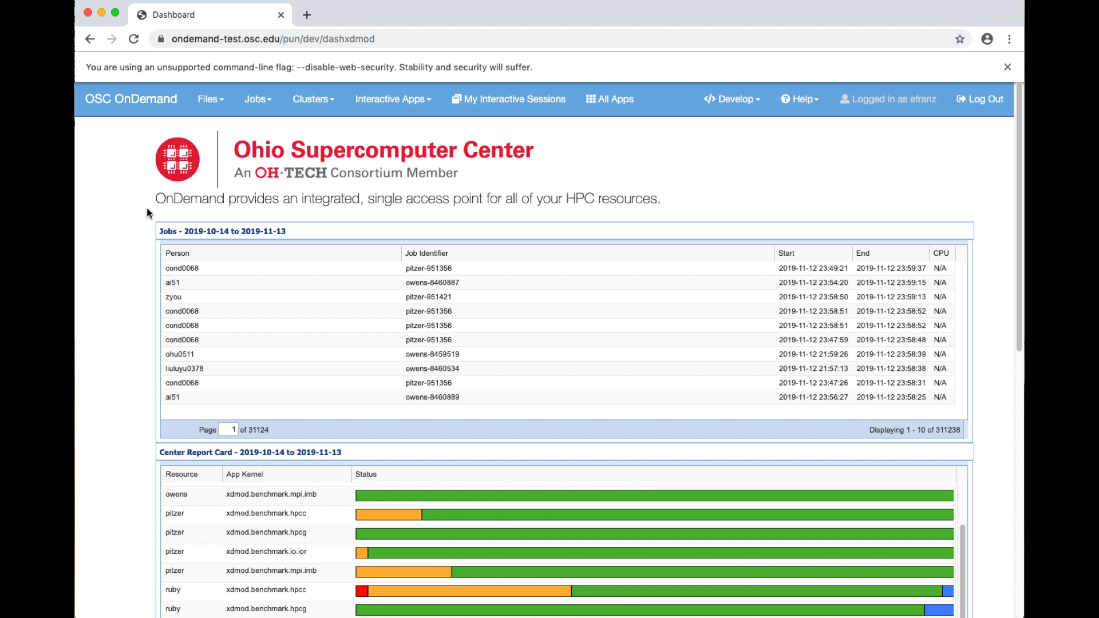
Dashboard with XDMoD (Video)

Slide 23
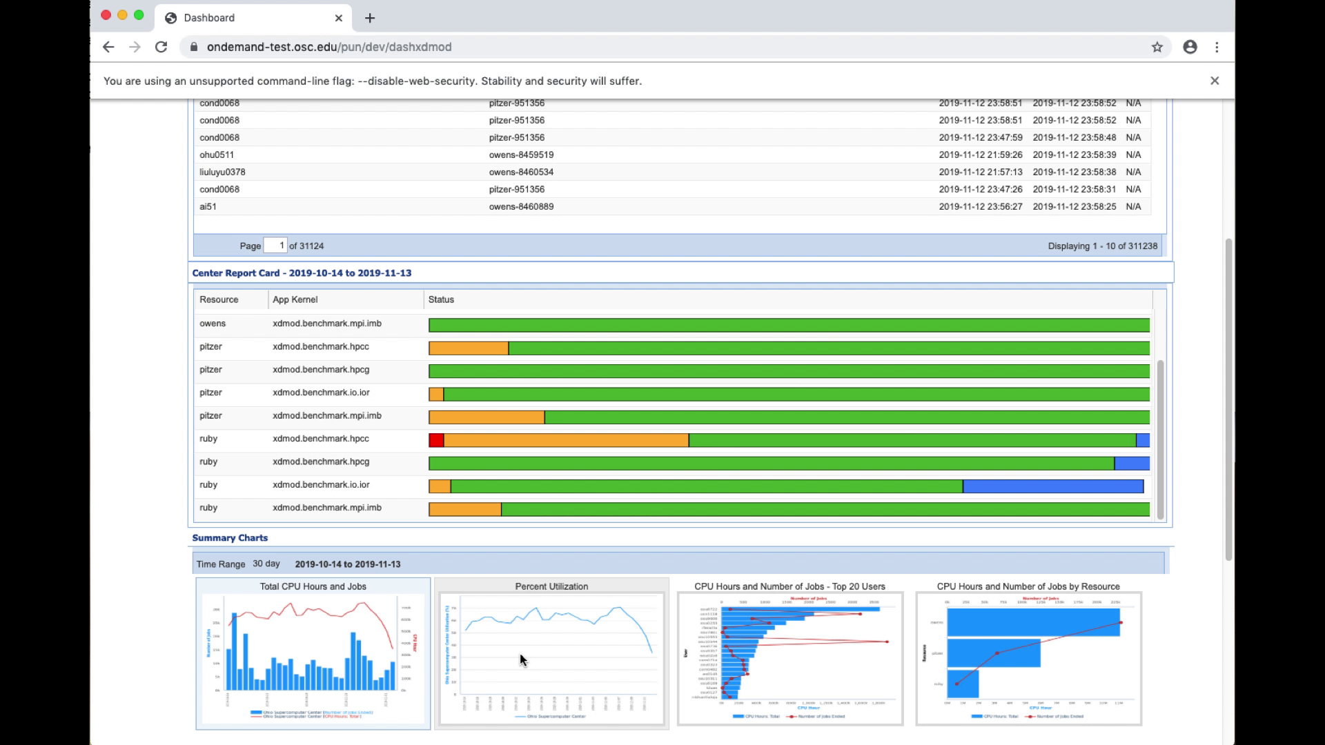
Dashboard with XDMoD (Screenshot)

Slide 24
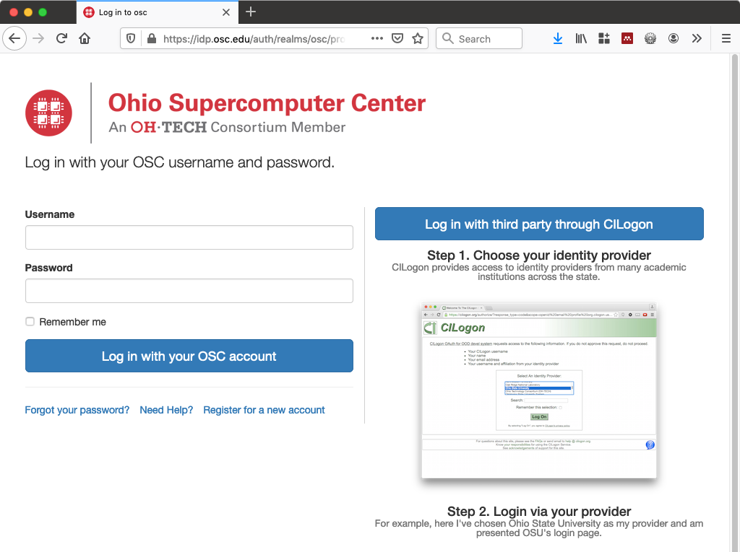
Keycloak Identity Brokering
Using Keycloak with OpenID connect to add authentication to OnDemand, backed by your LDAP
Add CILogon or other external identity providers as secondary login options
Keycloak handles first login flow to help the user map the external login to the LDAP login
In use at OSC – ask if you want directions on setting up similar and example Keycloak theme to use

Slide 25
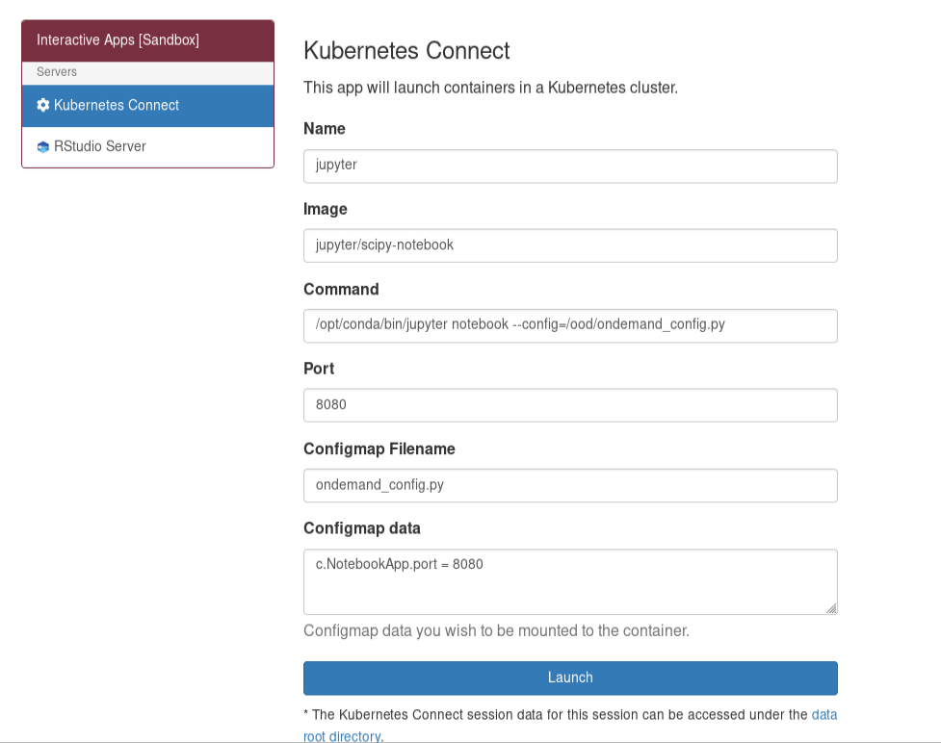
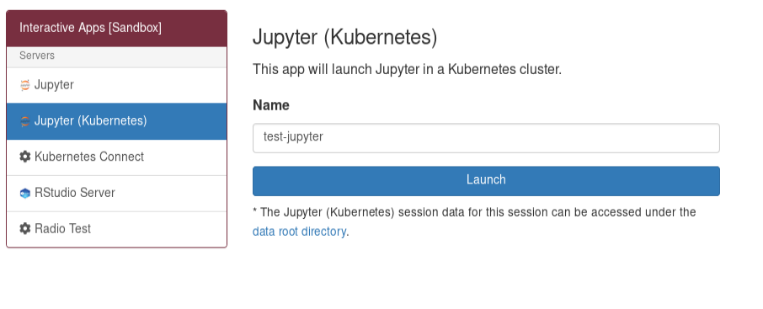
Kubernetes Adapter (1/2)
Can be configured to either launch specific images (reduce options for users) or any image (using any start command)
Can include a configuration file

Slide 26
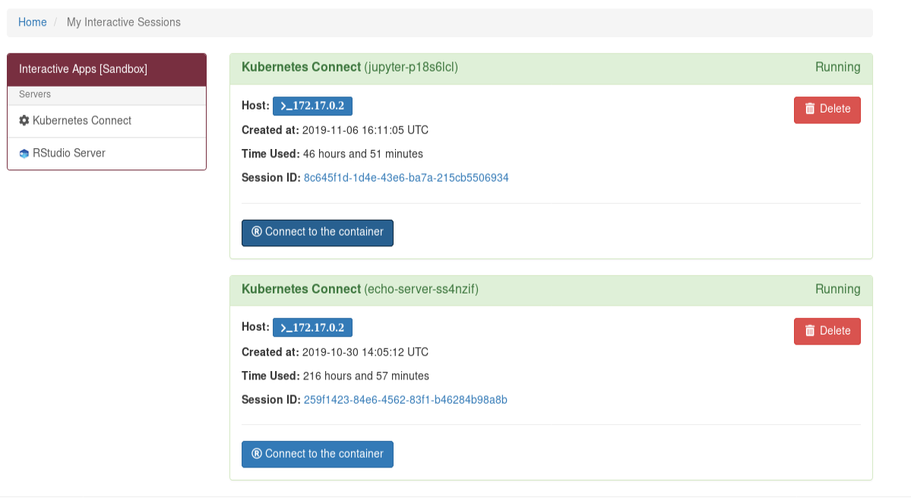
Kubernetes Adapter (2/2)
Connect to it like any other
batch connect application, and you connect to the running app within
Authentication enabled within container (but still a work in progress)
Work needed on mounting external user directories safely and securely

Slide 27
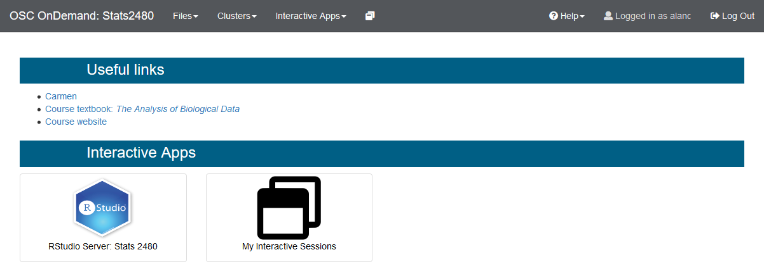
Custom Classroom Deployment
OOD was used to build a custom Dashboard and simplified RStudio launcher for OSU's STAT2480
Served 2 course sections totaling 200 students, connecting with a mixture of laptops and iPads
Well received by course faculty; additional OSC / OnDemand utilization is planned

Slide 28
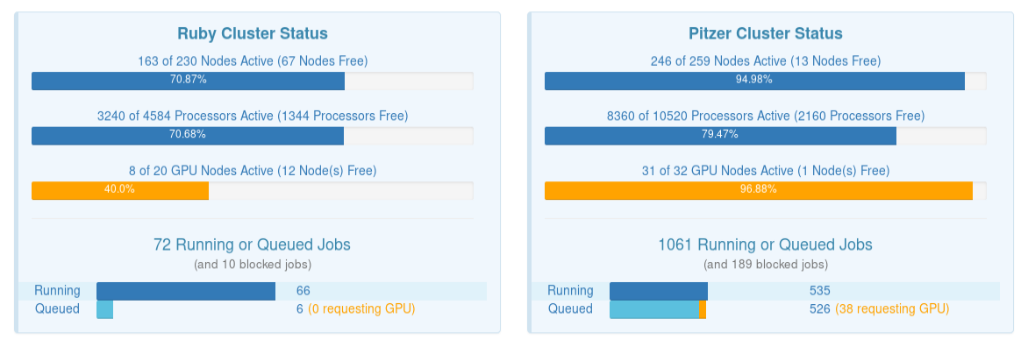
System Status with GPUs

Slide 29
Globus Integration (via Globus Auth)
Enable file transfer between Globus end points and local file systems
Enable using input files from Globus end points and having output files end up at Globus end points
Work similar to how Globus Auth integration with JupyterHub works
  Authenticate with Globus Auth to access OnDemand (via CILogon)
  Your Globus Auth API key is passed as request headers (or in environment) to the OnDemand apps
  Apps acting on your behalf can connect to Globus end points

Slide 30

OpenHPC Integration
OOD can integrate with Open HPC
Runs as an additional component
OOD is Managed with same OHPC tools that Manage Compute Nodes
VM OOD Boots and Loads Every Time Head Boots Up
Cluster Users & OOD Users are Automatically Sync’d

Slide 31

Ansible Role
Install on virtually any flavor of Linux
Allows for site configuration
Role is composable with other roles
Available on Github
Has anyone used this?

Slide 32

OpenStack
Virginia Tech is looking into using OOD with OpenStack
OSC had an SGCI summer intern who helped with that initiative.
Initial work is on Github

Slide 33
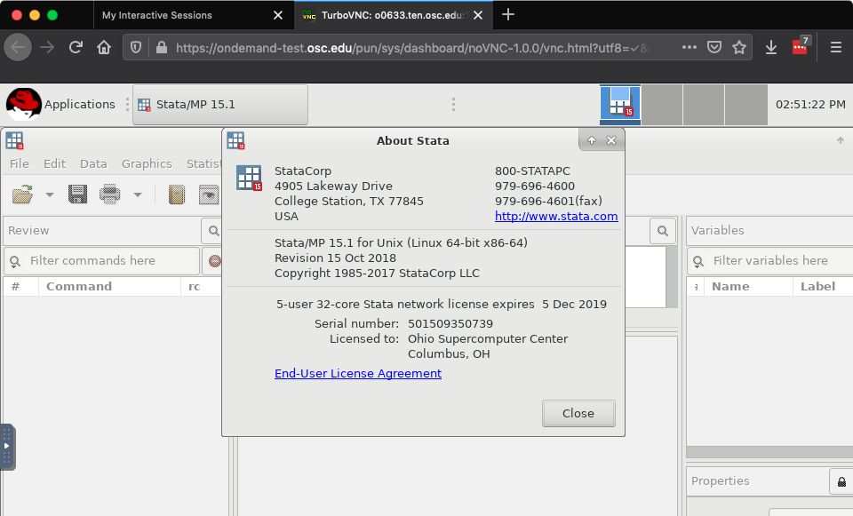
Stata App

Slide 34
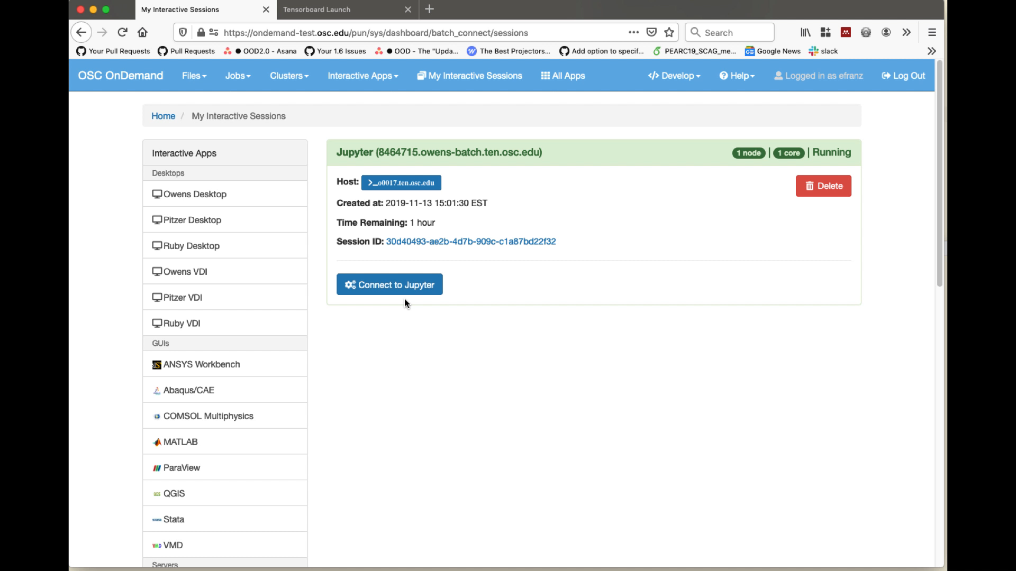
Tensorboard App (Video)

Slide 35
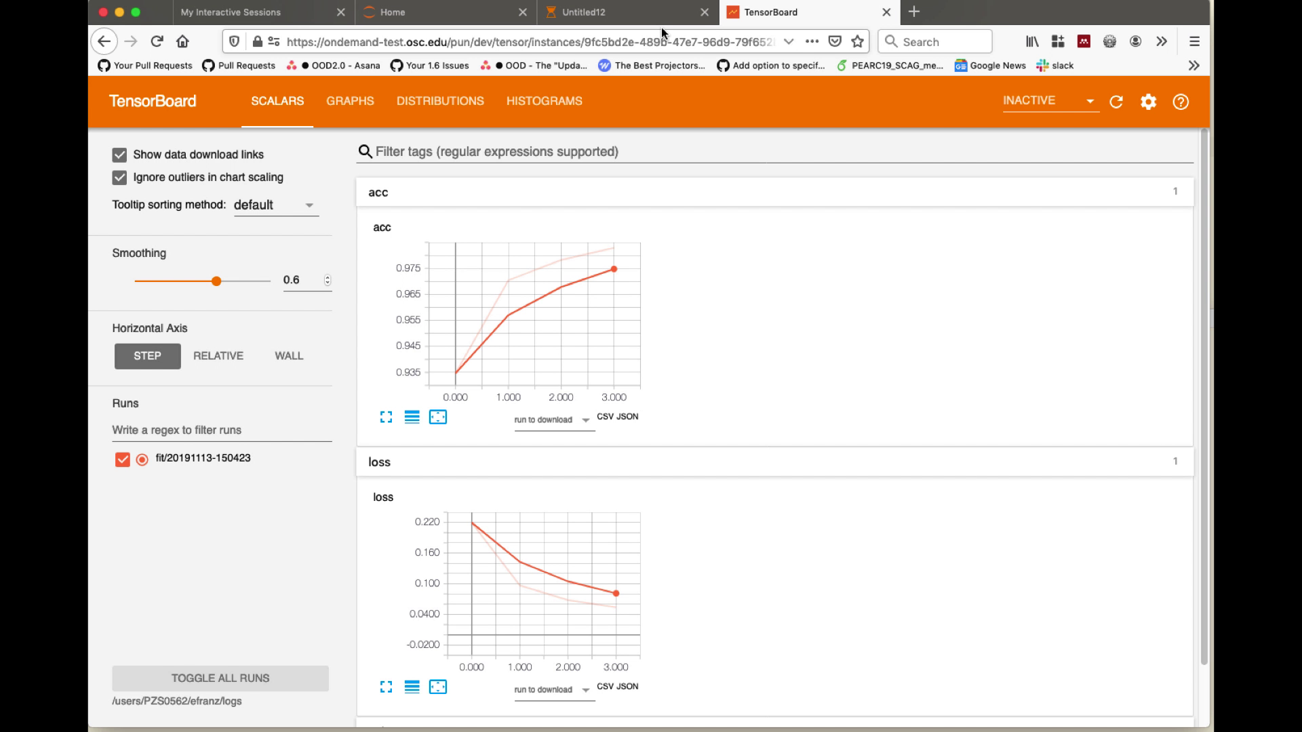
Tensorboard App (Screenshot)

Slide 36
QGIS App

Slide 37
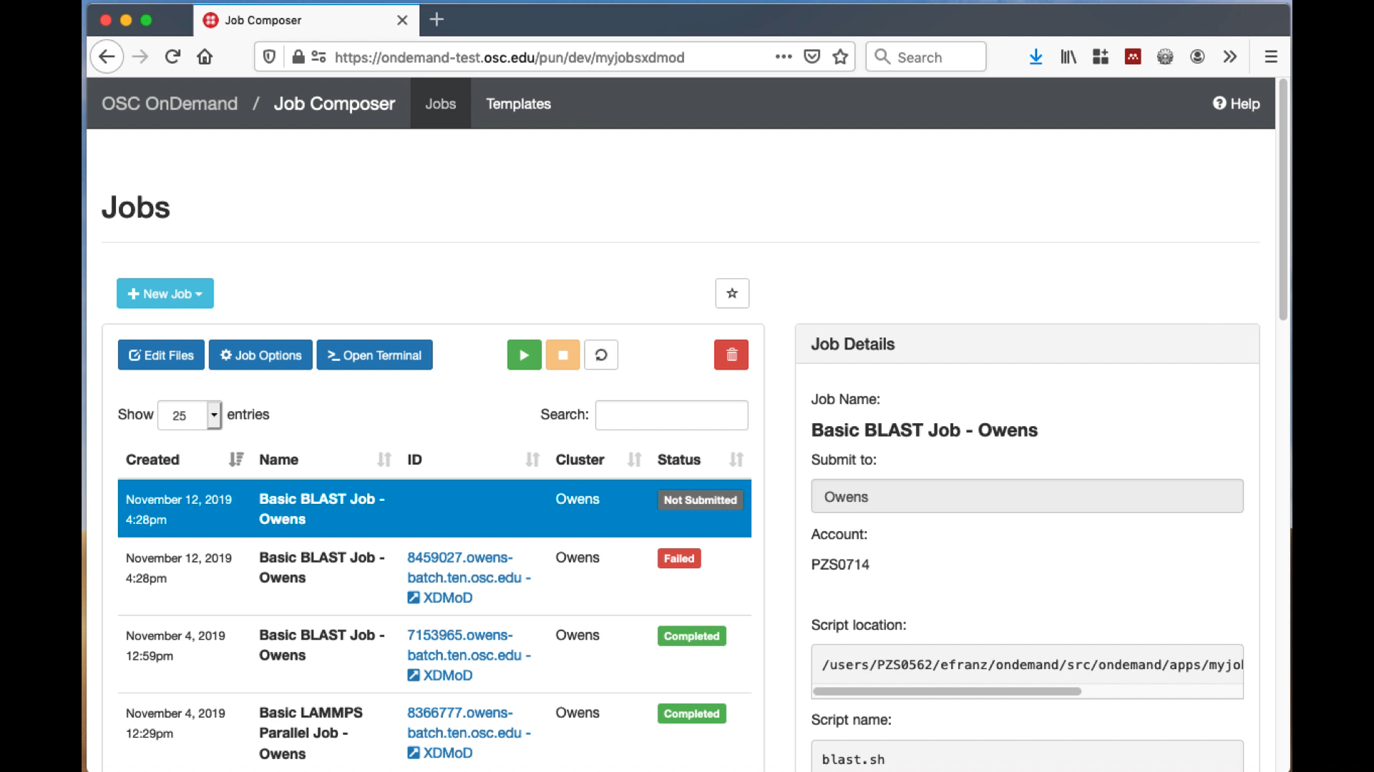
Job Composer with XDMoD (Video)

Slide 38
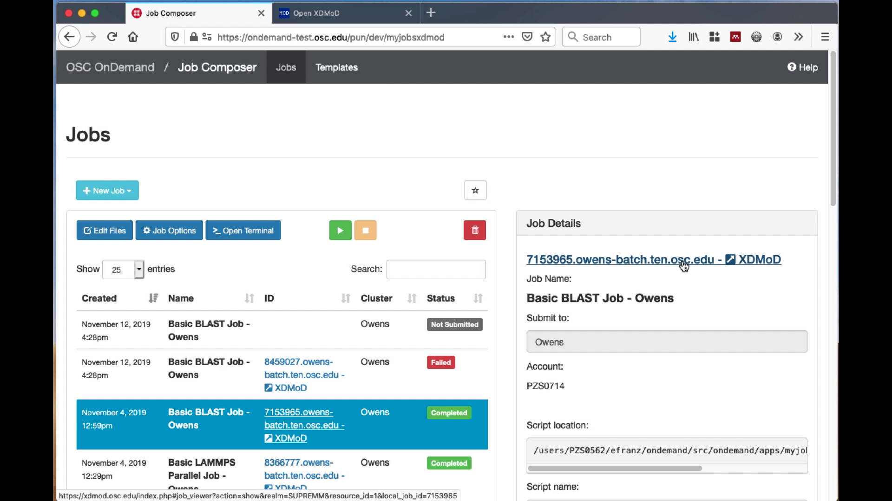
Job Composer with XDMoD (Screenshot)

Slide 39
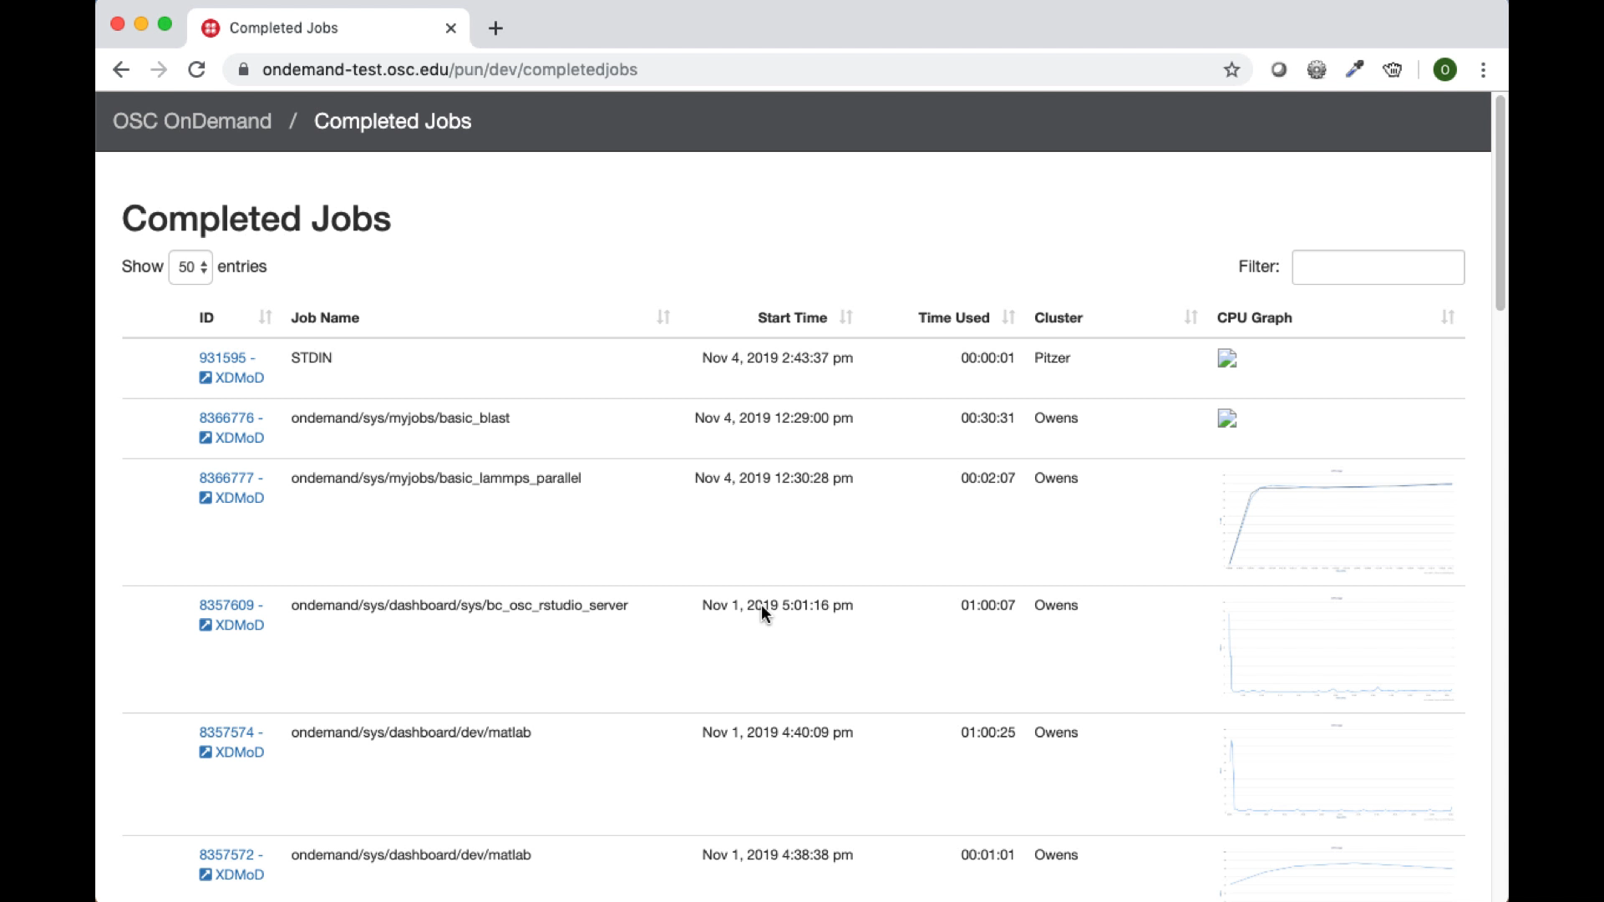
Completed Jobs with XDMoD (Video)

Slide 40
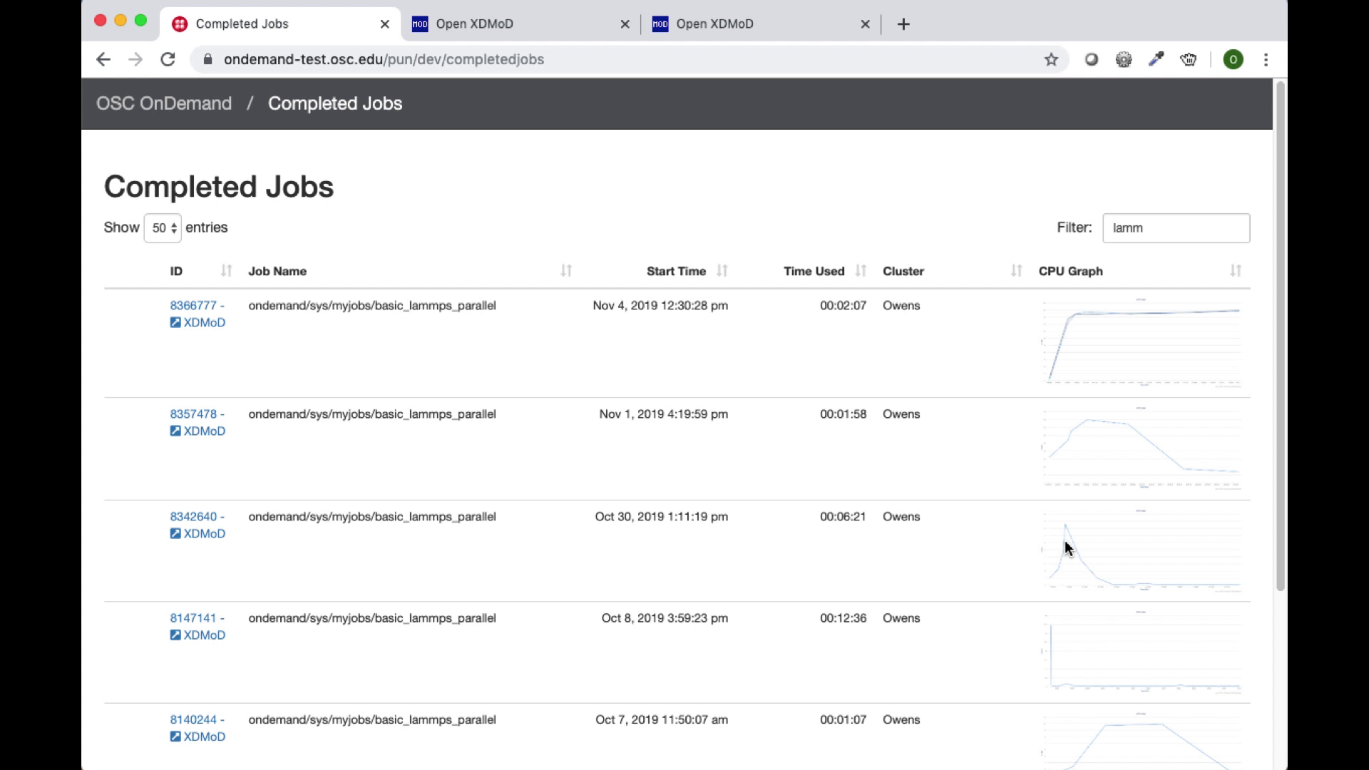
Completed Jobs with XDMoD (Screenshot)

Slide 41
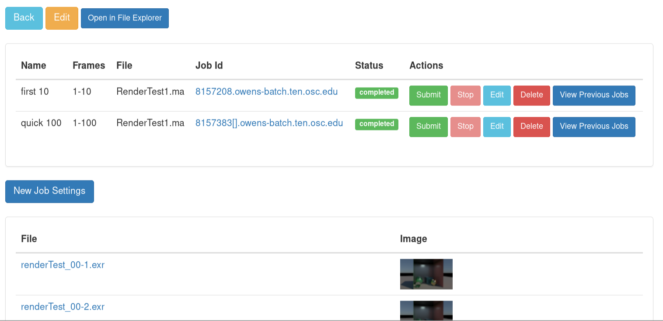
Render App
Easily use HPC for large scale frame rendering jobs
Currently using Arnold (Maya) but could be configured for apps such as Blender

Slide 42
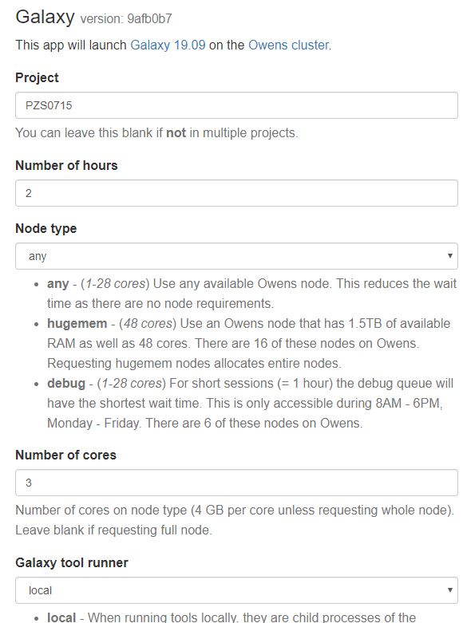
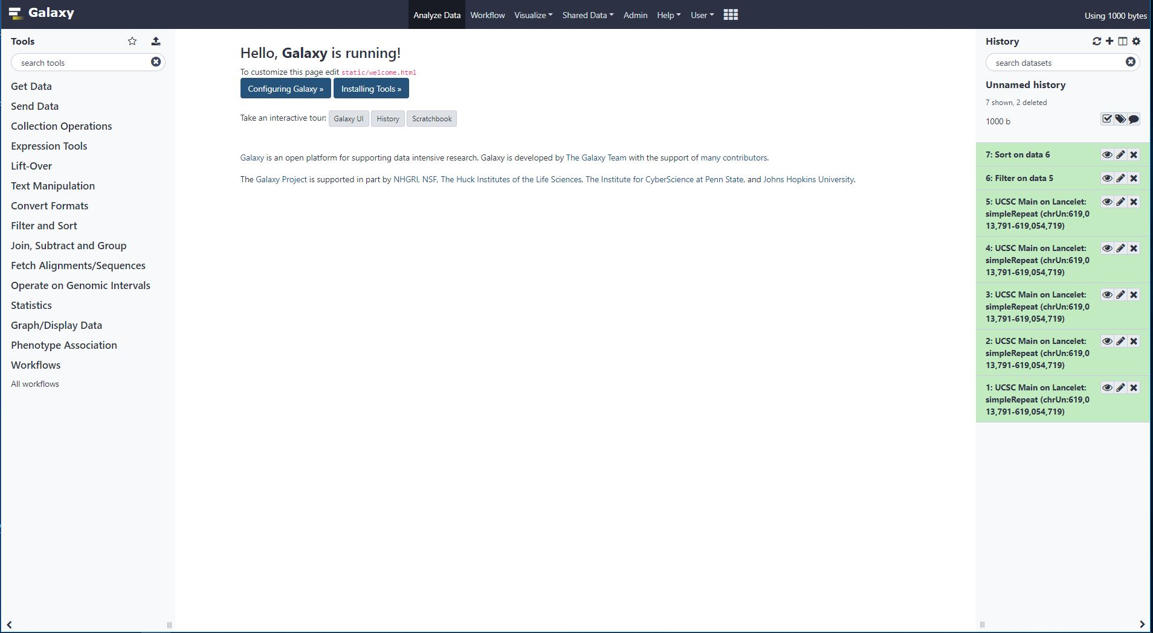

Galaxy App

Slide 43
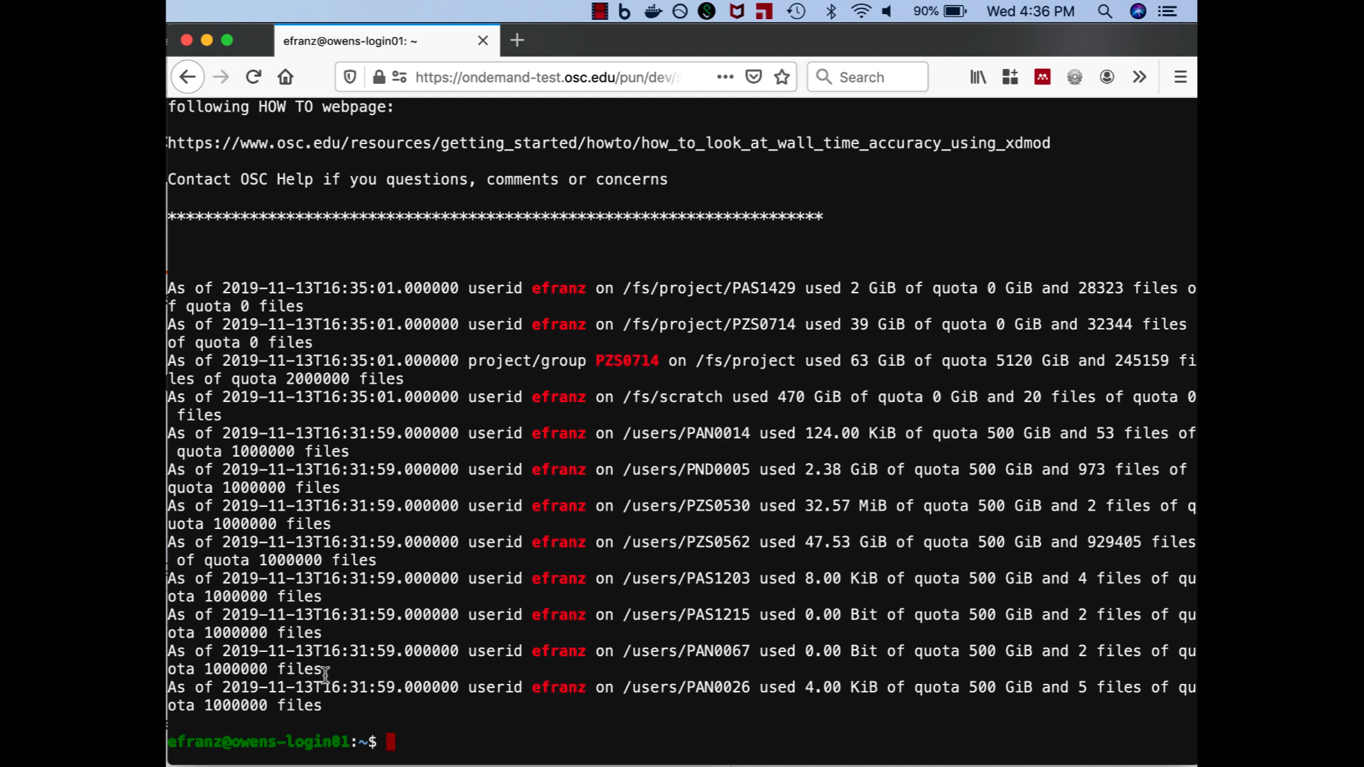
Shell Reconnect (Video)

Slide 44
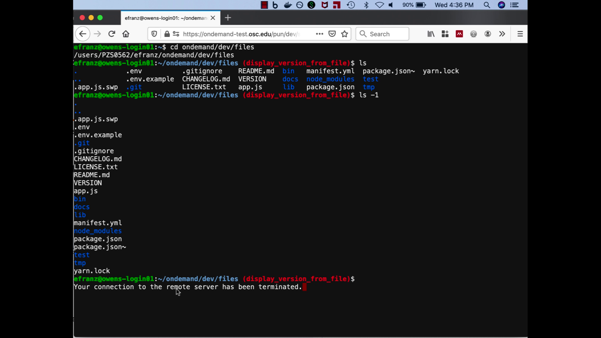
Shell Reconnect (Screenshot)

Slide 45
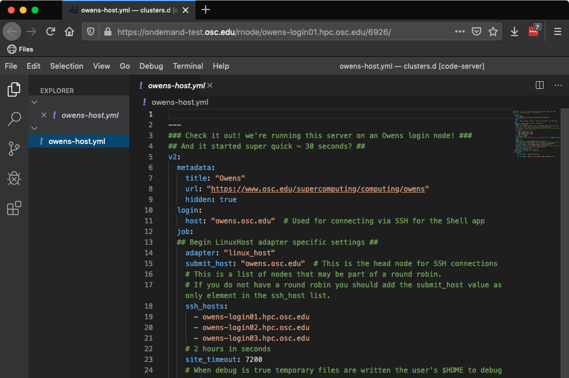
Visual Studio Code Server

Slide 46
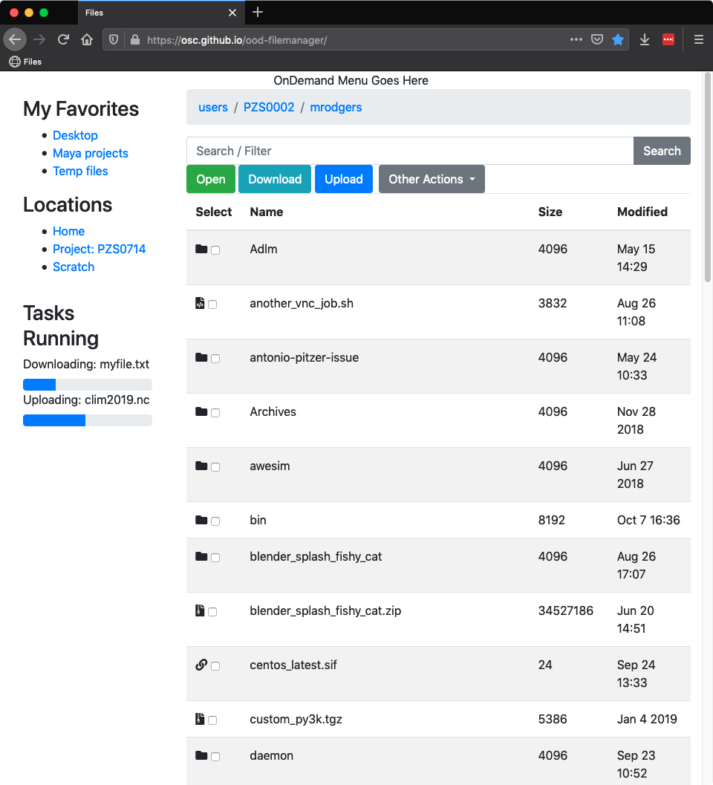
New Files App
Adopt Google-Drive-esque interface
Extend with integrations like open in Tensorboard/VMD/[name your app] and Globus integration
Support longer running actions such as copying or moving datasets, including submitting as data transfer jobs to different backends/tools like dmover, globus-url-copy, rft, stork, supermover
Resumable file uploads using tus compliant server that could run on separate host from OnDemand host

Slide 47
Staying in Touch
Visit our website
  http://openondemand.org
Use our Discourse
  https://discourse.osc.edu/c/open-ondemand
Join our mailing list
  https://lists.osu.edu/mailman/listinfo/ood-users
Our webinars are planned roughly quarterly
  Let us know what you’d like to learn about next

