Slide 1
Your Digital Presence “Better Science through Better Data 2019” 6 November 2019
Shelley Stall, American Geophysical Union
Sr. Director, Data Leadership
sstall@agu.org @ShelleyStall
https://orcid.org/0000-0003-2926-8353

Slide 2
About the AGU
Largest Earth and space science society
60,000 members; 137 countries
Much more than “geophysics”
Large annual meeting, 28,500 attendees
Largest Society Publisher in the Earth and space sciences
22 peer-reviewed journals
>6500 published papers in 2018
Outreach to government leaders and the public
Partnerships with European Geosciences Union, Japan Geoscience Union, and others
Notes:
EGU – reciprocal membership, joint development of code of ethics
JpGU – co-convening 2020 meeting

Slide 3
AGU’s position statement on data affirms that
“Earth and space sciences data are a world heritage. Properly documented, credited, and preserved, they will help future scientists understand the Earth, planetary, and heliophysics systems.”
https://sciencepolicy.agu.org/files/2013/07/AGU-Data-Position-Statement-Final-2015.pdf Photo Credit: Photo by Rick Meyers on Unsplash
Notes:
Photo by Rick Meyers on Unsplash, Smith County I-40 Rest Area, Lancaster, United States
Statement adopted by the American Geophysical Union 29 May 1997; Reaffirmed May 2001, May 2005, May 2006; Revised and Reaffirmed May 2009, February 2012 and September 2015.

Slide 4
What is your Digital Presence?
1. How you and your research appear in online content.
2. How well your work is integrated and connected in the scientific record through your publications, datasets, software, and other digital objects and content.

Slide 5
Who searches your Digital Presence?
Researchers doing background or literature review
Possible collaborators
Your institution
Your funder
Societies, Community Groups, Local Government Decision Makers, and on…
Notes:
Literature revew
Publication, datasets, geolocation, methodology
Body of work from an institution
Body of work from a grant

Slide 6
Why Do I Care?
Increase citations of your work – through traditional and non-traditional means
Connect with possible Collaborators
Improve Open Science practices
Connect to researchers in other domains

Slide 7
First step. You.
The most important element of your work is YOU.
How do others find you?
You, the researcher
Notes:
ORCID provides a persistent digital identifier that distinguishes you from other researchers and supports automated linkages between you and your research activities.

Slide 8
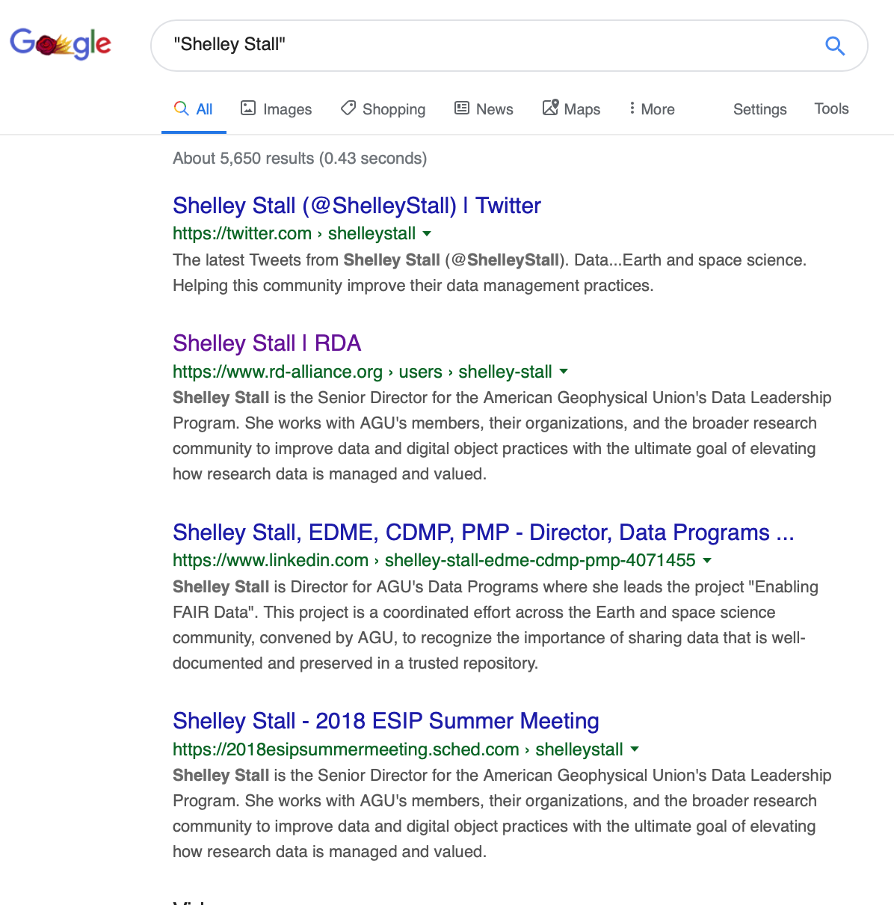

Slide 9
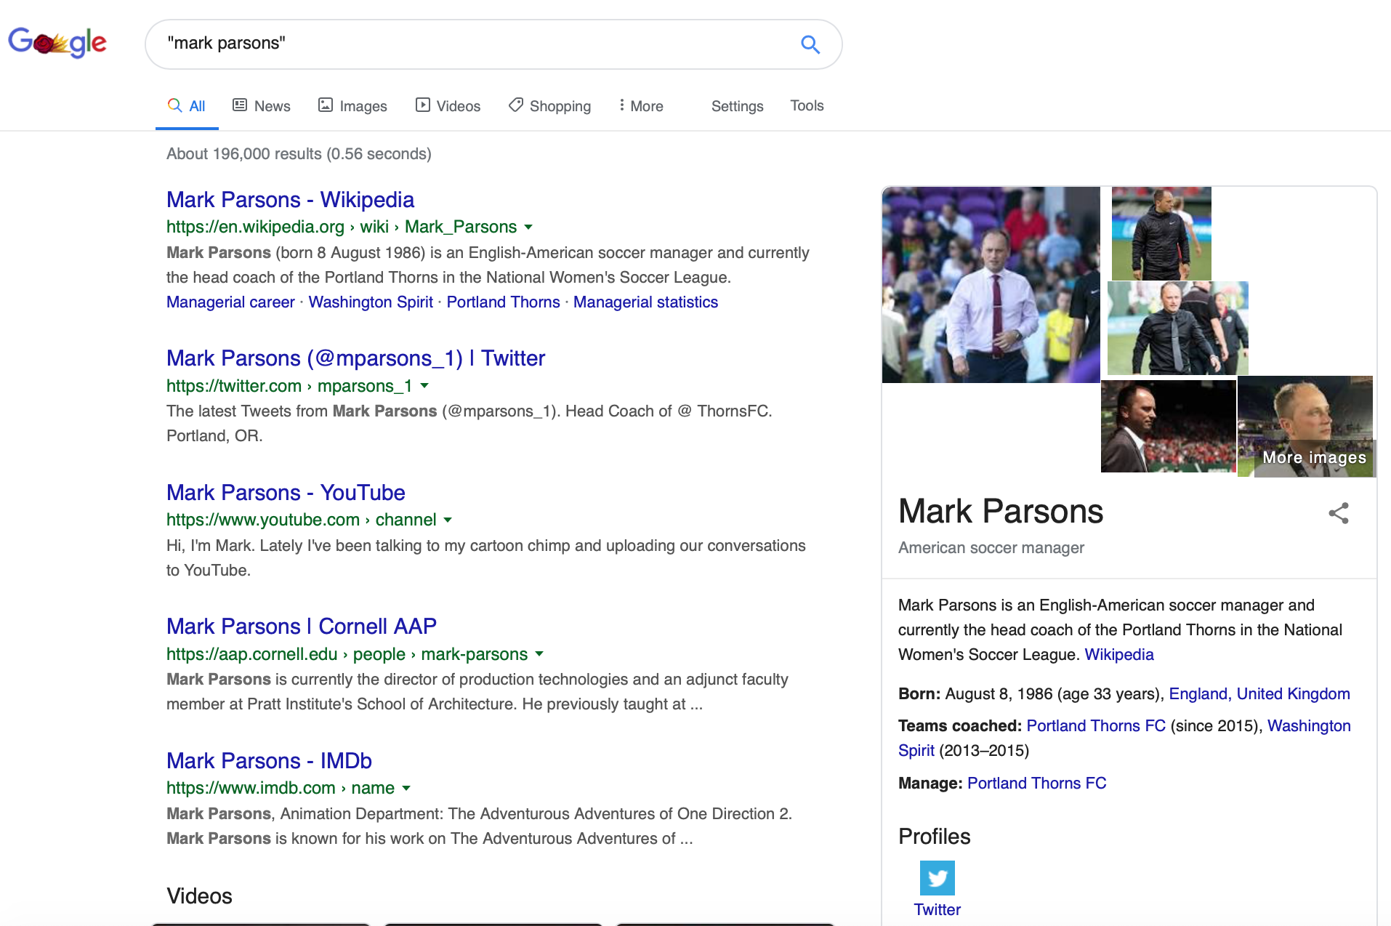
Head Coach of the Portland Thorns
Head Coach of @ ThornsFC
Lately I’ve been talking to my cartoon chimp and uploading our conversations to YouTube
Director of Production Technologies
Animation Department
Notes:
Rensselaer Polytechnic Institute (RPI)
National Snow and Ice Data Center
Secretary General of RDA ending a couple years ago

Slide 10
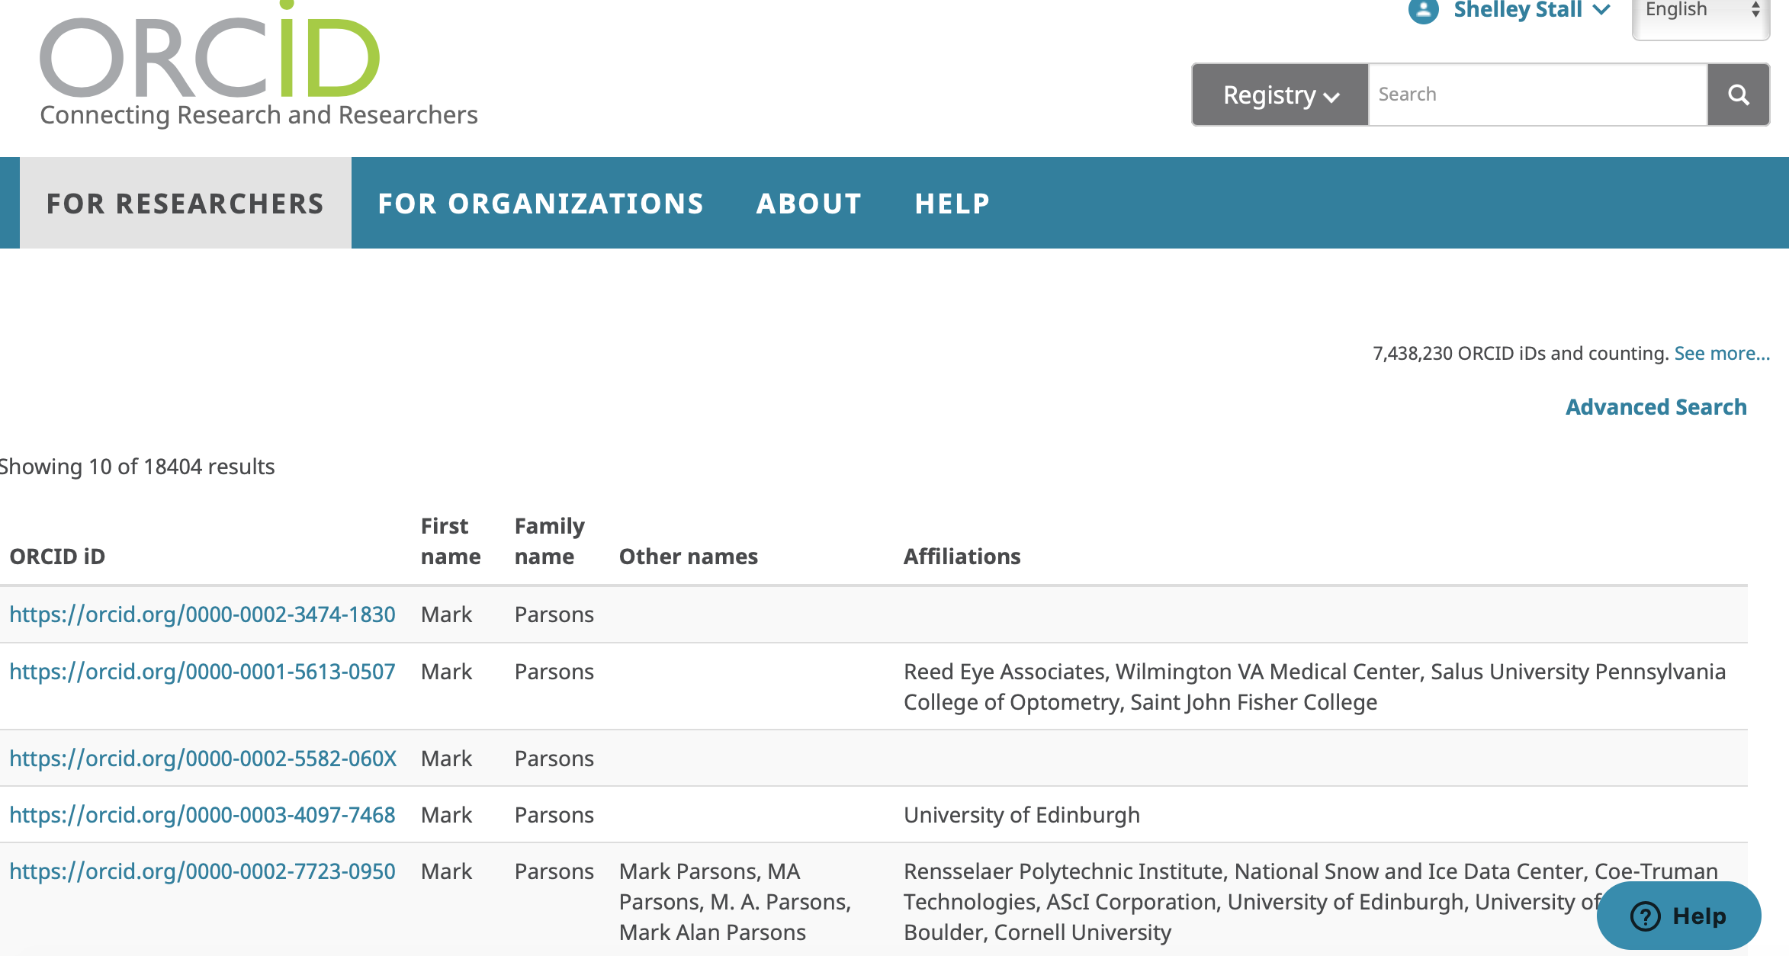

Slide 11
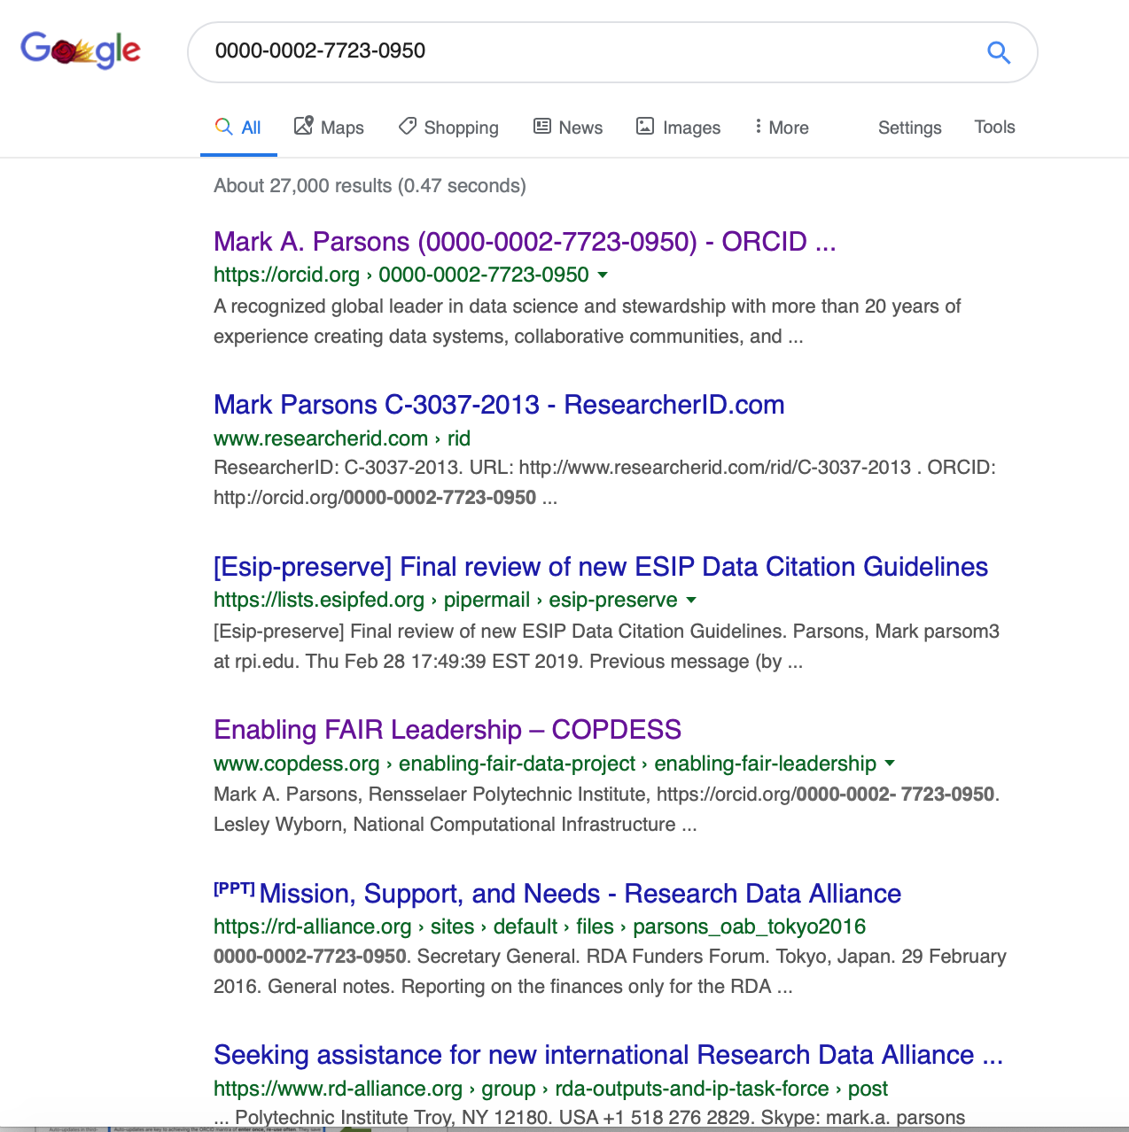

Slide 12
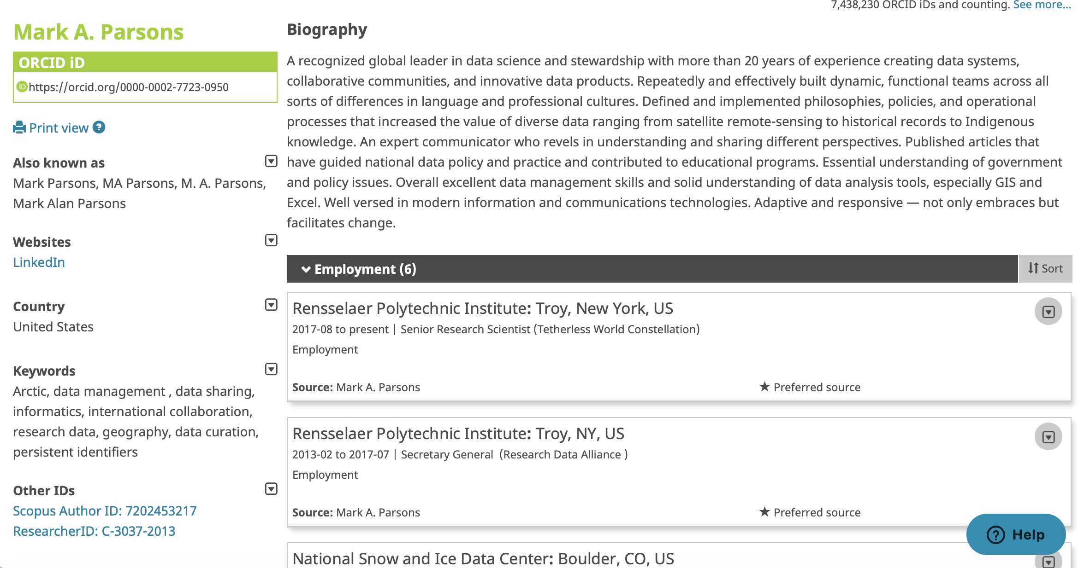

Slide 13
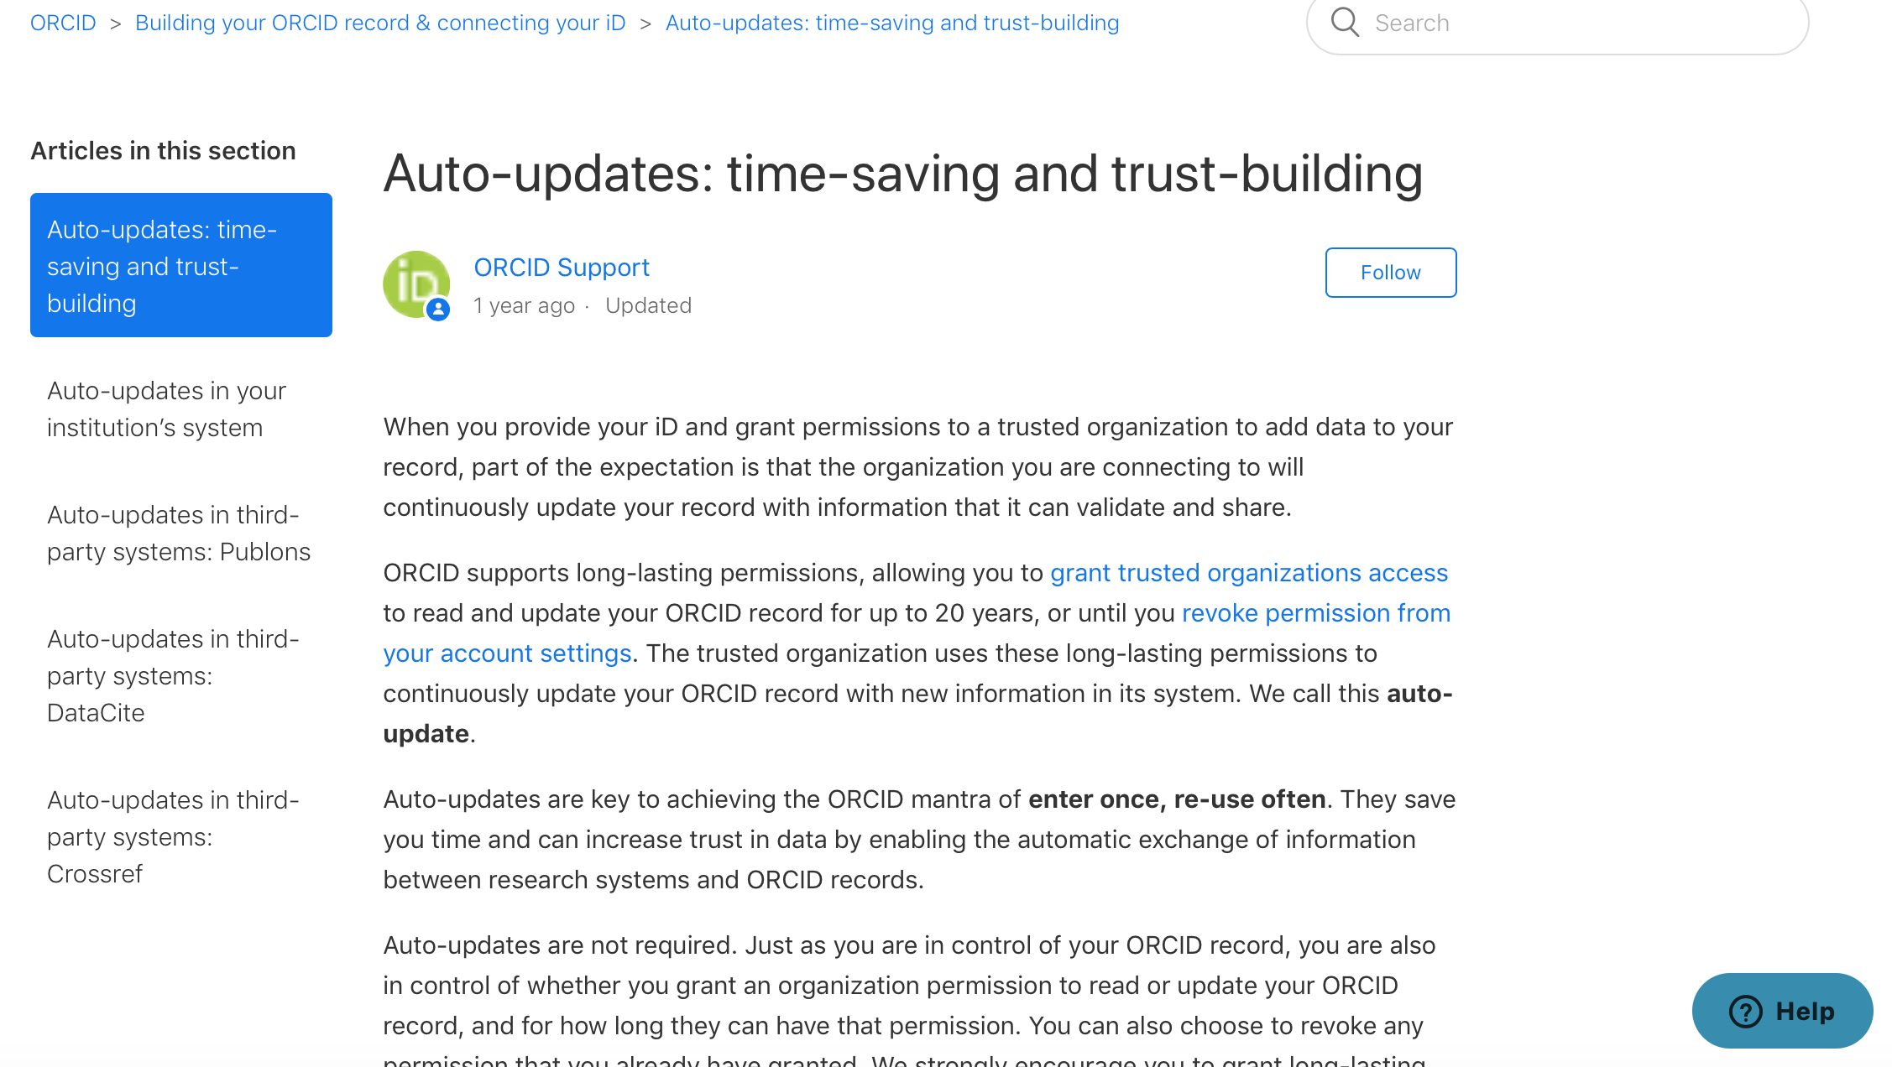
Hard to FIND Link….Make a note!!!
http://bit.ly/ORCID_Trust
Do All!

Slide 14
First step. You.
Your ORCID
ORCID provides a persistent digital identifier that distinguishes you from other researchers and supports automated linkages between you and your research activities.
You, the researcher – uniquely identified by ORCID
Notes:
ORCID provides a persistent digital identifier that distinguishes you from other researchers and supports automated linkages between you and your research activities.

Slide 15
Second step. Your publications.
You, the researcher – uniquely identified by your ORCID
Your publications are paramount for your career.
They MUST be associated with you and your co-authors to receive the necessary credit.
Your publication
Notes:
ORCID provides a persistent digital identifier that distinguishes you from other researchers and supports automated linkages between you and your research activities.

Slide 16
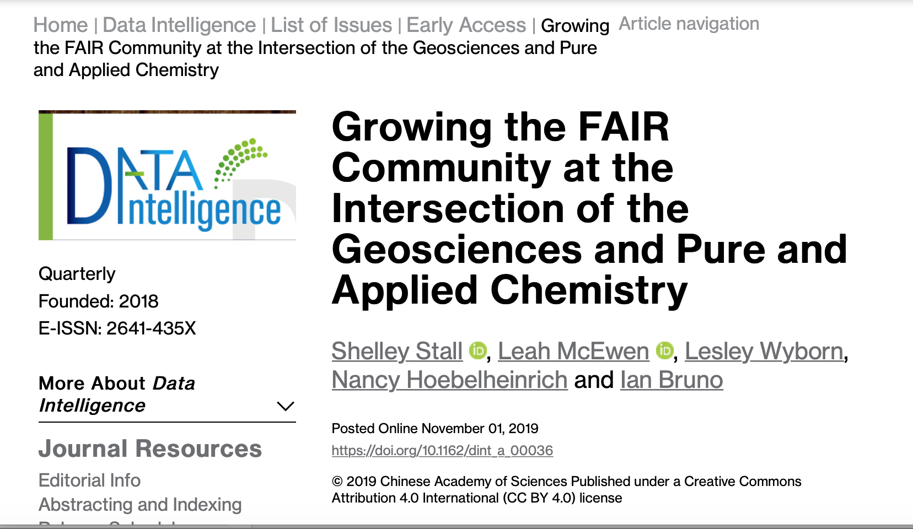
ORCID
Crossref DOI

Slide 17
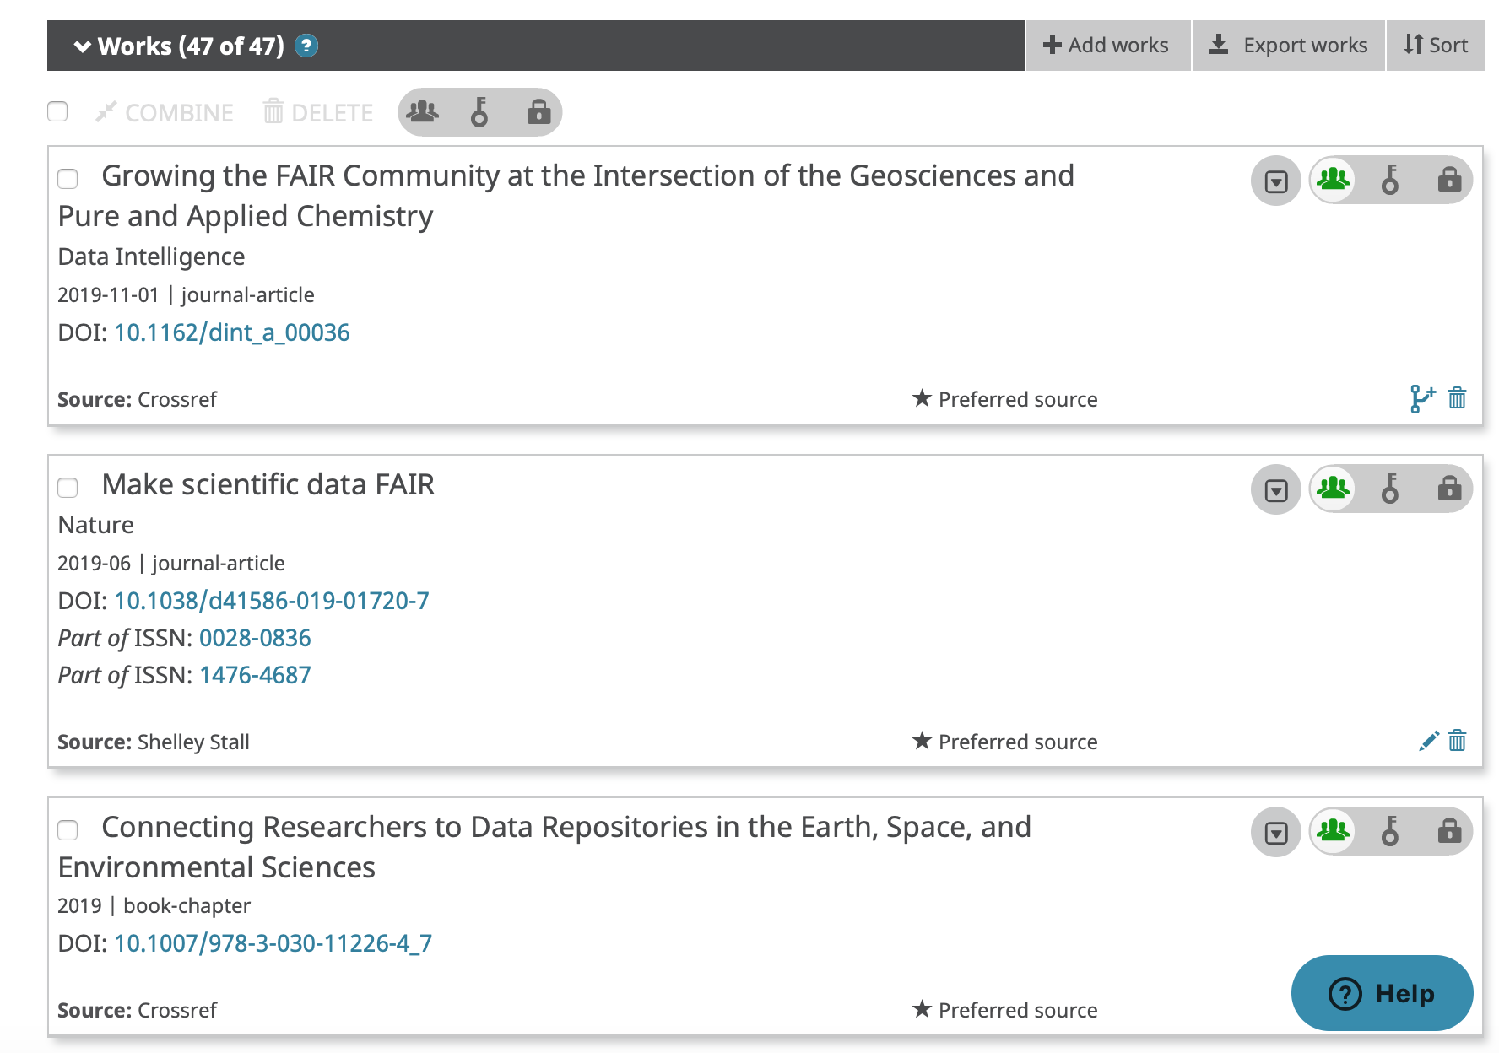

Slide 18
Second step. Your publications.
You, the researcher – uniquely identified by ORCID
Your publication’s Digital Object Identifier is most likely registered through Crossref by your journal when you publish.
Your publication – uniquely identified by the DOI, linked to your ORCID
Notes:
ORCID provides a persistent digital identifier that distinguishes you from other researchers and supports automated linkages between you and your research activities.

Slide 19
Third step. Building your digital content and connections.
You, the researcher – uniquely identified by ORCID
Funder
Your data
Your publication needs to include citations with the persistent identifier to all related research objects. (and availability statements for same)
Shown here are a few examples: data, software, other publication references.
Affiliation
Your publication references
Your publication – uniquely identified by the DOI, linked to your ORCID
Your software
Notes:
ORCID provides a persistent digital identifier that distinguishes you from other researchers and supports automated linkages between you and your research activities.

Slide 20
How can I work towards the best digital presence for my papers and research objects?
Optimize linking and discovery
Optimize understanding.
Optimize reuse.

Slide 21
Optimize linking and discovery
Every research object you link…
…has your ORCID
…is preserved in an open, trusted repository that supports discovery
persistent identifier,
harvestable content (e.g. schema.org)
…includes links to other related research objects

Slide 22
Optimize understanding
Every research object you link…
…is well-documented using metadata appropriate for the research object and community.
…uses vocabulary acceptable to your community. (don’t make up your own term without investigating if it exists already)

Slide 23
Optimize reuse and credit
Every research object you link…
…should have a clear usage license.
…should have a recommended citation.
Make sure your ORCID has trusted relationships with…
CrossRef
DataCite

Slide 24
Other Scholarly Work to be Recognized, Linked, and Promoted in your ORCID profile
Oral Presentation
Poster
Pre-Print
Webinar/Workshop
Society Volunteer Work
Local Community Support
International Standards Development

Slide 25
Digital Presence Visualization

Slide 26
The FREYA project
Slide Credit: Martin Fenner, DataCite, PARSEC meeting at RDA P14, 21 Oct 2019
Persistent Identifiers (PIDs) for the European Open Science Cloud (EOSC) with a focus on
New PIDs (e.g. organizations, instruments)
PID Graph: Connections between PIDs
PID Forum: Training and Outreach
PID Commons: Sustainability
FREYA project has received funding from the European Union’s Horizon 2020 research and innovation programme under grant agreement No 777523.
Website: www.project-freya.eu

Slide 27
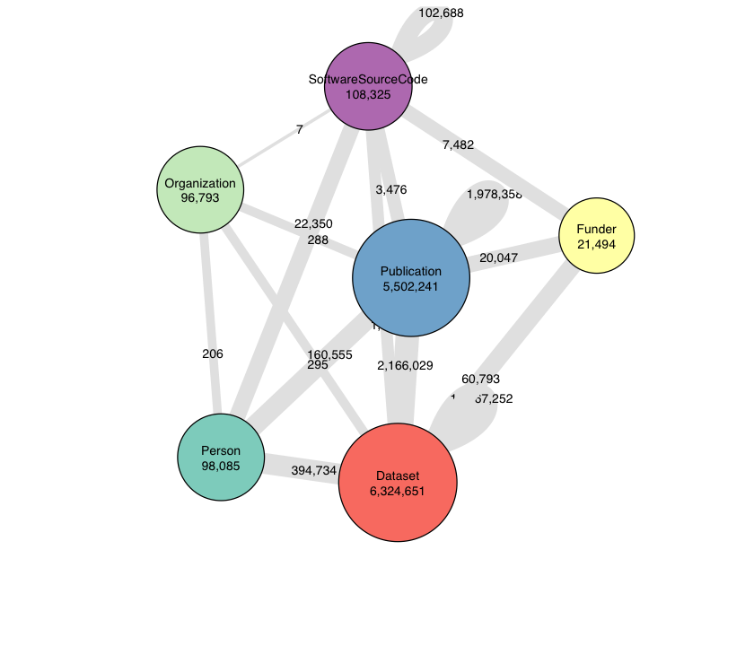
PID Graph is powered by GraphQL
https://api.datacite.org/graphql
PID Graph uses GraphQL to enable complex queries of the federated graph provided by FREYA partners
Jupyter Notebook
Fenner, M. (2019, June 30). FREYA PID Graph Key Performance Indicators (KPIs) (Version 1.1.0). DataCite. https://doi.org/10.14454/3BPW-W381
Slide Credit: Martin Fenner, DataCite, PARSEC meeting at RDA P14, 21 Oct 2019

Slide 28
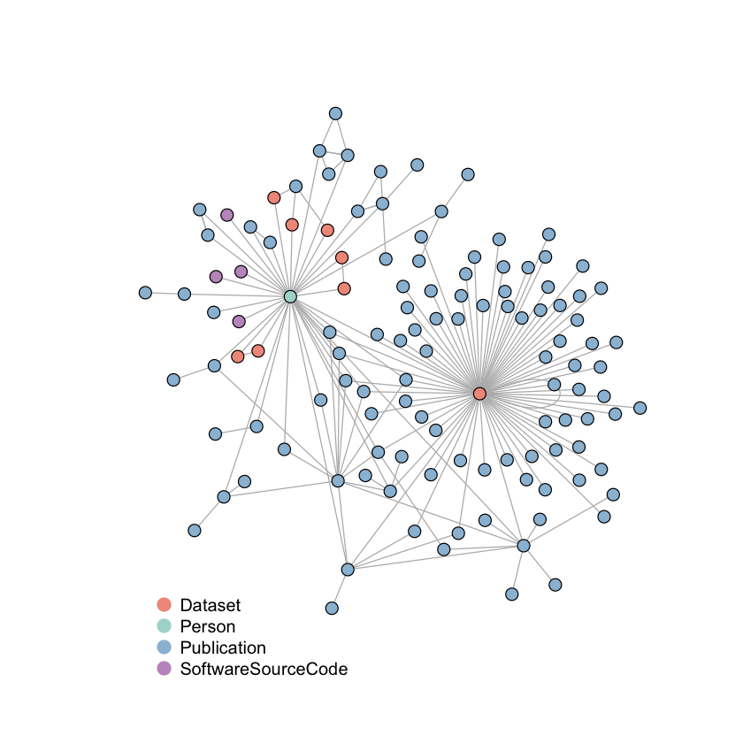
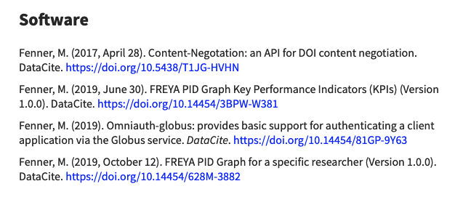
We can visualize the GraphQL Result for the User Story with a Jupyter Notebook
Jupyter Notebook
Fenner, M. (2019, October 12). FREYA PID Graph for a specific researcher (Version 1.0.0). DataCite. https://doi.org/10.14454/628M-3882
Slide Credit: Martin Fenner, DataCite, PARSEC meeting at RDA P14, 21 Oct 2019

Slide 29
Summary
Your digital presence can be managed by ensuring your publications and related research objects have persistent identifiers and are linked.
Use connecting tools like ORCID to do as much of the work as possible.
Optimize for linking, discovery, understanding, and credit for reuse

Slide 30
Questions?
Shelley Stall
American Geophysical Union
AGU Senior Director, Data Leadership
sstall@agu.org @ShelleyStall
https://orcid.org/0000-0003-2926-8353

Slide 31
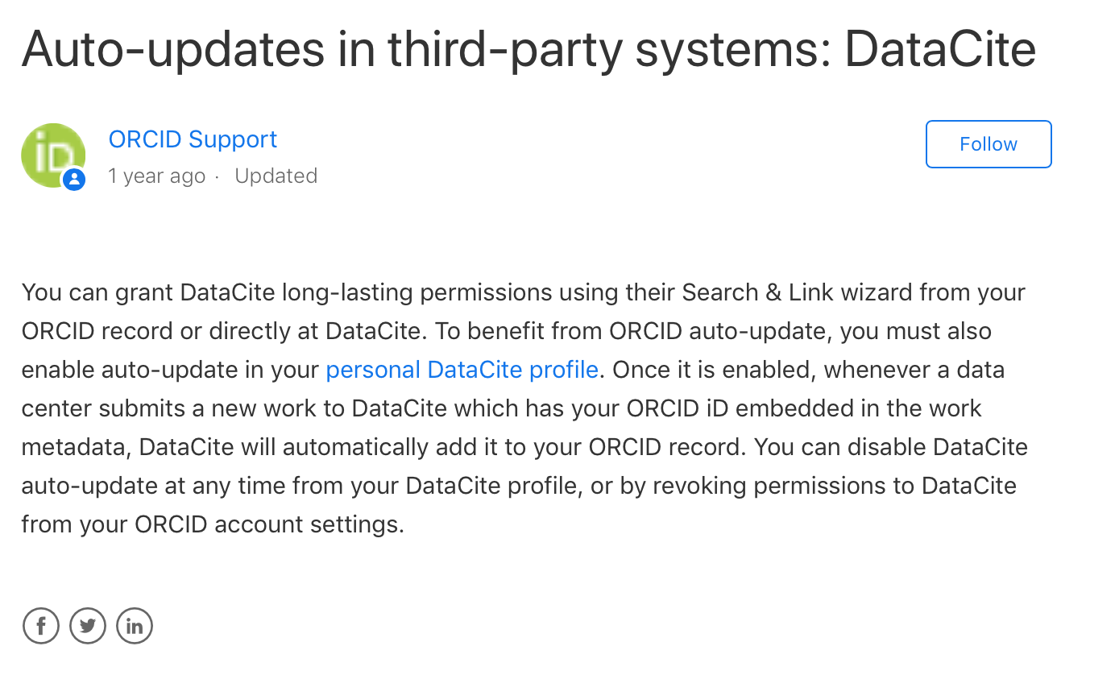

Slide 32
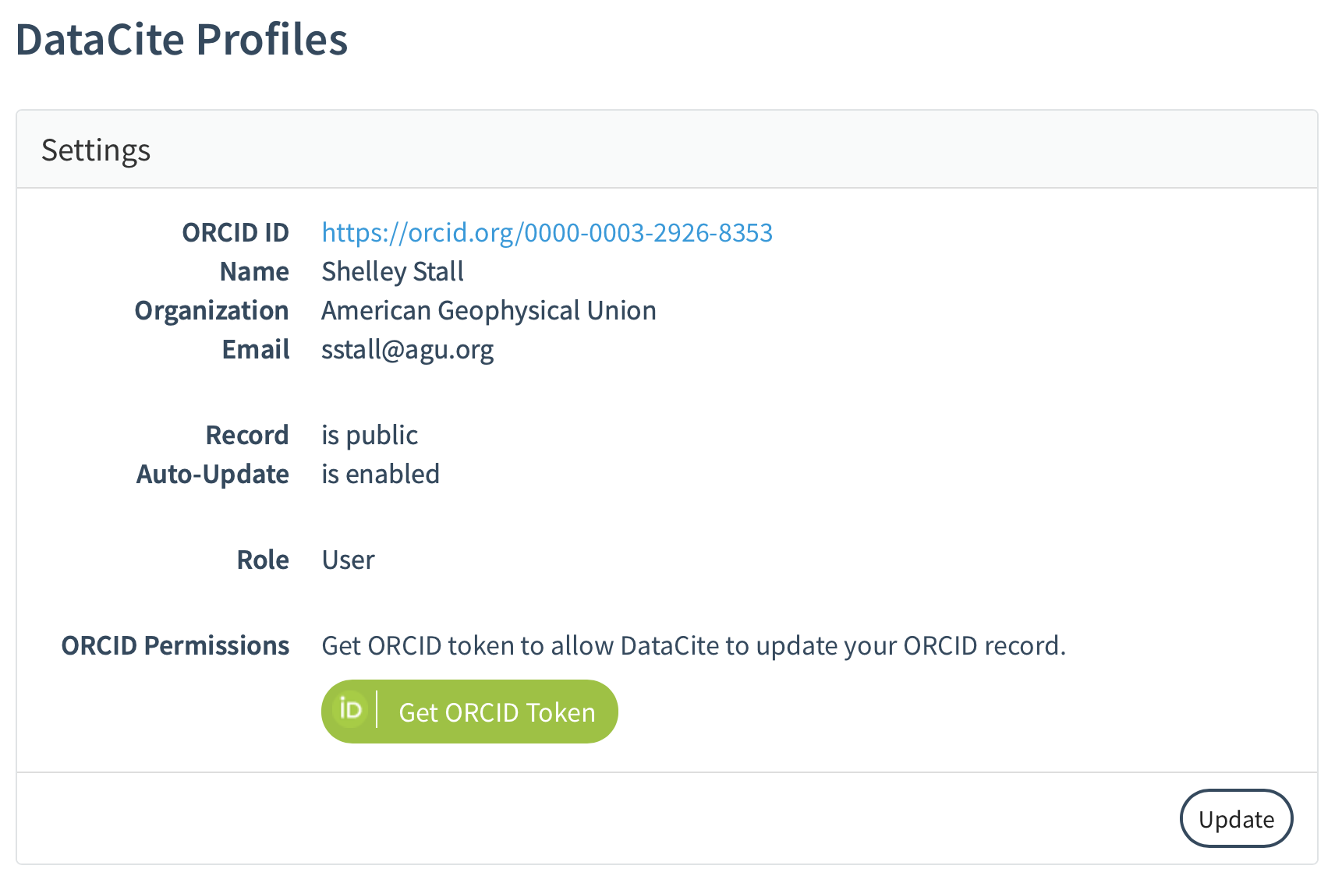

Slide 33
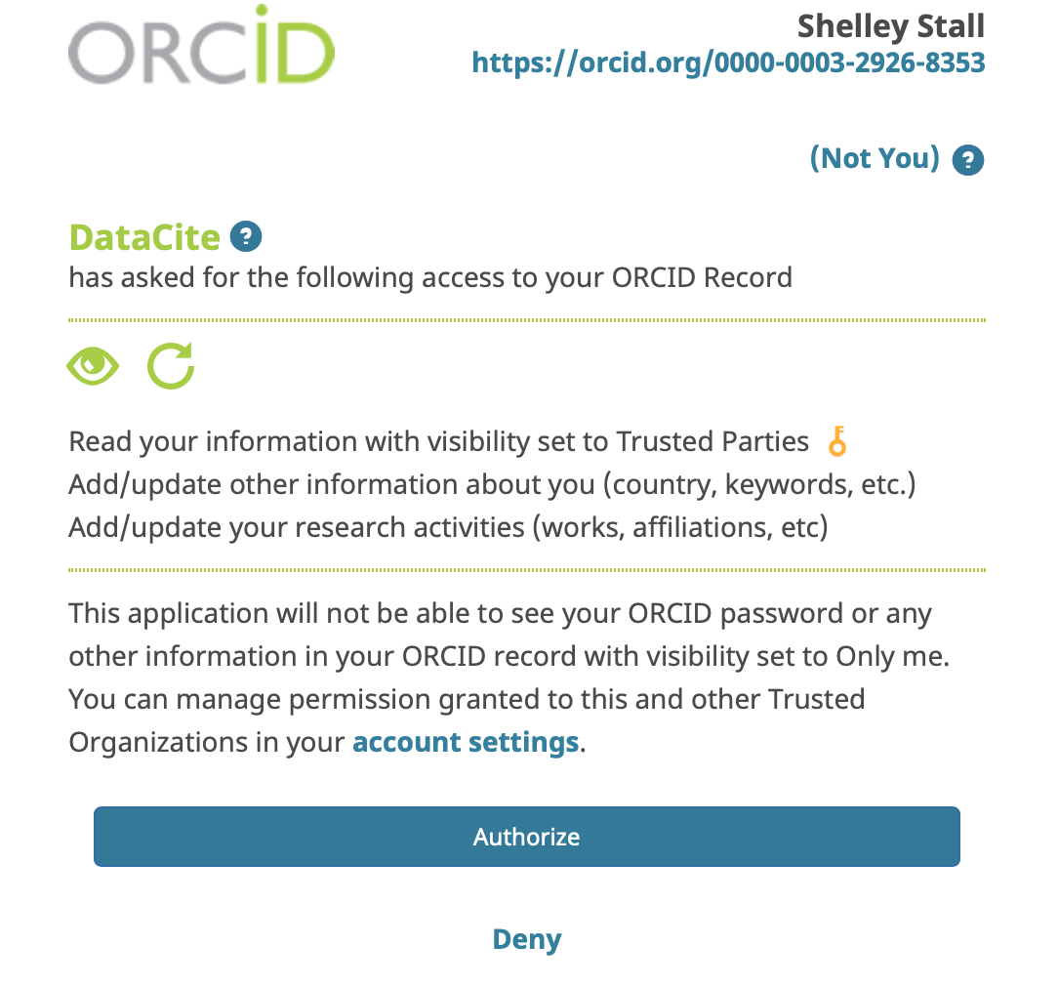

Slide 34
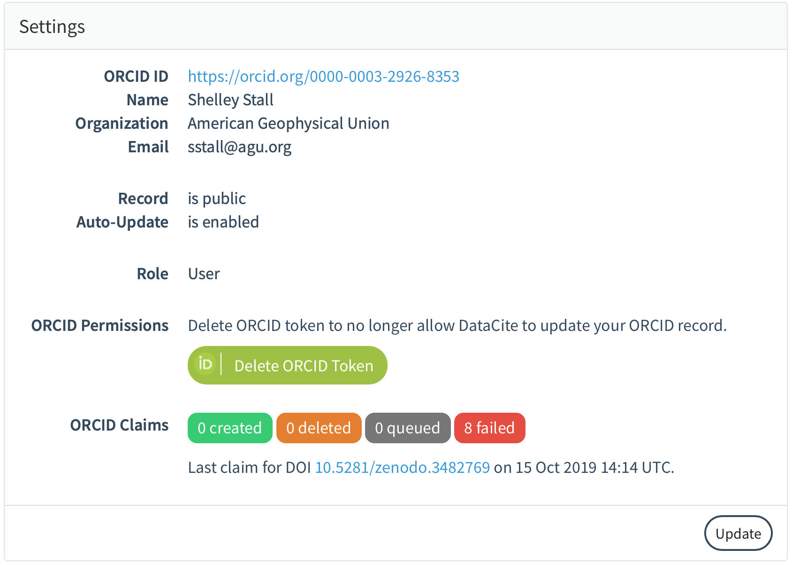

Slide 35
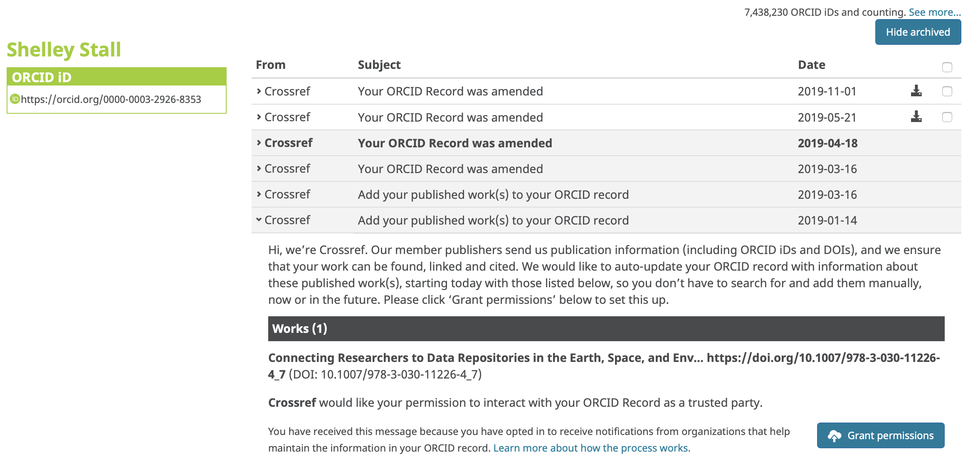
ORCID Email request for permissions establishes trusted link with Crossref

