Slide 1
Conceptualizing a US Research Software Sustainability Institute (URSSI)
Daniel S. Katz, Jeffrey C. Carver, Sandra Gesing, Karthik Ram, Nicholas Weber http://urssi.us
Assistant Director for Scientific Software & Applications, NCSA
Research Associate Professor, CS, ECE, iSchool d.katz@ieee.org, @danielskatz

Slide 2
Research software
Software developed and used for the purpose of research: to generate, process, analyze results within the scholarly process

Slide 3
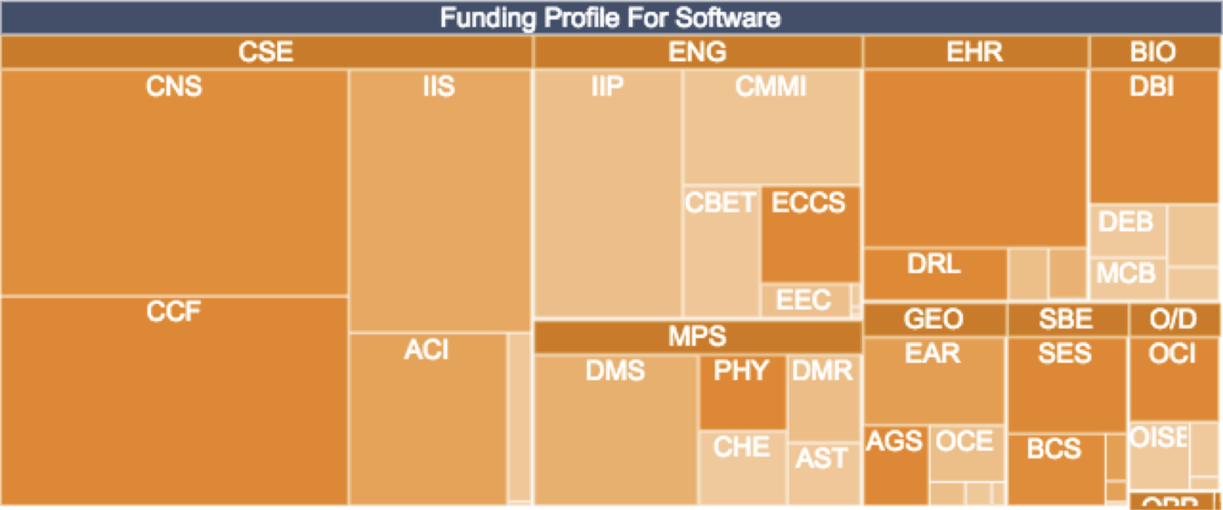
Why do we care about research software?
NSF
1995-2016: 18,592 awards totalling $9.6 billion with project abstracts that topically include “software”
~20% of the overall NSF research budget
DOE
Of 3 Exascale Computing Project areas, most of 2 (application development, software) are research software
“ECP is a 7-year project with a cost range of $3.5B–$5.7B” -- Paul Messina, 2017
Collected from http://www.dia2.org in 2017

Slide 4
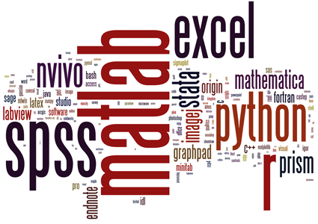
Why do we care about research software?
40 papers in Nature (Jan-Mar 2016)
32 explicitly mentioned software
Average 6.5 software tools/paper
Most research software
Top 100-cited papers:
6 of top 13 are software papers
vast majority describe experimental methods or software essential in their fields”
Nangia & Katz,​ 10.1109/eScience.2017.78
Nature, 10.1038/514550a

Slide 5
Why do we care about research software?
Surveys of UK Russell Group academics (2014)
& (US) National Postdoctoral Research Association (2017)
Use research software: 92% / 95% (UK/US)
Research not possible without software: 67% / 63%
Research possible but harder: 21% / 31%
Develop my own software: 56% / 28%
Hettrick, https://www.software.ac.uk/blog/2016-09-12-its-impossible-conduct-research-without-software-say-7-out-10-uk-researchers
Hettrick, at al.,10.5281/zenodo.14809
Nangia & Katz, 10.6084/m9.figshare.5328442.v1

Slide 6
Science gateways are part of research software
Science gateway frameworks and tools
Science gateway framework tool developers and maintainers are research software developers and maintainers
Science gateways built on these frameworks and tools
Science gateway builders are research software developers and maintainers
User-contributed elements (e.g. tools on HUBzero)
Science gateway teams support policies and practices that make others more likely to contribute elements to science gateways

Slide 7
Software sustainability
The capacity of the software to endure
The software will continue to be available in the future, on new platforms, meeting new needs
The practices, both technical and non-technical, that allow software to continue to operate as expected in the future
1st & 2nd from WSSSPE, 3rd from Hettrick
Cf. https://danielskatzblog.wordpress.com/2018/09/26/fundamentals-of-software-sustainability

Slide 8
Achieving software sustainability
Software will collapse if not maintained
Software bugs are found, new features are needed, new platforms arise
Software development and maintenance is human-intensive
Much software developed specifically for research, by researchers
Researchers know their disciplines, but often not software best practices
Researchers are not rewarded for software development and maintenance in academia
Developers don’t match the diversity of overall society or of user communities
K. Hinsen, Dealing With Software Collapse, CiSE, 2109. https://doi.org/10.1109/MCSE.2019.2900945

Slide 9
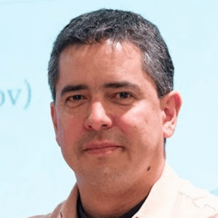
A rare success in the field
Barriers prevent recognition and career success for research software
An exception: Dr. Fernando Perez
Traditional untenured research scientist (in neuroscience & computational research)
On the side, co-developed IPython and Project Jupyter with a team
Software had far more impact than traditional scientific outputs
Evolved into Jupyter ecosystem
High profile awards followed
Now has fast-tracked tenured position at Berkeley

Slide 10
URSSI goals
Conceptualize (plan) a US Research Software Sustainability Institute
Cut across existing activities funded by NSF and beyond
Directly and indirectly positively impact all software development and maintenance projects
Focus on the entire research software ecosystem, including
People who create, maintain, and use research software
Research software
Research in research software
Outputs:
Eager supportive & inclusive community
Concrete institute plan configured to offer valued services
Published survey and data that demonstrates community need

Slide 11
URSSI team (SGCI members in bold)
PIs
Karthik Ram (PI, UC Berkeley)
Jeffrey Carver (Alabama)
Sandra Gesing (Notre Dame)
Daniel S. Katz (Illinois)
Nicholas Weber (Washington)
Advisory Committee
Richard Arthur (GE Global)
Michelle Barker (ARDC)
Phil Bourne (Virginia)
Daniel Crawford (MolSSI & Va Tech)
Neil Chue Hong (SSI & Edinburgh)
James Howison (Texas)
Kurt Schwehr (Google)
Jeff Spies (SHARE)
Nancy Wilkins-Diehr (retired)
Senior Personnel
Wolfgang Bangerth (Colorado State)
Anshu Dubey (Argonne)
Melissa Haendel (Oregon State)
Mike Heroux (Sandia)
Katy Huff (Illinois)
Suresh Marru (Indiana)
Kate Mueller (Notre Dame)
Jarek Nabrzyski (Notre Dame)
Kyle Niemeyer (Oregon State)
Marlon Pierce (Indiana)
Ariel Rokem (Washington)
Arfon Smith (STScI)
Tracy Teal (Carpentries)
Matt Turk (Illinois)
Rick Wagner (Argonne)
Mike Zentner (UCSD)

Slide 12
NSF institutes context
SGCI
GSI (Conceptualization)
IRIS-HEP
CFDSI (Conceptualization)
MolSSI
Technologies
URSSI
Disciplines

Slide 13
URSSI activities
Learn from community
Survey, workshops, ethnographic studies
Iteratively build understanding of challenges
Talk about what we’ve learned
Website (urssi.us), 33 blog posts (urssi.us/blog), articles, papers, talks
Overall, build community

Slide 14
General Workshop & Unconference – Berkeley
Key themes
Software: development, usability, and credit
Training & workforce development: Building upon existing models, designing new methods of instruction
People: Sustainability of RSEs as the human infrastructure of scientific software
Projects: Sustainability of software projects through organizational and institutional best practices
Blog post: http://urssi.us/blog/2018/08/23/report-from-the-first-urssi-workshop/

Slide 15
URSSI strawhorse from Berkeley Workshop
 | Supporting Software | Supporting People | Supporting the community | Science & research impact
Development Support (consulting & short term small project support) | X |  |  | X
Incubator (technology advice, business planning, usability advice, etc.) | X |  |  | X
Training (courses & guides) | X | X |  | X
Policy (research & campaigns) |  | X | X | X
Community (fellowships, workshops, blogs, website) | X | X | X | X

Slide 16
General Workshop & Unconference – Chicago
Key themes
Community building
Career path and institutional support for RSEs
Training and workforce development
URSSI summer school, for grad students, return as TAs/mentors
Sustainability as related to reproducibility, usability, discoverability
Discussed URSSI mission and vision
Strawhorse iteration
Added area: management, sustainability & governance
Development still unclear, scaling is problematic
Good ideas for other elements
Blog post: http://urssi.us/blog/2019/04/04/urssi-chicago-workshop-report/

Slide 17
Credit & Metrics Workshop – Santa Barbara
Short talks about relevant projects
Used Rumelt’s Strategy Kernel concept to plan potential URSSI work in this area
Diagnosis (problems & challenges)
Guiding principles
Coherent actions
Actions mostly in policy strawhorse area; some work done by fellows (community area)
Many actions proposed, $3m/year to do everything, must carefully select
Actions meant to support credit; must also work with other activities
R. Rumelt, Good Strategy Bad Strategy: The Difference and Why It Matters
Blog post: http://urssi.us/blog/2019/03/24/report-from-urssi-workshop-on-software-credit-citation-and-metrics/

Slide 18
Software Incubation Workshop – College Park
Participants
Apache Incubator
Code for Science & Society
eScience Institute Winter Incubators
ESIP Incubator
Mozilla Open Leaders
NumFOCUS
Software ecosystem researchers
How to support new and existing software projects that need to
Attract contributors & maintainers
Set up a governance model
Find and managing funding sources
Determine development practices
Compared existing models of support and guidance
Determined model of project phases; mapped existing efforts
Found need to coordinate incubators and fill gaps
Blog post: http://urssi.us/blog/2019/03/28/report-from-urssi-workshop-on-research-software-incubators/

Slide 19
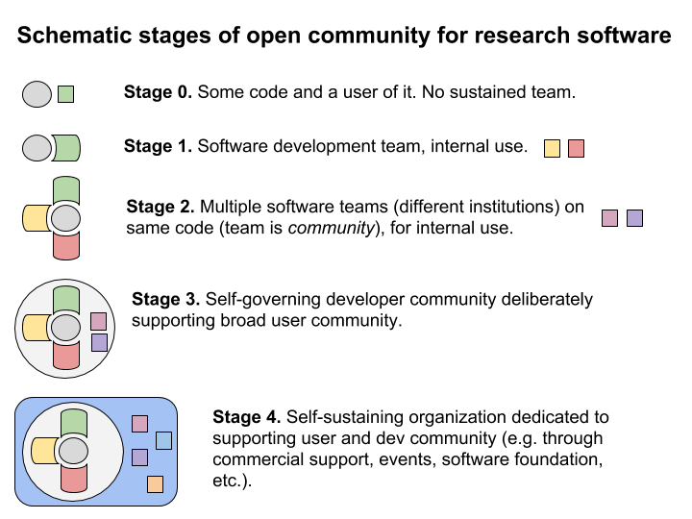
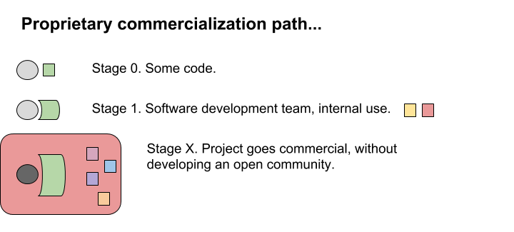
Project stages
S. P. Benthal, Software Incubator Workshop: A Synthesis, lhttp://urssi.us/blog/2019/02/25/software-incubator-workshop-a-synthesis/

Slide 20
Draft survey findings, 1200 responses
Time: Can’t allocate for software work as desired
Development process: People-related aspects are harder than they should be, not technical aspects
Peer code review: Less used than desired
Software development practices: Not well-supported by tools
Version control: Many still copying files to another place or zip file backups
Training: Many have no training, mostly of insufficient time
Funding & support: Nationally & locally, insufficient for software work
Performance reviews: Don’t significantly value software contributions
Diversity plan: Missing for most projects

Slide 21
Ethnographic studies
Observations & semi-structured interviews over 12 months
3 projects of different types, in astronomy, bioengineering, hydrology
Will produce case studies of how research software projects overcome challenges in
Recruiting contributors
Building a governance model
Seeking funding
Sharing credit

Slide 22
Final meeting - Chicago
PIs, Senior Personnel, Advisory committee members, selected experts
Design workshop
Discussed previous work
Lessons learned from past workshops
Initial ethnographic work
Initial survey results
Outlined URSSI implementation plan
Discussed partnerships and strategies
Proposed potential URSSI structure and activities
Assigned initial workforce and budget to structure

Slide 23
URSSI plan

Slide 24
Mission & Vision
PIs began to develop mission and vision statements in late 2018
Mission: the purpose for URSSI’s existence
Vision: what URSSI strives to achieve
Process
At first workshops asked about potential goals and vision
PIs found institutions with similar goals, compared mission & vision statements
Group facilitated by Neil Chue Hong developed drafts
Presented drafts at final URSSI meeting
Group & PIs refined final versions

Slide 25
Mission & Vision
Mission
Our mission is to improve the recognition, development, and use of software for a more sustainable research enterprise
We achieve this mission through collaboratively developing education, outreach, and software services that emphasize open, transparent reproducible, and cooperative practices
URSSI is an institute for software expertise as well as a social infrastructure that promotes an inclusive and diverse community of research software engineers, maintainers, contributors, and users
Vision
Empowered people, building better software, enabling exceptional research

Slide 26
Planning assumptions
Time: 5 years + potential 5-year extension
Budget: $3m-$5m per year
$3m is baseline & minimum needed
Build higher cost and higher return activities on that baseline
Activities: set of reinforcing (but separable) activities, potentially on different timelines
Due to demonstrated interest in supporting URSSI goals from private foundations and potential interest from other federal agencies
Partners: Improved software sustainability needed in all fields; URSSI can’t do everything
Many potential partners w/ overlapping goals
Indirection: Can’t directly work with the US software development community
URSSI is small, community is large
URSSI need to work indirectly and leverage other groups

Slide 27
High-level methods
Must choose initial targeted communities and efforts, focus on them for some period, then move on to next set
Must work closely with partners to amplify its efforts
Must be clever about using resources, attempt to achieve multiple outputs for activities whenever possible

Slide 28
Desired impact
URSSI's ultimate desired impact
as stated in its vision
is on scholarly research (science, engineering, etc.)
It aims to achieve this impact by:
Improving research software
Empowering people
Making contributions to the overall research software ecosystem

Slide 29
Desired impact: software
Improve the sustainability of research software by
Developing and sharing good-enough and best practices, including for testing, governance, codes of conduct, continuous integration
Documenting various sustainability models and providing guidance on how to choose between them
Promoting communities and appropriate governance models for open source research software
Building models to make best use of transient developers (e.g., students)

Slide 30
Desired impact: people
Improve careers of research software developer & maintainers by
Promoting new career paths
Developing and promoting use of research software usage and impact metrics for hiring and promotion
Promoting publication of research software
Developing and providing training
Encouraging a diverse set of participants to enter the field; decrease structural and systemic barriers to productive careers for members of underrepresented groups

Slide 31
Desired impact: research software ecosystem
Improve understanding and functioning of the ecosystem by
Documenting use of research software in research
Growing and participating in research software communities
Promoting increased understanding of importance of research software in research
Promoting software credit and citation mechanisms
Studying methods to catalog and promote research software
Supporting the use of software in reproducibility

Slide 32
In-progress URSSI structure
5 years, 5 themes
Incubator
Training
Community
Policy
Incubator
Providing technology, business planning, governance/licensing, and usability advice so that project ideas germinate into small projects, and small projects grow into viable sustainable projects
Training
Developing quick start guides, training modules, summer school
Community
Supporting diverse fellowships & champions, and putting on workshops and an annual conference
Policy
Research & analysis, gathering data and understand policy needs and potential changes; Advocacy, working to make changes occur
Management, Governance, Sustainability
Management, Governance, Sustainability
Driving URSSI, monitoring and acting on metrics and risks, bringing in community views and ideas, planning for future support

Slide 33
Example URSSI flow
5 years, 5 themes
Incubator
Training
Community
Policy
Trained staff & contributors
Collaborators & colleagues
Supportive institutional and funding culture
Project planning
New Software Project
Management, Governance, Sustainability

Slide 34
Example URSSI flow
5 years, 5 themes
Incubator
Training
Community
Policy
Course and modules
Fellowship & workshop topics
New topics
New studies, advocacy plans
Management, Governance, Sustainability
Community needs

Slide 35
Example URSSI flow
5 years, 5 themes
Incubator
Training
Community
Policy
Develop materials, customize for communities
Outreach & engagement
Develop material
Perform analysis, Support advocacy
Fellows
Management, Governance, Sustainability

Slide 36
Sustainability
Funding from other agencies & private foundations
Sloan expressed strong interest in URSSI, potentially could fund some activities
Other private foundations work in this space, have expressed interest in this type of activity, e.g., CZI, Schmidt
Sloan is willing to bring these foundations together and discuss how URSSI might be supported
DOE's related project (IDEAS-Productivity) will be ending around 2021
An opportunity for DOE & NSF to work together?
Institutional support (from our institutions) & membership fees from partner institutions (including industry)
Partners who will take on part of our mission over time (e.g., Carpentries in training)
Services with cost recovery, perhaps that spin-off

Slide 37
In 5 years … More science & engineering
Better research software skills → better research software
Better research software culture → better career paths for developers & maintainers
Better career paths → willingness to share software & join software communities
Better research software → researchers focus on their research

Slide 38
Next steps
Complete written draft plan by Dec 2019
Submit to NSF & make public
Run pilot summer school in Dec 2019 (URSSI “winter school”)
Gather feedback from NSF and public on draft plan
Gather lessons from winter school
Complete final plan by April 2020
Hope for NSF to offer chance to propose, and work with other potential funders

Slide 39
How to get involved in URSSI
Watch the web page: http://urssi.us
Join the mailing list – via form on the URSSI web page
Suggest and discuss topics: http://discuss.urssi.us
Follow on twitter: https://twitter.com/si2urssi
Write a blog, or suggest one we should cross-post
Use GitHub: http://github.com/si2-urssi/
Repos for the web site (PRs to add) and workshops
Talk to others about URSSI (including NSF)
If you have questions, want to suggest something, want to volunteer, email us: contact@urssi.us

