Slide 1
Software Professionals (RSEs) at NCSA
Data Science Summit, 8 November 2019
Daniel S. Katz
(d.katz@ieee.org, http://danielskatz.org, @danielskatz)
Assistant Director for Scientific Software & Applications
Research Associate Professor, CS, ECE, iSchool
Credit to Rob Haines for the original slides for our paper (https://arxiv.org/abs/1903.00732)

Slide 2
My software background
PhD in computational electromagnetics (developing new methods implemented in software)
Work in industry, national labs, academia, government
25 years of software development
15+ years of managing software developers and software projects (including 4 years at NSF running $30m SI2 program)
8 years of research in software as a scholarly product and software development & maintenance as a sociotechnical activity
Software citation, software sustainability, software publishing, software peer-review, …
Work on policies for software at NSF and in last year with OECD

Slide 3
Why do we care about research software?
Funding
~20% of NSF projects over 11 years topically discuss software in their abstracts ($10b)
2 of 3 main ECP areas are research software (~$4b)
Publications
Software intensive projects are a majority of current publications
Most-cited papers are methods and software
Researchers
>90% of US/UK researchers use research software
~65% would not be able to do their research without it
~50% develop software as part of their research
Collected from http://www.dia2.org in 2017
Hettrick, https://www.software.ac.uk/blog/2016-09-12-its-impossible-conduct-research-without-software-say-7-out-10-uk-researchers
Nangia & Katz;​ 10.1109/eScience.2017.78
“Top 100-cited papers of all time,” Nature, 2014 10.1038/514550a
Nangia & Katz, 10.6084/m9.figshare.5328442.v1

Slide 4
Software is a strategic advantage
Both direct (software itself) and indirect (things enabled by software and by professional software developers)
Competition between institutions
E.g., for faculty who want to go where they can be successful and are supported by resources including start up funding, facilities (computing, data, software, etc.) and staff
E.g., for projects that build or rely on software
UK Research Excellence Framework (REF)
System for assessing quality of research in UK higher education institutions, tied to university funding, includes software as an output and research that relies on software

Slide 5
How do we develop better research software?
There are two hard problems in Software Engineering:
People
Convincing others that “people” is a hard problem
So, lets talk about people…
Really:
Culture problems (hardest)
Management problems
Software problems (easiest)
https://martinfowler.com/bliki/TwoHardThings.html;
https://twitter.com/holman/status/776291833336979456
Notes:
There are two problems in Computer Science:
We only have one joke
It’s not funny

Slide 6
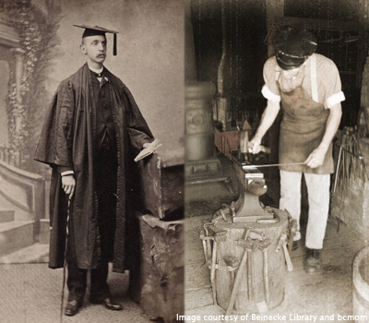
The Craftsperson and the Scholar
Scholar: archetypical researcher driven to understand things to their fullest capability
Find intellectually-demanding problems
Curiosity-driven, work on a topic until understanding has been acquired, pass on that understanding through teaching
Craftsperson: driven to create and leave behind an artifact that reifies their efforts in a field
Feels pain when things they make are fragile or ugly
Prefer to make things that explain themselves
Work requires patience, and pride in doing a job well
Scientific software requires individuals who combine the best of both roles
And can speak/translate both languages
http://www.software.ac.uk/blog/2012-11-09-craftsperson-and-scholar

Slide 7
What is a Research Software Engineer?
Software
Engineer
Software
Engineering
RSE
Researcher
Developer
Researcher
Research
https://danielskatzblog.wordpress.com/2019/07/12/super-rses-combining-research-and-service-in-three-dimensions-of-research-software-engineering/

Slide 8
Illinois NCSA: Innovative Software and Data Analysis
Organizational context
Research institute hosted at a university, outside of academic departments
Team size
25
Remit
Support individual needs; generalize those needs across projects; build software frameworks in response (both service and research)
Funding model
Research grants (soft funding)
Job security; career progression
Staff hired on indefinite contracts
Five grades of research programmer (RP): assistant, RP, senior, lead, principal
Moving to research software engineer (RSE) instead of RP

Slide 9
Work processes
Some agile methods used
Staff work on multiple projects and in multiple teams
Agile model doesn’t fully apply
Twice weekly team standups help keep every focused on tasks and share knowledge
Projects can adapt some agile methods while recognizing staff are shared
Line management & mentoring
2 co-leads and management committee (3 staff) manage and mentor staff
0.2 FTE institution support for each
Each project also has a senior developer, supported ~0.1 FTE on that project to mentor staff in that project
Goal: RSEs work on 2-3 projects (never 1)

Slide 10
High-level analysis of professional RSEs
Advantages
Institutional memory spanning projects, domains, time
Flexible workforce with flexible skills
Can support varying levels of efforts (e.g. portions of staff members)
Supports mentoring/coaching
Neutral
Costlier staff & better maintained code
Disadvantages
Perpetual precarious staffing allocations when solely reliant on grants with finite durations
Different than status quo model – hard to describe to funders/reviewers
Risk of siloed staff after prolonged embedding in projects

Slide 11
Career paths (NCSA)

Slide 12
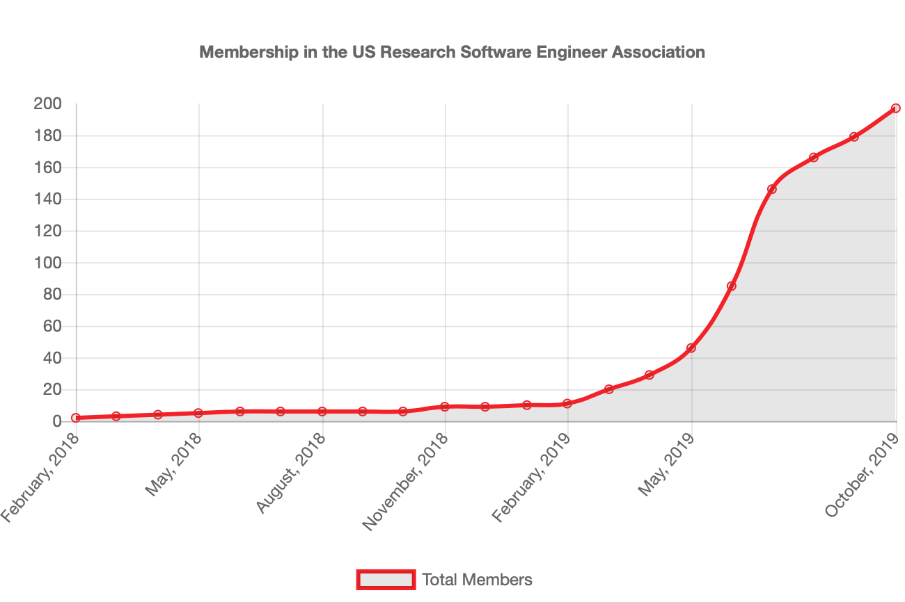
US RSE Association
Created with inspiration and support from Society of Research Software Engineering
Focused on US members and US issues
Networking, jobs, careers, events, …
In academia, labs, industry, …
Started in 2018, publicized in 2019
BOF at PEARC 2019, panel at SC19
About 200 members
https://us-rse.org

Slide 13
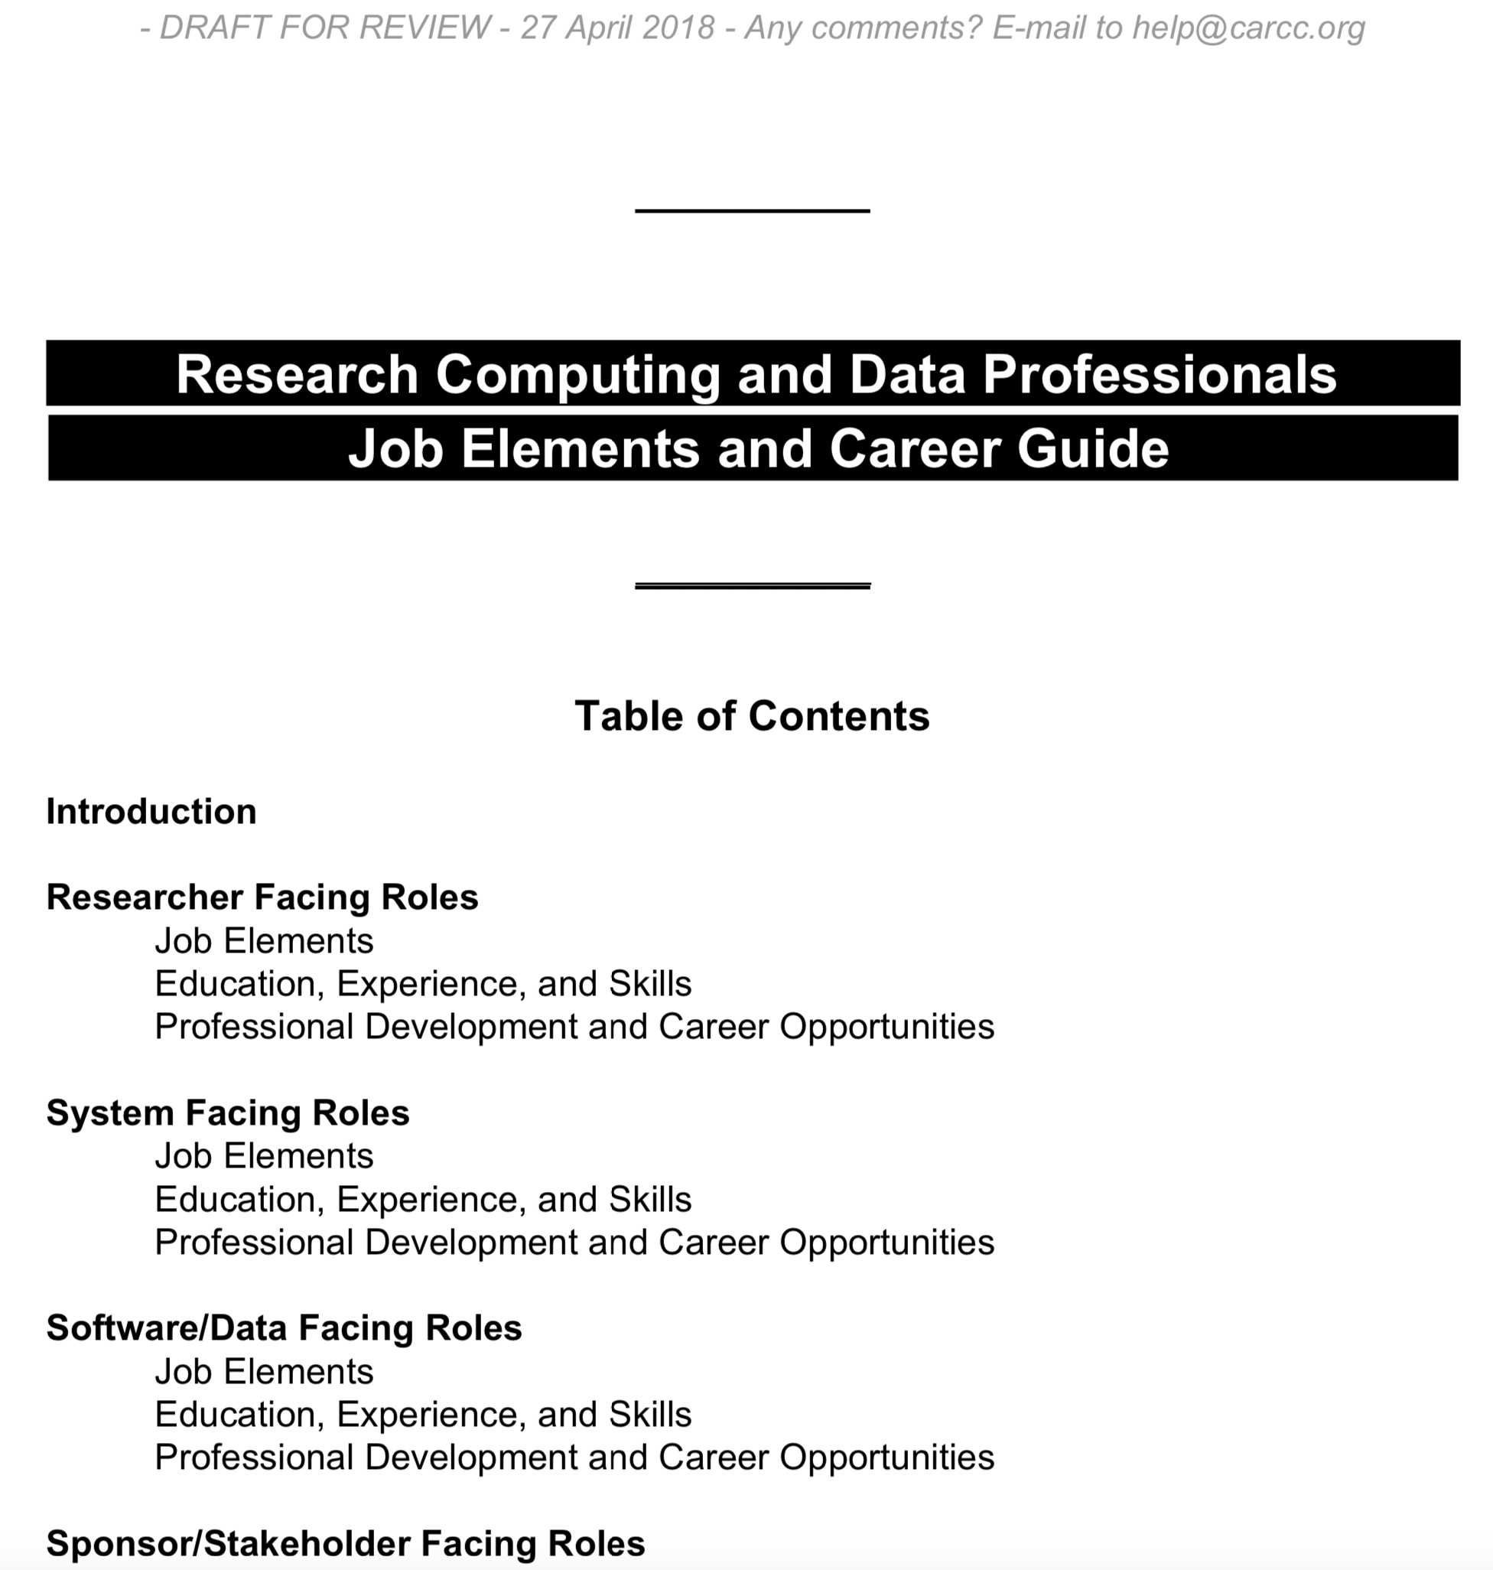
Career paths in US universities
Campus Research Computing Consortium (CaRCC)’s CI Workforce Development/Professionalization Committee held 2018 CI Professionalization Workshop
One outcome: draft Research Computing and Data Professionals Job Elements and Career Guide
Organized around “four facings” roles: researcher-facing, system-facing, software/data-facing, sponsor/stakeholder-facing
For RSEs and data scientists (software/data facing), similar to the NCSA descriptions
Now publicizing, presented to EDUCAUSE to get CIOs to support, initial implementation at BU & Harvard

Slide 14
Conclusions
Software is becoming recognized as an essential part of research
Support aspects of such software are not … yet
RSE staff, RSE groups
Models for sustaining, citing and crediting software
RSE-type groups are emerging globally to address these needs
RSEs and data scientists do not work in a vacuum
They are key to common research activities, such as hypothesis generation, study design, data analysis, and interpretation of results
Efforts to make this well understood and accepted by the scientific community at large are ongoing

Slide 15
Acknowledgments
Paper: 10.1109/SE4Science.2019.00009
Preprint: https://arxiv.org/abs/1903.00732
Thanks:
Rob Haines, Kenton McHenry, Caleb Reinking
Caroline Jay, Carole Goble, Jeff Carver, Sandra Gesing, Ian Cosden, Ian Cottam, James Howison, Simon Hettrick, Neil Chue Hong, Jeremy Cohen, James Hetherington, Mark Turner, Alys Brett, Catherine Jones, Christopher Woods, Andy Turner, Claire Wyatt

