Slide 1
The design process of domain-specific ontologies - The case studies in agriculture -
Tutorial, AEC/APC Symposium Asia, November 13, Tokyo, Japan (2019)
Hideaki Takeda
National Institute of Informatics
takeda@nii.ac.jp
@takechan2000

Slide 2
Today’s Talk
Aim:
Introduce the practical method to build domain-specific ontologies
Case 1: Agriculture Activity Ontology (AAO)
What is AAO? Why the ontology is needed?
How to build AAO?
Case 2: Crop Vocabulary (CVO)

Slide 3
Ontology?

Slide 4
Ontology (in Computer Science)
An ontology encompasses
a representation, formal naming and definition of
categories,
properties
and
relations between the concepts, data and entities
that substantiate
one,
many
or
all
domains of discourse
https://en.wikipedia.org/wiki/Ontology_(information_science)

Slide 5
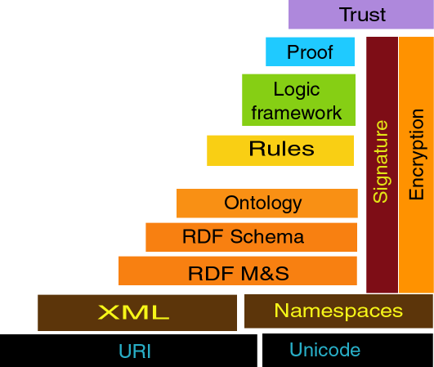
Architecture for the Semantic Web
Tim Berners-Lee http://www.w3.org/2002/Talks/09-lcs-sweb-tbl/

Slide 6
Semantic Interoperability
p = 10.2, t = 80.5
pressure? temperature?
Unit: pascal, Celsius
Product:
Location:
…

Slide 7
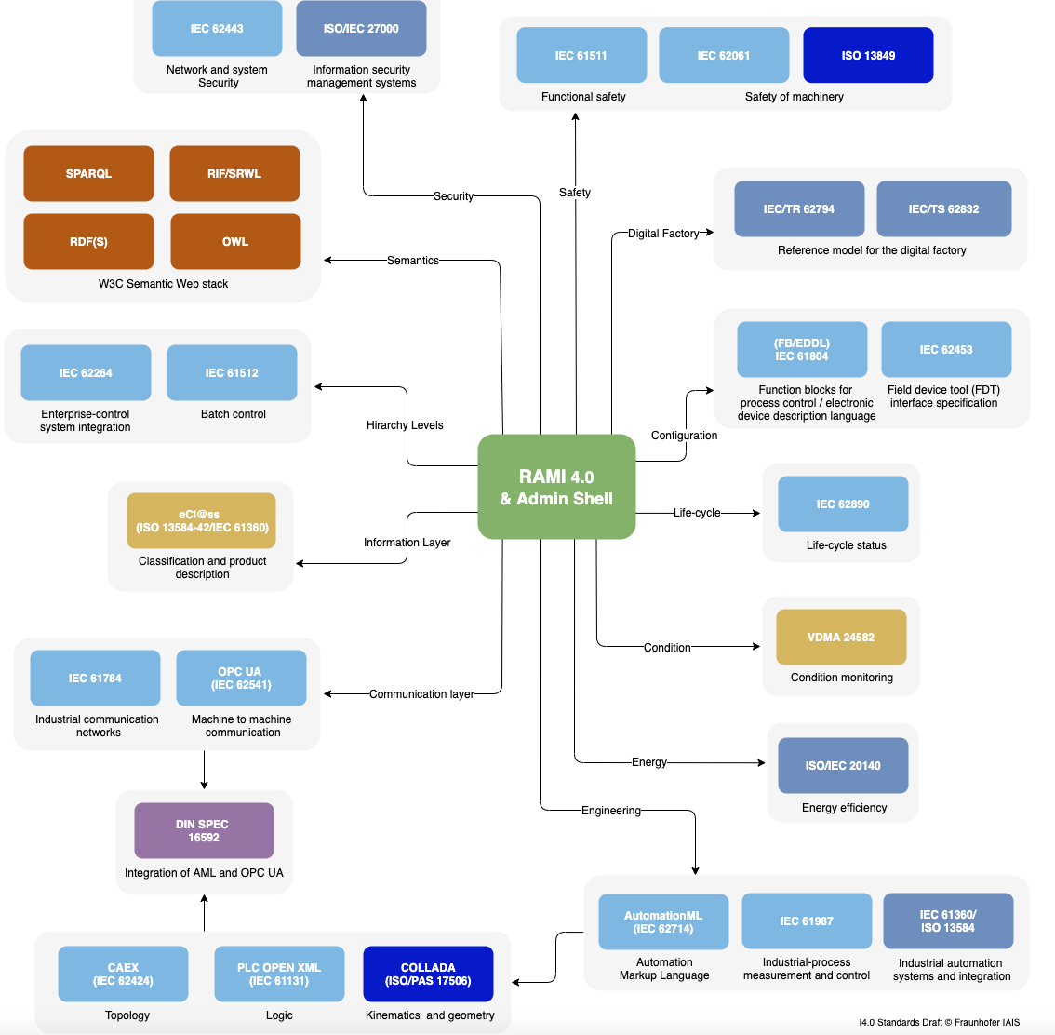
Industry 4.0
http://i40.semantic-interoperability.org/
I4.0 Standards Draft © Fraunhofer IAIS

Slide 8
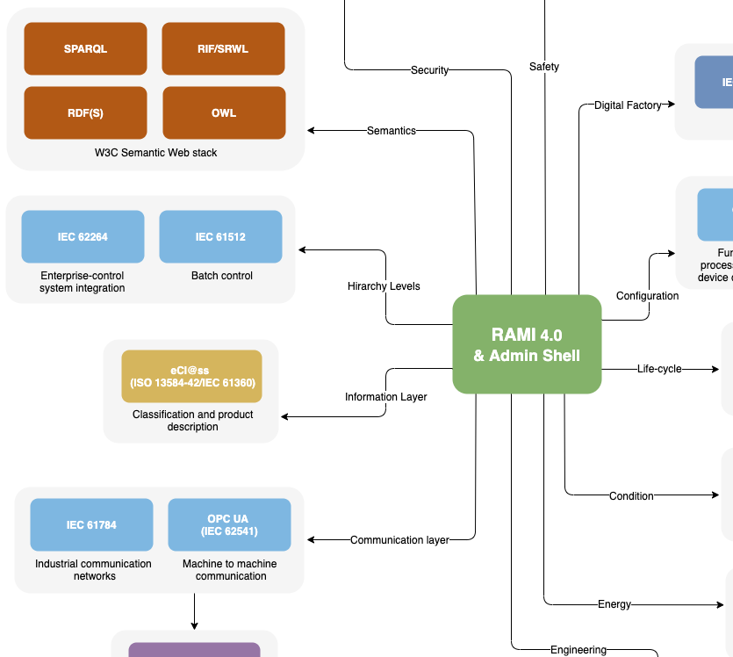

Slide 9
Ontology in Industrial Standards
Domain | Standard | Abstract
Manufactoring | ISO 13584 | Industrial automation systems and integration - Parts library,
 | IEC 62656 | Standardized product ontology register and transfer by spreadsheets
EEE | IEC 61630 | Standard data element types with associated classification scheme
 | IEC 61968 | Standards for information exchanges between electrical distribution systems
 | IEC 61970 | Standards deals with the application program interfaces for energy management systems (EMS)
Medicine | ISO 13606 | Standard for an information architecture to communicate Electronic Health Records (EHR) of a patient
 | IS0 18104 | Health informatics — Integration of a reference terminology model for nursing
IT | ISO 19763 | Information Technology – Metamodel Framework for Interoperability (MFI)
 | ISO 18384 | Information technology — Reference Architecture for Service Oriented Architecture (SOA RA)
 | ISO 15944 | Information technology — Business operational view
橋本 一成 , オントロジー技術に関する標準化動向 人工知能学会研究会資料 SIG-SWO-043-01, 2017

Slide 10
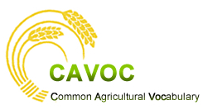
AAO : Agriculture Activity Ontology
Notes:
Next target of standardization is crop name

Slide 11
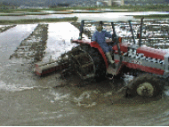
Standardization of Agricultural Activities
Background
Issues
Purpose
Agricultural IT systems are widely adopted to manage and record activities in the fields efficiently. Interoperability among these systems is needed to integrate and analyze such records to improve productivity of agriculture.
“Puddling”
“Puddling”
“Puddling”
しろかき
代かき
代掻き
Data in agricultural IT systems is not easy to federate and integrate due to the variety of the languages
It prevents federation and integration of these systems and their data.
“Puddling Activity”
代掻き作業
“Coarse pudding”
荒代(かじり)
“Pulverization”
砕土
“Coarse pudding”
“land leveling”
荒代かき
均平化
整地
“Land grading”
http://www.toukei.maff.go.jp/dijest/kome/kome05/kome05.html
To provide the standard vocabulary by defining the ontology for agricultural activity

Slide 12
AGROVOC
AGROVOC is the most well-known vocabulary in agriculture supervised by Food and Agriculture Organization(FAO) and the thesaurus containing more than 32,000 terms of agriculture, fisheries, food, environment and other related fields.
Thesaurus
AGROVOC organizes words by synonym, narrower/broader, and related relationship.
Narrower/broader relationship is not clearly defined. So relationship among bother words are often mixed and misunderstood.
harvesting
topping(beets)
baling
relationship between siblings
gleaning
mechanical harvesting
mowing
. . .
AGROVOC
The number of activity names about rice farming, which is important in Asia including Japan, are insufficient.

Slide 13
Lessons learnt – What should be considered
Define hierarchy clearly
Accept various synonymous words
Hierarchy is convenient for human to understand and for computers to process. But it often be confused by mixing different criteria on relationship among concepts/words. It causes difficulty when adding new concepts/words and when integrating different hierarchies.
Define relationship clearly between upper and lower concepts as basis of classification
Names for a single concept may be multiple by region and by crop
Clarify an entry word and their synonyms for each concept
Representation: ”Harvesting”
harvesting
topping(beets)
baling
harvesting
mechanical harvesting
relationship between siblings
gleaning
Harvest
Harvest
＋
byMachine
mechanical harvesting
[Act]
[means]
Inherit
mowing
manual harvesting
. . .
Harvest
＋
manually
Thesaurus (AGROVOC)
Ontology!
. . .
[means]

Slide 14
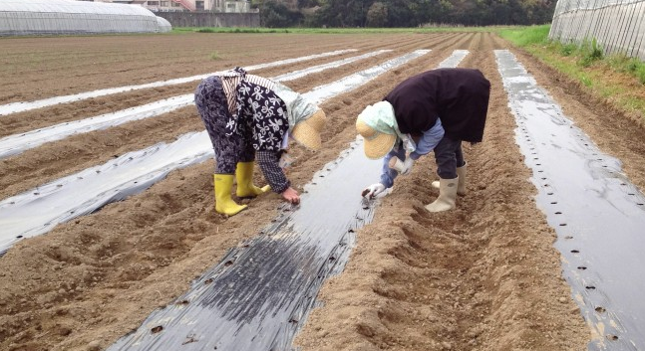
Designing of Agricultural Activity Ontology(AAO)
Define activity concepts
Define hierarchy
Seeding:
activity to sow seeds on fields for seed propagation.
property
value
“Seeding”
Purpose: seed propagation
Place : field
Target : seed
Act : sow
Seeding
Define activities with properties and their values
The hierarchy of activities is organized by property
New properties and their values are added
“purpose”, “act”, “target”, “place”, “means” , “equipment”, “season”, and “crop” in order.
Property values are specialized

Slide 15
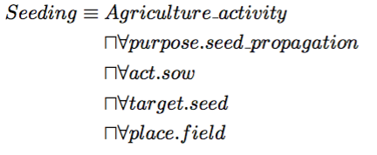
Designing of Agricultural Activity Ontology(AAO)
Formalization by Description Logics
Agricultural activity
Crop production activity
purpose：crop production
Crop growth activity
purpose：crop growth
Activity for control of propagation
purpose：control of propagation
Hierarchy by purpose
Activity for seed propagation
purpose：seed propagation
Activity for seed propagation
act : sow
target：seed
place：field
Seeding
Seeding

Slide 16
Designing of Agricultural Activity Ontology(AAO)
Differentiate concepts by property
Agricultural activity >…> Activity for seed propagation > Seeding
purpose : seed propagation
purpose : seed propagation
place : field
target : seed
act : sow
Well-drained paddy field < field
paddy field < field
Direct sowing of rice on well-drained paddy field
Direct seeding in flooded paddy field
purpose : seed propagation
place : well-drained paddy field
target : seed
act : sow
crop：rice
purpose : seed propagation
place : paddy field
target : seed
act : sow
crop：rice

Slide 17
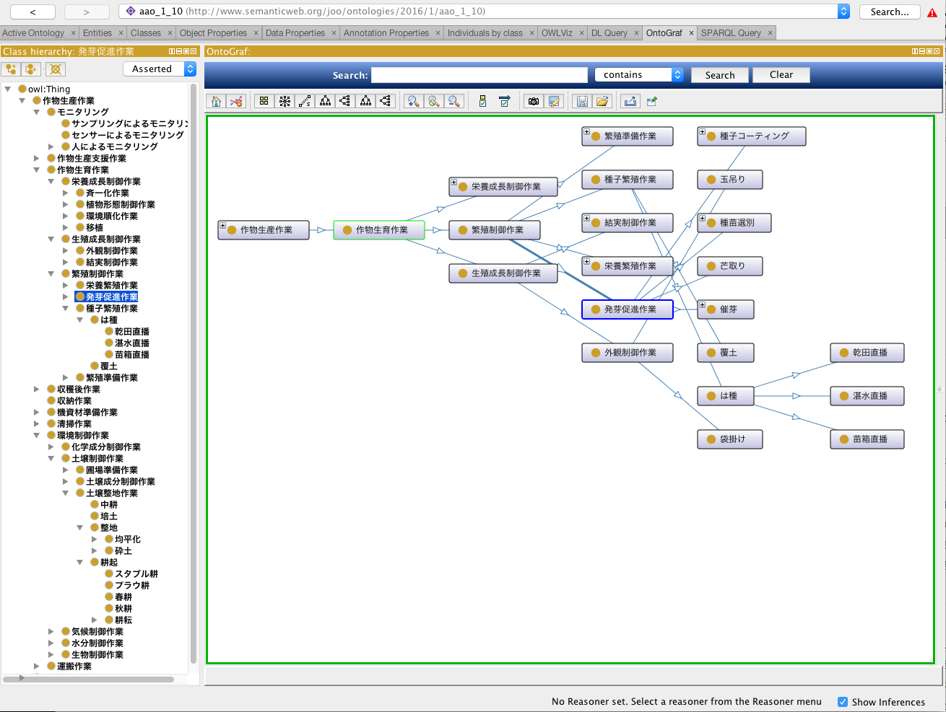
Designing of Agricultural Activity Ontology(AAO)
The Structuralizaion of the Agricultural Activities (Protégé)
Direct sowing of rice on well-drained paddy field
Activity for seeding
Direct seeding in flooded paddy field
Seeding on nursery box

Slide 18
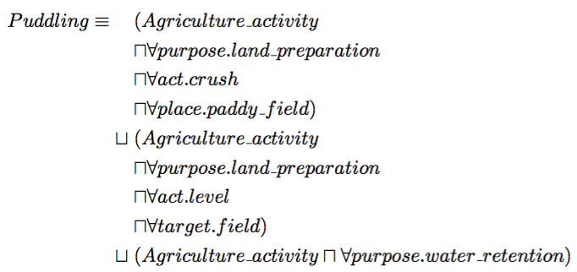
Designing of Agricultural Activity Ontology(AAO)
Polysemic concepts
Definition of agriculture activities with multiple purposes or other properties.
purpose : pulverization
purpose : water retention
purpose : land leveling
Puddling
[disjunction form]
Activity for water management
Water retention
Polysemic relationship
Land leveling
Pudlling
Land preparation
Pulverization
Subsoil breaking
Pulverization by harrow
[conjunction form]

Slide 19
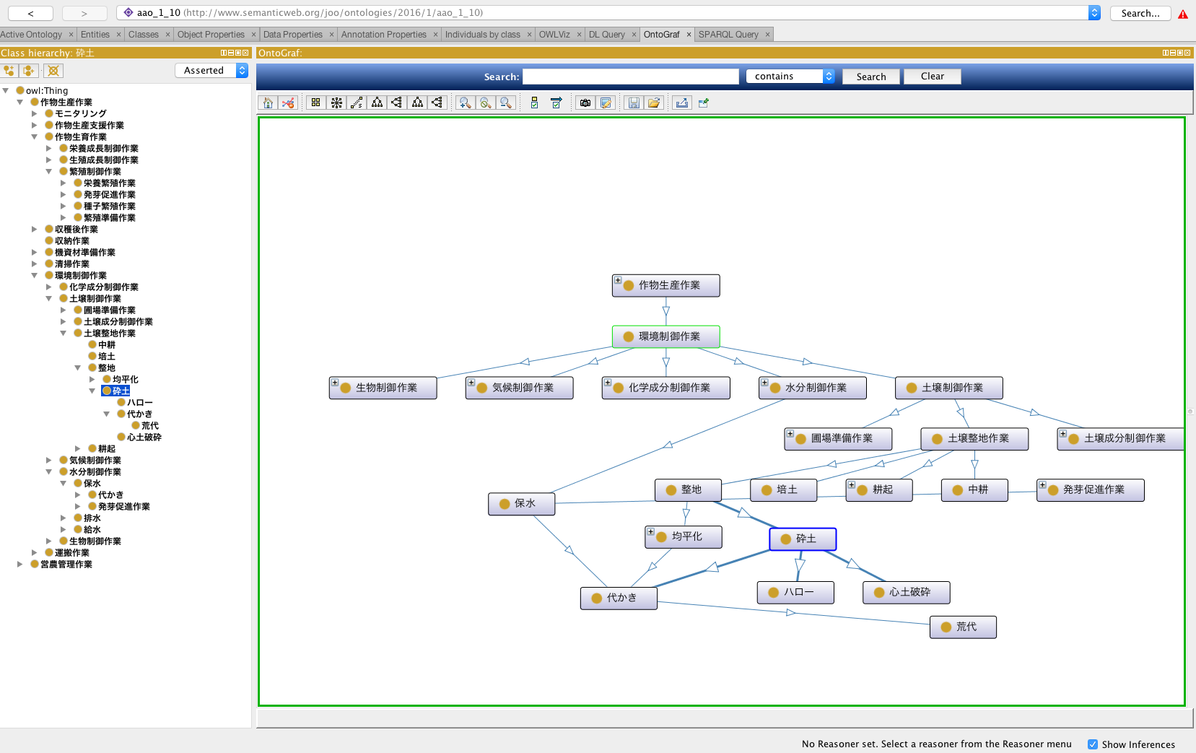
Designing of Agricultural Activity Ontology(AAO)
Polysemic concepts (Protégé)
Water retention
Land leveling
Pulverization
Puddling

Slide 20
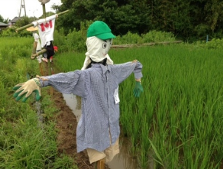
Reasoning by Agriculture Activity Ontology
Reasoning by Ontology
Infer the most feasible upper concept for the given constraints for a new words
？
Example of「Making scarecrow」
Activity for biotic control
Biotic control
purpose(0,1)
control of pest animals
purpose
(0,1)
Activity for suppression of pest animals
suppression of pest animals
purpose
(0,1)
means
(0,1)
suppression of pest animals
Physical means
Activity for suppression of pest animals by physical means
Activity for suppression of pest animals by chemical means
Purpose
(0,1)
Means
(0,1)
means
(0,1)
Physical means
Making scarecrow‘
?
act
(0,1)
target
(0,1)
Chemical means
build
scarecrow

Slide 21
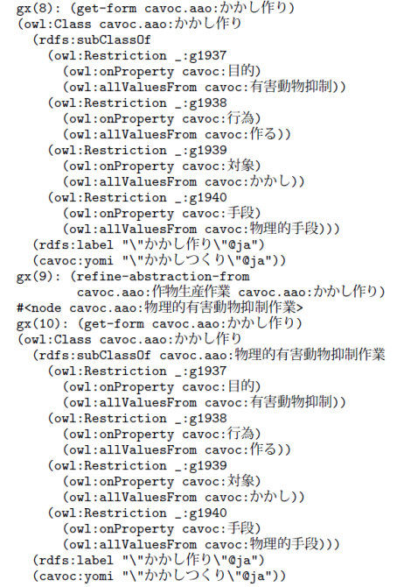
Reasoning by Agriculture Activity Ontology
[1]
[1] Seiji Koide, Theory and Implementation of Object Oriented Semantic Web Language, PhD Thesis, Graduate University for Advance Studies, 2011
Reasoning by Ontology
Infer the most feasible upper concept for the given constraints for a new words
Biotic control
Activity for biotic control
purpose(0,1)
control of pest animals
purpose
(0,1)
Activity for suppression of pest animals
suppression of pest animals
purpose
(0,1)
means
(0,1)
Inference with SWCLOS
Activity for suppression of pest animals by physical means
Activity for suppression of pest animals by chemical means
[1]
物理的手段
means
(0,1)
Physical means
means
(0,1)
Chemical means
かかし作り
Making scarecrow is a subclass of Activity for
suppression of pest animals by physical means
Making scarecrow
means
(0,1)
act
(0,1)
target
(0,1)
make
scarecrow

Slide 22
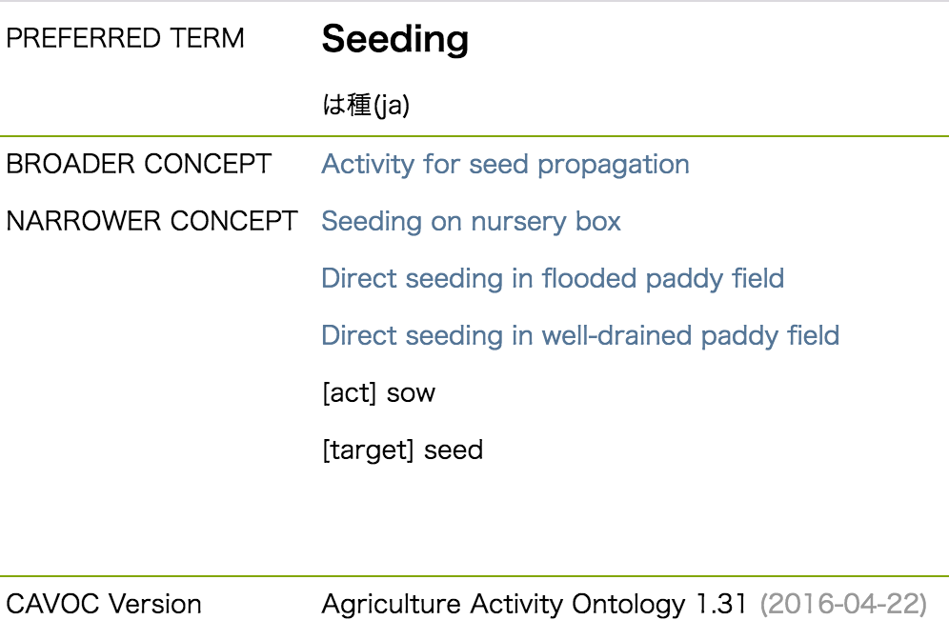
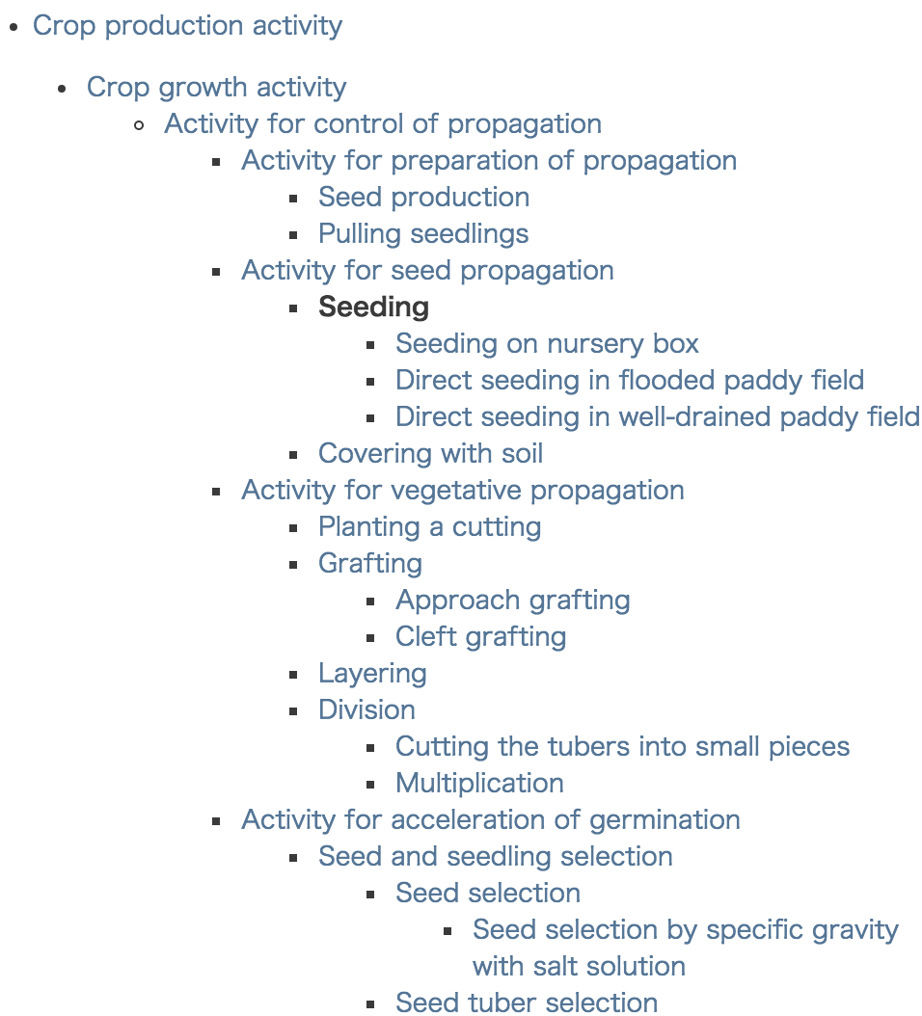
Applying Agricultural Activity Ontology
URI
Give a unique URI for each concept
http://cavoc.org/aao/ns/1/は種

Slide 23
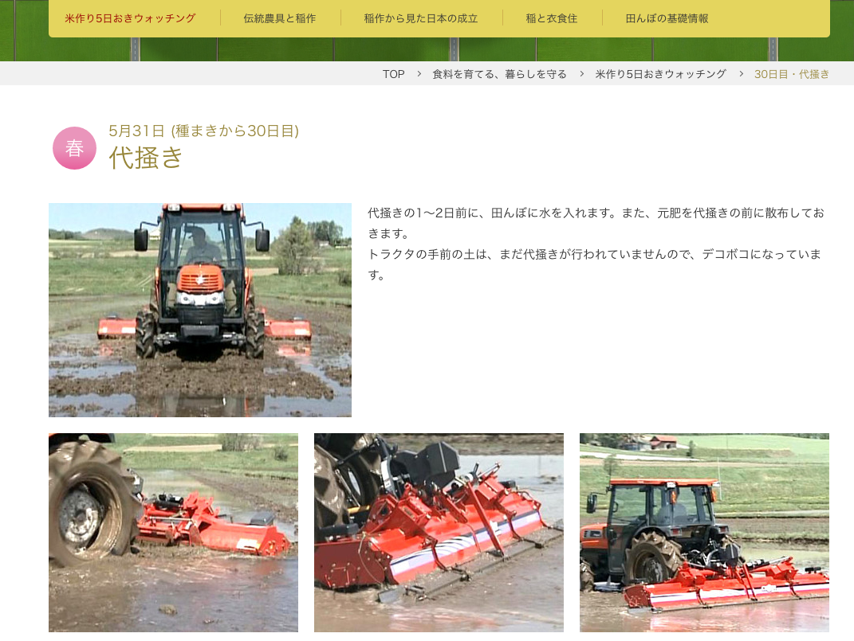
Web Services based on Agriculture Activity Ontology
Converting synonyms to core vocabulary
http://www.tanbo-kubota.co.jp/foods/watching/14_2.html
API
Puddling Activity
and sowing…
“Puddling Activity”
“sowing”
…
Puddling
Seeding
…
Converting
[system]
Puddling
and seeding…
AAO
[system’]

Slide 24
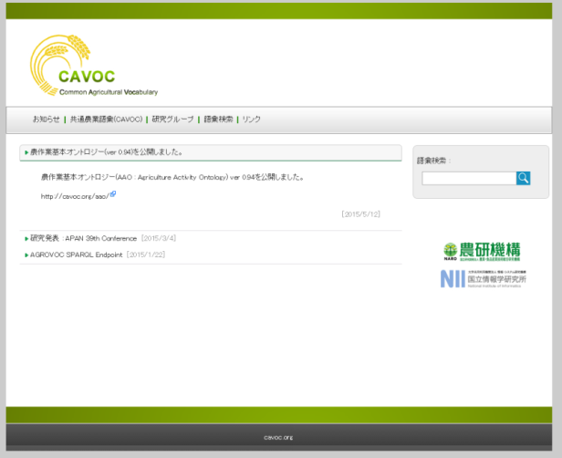
Agriculture Activity Ontology(AAO): Summary
Standardize the vocabulary for agricultural activities with the logical model
Define concepts of agriculture activities beyond
Conceptual variety (often dependent to crop and farm style)
Linguistic diversity (often dependent to crop and area)
adopted as the part of ”the guideline for agriculture activity names for agriculture IT systems” issued by Ministry of Agriculture, Forestry and Fisheries (MAFF), Japan in 2016,
Common Agricultural VOCabulary
http://cavoc.org/
Agriculture Activity Ontology (AAO) ver 1.31
http://cavoc.org/aao/

Slide 25
How did we build Agriculture Activity Ontology?
Share the experience of building ontologies
Design Process
0th Step: Project Formation
1st Step: Survey
2nd Step: Analysis of Data
3rd Step: Proposed Structure (1st)
4th Step: Introduction of Descriptions Logics
5th Step: Evaluation and Enrichment by domain experts

Slide 26
Design Process - 0th Step: Project Formation -
Cross-ministerial Strategic Innovation Promotion Program (SIP), “Technologies for creating next-generation agriculture, forestry and fisheries” (funding agency: Bio-oriented Technology Research Advancement Institution, NARO).
Project aim: define common vocabulary on agriculture activity
To share knowledge among farmers of different crops and different regions and different systems
Human understandable and machine readable
Four members from two organizations
Ontology Expert Researchers from National Institute of Informatics (NII)
Information Expert Researchers from National Agriculture and Food Organization (NARO)

Slide 27
Design Process - 1st Step: Survey -
Survey of existing vocabularies
Agrovoc: defined by FAO. Most popular and famous vocabulary in the domain
International
Maintenance
Machine readable (LOD)
Agropedia
In Japanese
With explanations
MAFF Guideline (prototype version)
Official
Related to Elements in Official Statistics

Slide 28
AGROVOC
AGROVOC is the most well-known vocabulary in agriculture supervised by Food and Agriculture Organization(FAO) and the thesaurus containing more than 32,000 terms of agriculture, fisheries, food, environment and other related fields.
Thesaurus
AGROVOC organizes words by synonym, narrower/broader, and related relationship.
Narrower/broader relationship is not clearly defined. So relationship among bother words are often mixed and misunderstood.
harvesting
topping(beets)
baling
relationship between siblings
gleaning
mechanical harvesting
mowing
. . .
AGROVOC
The number of activity names about rice farming, which is important in Asia including Japan, are insufficient.

Slide 30
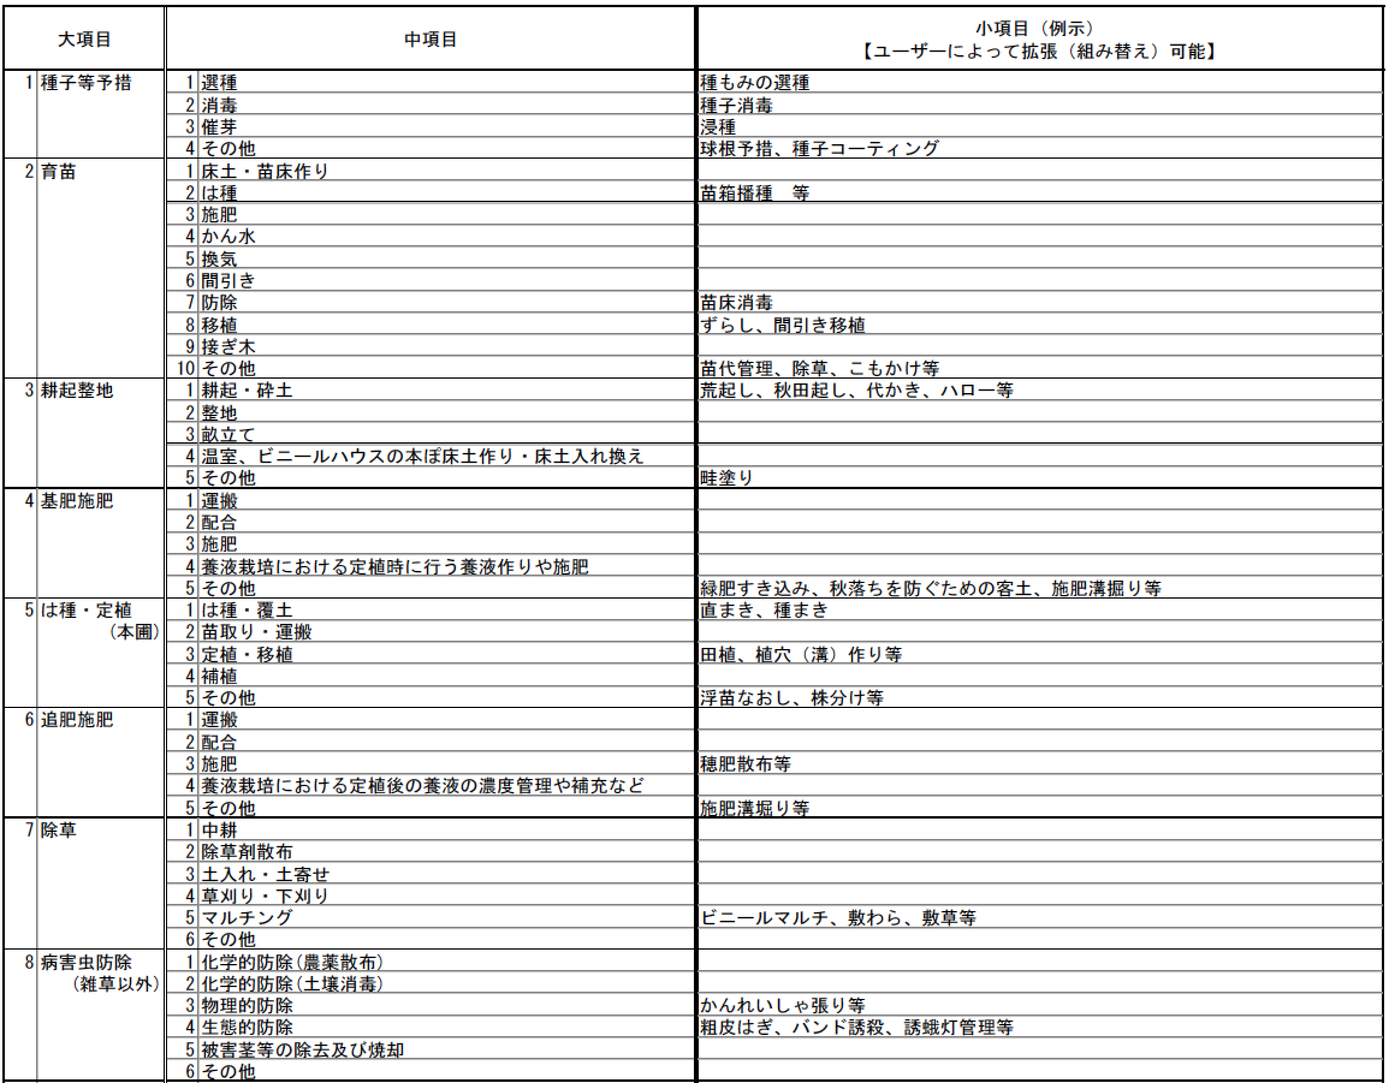
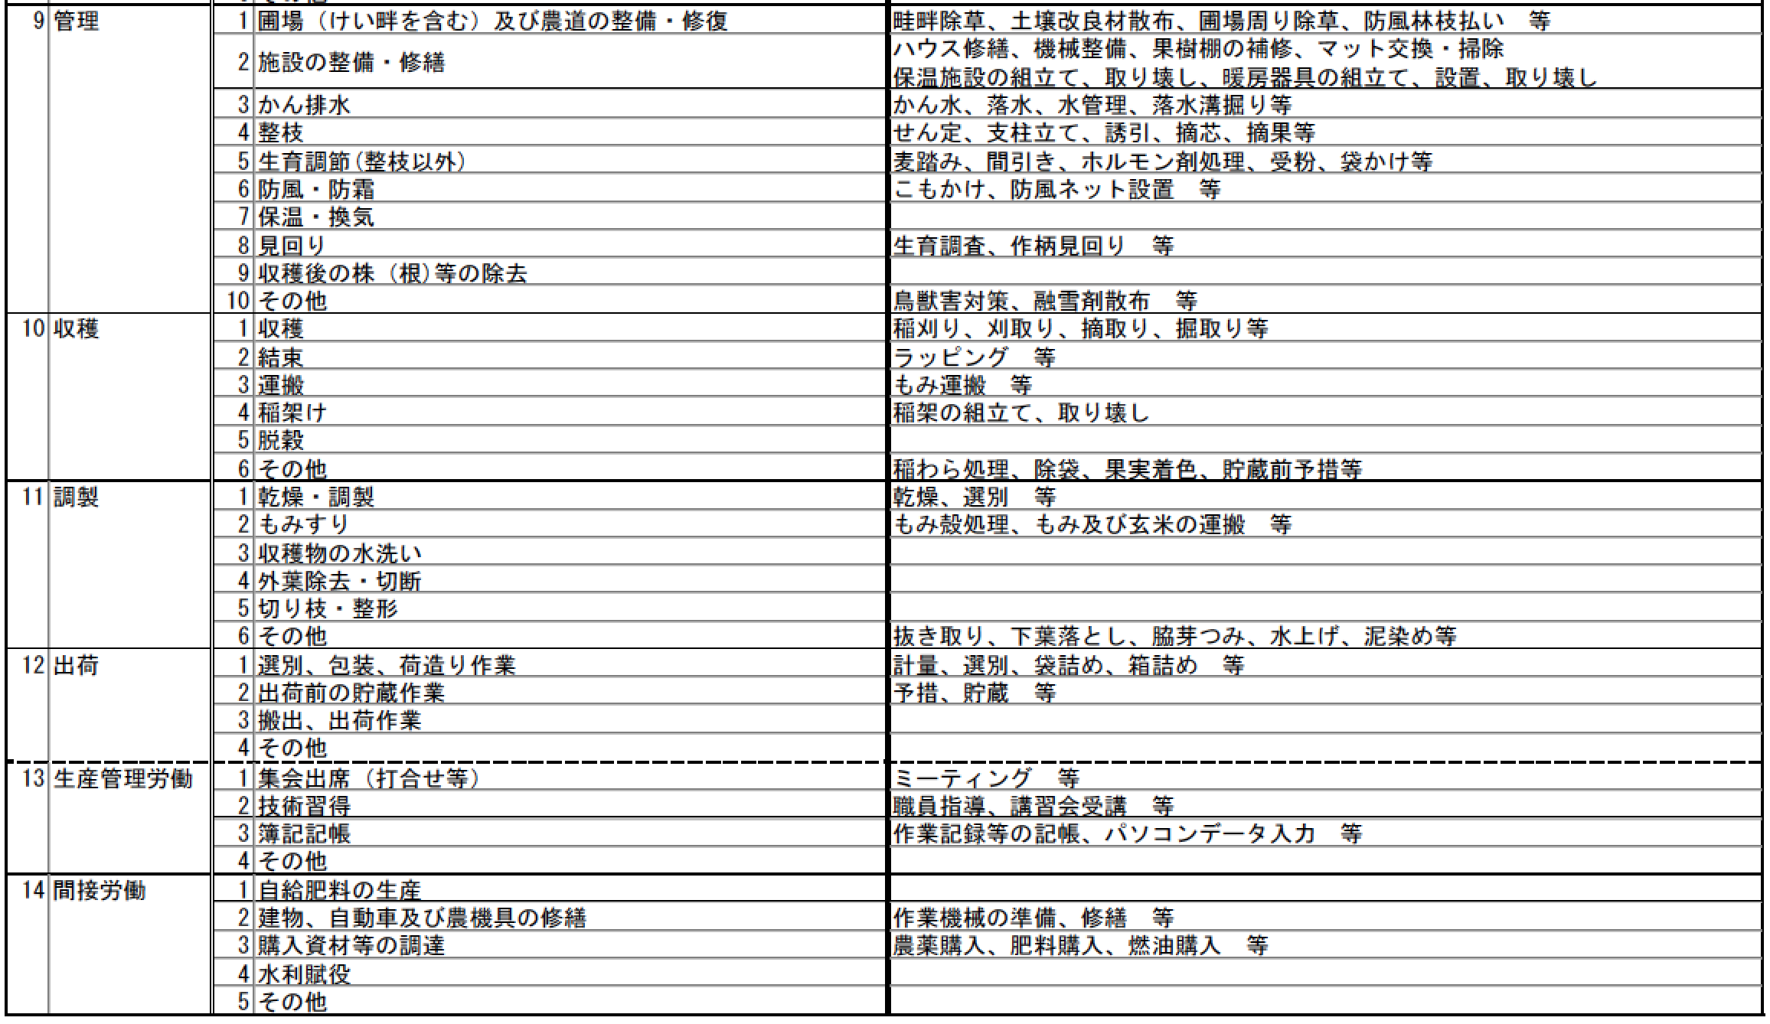
農業ITシステムで用いる農作業の名称に関する個別ガイドライン（試行版）

Slide 31
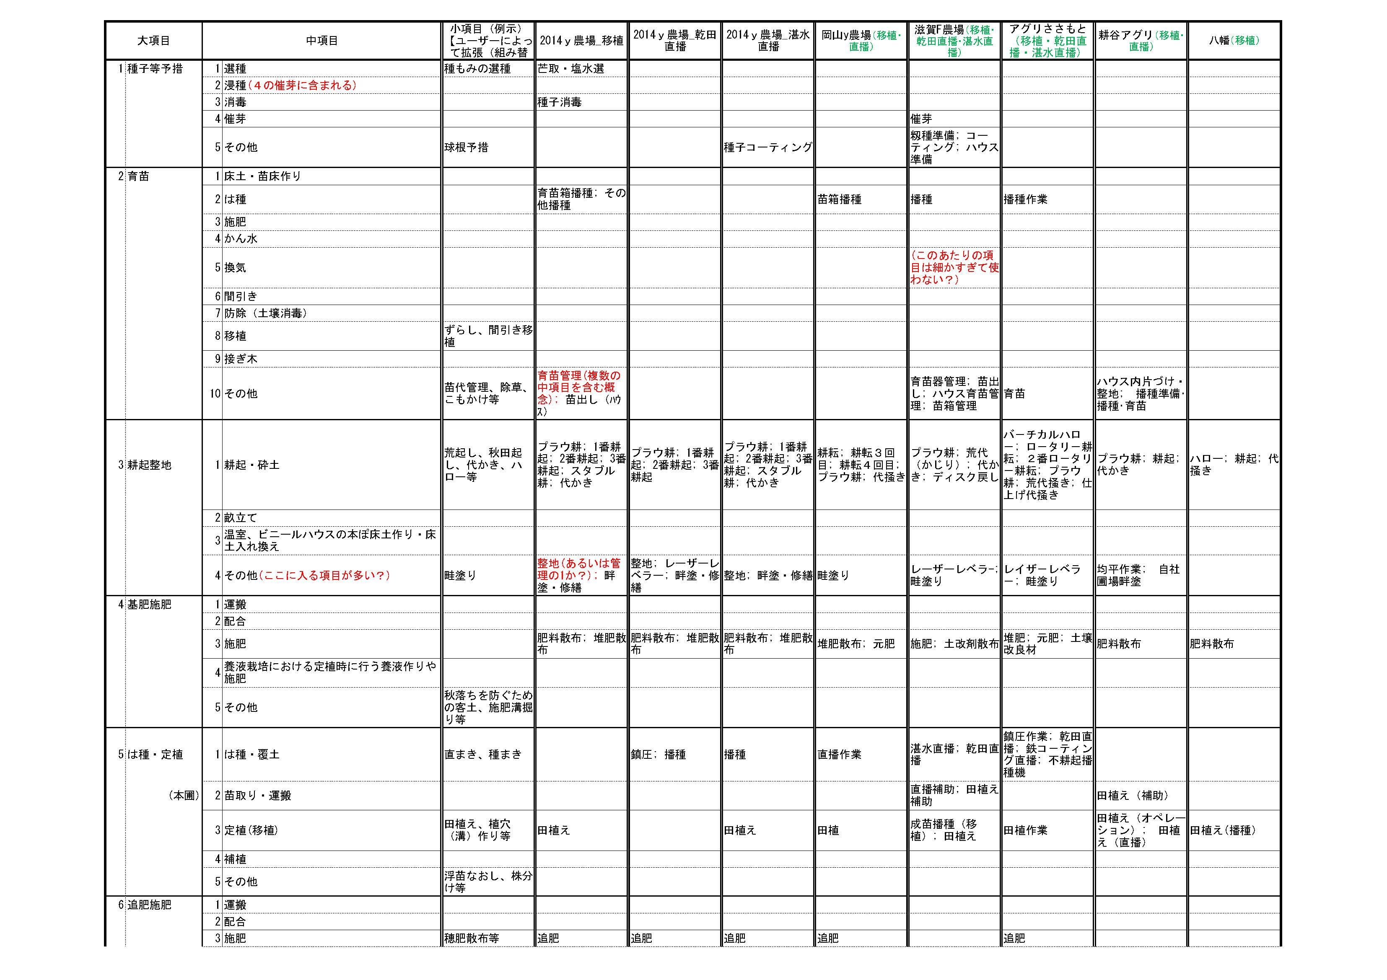
Design Process - 2nd Step: Analysis of data

Slide 32
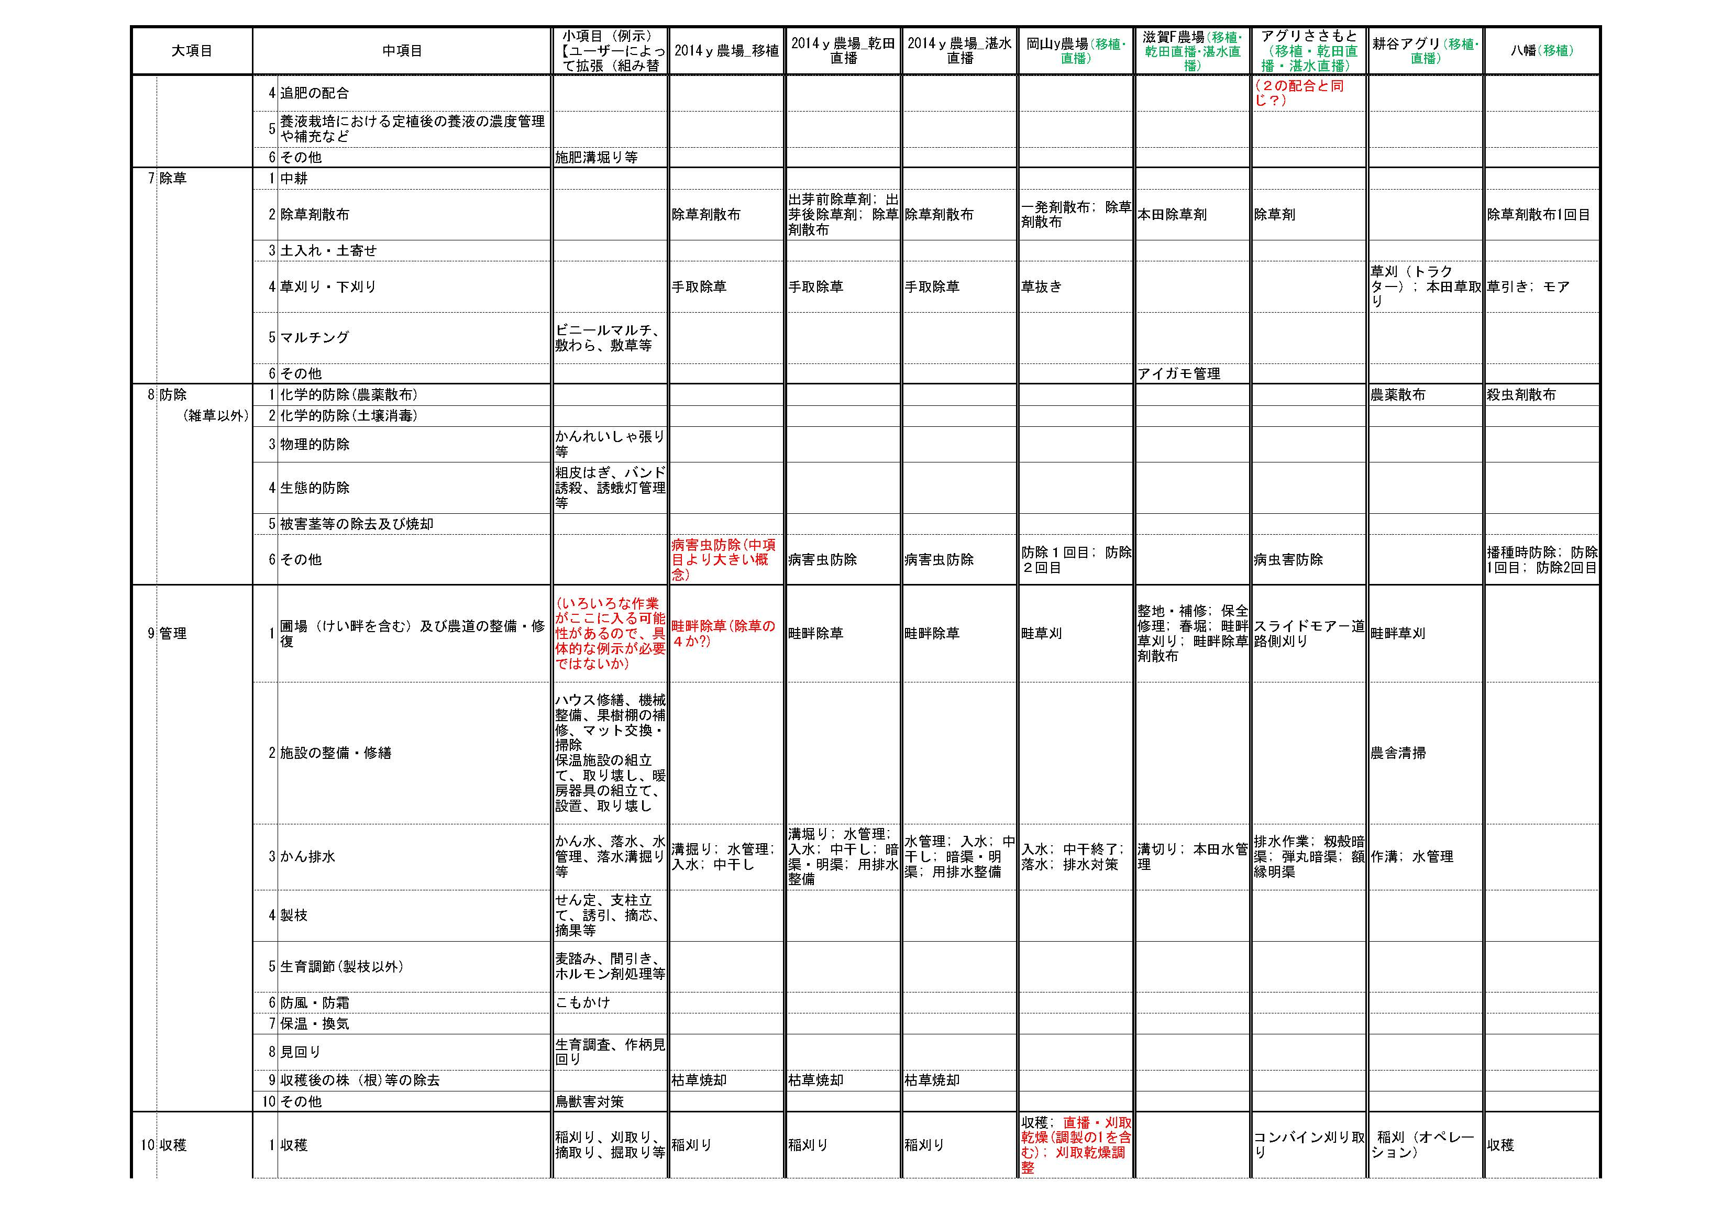

Slide 33
Design Process - 3rd Step: Proposed Structure (1st) -
Define hierarchy clearly
Accept various synonymous words
Hierarchy is convenient for human to understand and for computers to process. But it often be confused by mixing different criteria on relationship among concepts/words. It causes difficulty when adding new concepts/words and when integrating different hierarchies.
Define relationship clearly between upper and lower concepts as basis of classification
Names for a single concept may be multiple by region and by crop
Clarify an entry word and their synonyms for each concept
Representation: ”Harvesting”
harvesting
topping(beets)
baling
harvesting
mechanical harvesting
relationship between siblings
gleaning
Inherit
mechanical harvesting
mowing
manual harvesting
. . .
Thesaurus (AGROVOC)
. . .

Slide 34
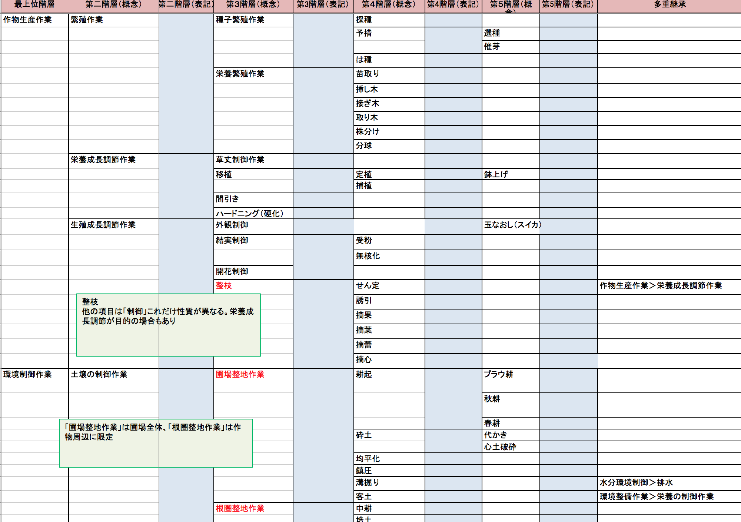

Slide 35
Design Process - 4th Step: Introduction of Description Logics -
Consideration of the structure
Discovery of logical structure
Reformation of the structure by Description Logics
Use of a property for each is-a relation
Introduction of a new property
Is-a hierarchy of a property value
Re-arrangement of classes
Representation: ”Harvesting”
Representation: ”Harvesting”
harvesting
mechanical harvesting
harvesting
mechanical harvesting
Harvest
Harvest
＋
byMachine
Inherit
[Act]
[Means]
manual harvesting
manual harvesting
Harvest
＋
manually
. . .
Ontology
. . .
[Means]

Slide 36
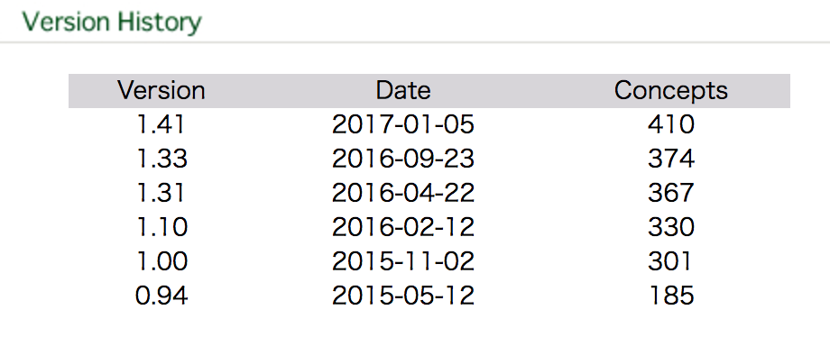
Design Process - 5th Step: Evaluation and Enrichment by domain experts -
Ask evaluations to experts
individual crops experts
Farmer management system developer
Feedback
Some alternation of class structure
Many new words
Crop-specific words
Area-specific words (dialect)

Slide 37
CVO : Crop Vocabulary
Notes:
Next target of standardization is crop name

Slide 38
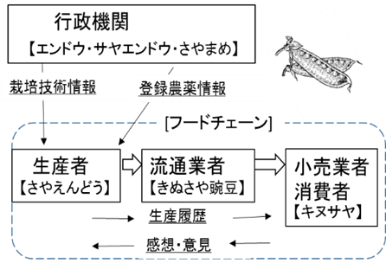
Standardization of crop name
Image of distribution flow of agriculture product, and information flow
Administrative agencies
[ Pea, Pod pea]
Cultivation technology
Agricultural chemical use reference
--- [Food chain]----
Distributor
Farmers
Retailers
[ Pod pea
“Kinusaya”]
[ Pod pea]
[ Pod pea
“Kinusaya”]
Product history
Product review
Information flow
Distribution flow
Notes:
This figure shows image of information flow, and distribution flow of agriculture product in food chain.
Various kinds of terms are used to describe crop in food chain.
In this example, We use pea, pod pea, pod pea “kinusaya”
To standardize crop name, we have built the Crop Vocabulary; CVO

Slide 39
CVO (Crop Vocabulary)
・CVO define the crop name with 4 kinds of property and their values
- 4 kinds of property
Scientific name, Synonyms, Mature/ Immature, Edible/ Non-edible, Edible part.
CVO
Pea
Synonyms；Garden pea
Scientific name; Pisum sativum
Mature pea seed
Synonyms；Pea (mature seed)
Scientific name; Pisum sativum
Mature/Immature ;Mature
Edible part; Seed
【Cultivar list】
・・・・
Green peas
Synonyms；
Scientific name; Pisum sativum
Mature/Immature ; Immature
Edible part; Seed
【Cultivar list】
“Usui”・・・・
Pod Pea
Synonyms；
Scientific name; Pisum sativum
Mature/Immature ; Immature
Edible part; Seed, Pod
【Cultivar list】
“Kinusaya” ・・・
Notes:
CVO define the crop name with 4 kinds of property and their values
- 4 kinds of property
Scientific name, Synonyms, Mature/ Immature, Edible/ Non-edible, Edible part.
CVO link to cultivar list

Slide 40
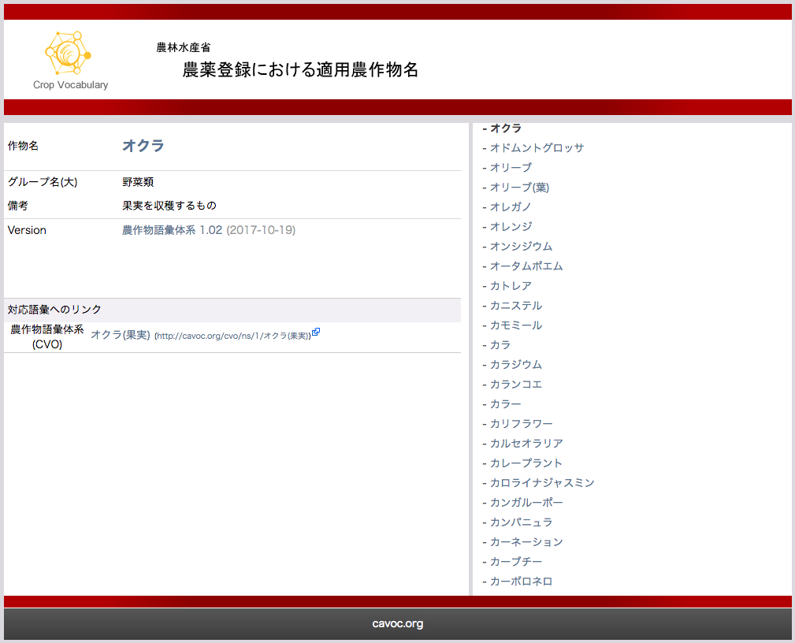
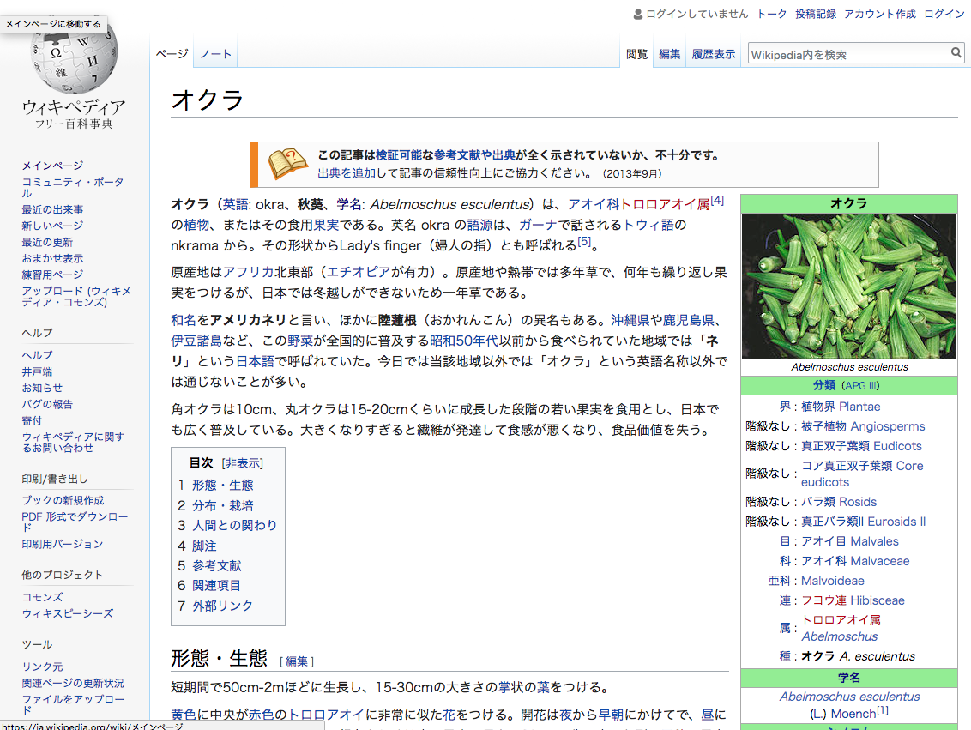
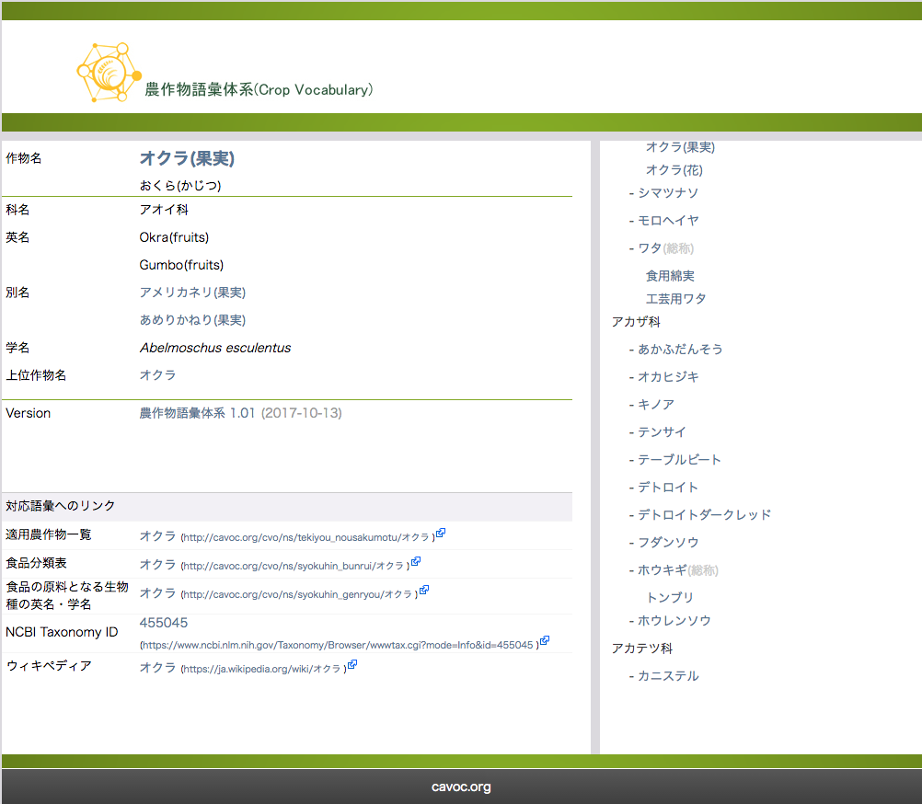
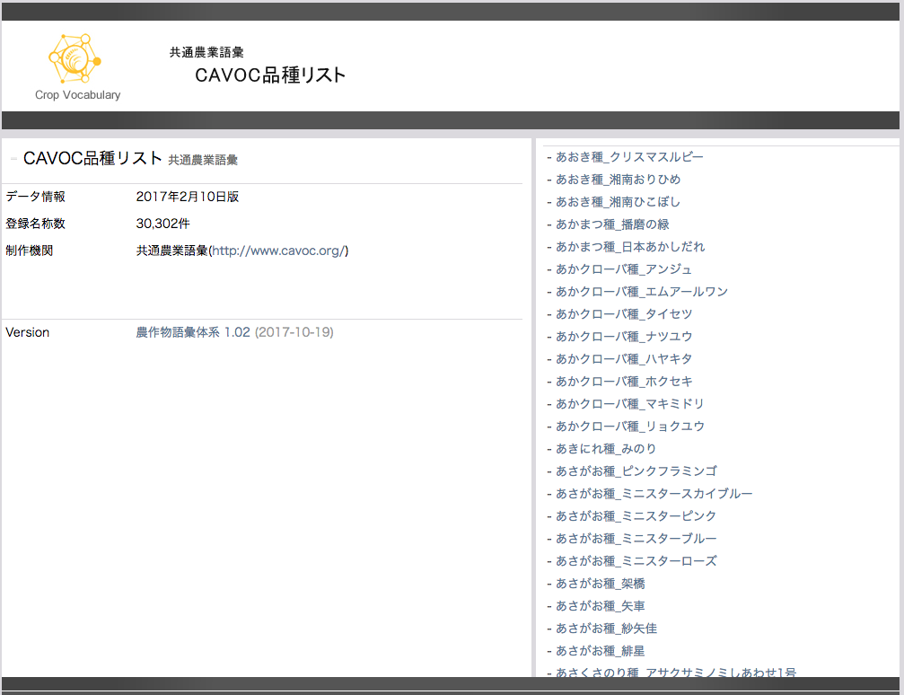
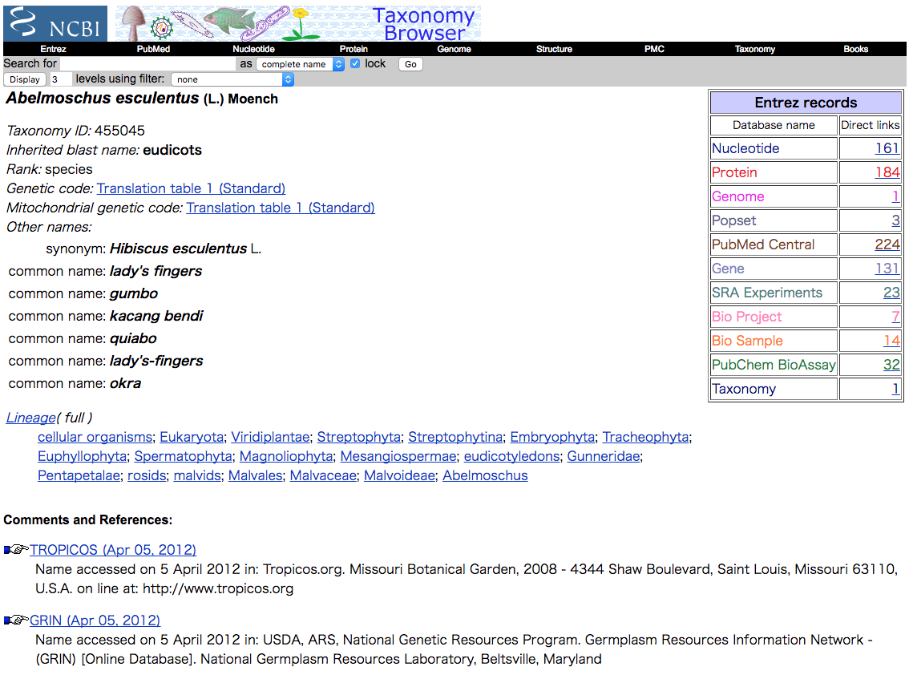
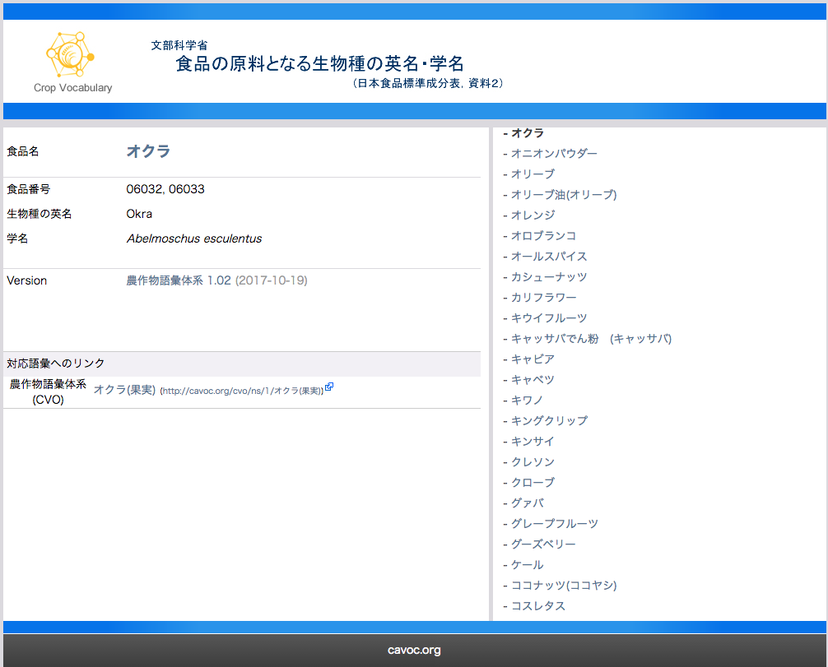
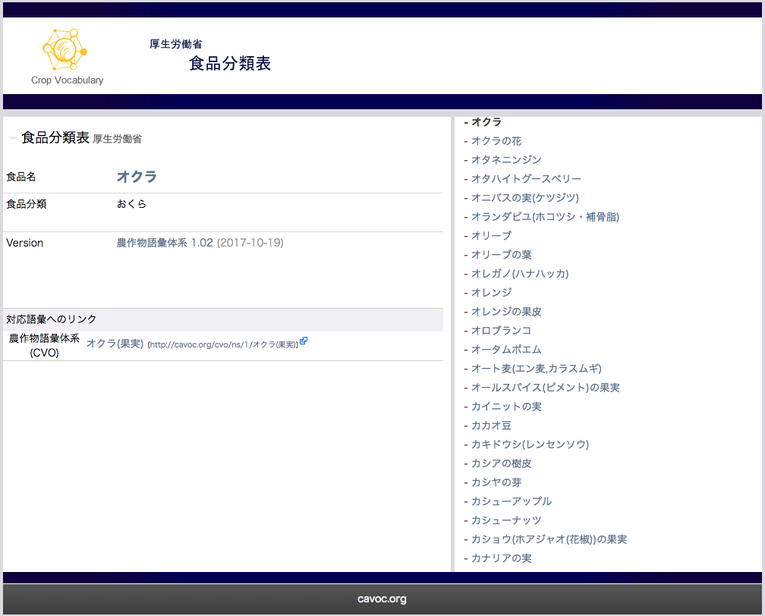
CVO (Crop Vocabulary)
CAVOC provides URI for crop names and API based on CVO
オクラ
= okra
WIKIPEDIA
NCBI Taxonomy DB
Crop names in Agricultural Chemical Use Reference by Ministry of Agriculture, Forestry and Fisheries, JAPAN)
CVO
オクラ(果実)
= okra(fruits)
id=455045
オクラ
= okra
オクラ
= okra
オクラ
= okra
WIKIPEDIA
Registered cultivar names
by CAVOC
Food names In food composition database by MEXT(Ministry of education, culture, sports, science and technology, JAPAN)
Crop names in Agricultural chemical residue reference by MHLW(Ministry of health, labour and welfare, JAPAN)

Slide 41
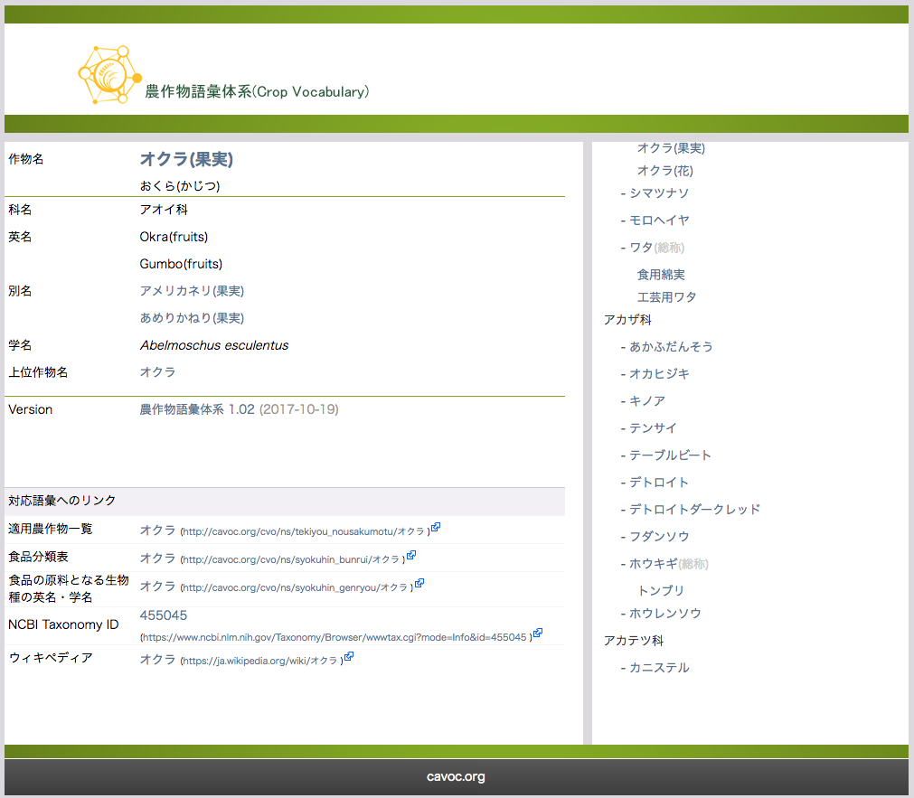
URI of Crop Names(CVO)
Crop name
List of crop names
Species name
English name
Synonym
Scientific name
Broader concept
Link to URI of ..
Agricultural Chemical Use Reference
Food names In food composition database
Agricultural chemical residue reference
Registered cultivar names
NCBI taxonomy Database
WIKIPEDIA

Slide 42
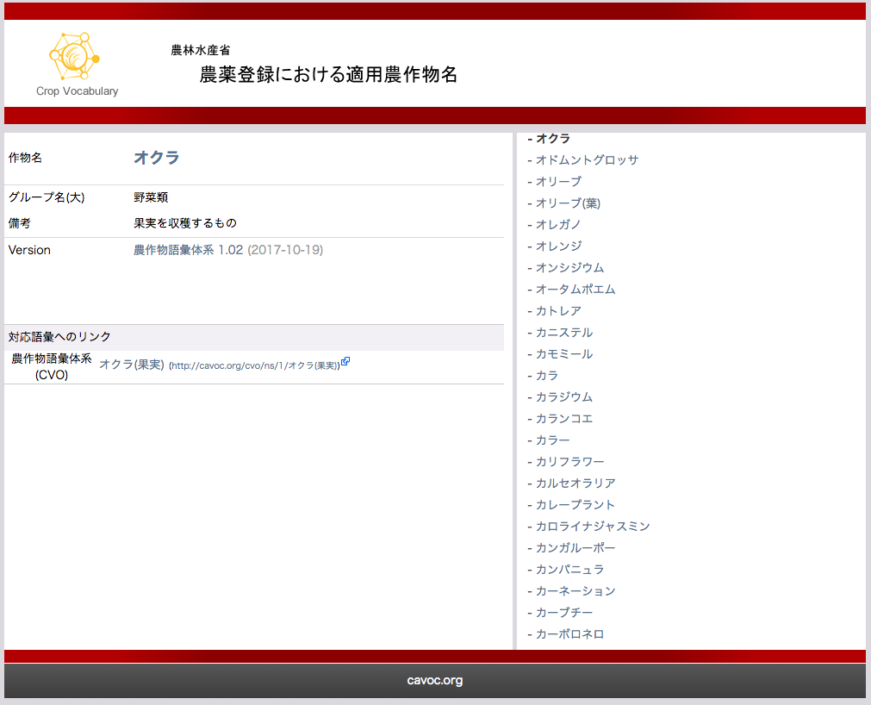
URI of Crop Names(Crop names in Agricultural Chemical Use Reference )
Crop name
List of crop names
Class name
Property values
Link to URI of CVO

Slide 43
API based on CVO
Crop names in Agricultural Chemical Use Reference
has crop name, class name and property value.
Food names In food composition database
has food name, food number, English name and scientific name.
http://cavoc.org/cvo/api/CVO_TekiyounousakumotuToCVO.php?term=いちょう(種子)
Input : crop name in Agricultural Chemical Use Reference.
Output : English name and Scientific name
Crop name : ギンナン
Link to :
イチョウ(種子)
ぎんなん(イチョウ)
CVO
Crop name : イチョウ(種子)
Class name : 果樹類
Property value :
種子を収穫するもの
Food name : ぎんなん(イチョウ)
Food number : 05008,05009
English name : Ginkgo
Scientific name : Ginkgo biloba
Crop names in Agricultural Chemical Use Reference
Food names In food composition database

Slide 44
How to build CVO
CVO is built by referring many existing data sources like standards in food industry and agricultural chemical industry.
Crop names in Agricultural Chemical Use Reference by MAFF (Ministry of Agriculture, Forestry and Fisheries, JAPAN)
Food names In food composition database by MEXT(Ministry of education, culture, sports, science and technology, JAPAN)
CVO
Crop names in Agricultural chemical residue reference by MHLW(Ministry of health, labour and welfare, JAPAN)
Registered cultivar names
by CAVOC
Notes:
CVO has links to other standards in food industry, agricultural chemical industry.

Slide 45
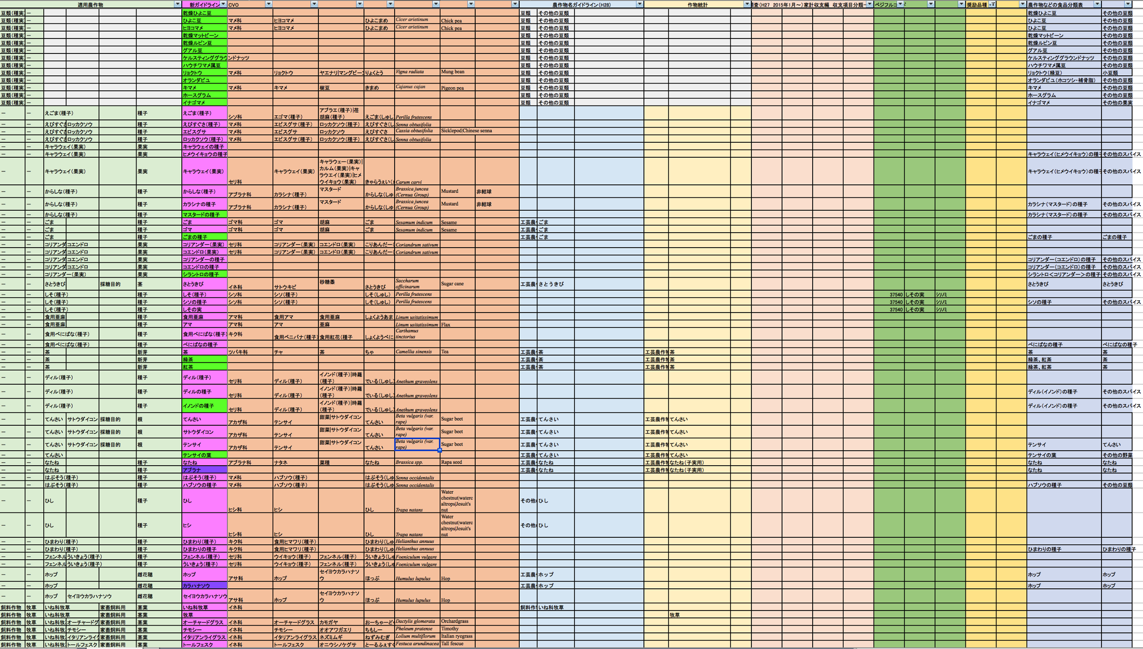
Data-driven
Crop names for
agricultural chemicals
Guideline name (2017)
Guideline name (2016)
Household budget survey
MAFF
Encourage varieties
Food
classifi
-cation
Crop statistics
Vegetable Code
CVO

Slide 46
What we’ve learnt
Survey and critics of existing vocabularies
Understanding of pros and cons
Fix the target
Data-driven approach
Avoid too abstract discussion
Small group of knowledgeable persons of two sides (domain and informatics)
Constructive discussion
Make the core then extend it
Introduction of AI experts
Introduction of more domain experts
Communication is important

Slide 47
Conclusion
There are no gold way to build ontologies. We adopt the bottom-up and minimum commitment approach. It requires time and effort. We believe that it is successful at least to build AAO and CVO.
Common Agricultural VOCabulary
http://cavoc.org/
Agriculture Activity Ontology (AAO)
http://cavoc.org/aao/
Crop Vocabulary (CVO)
http://cavoc.org/cvo/

