Slide 1
A user perspective on ORCID:
The past and the future
… for me.
André Leon S. Gradvohl, Dr.
0000-0002-6520-9740
University of Campinas, October 2019
Notes:
Add your organization’s logo, and presenter’s information

Slide 2
Agenda
A long time ago … before I started using ORCID
New features I’d like to have
A graph (network) of colleagues
Academic Genealogy (who was supervised by whom).
Word cloud based on publications keywords
Research groups
Biography in other languages
Try to reduce the Matthews Effect
Why we publish where we do?
Declaration on Research Assessment (DORA)
Notes:
Edit, add, or delete according to the aims of your session

Slide 3
A long time ago … before I started using ORCID
It was 2012…
Some of my works were not indexed by ResearchId (currently Publons).
I was looking for a way to have all my publications with a DOI listed on a single – accredited – site, preferably, worldwide accessible.
Then, I found ORCID!!
Notes:
If you like, add a screenshot of presenter's 16-digit iD
Introduce your audience to these basic facts about ORCID
Further reading: https://support.orcid.org/knowledgebase/articles/115256-what-is-orcid

Slide 4
New features …I’d like to have
Notes:
Quiz - encourage discussion with your audience.
Example prompt questions and answers:
- Who owns and controls your ORCID iD? – you do, this is why you register yourself, and you log in to authorize changes and grant permissions
- Who controls your visibility settings, deciding what information you share with everyone, and trusted parties? – you control this, and have fine-grained control over what information is shared with whom. No-one can update your ORCID record without your permission.
- With how many different systems is ORCID interoperable? – lots, ORCID is non-proprietary and fully interoperable with many research information systems
- Is ORCID specific to a country, language, or subject discipline? – no, ORCID is global and your iD stays with you through your career, no matter where you work or in what field.
Tell researchers that we allow and encourage you to link your ORCID iD to other identifiers. For example, you may link your iD to your Scopus Author ID, or ResearcherID, or ISNI. Learn more about adding other identifiers to your ORCID record https://support.orcid.org/knowledgebase/articles/1807516-other-identifiers
Further info: How is ORCID different from other researcher identifiers? https://support.orcid.org/knowledgebase/articles/907197-how-is-orcid-different-from-other-researcher-ident

Slide 5
A graph (network) of colleagues or co-authors
Who are my collaborators, and who is collaborating with who?
Source of data to build this feature:
Extract co-authors from works.
Colleague 2
Colleague 1
Colleague 3
Me
Colleague 4

Slide 6
Academic Genealogy (who was supervised by whom).
The Academic Genealogy, i.e., who were my supervisors at the graduate level (Masters, Ph.D.), and who did I supervised?
Source of data to build this feature:
Extract information from Education and Qualification section (Ph.D., Masters and Graduate, if possible).
It needs to include a field with the advisor’s name.
For information about who I supervised, it would be necessary to include a specific section or do a crosscheck from the students I supervised.
M.Sc. Supervisor
Ph.D Supervisor
Ph.D. Co-Supervisor
Me
Ph.D. Student 2
M.Sc. Student 1
Ph.D Student 1

Slide 7
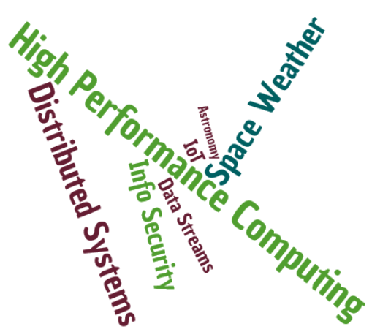
Word Cloud
What are the most frequent keywords I use in my publications?
Create a word cloud based on publications keywords.
Source of data to build this feature:
Keywords

Slide 8
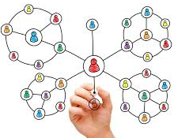
Research groups
Keep track of my research groups.
It is necessary to add a section in Orcid.

Slide 9
Some little adjustments: biography in other languages.
Allow biographies in other languages.
For example: If the user access from Brazil, show it in Portuguese.
Hi there!
Tudo bem?
Biografia
Biography
Biografía
Hola, ¿qué tal?

Slide 10
Reducing the Matthew Effect
Notes:
Quiz - encourage discussion with your audience.
Example prompt questions and answers:
- Who owns and controls your ORCID iD? – you do, this is why you register yourself, and you log in to authorize changes and grant permissions
- Who controls your visibility settings, deciding what information you share with everyone, and trusted parties? – you control this, and have fine-grained control over what information is shared with whom. No-one can update your ORCID record without your permission.
- With how many different systems is ORCID interoperable? – lots, ORCID is non-proprietary and fully interoperable with many research information systems
- Is ORCID specific to a country, language, or subject discipline? – no, ORCID is global and your iD stays with you through your career, no matter where you work or in what field.
Tell researchers that we allow and encourage you to link your ORCID iD to other identifiers. For example, you may link your iD to your Scopus Author ID, or ResearcherID, or ISNI. Learn more about adding other identifiers to your ORCID record https://support.orcid.org/knowledgebase/articles/1807516-other-identifiers
Further info: How is ORCID different from other researcher identifiers? https://support.orcid.org/knowledgebase/articles/907197-how-is-orcid-different-from-other-researcher-ident

Slide 11
Try to reduce Matthew effect
Merton and Zuckerman summarize Matthew Effect as “the rich get richer, and the poor get poorer.”
“The Matthew Effect in Science” Robert K. Merton.
“For to everyone who has will more be given, and he will have abundance; but from him who has not, even what he has will be taken away.” - Matthew 25:29.

Slide 12
Try to reduce Matthew effect
In the Sociology of Science: eminent scientists will often get more credit than a comparatively unknown researcher, even if their work is similar; it also means that credit will usually be given to researchers who are already famous.
How to reduce?
Increase the visibility of other types of scientific production (open datasets, open software, open science).
Increase the visibility of other scientific efforts (teaching, public outreach).
Why we publish where we do: Faculty publishing values and their relationship to review, promotion and tenure expectations (http://dx.doi.org/10.1101/706622. July 21, 2019).

Slide 13
Why we publish where we do http://dx.doi.org/10.1101/706622
Aim:
Understand priorities for publishing decisions and their perceived importance within the review, promotion, and tenure (RPT).
Data:
An online survey of academics at 55 randomly selected institutions across the US and Canada.
Main findings:
Respondents most value journal readership, while they believe their peers most value prestige and related metrics such as impact factor when submitting their work for publication.
Older and tenured respondents (most likely to serve on RPT committees) were less likely to value journal prestige and metrics for publishing, while untenured respondents were more likely to value these factors.
Results suggest disconnects between what academics value versus what they think their peers value, and between the importance of journal prestige and metrics for tenured versus untenured faculty in publishing and RPT perceptions.

Slide 14
Declaration on Research Assessment (DORA) https://sfdora.org
Aim:
The Declaration on Research Assessment (DORA) recognizes the need to improve how the outputs of scholarly research are evaluated.
Recommendations:
Try to eliminate the use of journal-based metrics, such as Journal Impact Factors, in funding, appointment, and promotion considerations;
Assess research on its own merits rather than based on the journal in which the research is published; and
Capitalize on the opportunities provided by online publication (such as relaxing unnecessary limits on the number of words, figures, and references in articles, and exploring new indicators of significance and impact).

Slide 15
Thank you so much for…
… the opportunity to meet you, …
… hear what I had to say, and …
… spend this nice day with you all!
Notes:
Quiz - encourage discussion with your audience.
Example prompt questions and answers:
- Who owns and controls your ORCID iD? – you do, this is why you register yourself, and you log in to authorize changes and grant permissions
- Who controls your visibility settings, deciding what information you share with everyone, and trusted parties? – you control this, and have fine-grained control over what information is shared with whom. No-one can update your ORCID record without your permission.
- With how many different systems is ORCID interoperable? – lots, ORCID is non-proprietary and fully interoperable with many research information systems
- Is ORCID specific to a country, language, or subject discipline? – no, ORCID is global and your iD stays with you through your career, no matter where you work or in what field.
Tell researchers that we allow and encourage you to link your ORCID iD to other identifiers. For example, you may link your iD to your Scopus Author ID, or ResearcherID, or ISNI. Learn more about adding other identifiers to your ORCID record https://support.orcid.org/knowledgebase/articles/1807516-other-identifiers
Further info: How is ORCID different from other researcher identifiers? https://support.orcid.org/knowledgebase/articles/907197-how-is-orcid-different-from-other-researcher-ident

