Slide 1
Engaging researchers with [institutional figshare]
Group sites
Laura Armstrong Senior eResearch Engagement Specialist Centre for eResearch
figshare fest New Zealand 2019
Notes:
Short talk about how we, the University of Auckland, are using our institutional figshare in ways that suit our researchers.

Slide 2
Data Publishing & Discovery Service - background
2015 - pilot, 2017 - production service for doctoral candidates and staff https://auckland.figshare.com Partnership - Centre for eResearch (CeR) - Business Owner, system admin, researcher engagement Connect - procurement, storage Libraries and Learning Service (LLS) - researcher engagement/support 2018 - National DOI consortium 2019 - 236 datasets in data.govt.nz - 666 DOIs year-to-date - 320k views, 69k downloads - 5+ Group sites

Slide 3
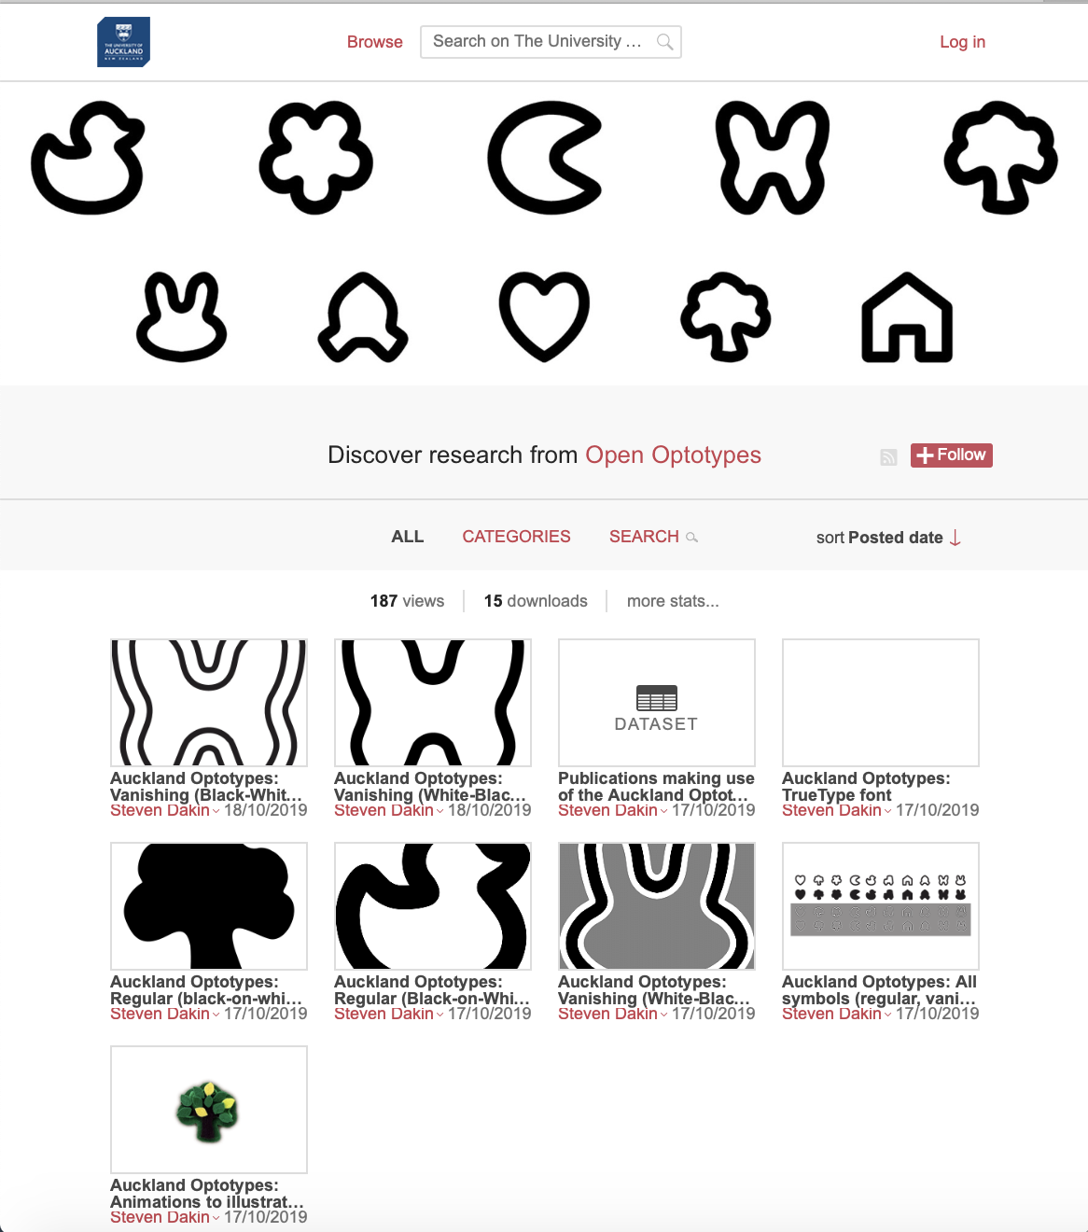
What do researchers want?
Digital Object Identifiers (DOIs) - persistent, resolvable, citable, versionable
Discoverability (via Google)
Visual display/browser preview
Branding or match website
Metrics
Self-service (easy and quick)
Low/no cost

Slide 4
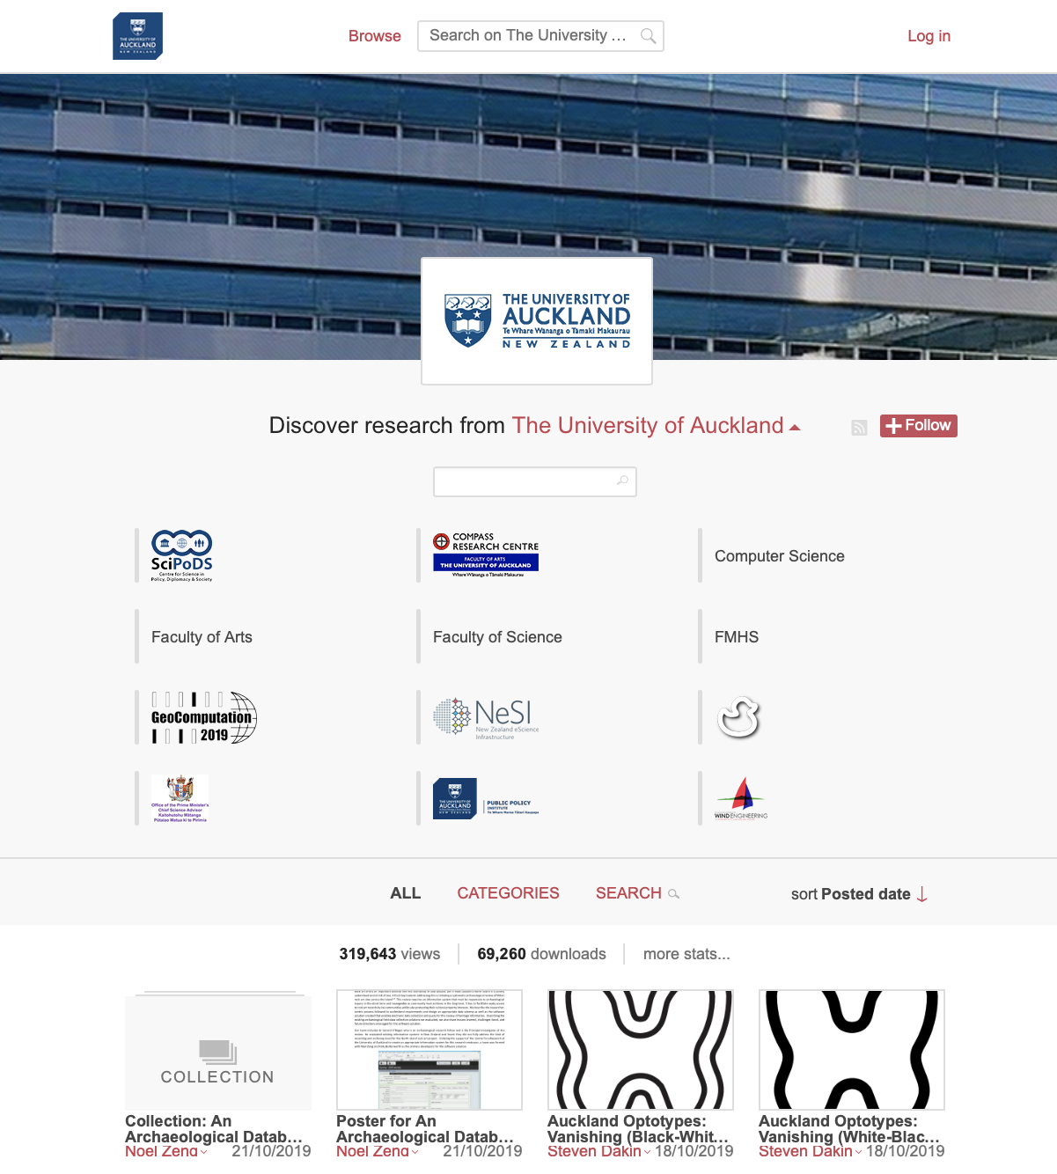
What are Group sites?
Subgroup of institutional site https://auckland.figshare.com
for research group, topic or event
Group site items > auckland.figshare.com > figshare.com
Branding
name, URL and short description
landing page - image, logo
item page - logo
(DOI)
Group site admins
Custom metadata

Slide 5
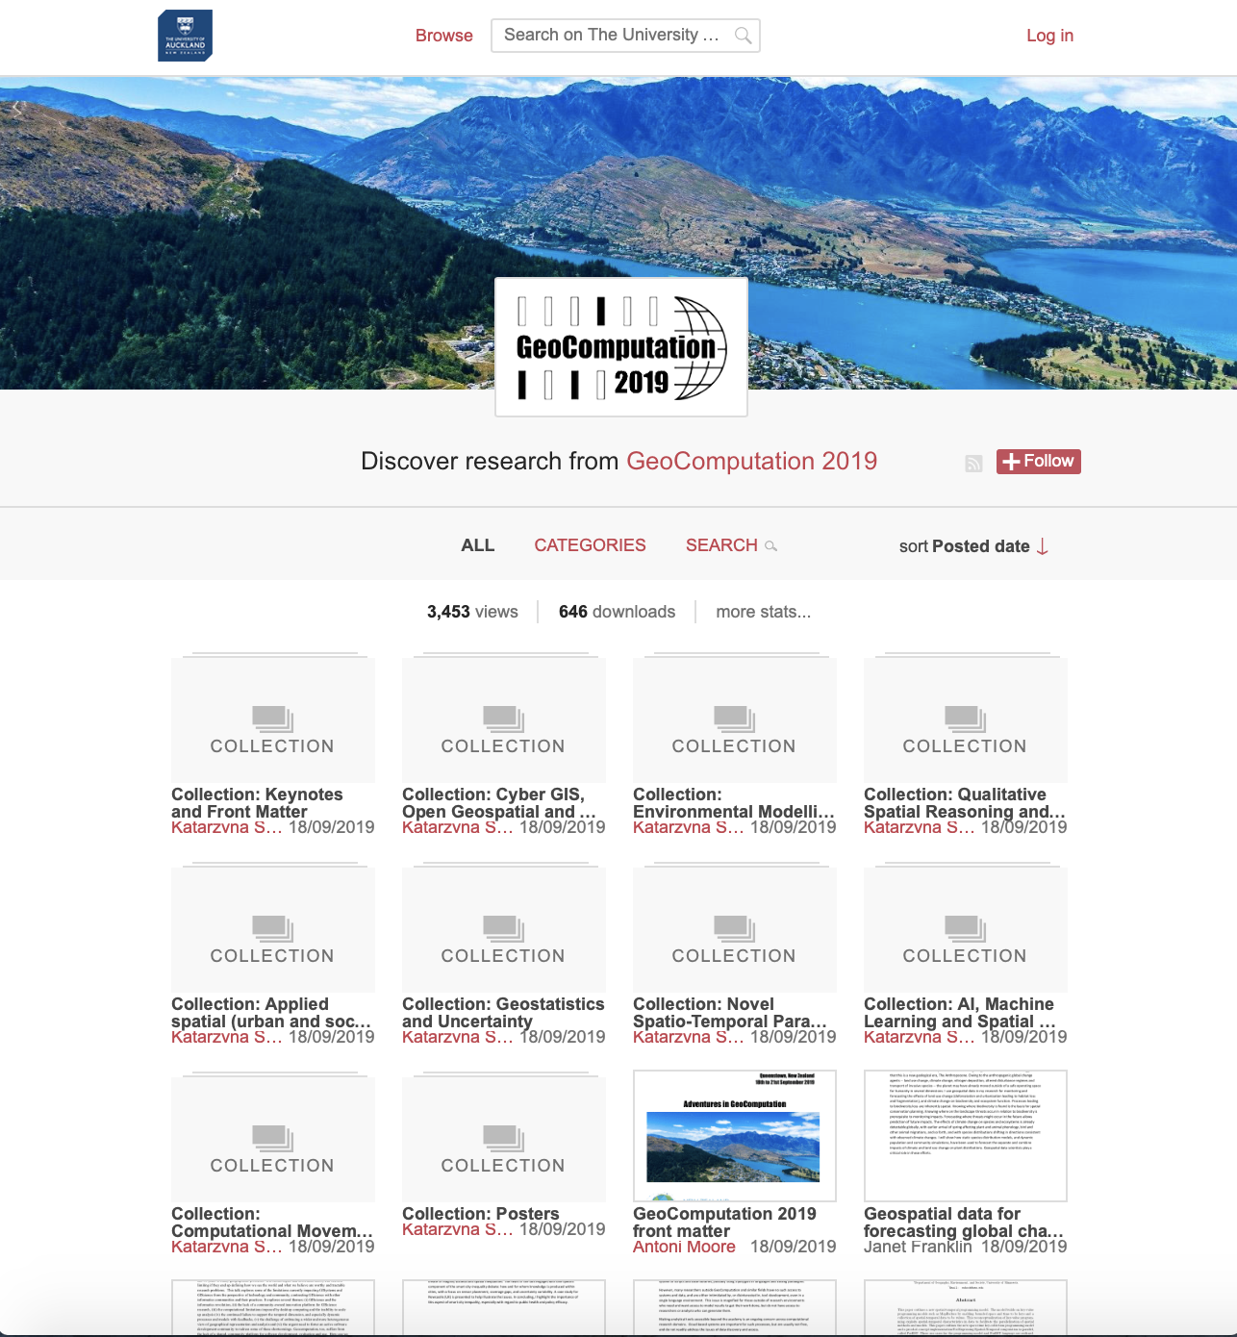
Meeting different needs
Conference /event - papers, presentations, posters e.g. APCWE, GeoComp., NeSI
Public engagement e.g. OPMCSA (branded DOI), PPI
Research group e.g. COMPASS (custom metadata), SciPoDS
Visual or other non-standard format e.g. OpenOptotypes
DOIs for items on existing website e.g. DEVORA (in-development)

Slide 6
Process
Name URL, admins, metadata fi
Researcher
Interest/Request
Consultation Why?
UoA?
Uploader(s)?
# Items
Timeframe
Examples
Open Ticket
Group details
Publish item(s)
Site public
LLS AE / RS
CeR
Create Group site
Make live (hidden)
Close ticket
Figshare support
Add branding
2-4 days
Notes:
2017- APCWE9 - process was a test.
2019 - streamlines the process.

Slide 7
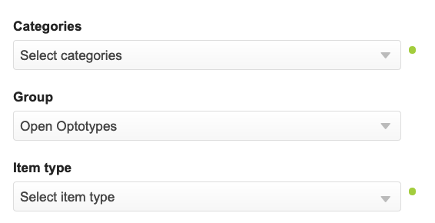
Publishing to Groups by user type
UoA uploaders are associated with 1 Group (e.g. Faculty), publishing to this group automatically
Group admins can publish to any associated Group via My Data & Collection metadata field (2019)
External uploaders or institutional uploaders not associated to Group
UoA Group X admin creates Project, setting storage to Group X
Invites collaborators to publish from Project
Project items are published to Group X
(Not able to create Collections)
Avoid publishing the Project

Slide 8
Thanks
Laura Armstrong
Senior eResearch Engagement Specialist
Centre for eResearch
l.armstrong@auckland.ac.nz @eResearchUoA

Slide 9
Links
Group structure [and use of Projects for non-Group admins to upload to Groups]: (login required) https://support.figshare.com/support/solutions/articles/6000153797-group-structure-and-subsequent-user-considerations-
Branding requirements: (login required) https://support.figshare.com/support/solutions/articles/6000149884-portal-branding-requirements
Projects: (no login required)
https://knowledge.figshare.com/articles/item/how-to-use-projects-and-collaborate-on-figshare
Batch editing: (no login required)
https://knowledge.figshare.com/articles/item/how-to-edit-in-batch

