Slide 1
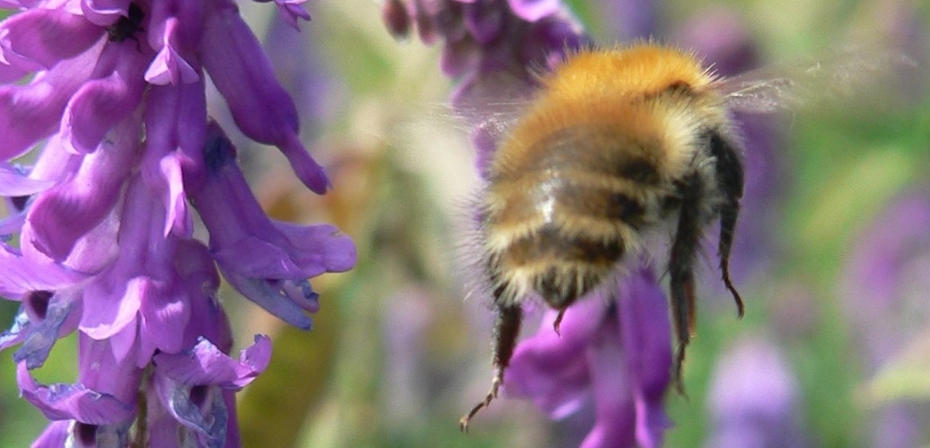
Towards an annual species distribution EBV for the United Kingdom
Nick Isaac
Tom August & Charlie Outhwaite
22/10/19
@drnickisaac
Notes:
Disclaimer: this talk was written with no knowledge of the MIS
Possibly add UCL logo

Slide 2
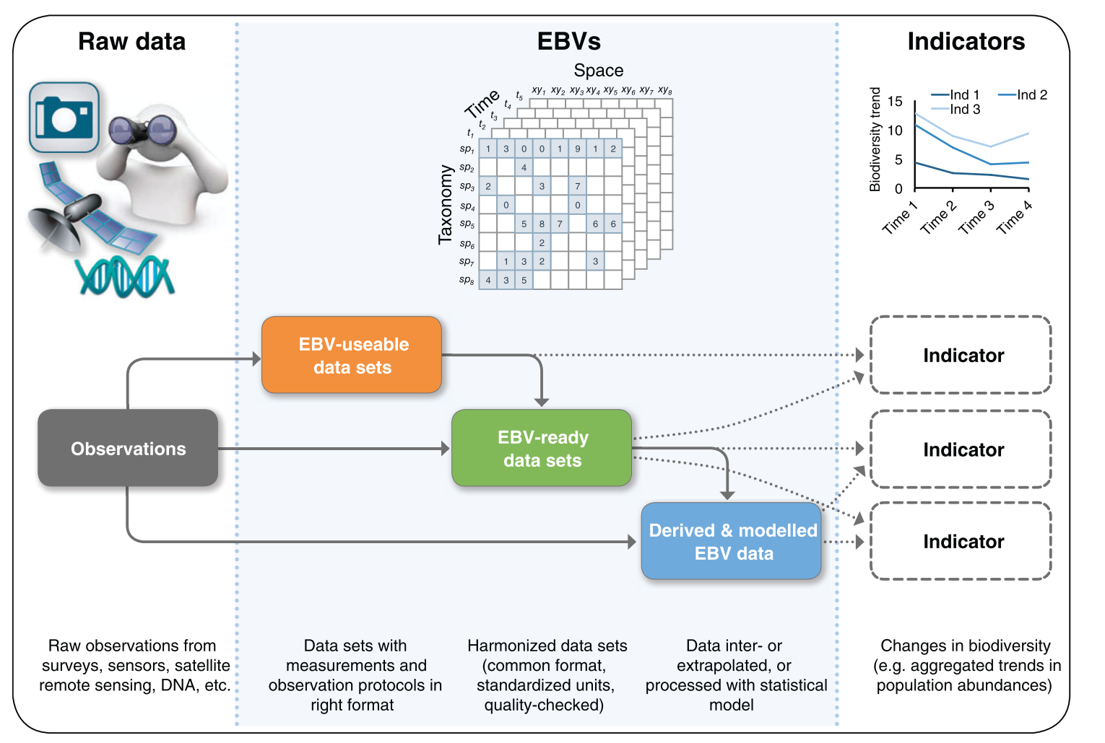
From observations to indicators
Kissling et al (2018) Biological Reviews 93: 600-625

Slide 3
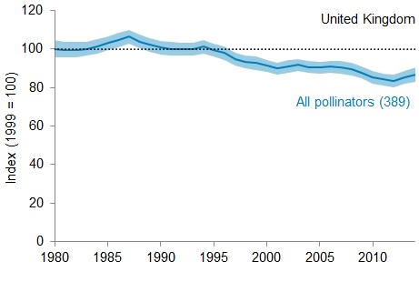
From observations to indicators
Observations
Database
Indicator
Statistical model
Species indices
y_{ij} |z_{it}

Slide 4
Talk outline
Occupancy trends from occurrence records
EBV Data product & Data paper
Doing it all again
Doing it better

Slide 5
Talk outline
Occupancy trends from occurrence records
EBV Data product & Data paper
Doing it all again
Doing it better

Slide 6
Ad hoc recording is biased
in time
in space
detectability
effort per visit
….....
Fortunately, we have Statistics
Isaac et al (2014) Methods in Ecology & Evolution 5: 1052-60
Isaac & Pocock (2015) Biol J Linn Soc 115: 522-531
Photo: Richard Comont

Slide 7
Occupancy models for occurrence records
State Model
(species trend)
y_{ijt}
z_{it}
Ψ_{it}
b_{t}
Observation
Model
u_{i}
p_{ijt}
a_{t}
Reverse-engineering the data collection process
L_{ij}
c
Isaac et al (2014) Methods in Ecology & Evolution 5: 1052-60
Outhwaite et al (2018) Ecological Indicators 93: 333-43

Slide 8
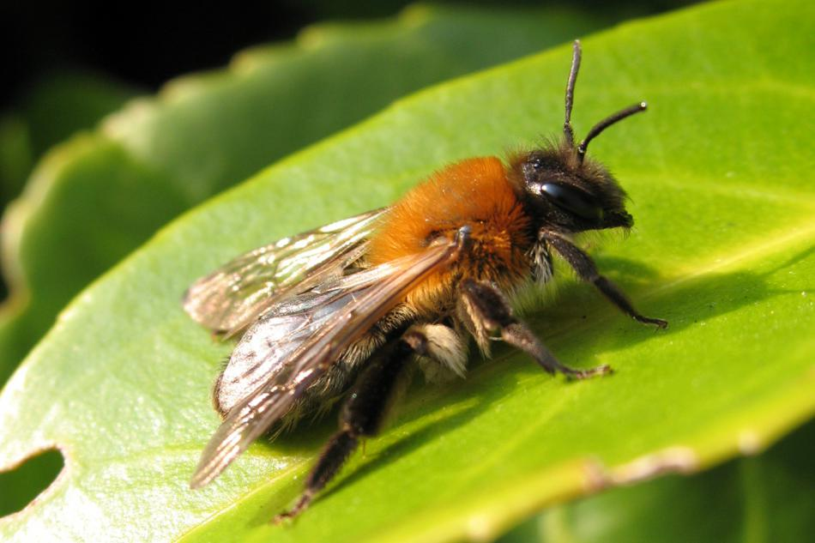
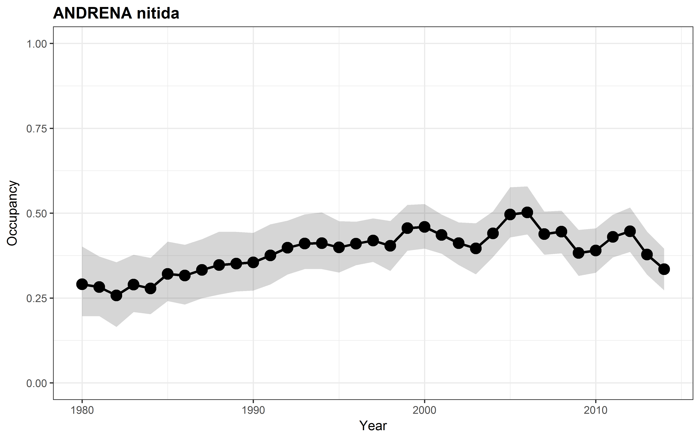
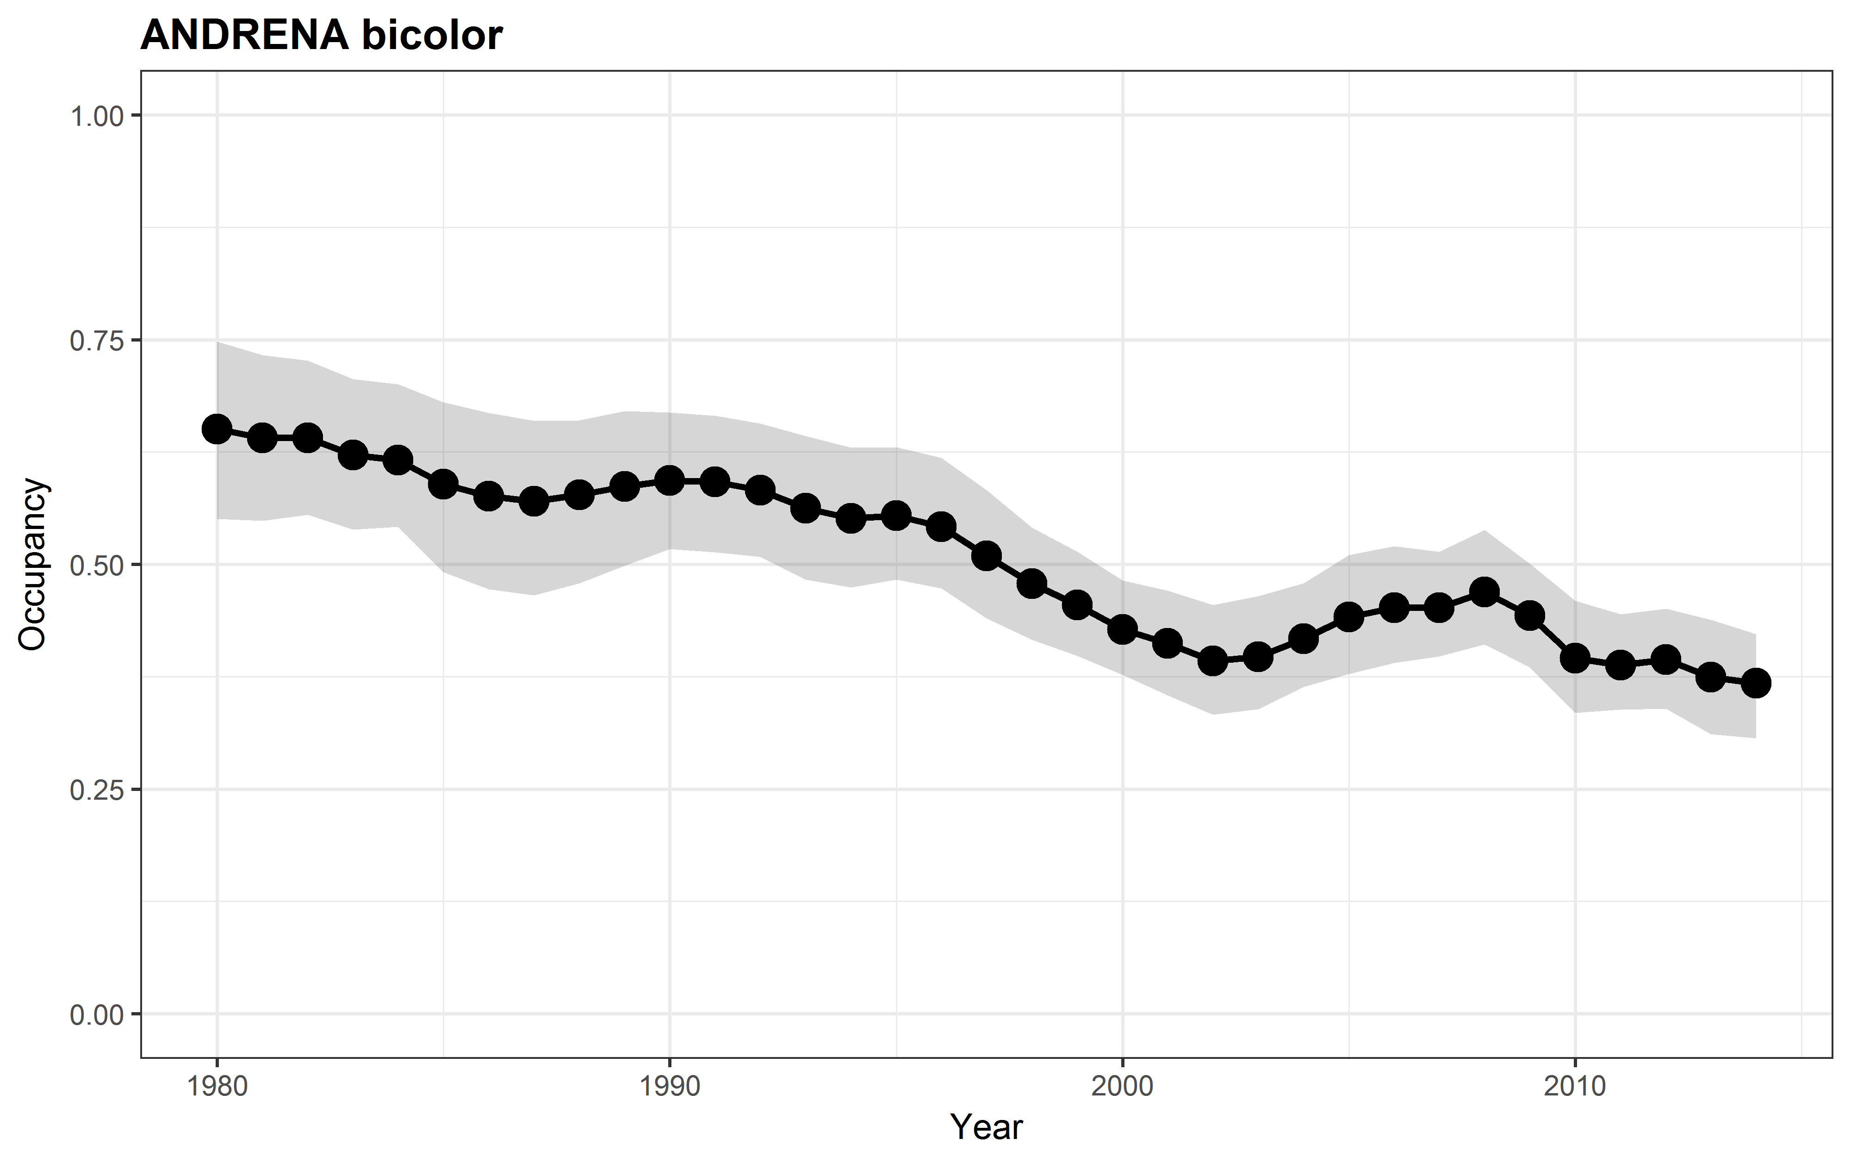
Occupancy model trends: bees
Andrena nitida
18% increase
Andrena bicolor
43% decline
Powney et al (2019) Nature Communications 10: 1018

Slide 9
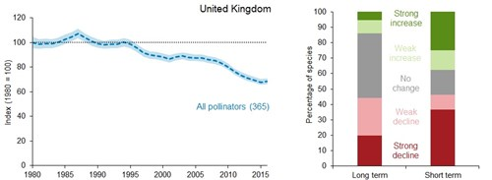
Indicator of pollinating insects (2019)
Net change: -33%

Slide 10
From observations to indicators
Observations
Database
Indicator
Statistical model
Species indices
y_{ij} |z_{it}

Slide 11
Talk outline
Occupancy trends from occurrence records
EBV Data product & Data paper
Doing it all again
Doing it better

Slide 12
EBV: Species indices as “data products”
Notes:
NB Species-richness and species’ occupancy are different margins of this cube.

Slide 13
EBV: Species indices as “data products”
Annual estimates of occupancy
Long term trend metrics
Summary stats + 1000 samples
46 years; 5293 species
Multiscale: UK, GB, England, Scotland, Wales
Outhwaite et al (2019) Environmental Information Data Centre
Notes:
NB Species-richness and species’ occupancy are different margins of this cube.

Slide 14
EBV: Data paper
Data Collation
Raw Data
24,118,549 records
10,750 species
(5,293 modellable)
Data Cleaning
Cleaned Data
Detection Histories
Detection Histories
Occupancy Modelling
Model Outputs: Posterior distribution of annual occurrence
Posterior Sample
1000 iteration sample of posterior distribution of annual occurrence
Species Trends
Annual growth rate of each species and associated credible intervals
Outhwaite et al (2019) Scientific Data in press

Slide 15
Talk outline
Occupancy trends from occurrence records
EBV Data product & Data paper
Doing it all again
Doing it better

Slide 16
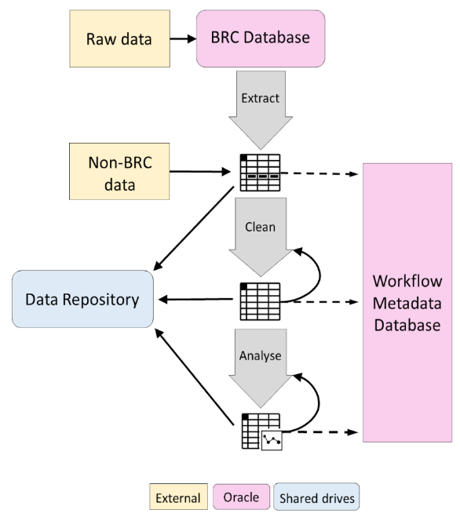
Workflows & auditing
Each year the data grows
The model structure becomes more refined.
Keeping track of model outputs requires good book-keeping!
Notes:
Something from Alex’s work. Mark, Jack & Gary are working on this.

Slide 17
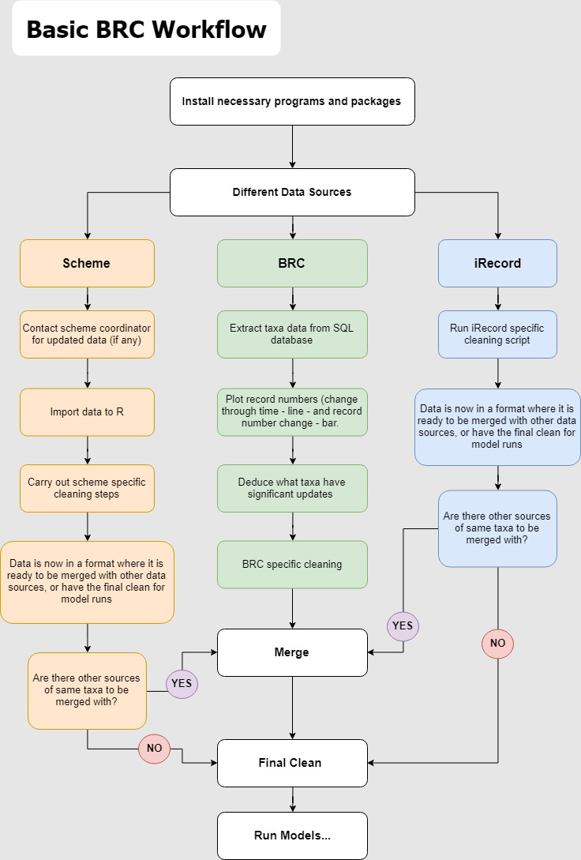
Occupancy modelling workflow
Data Collation
Raw Data
Data Cleaning
Cleaned Data
Detection Histories
Detection Histories
Occupancy Modelling
Model Outputs: Posterior distribution of annual occurrence
Posterior Sample
1000 iteration sample of posterior distribution of annual occurrence
Species Trends
Annual growth rate of each species and associated credible intervals

Slide 18
Future data products
Which metrics?
How frequently?
At what scale?
How should we publish them?
Do we meet the EBV Minimum Information Standards?

Slide 19
Talk outline
Occupancy trends from occurrence records
EBV Data product & Data paper
Doing it all again
Doing it better

Slide 20
Common data types are inter-related
1
✓
✓
2
4
0
✓
✗
spatial observation bias
imperfect detection of individuals
imperfect detection of species
0
✗
1
✓
2
0
✓
✗
Presence-only data
Count data
Presence-absence data
Isaac et al (2019) Trends in Ecology & Evolution (in press)

Slide 21
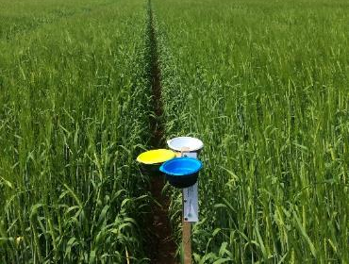
Integrated models: Pollinator Monitoring Scheme
Unstructured
Presence-only
>1000 sites (biased)
Citizen science
time
✓
✗
✗
✓
✗
✓
Model of recorder behaviour
✓
✗
time
✓
✗
✓
✗
✓
✓
✓
Repeated recording visits
✓
✓
✓
✓
✗
Standardized, replicated protocol
Presence-absence
75 random sites
Professional ID
✓
✗
✓
✗
time
True site occupancy
✗
✓
✗
✓
Model of detectability
✗
✓
✓
✗
✓
✗
✓
✗
Repeated pan traps

Slide 22
From observations to indicators
Observations
Database
Indicator
Statistical model
Species indices
Observations
Database
Indicator
Statistical model
Species indices
y_{ij} |z_{it}

Slide 23
Summary
We can model species’ status with occurrence data
Annual updates are becoming feasible
Conformance with EBV minimum standards?
Integrated modelling across data types will soon supplant occupancy modelling

