Slide 1
ORCID: Implementation and effective use at UQ
Dr Susan O'Brien
Program Manager
Research Management Business Transformation
Dr Elena Danilova
Manager
Scholarly Publishing
Library
https://research.uq.edu.au/rmbt/orcid

Slide 2
UQ research has impact
From science and sustainability to health and humanities – right across the world, every day
#1 in Australia
100%
~$750 million
Nature Index tables (2019)
of UQ research at or above world standard (ERA, 2018)
in research funding (2018)
31 per cent increase
in global partners since 2013
180 fellows
of learned academies are UQ staff and professors emeriti
14,500+ PhDs awarded since 1952
Notes:
UQ is one of Australia’s top research-intensive universities, not just for research quality and output, but also for the scale of our operations and breadth of our impact across disciplines.
Our reputation for creating change through research and commercialisation means we are a hub for curious minds who innovate and explore.
Our strong focus on innovation-led entrepreneurship and commercialisation, facilitated largely by our commercialisation company UniQuest, ensures we have clear pathways to develop these ideas into real products and assets that create positive change.
Some of our research achievements to date include:
developing the world’s first cancer vaccine that could save an estimated 250,000 lives per year.
empowering four million families to create the kind of environments where children can flourish.
developing superconductor technology used in two-thirds of the world’s MRI machines.
Slide last updated June 2019. Sources: Nature (research.uq.edu.au/about/international-rankings), funding and ERA (Research Impact flyer), PhDs (student progression – contact Tess Robinson), Fellows (UQ Annual Report)

Slide 3
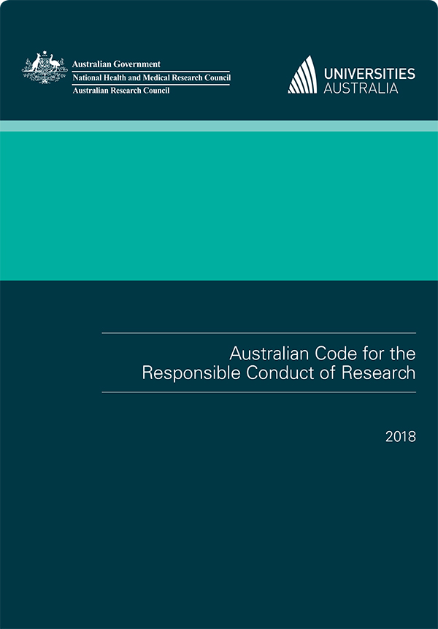
Research Management Business Transformation
Connectivity!
Enterprise systems to support researchers
Transparency and efficiency
Improved reporting capabilities
Better decision making
Research compliance and integrity
Notes:
Significant program of investment 2017- 2022
Progressively transforming the way research support and administration is delivered at UQ:
Research compliance and integrity within the research lifecycle
Transparency and efficiency for HDR Candidates, researchers and research managers
Services to support research
Improved reporting capabilities for individual researchers and the institution
Accurate data in real time to support better decision making
Connectivity is key
Supports:
Responsible Research Conduct
National Innovation and Science Agenda
Engagement and Impact
NHMRC Research Quality Strategy

Slide 4
ORCID: A key component of Research Management Business Transformation at UQ
Research management
Incorporated as an attribute of Single Sign On
Required before log in to new research and ethics management system
Research Infrastructure Management system will link publications to instrument use
Already in use at UQ for ARC grant rounds
Time saving
Data management
RDM records linked to researcher and research publications arising from data
Intrinsic component of integrity
Research outputs management
12,000+ publications per year
Accuracy
Time saving

Slide 5
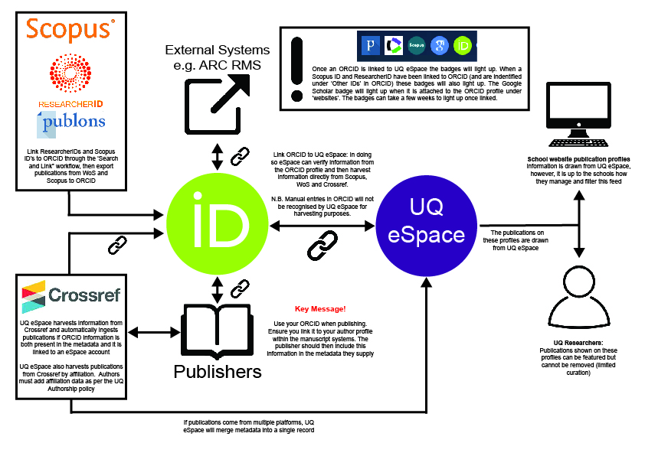
ORCID UQ Systems Integration

Slide 6
Success with Systems
Advantages to researchers and UQ:
UQ has harvested 8150 unique dois for UQ staff with linked ORCIDS
Publications as far back as 1978 are being collected as publishers add dois for older content
Researchers with authenticated ORCIDs in the publisher manuscript system benefit as additional outputs are registered with Crossref
There are 12277 doi-ORCID combinations for these 8150 unique dois

Slide 7
Success with HDRs
ORCID is:
Mandatory for all UQ HDR candidates
A requirement for HDR milestone completion
Included as a field in the UQ HDR thesis template
A requirement for thesis submission
Additionally:
HDRs with paid employment at UQ are encouraged to link their ORCID to their staff profile to provide ease of merging the profiles post-graduation
ORCID will be used to track careers of UQ PhD Graduates

Slide 8
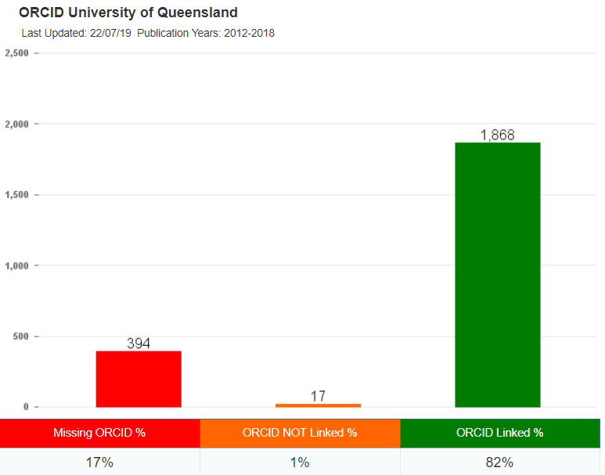
Success with Academic Staff Engagement
83% of all level B-E academic staff have authenticated ORCIDs
79% including level A (high churn at level A)
ORCID flows through to the identity management system and are available as an eduperson attribute
Academic staff actively engaged in using ARC’s RMS ORCID integration in the grant application process (early 2019)
High rewards for academics with active ORCID use
e.g. Professor Yusuke Yamauchi of AIBN has harvested 130 pubs via ORCID in Crossref

Slide 9
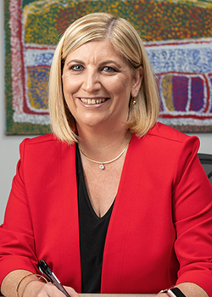
Success strategy for ORCID at UQ
Senior leadership champions - DVCR and other Senior Executive
Project funding: Research Management Business Transformation
UQ Library team dedicated to promote ORCID use:
Assisting researchers and HDR candidates establish and curate their ORCID and link to UQ systems
Supporting Research Leaders to explain benefits and set up exemplar profiles
Coffee shop ORCID drop-in sessions
University-wide promotional events
Comprehensive up-to-date LibGuides
Automated emails prompting researchers to link/create ORCID
Adding capability to export publications to ORCID profile (particularly needed for non-traditional research outputs)
Ensuring ORCID is actively linked to all relevant UQ systems

Slide 10
Challenges - external
Publishers not all sending information to Crossref to indicate authenticated ORCIDs (most are coming in with an N rather than a Y in this field)
We have had cases where the published article online has the author ORCID displayed, but the publisher did not send the data to Crossref – we approached one publisher and they rectified this
Databases mapping varies: e.g. Scopus ISSN problem
ORCID should be given priority when it comes to disambiguation: e.g. ORCID linked to Scopus, published with ORCID, new affiliation, cross disciplinary publication > new Scopus Author ID created
More collaboration needed when big changes are planned to be implemented, e.g. Merge of RID and Publons – link inactive under ORCID Trusted Organisations for a long period of time, no clear path to export publications from Publons to ORCID
Notes:
Most publishers are not sending info to crossref to indicate the ORCIDs they have are authenticated (most are coming in with an N rather than a Y in this field – which may not reflect what publishers are actually doing but does highlight that they are not sending the full details to crossref). We have also had cases where the published article online has the author ORCIDs displayed, but the publisher did not send the data to crossref – we approached on publisher and they rectified this.

Slide 11
Challenges - internal
HDRs have 100% ORCID uptake but many are still confused about what an ORCID is.
There is fear that Publishers will look at the ORCID and not accept a paper because they have no prior publications.
Researchers may mistake integration with automation.
They need to Create ORCID > Link to the university systems > Curate ORCID profile > Use ORCID ID when publishing
Notes:
Most publishers are not sending info to crossref to indicate the ORCIDs they have are authenticated (most are coming in with an N rather than a Y in this field – which may not reflect what publishers are actually doing but does highlight that they are not sending the full details to crossref). We have also had cases where the published article online has the author ORCIDs displayed, but the publisher did not send the data to crossref – we approached on publisher and they rectified this.

Slide 12
There is no time to rest on our laurels! More work is needed and work is underway. Thankyou! ☺ Any questions?
Dr Susan O’Brien | RMBT Program Manager
Office of the DVCR
s.obrien@research.uq.edu.au
07 33432013 | 0403 901840
Dr Elena Danilova| RMBT Program Manager
UQ Library
e.danilova@library.uq.edu.au
|

