Slide 1
Integrating ORCiD with corporate systems: a case study at the University of South Australia
Karen Ayles, Acting Research Connections Librarian
Tracy Quixley, Acting Discovery Services Coordinator
Notes:
Introduction
Introduction & acknowledgment of James & Cathy.
Together, we are going to give you a brief overview of the work we have been doing at the University of South Australia as part of our ORCID Integration project.

Slide 2
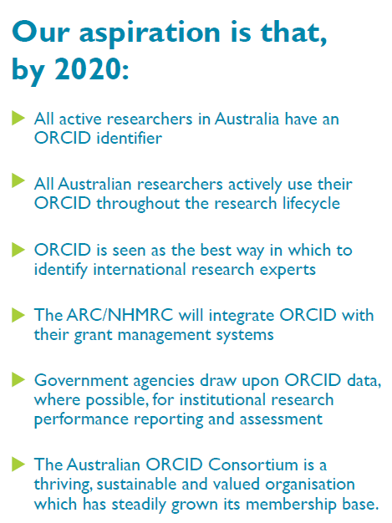


AAF’s vision
Australian Access Federation 2017, ORCID Australia Vision 2020, AAF, viewed 30th April 2019, https://aaf.edu.au/media/2017/ORCID/ORCID_Aust_Vision_FIN_LR_20170706.pdf.
Notes:
Use of ORCID iDs
The Australian Access Federation outlined in its vision for 2020 the goal that all active researchers in Australia have an ORCID identifier, and that they actively use their ORCID throughout the research lifecycle.
The UniSA Library has been working for the last three years to encourage our researchers to create an ORCID iD and keep their profile up-to-date.

Slide 3
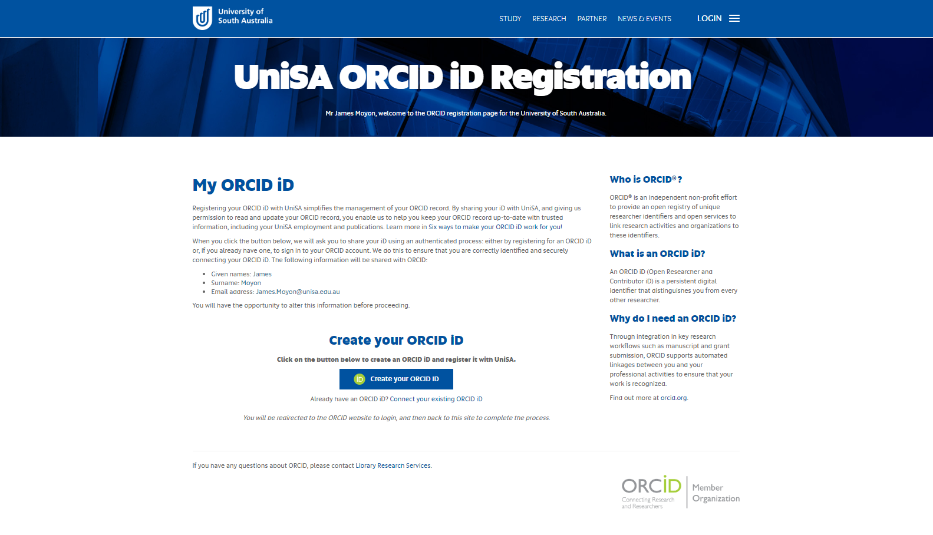
Notes:
UniSA ORCID iD Registration
The first step in our project to integrate with ORCID was to provide functionality for our researchers to authorise UniSA as a Trusted Party to their ORCID record.
This allows UniSA to read a researcher’s ORCID record, to contribute data to selected sections, and to push a researcher’s ORCID iD to other corporate systems, thus maximising the impact of their ORCID iD.

Slide 4

ORCID RMS Integration
Australian Research Council 2018, ORCID integration into RMS, ARC, viewed 30th April 2019, https://www.arc.gov.au/news-publications/media/feature-articles/orcid-integration-rms.
Notes:
Integration between ORCID and ARC RMS
One of our first aims was to create system interfaces to enrich our researchers’ ORCID records with affiliation and publication date for use in the 2020 ARC Discovery Project applications.

Slide 5

ORCID Integration project
Notes:
Integration with ORCID
We developed processes to add employment affiliations from UniSA’s HR system, however this has since disabled as there were challenges regarding the position details. The main process was around pushing publication from the UniSA Research Outputs Repository into ORCiD.
This functionality reduces the need for researchers to manually keep their ORCID profiles up-to-date.

Slide 6
ORCID Integration project
Notes:
Harvest of data from ORCID
The second part of the process was to create a process to import publications from ORCID records into the UniSA Research Outputs Repository.
This facilitates on-boarding of new researchers, particularly for ERA reporting.

Slide 7
ORCID Integration project
Notes:
Impact on downstream systems
(The bigger picture)
Following ORCID’s mantra of “Enter Once, Reuse Often”, UniSA is committed to making the best use of our researchers’ ORCID data, and to feature their ORCID iD whenever possible.
ORCID iDs were already featured on our Staff Home Pages and our Research Data Access Portal, and are integrated into our HR system and our custom Data Management Planning System.
As part of the project, ORCID iDs have now been added to our Library’s catalogue search, which is based on Ex Libris’ Primo cloud-based software. This allows for searching by ORCID iD and therefore makes it easier to disambiguate/identify authors.

Slide 8
ORCID Integration project
Notes:
ORCID iDs for HDR candidates
As of 2019, ORCID iDs have been mandated for HDR candidates at UniSA.
To support this, we developed a process to import HDR ORCID iDs into our (Medici) student system.
Our next development will be to provide the same ORCID record enrichment interfaces for HDR candidates as we do for staff. (e.g. ORCiD badges on SHP)

Slide 9
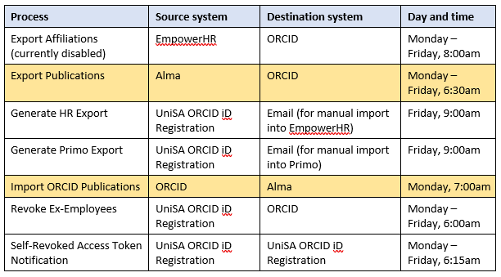
Schedule for all ORCID scheduled processes
Notes:
Schedule for all ORCiD scheduled processes
To have all these processes run seamlessly, we have to rely on a well planned schedule
Publication tasks from Alma to ORCiD are highlighted in yellow:

Slide 10
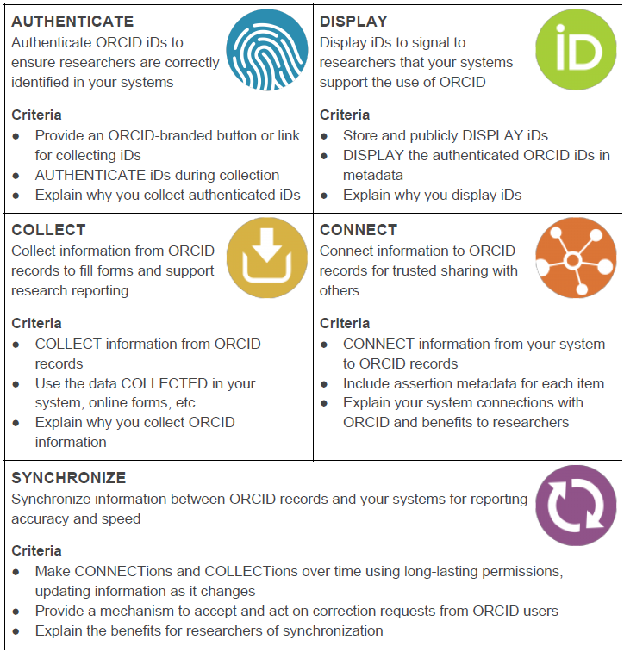

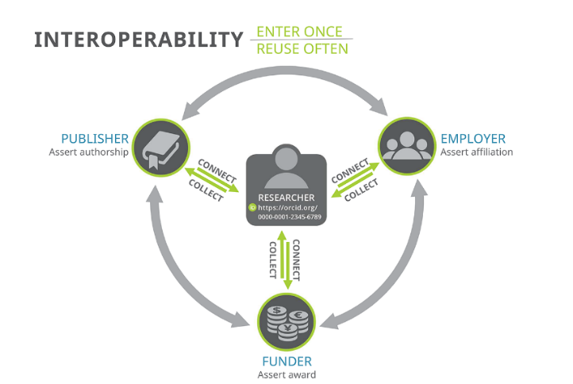
ORCID Collect & Connect Program
ORCID 2018, Welcome to Collect & Connect: ORCID’s integration and engagement program, ORCID, viewed 30th April 2019, https://orcid.org/content/collect-connect.
ORCID 2018, ORCID’s Collect & Connect Program: Badges and sample communications text, viewed 30th April 2019, https://figshare.com/articles/ORCID_s_Collect_Connect_Program_Badges_and_sample_communications_text/6391325.
Notes:
ORCID Collect & Connect program
In terms of the Collect & Connect program we’ve receive 3 out of the 5 badges.
After providing a demo of our system interfaces to ORCID, ORCID found us to meet the requirements for several of the badges, including Authenticate, Display, and Connect.

Slide 11
User Acceptance Testing (UAT)
Each phase involved testing by researchers, PhD students or professional staff:
  Empower HR and Primo
  Revocation
  Affiliations
  ‘Push’ outputs Alma > ORCiD
  ‘Pull’ outputs ORCiD > Alma
Notes:
User Acceptance Testing (UAT)
Each phase involved testing by researchers, PhD students or professional staff (Library, ISTS, HR).
As plans were completed the feedback was reviewed and changes implemented.

Slide 12
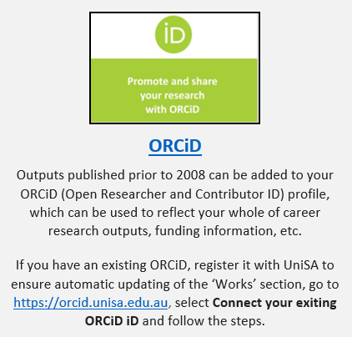
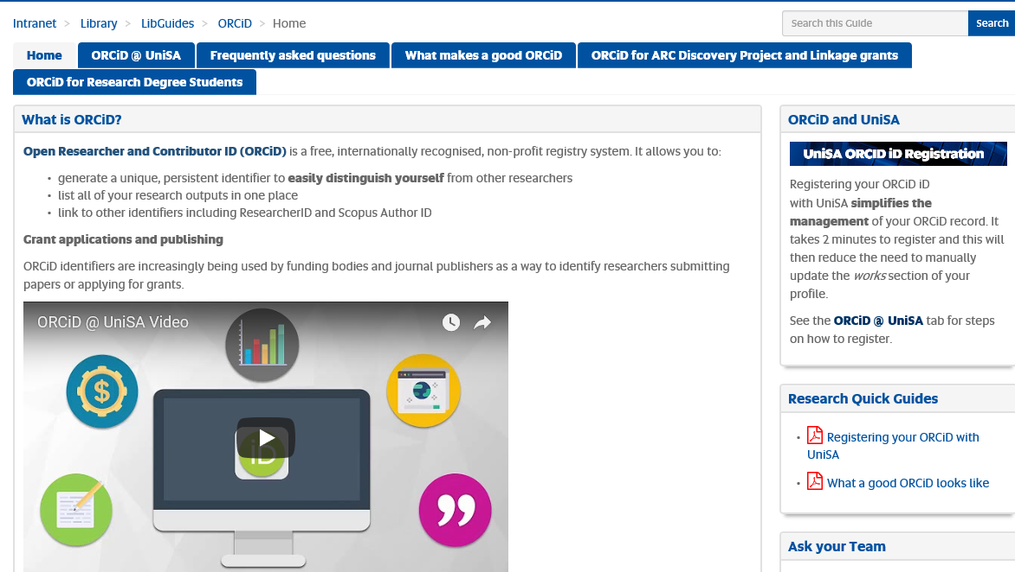
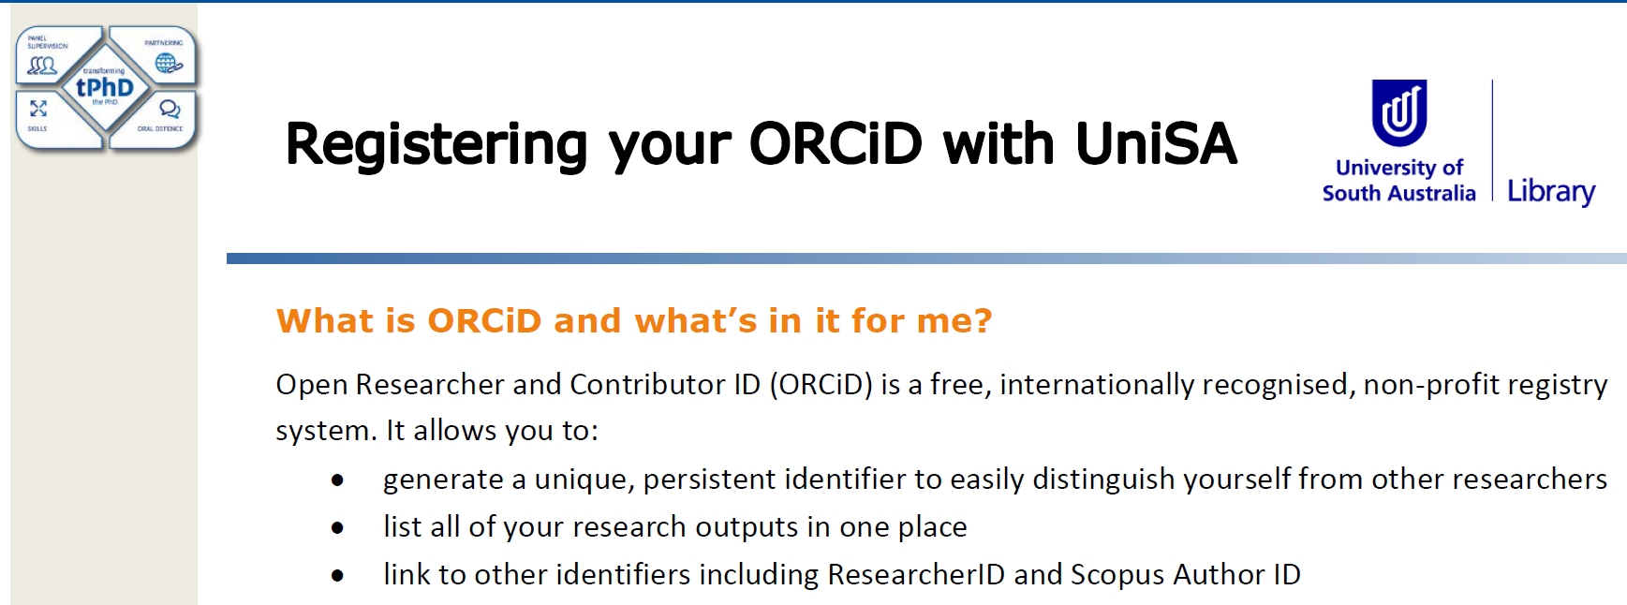

Communication plan
Notes:
Comms
A comprehensive communication plan was developed, and the ORCiD Research Guide provided a one stop shop for all things ORCiD to our clients
Including:
Staff portal
90-second video
Targeted emails
School Board and Research Committee presentations and reports
Research@UniSA seminar; Early Career Researcher presentation
Email signature file
ARC grant applicants
Welcome new staff emails

Slide 13
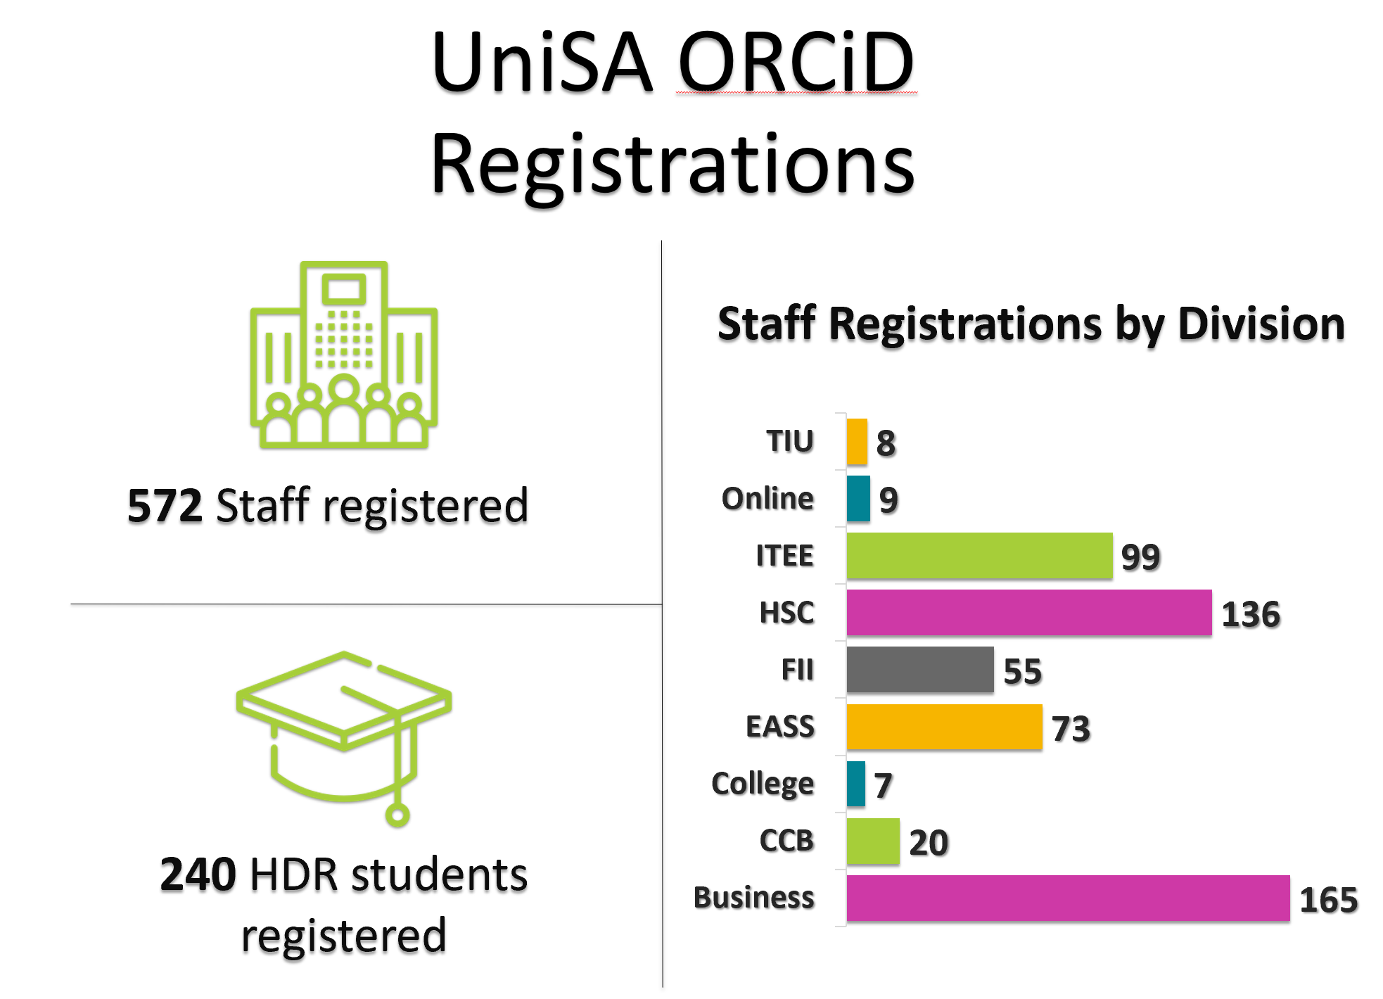


Some statistics
First-time UniSA ORCID Data Harvests
10673 publication metadata records uploaded to ORCID
1988 publication metadata records downloaded to UniSA Research Outputs Repository
Notes:
Some statistics
So far over 501 staff have registered their ORCiD with UniSA, 54% of total known staff with ORCiD profiles
Over 10 000 output metadata records have been matched or uploaded to these ORCiD profiles
Almost 2000 output metadata records have been sent to the Repository from ORCiD profiles

Slide 14
Key achievements
✓ Strong take-up in user registrations/system engagement
✓ Reduced administrative burden
✓ New efficiencies in staff on-boarding
✓ Increase in overall number of outputs being harvested
✓ Enhancement to UniSA’s research profile
✓ Used to auto-populate outputs in ARC’s Research Management System
Notes:
Key achievements
There were a number of achievements, including:
When we process the research outputs of staff who have joined UniSA, we can bring all their outputs into Alma using their ORCiD. Including their ORCiD is part of the recruitment process, and when Academic Librarians meet with new staff they are encouraged to register straight away
ORCiD is a more comprehensive and timely source for outputs
And many researchers used ORCiD as a way to auto-populate their outputs into the ARC Research Management System.

Slide 15
Testimonial
“By registering my ORCiD with UniSA I know that all of my publications will be captured and automatically updated to my staff home page. This has been a great help to me!”
- Prof Alison Coates, School of Health Sciences
Notes:
Testimonial

Slide 16
What’s next?
PART 1
Using ORCiD for accreditation processes
ORCiD on thesis title page
Academic Librarians continue to exploit opportunities to engage with staff about their research
Short workshops for HDR students to learn about ORCiD and how it fits into the research lifecycle
Notes:
What’s next?
Part 1
We are currently exploring how we can use ORCiD to ensure we have all research outputs in the Repository for national and international accreditation, e.g. EQUIS.
For the HDRs students, we are offering 30-minute workshops about ORCiD, and we are already starting to see theses coming through with the ORCiD iD on the thesis title page.
From a more reporting side:
We can’t see when somebody registers their ORCiD with UniSA is their profile is public or private. We would like our reports to reflect this in the future.
We want our reports to show if ORCiD profiles are correctly set-up with Scopus, RID, Crossref, etc. Which means we want our reports to show us what is misconfigured so that our Academic Librarians …..
Reengineer our onboarding process of new staff
Work together wit grant winners

Slide 17
What’s next?
PART 2
Are ORCID profiles public or private?
Correctly set-up profiles?
Streamlining the onboarding process of new staff members
Collaborate with grant winners
HDR registrations count
Export affiliations re-instated
Notes:
What’s next?
Part 2
At the moment we can’t determine whether an ORCiD profile registered with UniSA, is made public or private. We would like our reports (which we get from our IT department) to reflect this, so that we can contact academics/researchers and request for private profiles to be made public.
We want our reports to show if ORCiD profiles are correctly set-up with Scopus, RID, Crossref, etc. (by this, we mean adding them as trusted organizations). And if not, we would like to ask our Academic Librarians to contact the particular researchers and academics to offer support.
Re-engineering our onboarding workflow of new staff – currently it’s a very a manual process so consequently we would like to explore the feasibility of not adding research outputs manually, but rather trust that they are in ORCiD and that we can simply pull them in.
Work together with grant winners to ensure that their ORCiD profiles are as such that it can be seamlessly exported to the RMS (Research Management System) of the ARC
At the moment we don’t have the ability to report on HDR registrations ourselves (we can’t see the numbers – which means we can’t measure our success). We have to contact our IT department and submit a special report for it.
And lastly, export affiliations – our HR system is currently disabled. We got it to work, but the position details of UniSA staff were a challenge.

Slide 18
Lessons learned
Great collaborative opportunity for ISTS and Library staff to work together to share knowledge and upskill
Be clear about identifying business requirements and resources
Translate jargon/code so both teams understand each other
Notes:
Lessons learned
This was one of the first big joint projects that the Library and IT worked on together, involving Steering Groups, Project Teams, end-users and loads of documentation and testing!
As the project evolved, we learnt to double-check that we were speaking the same language and work towards agreed outcomes and timelines. Communication, both written and oral was crucial, as was sharing knowledge and expertise between the teams.
The ORCiD@UniSA integration project truly embraced the University's mantra of a One Team approach.

Slide 19

UniSA ORCiD video
Notes:
Video
ORCiD – NHMRC.
Mention this is a future development.

Slide 20
James Moyon, Senior Information Technologist
James.Moyon@unisa.edu.au
Cathy Mahar, Research Connections Librarian
Cathryn.Mahar@unisa.edu.au
Notes:
Introduction
Thanks to James and Cathy

