Slide 1
ORCID@CSIRO
Leanne Griffiths
Senior Manager Information Outreach
CSIRO Information Management & Technology
8th October 2019
Notes:
Today I am going to share with you our journey in the past 12 months, talk about how the integration went, some of the success stories, our current challenges and what plans we have for the future.

Slide 2
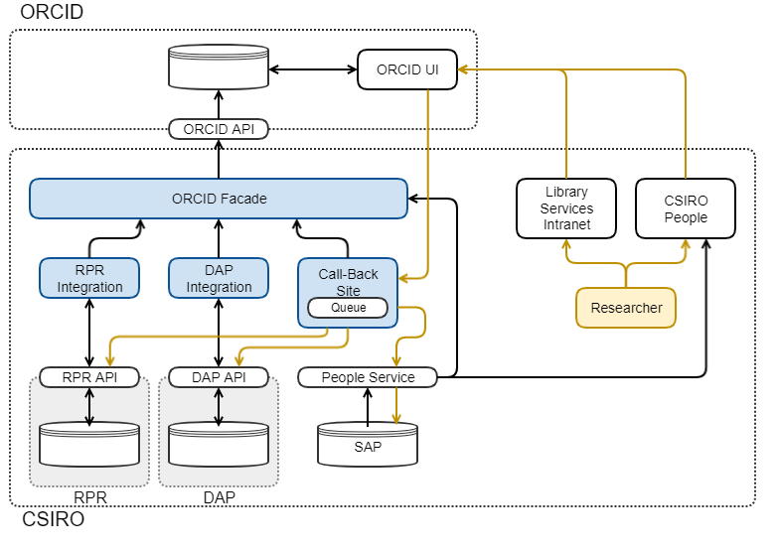
ORCID@CSIRO integration – what did we do?
Notes:
ORCID profile automatically updated with output captured in CSIRO Research Publications Repository and CSIRO Data Access Portal.
ORCID badges on records in CSIRO DAP, RPR and CSIRO People
Types include Publications, Conference, Intellectual Property and Other
- Software from data and resources for facilities and collections

Slide 3
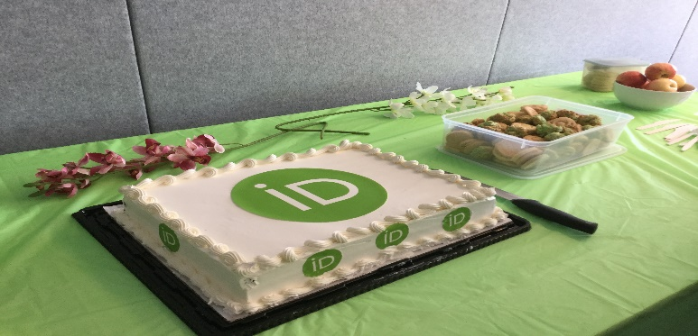
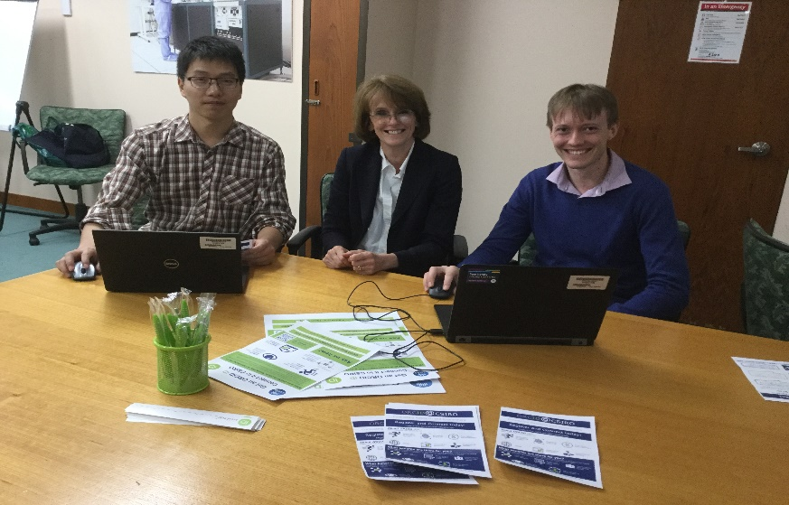
ORCID @CSIRO
Launched February 2019
Over 1,100 connections in first 6 months
Recognition from ORCID as best practice integration
Notes:
October 2018, 550 current employees had an ORCID profile, 116 different ways of presenting CSIRO affiliation (eg CSIRO, Commonwealth etc, Division of Animal Health), no connectivity between systems

Slide 4
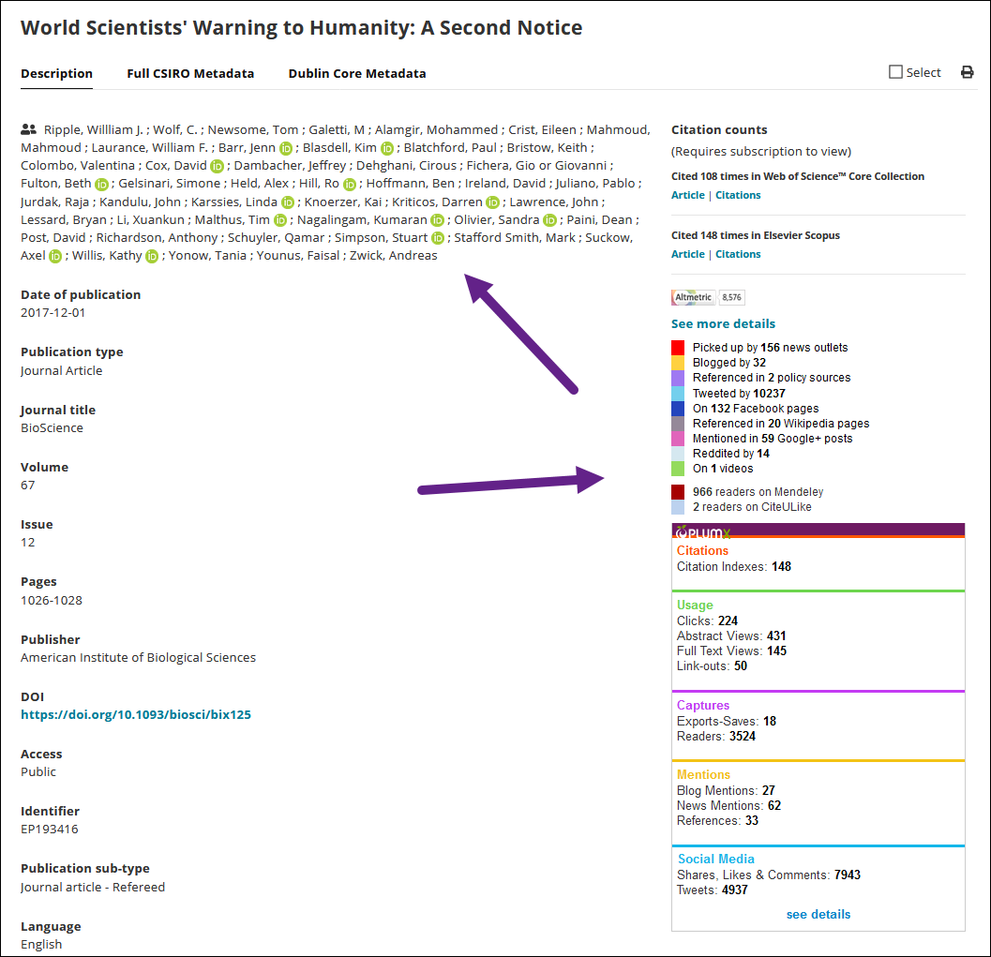
ORCID @CSIRO
Notes:
CSIROs top scoring record in Altmetric. With the projects dedicated to adding DOIs to content, the number of records in Altmetric Explorer for Institutions has grown to 39,306

Slide 5
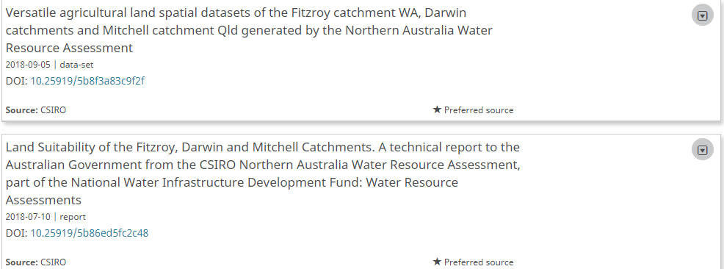
ORCID @CSIRO

Slide 6
ORCID@CSIRO
Notes:
Reporting

Slide 7
ORCID@CSIRO
Notes:
The next few slides will show the reporting that we have initiated

Slide 8
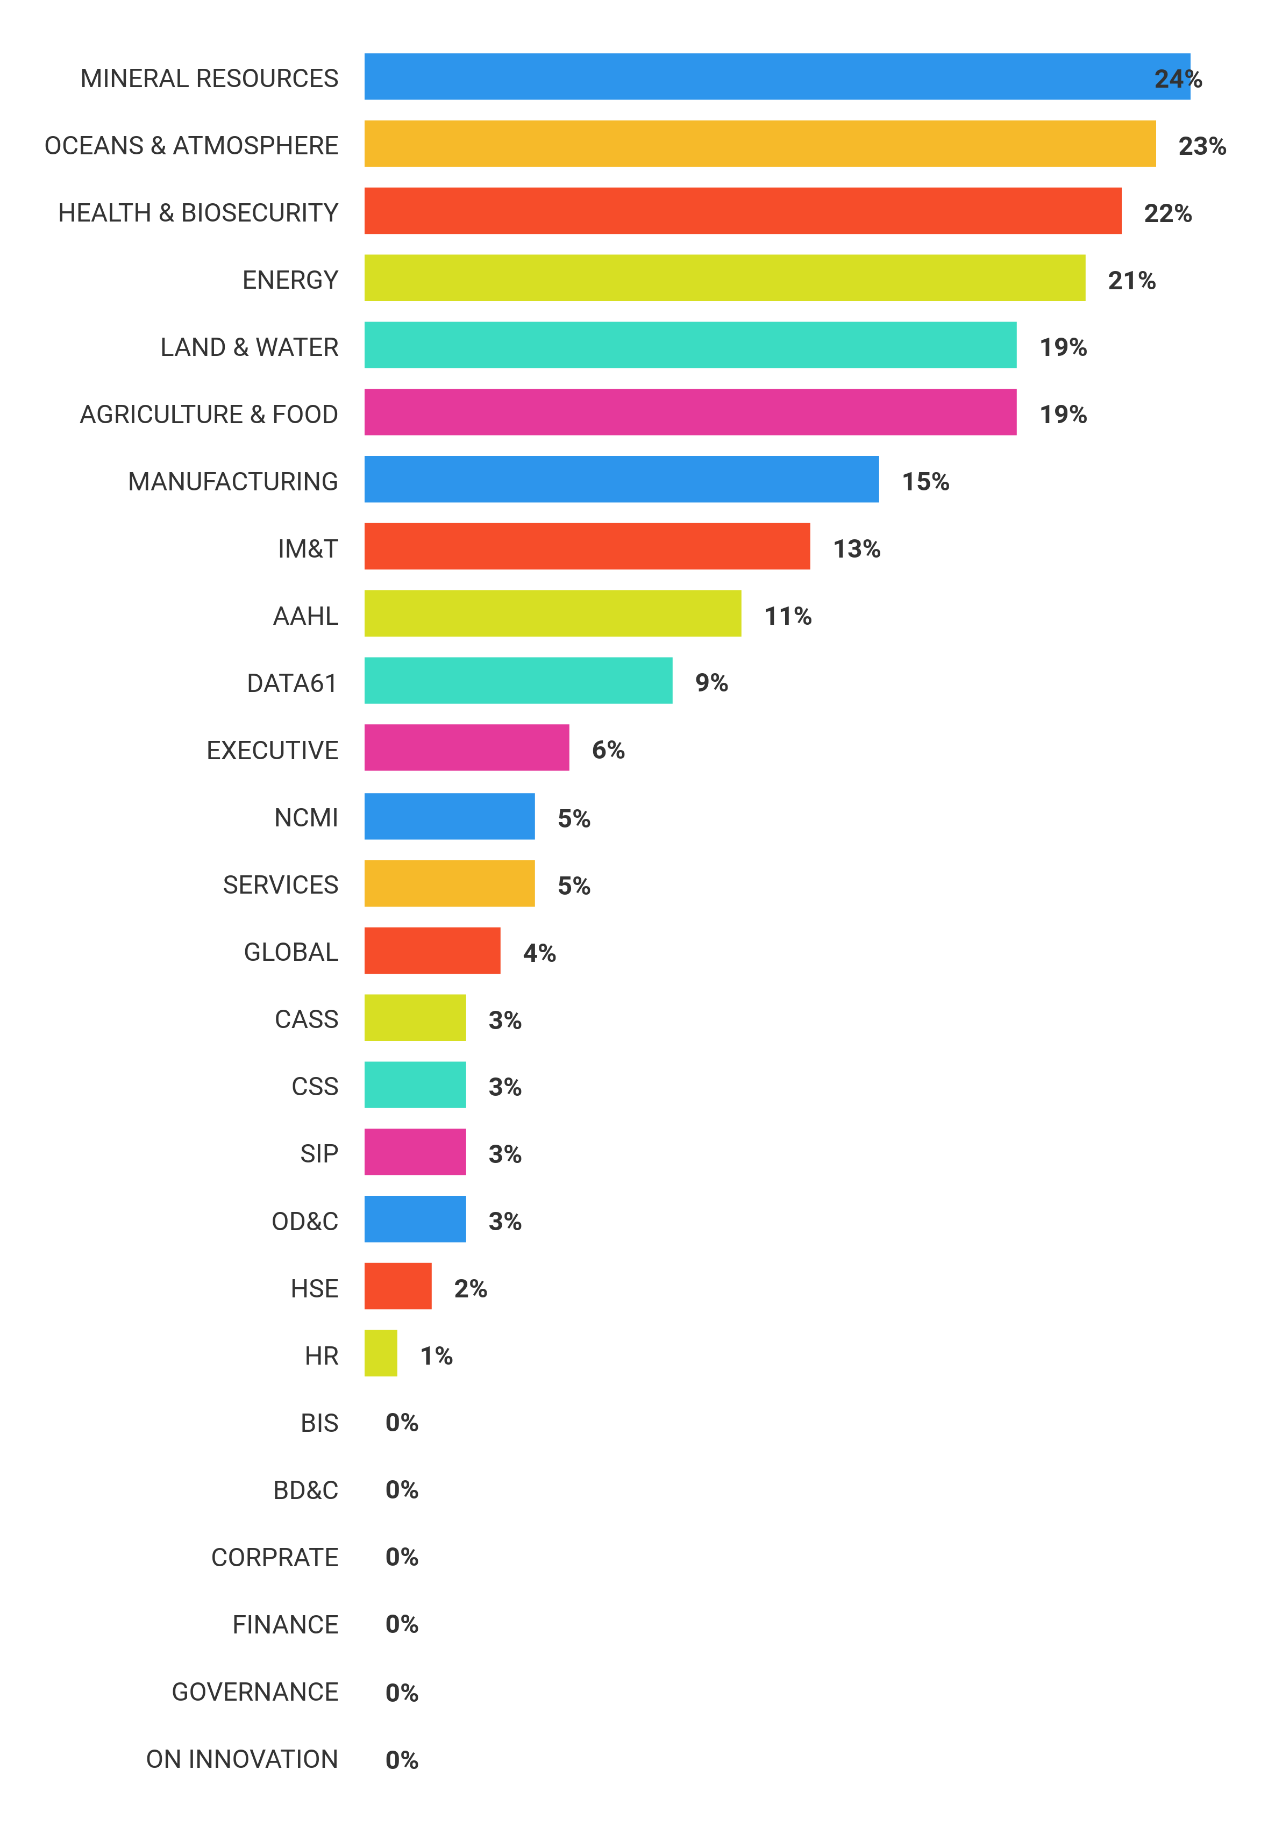
ORCID@CSIRO

Slide 9
ORCID@CSIRO – successes & challenges
Successes
Sustained uptake
Over 1,100 connections in 6 months
Support from senior management
Challenges
Continuous rollout (new employees etc)
Knowing if a problem is at our end or with ORCID
Retaining ORCID permissions for cessations
Still to tackle “removed permission” use case
Collecting and storing ORCID (and access tokens) for non-employees
Alumni
Facility users
Privacy, etc
Federated vs centrally managed?
Notes:
Types include Publications, Conference, Intellectual Property and Other
- Software from data and resources for facilities and collections

Slide 10
ORCID@CSIRO – Future plans
Planning migration to Api version 3.0
Minting handles for records in CSIRO Research Publications Repository
Admin tool to enable common issues to be fixed
Increasing timeout (errors on daily run)
Notes:
Types include Publications, Conference, Intellectual Property and Other
- Software from data and resources for facilities and collections

Slide 11
ORCID@CSIRO – Current Project
Connecting Facilities and Collections to Research
Investigating the use of persistent identifiers for CSIRO Facilities and Collections and connecting successful proposals to a proposers ORCID (Research Resources)
Understand and model research facilities and collection proposal ecosystems and determine the best way of implementing persistent identifiers
Custodians of research facilities and
collections are able to understand and
report on their impact
with the use of persistent identifiers

Slide 12
Thank you
Information Management & Technology
Leanne Griffiths Senior Manager
Information Outreach
t +61 8 8303 8556
e Leanne.griffiths@csiro.au
Information Management & Technology

