Slide 1





How to foster a community-led cultural shift towards open scholarship
Dr. Jon Tennant
FORCE11, Scotland Oct 16th, 2019
https://orcid.org/0000-0001-7794-0218

Slide 2
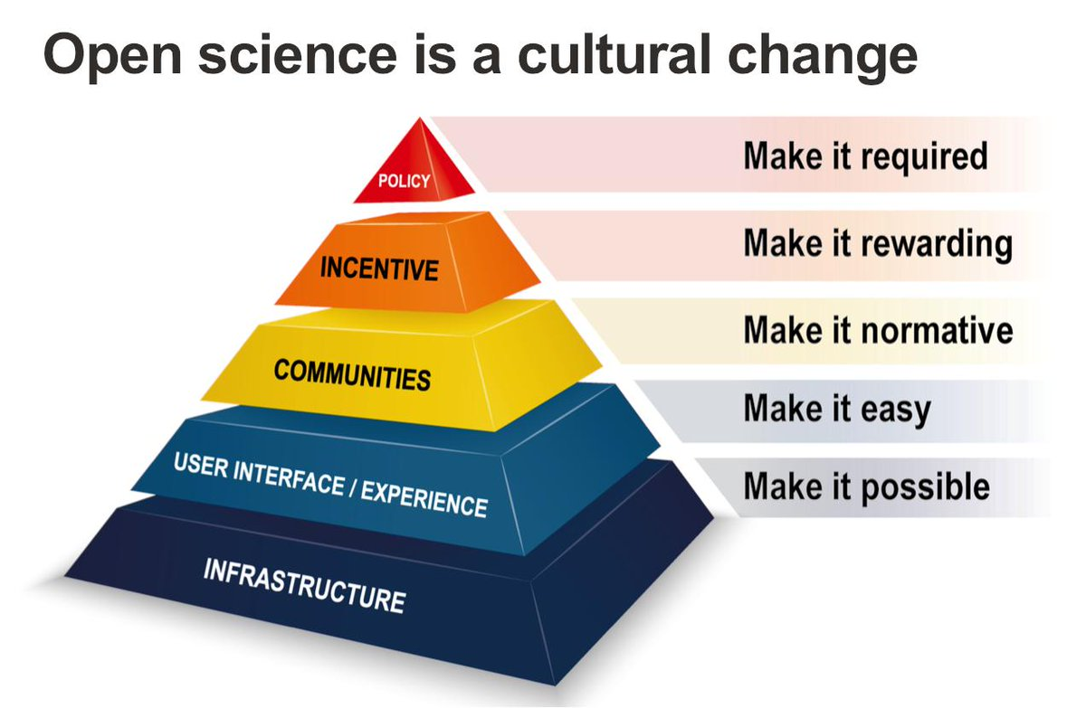
https://twitter.com/EPFLOpenScience/status/1170959367140777984 (adapted from Brian Nosek)

Slide 3
Why “Open Science”
Scholarly communication is not working as well as it should be
Slow, wasteful, locked away
Ruled by commercial interests
Reproducibility “crises”
Questionable research practices
Closed science means people suffer
@OpenScienceMOOC

Slide 4
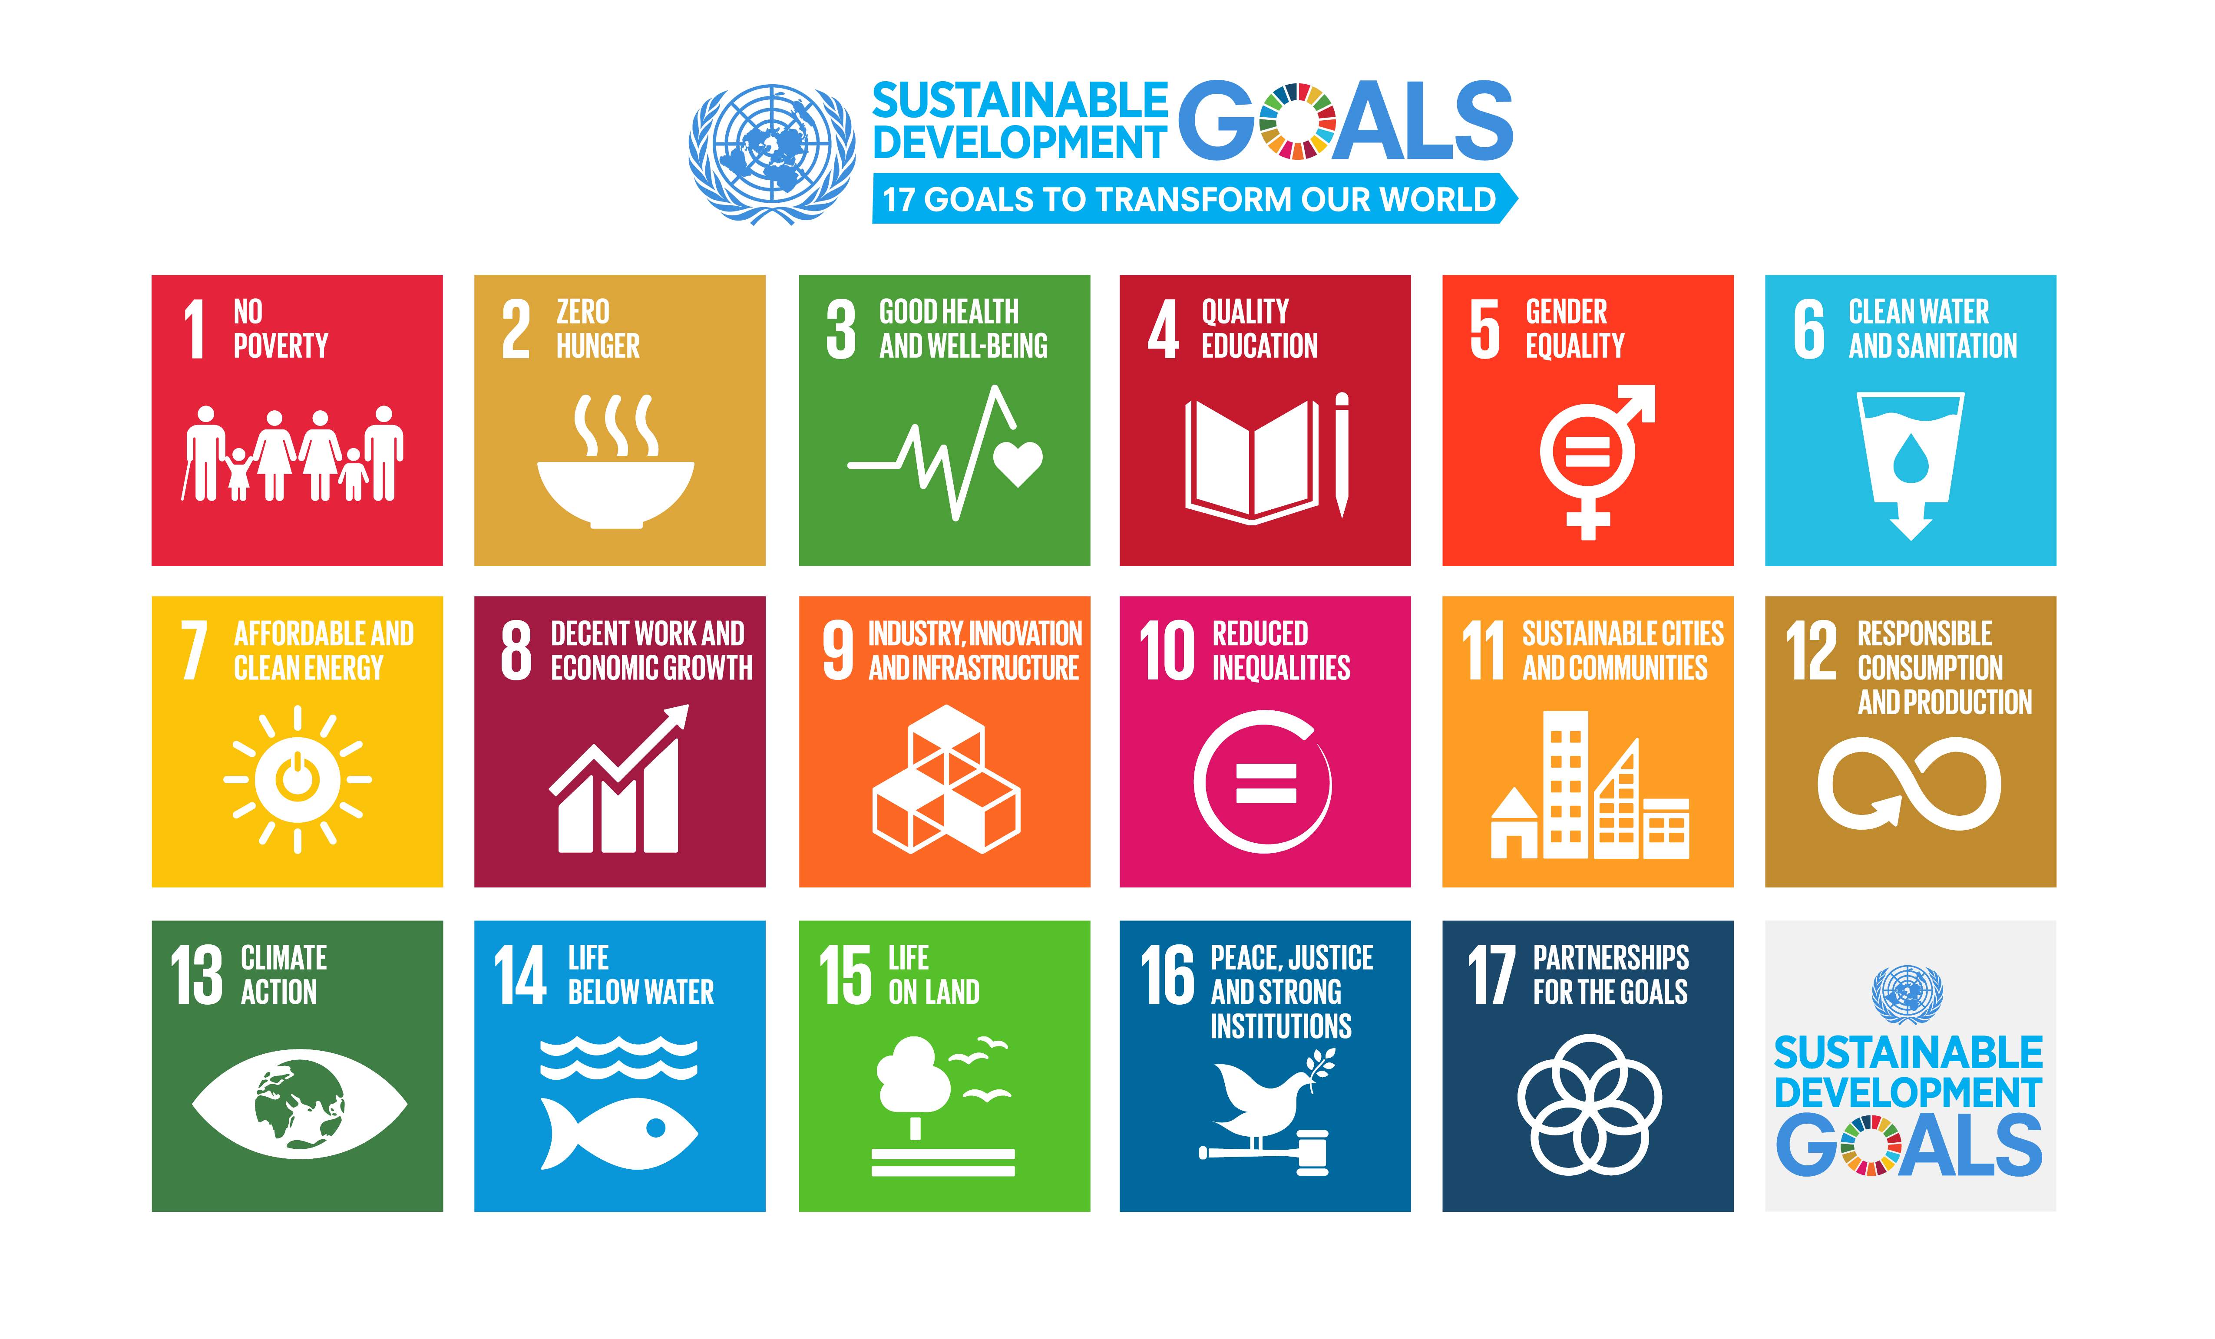
We need science if we are going to help quickly and sustainably solve these

Slide 5
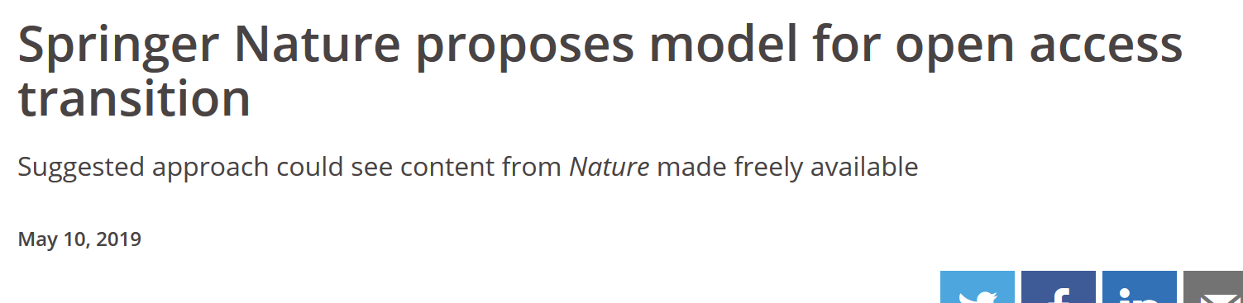
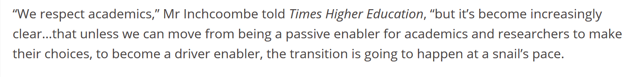
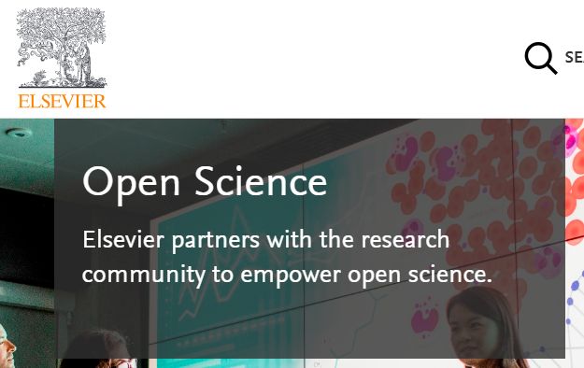
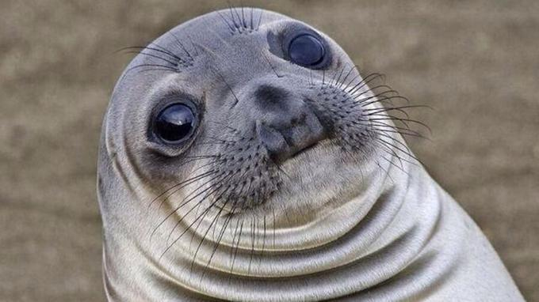
Who is leading the change?
https://www.timeshighereducation.com/news/springer-nature-proposes-model-open-access-transition
@OpenScienceMOOC

Slide 6
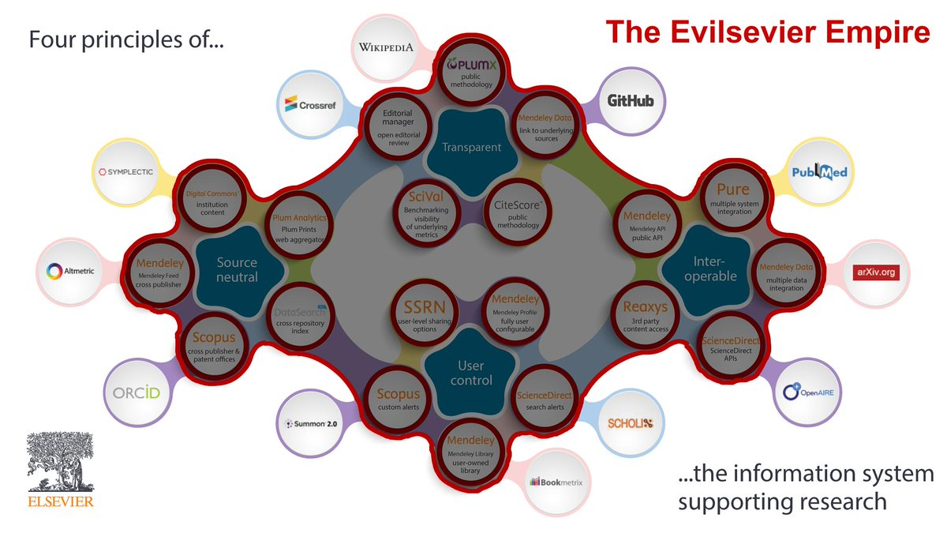
Who is leading the change?
Organisations still stuck in a pre-digital mindset whose primary product was developed in the 17th Century.
https://twitter.com/brembs/status/1100713883373838337
@OpenScienceMOOC

Slide 7

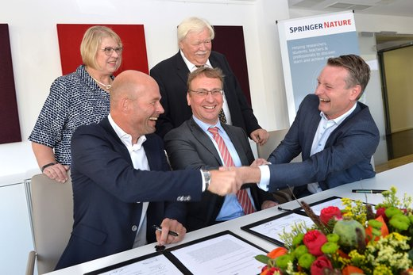
Who is leading the change?
We can do better.
But as individuals we are powerless to face these tasks alone.
https://twitter.com/brembs/status/1100713883373838337
@OpenScienceMOOC

Slide 8
The way we do research has changed for good
We now have new expectations
Transparency
Not secrecy
Collaborative
Not solo
Continuous
Not discretised
@OpenScienceMOOC

Slide 9
We should be training ourselves
Sustained community engagement across disciplines
Rethinking our mindset
Changing the incentive system
@OpenScienceMOOC

Slide 10
What do researchers care about?
Saving time and effort
Problem solving
Advancing research
We give them the knowledge and skills to do this
@OpenScienceMOOC

Slide 11
Welcome to the Open Science MOOC
Stands for Massively Open Online Community
Combining the best parts of Open Science, Open Source, and Open Education
https://opensciencemooc.eu/

Slide 12
Our vision of the future
To help make ‘Open’ the default setting for all global research.
We want to help create a welcoming and supporting community, with good tools, teachers, and role-models, and built upon a solid values-based foundation of freedom and equitable access to research.
@OpenScienceMOOC

Slide 13
Walk the walk, talk the talk
Be honest with each other as a matter of civility
Be brave – ask the difficult questions
We‘re not trying to sell you anything
Ask how we can support the wider community
We aren‘t going to solve everything
@OpenScienceMOOC

Slide 14
How we collaborate
Open Slack channel for discussions
Open GitHub for development
Eliademy for actual courses
Steering committee and advisory board
Future: Migration to Mattermost/GitLab
https://digitalcommons.du.edu/collaborativelibrarianship/vol11/iss2/2/

Slide 15
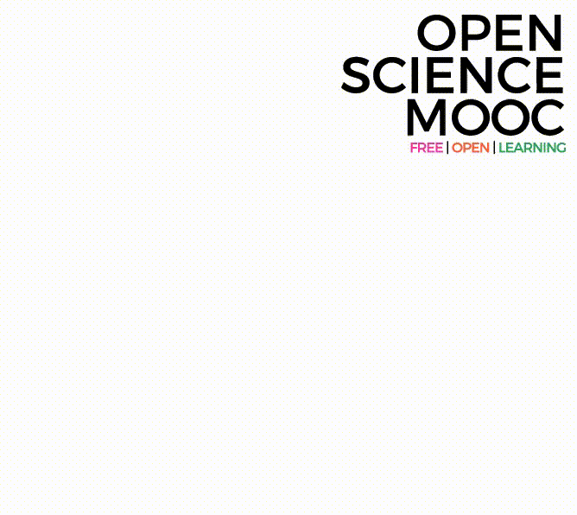
Can we break the inertia?
Education, training, support.
  Empowerment and leadership for the next generation.
    Shifting power dynamics to reduce bias and abuse.
      Building a global community based on strong values, sharing and collaboration.
        Massive-scale engagement to re-align Open Science with current incentive structures.
GitHub: https://github.com/OpenScienceMOOC
Website: https://opensciencemooc.eu
Twitter: @OpenScienceMOOC
Email: info@opensciencemooc.eu
@protohedgehog

Slide 16
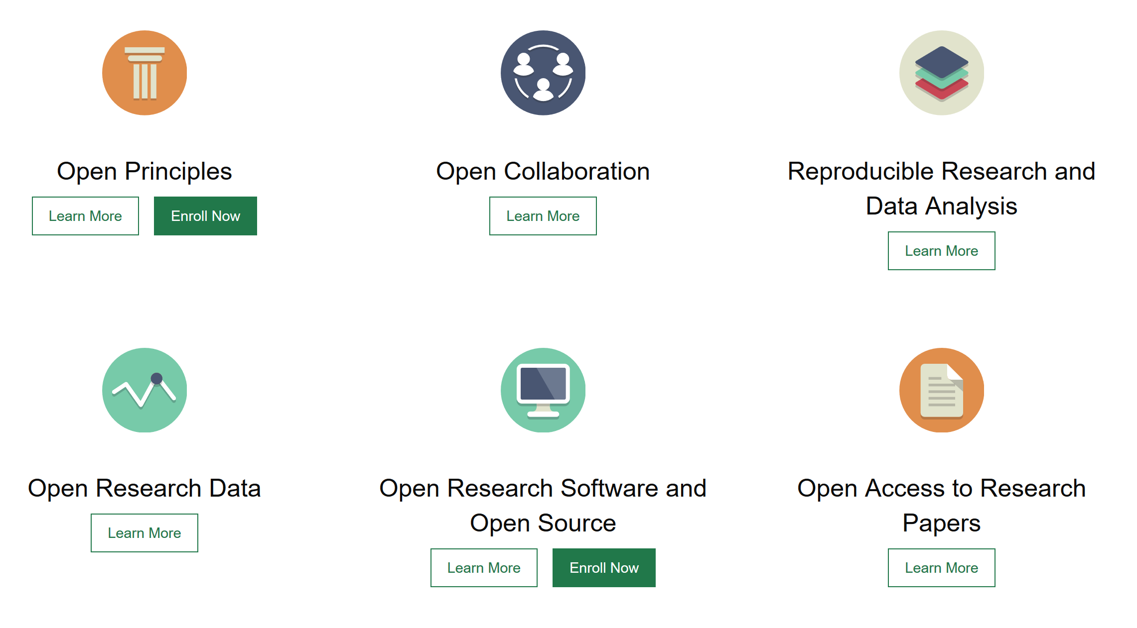
Modular learning
@OpenScienceMOOC

Slide 17
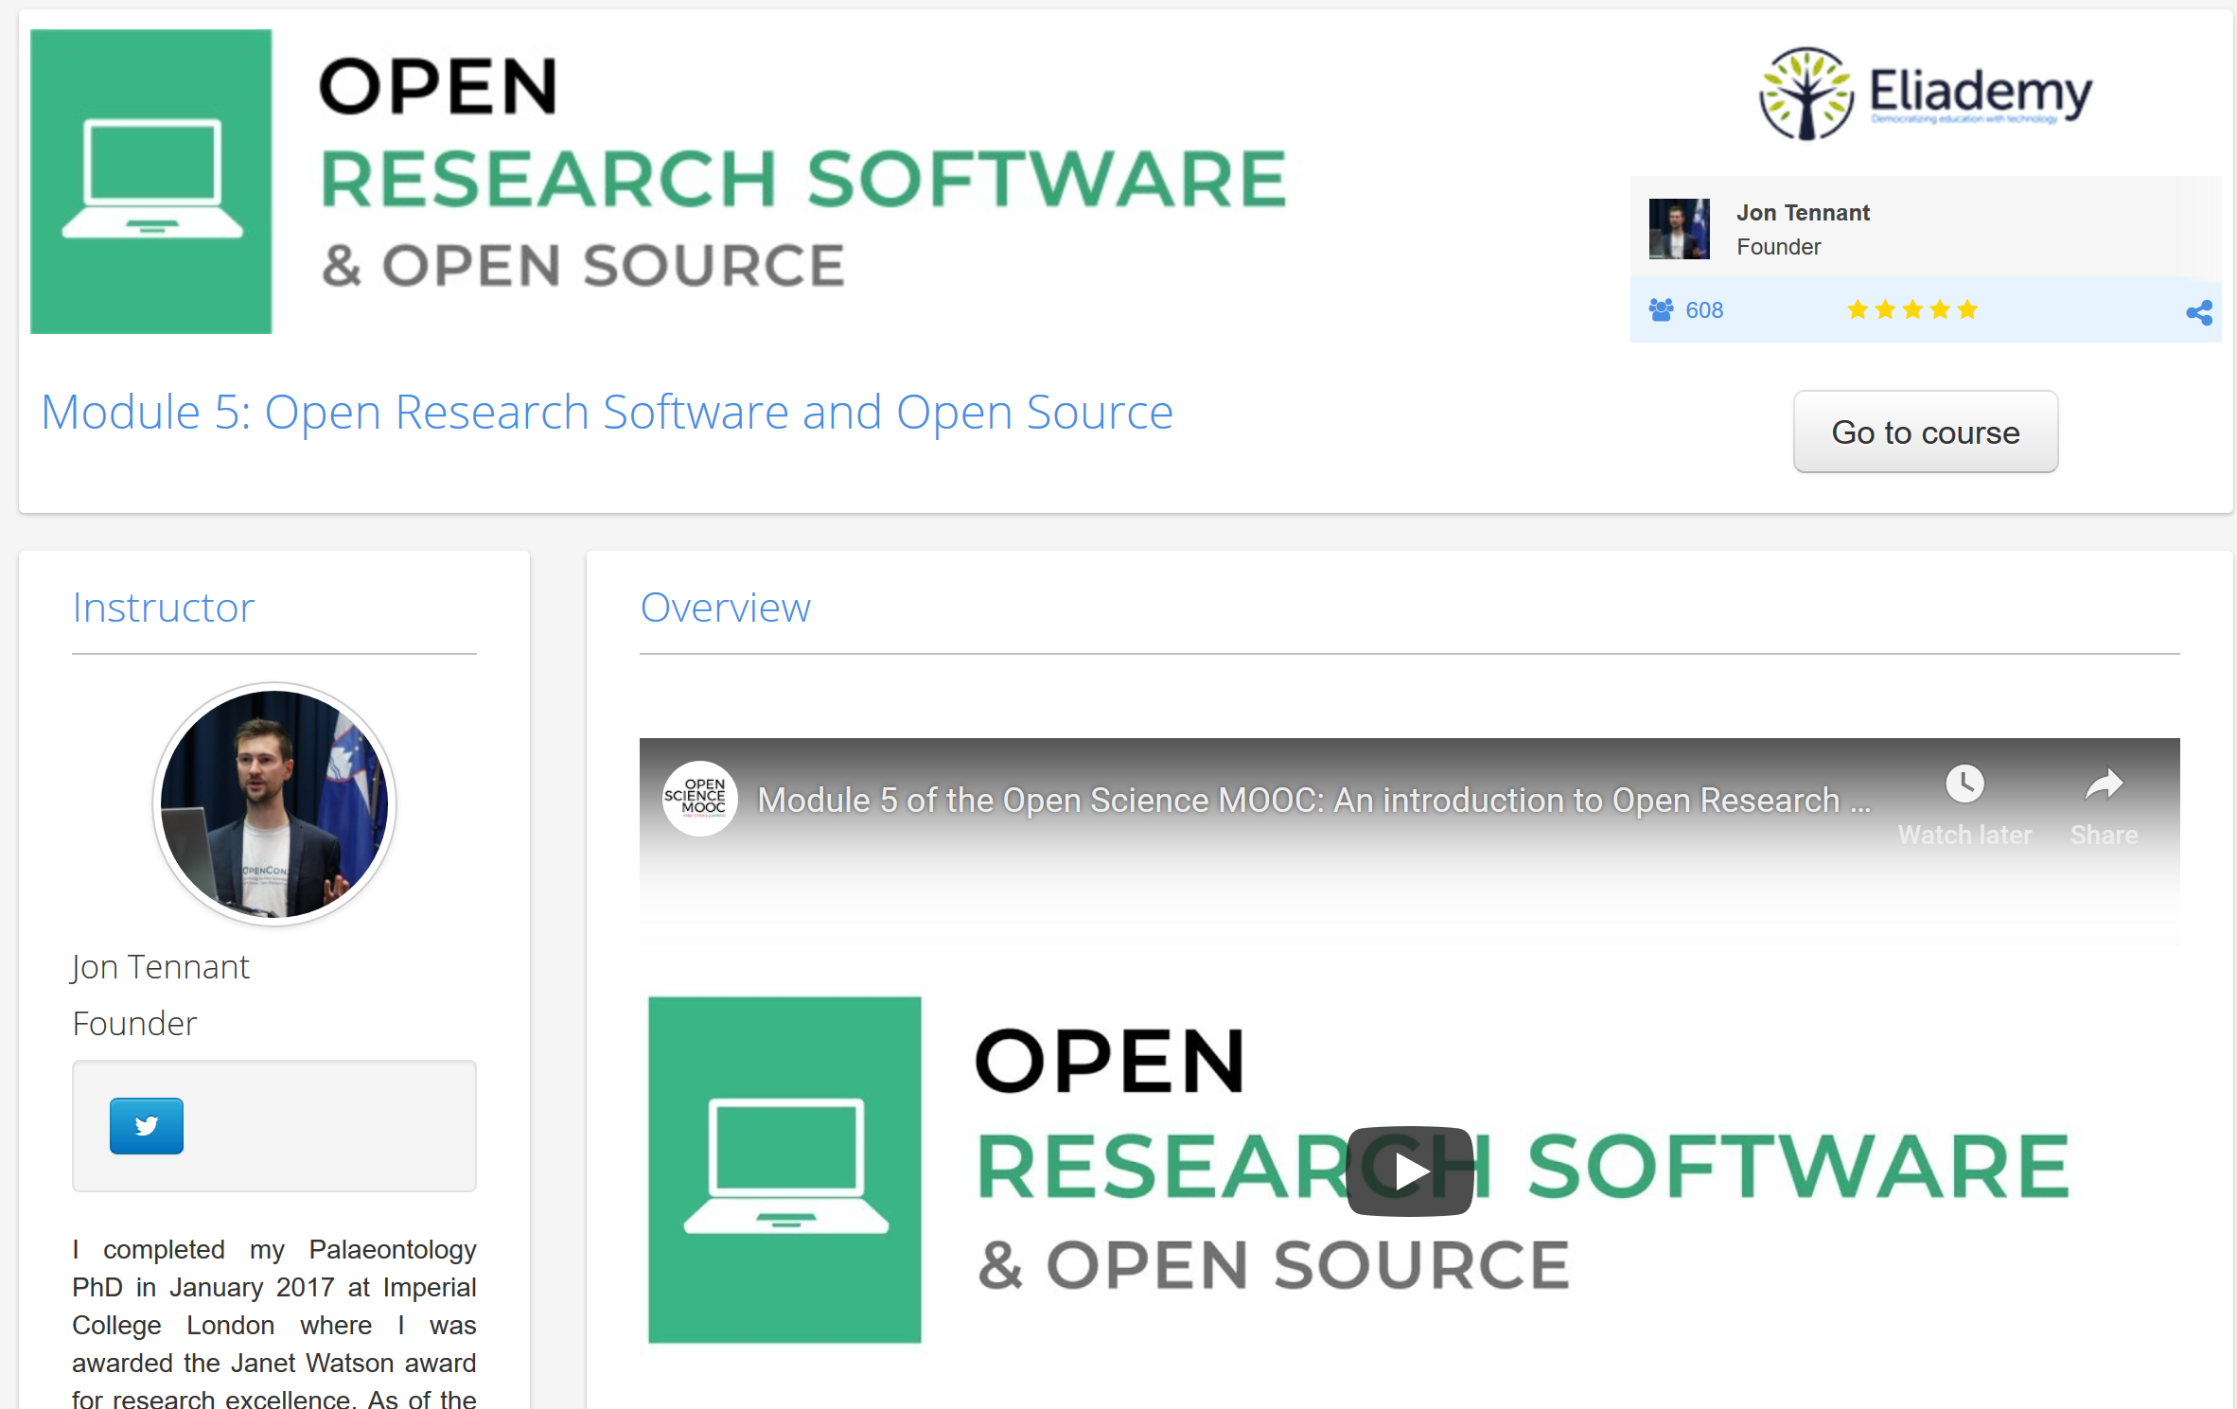
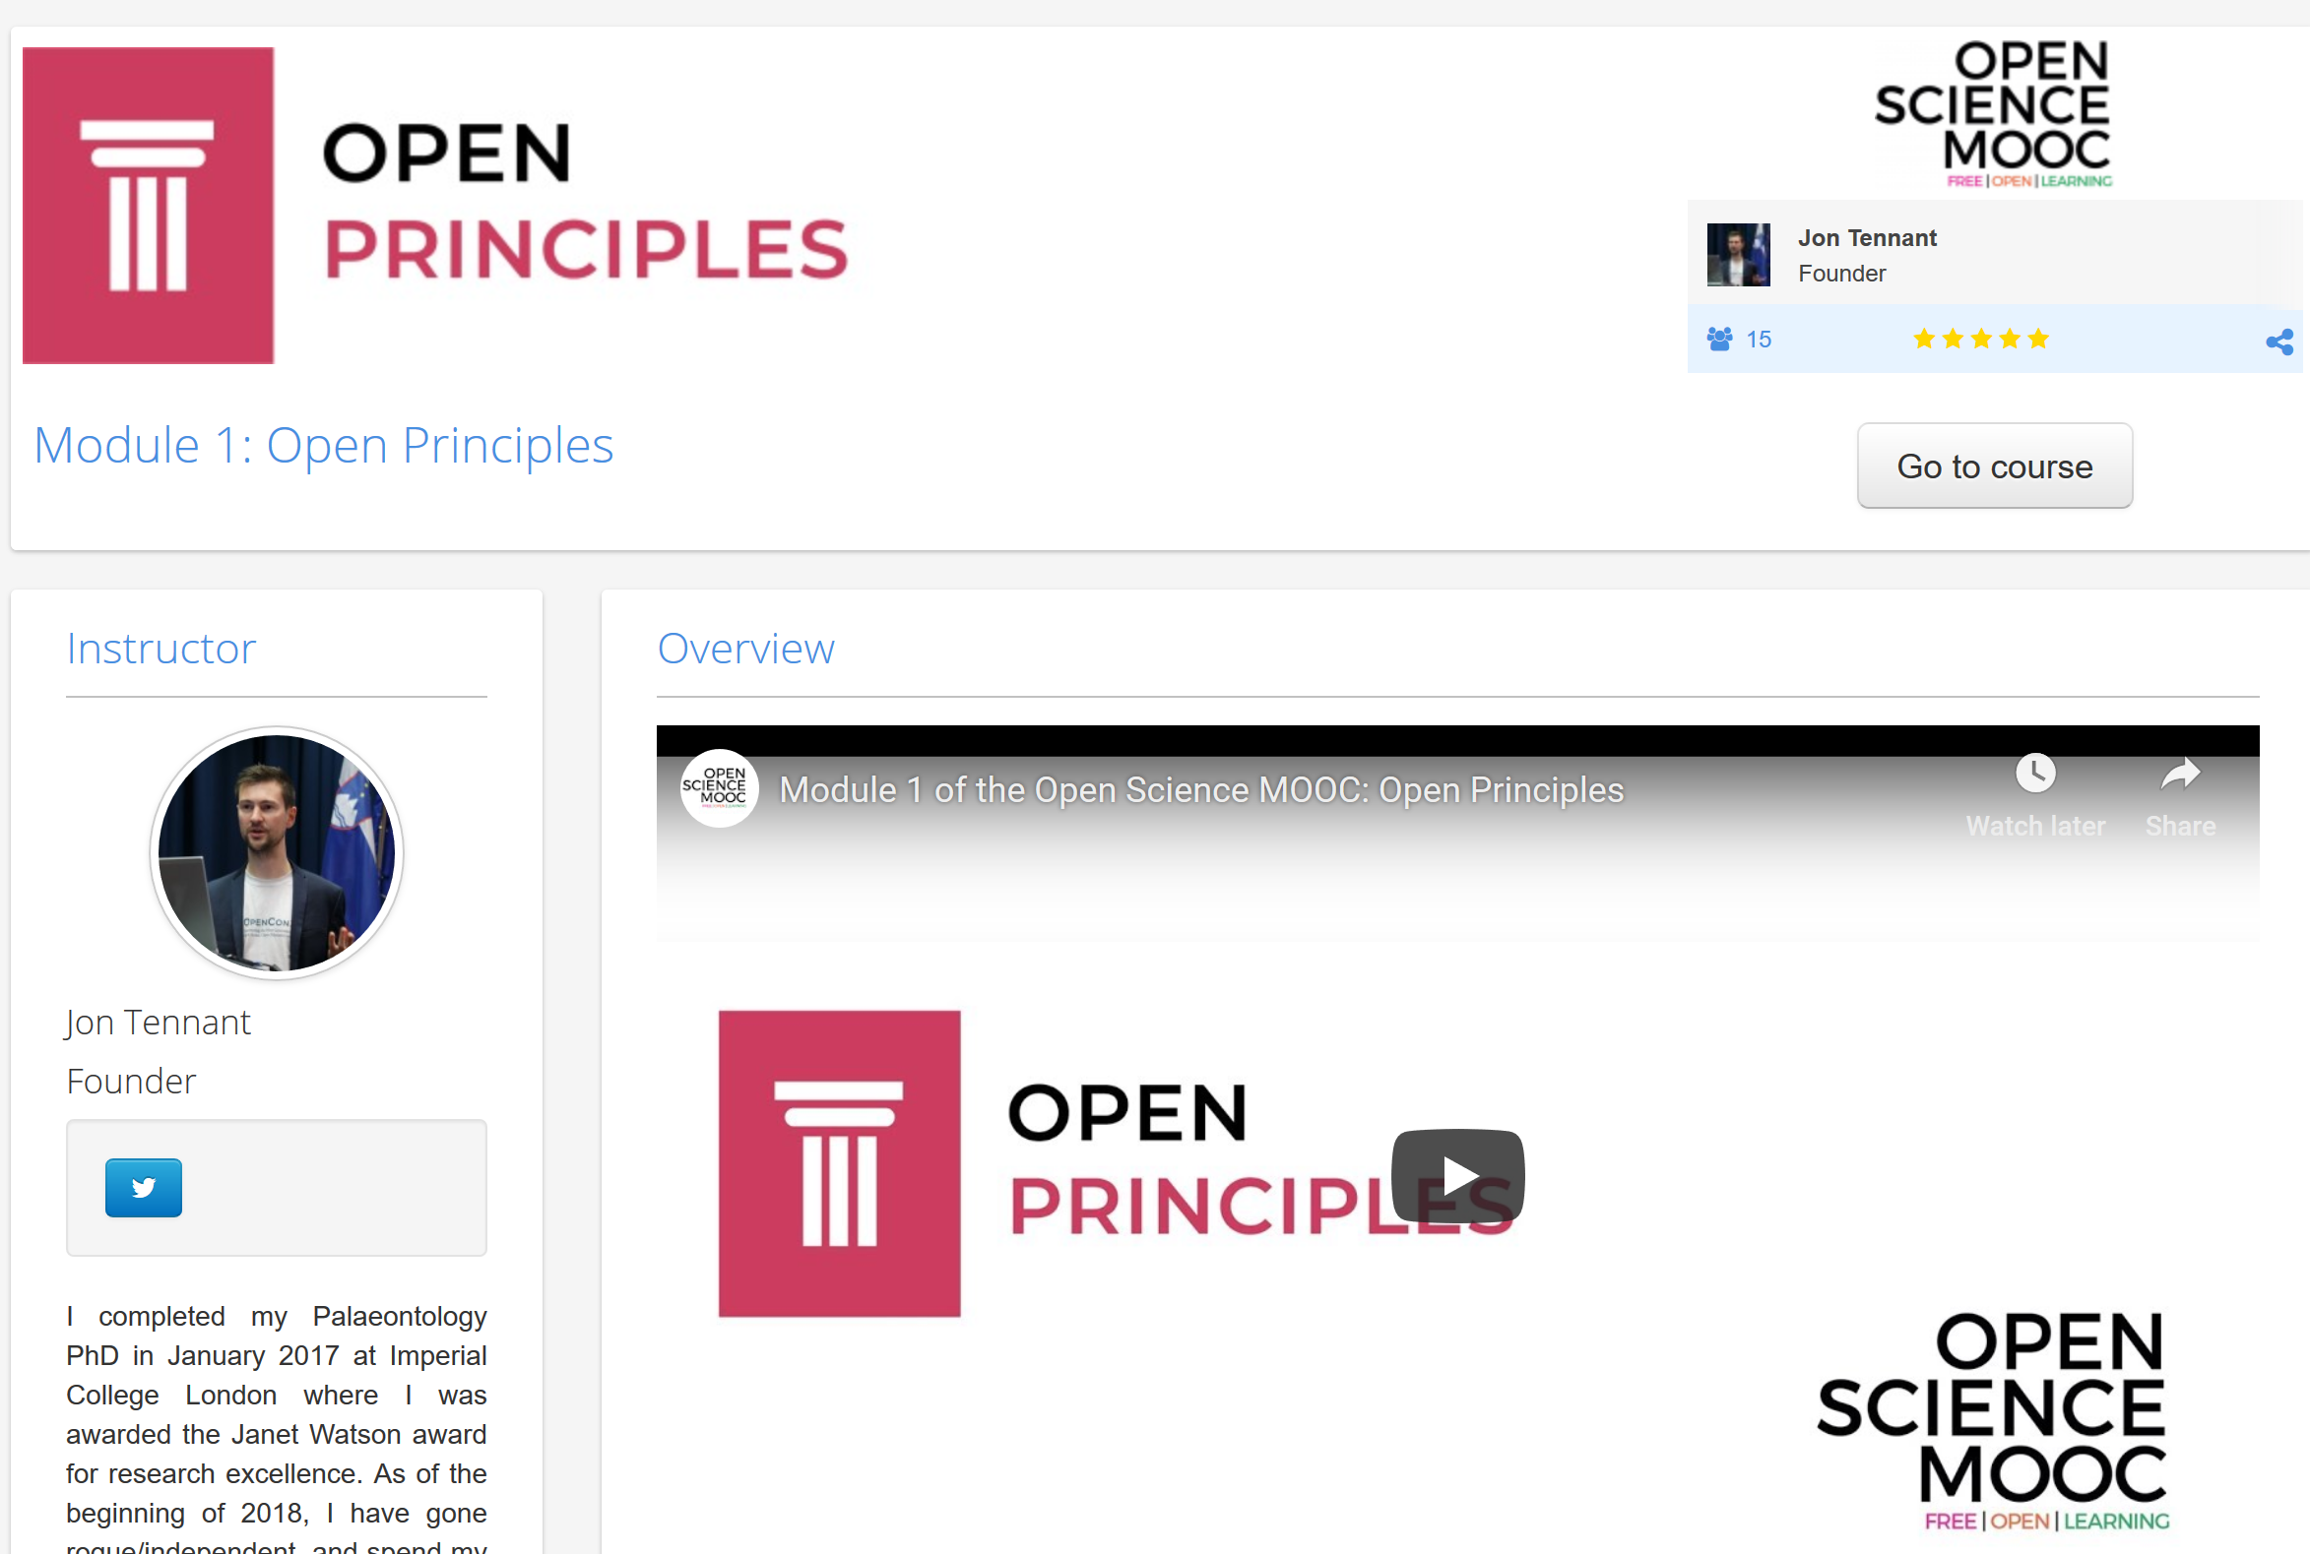
https://eliademy.com/catalog/oer/module-1-open-principles.html
https://eliademy.com/catalog/oer/module-5-open-research-software-and-open-source.html

Slide 18
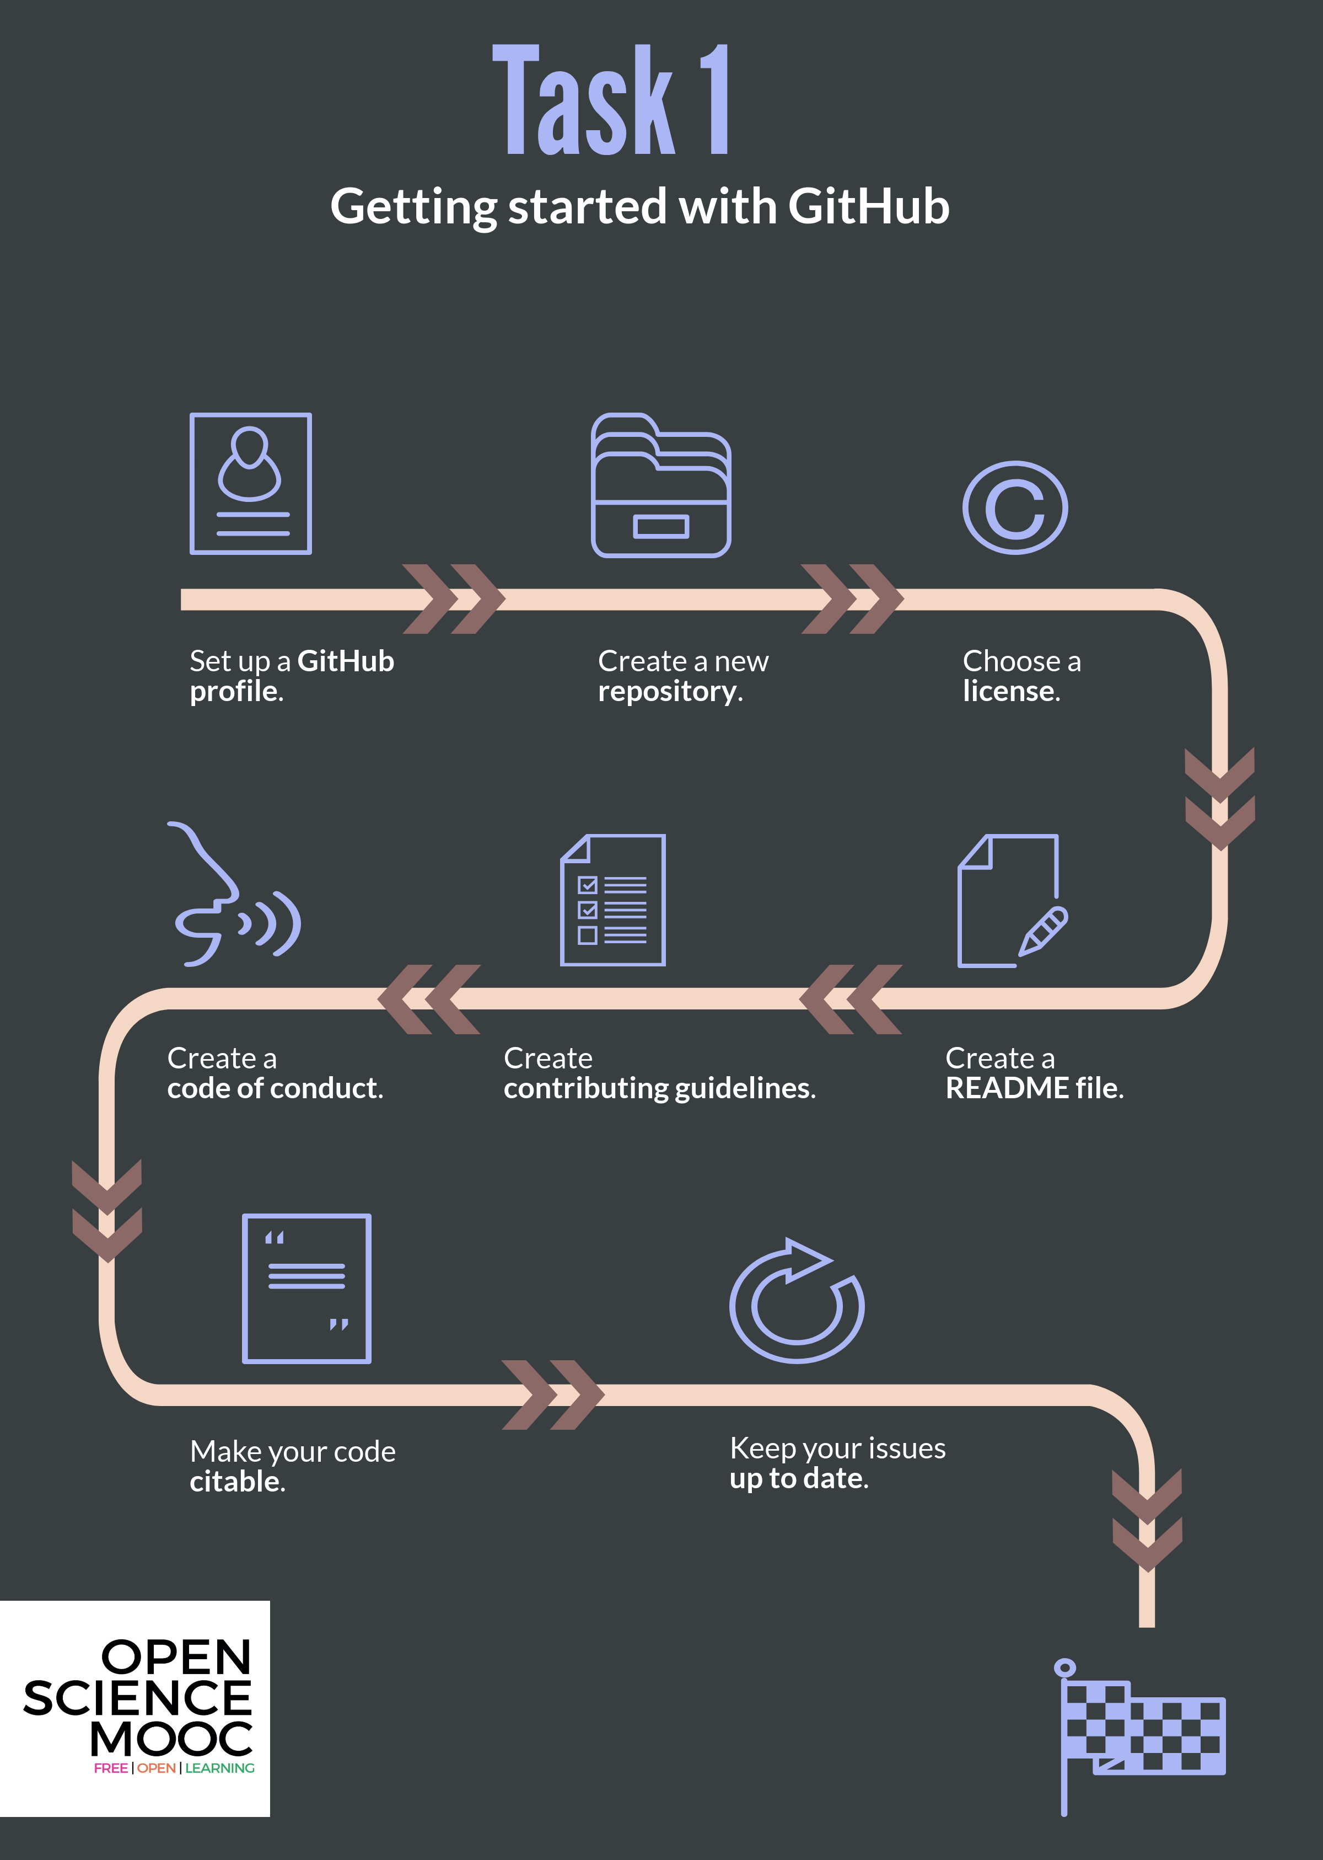
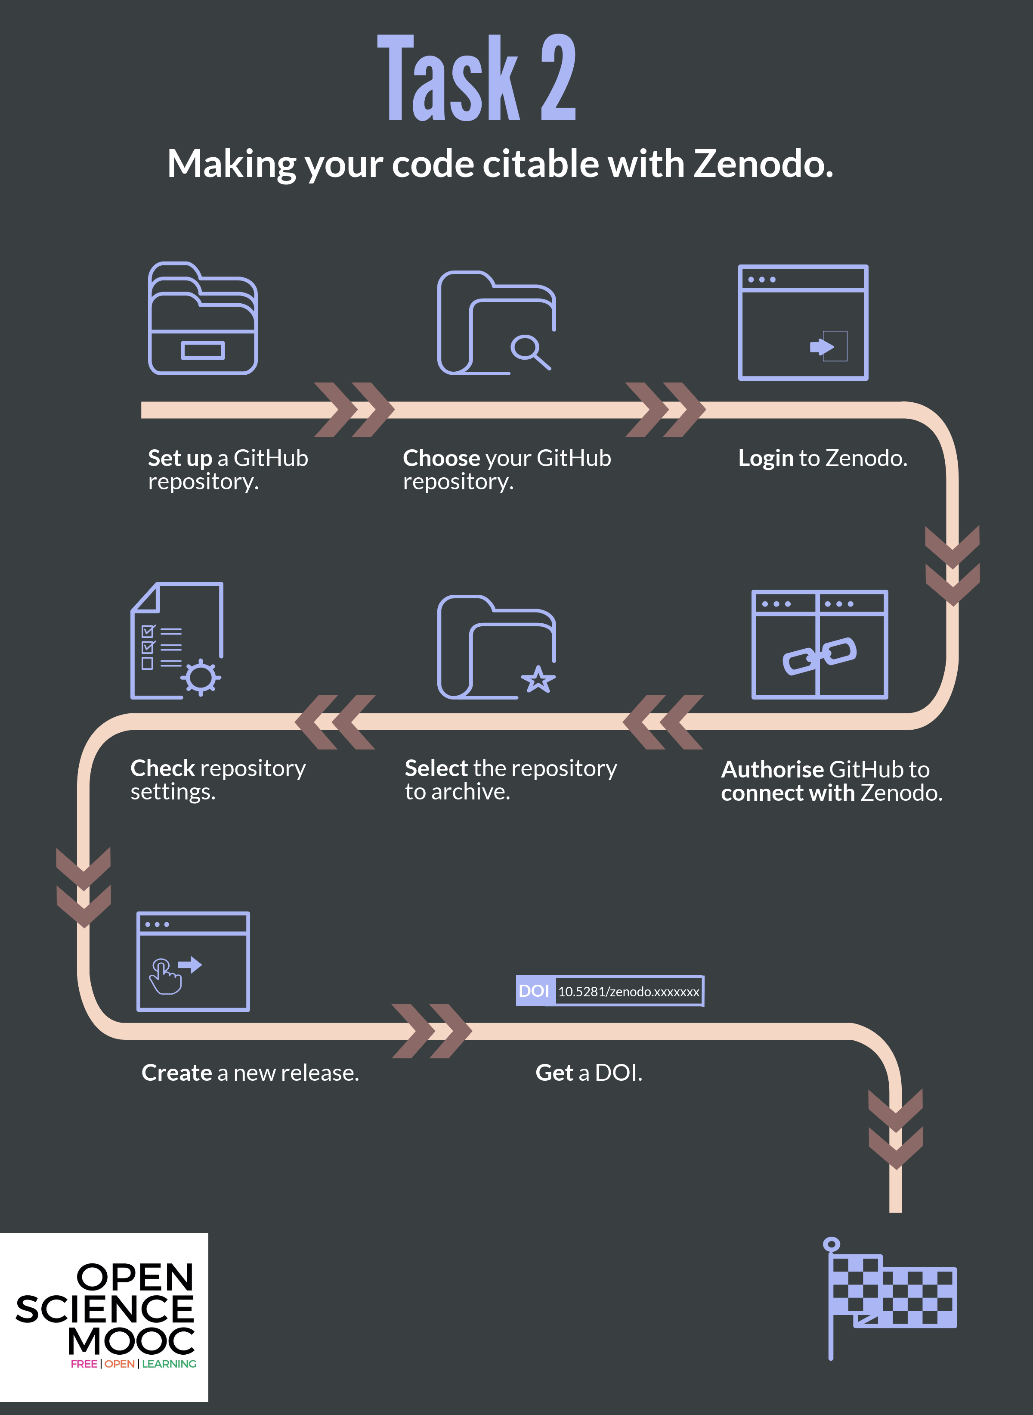

Slide 19
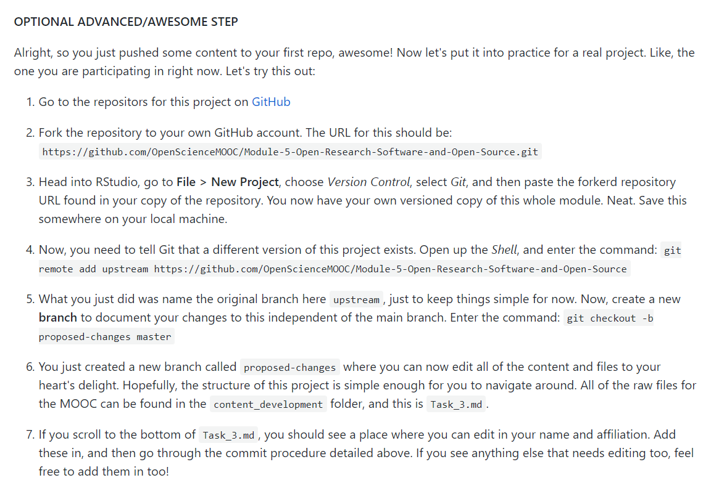
A fully interactive learning style
This allows learners to actually edit the MOOC content for this module. Nice.
Learning is based on participation and collaboration.
@OpenScienceMOOC

Slide 20
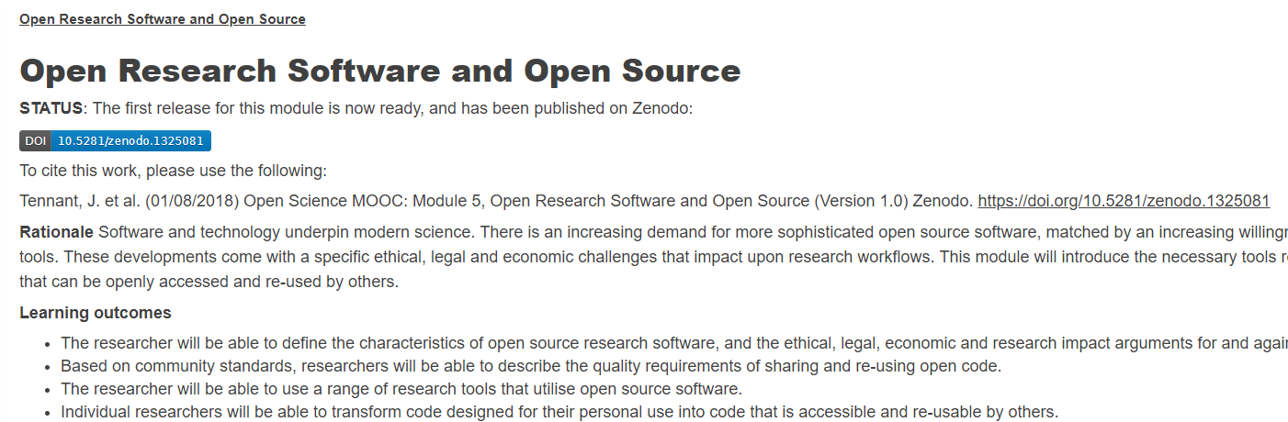

Open for re-use
@OpenScienceMOOC

Slide 21
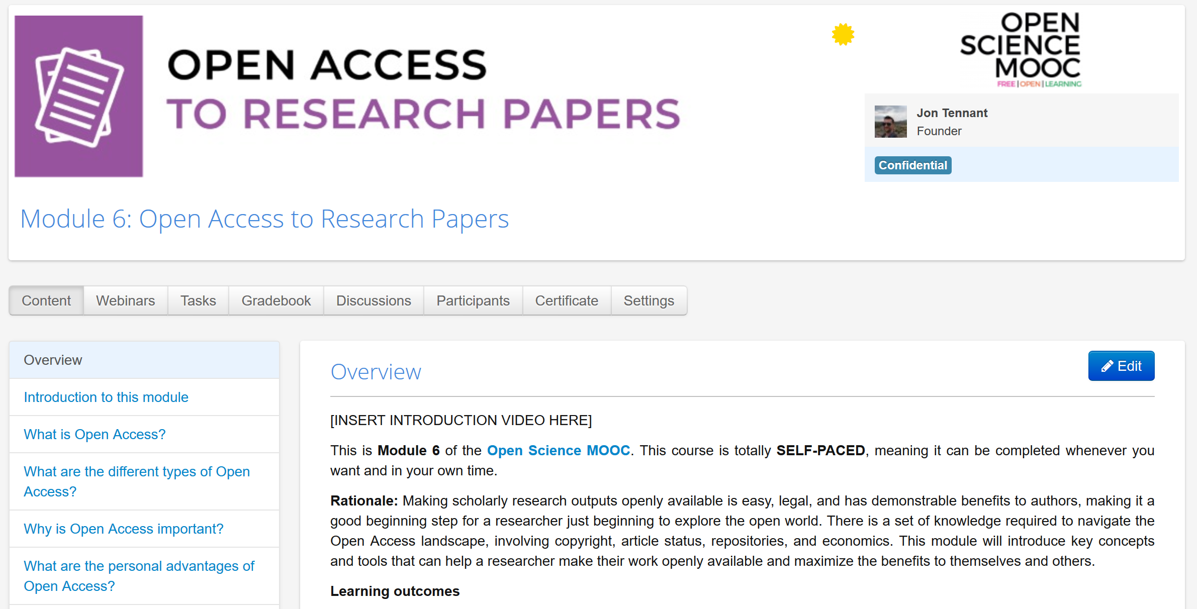
Coming soon!
https://www.youtube.com/playlist?list=PLjy-OBIh84jrUB5wHQ6K_wWWPq5ksqnaT
@OpenScienceMOOC

Slide 22
How do we get to where we want?
Imagine a future defined by the values and principles of Open Science:
        Freely available public good
        Rigorous and reproducible
        Open to ALL
        Isn’t that just GOOD science?
@OpenScienceMOOC

Slide 23
Status
In development
2 modules currently live, 1000 enrolled participants
950 Slack community members
7700 Twitter followers
150 strong GitHub development team
45 strategic partnerships
2 more modules in progress
https://www.dataplanes.org/osmooc-dashboard/

Slide 24
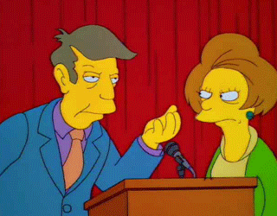
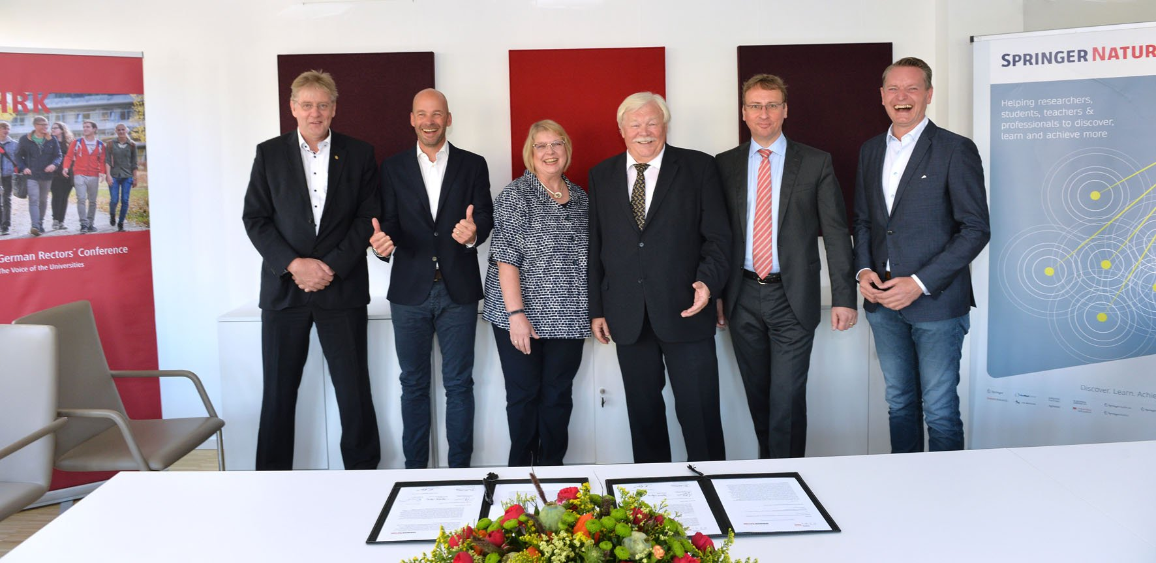
For the clichéd dissenters
@OpenScienceMOOC

Slide 25
Skeptical? You should be.
@OpenScienceMOOC
But it’s not as new as you think.
Science was founded on openness.
We closed it down.
It’s time to open it up again.

Slide 26
What do we need to change cultures?
Leadership from those who are less at risk
  They need to invest in our future
  Make sure that the system we are creating is in the best interests of future generations
For each of us to take small steps where we can
  Without putting ourselves at risk
  Be aware of the options available to us
And some times to be brave
  To stand up for what we believe in
  To ask the challenging questions
  To be deeply introspective of what we are doing and why
@OpenScienceMOOC

Slide 27
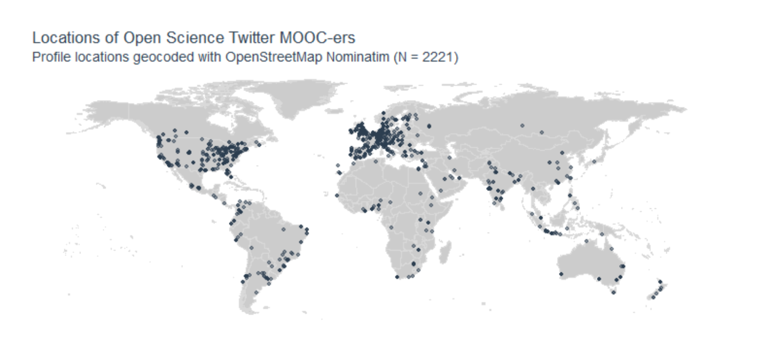
I invite you all to join us!
https://github.com/lhehnke/opensciencemooc-followers
https://osmooc.herokuapp.com/ - Slack
https://open-science-mooc-invite.herokuapp.com/ - GitHub
@OpenScienceMOOC

Slide 28
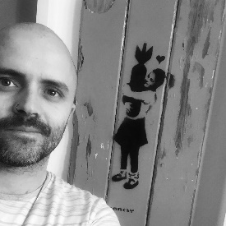
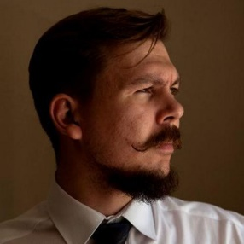
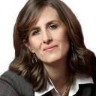
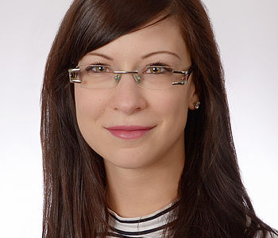
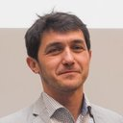
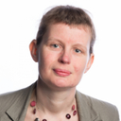
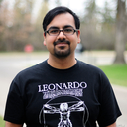
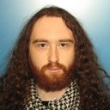
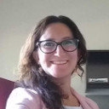
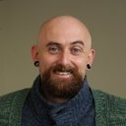
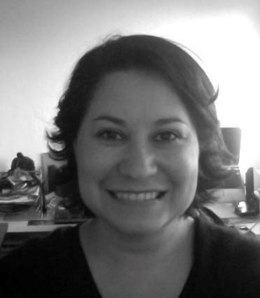
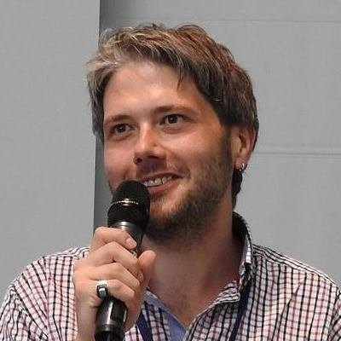
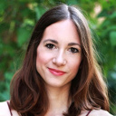
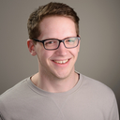
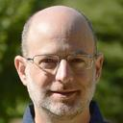
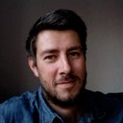
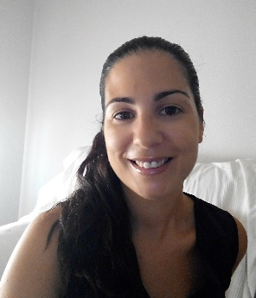
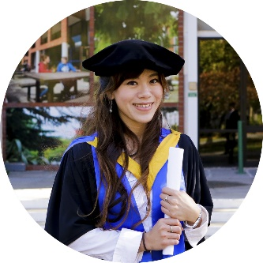
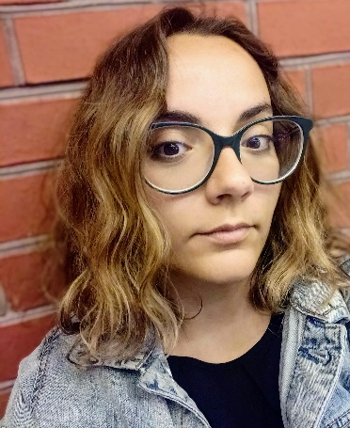
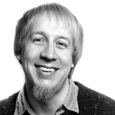
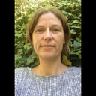
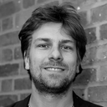
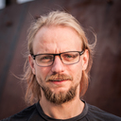
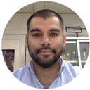
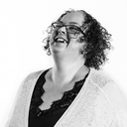
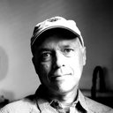
Never doubt that a small group of thoughtful, committed citizens can change the world; indeed, it's the only thing that ever has.
Margaret Mead

Slide 29
At FORCE11, we need you!
What does collaboration in Open Science mean to you?
Come find me (or someone from the Steering Committee) during the conference, and let’s make a video together and share it with the world! ☺

