Slide 1
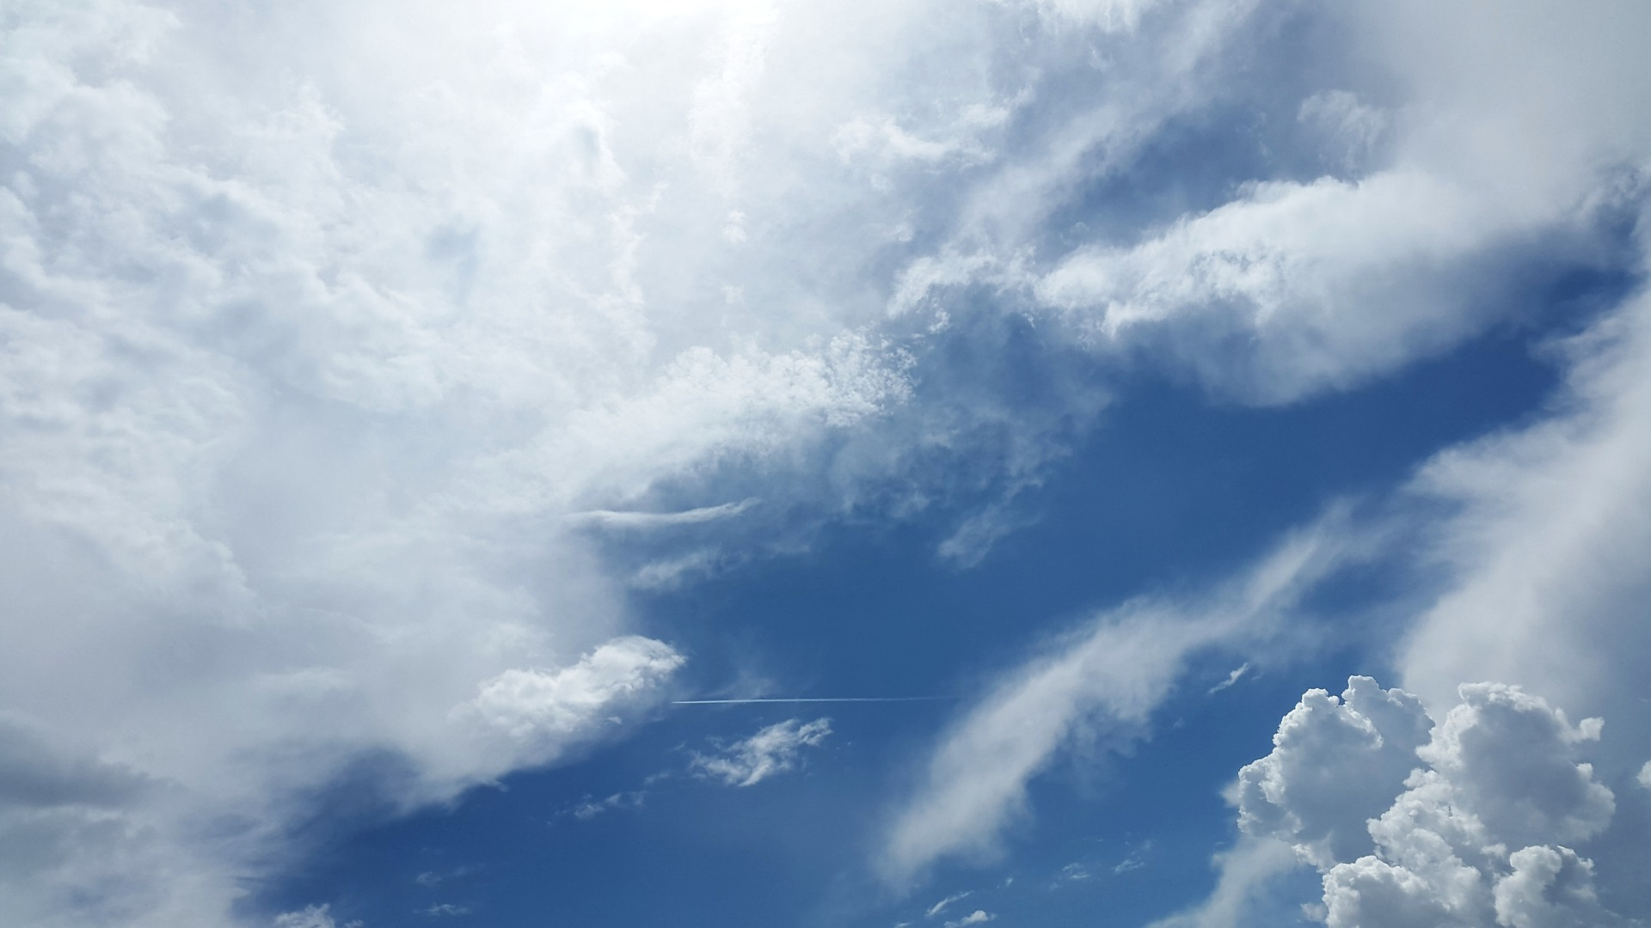
The Future of Science is Open!
Loek Brinkman
L.Brinkman@uu.nl
@LoekBrinkman
Notes:
intro: 10 min
Zelf aan de slag: 10 min
nabesprekeing: 10 min

Slide 2
Overview
Me: (30 minutes)
Intro
Open Access
Open Data
Your career in the age of open
You: (60 minutes)
Open Access
Open Data
Your career in the age of open

Slide 3
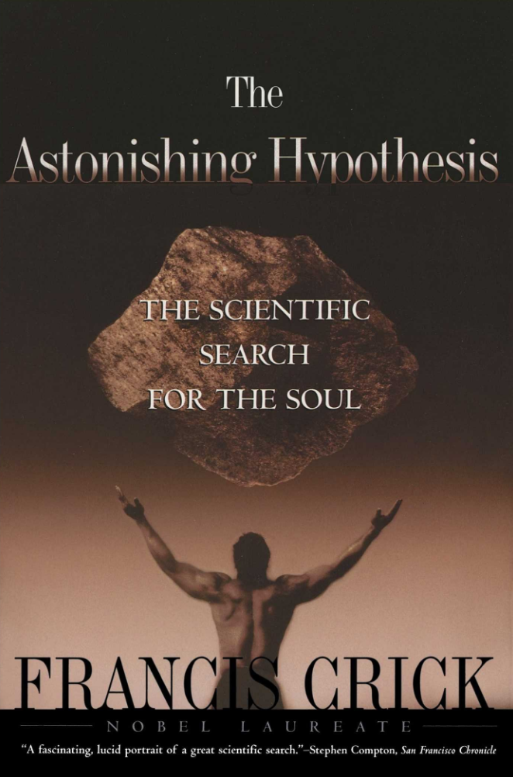
Two things I care about:
Consciousness & the brain
Improving science

Slide 4
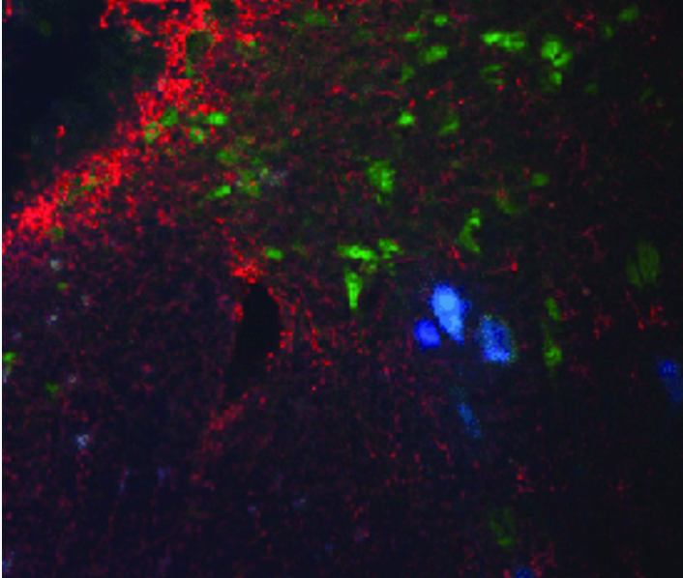
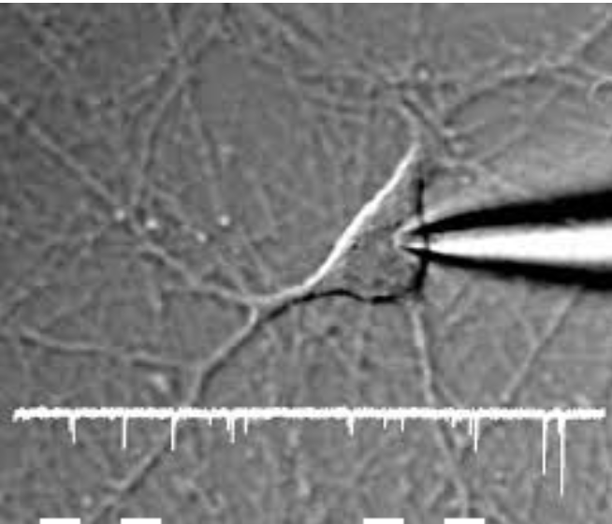
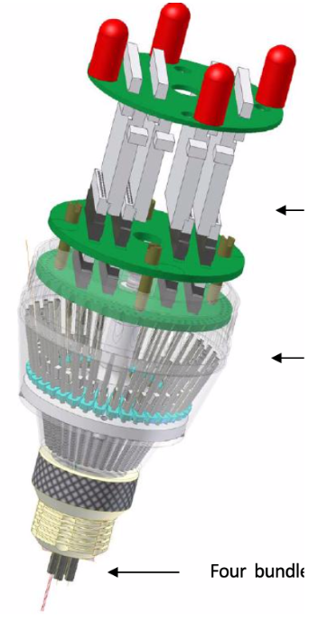
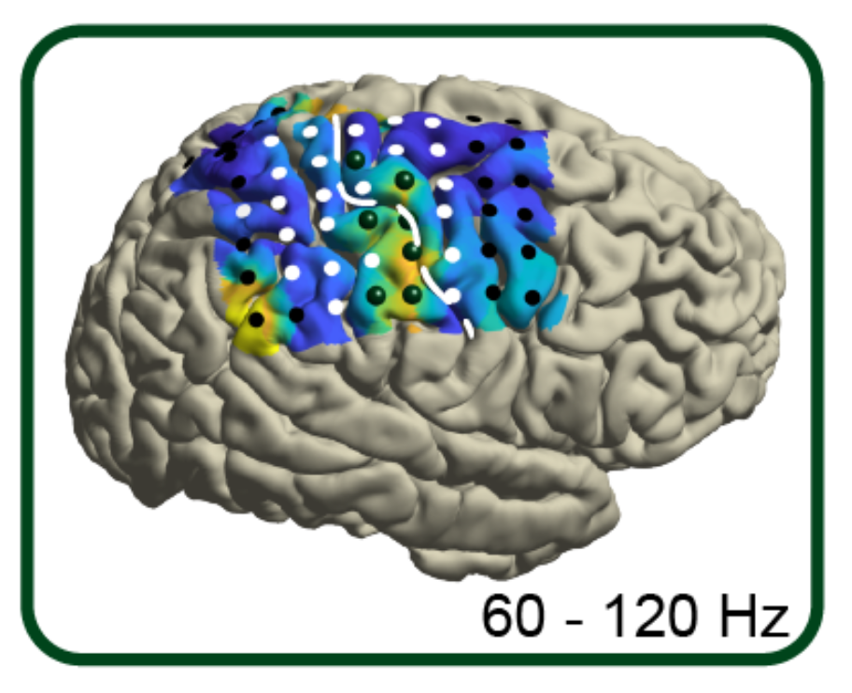
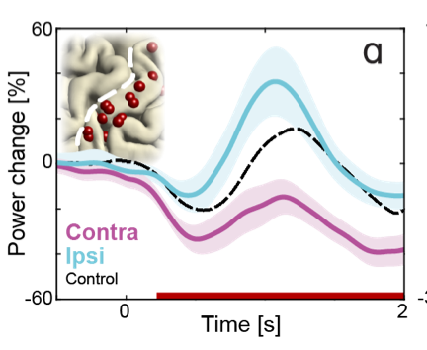
Consciousness and the brain

Slide 5
Improving Science
Science is beautiful, and we van make it even better!
What I do:
Open Science advocacy
Open Science in education
Research on Open Science (?)

Slide 6
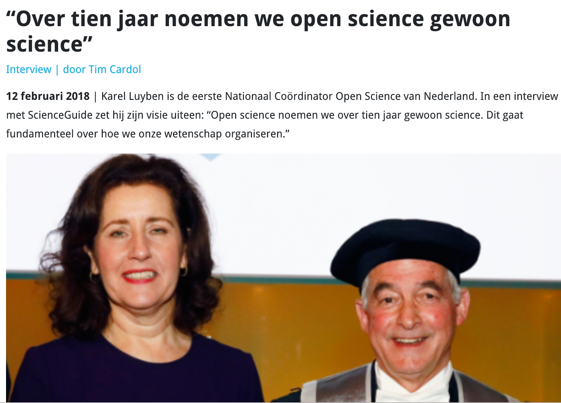
Advocated by researchers, institutions, funders and policy makers
2017
Notes:
Ambities UU!

Slide 7
What is Open Science?
New research practices
Accelerate scientific progress, by increasing:
`````
`````
`
Open Access, open materials
Open data & code
Preregistration
Reproducibility and Replicability
Open to participate,
Public Engagement
Notes:
The way we conduct research is changing

Slide 8
Open Access

Slide 9
Open Access
Slide adopted from Jeroen Bosman, Bianca Kramer. Modified by Barbara Vreede
Direct and free access to research papers
Ambition National Plan: 100% Open Access
 | gold | hybrid-gold | green | preprint
Who provides access? | publisher | publisher | author | author
Where? | ~10K journals | almost all subscription journals | institutional repository | preprint archives
When? | Upon publication | Upon publication | After embargo | Around submission
How much does it cost? | ~0-4000 $ (diamond/platinum if free) | ~1000-6000 $ | free | free
Who pays? | you / UU OA fund 50% | you / VSNU big deals | n/a | n/a
Does it fulfill funder requirements? | always | currently yes, but unsure in future | depends on embargo period | usually not
Who has copyright? | author, with limited CC license options | author, with exclusive rights for publisher | publisher | author, with CC licence of choice

Slide 11
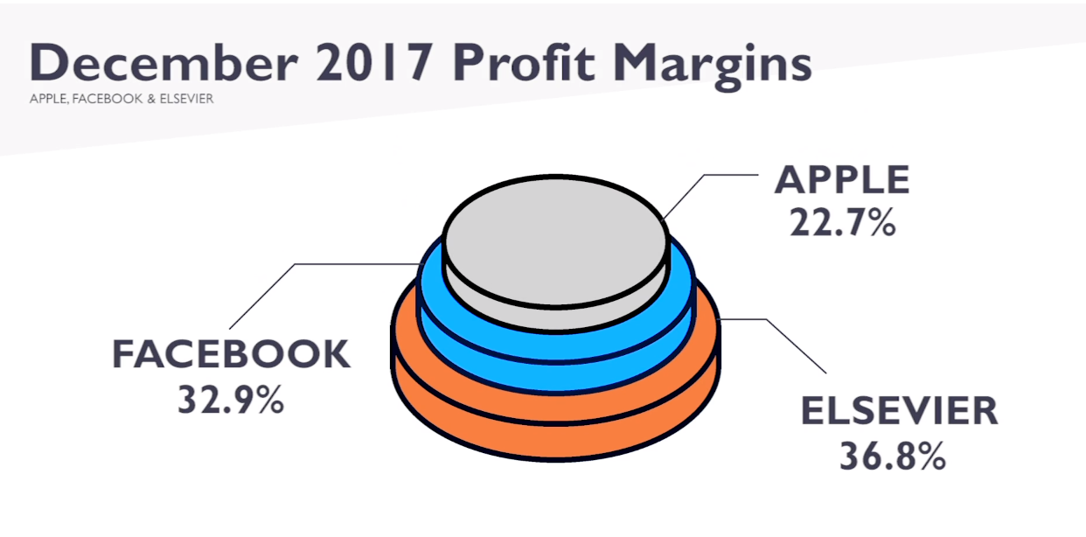
Kill the ‘subscription fee’ model

Slide 12
Open Data

Slide 13
Open Data
Why?
Verifiability & Reuse
Increase impact of your work
Often prerequisite for publication
How?
Where?

Slide 14
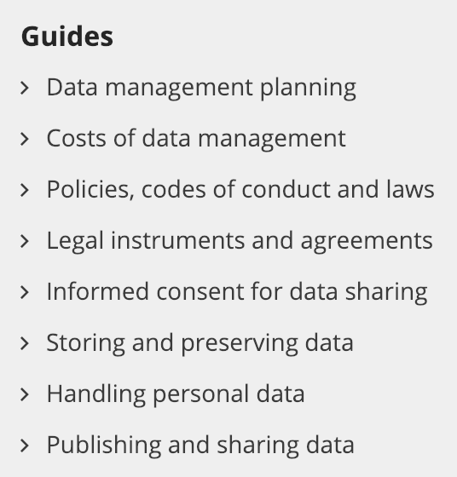
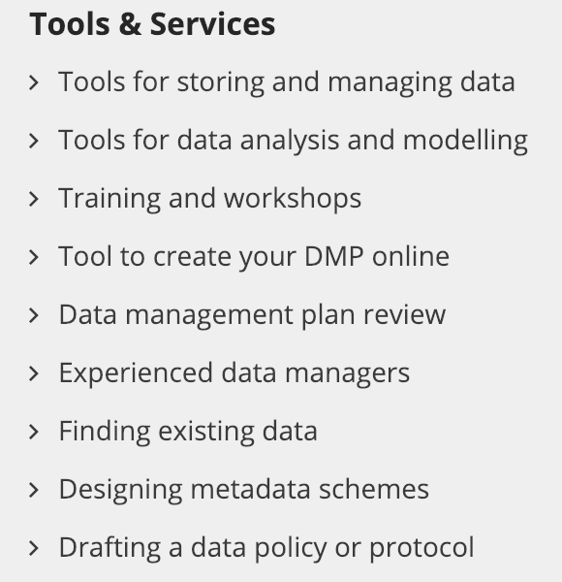
How to share data

Slide 15
Source: LIBER Europe

Slide 16
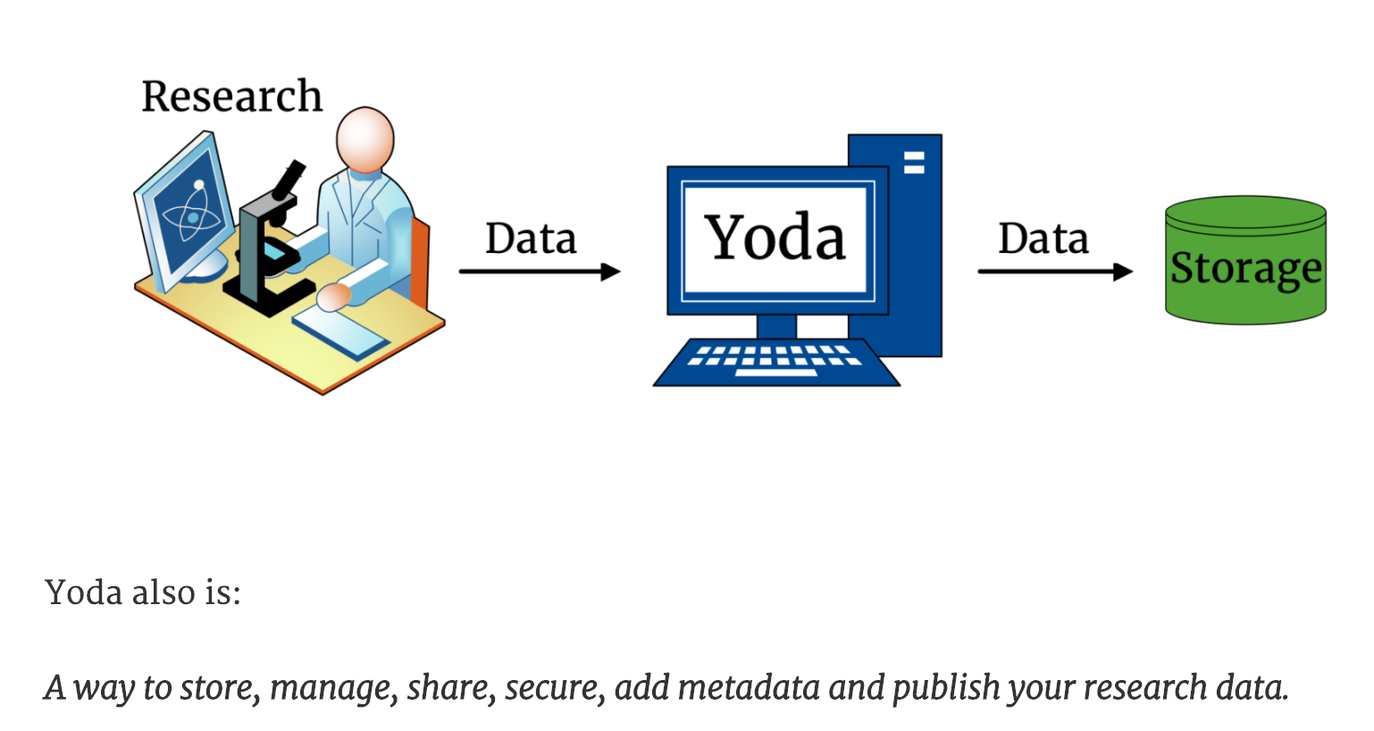
Where to share data
YODA
DataverseNL
Open Science Framework
European Open Science Cloud
https://osf.io/tgvhy/

Slide 17
Your Career in the Age of Open

Slide 18
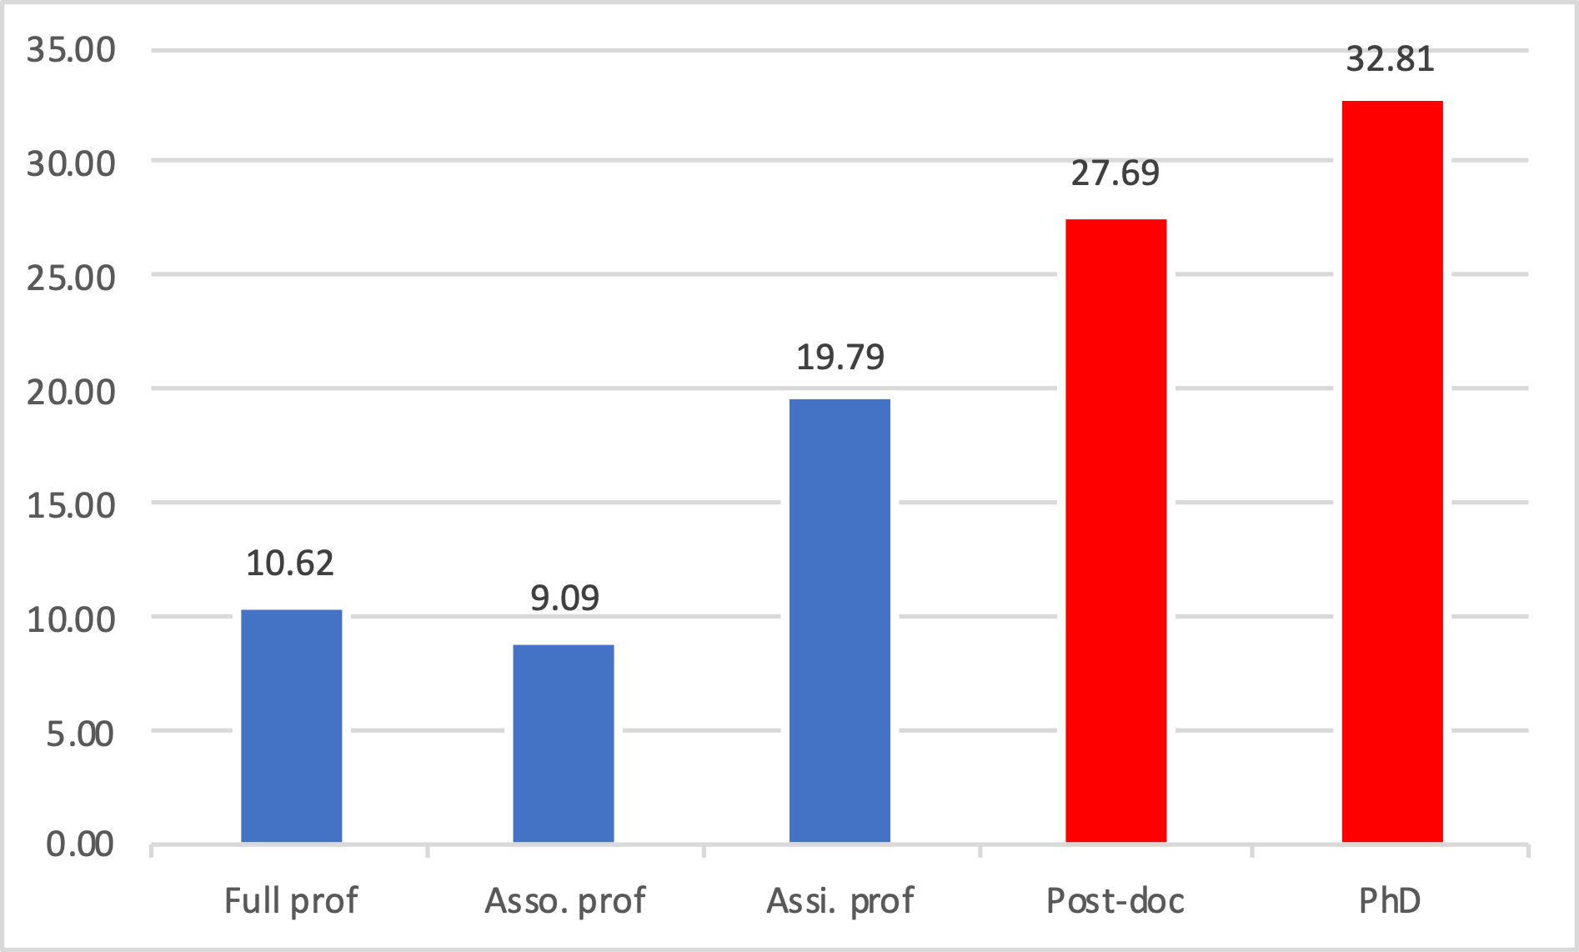
Your career in the age of open
>10% stays in academia
Transferable skills highly valued outside academia
Fixed positions*
Temporary positions
*assistant professor positions can also be temporary

Slide 19
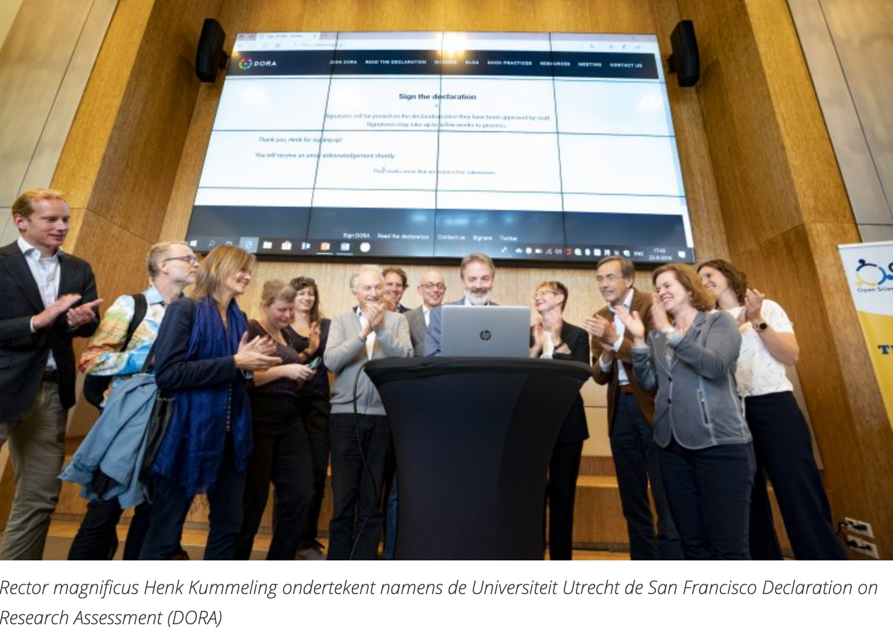
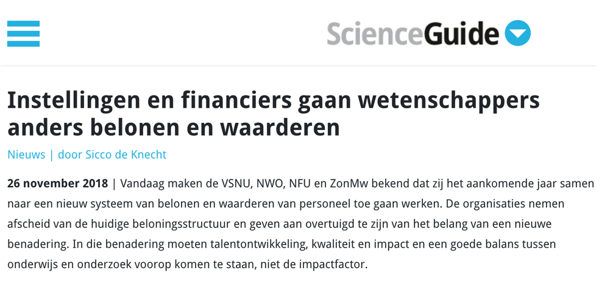
Your career in the age of open
How to make it before 2018
(many) publications in high-impact journals
H-index (citations)
Grants
Teaching(?)
How to make it in 2020
Impactful publications
Open Science increases impact
Diverse career paths
…and previous criteria

Slide 20
Your turn!
3 topics (Open Access, Open Data, Your Career)
Per topic: 3 parallel groups of 5-6 students per topic
Discuss with the group the point on www.tinyurl.com/OpenNeuro2019
After 15 minutes, one stays and the rest moves on to the next topic

Slide 21
Want more Open?
www.openscience-utrecht.com
@OpenSciUtrecht

