Slide 1
Developing your digital researcher profile
Dr. Jon Tennant
@protohedgehog
Odense, Denmark Oct 3rd, 2019
https://orcid.org/0000-0001-7794-0218

Slide 2
ORCID
Unique identifier
Like an academic CV
Integrated
Free
Useful
https://orcid.org/0000-0001-7794-0218

Slide 3
Open Science Framework
Does a bit of everything
Open Source
Preprint servers
Integrated
https://osf.io/59jh6/

Slide 4
ImpactStory
Combines ORCID with Altmetric
Fun and useful
Badges/achievements
Open Source

Slide 5
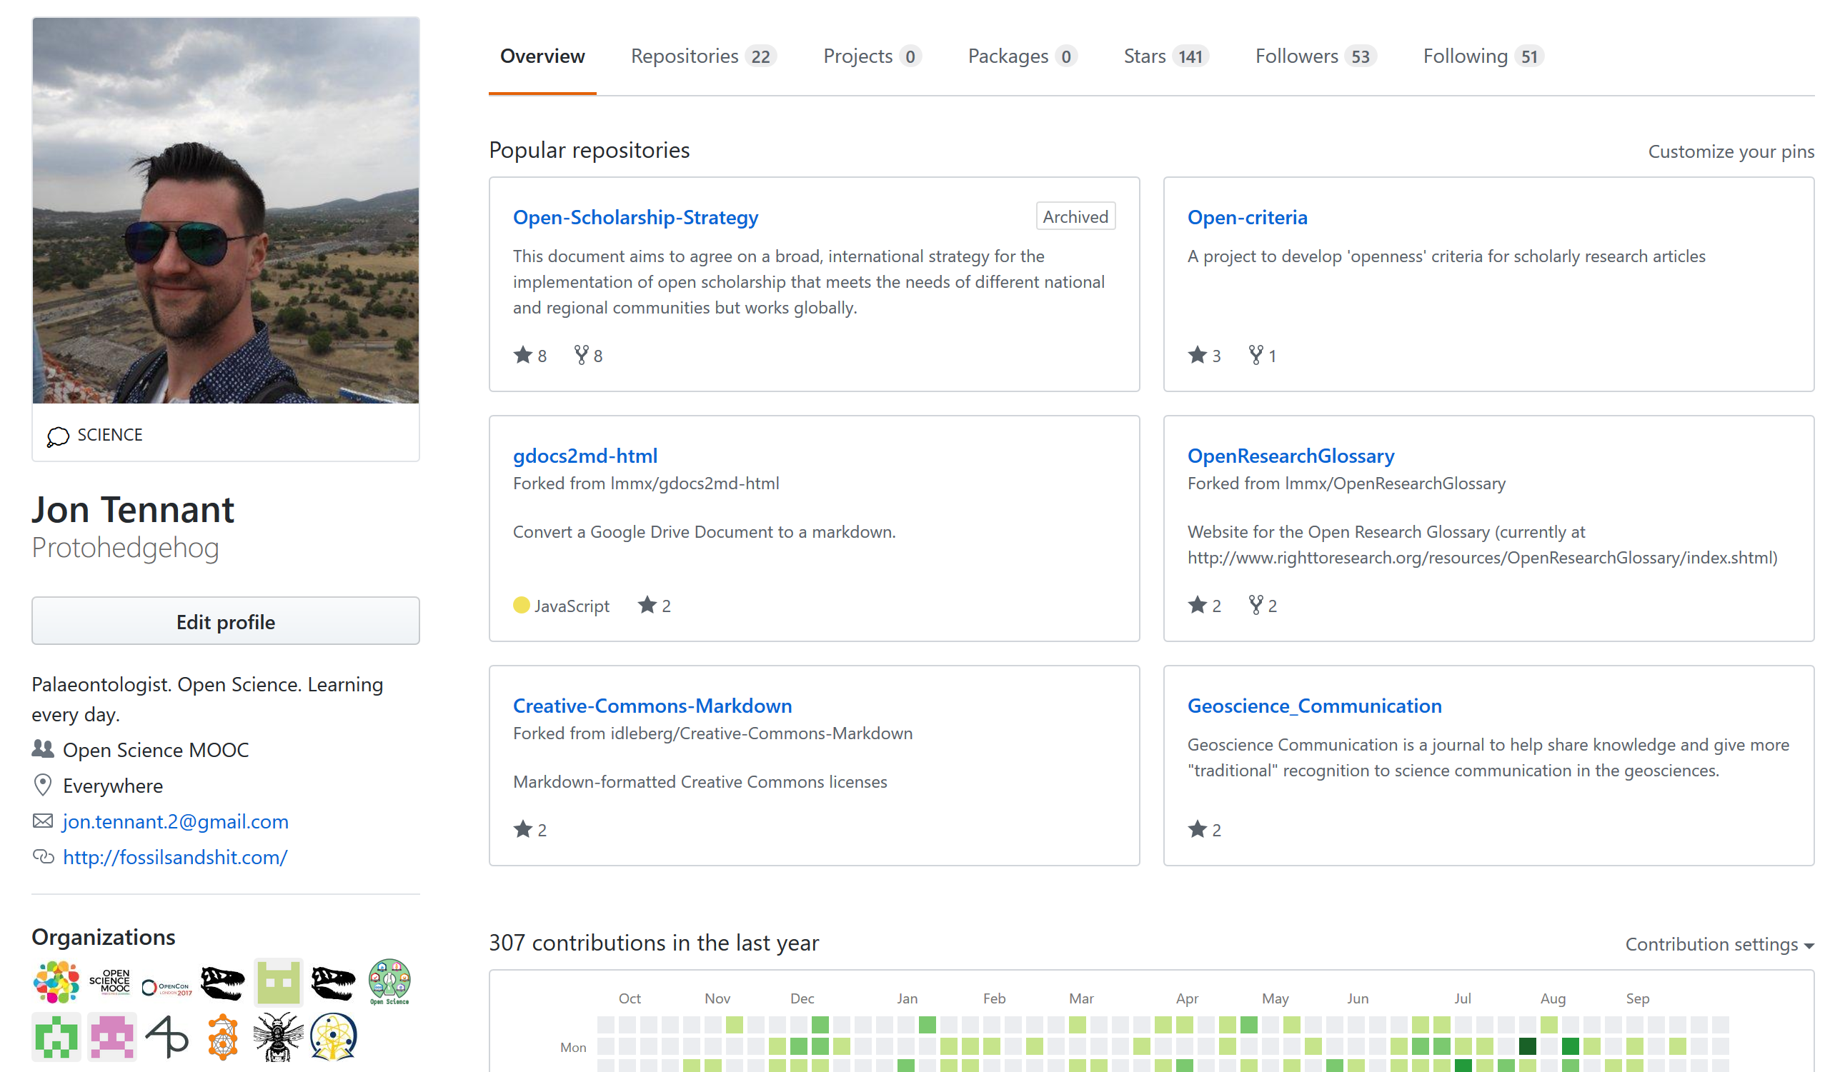
GitHub
Not just for coders
Large community
Project management
Website deployment
Owned by Microsoft

Slide 6
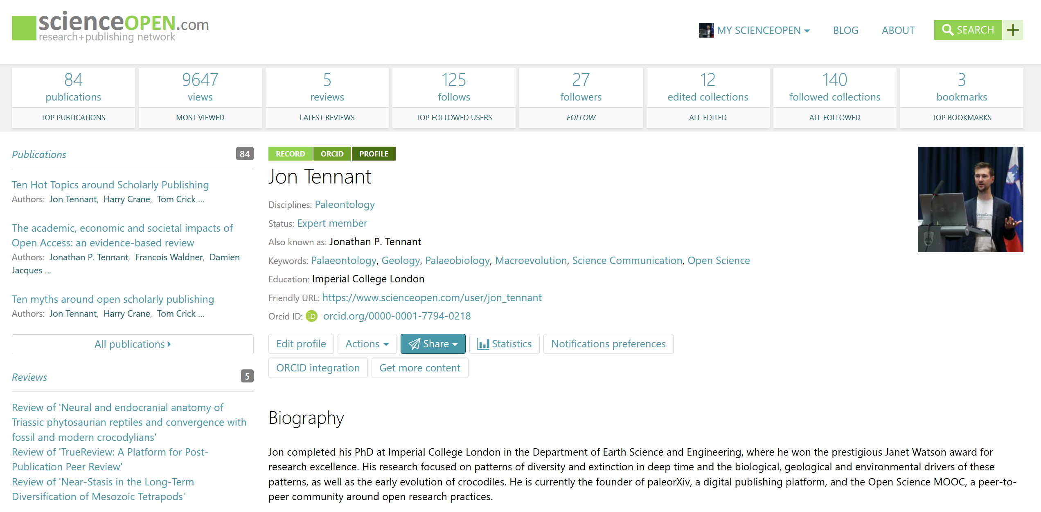
ScienceOpen
Integrated with ORCID
Collections
Peer review
User dashboard
Not Open Source
https://www.scienceopen.com/user/jon_tennant

Slide 7
Publons
Peer review record
Editorial record
Integrated with ORCID
Integrated with WoS
Owned by Clarivate Analytics
https://publons.com/researcher/193456/jonathan-p-tennant/

Slide 8
Kudos
Free
Impact grower
Simple
Integrated-ish
Not Open Source
https://www.growkudos.com/

Slide 9
Mendeley
Owned by Elsevier
Use Zotero instead
https://bit.ly/2PPjwRK - Democratising knowledge: A report on scholarly publisher Elsevier

Slide 11
https://twitter.com/brembs/status/1100713883373838337

Slide 12
https://zenodo.org/record/3417484#.XYYuoGaxXZs via Peter Kraker

Slide 13
ResearchGate
https://www.nature.com/articles/d41586-018-06945-6

Slide 14
Academia.edu
https://osc.universityofcalifornia.edu/2015/12/a-social-networking-site-is-not-an-open-access-repository/

Slide 16
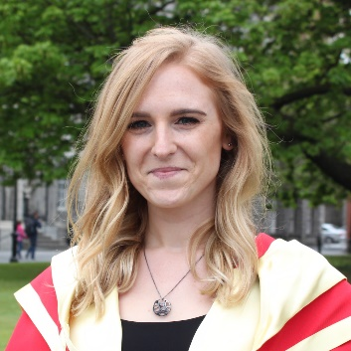
It’s your work. Publish where you want. But don’t lock it up.

Slide 17
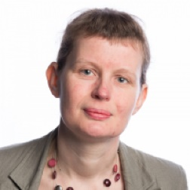
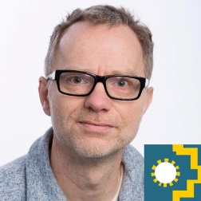
Notes:
17

Slide 18
Pro-tips
Get a personal website
Avoid ‚platform fatigue‘
Think sustainably and strategically
Beware of vendor/user lock in
Find a way to be unique
Leader or sheep?
Love your librarian

Slide 19
Further reading and resources
Task 2, Module 1, of the Open Science MOOC
Who isn‘t profiting off the backs of researchers, Discover Magazine
Dear scholars, delete your account at Academia.edu, Forbes
101 Innovations in Scholarly Communication: How researchers are getting to grip with the myriad of new tools, by Bianca Kramer and Jeroen Bosman

