Slide 1
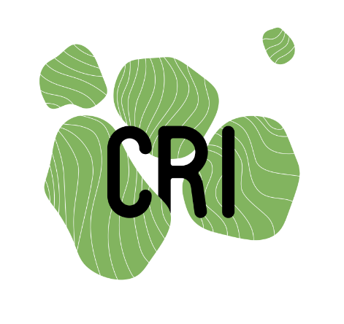
How to social media like a pro
Dr. Jon Tennant
@protohedgehog
Odense, Denmark Oct 3rd, 2019
https://orcid.org/0000-0001-7794-0218

Slide 3
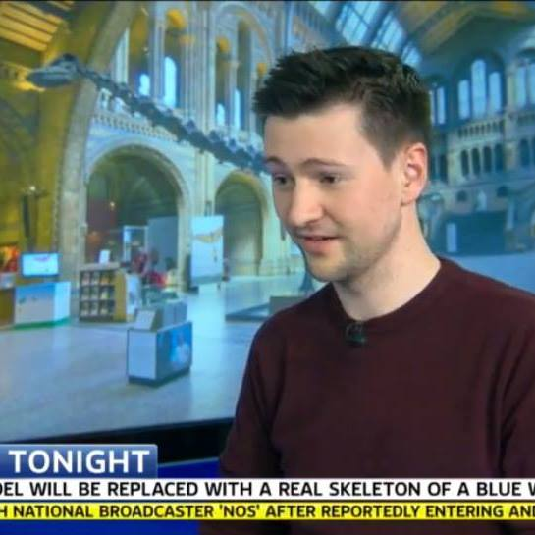
My credentials – back in the day
https://www.nature.com/scitable/blog/earthbound/
https://blogs.egu.eu/network/palaeoblog/
http://www.palaeocast.com/
Used to give these talks/workshops during my PhD via the Science Communication Forum
Freelancer writer: The Conversation, Discover Magazine, BBC Wildlife, Earthtouch, Nature Earthbound
Experience working in science policy in the UK

Slide 4
My “credentials” - 2019
http://fossilsandshit.com/
Community Editor, PLOS Paleo
Freelance science and science communication consultant
Work appears pretty much all over
Mostly now focussed on open scholarly communication
Still not really sure what I’m doing
https://twitter.com/Protohedgehog

Slide 5
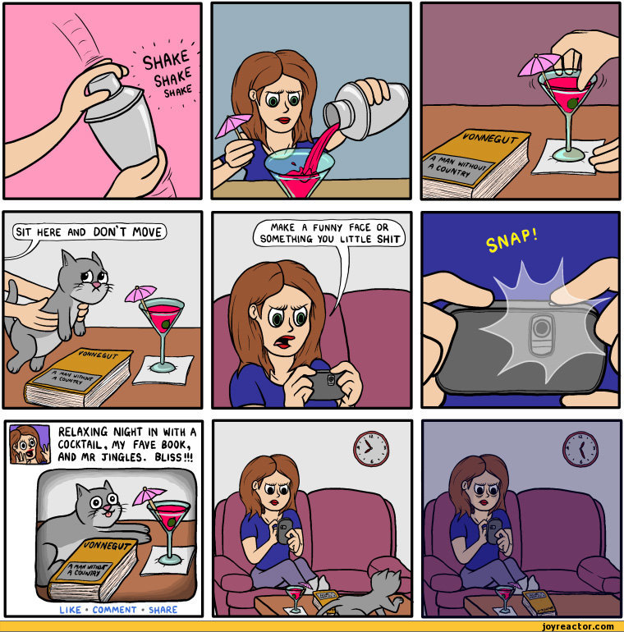

Slide 6
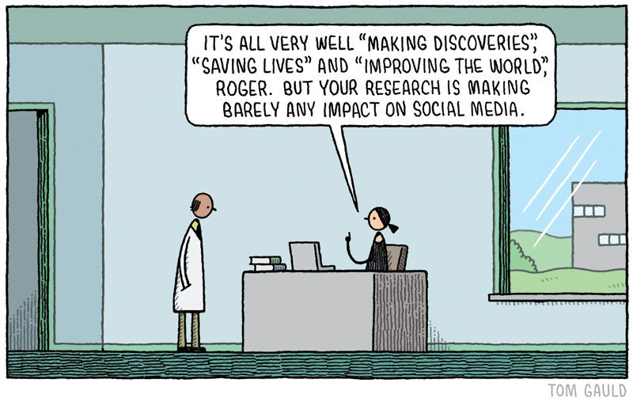
So, for scientists, what‘s all the fuss about?
Broadcasting your work
Conversations and networking
Jobs! Grants! Events! Opportunities
Advice and support
#openscience #openaccess #opendata #PhDchat
New skills
Increasing your digital impact
Inspiration and creativity

Slide 7
Blogging
Pros
Cons
Opens up your research
Combines access & accessibility
Reach new audiences
Feedback about your research
Natural development of your online profile
A record of your research and thoughts
Impact case studies
Time. Never enough time
Privacy and over-sharing
Can be seen as ‘self-promotion’
Requires a strategic approach
Not “peer reviewed”
Can detract from research time
Energy consuming
Requires commitment

Slide 8
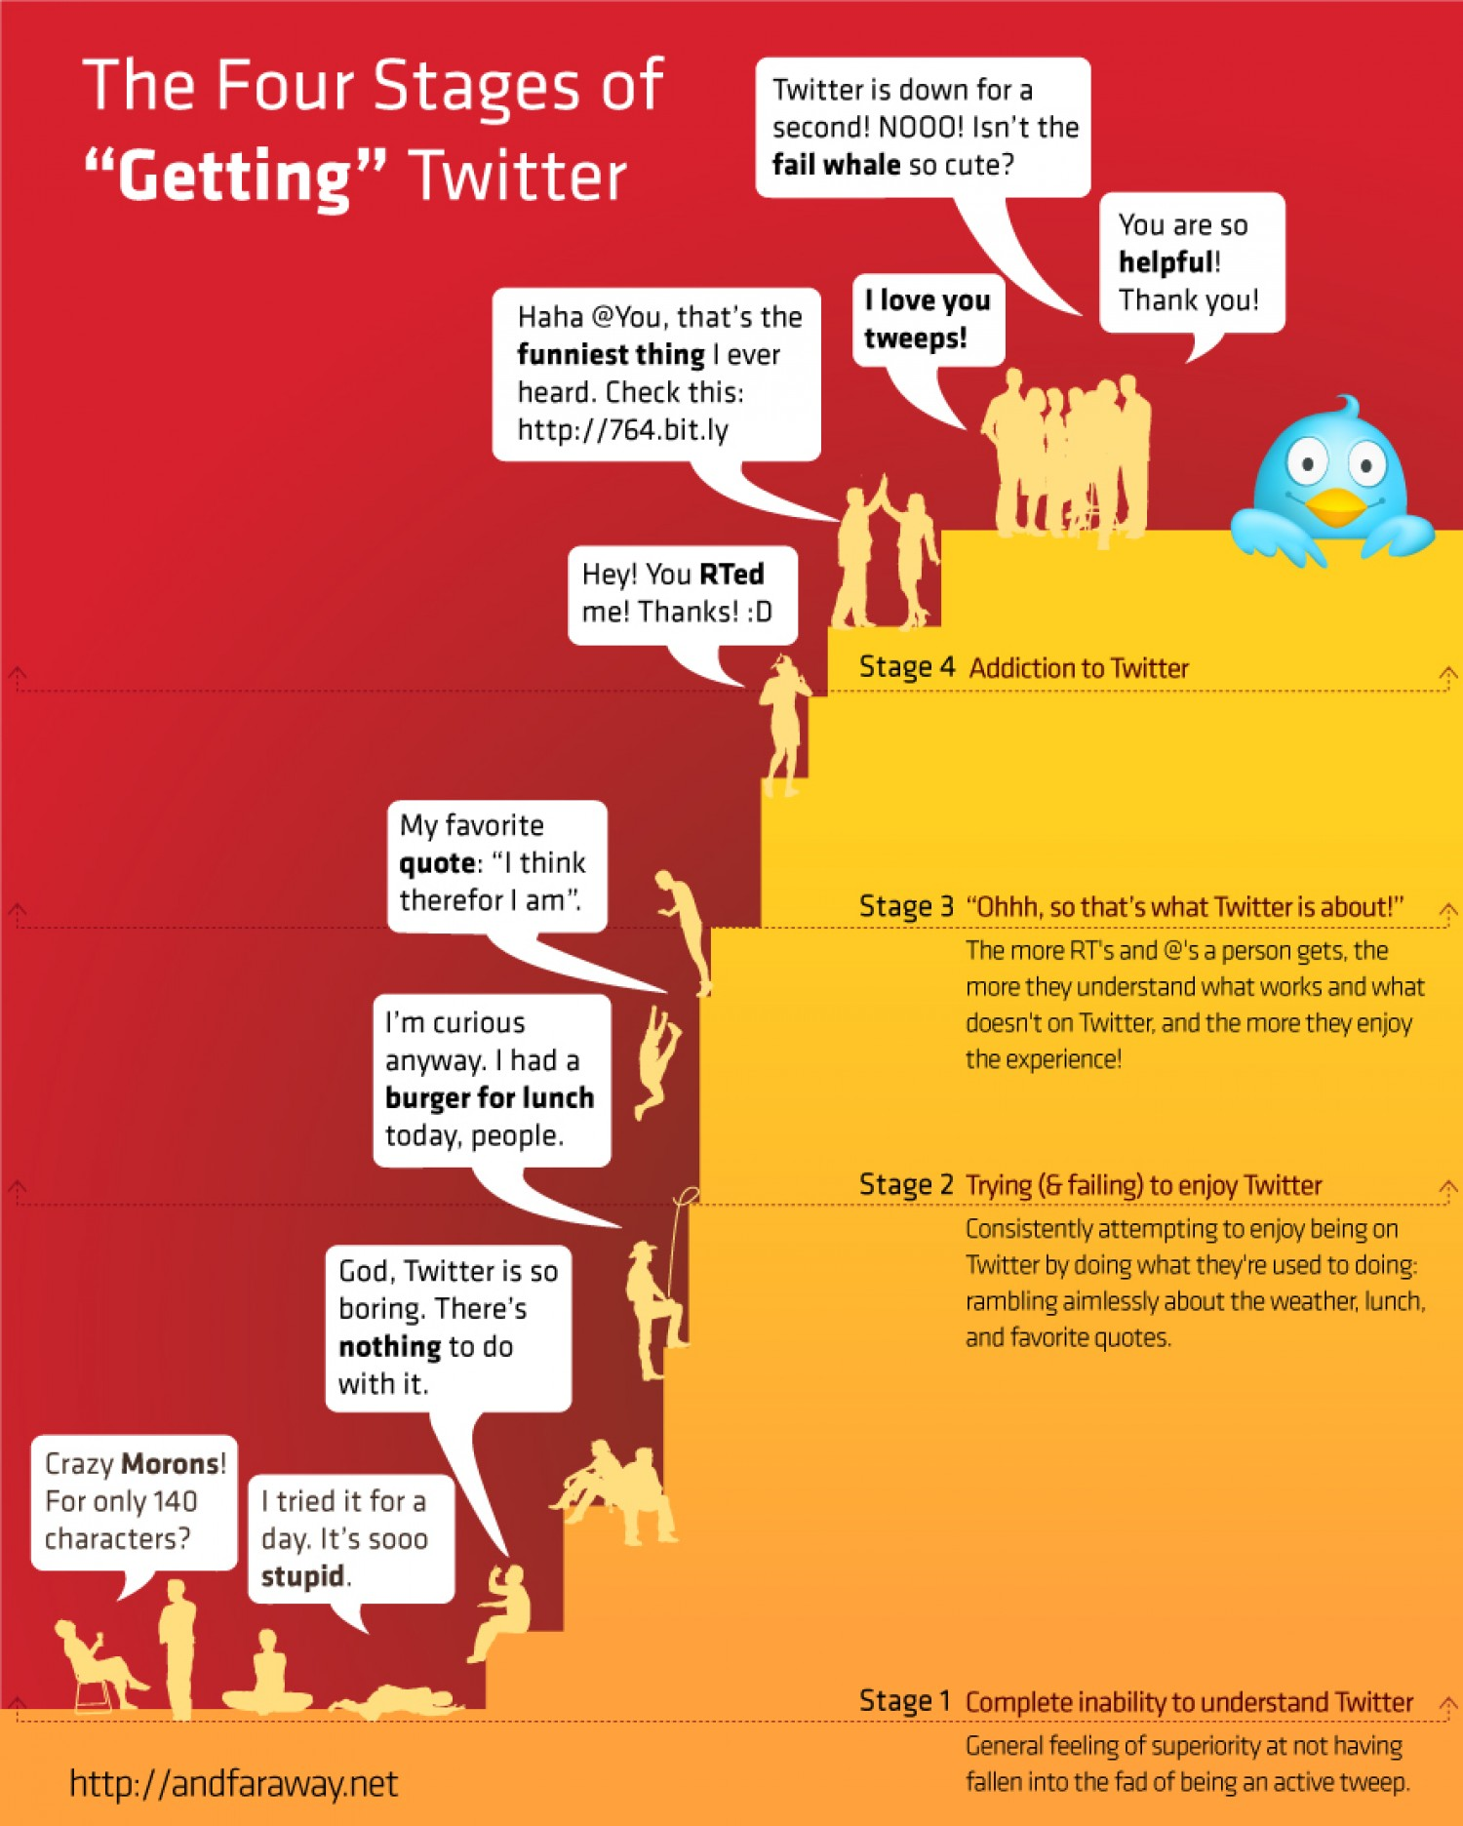
Twitter
Good for: Soundbiting, conversations, virtual conferences
How to use: With caution
How I use: Strategically
Good examples: WhySharksMatter, DaniRabaiotti, DrShaena
Cons: Highly addictive

Slide 9
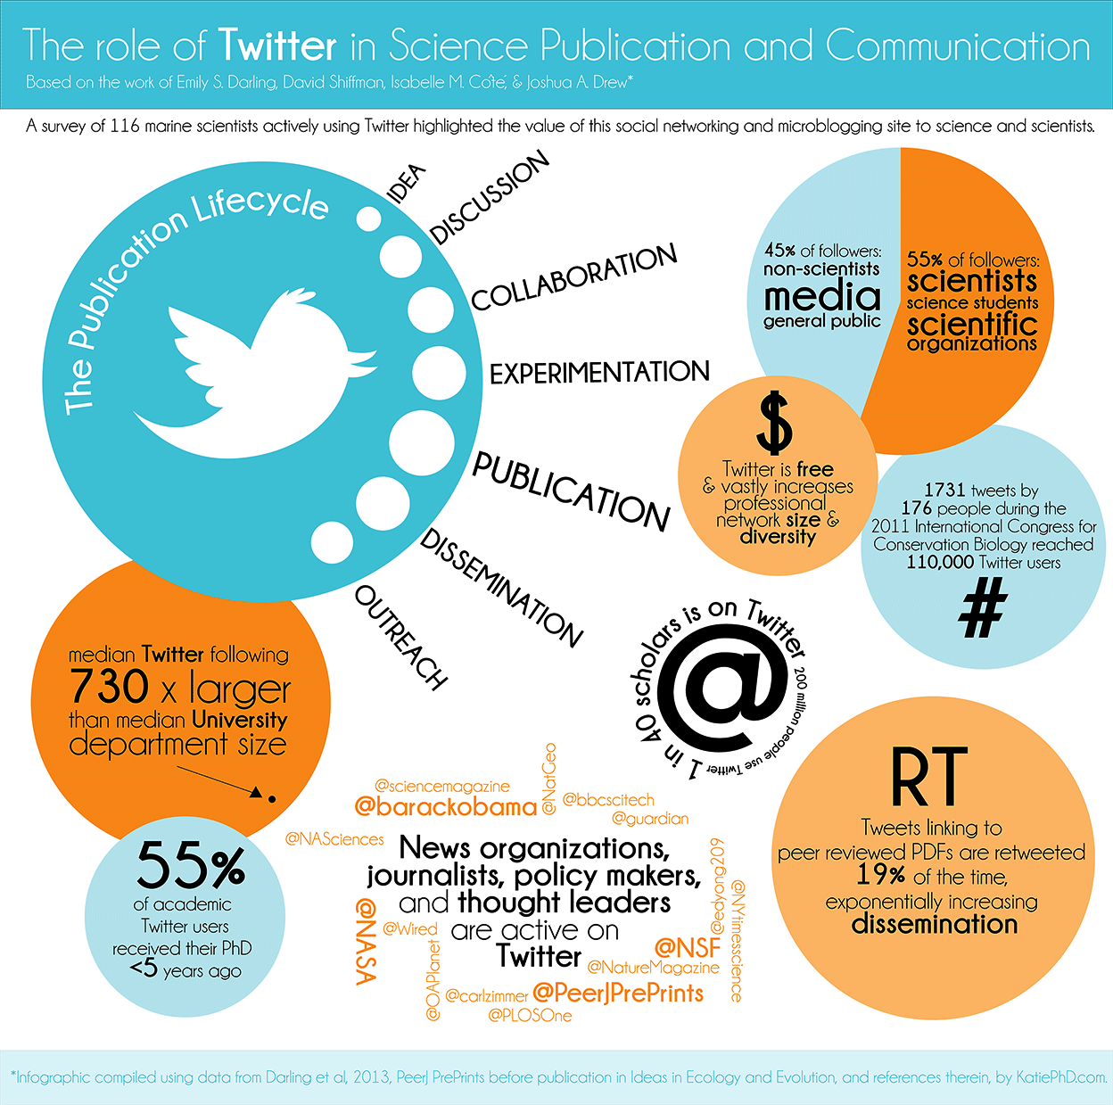

Slide 11
Twitter
https://twitter.com/Protohedgehog/status/1178684430933733377

Slide 14
Facebook
Good for: Maintaining friendships online, stalking
How to use: Sharing papers, groups and pages
How I use: Small groups, posting updates, messenger function
Cons: It’s Facebook
https://www.facebook.com/OpenScienceMOOC/

Slide 15
LinkedIn
Good for: Digital CV for your academic and non-academic work
How to use: Join relevant groups, follow people
How I use: Post updates or articles

Slide 16
YouTube
Good for: Videos
How to use: Creating channels
How I use: Playlists for the Open Science MOOC
Downsides: Takes a lot of time, effort, and often money
Takes sustained commitment to build a following
https://www.youtube.com/channel/UCuRYnv28aGLz6iyxduJhf9g?view_as=subscriber

Slide 17
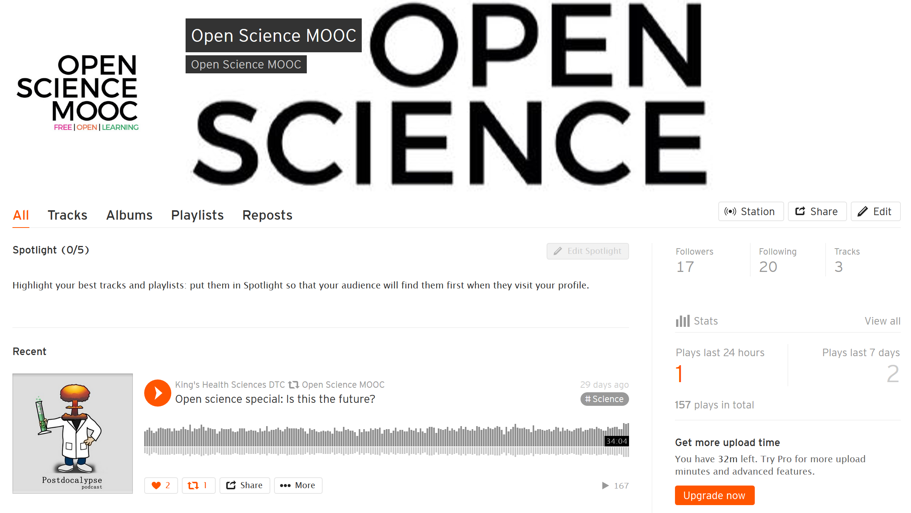
Soundcloud
Good for: Audio
How to use: Podcasts
How I use: Podcasts for the OS MOOC
Cons: Time, effort, money
https://soundcloud.com/open-science-mooc

Slide 18
Instagram
Good for: Pictures
How to use: Pretty pictures of science, projecting a false image of reality, turning your lack of meaningful talent into being an ‚influencer‘....
How I use: NA
https://www.instagram.com/igdoreinstitute/

Slide 19
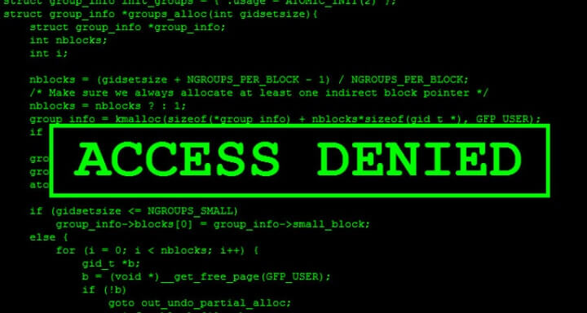
WhatsApp
Good for: Instant messaging
How to use: Message instantly, group functions
How I use: Combined professional/personal relationships
Alternatives: Signal, Telegram

Slide 20
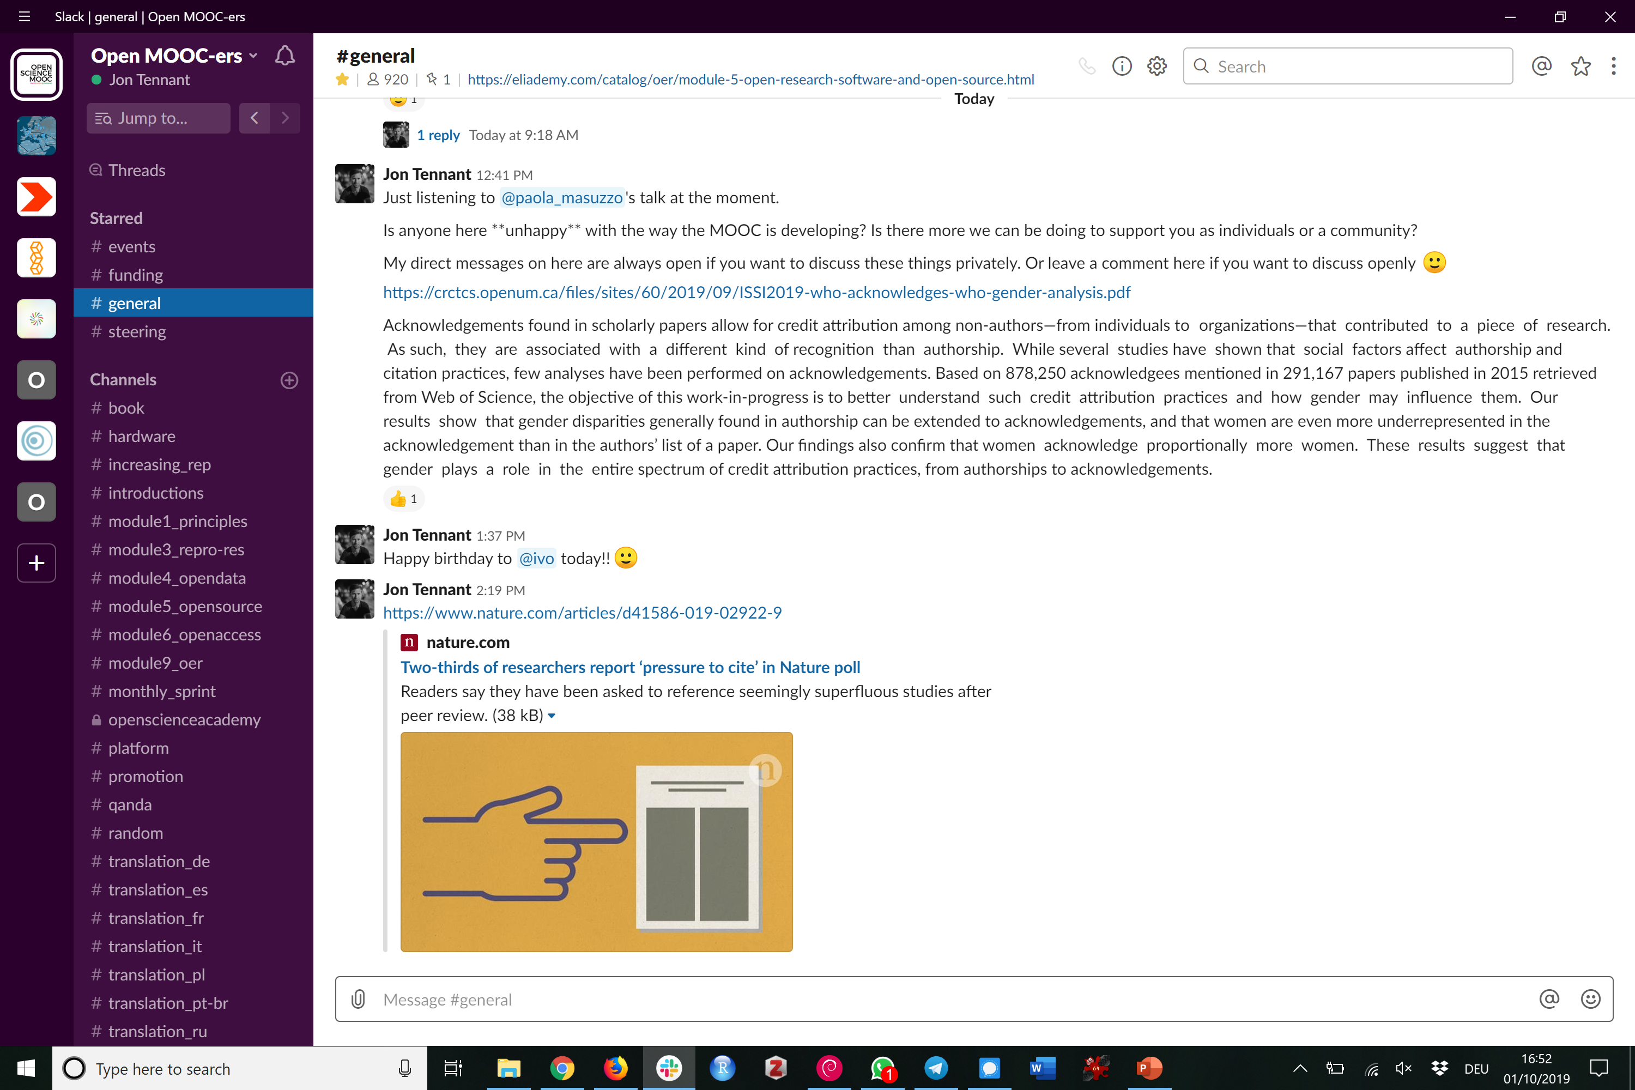
Slack
Good for: Large communities, instant messaging
How to use: Community management
How I use: Multiple community communications
Good examples: Lecturers Without Borders, ASAPbio
Cons: Size goes up, costs go up
https://osmooc.herokuapp.com/

Slide 21
Token inspirational quote
"As the open science movement is demonstrating, the solitary genius of individuals is rarely superior to the speed and power of expert networks. We are stronger, wiser, and more creative as a community. And we are going to need all of that." - @LizNeeley, 2013.
http://blogs.nature.com/soapboxscience/2013/05/15/science-communication-at-a-tipping-point

Slide 22
Final pro-tips
Be brave. Be honest
Find your voice and radiate your personality
Find a strategy for what works best for you
You will not become a social media pro overnight
Do not purely self-promote
Amplify others, not just yourself
Find a community
Don’t pressurise yourself

Slide 23
Further reading
Why I tweet, by Manu Saunders
Social media for academics, by Mark Carrigan
An introduction to social media for scientists, by Bik and Goldstein
Using selfies to challenge public stereotypes of scientists, by Jarreau et al.
Scientists on Twitter: Preaching to the choir or singing from the rooftops?, by Côté and Darling
Social media as a scientist: a very quick guide, by Jack Leening
Ten simple rules for live tweeting at conferences, by Ekins and Perlstein
Ten simple rules for effective online outreach, by Bik et al.
Ten simple rules for building and maintaining a scientific reputation, by Bourne and Barbour

