Slide 1
Create a National Network of Scientists
Notes:
VIVO is an effort funded by the National Institutes of Health, to create a national network of scientists. The network is data and tools which fit together to enable a broad collection of scientific activities.

Slide 2
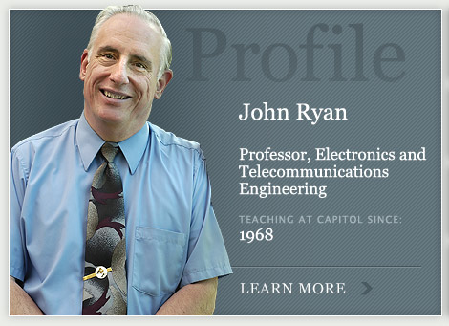
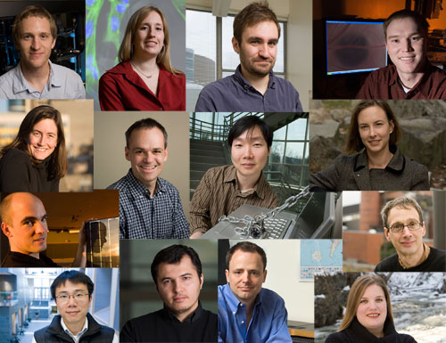
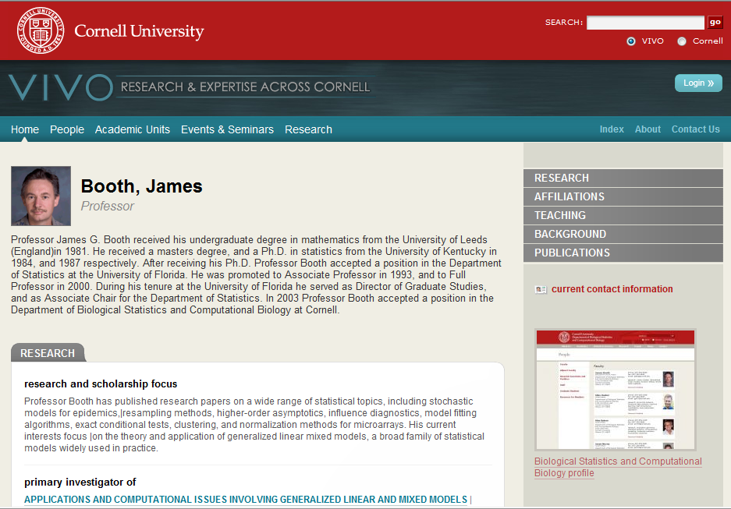
Public data about scientists’ interests, activities and accomplishments
Notes:
VIVO will provide data about an institution’s scientists, as many faculty profiling systems and web sites do now. At each school, VIVO enables research discovery – providing information about research and researchers. Across institutions VIVO provides a uniform semantic structure to enable a new class of tools using the data to advance science. Each institution provides its own VIVO system and data. Local governance determines data to be provided.

Slide 3
Notes:
More tools -> more scientists; more scientists -> more tools. Biochemistry department at Stanford

Slide 4
Ribbon schematic (hand drawn & colored, in 1981) of the 3D structure of the protein triose phosphate isomerase
Notes:
: Ribbon schematic (hand drawn & colored, in 1981) of the 3D structure of the protein triose phosphate isomerase. The barrel of 8 beta-strands is shown by green arrows and the 8 alpha-helices as brown spirals. By Jane Richardson
Today’s science is team science – proteomics, the study of protein distributions in cells, requires specialists in computer science, mathematics, imaging, visualization, statistics, stochastic modeling

Slide 5
Tools for science
Notes:
The national network is people, data and tools for science. VIVO will collaborate with tool builders to provide data about scientists to tools. In this way, data is not replicated into the tools, but rather stays with the institution and the scientist.

Slide 6
Record data as triples:
subject, predicate, object

Slide 7
Every piece of data has an address
Notes:
VIVO uses linked open data concepts to provide data as RDF at URIs for each scientist.

Slide 8
Faculty express interests using Controlled Vocabularies
Notes:
Controlled vocabularies, represented in Ontologies are used to express faculty research interests, providing precision and hierarchy of concepts.

Slide 9
Institutions record activities
Notes:
Additional data for VIVO comes from existing institutional sources, such as Human Resources systems and faculty activity systems.

Slide 10
Archives record accomplishments
Notes:
Archives

Slide 11
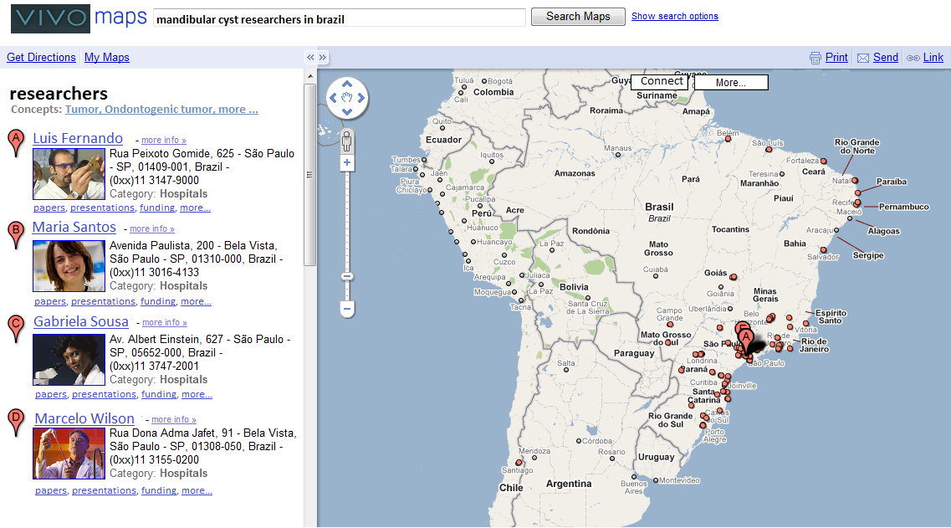
Find Scientists
Search for Science

Slide 12
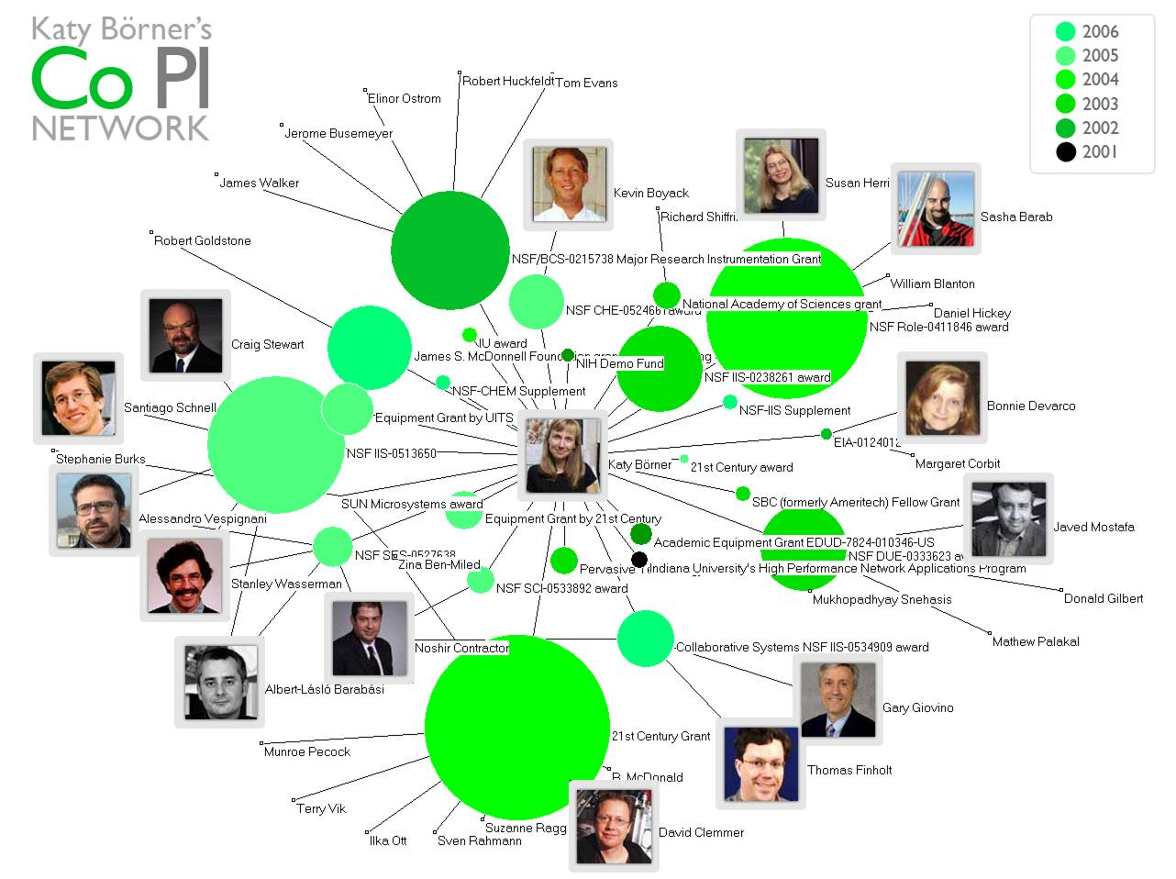
Study
Science

Slide 13
Information about Science

Slide 14
Teaming Tools

Slide 15
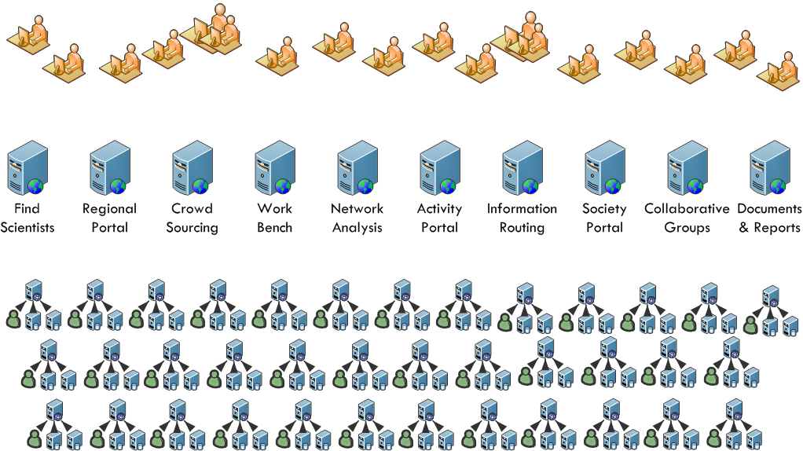
Data, Tools, Scientists
Notes:
A collection of VIVO systems at institutions provide data to a national collection of applications. Applications take many forms and will come from many sources. Applications rely on VIVO and compatible systems to provide data about scientists’ interests, activities and accomplishments. Scientists use these applications to find scientists, participate in teams, get current information about science, study science and simplify science.

Slide 16
Collaborate with everyone

Slide 17
Open software, open ontology, open process

Slide 18
Notes:
In the end, it’s about people. People who do science. People who support science. People who study science. VIVO provides a social fabric for science. For who we are. For what we learn. For what we build. For what we discover.

Slide 19
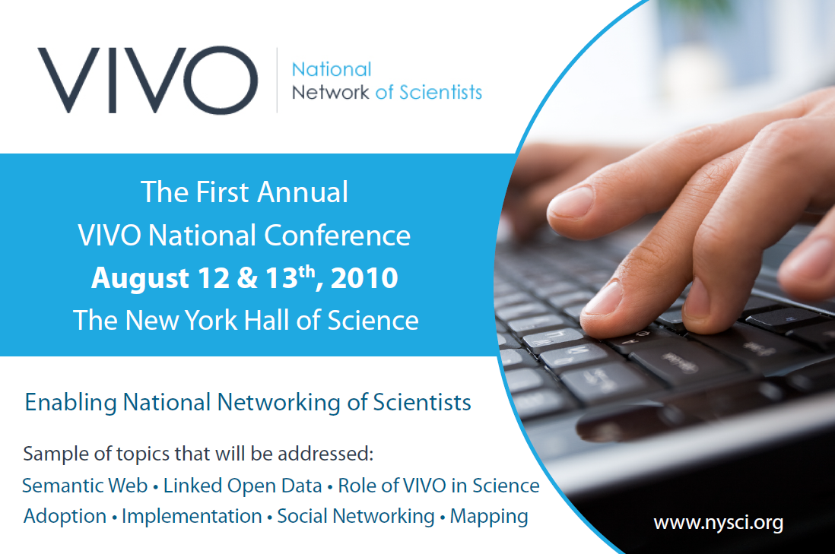
Notes:
Conference postcard

Slide 20
VIVO
www.vivoweb.org
Notes:
VIVO is looking for collaborators. Schools to adopt VIVO for their scientists. Data providers – publishers, agencies, aggregators. Developers building tools. Visit our web site to learn more.

