Slide 1
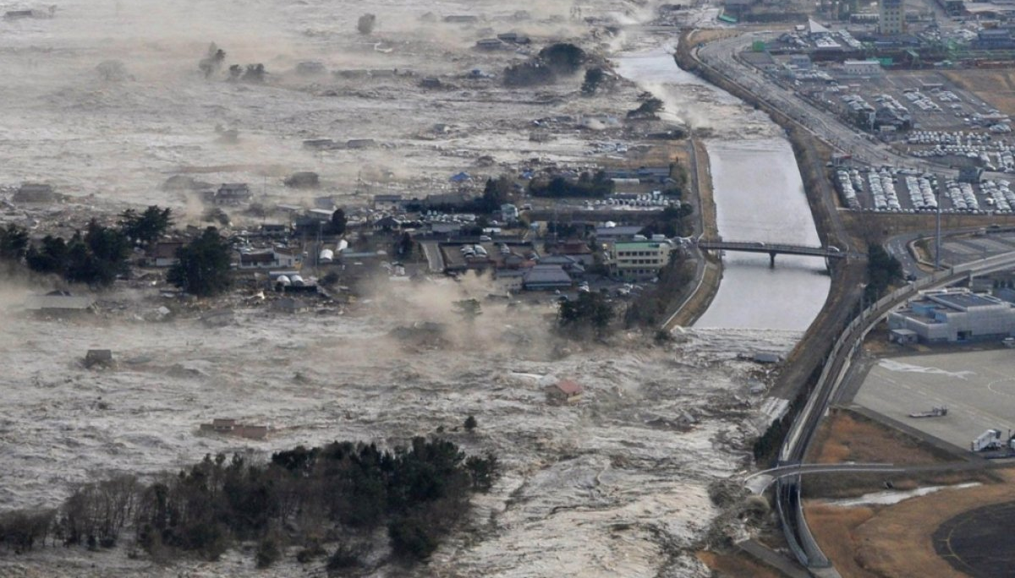
Resolving the tsunami wave: interpreting palaeotsunami deposits by integrating numerical modelling and sedimentology
Jon Hill
Graham Rush, Luke Hodson, Jeff Peakall, Natasha Barlow, Roland Gehrels, Dave Hodgson

Slide 2
Acknowledgements
Dr Sue Dawson
Prof Matt Piggott
Prof Alistair Dawson
Frances Taylor
Charlotte Desmond
Ashley Elliot
Jenna Mohan
Dr Lis Bowman
Dr Georges Kesserwani

Slide 3
Feel free to…
Tweet (@jonxhill)
Take picture/videos
More info:
10.6084/m9.figshare.9861263
https://envmodellinggroup.github.io/

Slide 4
Japan, 2011
Notes:
Kuji port, north end of the main island. North of Sendai

Slide 5
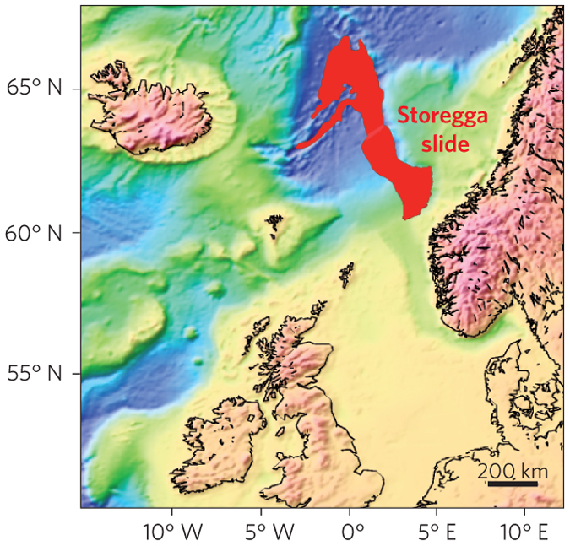
Storegga: largest tsunamigenic submarine slide
3000km³ of sediment.
1-2 degree slope.
Estimated run-ups of 20m in Norway, Faroes and Shetlands.
8150 yr (autumn)
Bondevik et al. (2005)

Slide 6
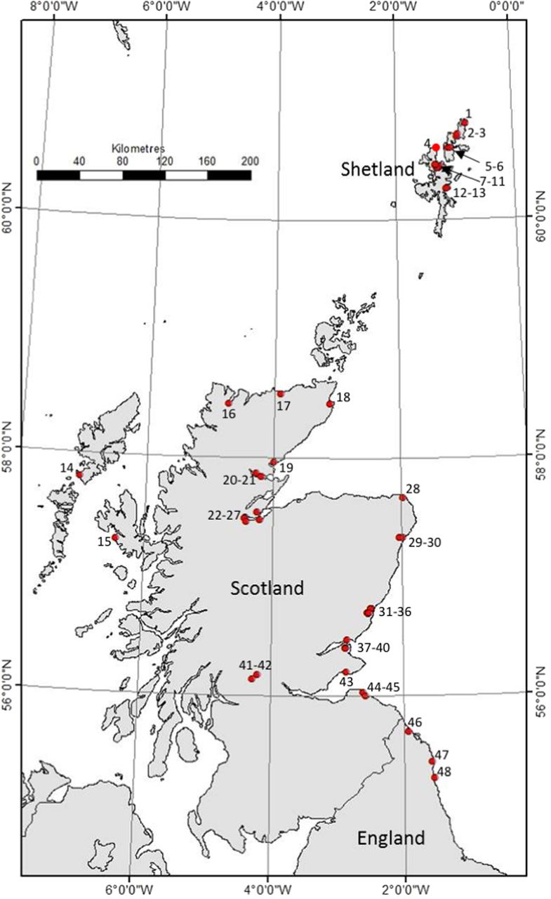
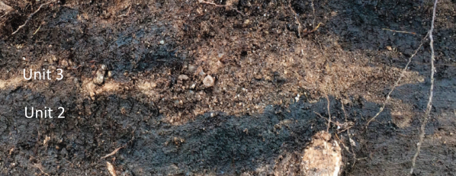
Storegga deposits
Long, A. J, et al. 2016. Journal of Quaternary Science 31 (3): 239–55.
Long, D., 2018. Geological Society, London, Special Publications 456, 143–165.

Slide 7
Hill, J., et al.2014. Ocean Modelling 83 (0): 11–25.
https://fluidityproject.github.io/

Slide 8
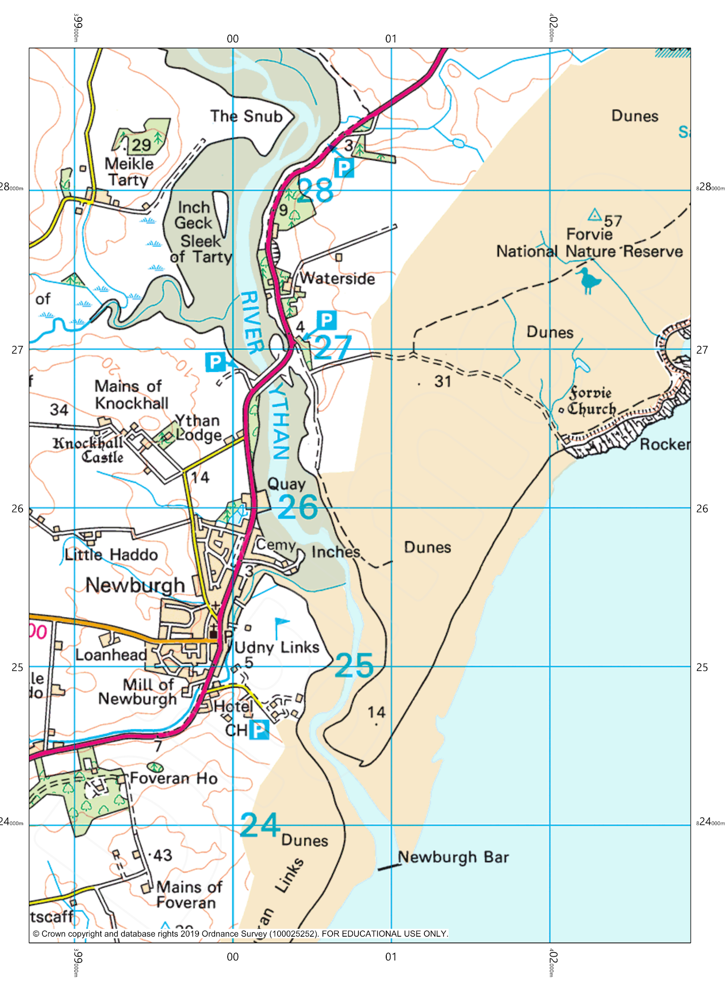
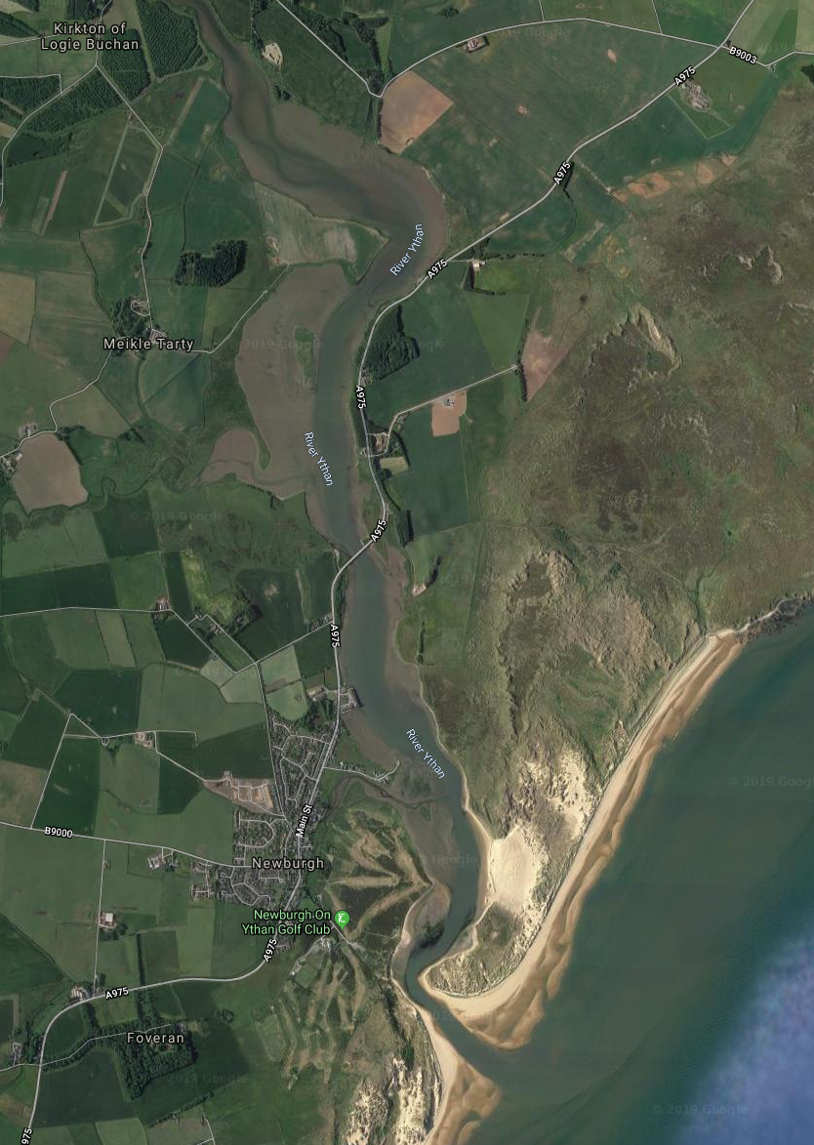
Ythan valley

Slide 9
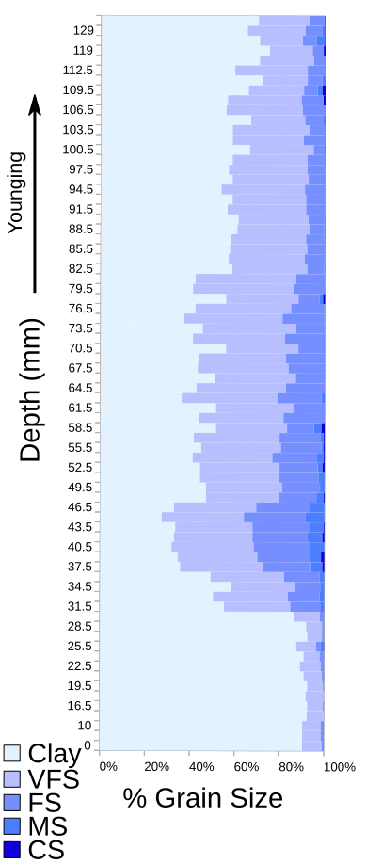
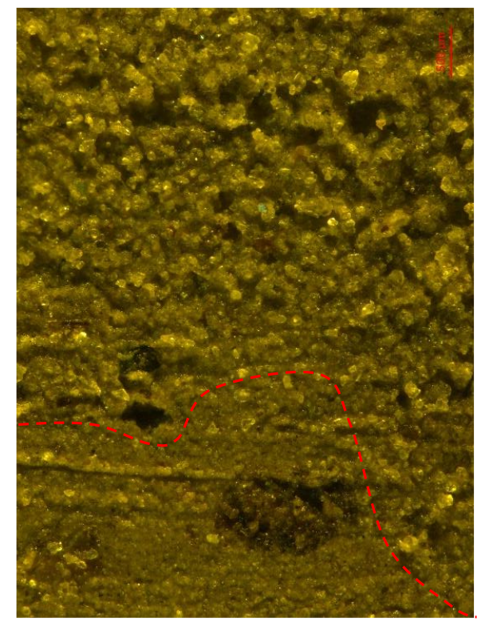
Core A004

Slide 10
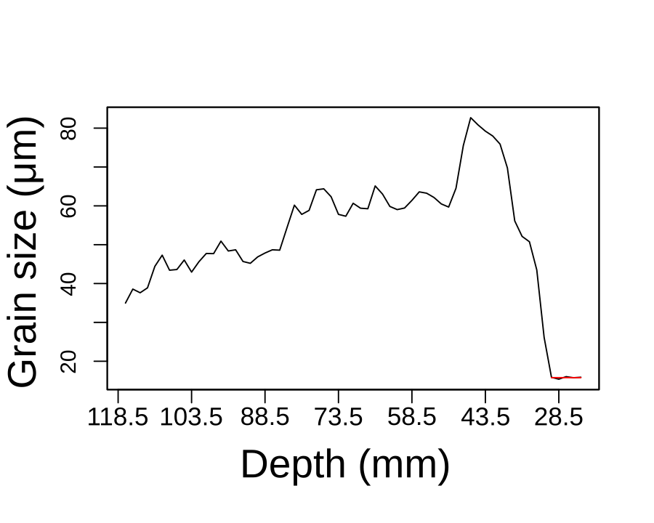
Core A004

Slide 11
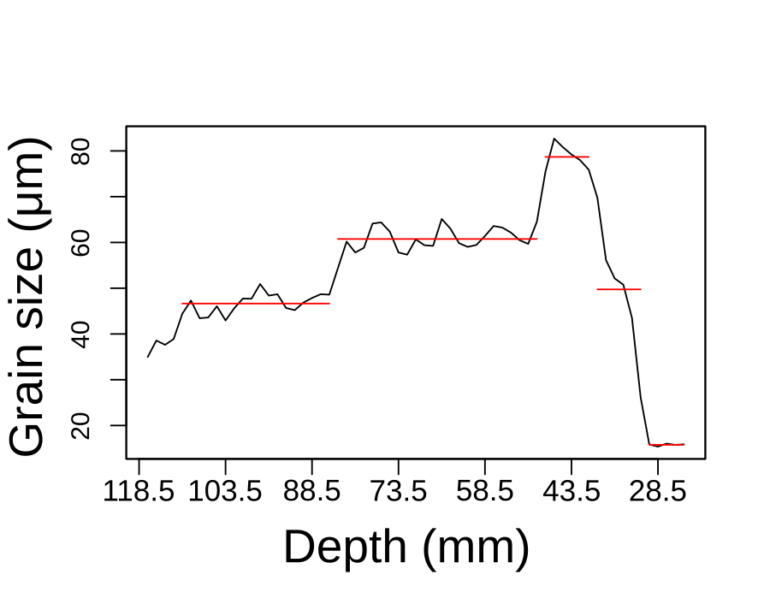
Core A004

Slide 12
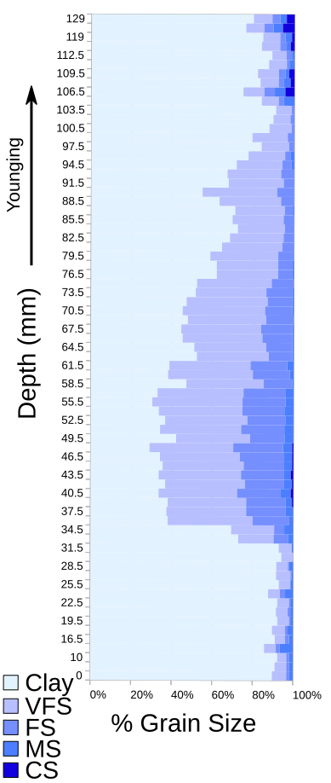
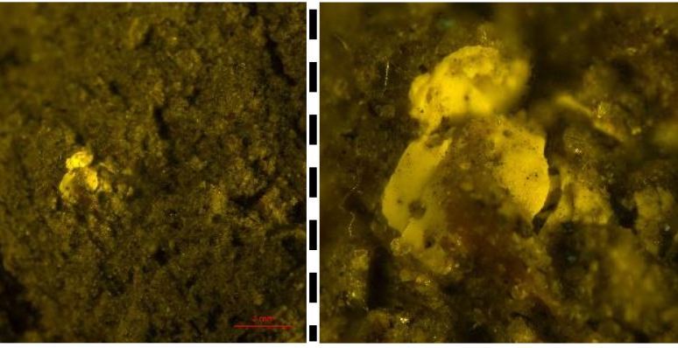
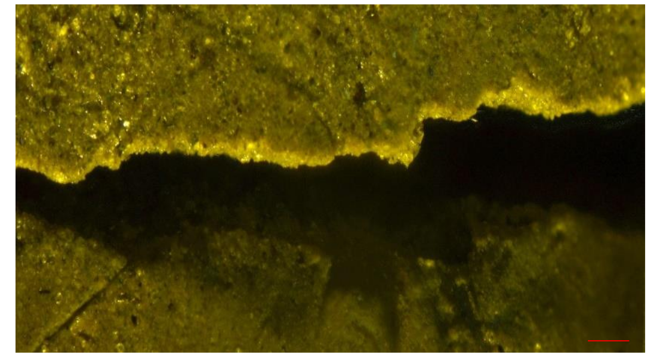
Core B003

Slide 13
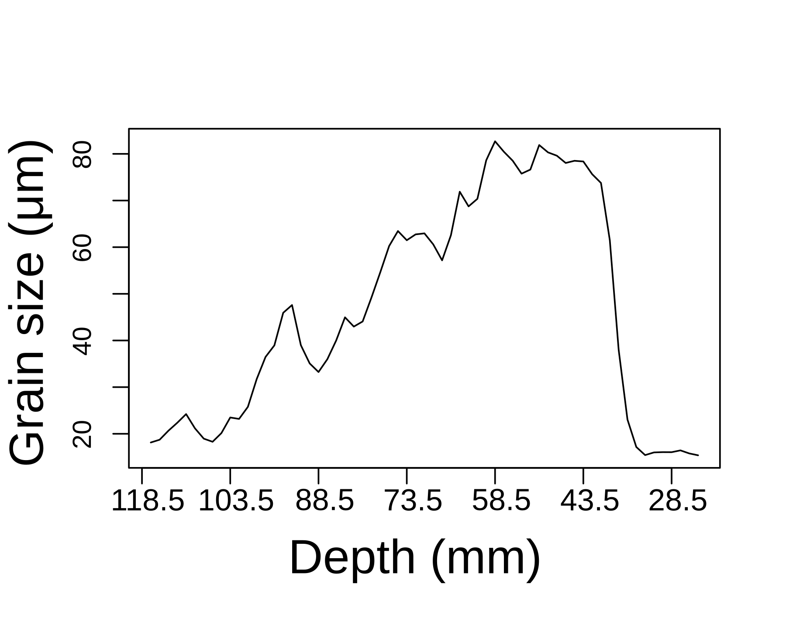
Core B003

Slide 14
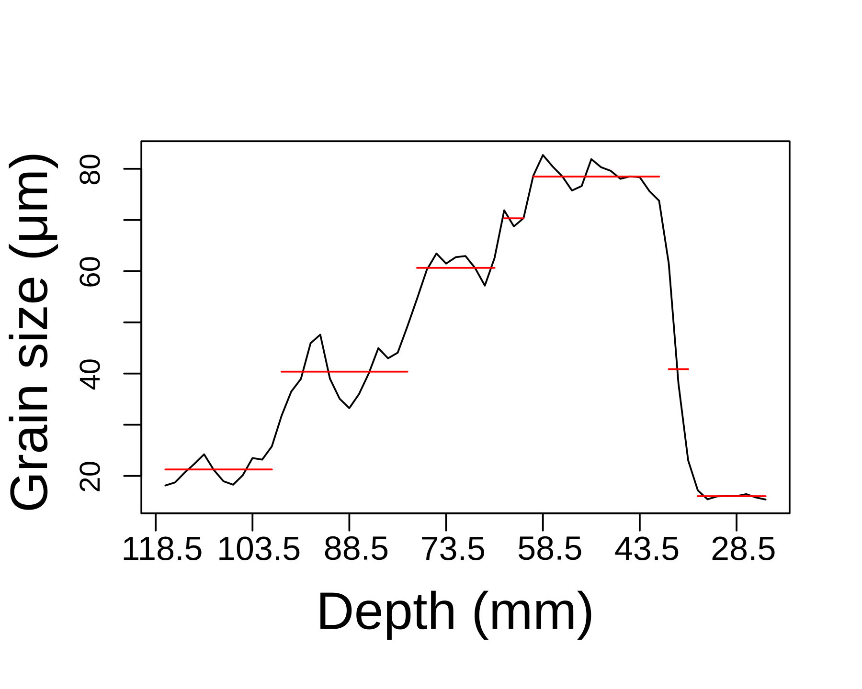
Core B003

Slide 15
Hill, J., et al.2014. Ocean Modelling 83 (0): 11–25.
https://fluidityproject.github.io/

Slide 16
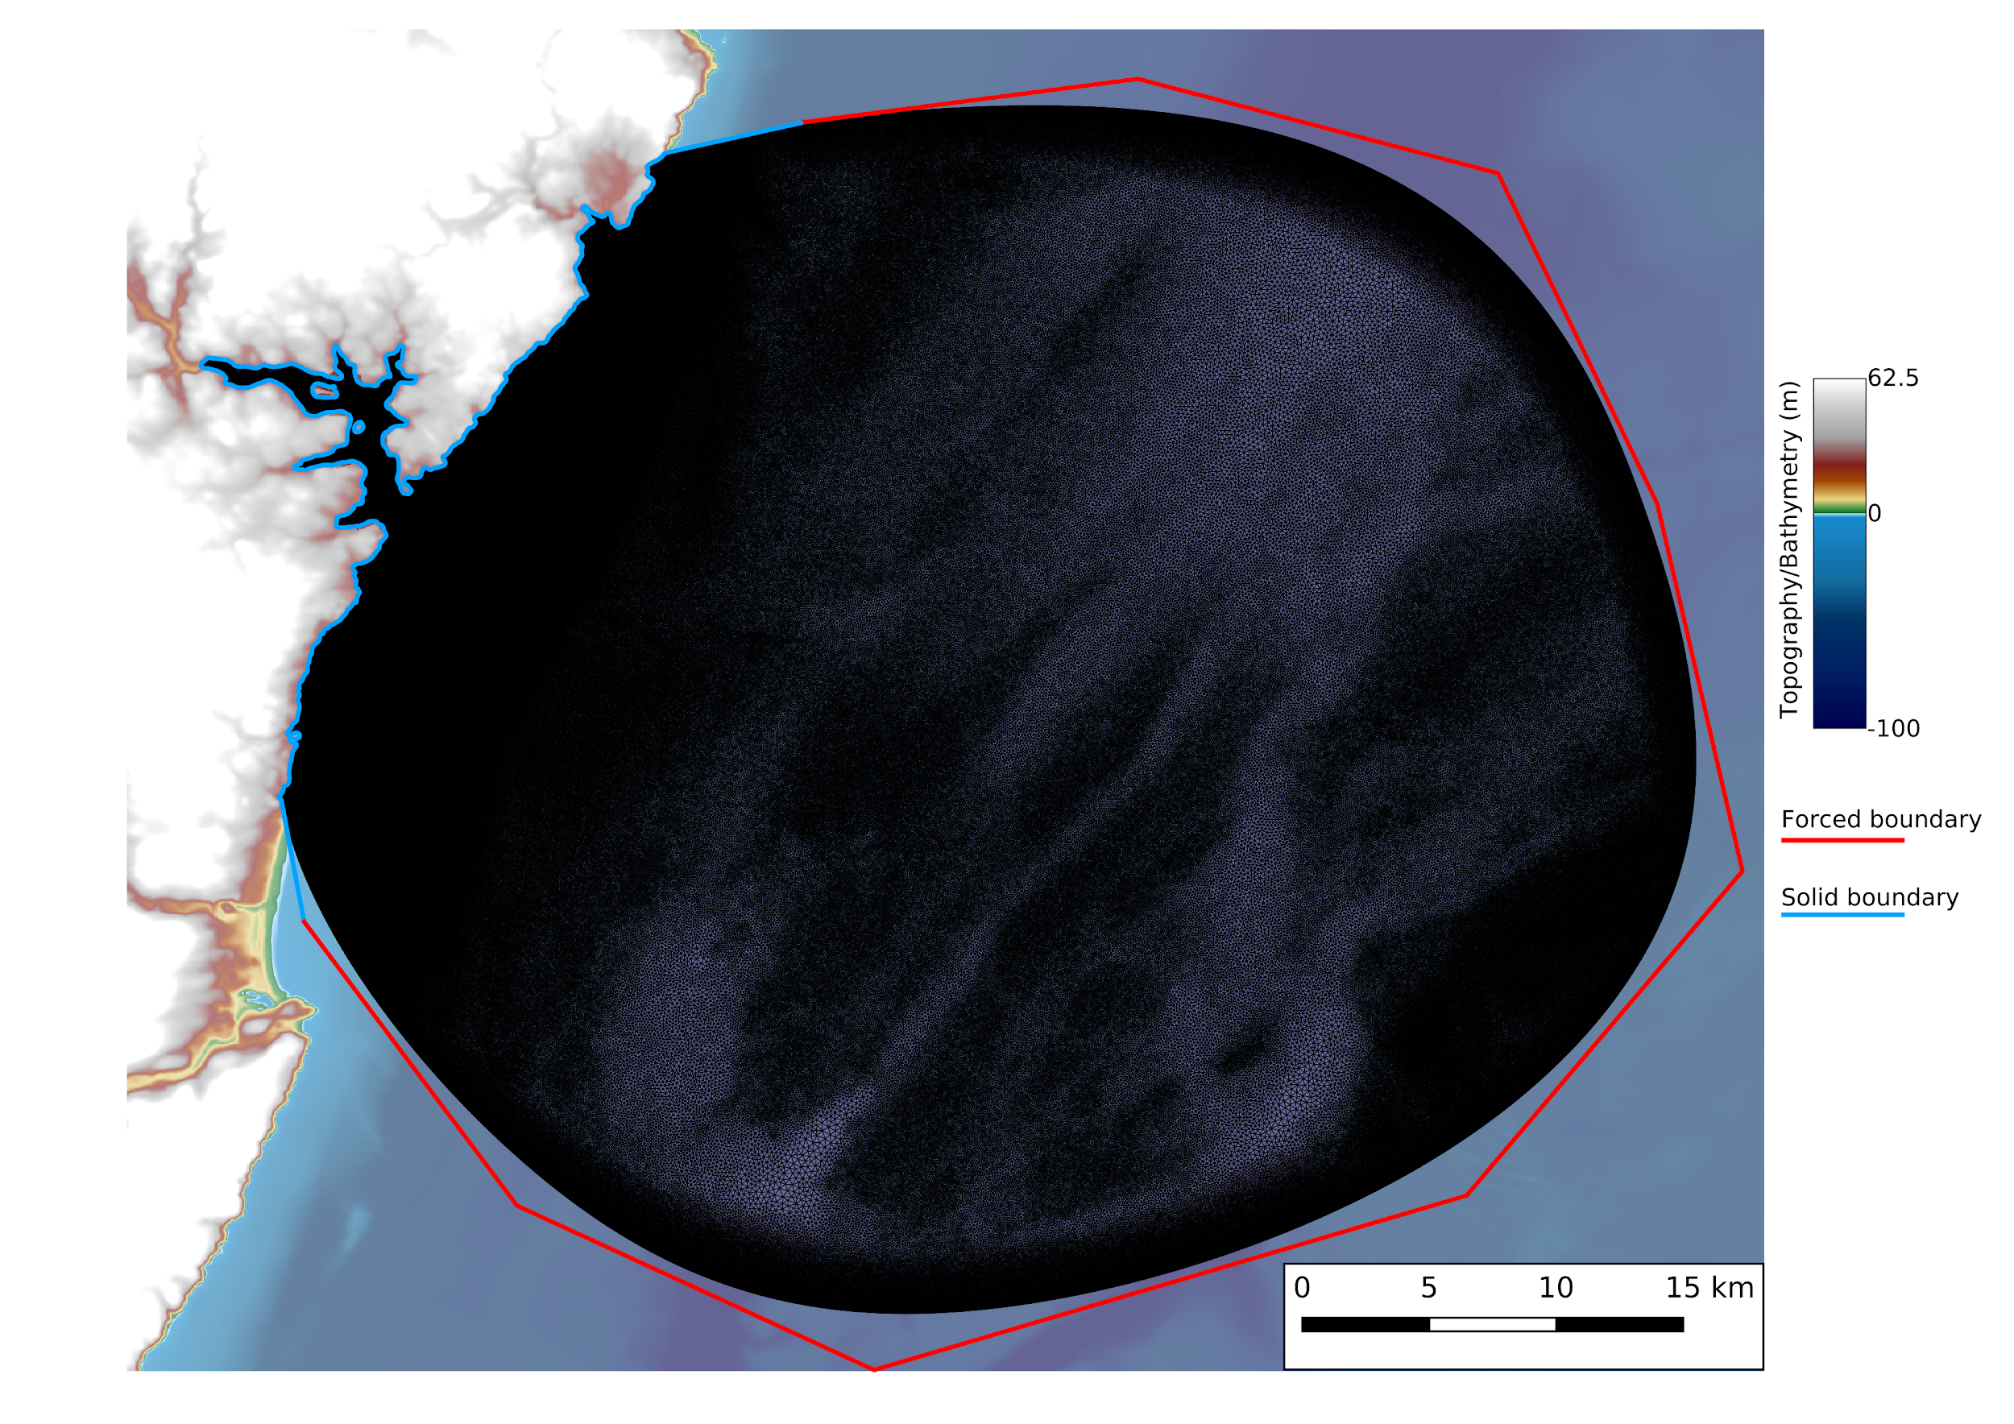
https://thetisproject.org/
github.com/EnvModellingGroup/hrds
Hill, 2019. 10.21105/joss.01112

Slide 18
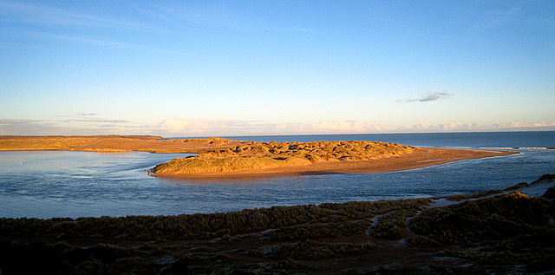
Palaeo-geomorphological reconstruction

Slide 19
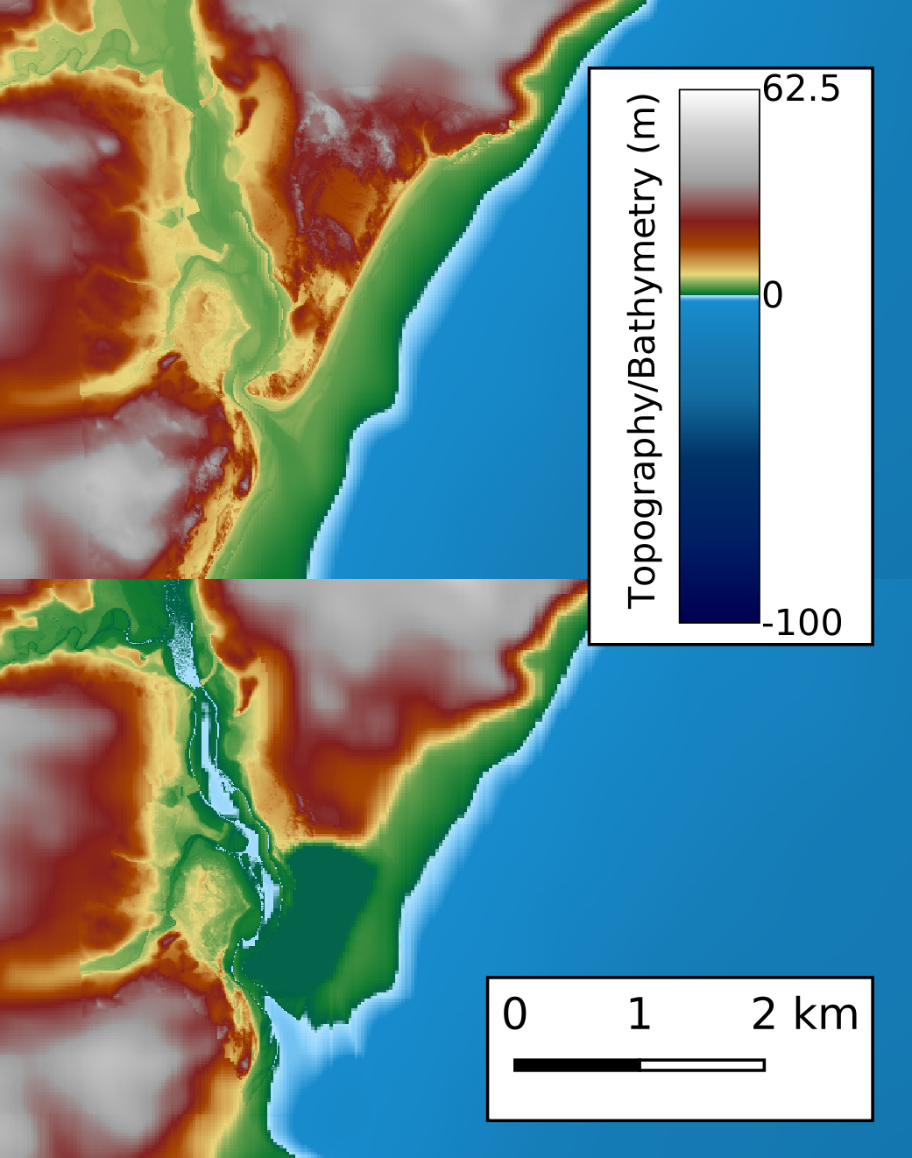
Remove river aggradation
Remove spit and sand dunes

Slide 21
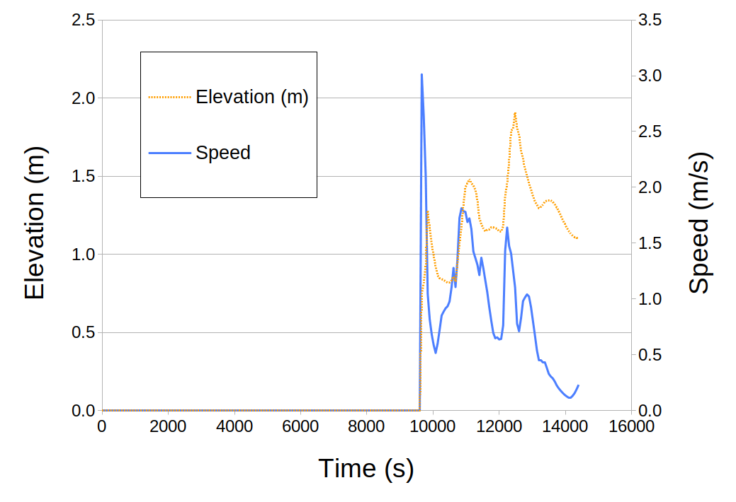

Slide 22
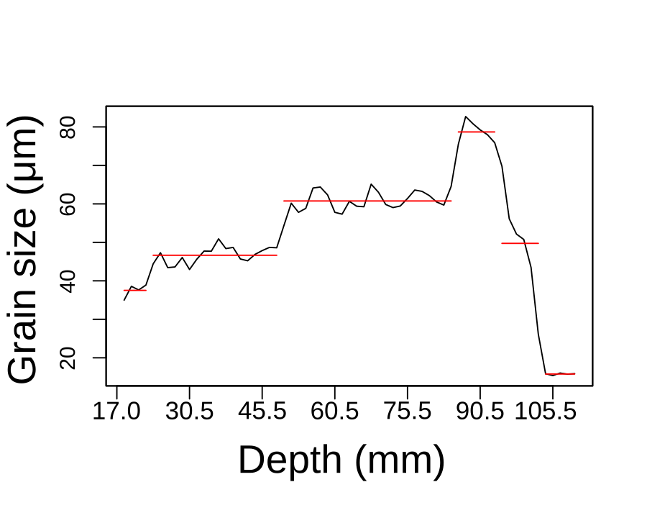

Slide 23
Summary
The sedimentological record is crucial to capture the extreme events
Combining numerical modelling & sedimentology gives insight into palaeo-extreme events
We show that Ythan valley experiences one large wave with three pulses
Future work will use an adjoint to explore sensitivity to palaeobathymatric reconstruction
https://envmodellinggroup.github.io/
10.6084/m9.figshare.9861263
Tweet (@jonxhill)

