Slide 1
Radial magnetic inversion to retrieve the geometry of 3D sources
Authors: Leonardo Vital*
Vanderlei C. Oliveira Jr.
Valéria C. F. Barbosa
Institution: Observatório Nacional, Rio de Janeiro, Brazil
September 2019

Slide 2
Summary of the talk
Defining the source
Inversion controls
Synthetic data study
Inversion of the Diorama anomaly
Conclusions

Slide 3
Defining the source

Slide 4
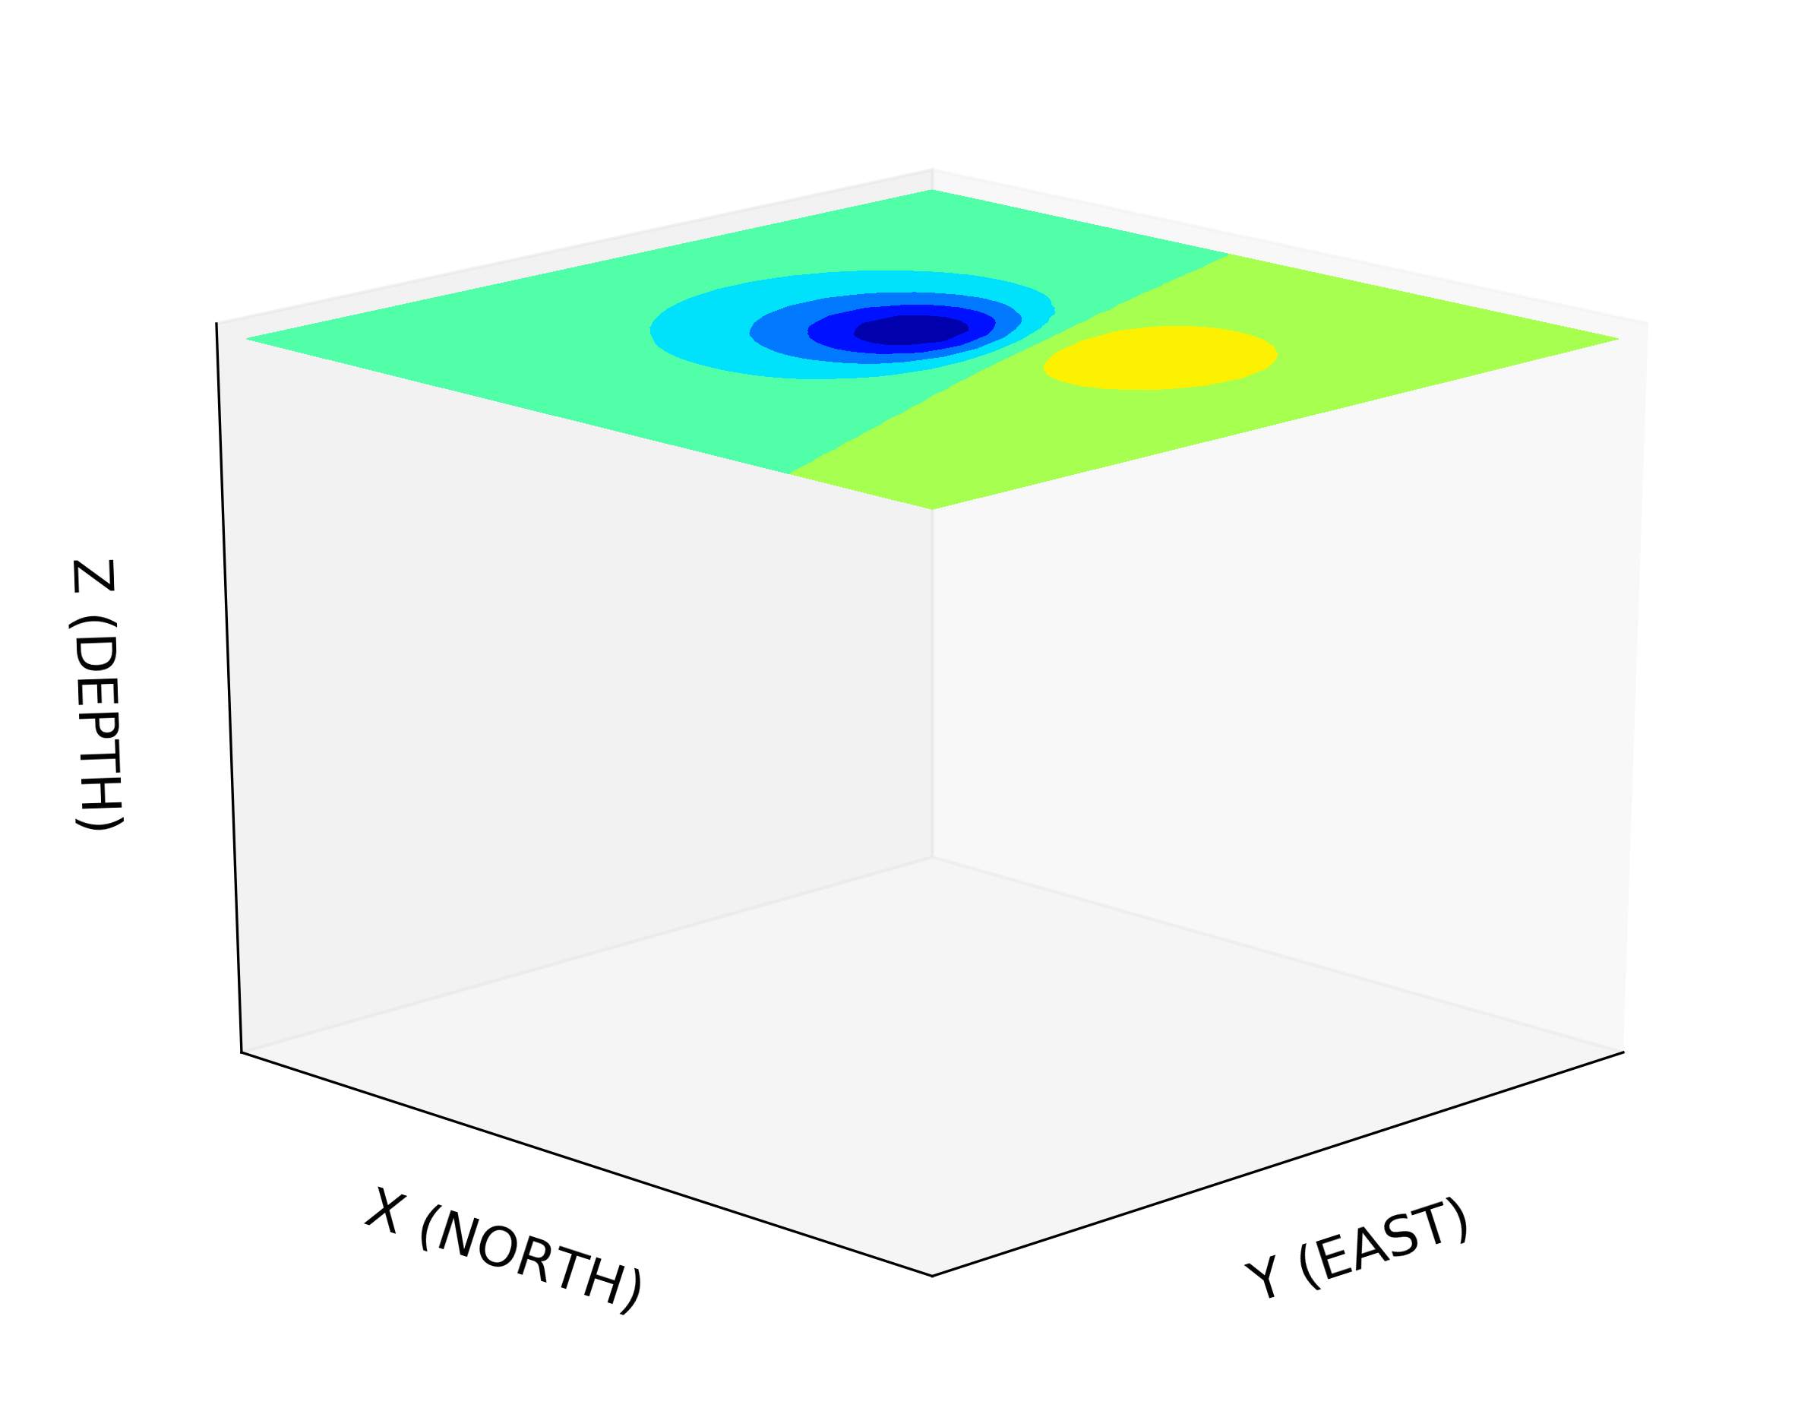
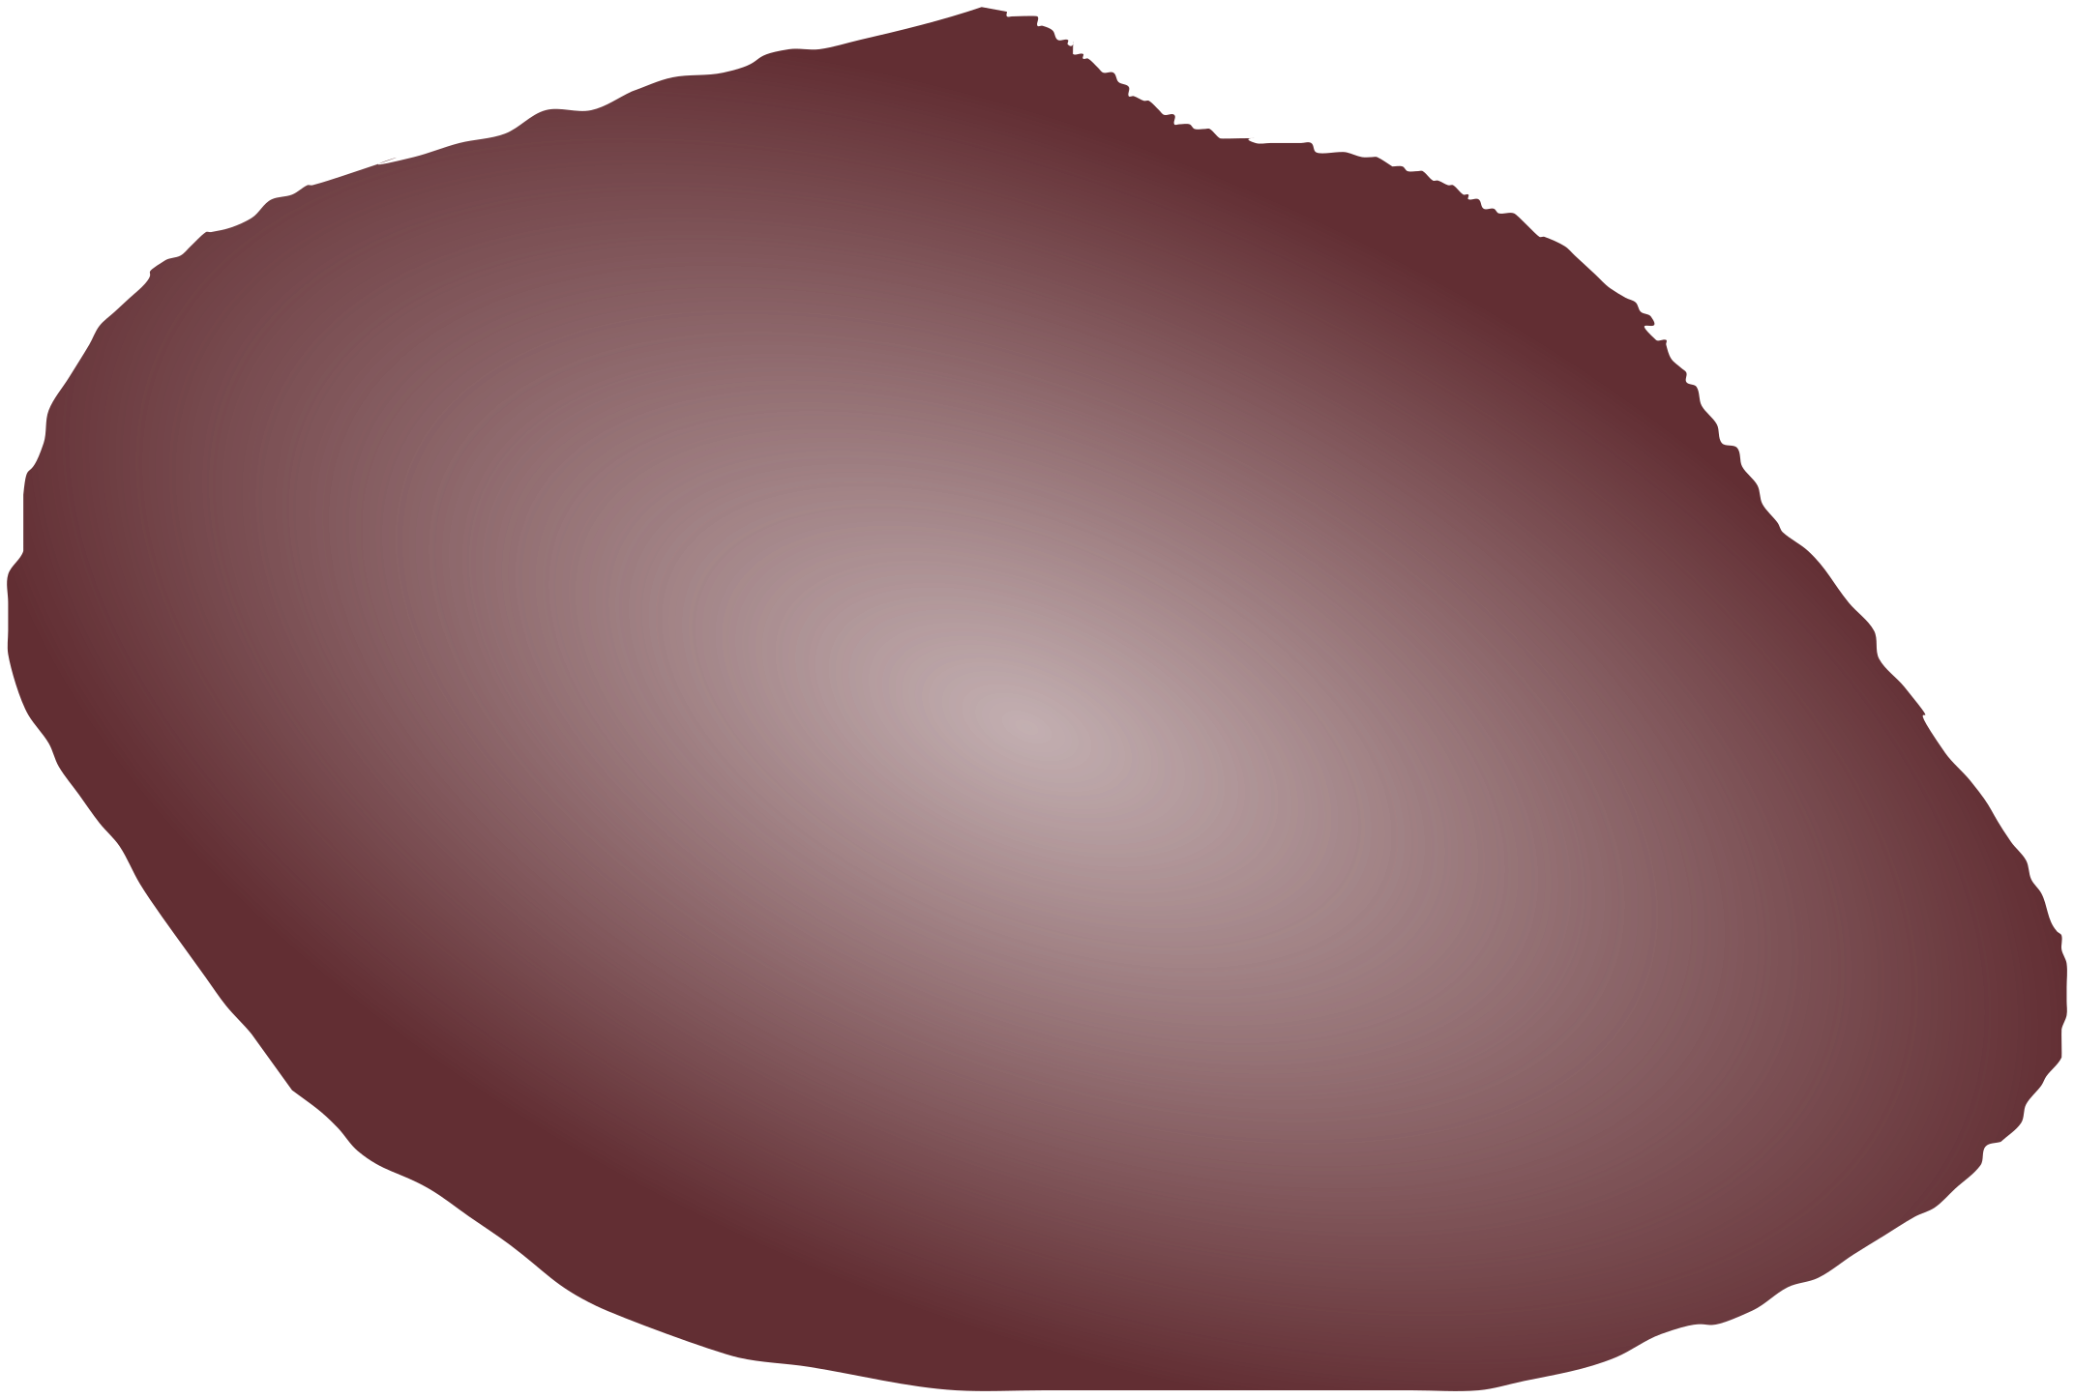
Objective of the inversion
total-field anomaly
Estimate the shape of an isolated 3D magnetic source
3D source
Assumptions:
depth to the top
Resultant magnetization vector (uniform!)
How can we describe the source?
Notes:
The objective of the inversion is to estimate the shape of an isolated 3D magnetic source. Let this body be a magnetic source.
The 3D source produces a total-field anomaly. But for all of the inversion methods, we must know some prior information.
Specifically for this method, we must know the depth to the top and its resultant magnetization (uniform!!!).
Strength and direction. Based on this information, we can estimate a magnetization distribution that explains the measured anomaly.
How can we describe the source?

Slide 5
Describing the source
Approximate the source by a set of polygonal prisms
magnetic anomaly
set of prisms
vertically juxtaposed
fixed magnetization
polygon as a horizontal cross-section
The sides of the polygon must describe the depth slices of the source
Notes:
There are specially two ways to interpret the shape of a magnetic source: voxel and parametric inversions. Many geo. Fig. spheres, ellipsoids, rectangular prisms, etc.
Here, we use a set of polygonal prisms to represent the magnetic source.
The prisms are vertically juxtaposed. So they cannot be separated.
They have the same magnetization vector.
have a horizontal cross-section described by an unknown polygon.
We expect that the sides of the polygon can describe the edges of the source along with the depth. How will they fit the source?

Slide 6
Parametrization
The polygon vertices are described by polar coordinates associated to an origin
The angles are equally spaced within the prism
From 0º to 360º
X
number of vertices
Z
Y
origin
Notes:
describe the vertices by polar coordinates. radius and angles where j varies from 1 to V. Every prism in the interpretation model has the same number of vertices.
origin is the point from where the radii spread.
Angles are fixed and equally spaced from 0º to 360º.
dz is the depth extent of the prism.

Slide 7
Parameters of the prism
The radii and the coordinates of the origin define the parameters of the k-th prism
X
Z
Y
Notes:
We set all the radii in a V-dimensional vector. So the vector
Click
Also, we set the origin coord.
Click
We allow the radii to change radially and the origin can change in any horizontal direction

Slide 8
Parameter vector
For a set of L prisms, we have
The depth extent is the same for all prisms!!
X
Z
Y
Notes:
Now, for a set of L prisms, we have the M-dimensional parameter vector that we are going to use for the forward and inverse modelling.
The vector p contains the radii and the coordinates of the origin of all prisms.
This vector is a M-dimensional vector where M is given by.
In other words, the depth extent is one parameter that is the same for all prisms.

Slide 9
Forward modeling
The total-field anomaly data produced by the set of prisms at the i-th observation point is given by Plouff (1976)
X
Z
Y
Notes:
we compute the total-field anomaly data produced by a set of polygonal prisms using fatiando a terra, that means slicing the earth, which is a package on Python for Geophysics, it computes that Based on Plouff 1976.
So at the observation point i the total-field anomaly will be given by
this equation that depends on the observation coordinates, the magnetization vector, depth extent, depth to the top, and the parameter vector.

Slide 10
Inversion controls

Slide 11
Inverse Problem
Estimate the p that minimizes the objective function
The data-misfit function
The constrained function
Non-linear
Marquardt’s iterative method
Notes:
In the inverse problem we estimate the parameter vector p that minimizes the objective function.
Which is composed by two terms, the data misfit function (is the difference between the observed and predict data) and the constrained function that contains the regularization constraints.
Once the function to calculate the predict data is nonlinear, we use the iterative Marquardt’s method to solve the problem.

Slide 12
Smoothness constraint on the adjacent radii defining the horizontal section of each vertical prism
r
k
r
k
X
j
≈
j+1
Z
Y
This constraint favors solutions composed by vertical prisms defined by approximately circular cross-sections.
Notes:
One of the constraint is the smoothness on the adjacent radii. It imposes the values of rjk and rj1k to be closer.
This is applied for all pairs of radius within the same prism. This constraint imposes a circular cross-sections to the polygons of the prisms.

Slide 13
Smoothness constraint on the radii of vertically adjacent prisms
r
k
r
k+1
X
j
≈
j
Z
Y
Y
This constraint favors solutions with a vertically cylindrical shape.
Notes:
This constraint is the smoothness on the radii of vertically adjacent prism. What does it men?
That the rjk will be close to rjk1. This is applied for all radii and all prisms.
This constraint imposes a cylindrical shape for the solution.

Slide 14
Smoothness constraint on the horizontal position of the origins of the vertically adjacent prisms
(
x
k+1
,
y
k +1
)
0
0
X
(
x
k
,
y
k
)
0
0
Z
Y
(
x
k
,
y
k
)
≈
(
x
k+1
,
y
k +1
)
0
0
0
0
It imposes smooth horizontal displacement between all vertically adjacent prisms.
Notes:
This constraint imposes smoothness on the origin coordinates of adjacent prisms.
So, with this constraint the coordinates of the origin of the prism Pk must be close to the coordinates of the origin of the prism Pk1.
This constraint imposes a smooth displacement between all prisms.

Slide 15
Synthetic data study

Slide 16
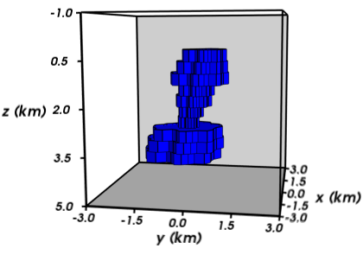
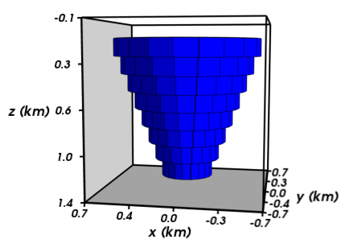
Models
z0 = 50 m
bottom = 1250 m
purely induced magnetization
5 A/m and (-21º, -21º)
z0 = 200 m
bottom = 4200 m
remnant magnetization
10 A/m and (60º, -40º)
Notes:
To evaluate the performance of the method we simulated two magnetic sources. The first one has a simple geometry, depth to the top, bottom and pure induced magnetization.
The model tapers like a funnel and the prisms have circular shapes. This model satisfies all the constraints included in the method.
The second model has a complex geometry which does not satisfy the constraints.

Slide 17
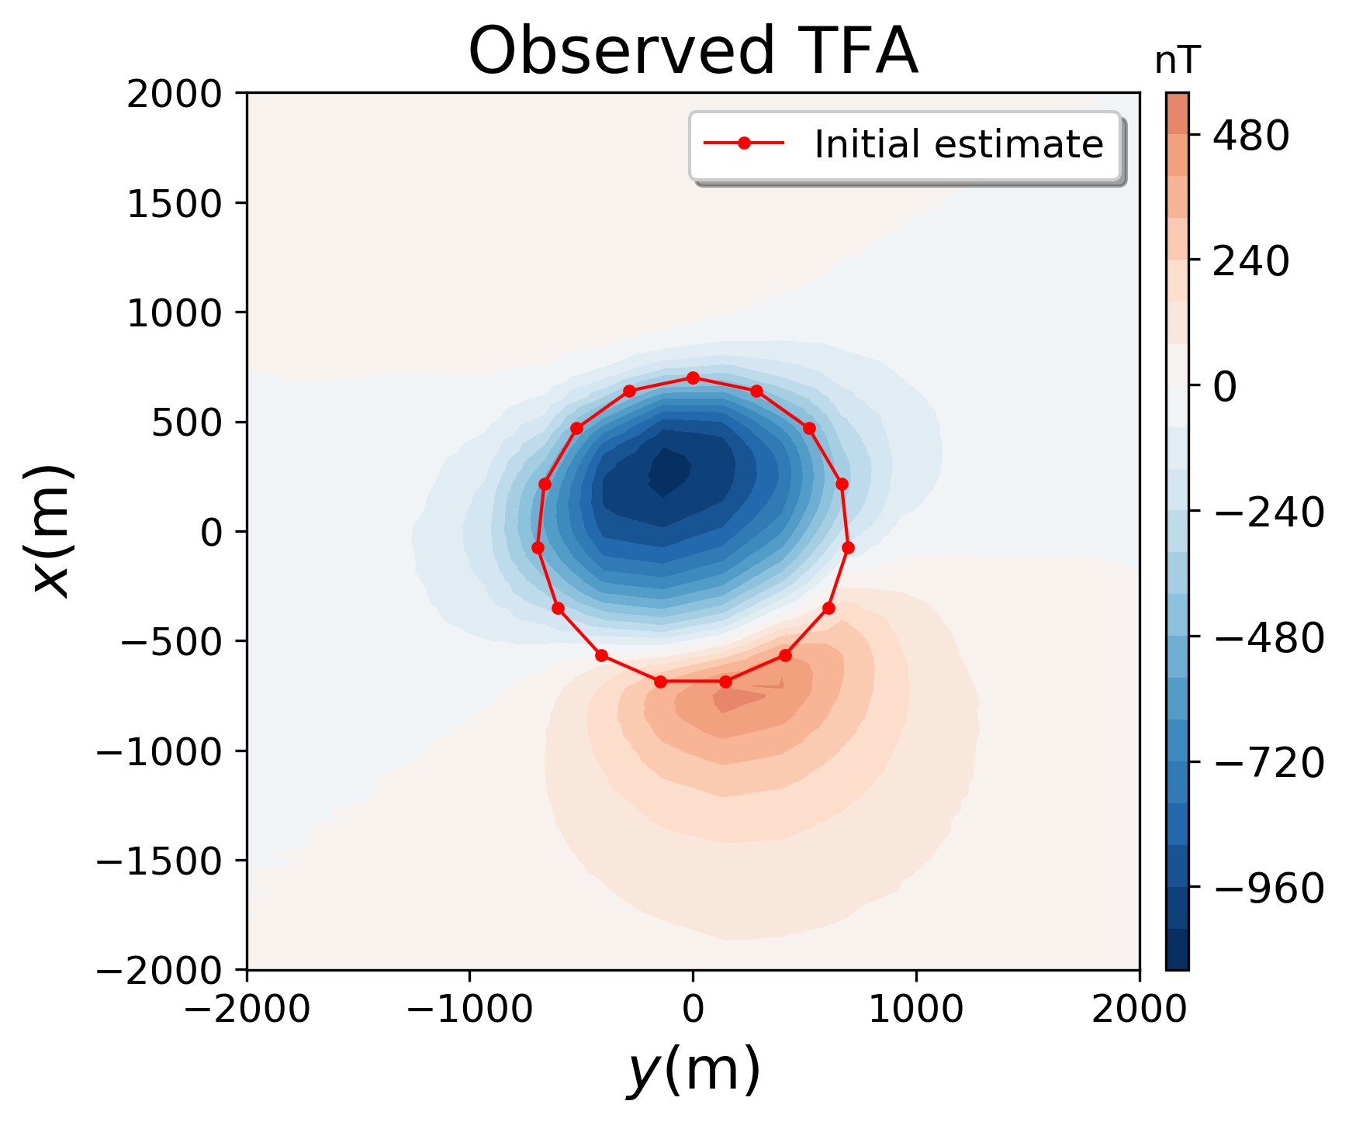
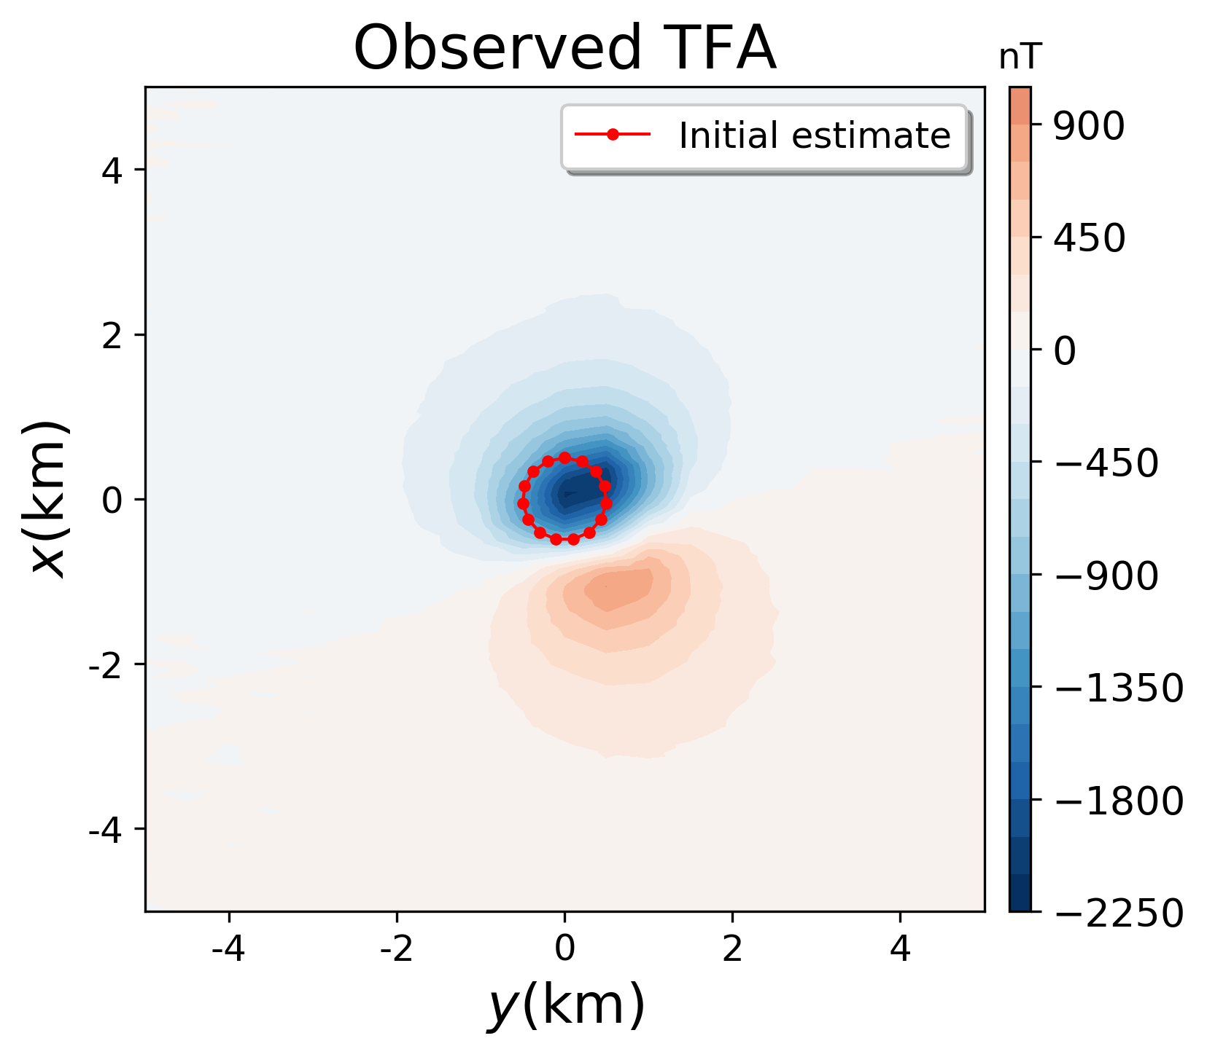
Data
Gaussian noise 1 nT
Gaussian noise 5 nT
1900 pts
2100 pts
Flight points
100 m height
Initial radius 500 m
Initial radius 500 m
Notes:
As the initial guesses we used cylinders with a radius of 500 m.
The intention here is that the cylinder must involve part of the anomaly.
But it depends on the behavior of the inversion and the regularization, there are many possibilities.

Slide 18
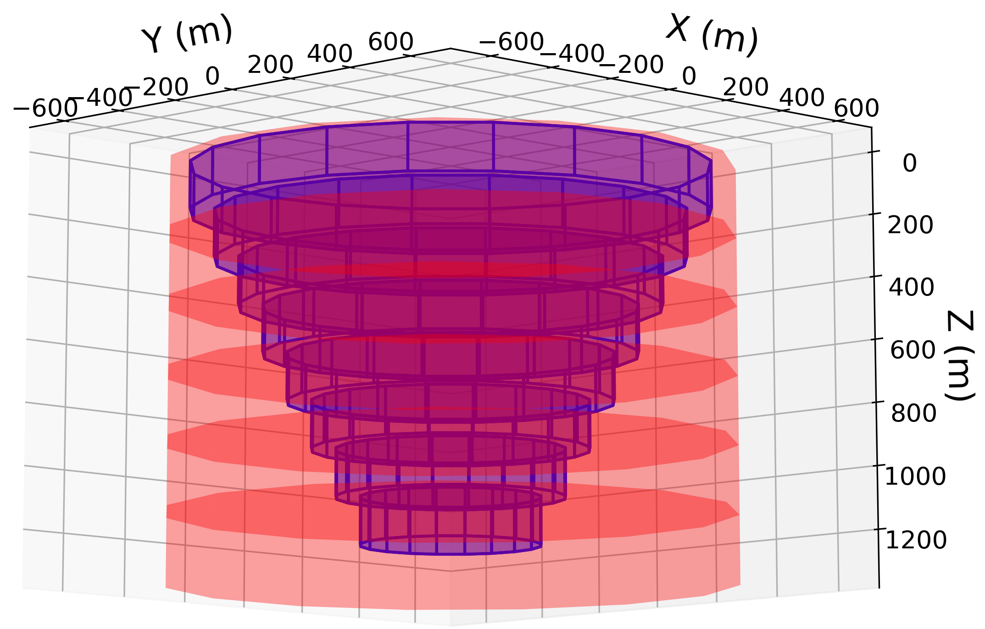
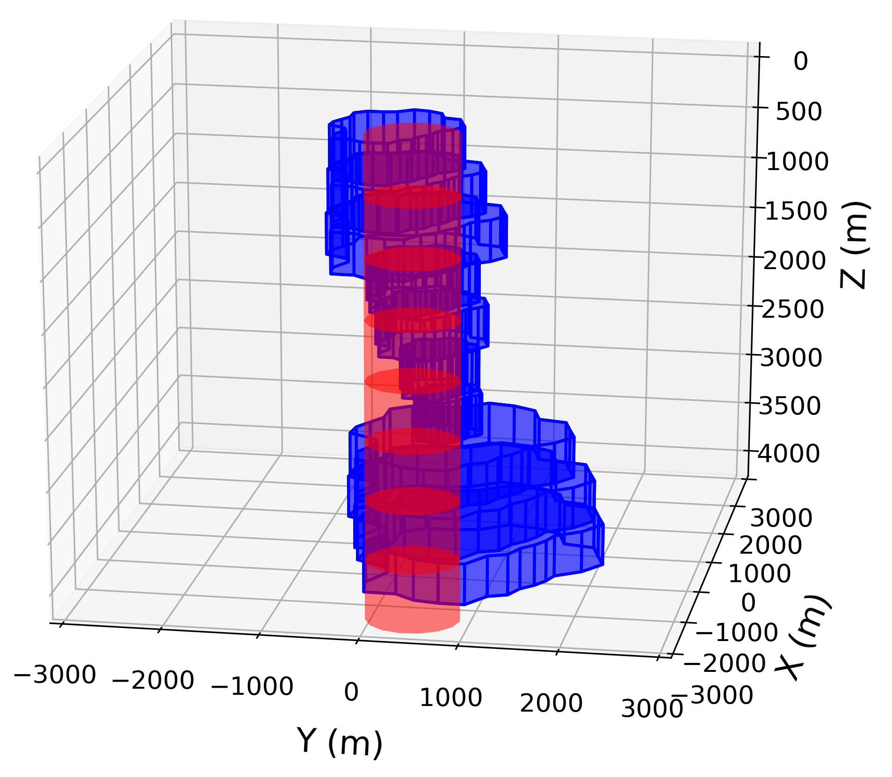
Initial guesses
4800 m
1200 m
4000 m
1320 m
Initial guess
True source
True magnetization
True depth to the top
Notes:
The data produced by the simple model was calculated in irregular grid simulating an airborne survey.
As a initial guess we used a cylinder bigger than the body and based on the horizontal distribution of the anomaly.
We set the true depth to the top and the magnetization vector. The bottom of the initial guess is deeper than the simple model.
Also, the initial guess has less prisms than the true body.

Slide 19
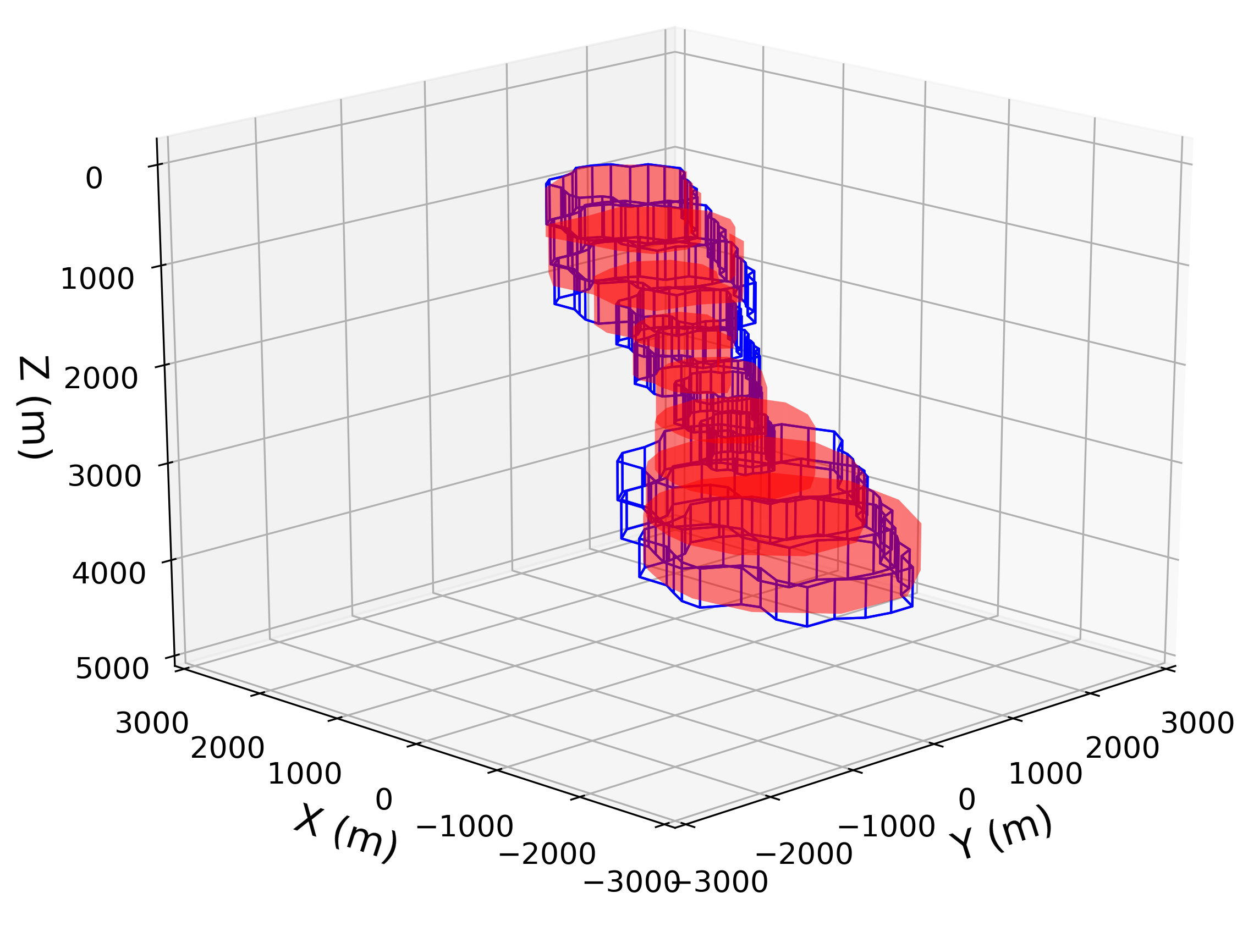
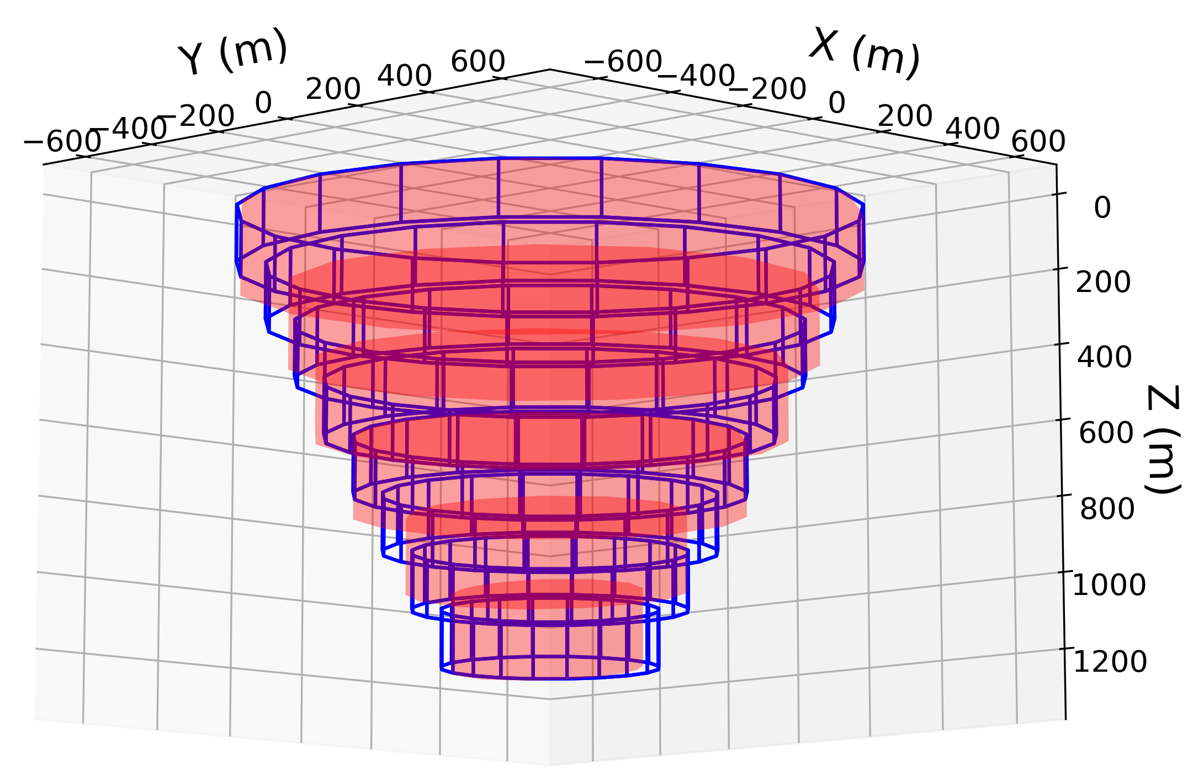
Estimates
1200 m
4000 m
3875 m
1204 m
Estimated source
True source
true volume 0.755 km³
est. volume 0.752 km³
true volume 8.40 km³
est. volume 8.29 km³
Notes:
The estimated source for the simple model retrieves the shape of the source very accurately. The estimated depth to the bottom is very close to the true one.
So the method works fine for a simple geometry source.
For

Slide 20
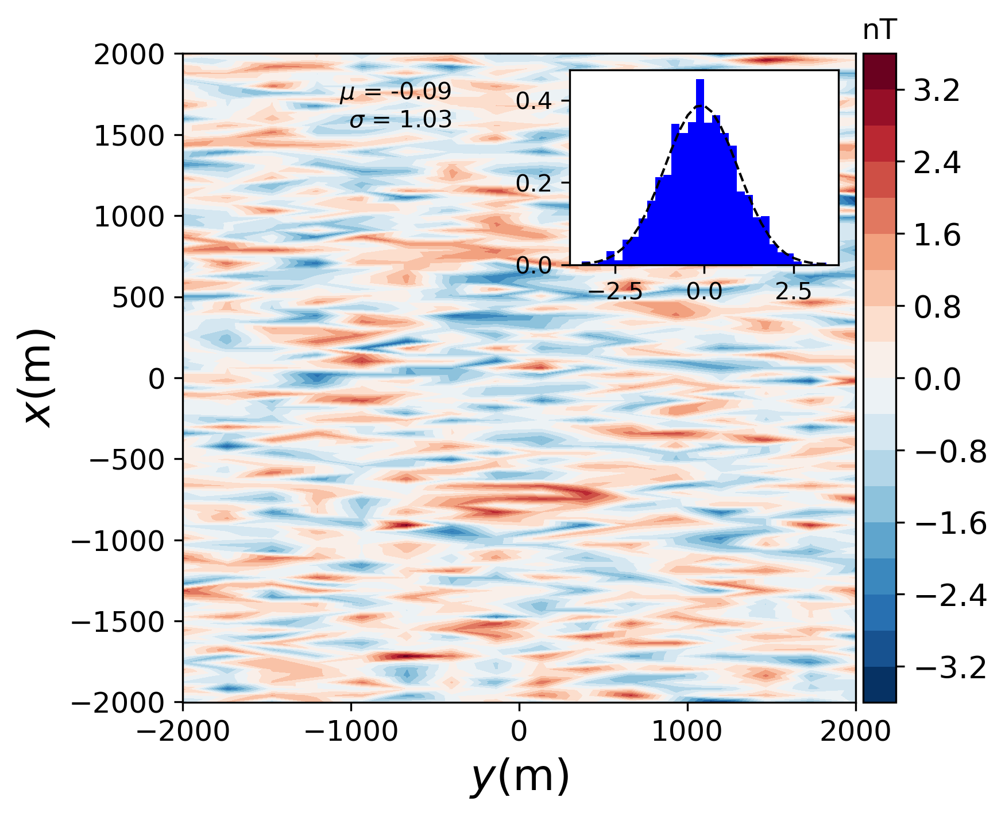
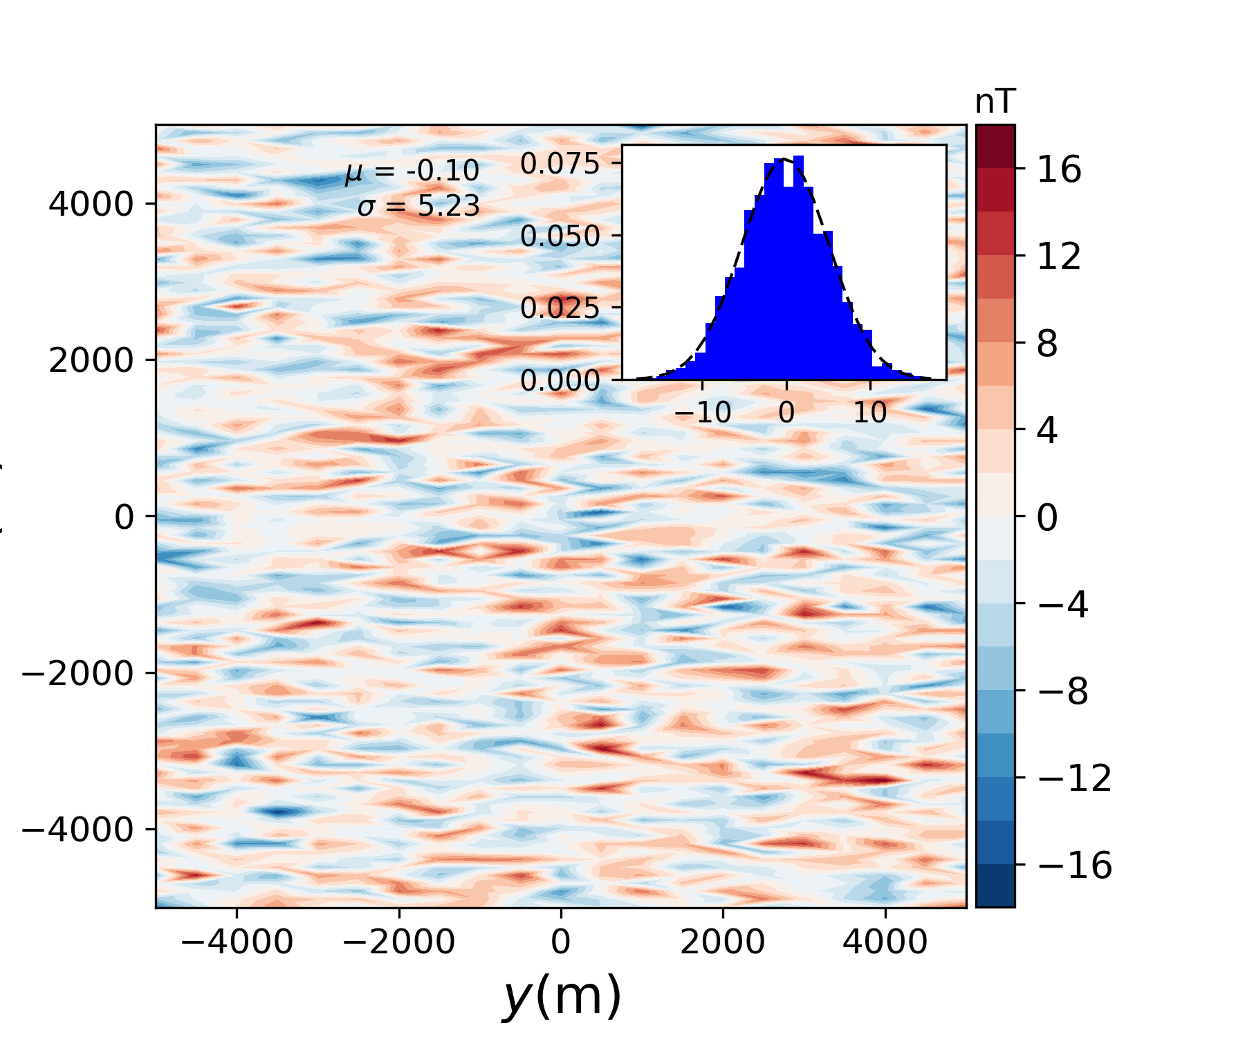
Fit: difference
Misfit 0.5%
Mean misfit 0.09 nT
Std misfit 1.03 nT
Misfit 2%
Mean misfit 0.10 nT
Std misfit 5.23 nT
Notes:
Now we are going to show the fit of the data. These are the difference between the observed and predict data. We can see that the amplitude of the difference is quite low compared to the synthetic anomaly.

Slide 21
Inversion of the Diorama anomaly

Slide 22
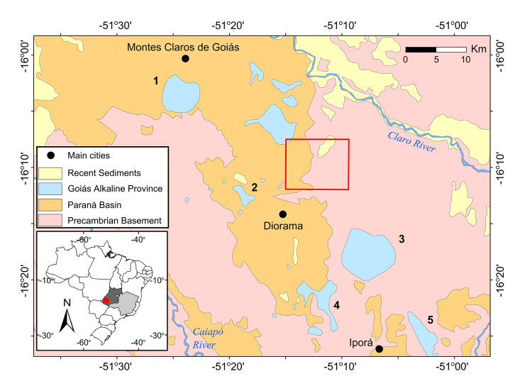
Application to real data (GAP)
Goiás state, Brazil
Mafic rocks
Diorama anomaly
Estimated magnetization direction
(Oliveira Jr. et al., 2015)
Notes:
The area of study is the Goias Alkaline Province, known as GAP. There are occurrences of mafic rocks that is located in the state of Goiás, Brazil.
We chose the Diorama anomaly because there is a work which has estimated the magnetization direction of the anomaly.

Slide 23
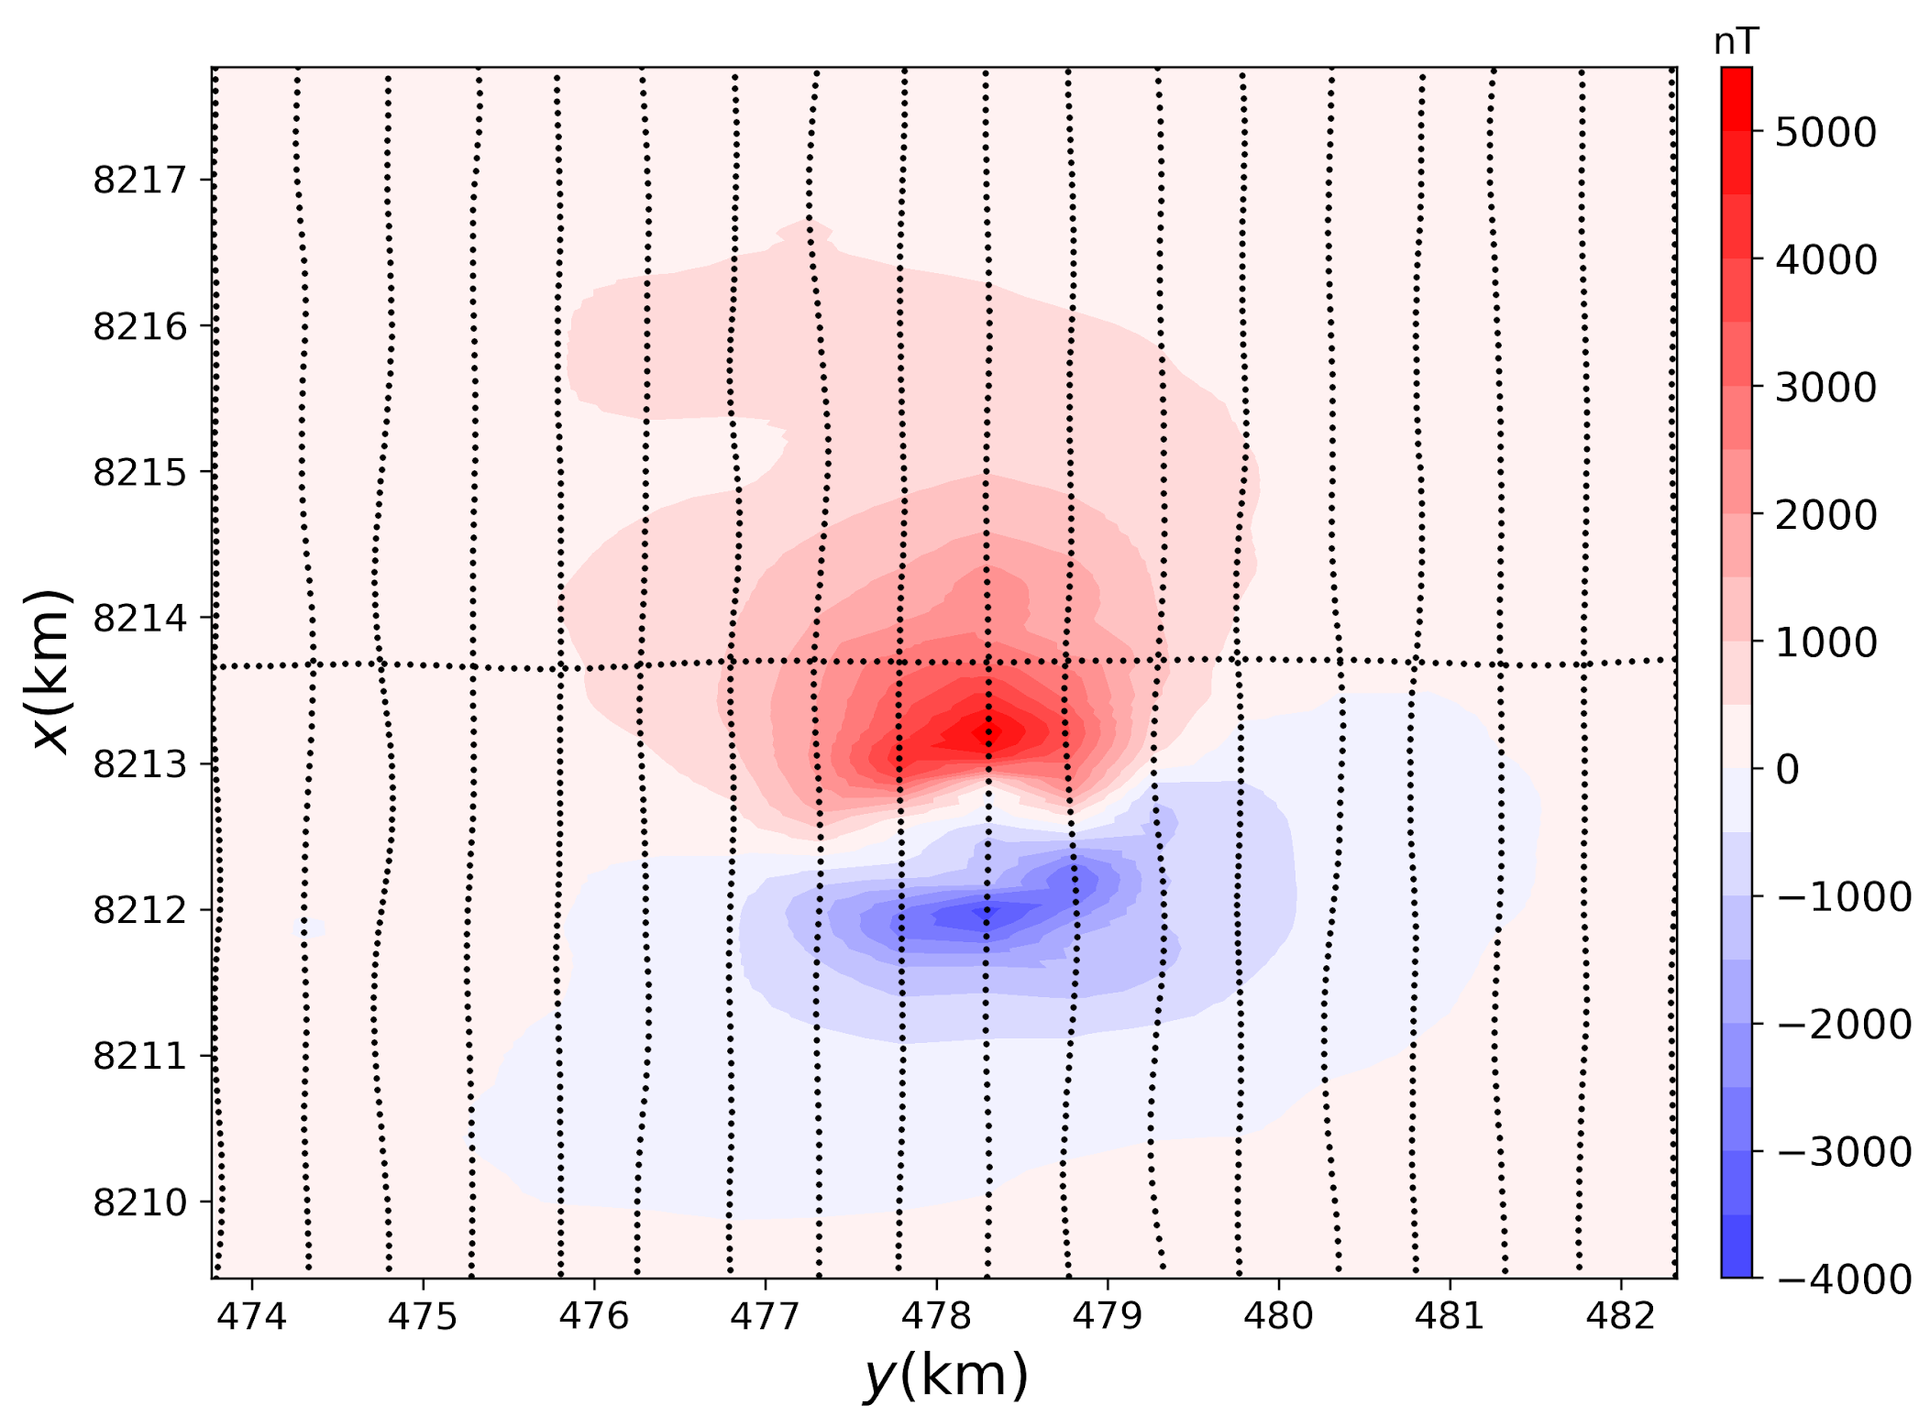
Diorama: Total-field anomaly
anomaly range 9000 nT
flight height 100 m
500 m of spacing
upward continuation to 1000 m
main field (-19º, -18º)
estimated direction (-71º, -23º)
2000 obs points
Notes:
The survey used in this work was measured at a approximately constant height of 100 m.
The lines are spaced by 500 m.
Oliveira Jr. estimated the magnetization direction using an upward continuation to attenuate the effect of shallower sources.
So we used the upward continued data for the inversion.
This is the direction of the main field, so que we can see the low values of the inclination and declination.
The estimated direction was (-71, -23), suggesting a strong remnant magnetization.

Slide 24
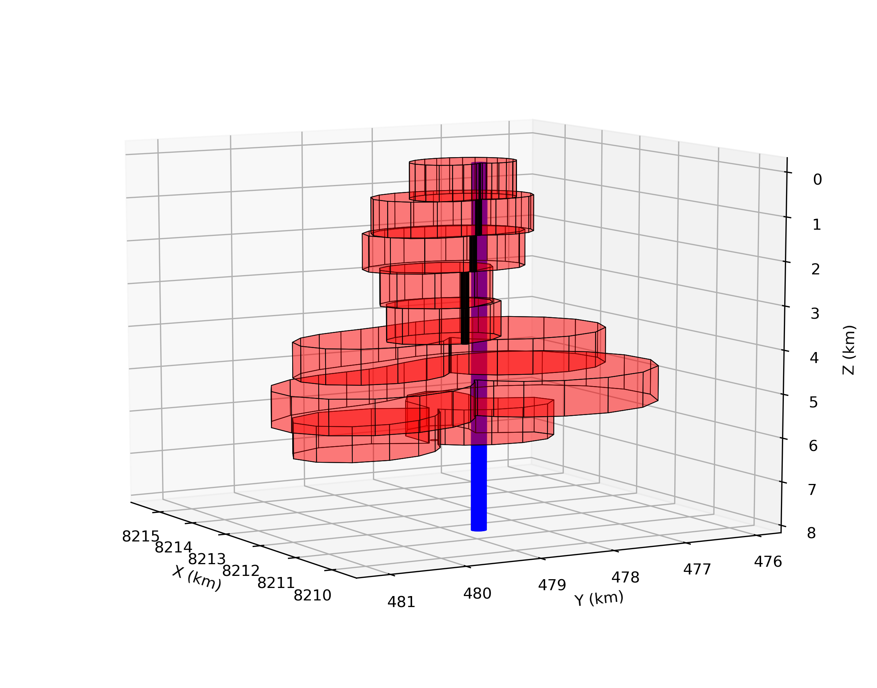
Real data - result
initial radius 100 m
depth to the top 50 m
mag. strength 14 A/m
inc & dec (-71º, -23º)
volume 26.26 km³
smooth edges
8500 m
6580 m
Estimated source
Initial guess
Notes:
The estimated source has a complex geometry.

Slide 25
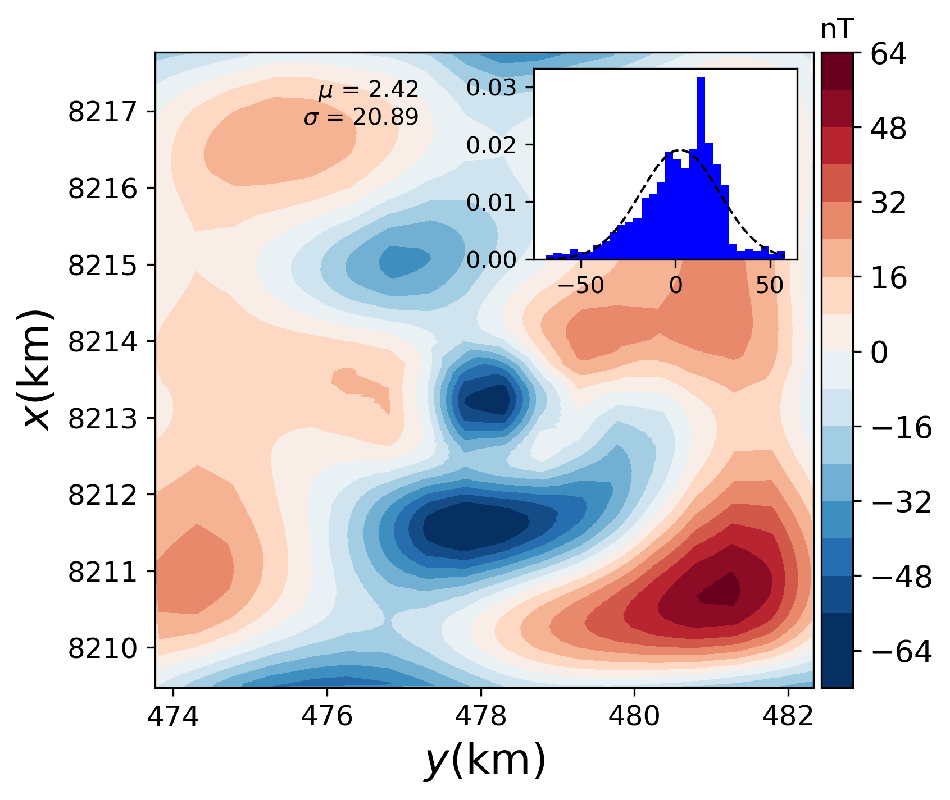
Misfit: difference
Anomaly range 9000 nT
Difference range 140 nT
Misfit 9.4%
Mean misfit 2.42 nT
Std misfit 20.89 nT
Reasonable misfit

Slide 26
Conclusions
Estimates the shape of an isolated source
Introduces compactness constraints via interpretation model
The real data result has a reasonable misfit
Investigate the relationship between the solution and the upward continuation
Test the hypothesis of an interfering shallower body

Slide 27
Acknowledgments
Scholarships, fellowships and support:
Dataset:

