Slide 1
Effects of Bitter Crab Disease on the gene expression of Alaskan Tanner Crabs
Grace Crandall
Roberts Lab, UW SAFS
NSA/PCS PCSGA 2019
Notes:
12 minute talk, 3 minutes questions
ADD IMAGE CITATIONS

Slide 2
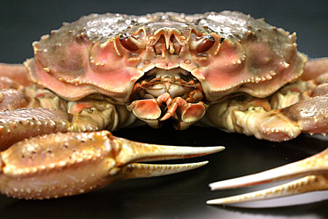
Tanner Crab (Chionoecetes bairdi )

Slide 3
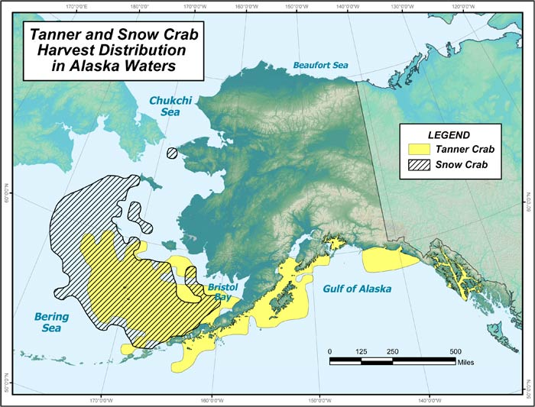
Range and economic importance
SE population: $21million fishery (2014)
Often marketed under “snow crab”
Market sized males: 7-9 years old, 2-4 lbs
Image: ADF&G
Notes:
https://www.adfg.alaska.gov/index.cfm?adfg=tannercrab.main
Range AK-OR

Slide 4
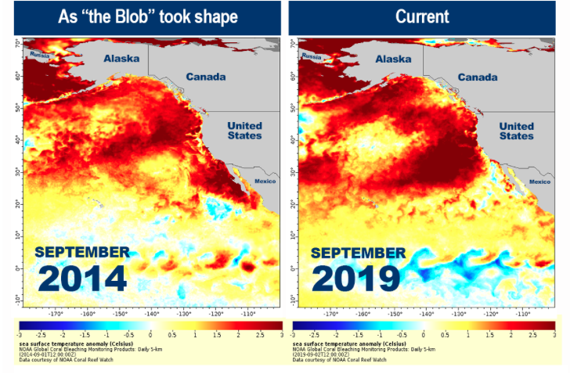
Threats to fishery
Bitter Crab Disease (“Principle Threat” - ADF&G)
Prevalence ( SE Alaska vs. Bering Sea)
2. Warming oceans
Increase BCD prevalence?
NOAA Fisheries
Notes:
https://www.fisheries.noaa.gov/feature-story/new-marine-heatwave-emerges-west-coast-resembles-blob

Slide 5
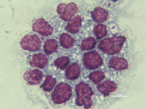
What is bitter crab disease?
Parasitic dinoflagellate Hematodinium spp.
Takes over hemol spaces in crab
Outcompetes host for nutrients + oxygen
Transmission: unknown
Molting?
Ingestion? (water column; cannibalism)
Hemolymph smear: Hematodinium → purple
Notes:
Transmission: recently molted, ingestion

Slide 6
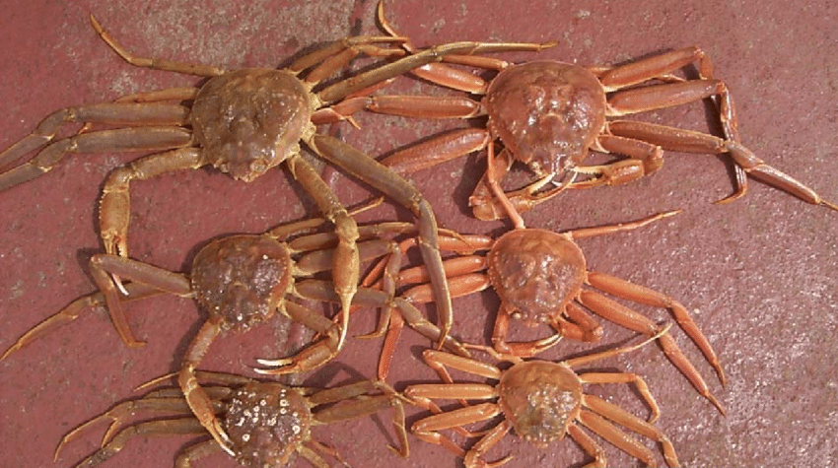
Bitter Crab Disease signs
red/cooked-looking carapace

Slide 7
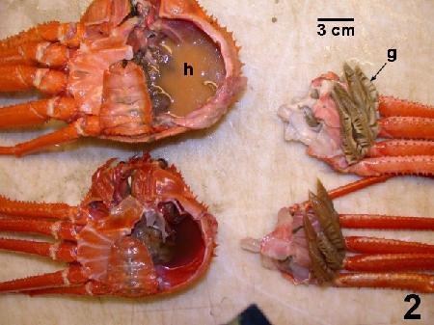
Bitter Crab Disease signs
Milky hemolymph

Slide 8
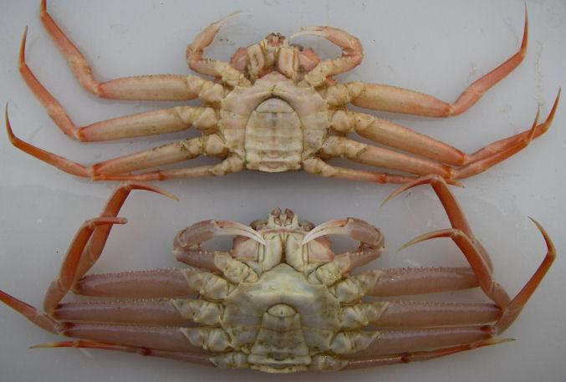
Bitter Crab Disease signs
Mottled legs

Slide 9
Bitter Crab Disease signs
Lethargy

Slide 10
Bitter Crab Disease signs
Bitter, chalky meat
Notes:
When cooked

Slide 11
Diagnosis
Gross signs
PCR
Hemolymph smears
Histology

Slide 12
Diagnosis Prognosis
Gross signs
PCR
Hemolymph smears
Histology
Death…?
Chronic…?
Death from secondary factors…?
Suffocation; starvation; etc.

Slide 13
Goals of project
ID genes in crab that are involved in immune and temperature response
ID genes in parasite that are involved in virulence

Slide 14
Why care about genes?
Unbiased
Basic functionality in organism
Differential abundance → how conditions affect organism
Understand unknowns: mortality; transmission; ocean warming
Fishery management
Notes:
Unbiased: either genes are present or not; the ones that are present will tell us what biological processes are taking place
So many unknowns - helps us unbiased understand (bring back temperature picture) maybe if we have a better idea - better idea of what to predict for fisheries
How will I find the genes??

Slide 15
Transcriptomics

Slide 16
Transcriptomics
DNA → RNA → Protein
transcribe
translate
RNA sequence = transcriptome
Notes:
Up next: experimental design

Slide 17
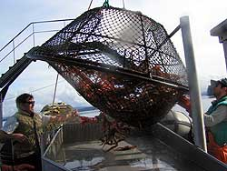
Sampling and acclimation
~400 immature, male crabs sampled from Juneau by ADF&G fall 2017
cPCR at NOAA lab for initial infection status
Crabs acclimate for 9 days to tanks
Notes:
Immature males because thought that intermediate age are most susceptible - especially during molting when they are most vulnerable
Mature determined by some ratio of carapace to cheliped length

Slide 18
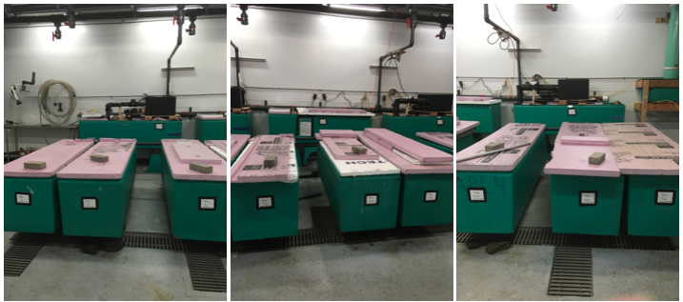
Treatments
180 crabs chosen to continue
Hemolymph sampled: RNA extraction
Separated into 3 temps → 10 infected, 10 uninfected per tank
4˚C
“cold”
10˚C
“warm”
6˚C
“ambient”

Slide 19
Hemolymph sampling timeline
Day 0
Crabs brought to lab
Day 9
Crab hemolymph sampled, then split into temp
treatments
Day 12
Crab hemolymph sampled
Day 26
crab hemolymph sampled, experiment breakdown

Slide 20
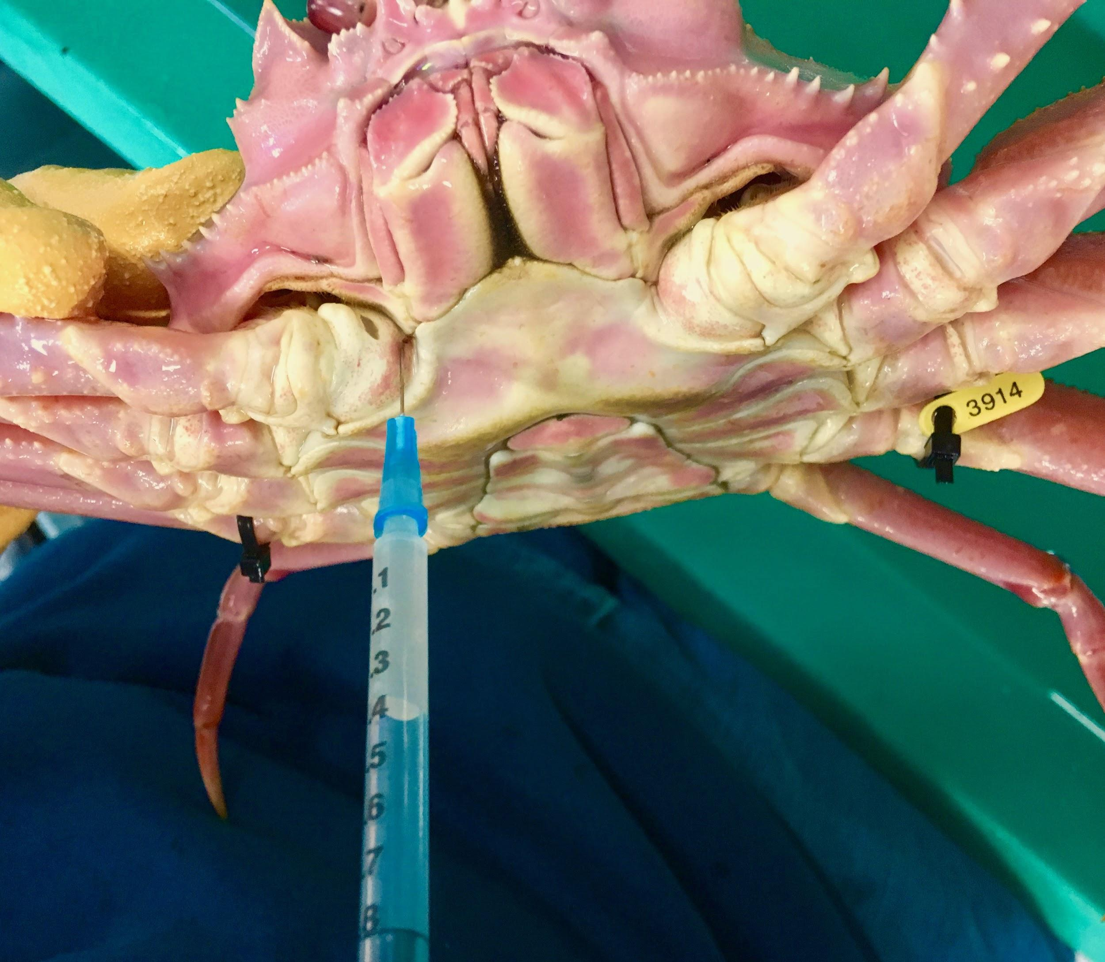
How did we sample hemolymph?
Stored in RNAlater for RNA extraction
Notes:
Sampled hemolymph at day 9, 12, and 26 for RNA extraction (transcriptome, annotation) and

Slide 21
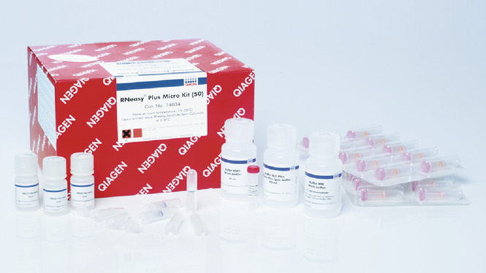
Processing samples
RNA extraction
RNeasy Plus Micro Kit (Qiagen)
NWGC: library prep and sequencing
Pooled samples
Notes:
Different libraries made - but don’t have data - here’s what’s coming

Slide 22
Transcriptomes in the works
Infection status | Sampling day
infected | 9
Uninfected | 9
Infected | 12
Uninfected | 12
Infected | 26
Uninfected | 26
Notes:
I had anticipated having data back to share results, but since I haven’t received it, I’ll share first transcriptome

Slide 23
First transcriptome
Pooled sample:
Day 26, infected and uninfected, cold and ambient
Notes:
Value - developing pipeline; identifying genes

Slide 24
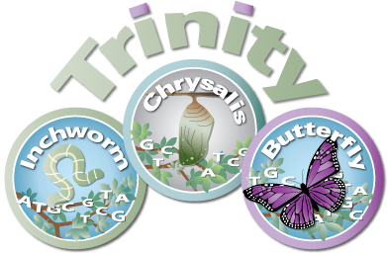
Transcriptome assembly
Transcriptome
143,172 contigs
Notes:
Assembled data
# of sequences (contigs)
A contig (from contiguous) is a set of overlapping RNA segments that together represent a consensus region of RNA.

Slide 25
Compared transcriptome to known Dinophyceae proteins
Matched:
Hematodinium
Did not match:
Crab
26.3%
73.7%
Notes:
Dinophyceae is the dinoflagellate class (Hematodinium is a dinoflagellate)
From contigs - % that are putative crab and % that putative hematodnium
Dinoflagellates (background) - share that those are putative Hematodinium, rest are crab

Slide 26
Annotation
Gene ontology (GO) terms for
crab and Hematodinium protein lists

Slide 27
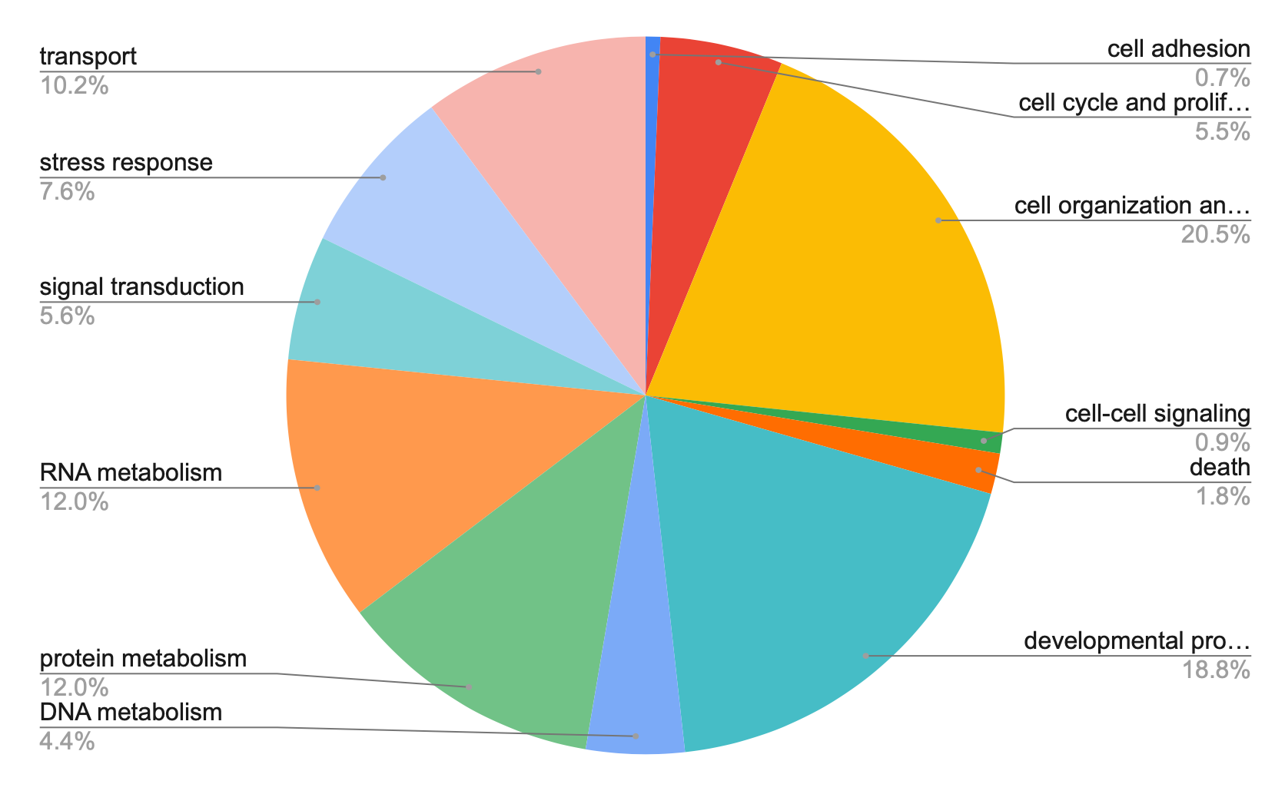
Hematodinium biological processes
Notes:
https://docs.google.com/spreadsheets/d/1lNeKlqT5q57WgtVkARp-Afhr9FAchR7OsH9lzNBx6TU/edit#gid=0

Slide 28
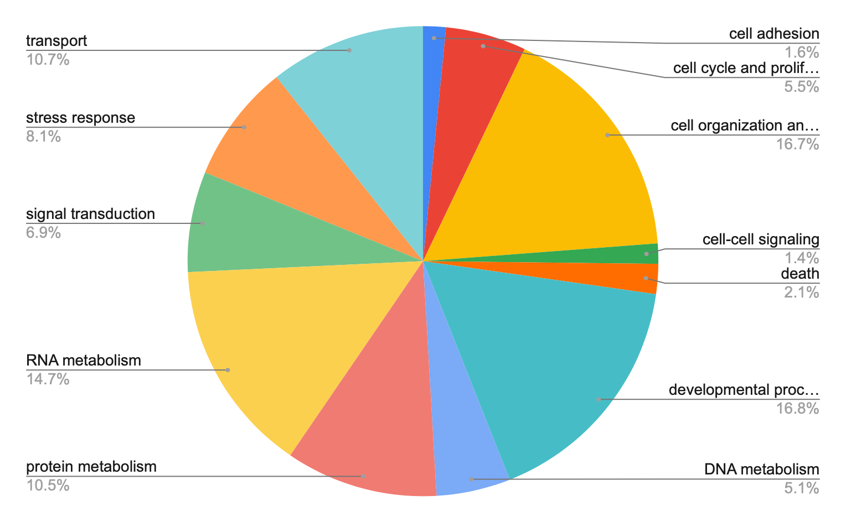
Crab biological processes
Notes:
https://docs.google.com/spreadsheets/d/19KVnNG6F3dFFhexe2TuVgkLw_bHXOdu3OsY2bU4Wb3Y/edit#gid=0

Slide 29
Crab biological processes
Notes:
https://docs.google.com/spreadsheets/d/19KVnNG6F3dFFhexe2TuVgkLw_bHXOdu3OsY2bU4Wb3Y/edit#gid=0
Stress: immune and temperature stress

Slide 30
Crab response genes
Recognize protein patterns produced by pathogens → activate innate immune response
Keeps immune response going → inhibits breakdown of proteins that initiate innate immune response
Attracts T cells in response to inflammatory stimulus
Heat shock protein → produced in response to stressful conditions

Slide 31
Next steps
Transcriptomes accounting for sampling day and infection status
Transcriptomes accounting for temperature and infection status
Compare across transcriptomes for differential gene expression
Notes:
Waiting on data for step number 1
Have a pipeline that will help with processing new data
Will allow us to predict whether it will be what in future with increasing temperatures
May help with disease death, transmission? Unknowns? When look at parasite and crab genes together

Slide 32
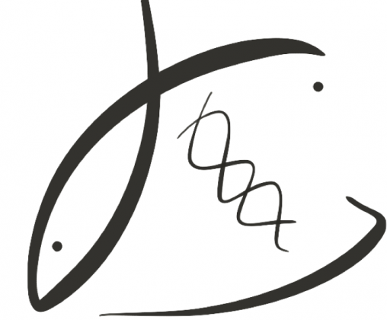
THANK YOU!
P.I.s:
Dr. Steven Roberts
Dr. Pam Jensen
Roberts Lab:
Jay Dimond
Laura Spencer
Shelly Trigg
Brent Vadopalas
Yaamini Venkataraman
Sam White
UW NWGC
bittercrab.science
grace-ac.github.io
Podcast: DecaPod
Notes:
Thank you
Stay involved for upcoming results by following the project website, my online notebook, and tuning into our podcast “DecaPod”

