Slide 1
Is Open Science the better Science?
Dr. Isabel Steinhardt
23.09.2019
Universidad Autónoma de San Luis Potosí

Slide 2
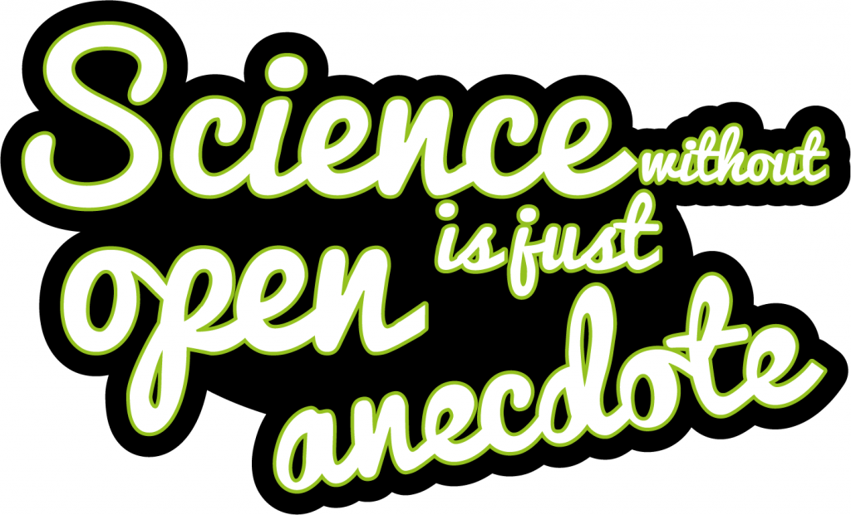
If Open Science is the answer, what is the question?
Inspired by Dr. Catherine Cronin https://catherinecronin.net/presentations/
Sticker design & contact @melimming; quote from @chartgerink – CC0 public domain

Slide 3
https://reader.elsevier.com/reader/sd/pii/S0016328717301969?token=20782BDBB94D7A7AAF17FAAFD072B795BE85A38C11CE035D78541DB2D5755E0D3DCCAC769B592202ECE1A22B675908E0

Slide 4
“Improper research techniques, lack of accountability, disciplinary and political groupthink, and a scientific culture biased toward producing positive results together have produced a critical state of affairs.” (p. 11)
Randall/Welser 2018: The irreproducibility crisis of modern science: causes, consequences, and the road to reform. http://www.sealevel.info/NAS_irreproducibilityReport.pdf

Slide 5
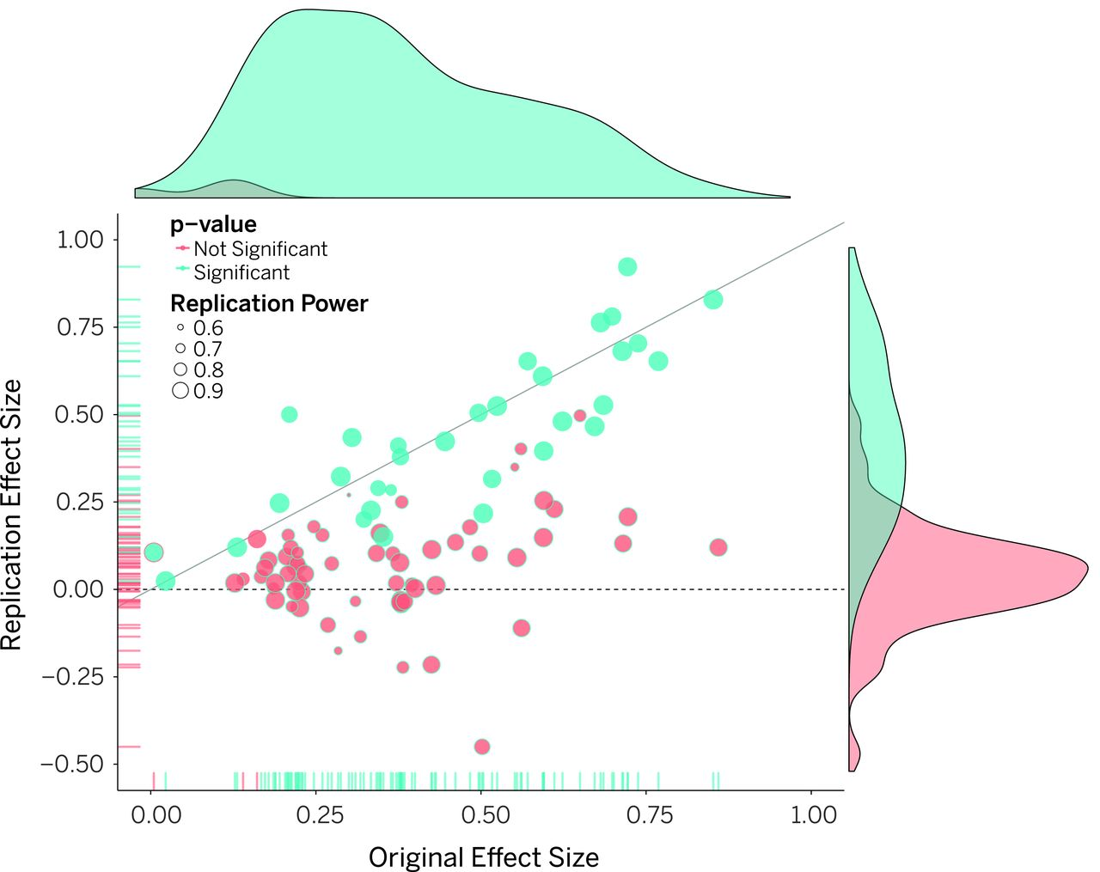
“Ninety-seven percent of original studies had significant results
(P < .05). Thirty-six percent of replications had significant results; 47% of original effect sizes were in the 95% confidence interval of the replication effect size; 39% of effects were subjectively rated to have replicated the original result; and if no bias in original results is assumed, combining original and replication results left 68% with statistically significant effects.” (abstract)
Open Science Collaboration (2017): Estimating the reproducibility of psychological science, Science Vol. 349, Issue 6251, aac4716 DOI: 10.1126/science.aac4716

Slide 6
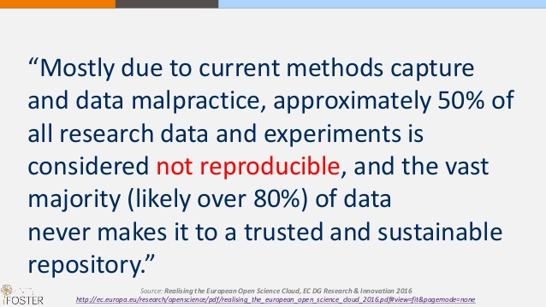

Slide 7
“Survival in academia depends on publications in refereed journals. Authors only get their papers accepted if they intellectually prostitute themselves by slavishly following the demands made by anonymous referees who have no property rights to the journals they advise.”
Frey, B.S. (2003): Publishing as Prostitution? – Choosing Between One's Own Ideas and Academic Success, Public Choice, 116/1, p. 205-223.

Slide 8
“The effect of this is the continued erosion of the academic journal marketplace, and knowledge discrimination against those who are less financially privileged than all but the wealthiest portion of research institutes. Furthermore, as Elsevier almost entirely publishes only English-language research, this strongly discriminates against indigenous forms of knowledge, research conducted in non-English native speaking countries, and academics who do not speak English fluently as a first language.” (p. 14)
Tennant, Jonathan. (2018). Democratising Knowledge: a report on the scholarly publisher, Elsevier. Zenodo. http://doi.org/10.5281/zenodo.1744583

Slide 9
What is Open Science??

Slide 10
Müller-Birn, Claudia. (2018, November). Open Science - From our Values to our Research Practice. Zenodo. http://doi.org/10.5281/zenodo.1576433

Slide 11
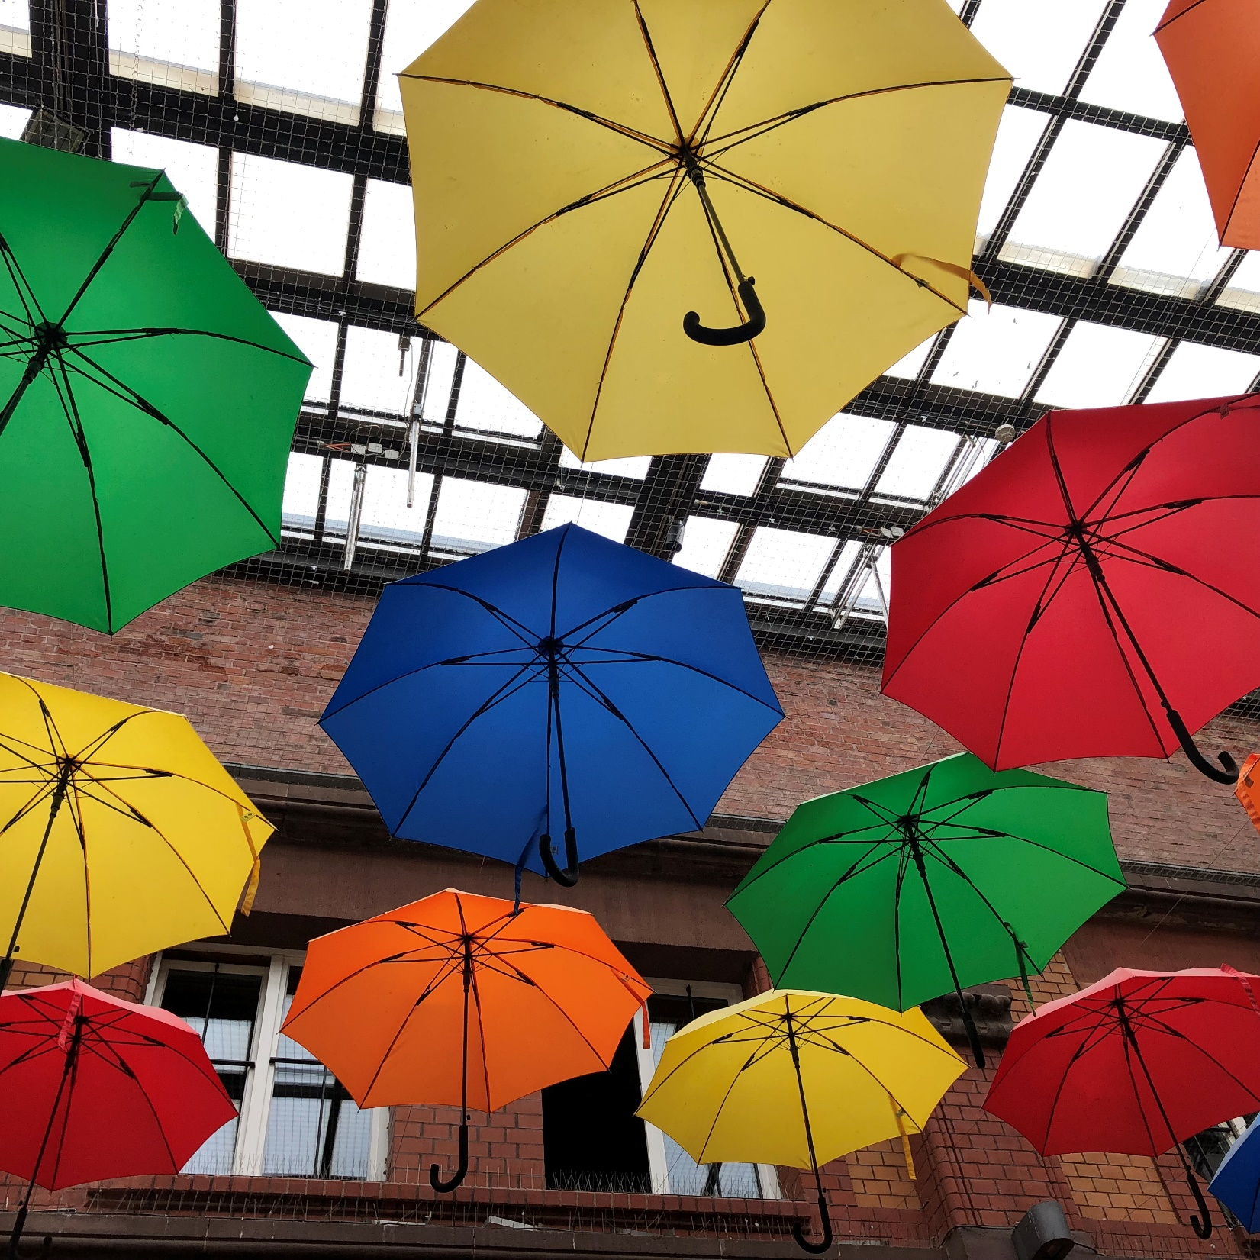
Open Methodology
Open Source
Open Data
Open Access
Open Peer Review
Open Infrastructure
Open Education
Citizen Science

Slide 12
Idea
Proposal
Funding
Collection
Analysis
Publish
Archive
Research Process
Open Methodology

Slide 13
Idea
Proposal
Funding
Collection
Analysis
Publish
Archive

Slide 14
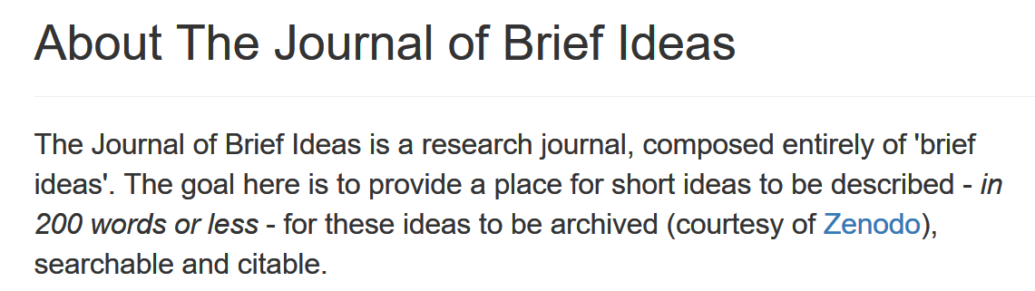
https://riojournal.com/
http://beta.briefideas.org

Slide 15
Idea
Proposal
Funding
Collection
Analysis
Publish
Archive

Slide 16
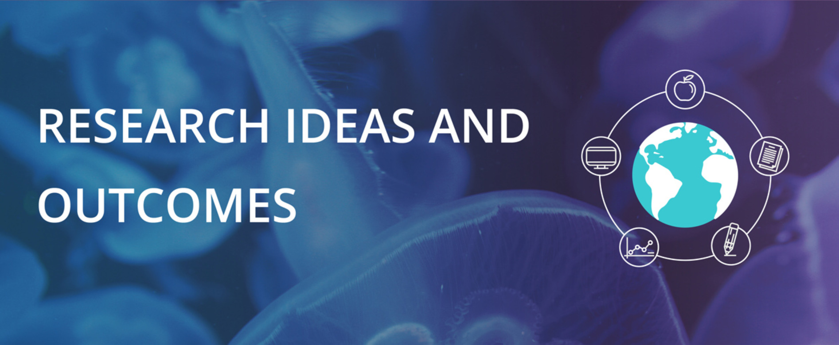
Publish the proposal
https://riojournal.com

Slide 17
Idea
Proposal
Funding
Collection
Analysis
Publish
Archive

Slide 18
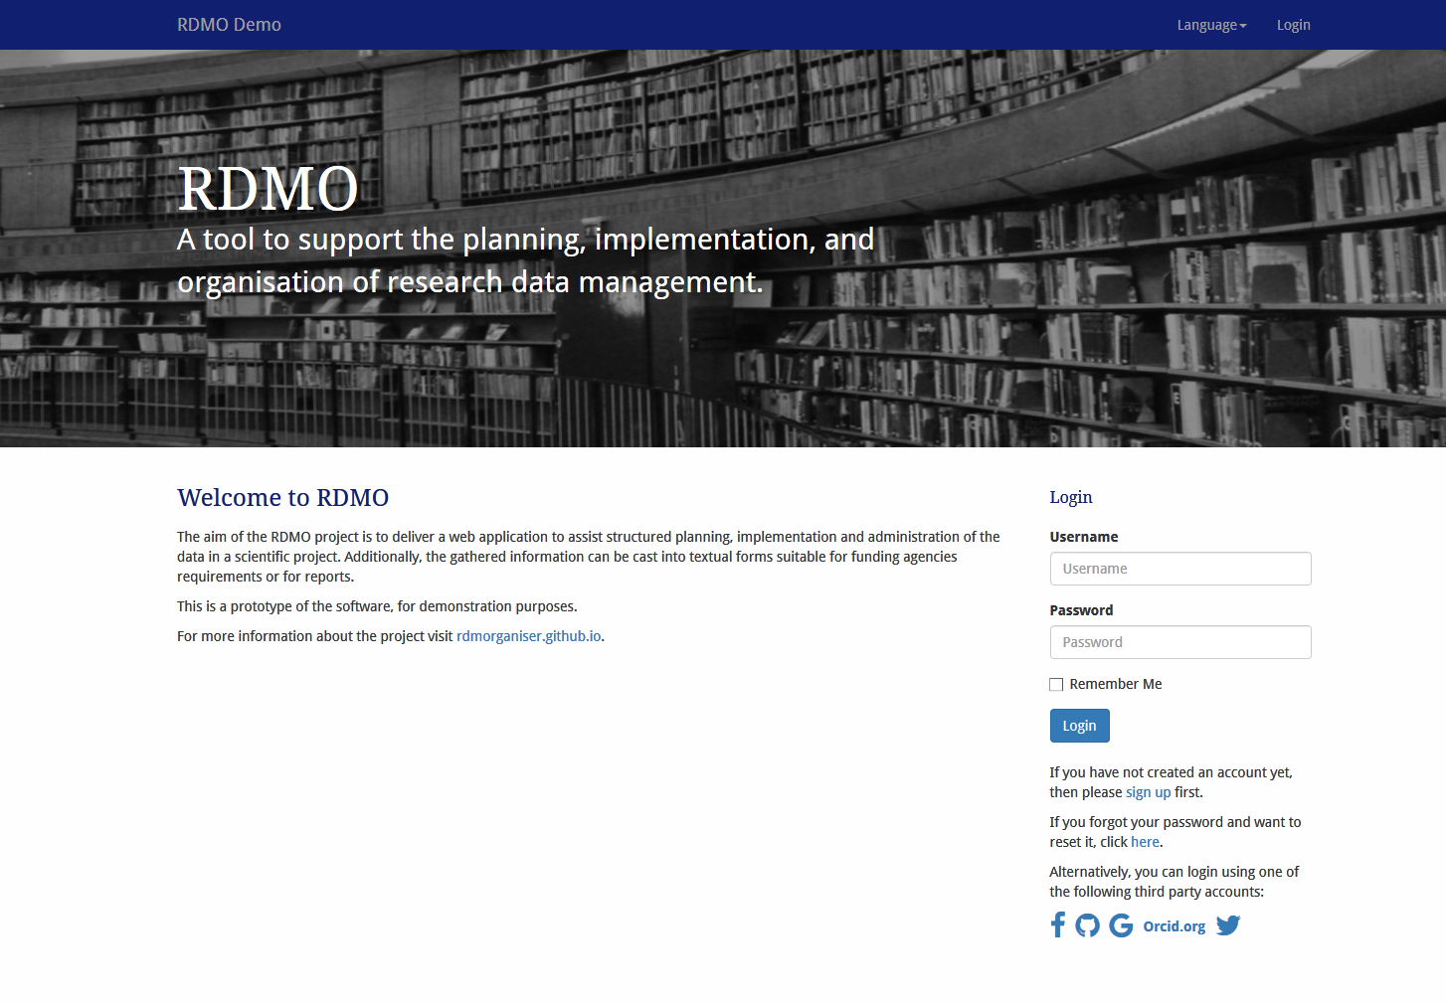
https://rdmo.aip.de/

Slide 19
Idea
Proposal
Funding
Collection
Analysis
Publish
Archive

Slide 20
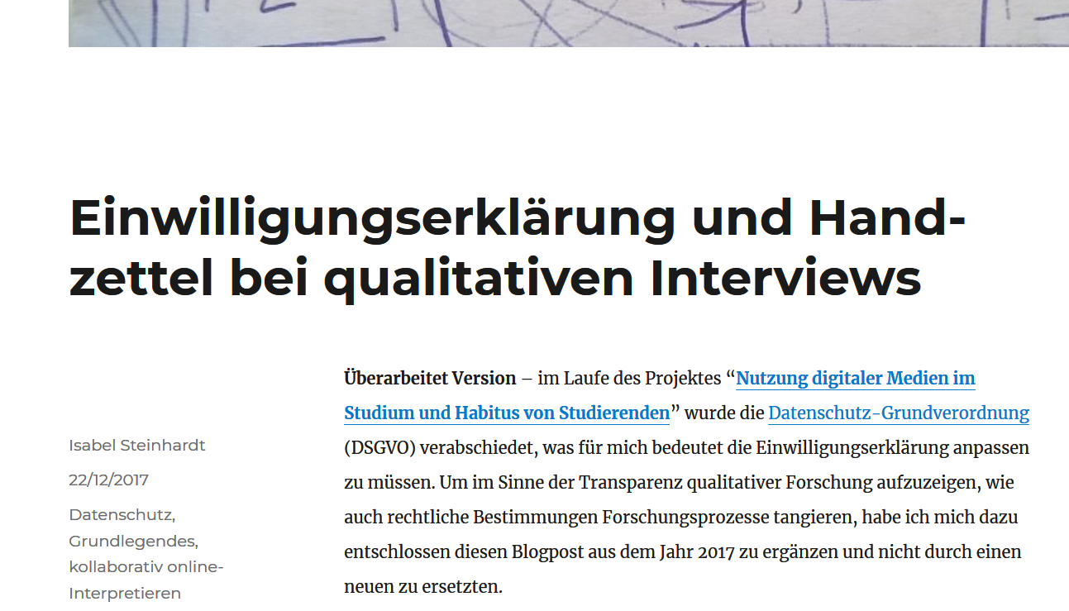
https://sozmethode.hypotheses.org/292
Declaration of consent

Slide 21
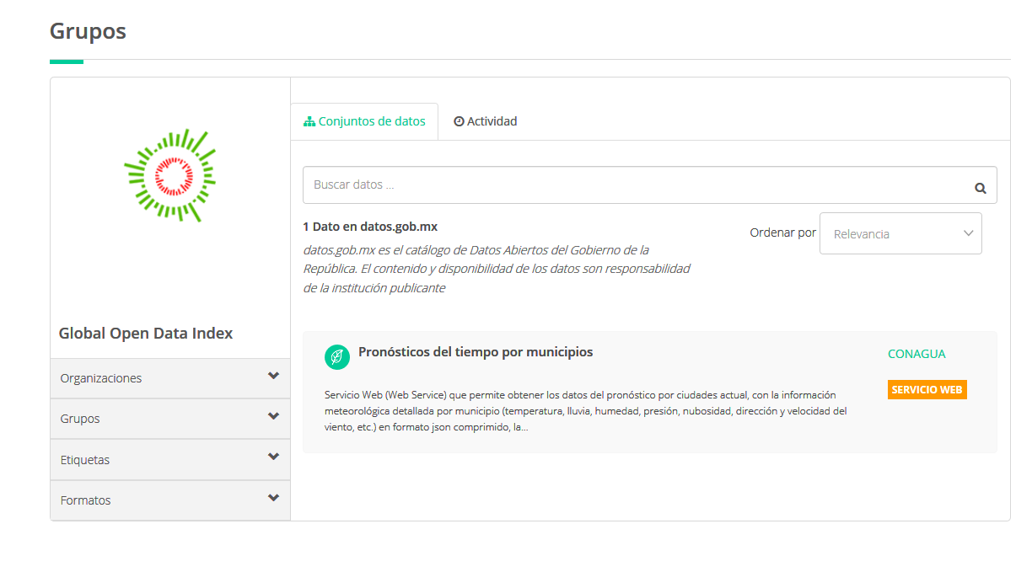
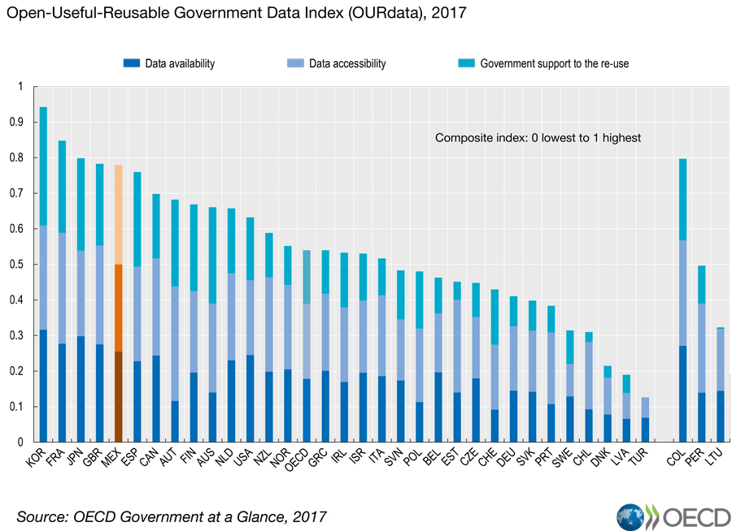

Slide 22
Idea
Proposal
Funding
Collection
Analysis
Publish
Archive

Slide 23

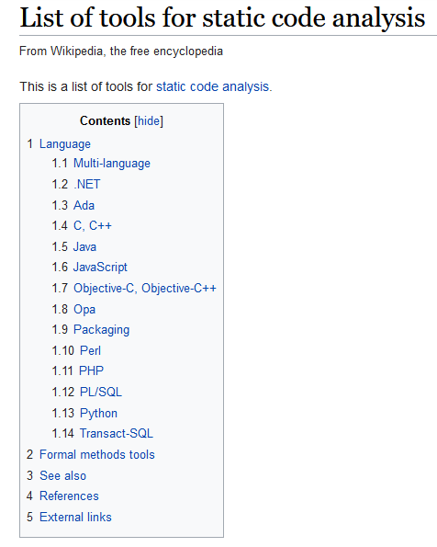
https://en.wikipedia.org/wiki/List_of_tools_for_static_code_analysis
Open Source Initiative official SVG (https://commons.wikimedia.org/wiki/File:Opensource.svg), „Opensource“, https://creativecommons.org/licenses/by/2.5/legalcode

Slide 24
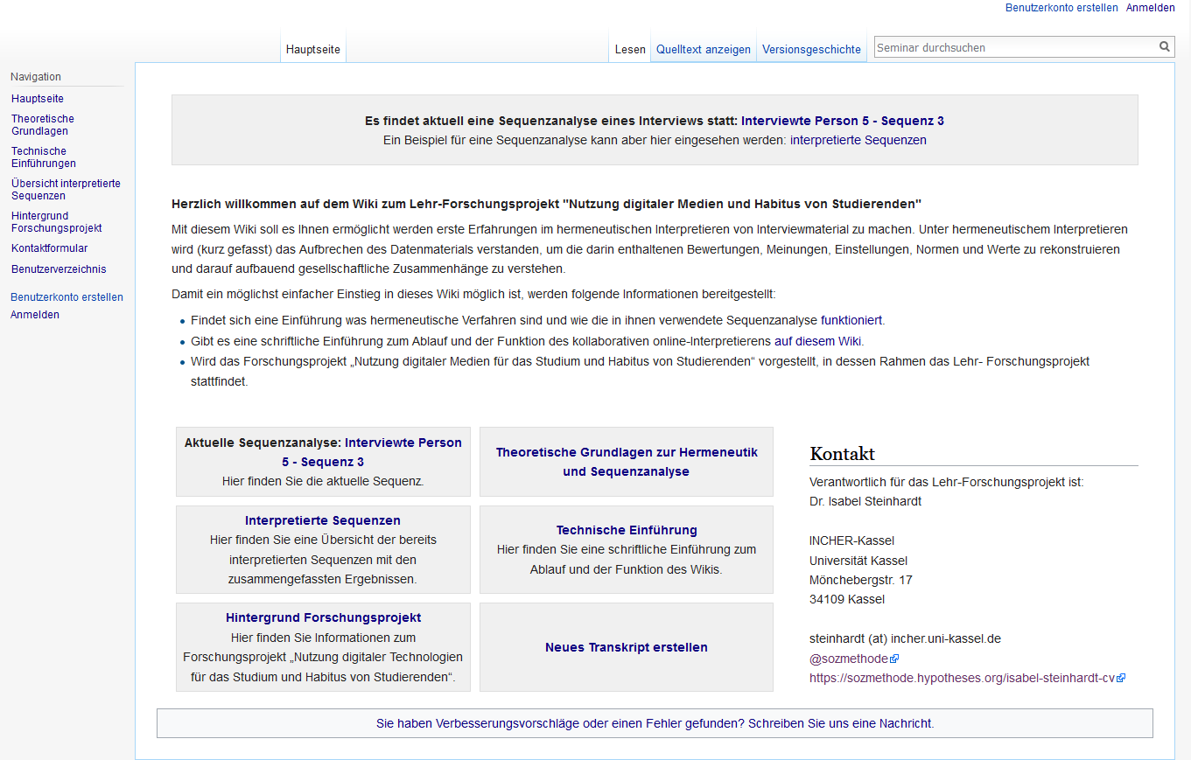
www.sozmethode.de
A wiki to interpret hermeneutically open and online

Slide 25
Idea
Proposal
Funding
Collection
Analysis
Publish
Archive

Slide 26

Open Access

Slide 27
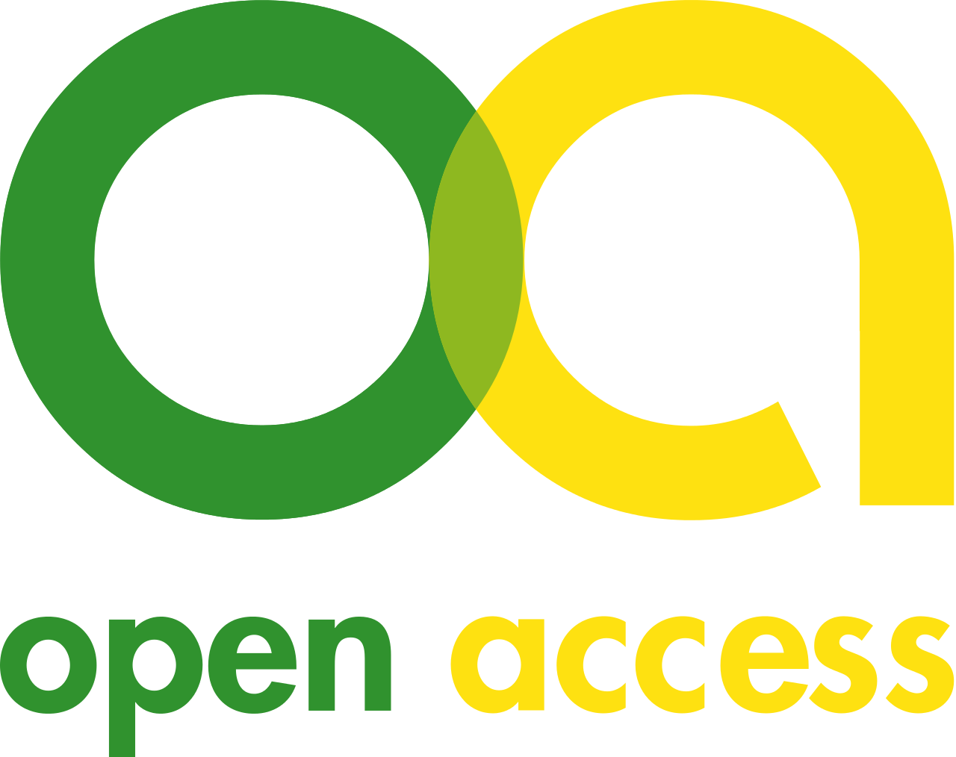
Types of OA
Golden
Green
Hybrid
Bronze

Slide 28
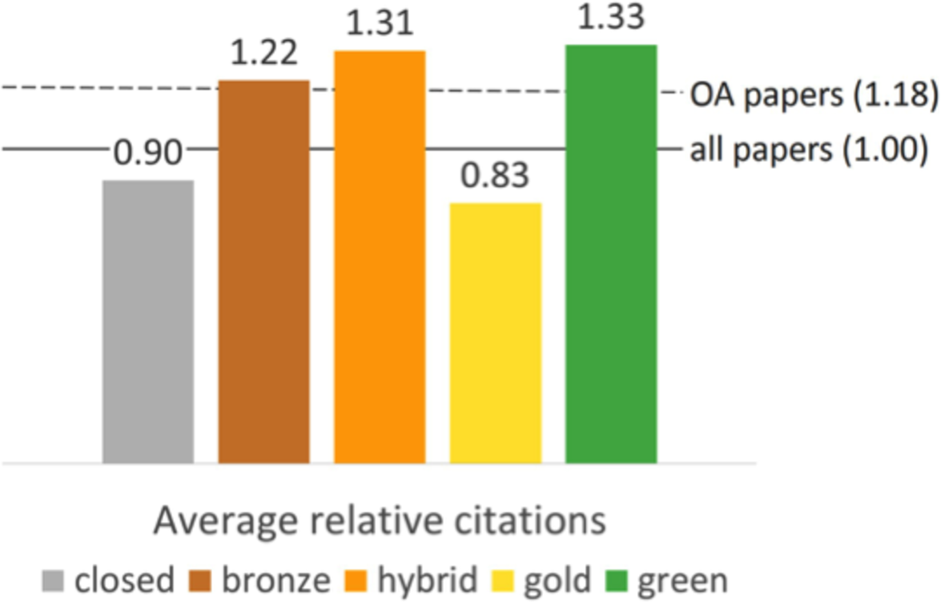
“Our results confirm the Open Access Citation Advantage found by other studies: open articles receive 18% more citations than otherwise expected.”
Piwowar H, et al. 2018. The state of OA: a large-scale analysis of the prevalence and impact of Open Access articles. PeerJ 6:e4375 https://doi.org/10.7717/peerj.4375

Slide 29
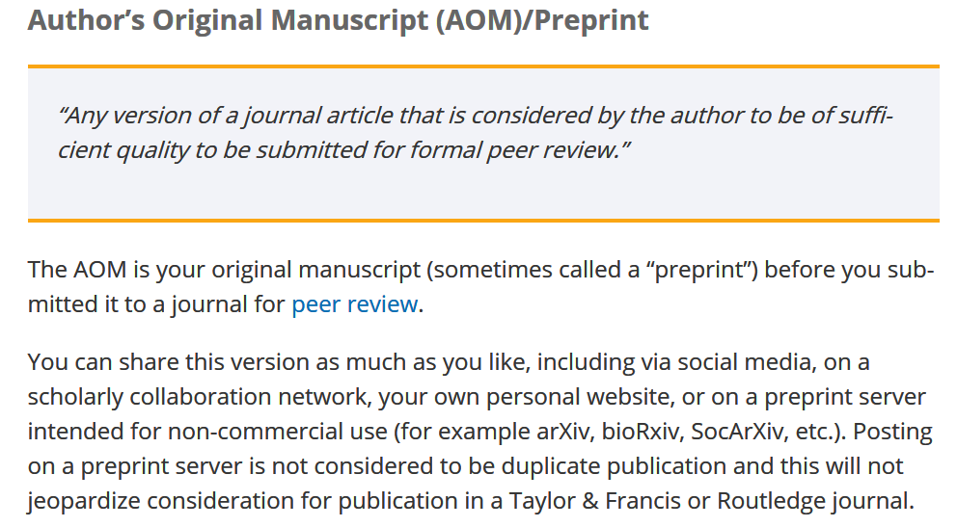
https://authorservices.taylorandfrancis.com/sharing-your-work
Springer: https://www.springer.com/gp/open-access/authors-rights/preprint-sharing/16718886
Elsevier: https://www.elsevier.com/about/policies/sharing

Slide 30
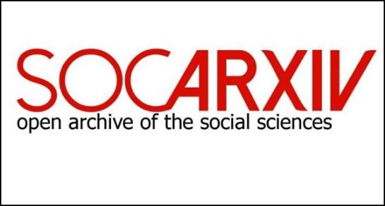



Slide 31
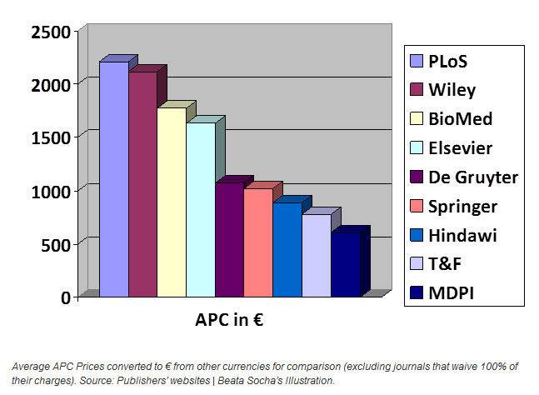
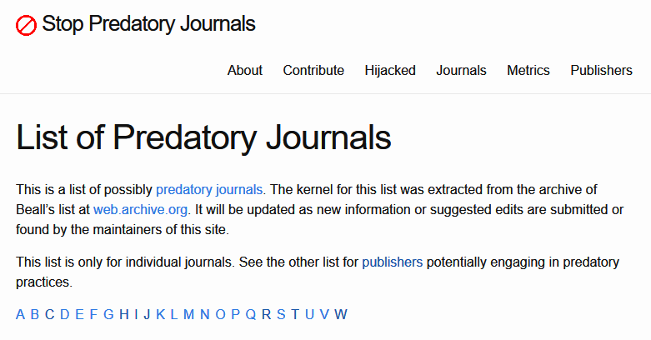

https://predatoryjournals.com/journals/
https://openscience.com/how-much-do-top-publishers-charge-for-open-access/
https://doaj.org/

Slide 32
Idea
Proposal
Funding
Collection
Analysis
Publish
Archive

Slide 33
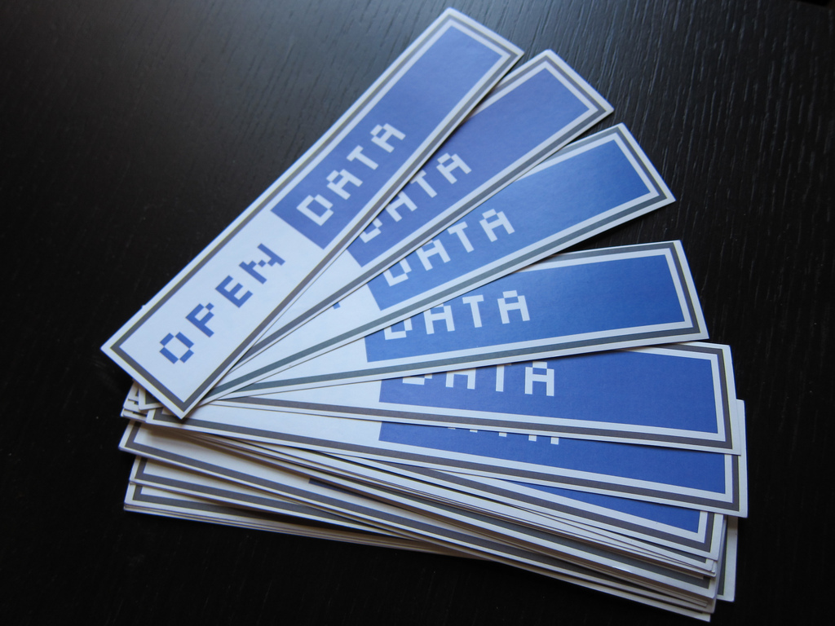
Open Data

Slide 34
“Open data is data that can be freely accessed, reused, remixed and redistributed, for academic research and teaching purposes and beyond. Ideally, open data have no restrictions on reuse or redistribution, and are appropriately licensed as such. In exceptional cases, e.g. to protect the identity of human subjects, special or limited restrictions of access are set.”
(Foster https://open-science-training-handbook.gitbook.io/book/open-science-basics/open-research-data-and-materials)

Slide 35
Data excuse bingo by @jenny_molloy
My data contains personal/ sensitive information | My data is too complicated | People may misinterpret my data | My data is not very interesting
Commercial funder doesn‘t want to share it | We might want to use it in a(nother) paper | People will contact me to ask about stuff | Data Protection/National Security
It‘s too big | People will see that my data is bad | I want to patent my discovery | It‘s not a priority and I‘m busy
I don‘t know how | I‘m not sure I own the data | Someone might steal/plagiarise it | My funder doesn‘t require it

Slide 36


Shirazibustan (https://commons.wikimedia.org/wiki/File:Zenodo_logo.jpg), https://creativecommons.org/licenses/by-sa/4.0/legalcode
Darby (https://commons.wikimedia.org/wiki/File:GitLab_Logo.svg), https://creativecommons.org/licenses/by-sa/4.0/legalcode

Slide 37
Open Science is the answer?
We need a cultural chance!

Slide 38
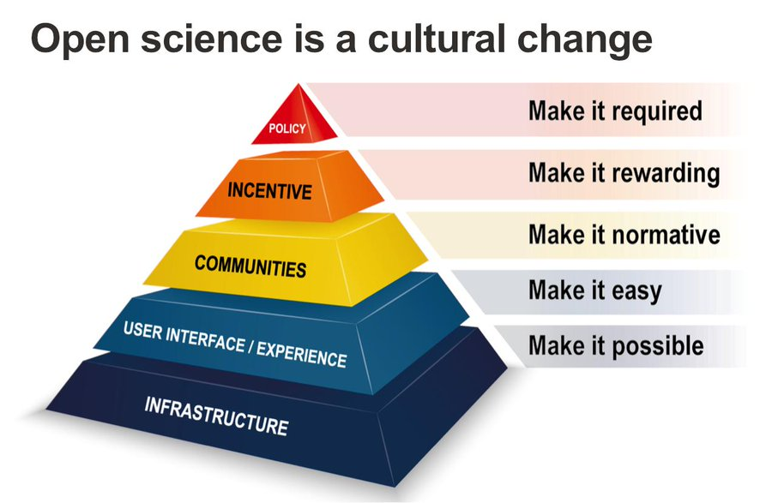
Taken from Brian Nosek https://osf.io/r9v3p/ and https://cos.io/blog/strategy-culture-change/

Slide 40
Findable
Metadata
Accessible
Repository
Reusable
Licensing
Interoperable
Methodology
Identifier
Social Media
Publish
Transparency
Vocabulary
www.go-fair.org/fair-principles/

Slide 41
Melanie Imming, & Jon Tennant. (2018, June 8). Sticker open science: just science done right (Version ENG). Zenodo. http://doi.org/10.5281/zenodo.1285575

Slide 42
What can you change to create a better science?
Dr. Isabel Steinhardt
steinhardt@incher.uni-kassel.de
@sozmethode
Steinhardt, Isabel. 2019. Teaching Open Science and qualitative methods. https://osf.io/preprints/socarxiv/b3zf7.
Blog: https://sozmethode.hypotheses.org

