Slide 1
Amplitude of the magnetic anomaly vector for interpretation at low latitudes
Felipe F. Melo, Shayane P. Gonzalez, Valeria C.F. Barbosa and Vanderlei C. Oliveira Jr

Slide 2
Motivation
Top = 0.1 km
Base = 2.1 km
Thickness = 0.1 km
Width = 2 km
Length = 2 km
Mag = 2 A/m
Northing (km)
Top = 0.8 km
Base = 7 km
Width = 0.5 km
Length = 1.5 km
Mag = 1.5 A/m
Downward (km)
Easting (km)

Slide 3
Motivation
Somewhere in the USA ....
High magnetic latitude
Total field anomaly
$I=i=60°$ $D=d=10°$

Slide 4
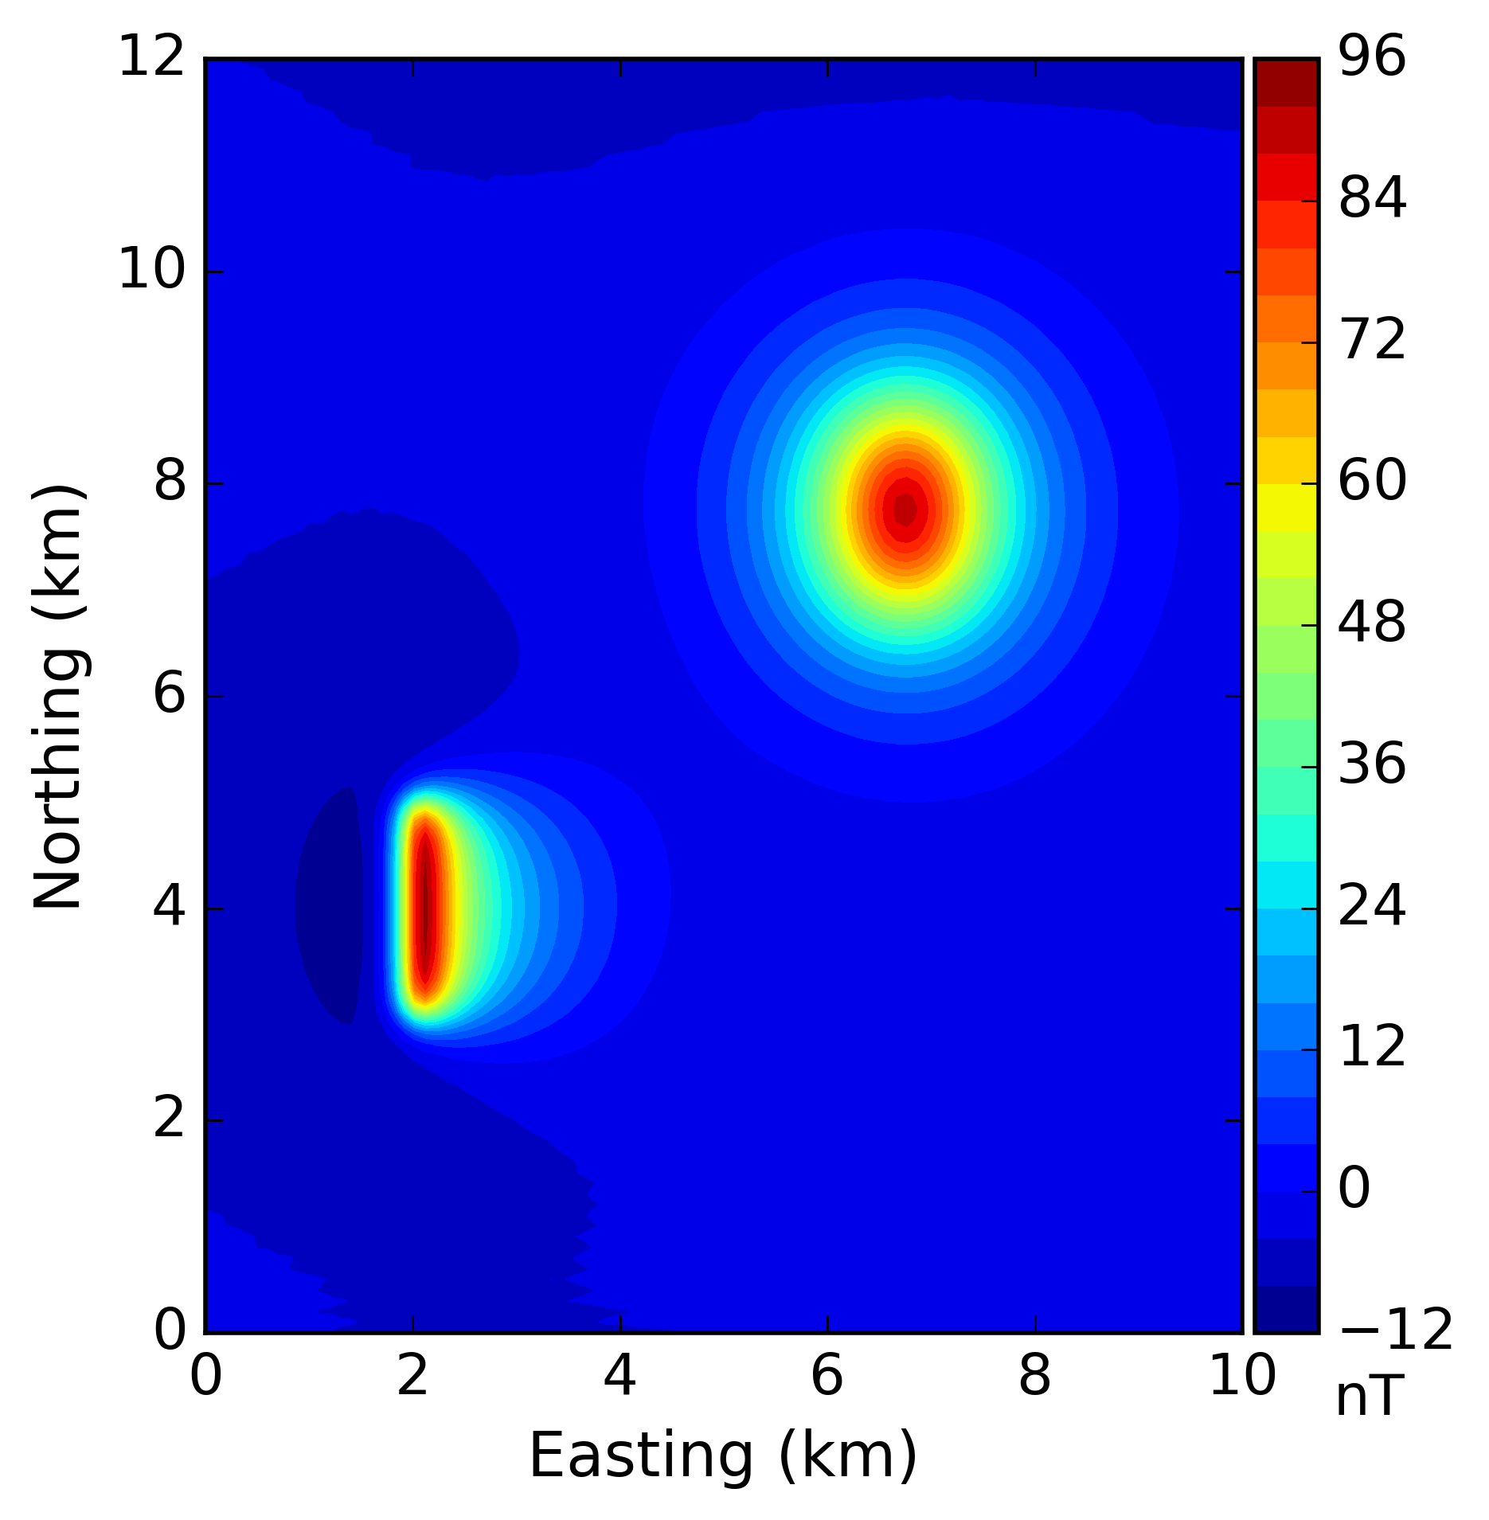
Motivation
Somewhere in the USA ....
High magnetic latitude
Standard
processing
procedure
in
North
America
Total field anomaly
Reduction to the pole (RTP)
$I=i=60°$ $D=d=10°$

Slide 5
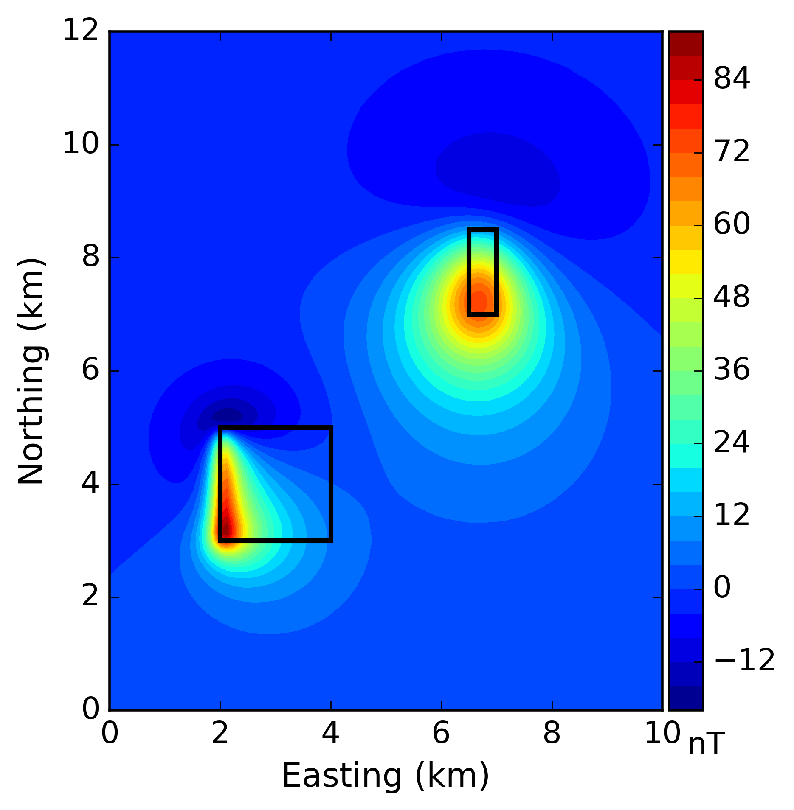
Motivation
Somewhere in the USA ....
High magnetic latitude
Standard
processing
procedure
in
North
America
Total field anomaly
Reduction to the pole (RTP)
$I=i=60°$ $D=d=10°$

Slide 6
Motivation
Somewhere in the north of Brazil ....
Low magnetic latitude
Total field anomaly
$I=i=−8°$ $D=d=−20°$

Slide 7
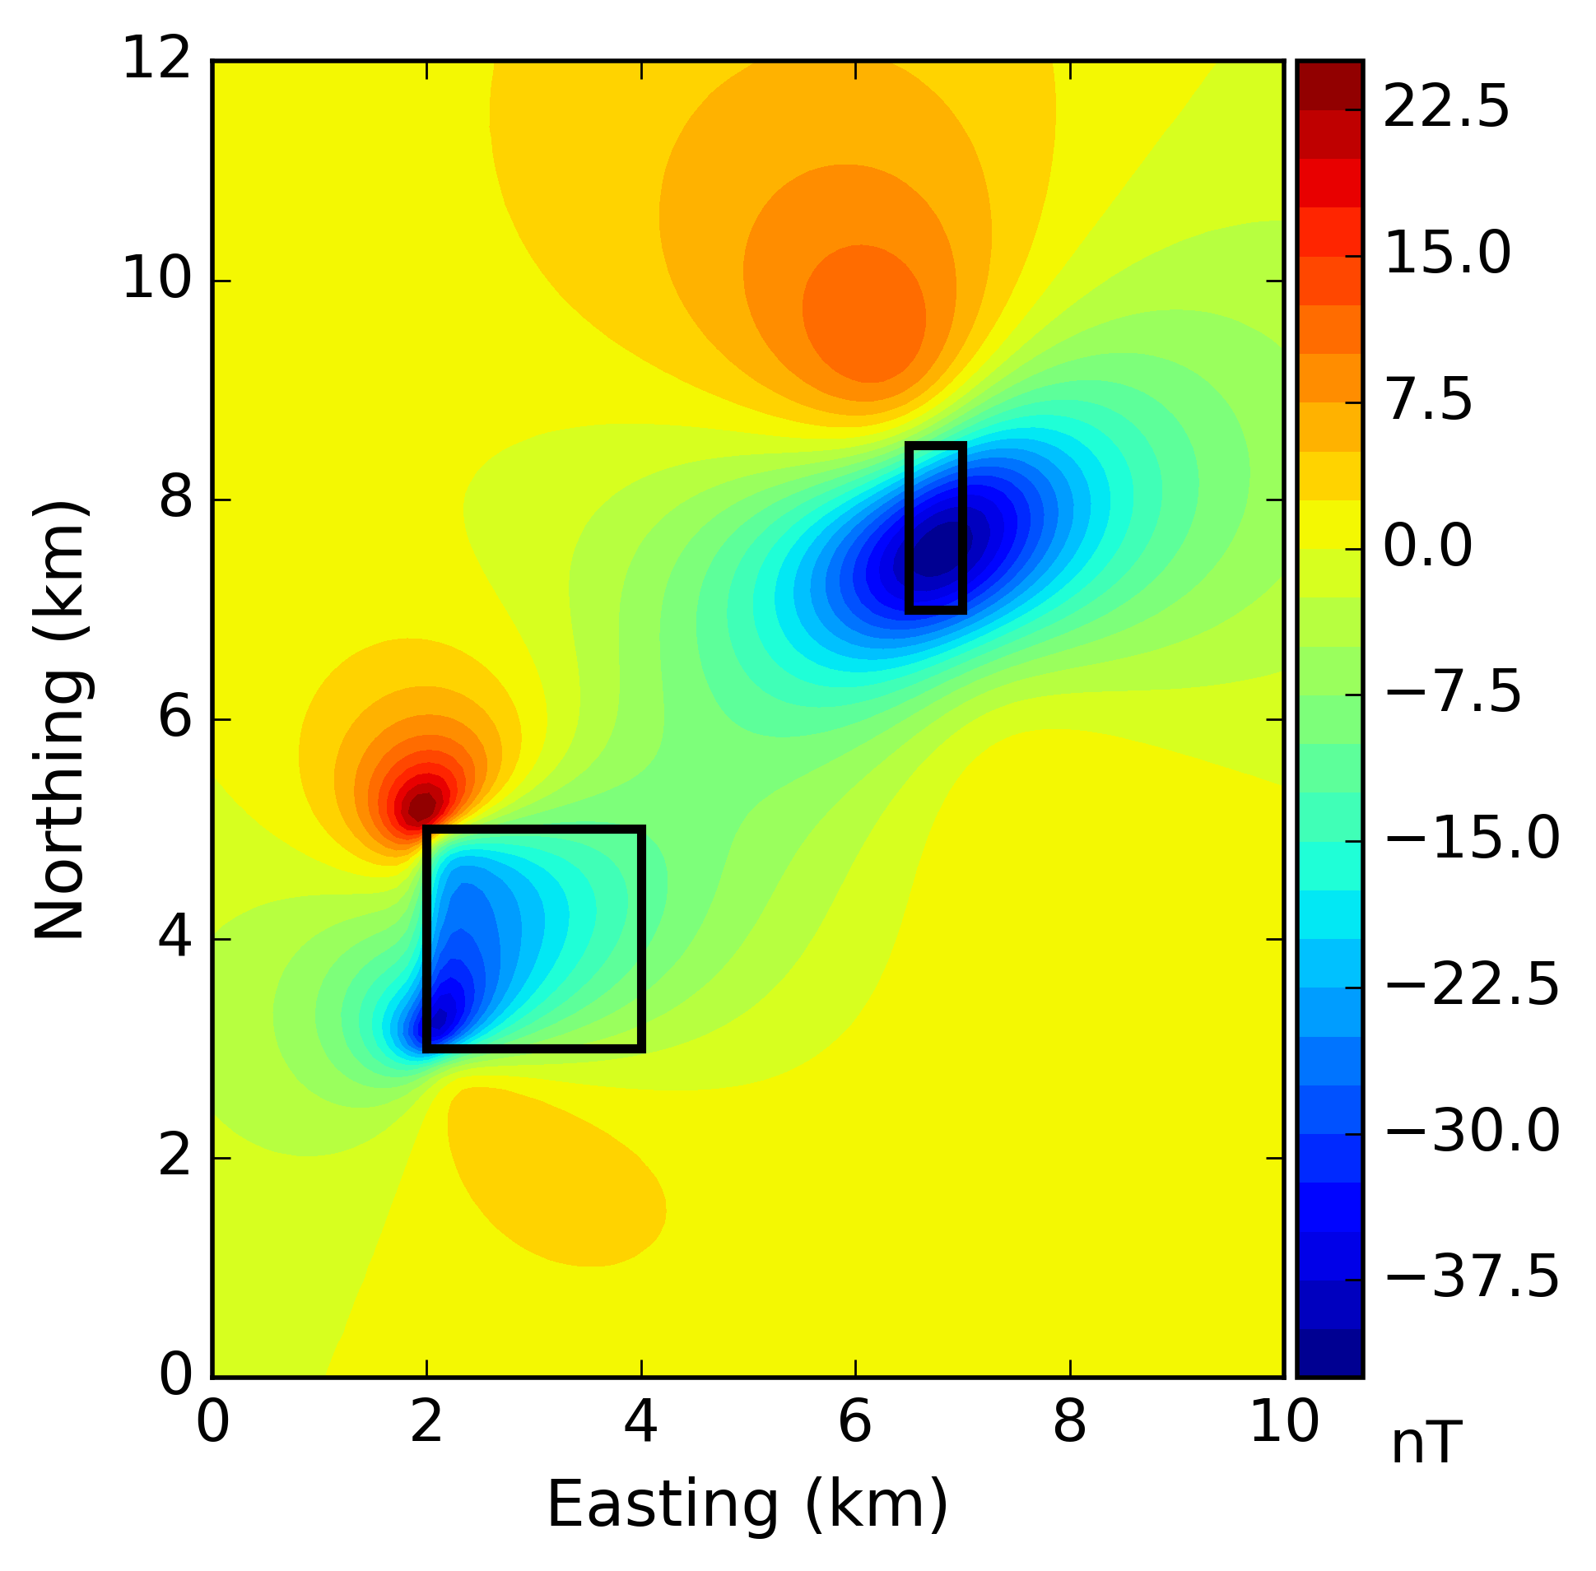
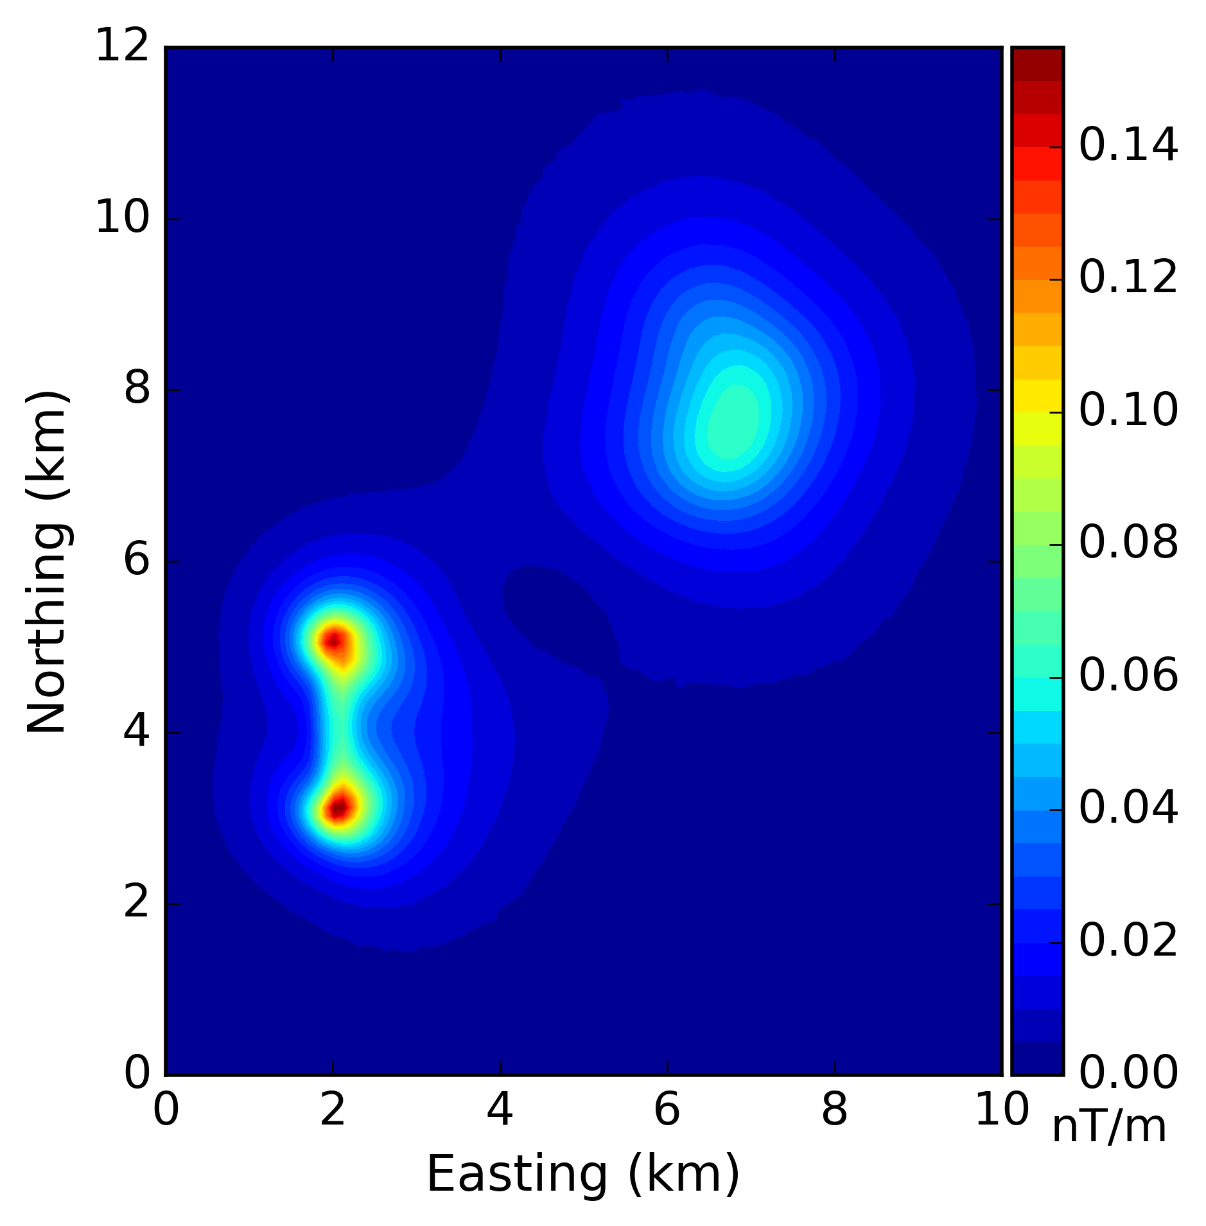
Motivation
Somewhere in the north of Brazil ....
Low magnetic latitude
Standard
processing
procedure
close
to the
magnetic
equator
Total field anomaly
Total gradient amplitude (TGA or 3D AS)
$I=i=−8°$ $D=d=−20°$

Slide 8
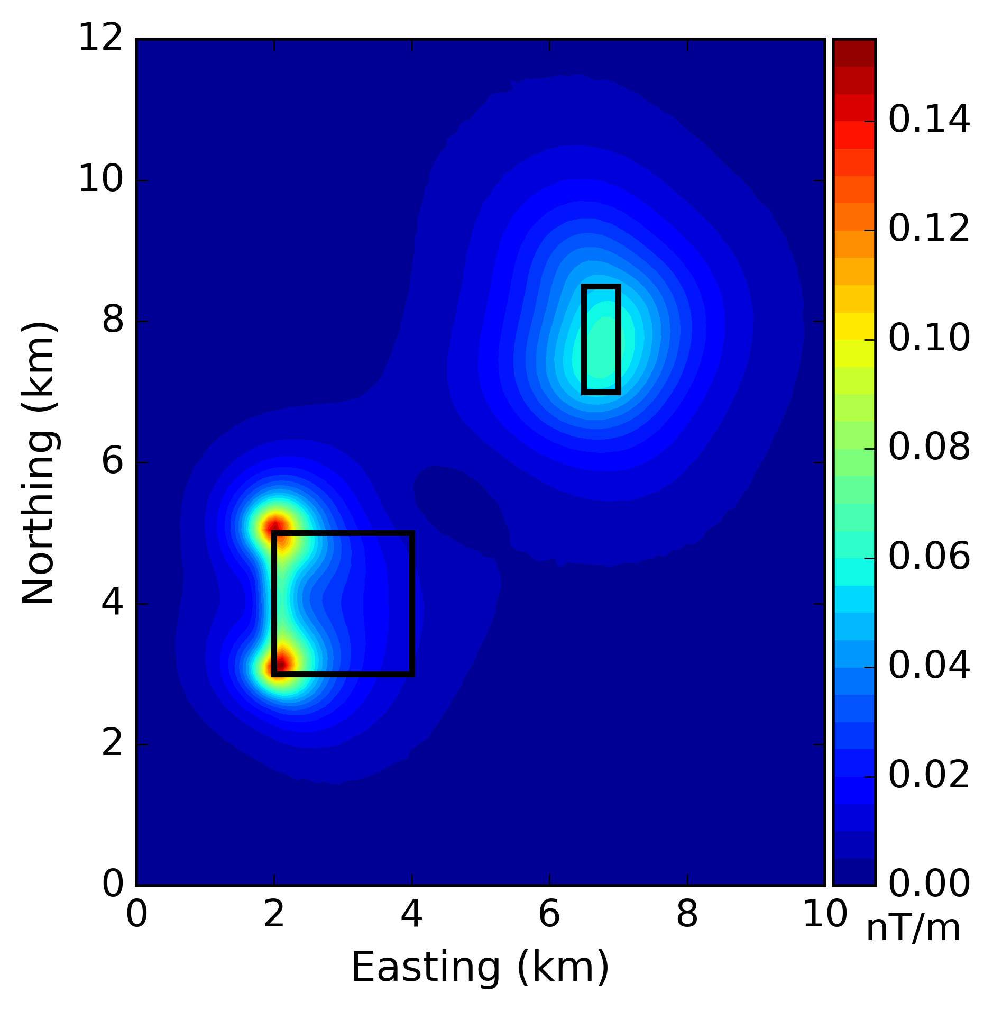
Motivation
Somewhere in the north of Brazil ....
Low magnetic latitude
Standard
processing
procedure
close
to the
magnetic
equator
Total field anomaly
Total gradient amplitude (TGA or 3D AS)
$I=i=−8°$ $D=d=−20°$

Slide 9
Motivation
High magnetic latitude
Low magnetic latitude
RTP
TGA

Slide 10
Objective
Use the amplitude of the magnetic anomaly vector for interpretation at low latitudes;
Compare the results with the Total gradient amplitude (TGA) and with gravity data;
Perform interpretation in a region close to the magnetic equator (north of Brazil).

Slide 11
Content
Introduction
Methodology
Synthetic Tests
Real data application
Conclusions

Slide 12
Content
Introduction
Methodology
Synthetic Tests
Real data application
Conclusions

Slide 13
Introduction
For magnetic interpretation at low latitudes, the reduction to the pole is unstable and some authors worked on this issue on space and Fourier domains (Silva, 1986; Swain, 2000; Li and Oldenburg, 2001; Li et al., 2014);
From a practical point of view, McLeod et al. (1993) used the 3D AS (Roest et al., 1992) for interpretation at low latitudes;
Li (2006) demonstrated that the 3D AS (or TGA) is dependent of the magnetization direction and the source’s geometry;
Stavrev and Gerovska (2000) show that the amplitude of the magnetic anomaly vector is weakly dependent on the magnetization direction;
Some authors took advantage of this behavior and performed inversions (Li et al., 2010; Liu et al., 2013, 2015, 2017; Li and Li, 2014; Leão-Santos et al., 2015; Krahenbuhl and Li, 2017).

Slide 14
Content
Introduction
Methodology
Synthetic Tests
Real data application
Conclusions

Slide 15
Methodology
Amplitude of the magnetic anomaly vector
$$B=\sqrt{B_{x}^{2}+B_{y}^{2}+B_{z}^{2}}$$
Total gradient amplitude (TGA or 3D-AS)
$$TGA=\sqrt{{\left(\frac{∂T}{∂x}\right)}^{2}+{\left(\frac{∂T}{∂y}\right)}^{2}+{\left(\frac{∂T}{∂z}\right)}^{2}}$$
Synthetic test - The vertical component of the gravity data $\left(g_{z}\right)$
Real data – Bouguer anomaly

Slide 16
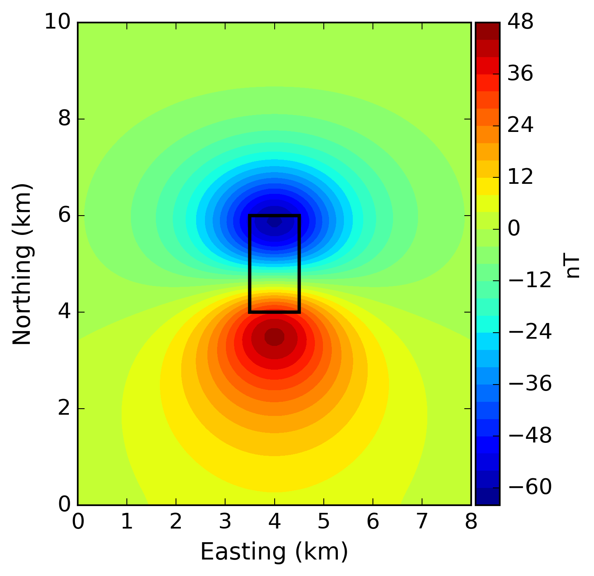
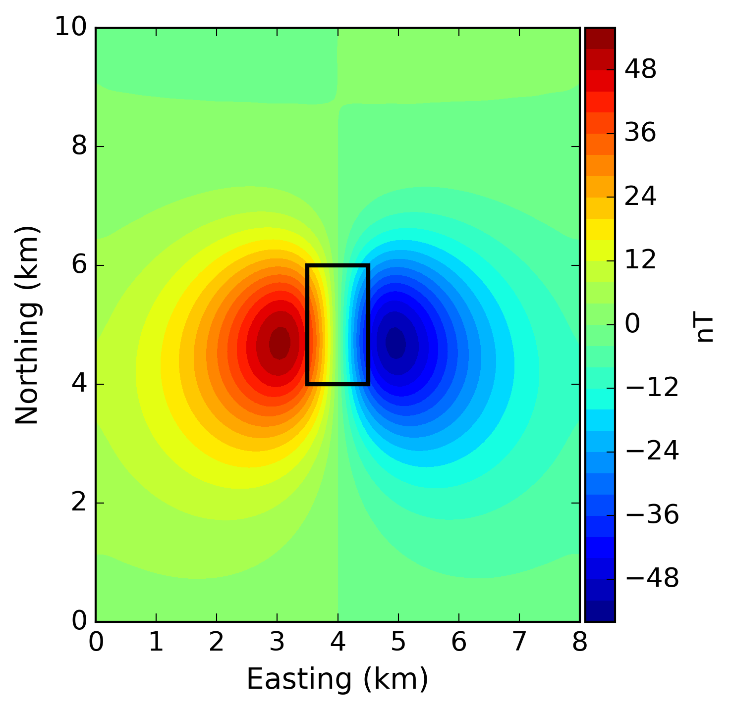
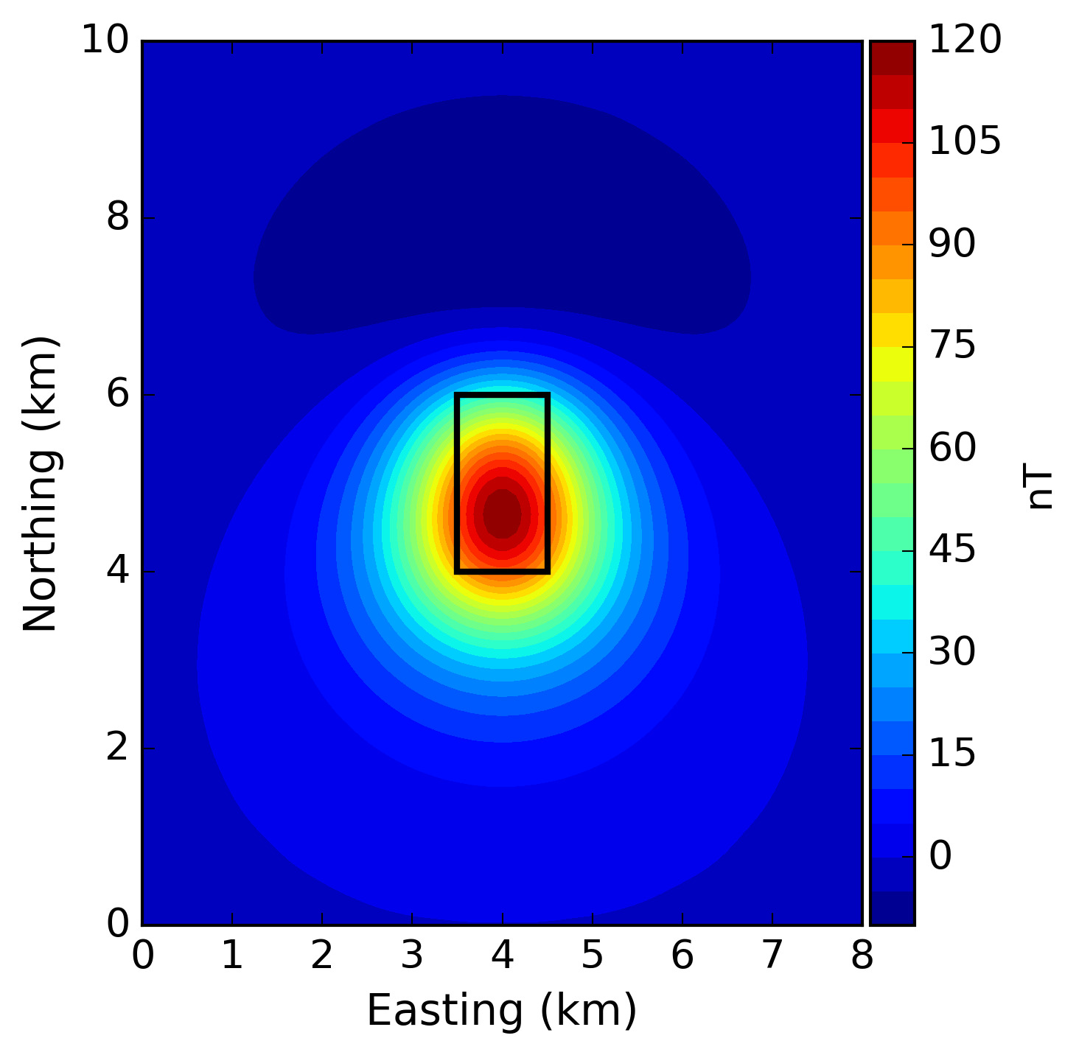
Methodology
$$B_{x}$$
Total-field anomaly
$$B_{y}$$
$$B_{z}$$
$I=i=60°$ $D=d=0°$

Slide 17
Methodology
$$B_{x}$$
Total-field anomaly
Amplitude of the magnetic anomaly vector
$$B_{y}$$
$$B=\sqrt{B_{x}^{2}+B_{y}^{2}+B_{z}^{2}}$$
$$B_{z}$$

Slide 18
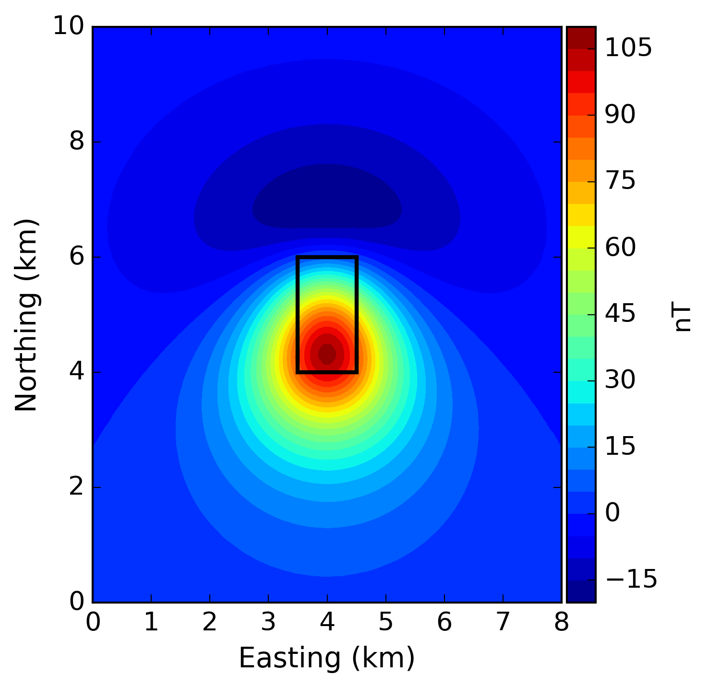
Methodology
$$B=\sqrt{B_{x}^{2}+B_{y}^{2}+B_{z}^{2}}$$
$$B_{x}$$
Total-field anomaly
Amplitude of the magnetic anomaly vector
$$B_{y}$$
$$B_{z}$$

Slide 19
Methodology
We compute the Amplitude of the magnetic anomaly vector via the equivalente layer principle (Dampney, 1969).
Li and Li (2014) showed that the computation of the Amplitude of the magnetic anomaly vector via Fourier leads to wrong amplitude and shape results on uneven or rugged surfaces.

Slide 20
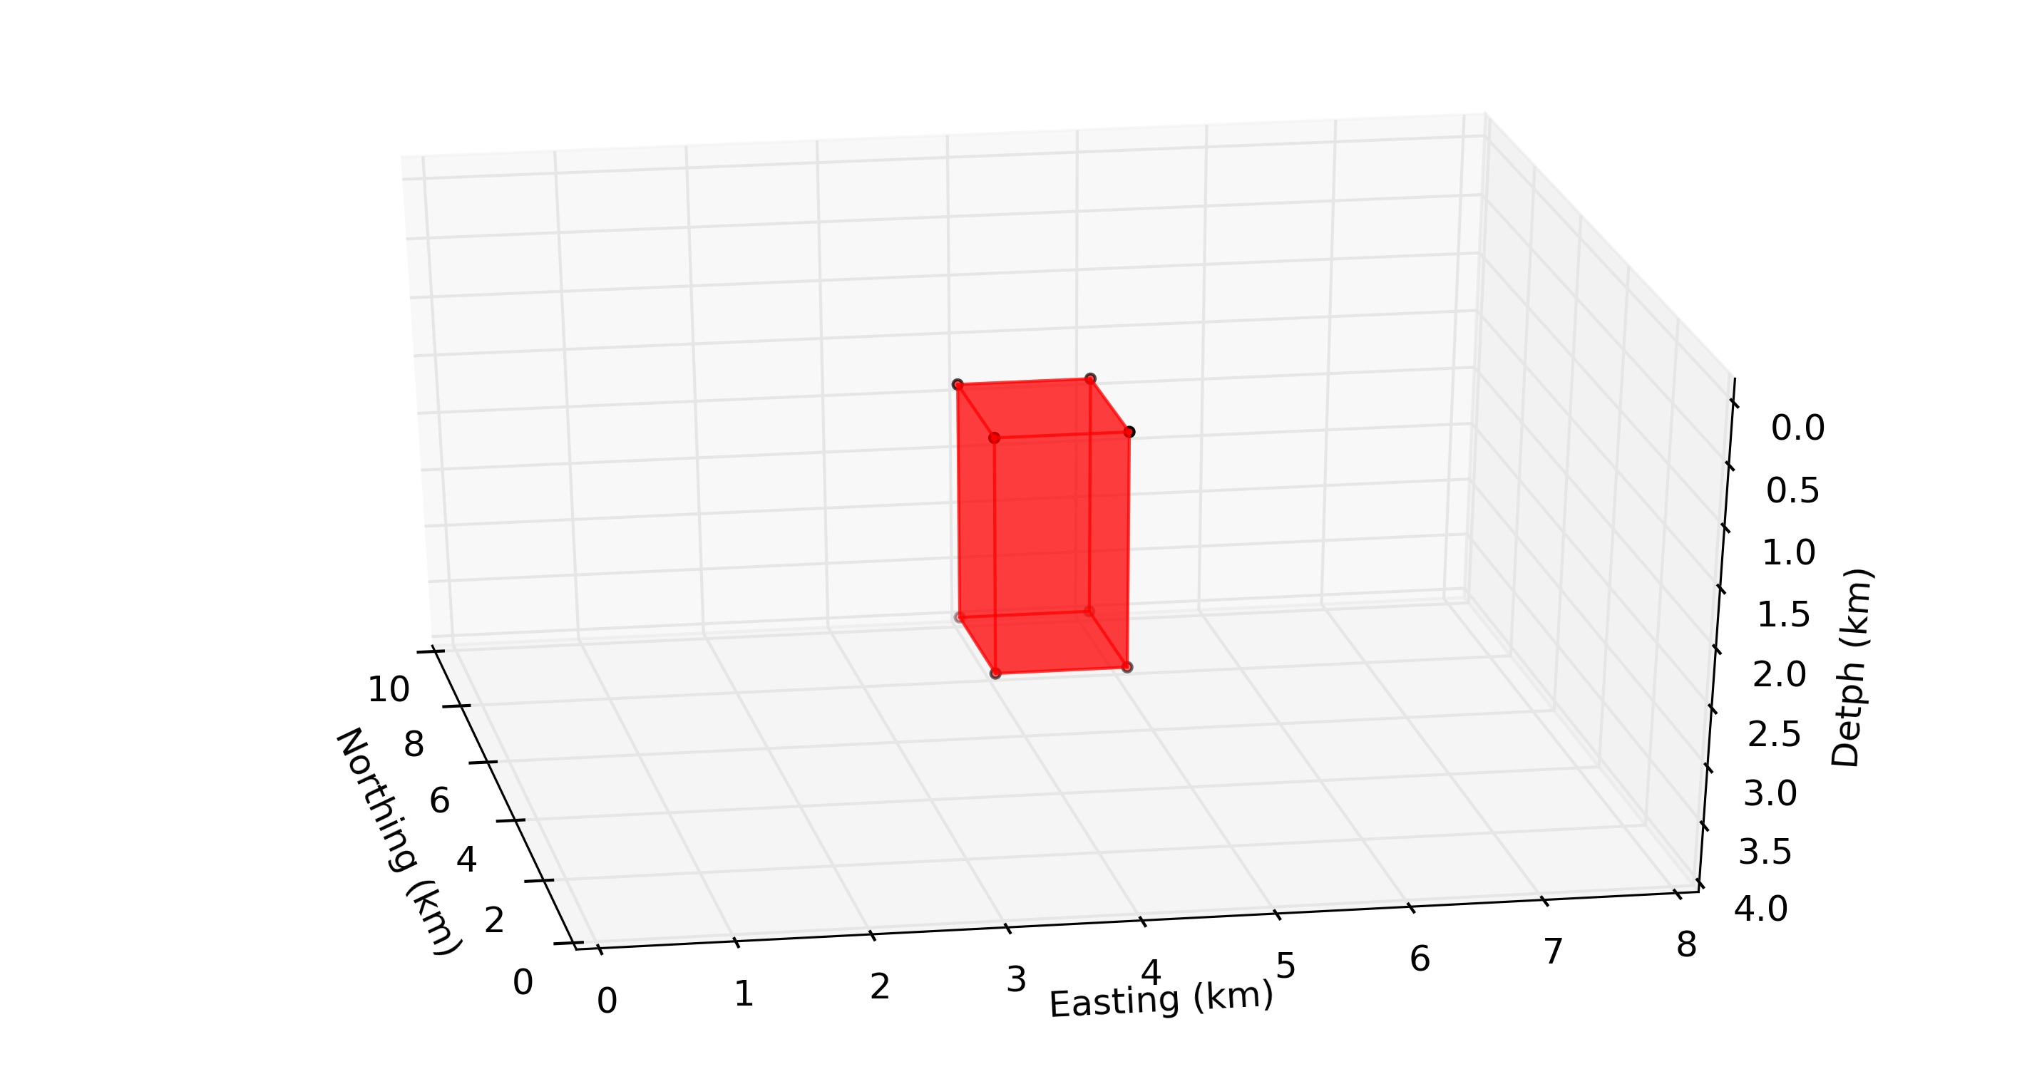
Methodology
Source

Slide 21
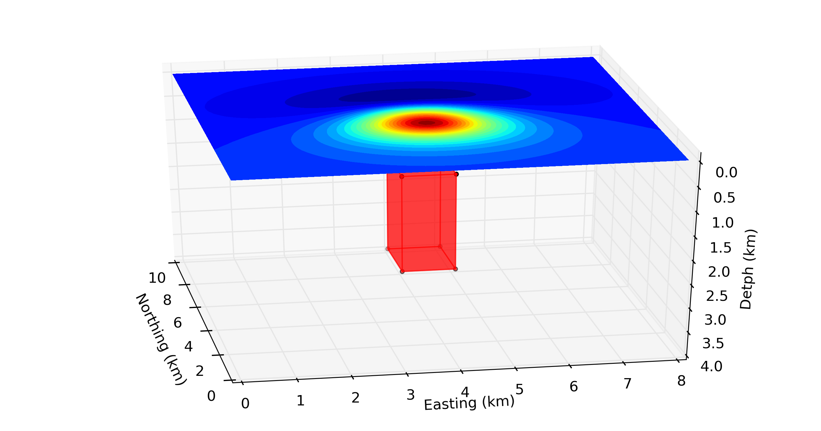
Methodology
Total-field anomaly
Source

Slide 22
Methodology
Potential-field observations produced by a
3D physical-property distribution can be exactly reproduced by a continuous and infinite
2D physical-property distribution.
Potential-field observations
In theory
Dampney (1969)
Total-field anomaly
Source
3D physical-property distribution

Slide 23
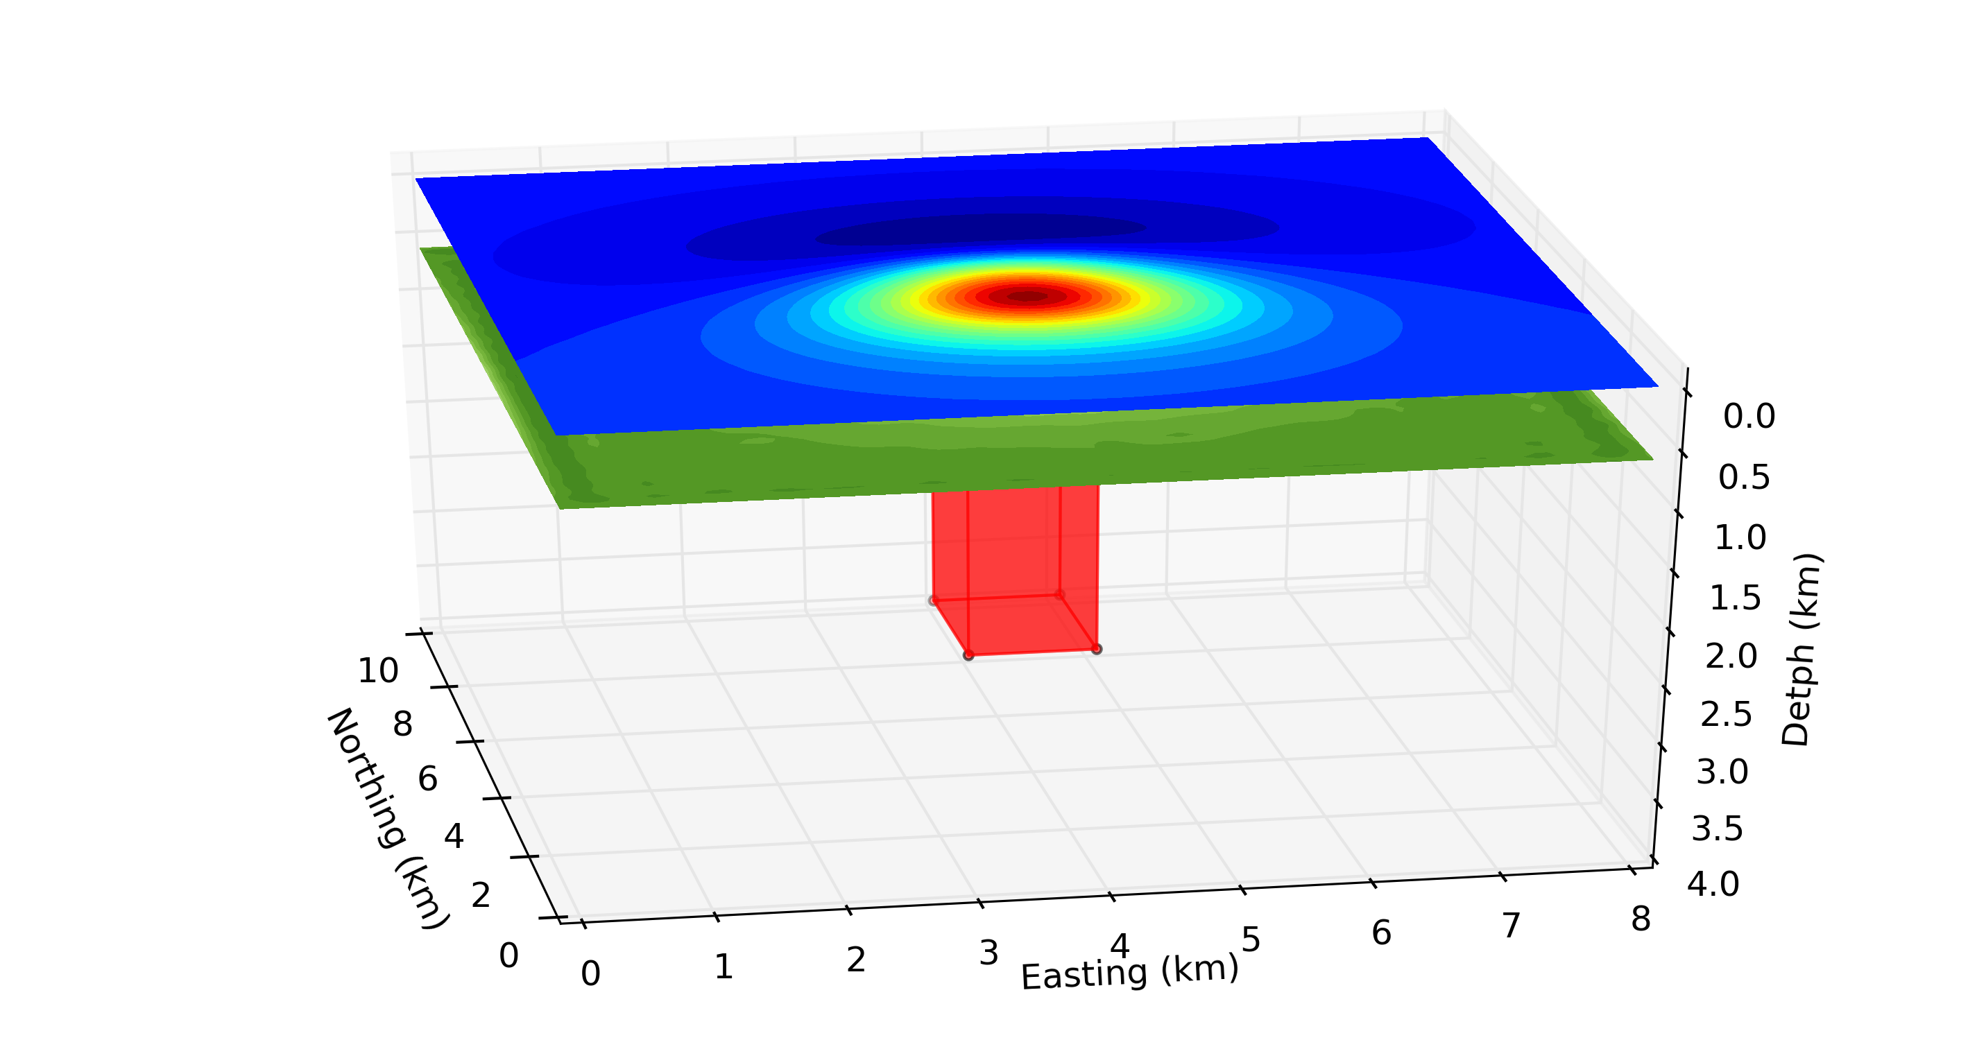
Methodology
Potential-field observations produced by a
3D physical-property distribution can be exactly reproduced by a continuous and infinite
2D physical-property distribution.
Potential-field observations
In theory
Dampney (1969)
Total-field anomaly
2D physical-property distribution
Source
3D physical-property distribution

Slide 24
Methodology
The 2D physical-property distribution is approximated by a finite set of equivalent sources arrayed in a layer with finite horizontal dimensions and located below the observation surface.
Potential-field observations
In practice
Dampney (1969)
Total-field anomaly
Source
3D physical-property distribution

Slide 25
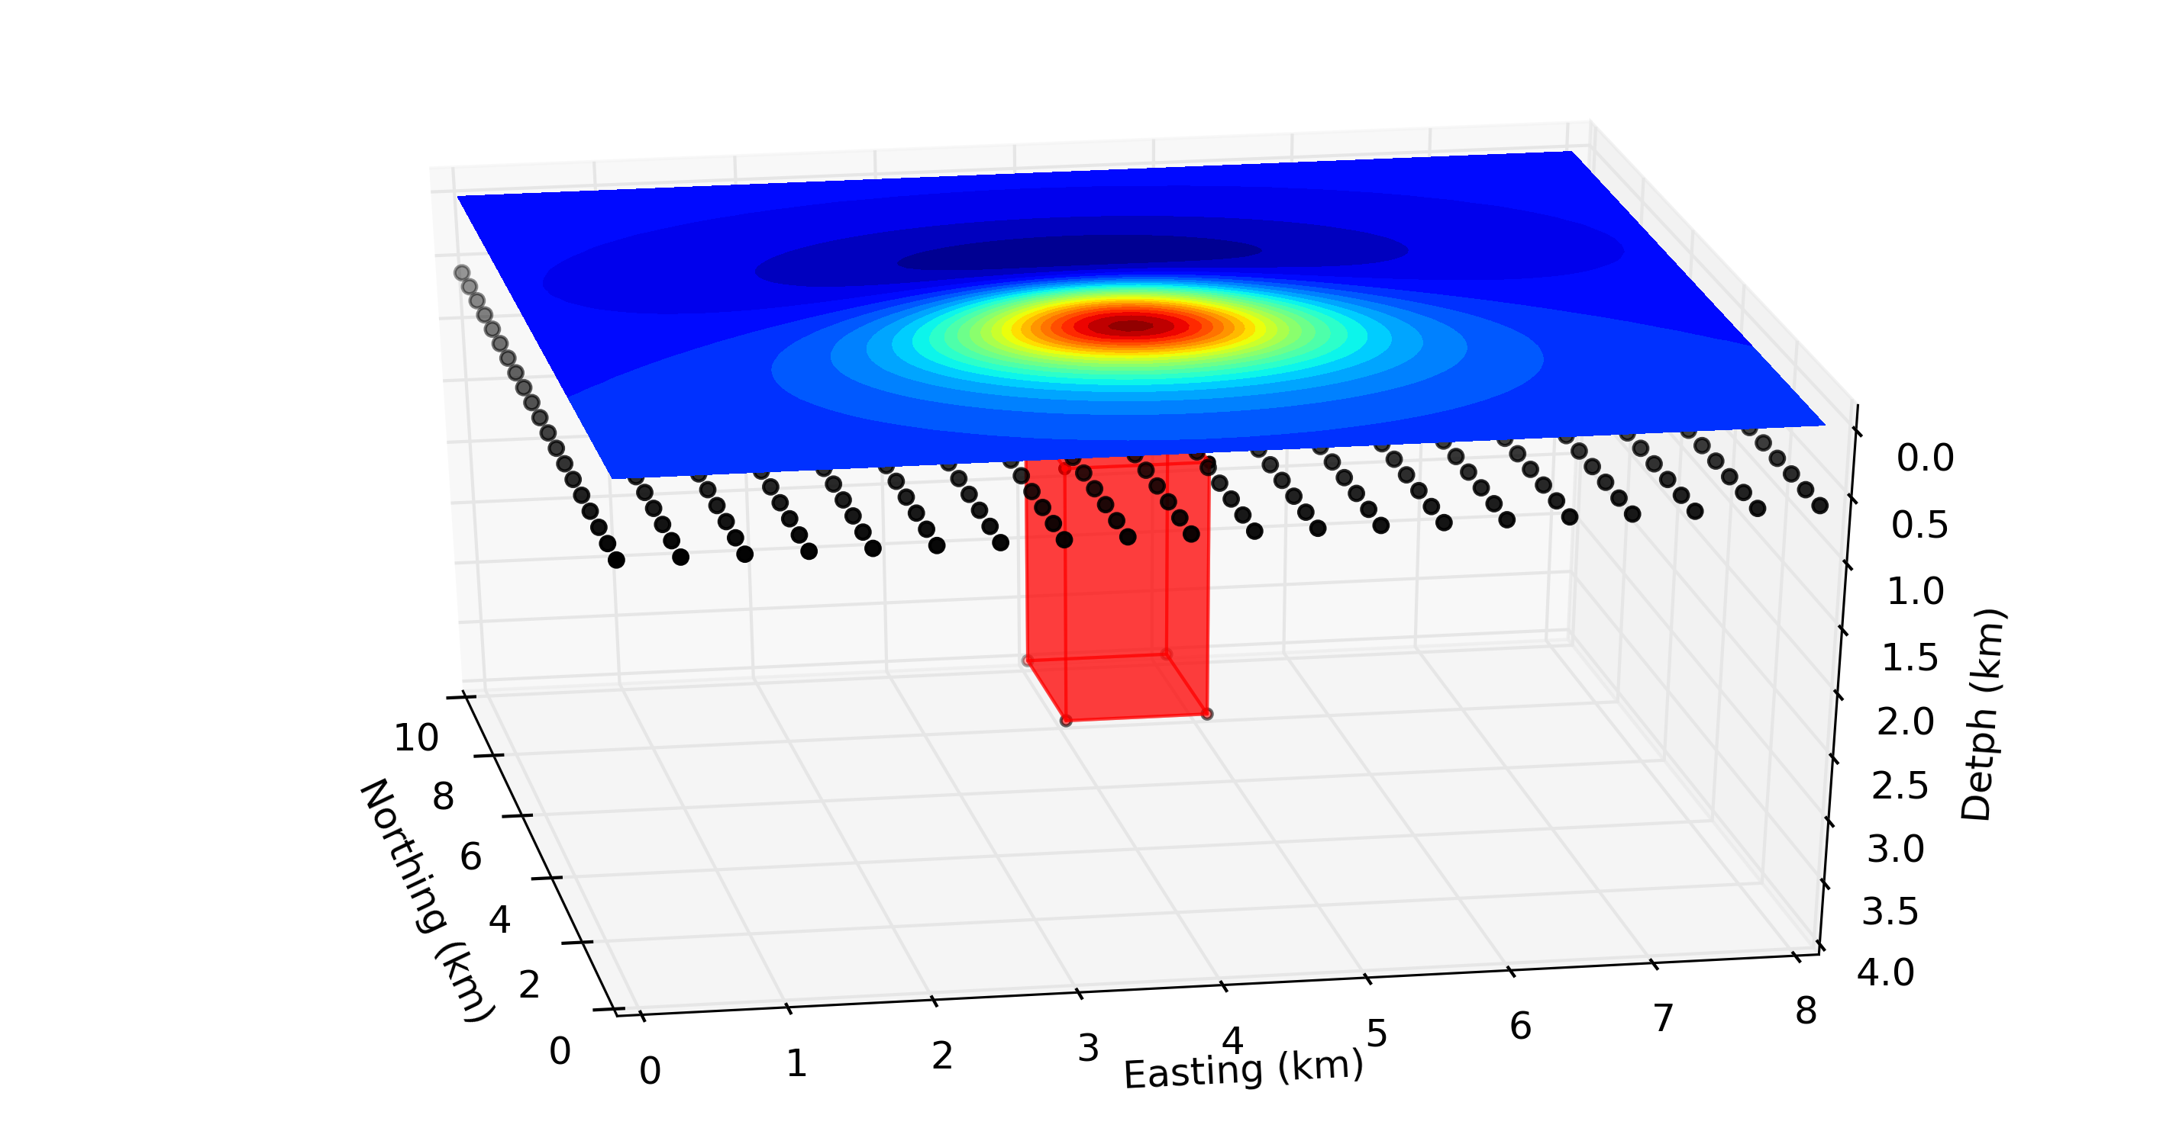
Methodology
The 2D physical-property distribution is approximated by a finite set of equivalent sources arrayed in a layer with finite horizontal dimensions and located below the observation surface.
Potential-field observations
In practice
Dampney (1969)
Total-field anomaly
Equivalent sources (dipoles)
Source
3D physical-property distribution

Slide 26
Methodology
The 2D physical-property distribution is approximated by a finite set of equivalent sources arrayed in a layer with finite horizontal dimensions and located below the observation surface.
Potential-field observations
ZOOM IN
Total-field anomaly
Equivalent sources (dipoles)
Source
3D physical-property distribution

Slide 27
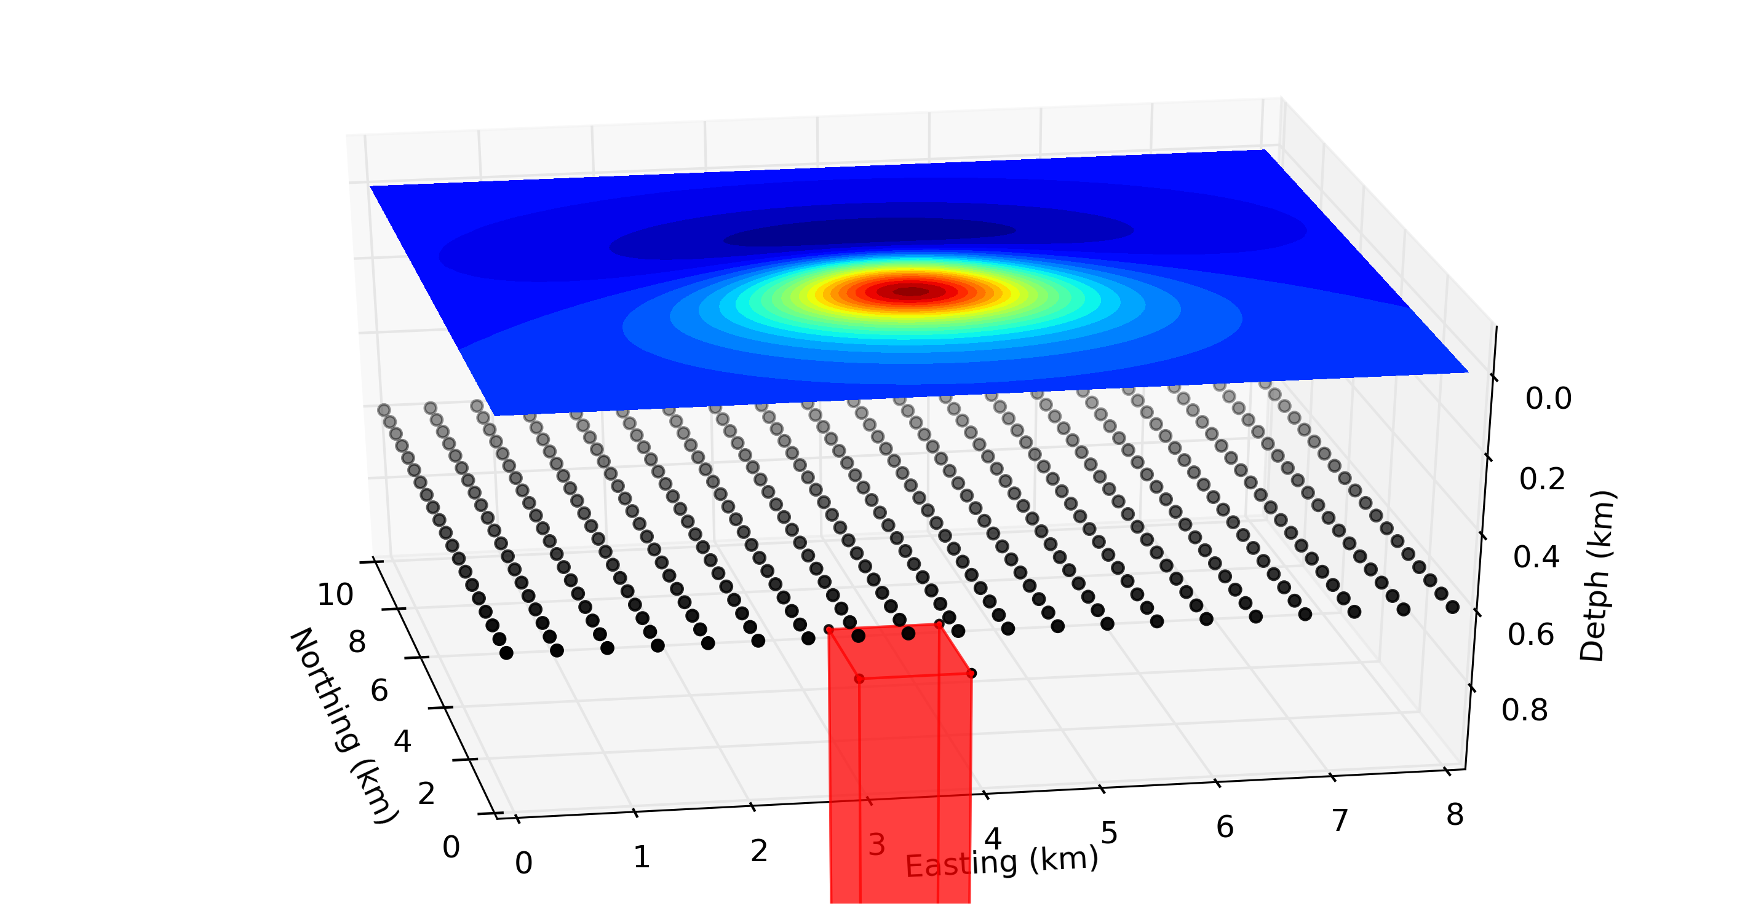
Methodology
Potential-field observations
In practice
Total-field anomaly
Equivalent sources (dipoles)
Source
3D physical-property distribution

Slide 28
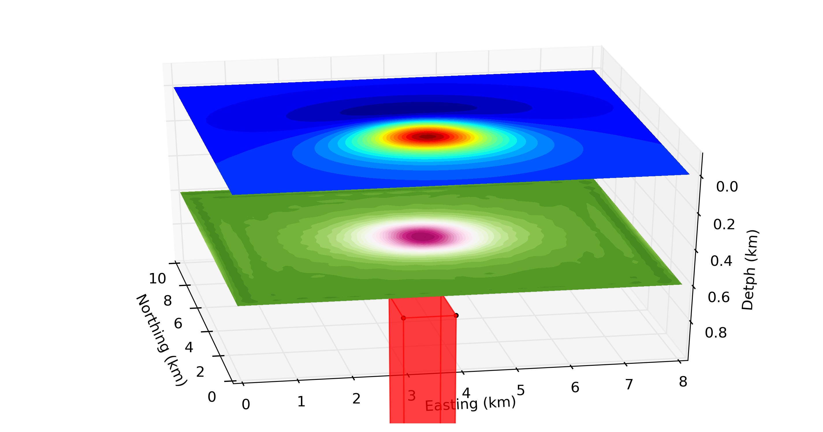
Methodology
Potential-field observations
In practice
Total-field anomaly
Physical property - magnetic moment intensity
Source
3D physical-property distribution

Slide 29
Methodology
Amplitude of the magnetic anomaly vector
$$B=\sqrt{B_{x}^{2}+B_{y}^{2}+B_{z}^{2}}$$
$$B_{x}$$
$$B_{y}$$
$$B_{z}$$
$$b^{α}=$$
$$T^{α}$$
$$\hat{p}$$
Physical property - magnetic moment intensity
$α=x,y,z$ directions

Slide 30
Content
Introduction
Methodology
Synthetic Tests
Real data application
Conclusions

Slide 31
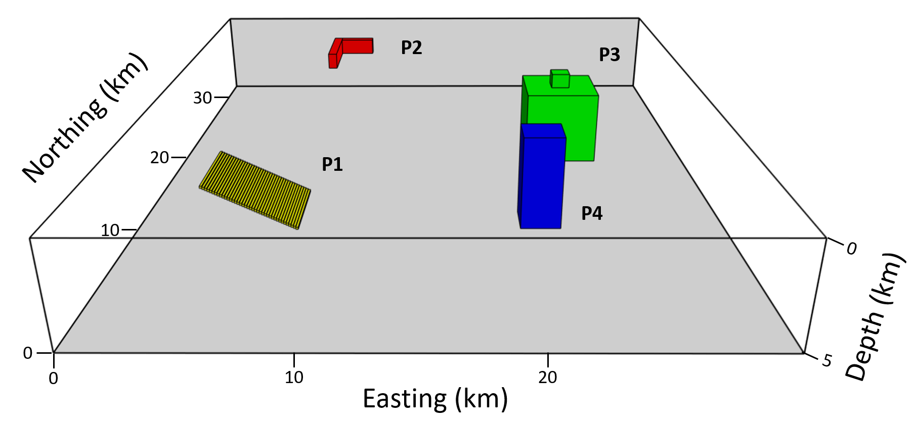
Grid = 116 x 97 points (N-E)
$∆x=∆y=0.3$ km
Flight $=0.15$ km
Synthetic Tests
Top = 0.2 km
Base = 1 km
Width = 1 km
Top = 0.2 km
Base = 1.1 km
Width = 0.5 km
Top = 0.1 km
Base = 2.1 km
Width = 4 km
Thickness = 0.1 km
Top = 1 km
Base = 5 km
Width = 4 km
Top = 0.2 km
Base = 5 km
Width = 2 km

Slide 32
Synthetic Test 1 – Vertical incidence
Dependent on the source’s geometry
Total-field anomaly
Total gradient amplitude

Slide 33
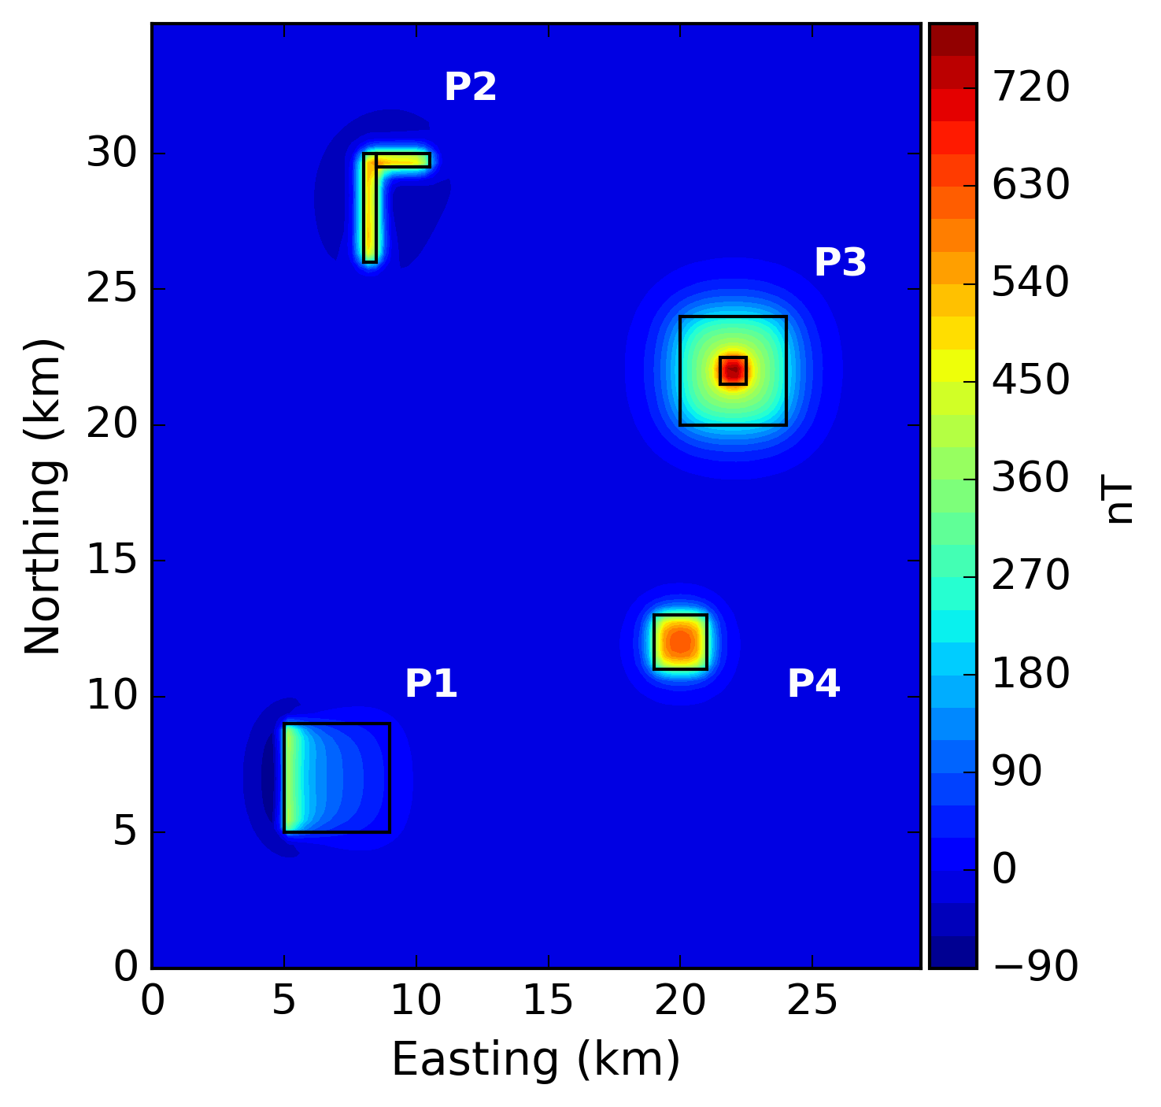
Synthetic Test 1 – Vertical incidence
Amplitude of the magnetic anomaly vector
Total-field anomaly

Slide 34
Synthetic Test 1 – Vertical incidence
Vertical component of the gravity data $\left(g_{z}\right)$
Total-field anomaly

Slide 35
Synthetic Test 2 – Mid latitude
$$I=D=45°$$
$$i=d=45°$$
$$i=d=45°$$
$$i=d=45°$$
$$i=d=60°$$

Slide 36
Synthetic Test 2 – Mid latitude
Dependent on the magnetization direction
Total-field anomaly
Total gradient amplitude

Slide 37
Synthetic Test 2 – Mid latitude
Amplitude of the magnetic anomaly vector
Total-field anomaly

Slide 38
Synthetic Test 3 – Low latitude
$$I=−8°$$
$$D=−20°$$
$$i=−8°$$
$$d=−20°$$
$$i=d=45°$$
$$i=−8°$$
$$d=−20°$$
$$i=d=60°$$

Slide 39
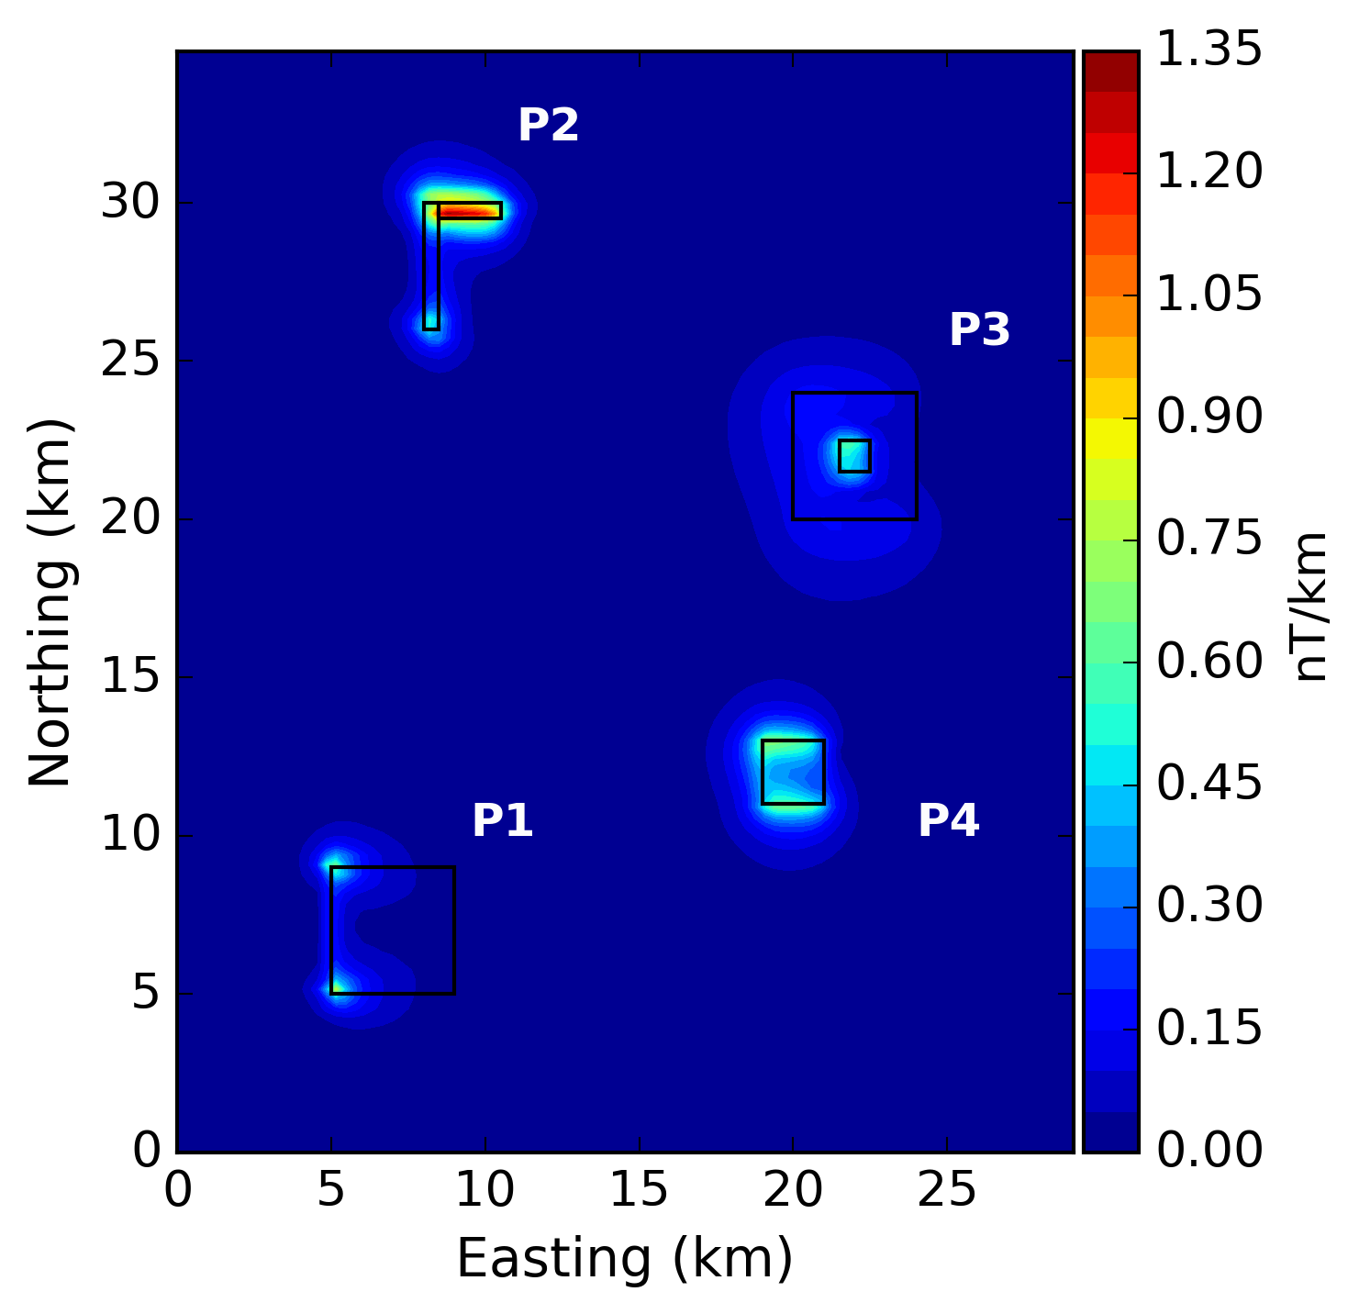
Synthetic Test 3 – Low latitude
Total-field anomaly
Total gradient amplitude

Slide 40
Synthetic Test 3 – Low latitude
Amplitude of the magnetic anomaly vector
Total-field anomaly

Slide 41
Content
Introduction
Methodology
Synthetic Tests
Real data application
Conclusions

Slide 42
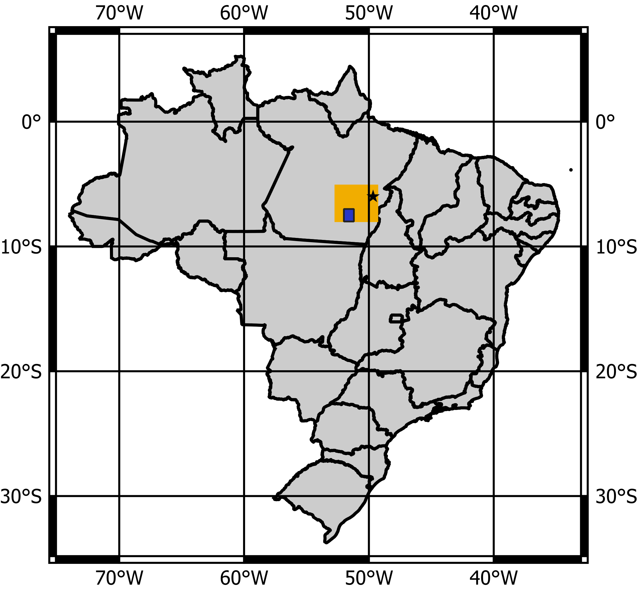
Real data application
Carajás Mineral Province (CPRM, 2015)
Serra Pelada mine
Flight line $=3$ km (north–south)
Tie line $=12$ km
Flight height $=0.9$ km

Slide 43
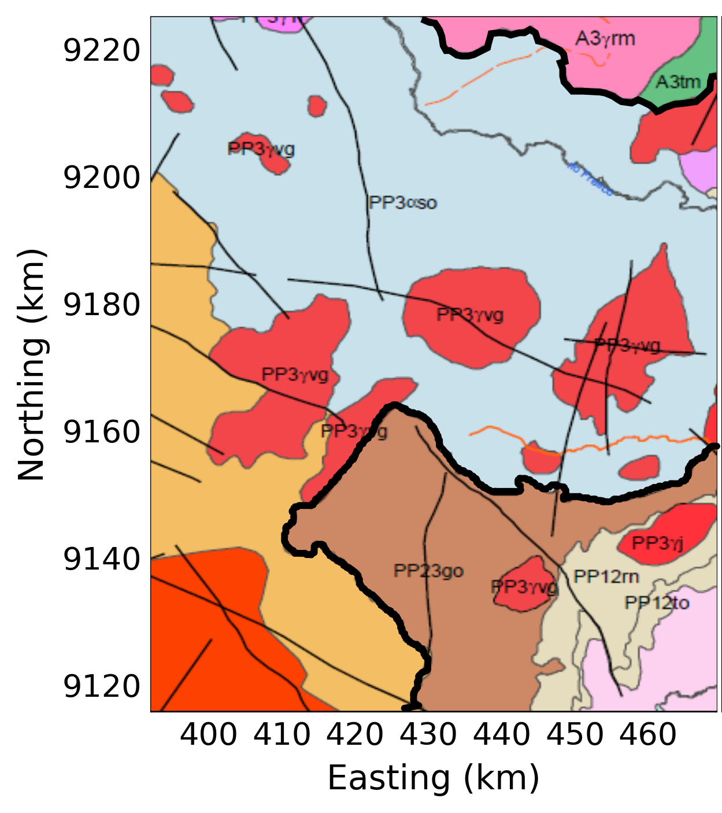
Real data application
Geologic map
Intracontinental
magmatism
Sedimentary formations
Sandstones and shales
granitic intrusions
effusions of andesite
granitic intrusions
effusions of rhyolite
Iriri-Xingu Domain
Rio Maria Domain

Slide 44
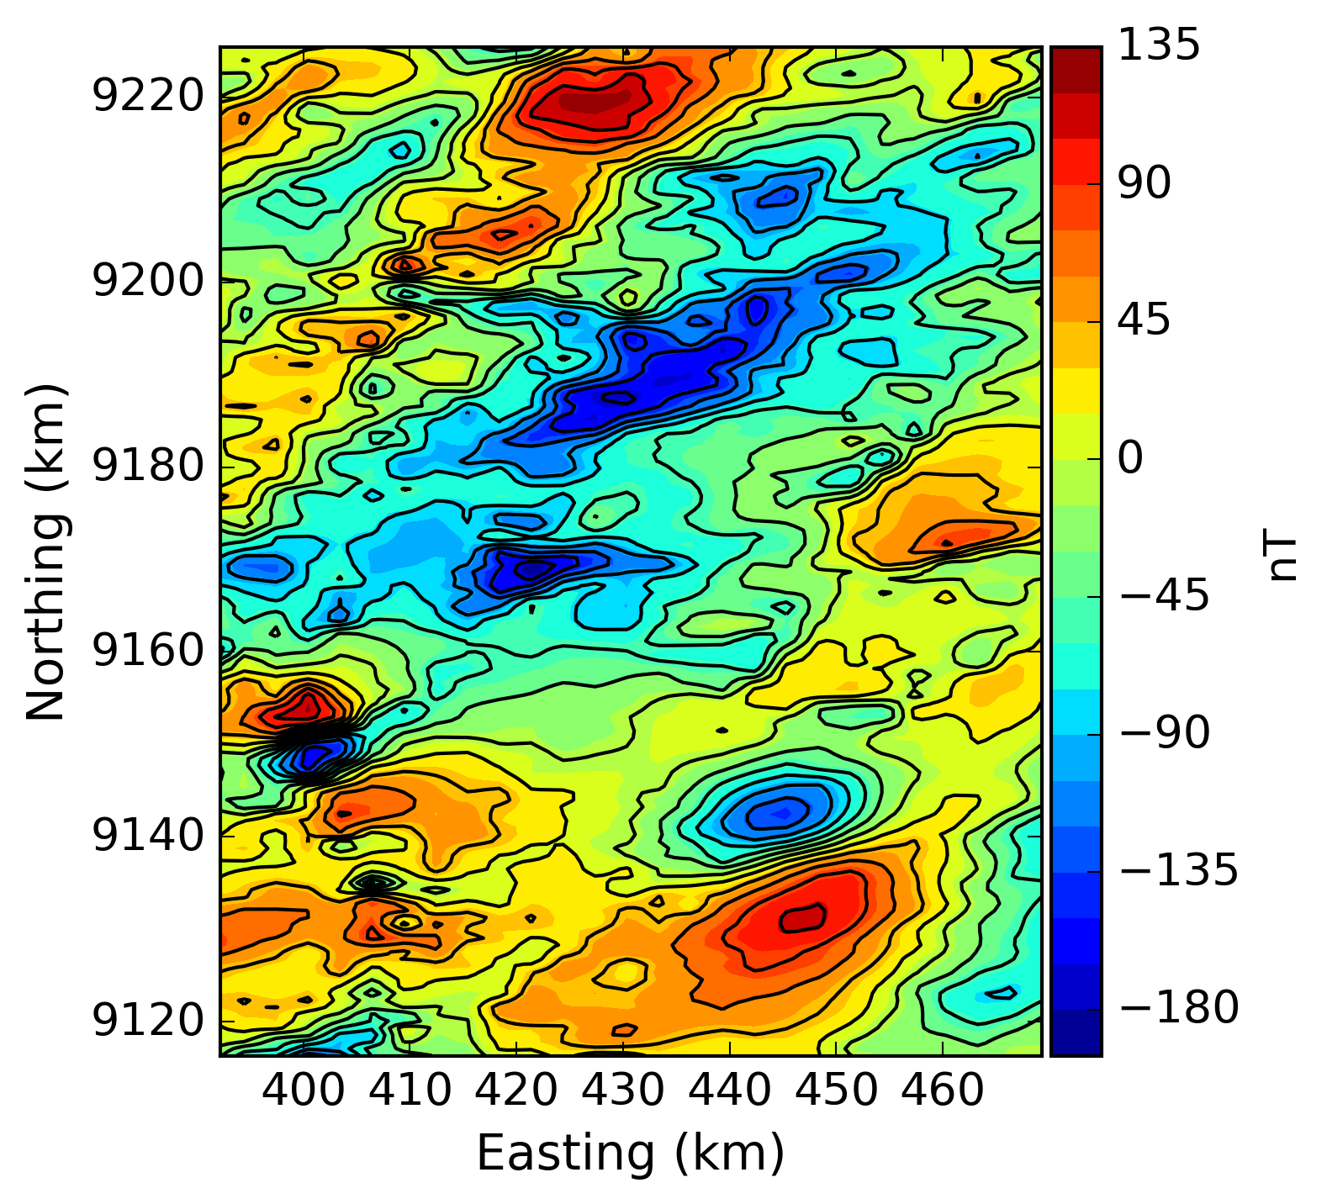
Real data application
Total-field anomaly
Grid $149×106$ points (N – E)
Grid $→ ∆x=∆y=0.75$ km

Slide 45
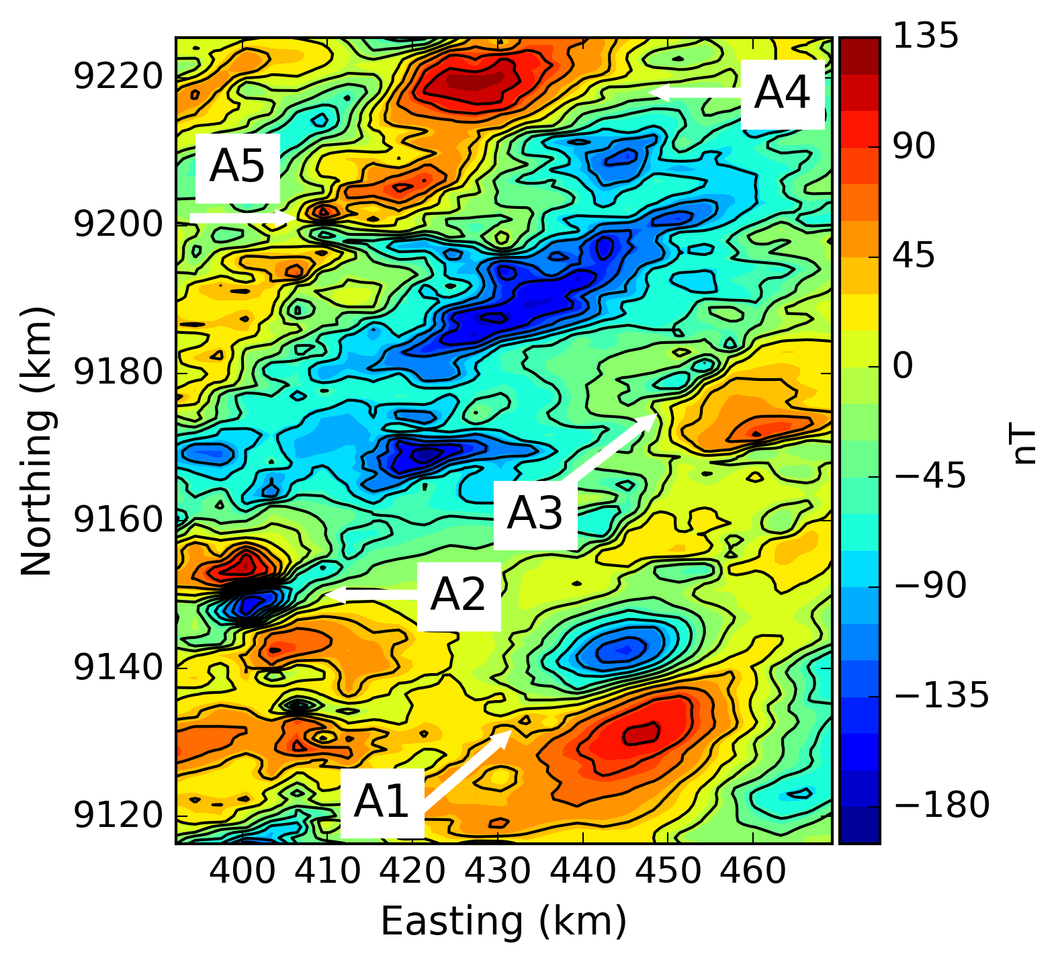
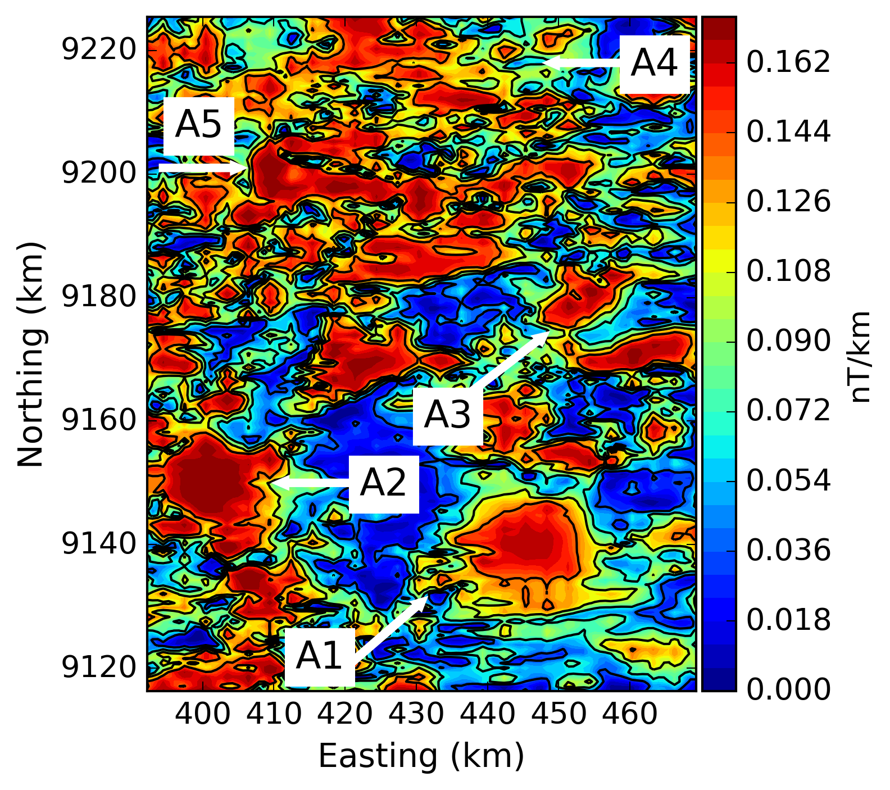
Real data application
Total-field anomaly
Total gradient amplitude

Slide 46
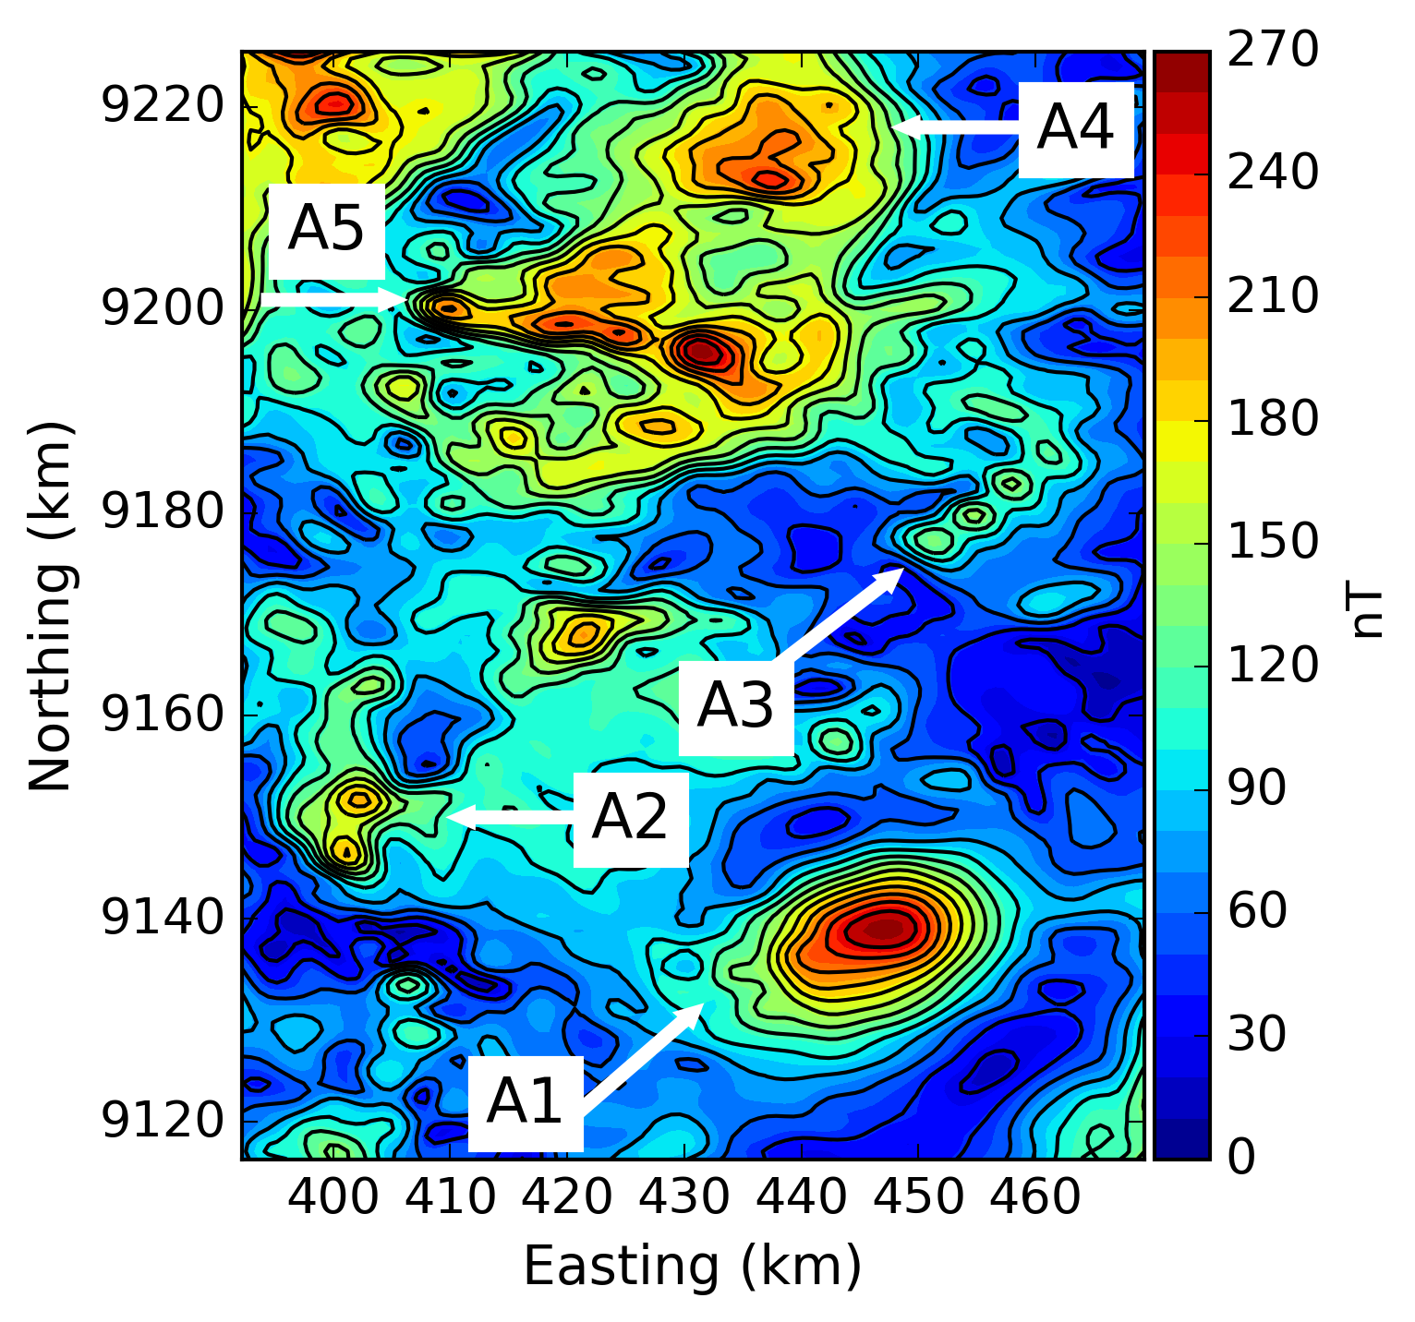
Real data application
Amplitude of the magnetic anomaly vector
Total-field anomaly

Slide 47
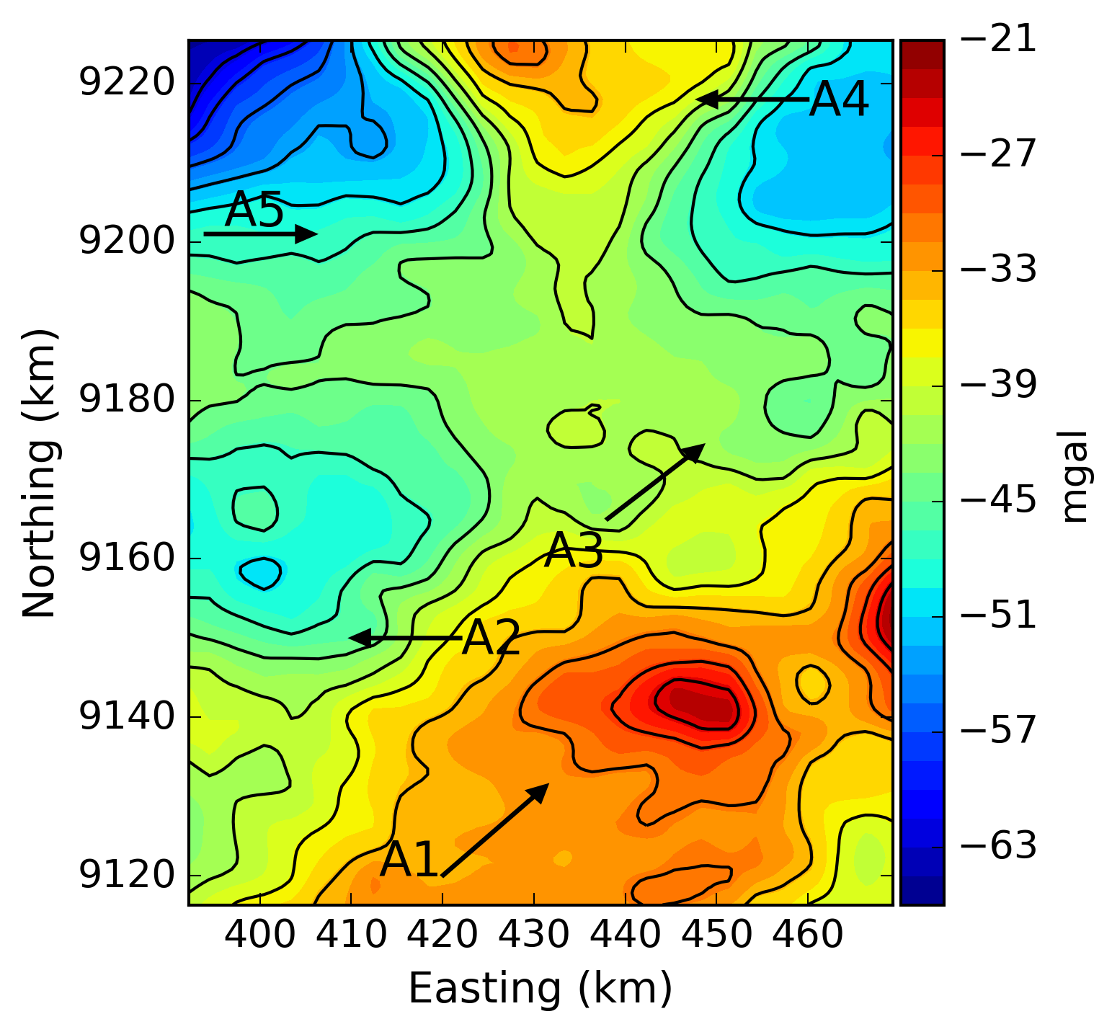
Real data application
Shallow sources?
Total-field anomaly
Bouguer anomaly

Slide 48
Real data application
Amplitude of the magnetic anomaly vector
Geologic map
A4
A5
A3
A2
A1

Slide 49
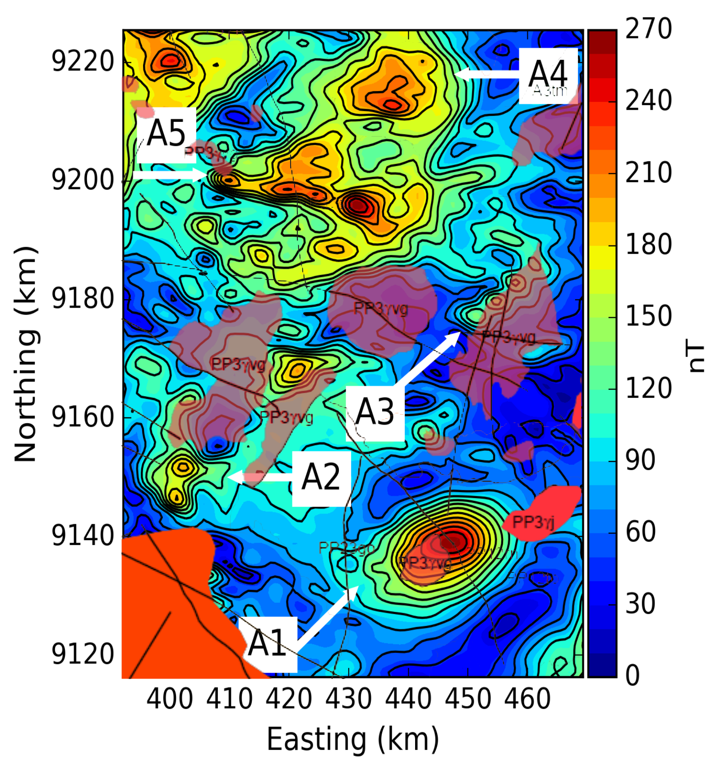
Real data application
Intrusions in the geologic map overlaying the
Amplitude of the magnetic anomaly vector

Slide 50
Content
Introduction
Methodology
Synthetic Tests
Real data application
Conclusions

Slide 51
Conclusions
We have illustrated the potential of the amplitude of the magnetic anomaly vector as an alternative to locate the sources;
The amplitude of the magnetic anomaly vector has the advantage of being weakly sensitive to dipping sources, low magnetic inclinations and remanent magnetizations;
Application to aeromagnetic data close to the magnetic equator showed its good performance in interpretation;
Anomalies were identified suggesting the continuity of outcropping intrusions in depth;
The amplitude of the magnetic anomaly vector can be used as a tool in enhancing the magnetic data at the early stages of an exploration program.

Slide 52
Acknowledgments
Lucien LaCoste Scholarship
Datasets:

Slide 53
Amplitude of the magnetic anomaly vector for interpretation at low latitudes
Felipe F. Melo, Shayane P. Gonzalez, Valeria C. F. Barbosa and Vanderlei C. Oliveira Jr
felipe146@hotmail.com

Slide 54
References
Almeida, F.F.M., Y. Hasui, B.B. Brito Neves, and R.A. Fuck, 1981, Brazilian structural provinces: An introduction: Earth-Science Reviews, 17, 1–29.
Blakely, R. J., 1996, Potential theory in gravity and magnetic applications. Cambridge University Press.
CPRM, 2015, Project: Aerogephysical survey of Carajás: Survey and data processing: Final report, vol. 22, maps.
Dampney, C. N. G., 1969, The equivalent source technique: Geophysics, 34, 38–53.
Davis, K., and Y. Li, 2011, Fast solution of geophysical inversion using adaptive mesh, space-filling curves and wavelet compression: Geophysical Journal International, 185, 157–166.
Klein, E. L., J. B. Rodrigues, J. D. S. Queiroz, R. G. Oliveira, S. B. Guimarães, and C. L. Chaves, 2016, Deposition and tectonic setting of the Palaeoproterozoic Castelo dos Sonhos metasedimentary formation, Tapajós Gold province, Amazonian Craton, Brazil: age and isotopic constraints: International Geology Review, 59, 1–21.
Krahenbuhl, R. A., and Y. Li, 2017, Investigation of magnetic inversion methods in highly magnetic environments under strong self-demagnetization effect: Geophysics, 82, no. 6, J83–J97.
Leão, J.W. D., and J. B. C. Silva, 1989, Discrete linear transformations of potential field data: Geophysics, 54, 497–507.
Leão-Santos, M., Y. Li, and R. Moraes, 2015, Application of 3D magnetic amplitude inversion to iron oxide-copper- gold deposits at low magnetic latitudes: A case study from Carajás Mineral Province, Brazil: Geophysics, 80, no. 2, B13–B22.
Li, X., 2006, Understanding 3D analytic signal amplitude: Geophysics, 71, no. 2, L13–L16.
Li, Y., and D. W. Oldenburg, 2001, Stable reduction to the pole at the magnetic equator: Geophysics, 66, 271–578.
Li, Y., and D. W. Oldenburg, 2010, Rapid construction of equivalent sources using wavelets: Geophysics, 75, no. 3, L51–L59.

Slide 55
References
Li, Y., S. E. Shearer, M. M. Haney, and N. Dannemiller, 2010, Comprehensive approaches to 3D inversion of magnetic data affected by remanent magnetization: Geophysics 75, no. 1, L1–L11.
Li, Y., H. Zhanxiang, and L. Yunxiang, 2012, Application of magnetic amplitude inversion in exploration for volcanic units in a basin environment: Geophysics, 77, no. 5, B219–B225.
Liu, S., X. Hu, T. Liu, J. Feng, W. Gao, and L. Qiu, 2013, Magnetization vector imaging for borehole magnetic data based on magnitude magnetic anomaly: Geophysics, 78, no. , D429–D444.
Li, S., and Y. Li, 2014, Inversion of magnetic anomaly on rugged observation surface in the presence of strong remanent magnetization: Geophysics, 79, no. 2, J11–J19.
Li, Y., M. Nabighian and D. W. Oldenburg, 2014, Using an equivalent source with positivity for low-latitude reduction to the pole without striation: Geophysics, 79, no. 6, J81–J90.
Liu, S., X. Hu, H. Zhang, M. Geng, and B. Zuo, 2017, 3D magnetization vector inversion of magnetic data: Improving and comparing methods: Pure and Applied Geophysics, 174, no. 12, 4421–4444.
MacLeod, I. N., K. Jones, and T. F. Dai, 1993, 3-D Analytic signal in the interpretation of total magnetic field data at low magnetic latitudes: Exploration Geophysics, 24, 679–688.
Roest,W. R., J. Verhoef, and M. Pilkington, 1992, Magnetic interpretation using 3-D analytic signal: Geophysics, 57, 116–125.
Siqueira, F. C., V. C. Oliveira Jr., and V. C. Barbosa, 2017, Fast iterative equivalent-layer technique for gravity data processing: A method grounded on excess mass constraint: Geophysics, 82, no. 4, G57–G69.
Silva, J. B. C., 1986, Reduction to the pole as an inverse problem and its application to low-latitude anomalies: Geophysics, 51, 369–382.
Uieda, L., V. C. Oliveira Jr., and V. C. F. Barbosa, 2013, Modeling the Earth with fatiando a terra: Proceedings of the 12th Python in Science Conference (SciPy 2013), 96–103.

