Slide 1
ORCID IN RESEARCH ORGANISATIONS
Paula Demain
September 13, 2019
I
@ORCID_Org

Slide 2
Imagine a world where:
You could search the internet and find all of a researcher’s work with a single query – in any browser
You could auto-populate standard publication and grant forms – any platform, any country
You could in near real time see what your researchers or grantees are publishing – and also know their current affiliation and other funding

Slide 3
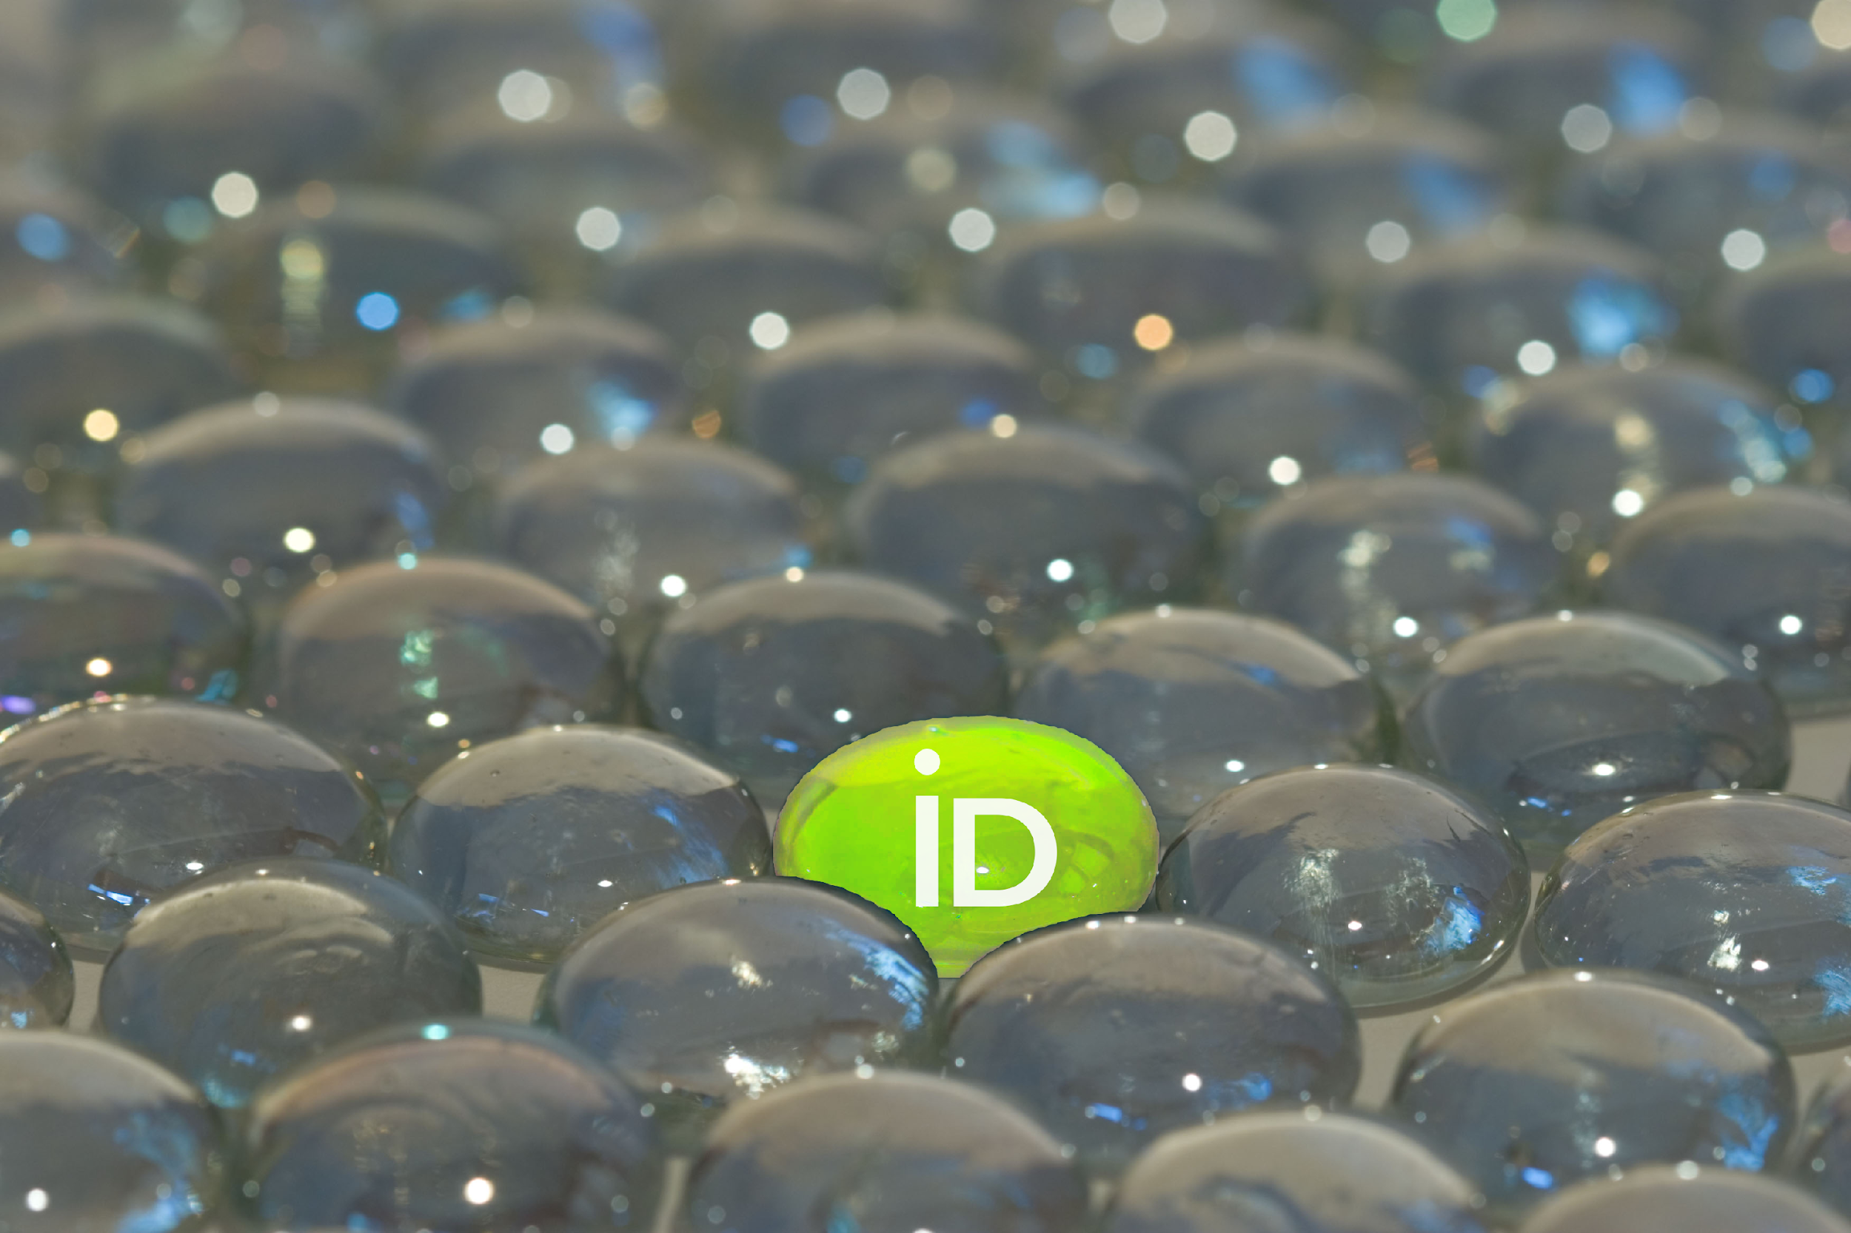
WHAT IS ORCID?
An identifier for researchers
A registry
A set of standard procedures (APIs) for connecting researchers to their affiliations and activities
A committed community building connectors
An international-scale open research effort
Notes:
ORCID is many things
We are an identifier for researchers. This 16-digit unique identifier can be used by researchers with their name to uniquely identify them. It is free and easy to get, and stays with the person throughout his or her career. Throughout this presentation we will refer to the identifier as the ORCID iD, which is our preference, though occasionally you may hear people talk about the identifier as the “ORCID”
ORCID is a registry. We provide an online registry for researchers to obtain an ORCID iD. The registry also stores an ORCID record which includes references to activities associated with the individual’s ORCID iD, such as a grant award, a publication, a data set or a research institution affiliation. The use of the registry is also free to individuals, and there they are able to control the visibility and access to the information associated to their iD.
ORCID is a set of standard procedures, or APIs) for connecting researchers to their affiliations and activities. I mentioned the ORCID record that is contained in the registry with the iD. This record is generally populated by ORCID members using these standard procedures or APIs. This approach enables automated, machine-to-machine additions and updates of important research activity and affiliation information.
ORCID is a committed community that is building connectors. The machine-to-machine additions and updates are made possible through “connectors” that are built by member organizations and the system vendors that they use. With explicit consent from the individual researchers and scholars, the ORCID community is building a connected web of trusted information that can be reliably exchanged.
ORCID is an international-scale open research effort. We accomplish all of these things through collaboration among the international research community of individuals and organizations. Researchers enable this information flow, allowing for global exchange of information regardless of where they are and who they collaborate with.

Slide 4
Notes:
In general, ORCID’s vision is a world where all who participate in research, scholarship and innovation and uniquely identified and connected to their contributions and affiliations across time, disciplines, and borders.

Slide 5
THE ORCID COMMUNITY
1059 members from 44 countries
660+ system connectors: all research sectors
Over 7 million researchers
Consortia in:
Americas: Brazil, Canada & US
EMEA: UK, Norway, Finland, Denmark, Sweden, Netherlands, Belgium, Germany, Italy, Greece, Israel, Austria, Portugal, South Africa
APAC: Australia, New Zealand, Taiwan
https://orcid.org/statistics
Notes:
And the community makes this possible.
This community consists of 1059( members from 44 countries, and over 660 connectors build in all research sectors. There are over 7 million researchers with ORCID iDs – an extremely impressive number when you consider that researchers register for their ORCID iDs themselves. About 2/3rds of these researchers obtain an iD in the middle of a research workflow that they care about, like submitting a manuscript for publication or applying for a grant.
1.7 million of the iDs have records with connected information – you can see here the numbers of items that have been attached to ORCID iDs in the ORCID registry. (remember that more than one item can be attached to any record). As more ORCID member organizations build connectors, the whole community will benefit from increasing numbers of records with connections.
Finally, 727 member organizations of ORCID participate in national or regional consortia. These consortia benefit from shared approaches, synergies in messaging, and increased national or regional information sharing. Members also benefit from reduced costs for ORCID membership. In some locations consortia facilitate activities like national research outcomes reporting. In others, consortia are facilitating the use of ORCID iDs as national research identifiers for people but we will share more on that later

Slide 6
ORCID RESTS ON A SIMPLE IDEA
By pooling the know-how and influence of the international research community, we can deliver a huge step forward for the openness and reliability of research information.
Notes:
We’ve been talking about the community approach to building this shared web of information. ORCID rests on a simple idea: by pooling the know-how and influence of the international research community, we can deliver huge step forward for the openness and reliability of research information. This is where you can help!

Slide 7
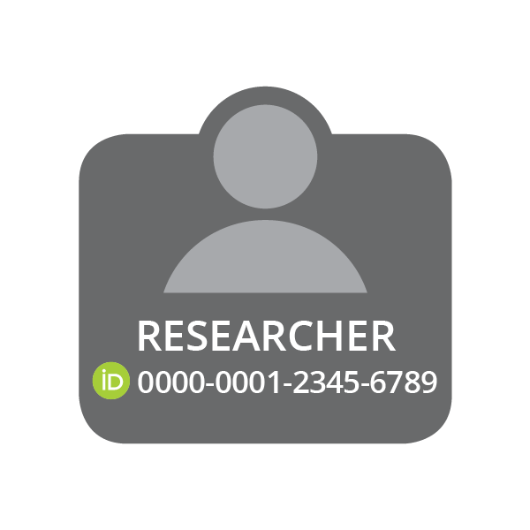
PUBLISHER
Assert Authorship
EMPLOYER
Assert Affiliation
CONNECT
CONNECT
COLLECT
COLLECT
CONNECT
COLLECT
FUNDER
Assert Award
Notes:
This diagram illustrates how it works. And, please bear with me as I tell you a small story.
As you can see, we have put the researcher at the center of this circle. This is because the researcher controls when and if information is connected to or shared from his or her ORCID record.
Let’s suppose that a new faculty member has been hired by your research institution. Like many other organizations, you ask to COLLECT her ORCID iD by having her sign into the ORCID site for ORCID to reliably provide her identifier to you. In addition to providing an error-free iD, this process also provides permission to your institution to read and write to her ORCID record. With the permission to write to her ORCID record, your institution can CONNECT affiliation information to her ORCID record. This means the addition of authoritative metadata describing the faculty member’s association to your institution is provided **by your institution**, complete with a unique identifier for your institution, the ability to precisely control how your institution’s name is expressed, and a clear articulation when faculty member’s connection to your institution began. Note that this permission to write to the record extends to the ability to update or correct the data that you have added when needed. Once this authoritative affiliation assertion is CONNECTED to the ORCID record by you, the faculty member may grant permission to others to read it.
For example, let’s imagine that she is now at the start of a research project. She has decided to apply for funding, and starts the application process on the funders website or system. During this process the funder asks to COLLECT her ORCID iD so that it can be included in the application. As part of this exchange, the funder ALSO receives permissions to read and write to her ORCID record. In reading her ORCID record, information stored in her is used to facilitate or even automate the population of the grant application. Included in this information is the affiliation that your institution had CONNECTED previously. This delights the funder because of the additional confidence that they get from this authoritative piece of data – an affiliation related to the iD, provided by the institution themselves! In this story, our researcher is successful in her proposal. The grant is awarded, and metadata about the grant is CONNECTED to her ORCID record by the funder, complete with the funder’s unique identifier, a universal grant ID and high-level information about the grant.
AND... Since your institution has already COLLECTED permissions to read her record, your systems are automatically notified about this great news in near real time. Your systems can be updated to record this successful award!
Now, research has been going on, and it is time for her to publish some results. She signs into the publisher’s manuscript submission system where the publisher asks to COLLECT her ORCID iD, again by signing into the ORCID site, and for ORCID to provide the information. Along with the iD, the publisher also COLLECTS permissions to read and write to her ORCID record. In reading the record, the publisher is also delighted to find your authoritative affiliation assertion, and offers to use it for the affiliation on this publication. In addition, the grant ID included in the award assertion CONNECTED by the funder is also available. If applicable, the publisher uses this information to include it in the metadata for the manuscript, should it be accepted. Again successful, our researcher’s paper is accepted for publication. The ORCID iD and grant ID are included in the paper’s metadata, and the publisher CONNECTS metadata about this publication to her ORCID record.
AGAIN- since your institution has already COLLECTED permissions to read her record, your systems are automatically notified about this publication, and the information can be stored in your systems. In addition, since the funder also has already COLLECTED permission to read her record, their systems are also notified about the publication. By including the publication in their records the our researcher no longer has to type in this output from the grant reducing her burden. The institution, funder and publisher have all received accurate and up-to-date information, and the researcher only needed to sign into the ORCID site as part of existing workflows to provide permission for this exchange to happen.
So, I’ll take a moment here to see if there are any questions... [

Slide 8
KEY BENEFITS for Research Institutions
Reliable connections
International scope
Pre-populate forms
Alumni updates
Machines do the work
Obtain consent to use data
Researchers support ORCID
PHOTO: mallow sundae by jennie collbran
CC BY-NC-ND 2.0 https://flic.kr/p/2HFwFT
Notes:
Research institutions can develop trustworthy & reliable connections, which provide several benefits as describe here. In the next slides we’ll go over each.

Slide 9
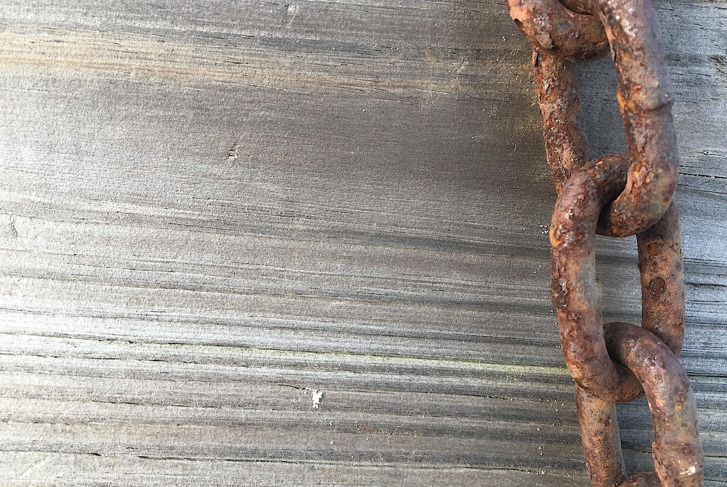
RELIABLE CONNECTIONS
Control how your organization name is expressed in systems your researchers use
Include unique organization identifier
CONNECT authoritative affiliation information to researcher records
PHOTO: Linked by NAS Alan Levine CC0 https://flic.kr/p/VKfww6
Notes:
Reliable connections to your institution
Create unambiguous links between your institution and the people and activities associated with it. Connecting an affiliation provides three key benefits
You can control how your institution’s name is expressed, and when this information is read by other systems with the researcher’s permission, your preferred name is shared as well.
You can include a unique identifier for your institution, making it easier to tie research activities and affiliations back to your institution even when the information is stored in other systems. Support Ringgold, LEI, GRID and Funder registry IDs
You can explicitly assert authoritative connections between your institution and the people that perform research at and are educated by your institution.

Slide 10
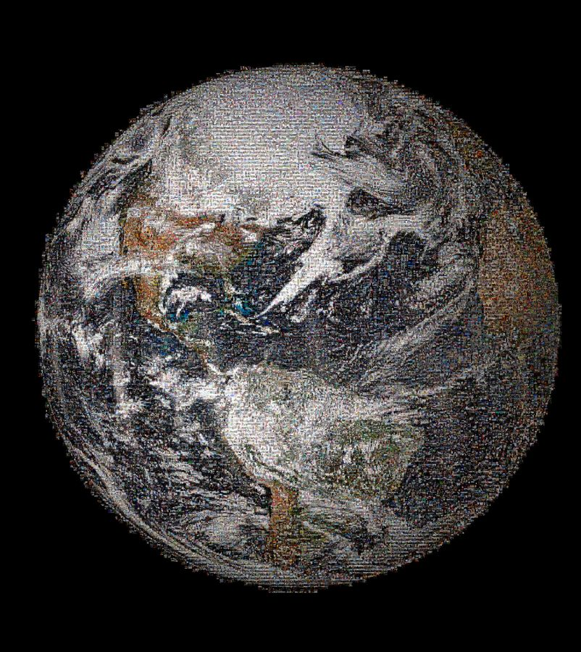
INTERNATIONAL SCOPE
Benefit from a broadly-used, reliable, and mobile identifier for your faculty, staff, students, and alumni
PHOTO: The Making of NASA's Global Selfie: 100+ Countries, Thousands of Photos by NAS Goddard Space Flight CC 2.0 https://flic.kr/p/nqjkaJ
Notes:
With researchers in nearly every country and member system connectors around the globe, your institution benefits from a broadly-used, reliable and mobile identifier for your faculty, staff, students and alumni

Slide 11
PRE-POPULATE FORMS
Receive real-time notifications about research activities, avoiding after-the- fact reporting and form-fatigue
PHOTO: Custom form elements.by Mårten Björk CC BY 2.0 https://flic.kr/p/86cM6z
Notes:
Many organisations use ORCID to prepopulate forms and this is something that we have been working with our funder community on. They are also CONNECTING award information to records to increase transparency of this information, and enable others to COLLECT it from ORCID records.

Slide 12
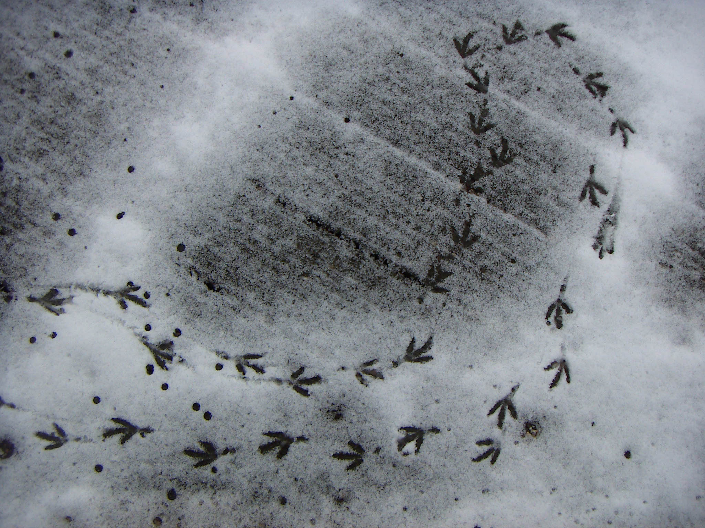
ALUMNI UPDATES
Gain insights about former faculty, staff and students.
Automatically be alerted to new contributions – publications, grants and awards, affiliations and more!
PHOTO: Footprints by Holly Gramazio CC BY-NC 2.0 https://flic.kr/p/yvVMz
Notes:
Permissions to COLLECT information from ORCID records persist until the researcher revokes these permissions. As a result, these permissions can last beyond your formal relationship with the individual. This means that you can gain insights about former faculty, staff and students even after they leave your campus. Your systems can automatically be notified about scholarly activities performed by both your current and future researchers

Slide 13
MACHINES DO THE WORK
Do all of these activities efficiently and at low cost through machine-to-machine communications using ORCID’s reliable platform
PHOTO: machine by Eugen Stoll CC BY 2.0 https://flic.kr/p/5c8cz
Notes:
Go through slide quickly

Slide 14
DATA WITH CONSENT
Current trends and regulations are putting individuals at the center of their data use.
Strengthen trust and confidence by sharing through ORCID’s permission model
PHOTO: HELLO, my name is... By thomas stein CC BY-SA 2.0 https://flic.kr/p/4qijZc
Notes:
Go through slide quickly

Slide 15
RESEARCHERS SUPPORT ORCID
Per our 2017 community survey, respondents strongly agree that an ORCID iD is essential for researchers
85.9% of respondents believe requiring the use of ORCID iDs is beneficial to the global research community
PHOTO: High Five Panda By Mark Dumont CC BY 2.0 https://flic.kr/p/ipWWpK
Notes:
We sometimes hear from institutions that they are concerned researchers will push back about the use of iDs. There are a growing number of publishers and funders who are requiring iDs. We conducted a survey of researchers – both those with and without iDs. We found strong support for them. In fact 85.9% of respondents believe that requiring the use of ORCID iDs is beneficial to the global community.

Slide 16
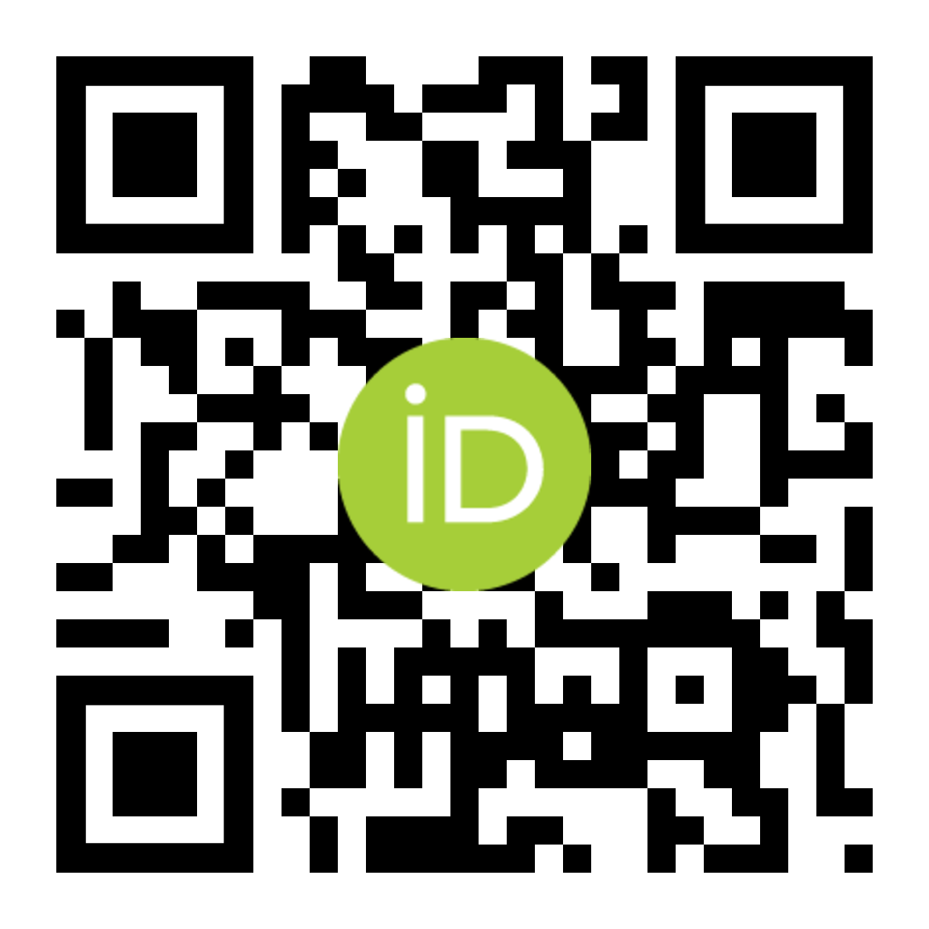
THANK YOU...
Ivo Wijnbergen
Manager, EMEA Engagement
Paula Demain
Engagement Lead, UK, Italy & Northern Europe
Find out more at https://orcid.org
Register at https://orcid.org/register
Email support@orcid.org
Twitter @ORCID_Org

