Slide 1
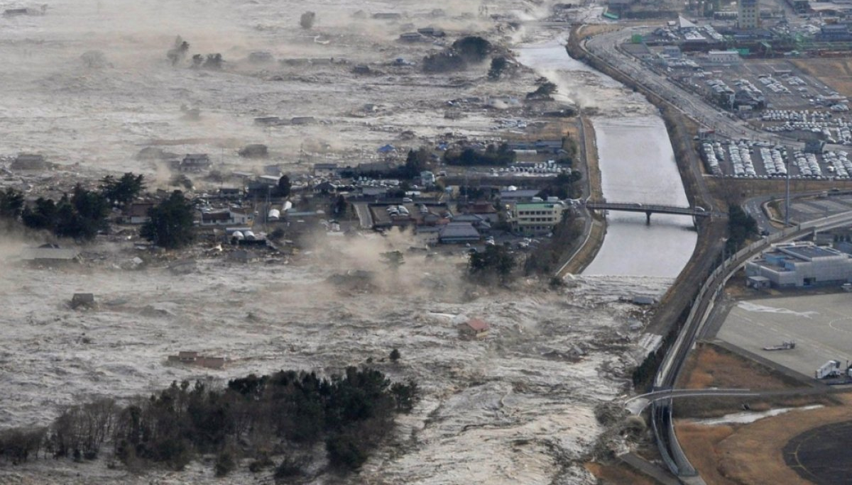
Resolving the tsunami wave: interpreting palaeotsunami deposits by integrating numerical modelling and sedimentology
Jon Hill
Graham Rush, Luke Hodson, Jeff Peakall, Natasha Barlow, Roland Gehrels, Dave Hodgson

Slide 2
Acknowledgements
Dr Sue Dawson
Prof Matt Piggott
Prof Alistair Dawson
Frances Taylor
Charlotte Desmond
Ashley Elliot
Jenna Mohan
Dr Lis Bowman
Dr Georges Kesserwani

Slide 3
Feel free to…
Tweet (@jonxhill)
Take picture/videos
More info:
10.6084/m9.figshare.9861263
https://envmodellinggroup.github.io/

Slide 4
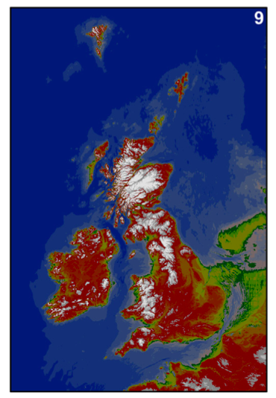
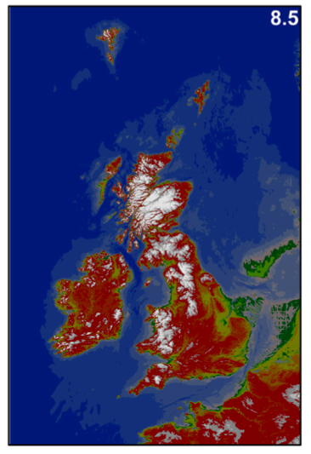
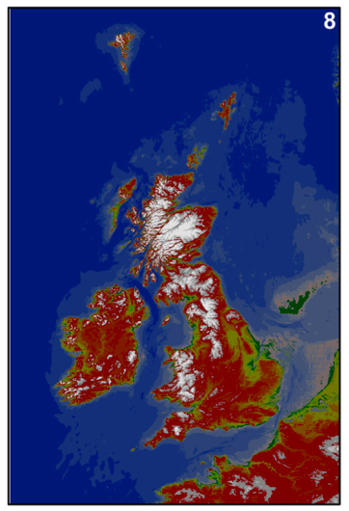
Palaeobathymetric changes
Sturt, F., et al., 2013. Journal of Archaeological Science, 40(11), pp.3963–3976.

Slide 5
Hill, J., et al.2014. Ocean Modelling 83 (0): 11–25.
https://fluidityproject.github.io/

Slide 6
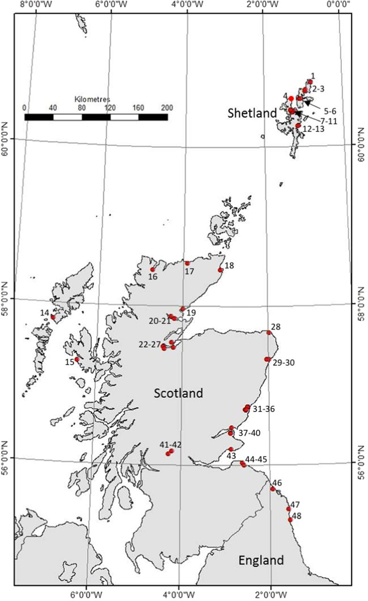
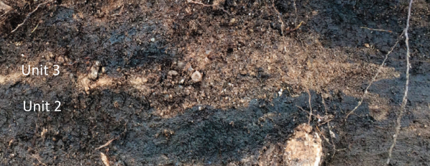
Storegga deposits
Long, A. J, et al. 2016. Journal of Quaternary Science 31 (3): 239–55.
Long, D., 2018. Geological Society, London, Special Publications 456, 143–165.

Slide 7
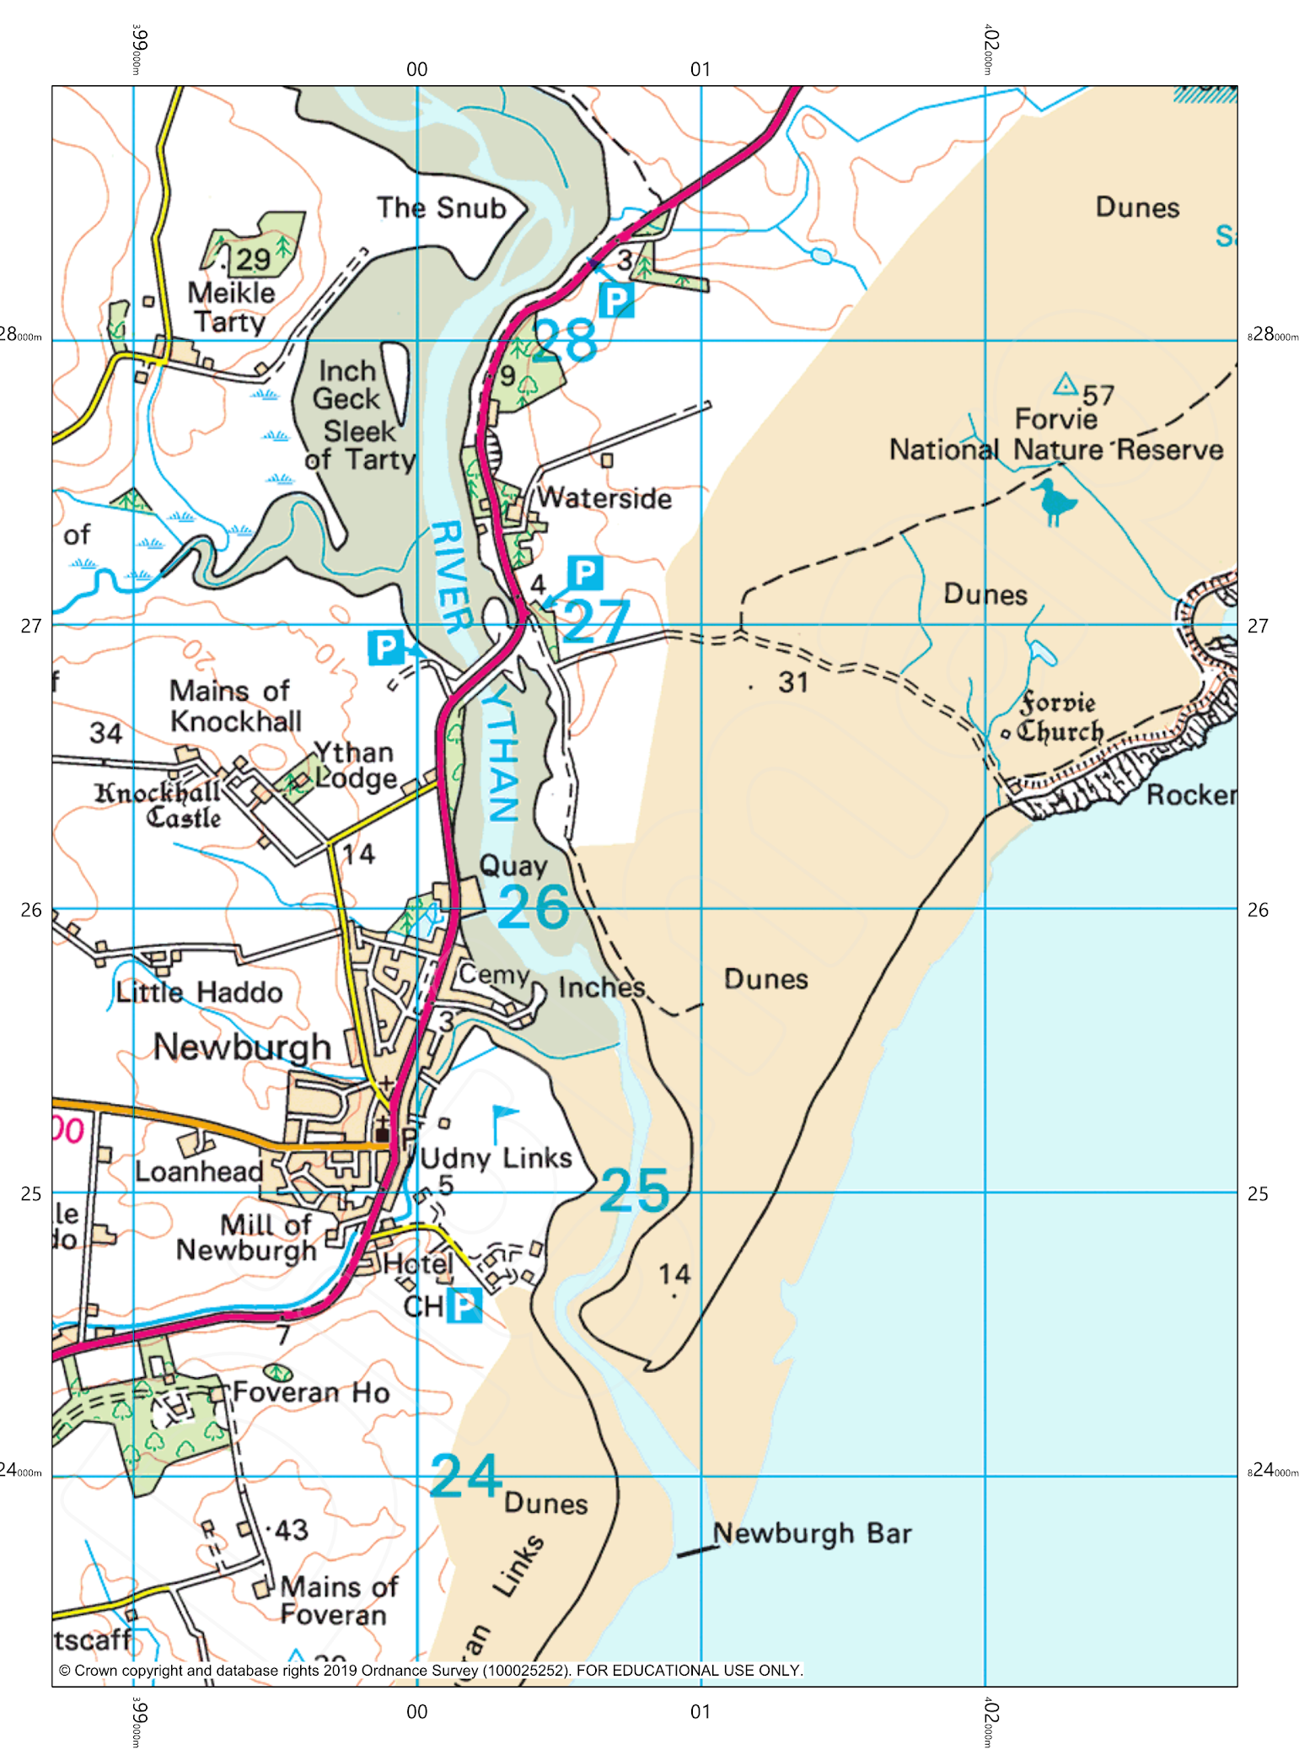
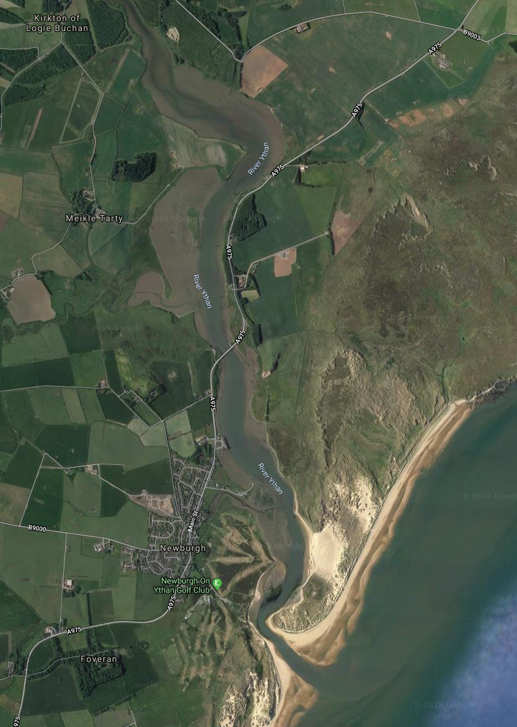
Ythan valley

Slide 8
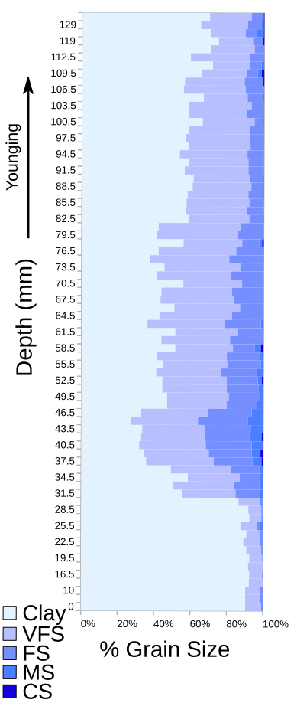
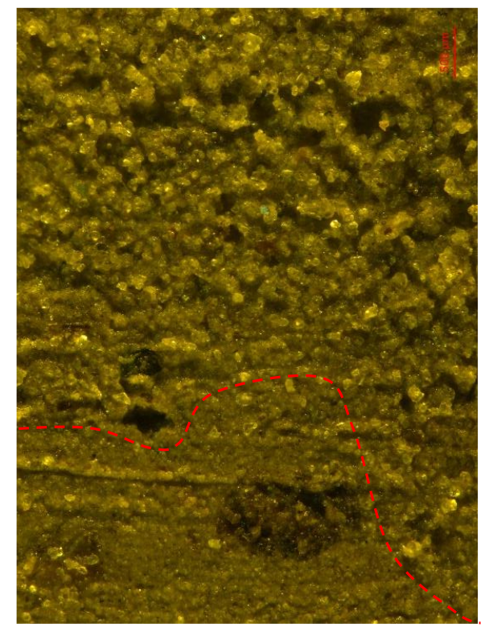
Core A004

Slide 9
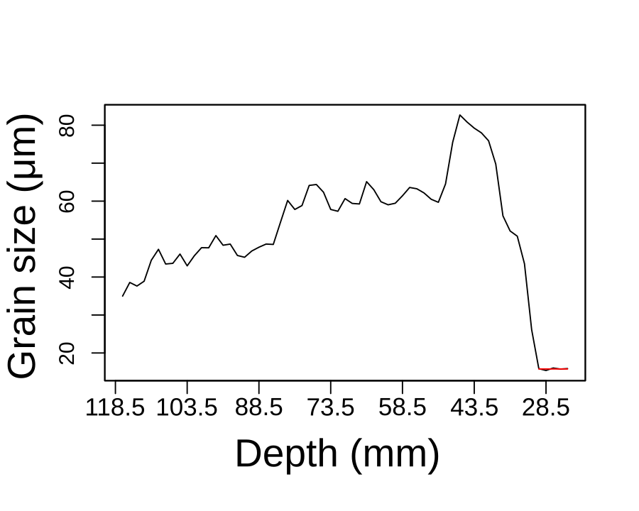
Core A004

Slide 10
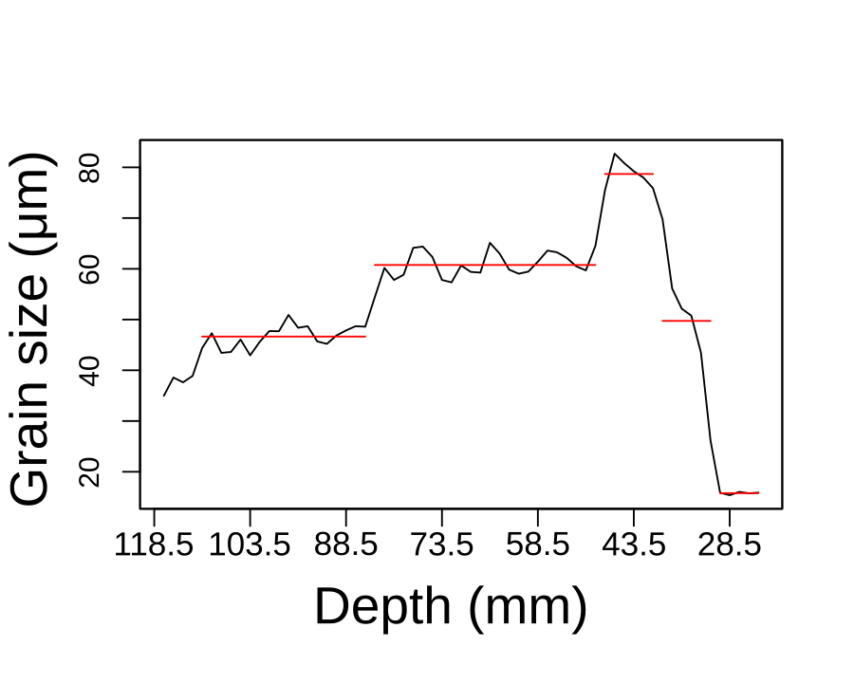
Core A004

Slide 11
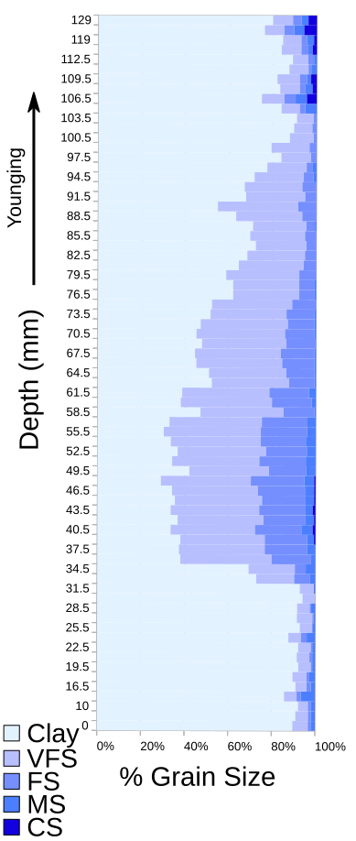
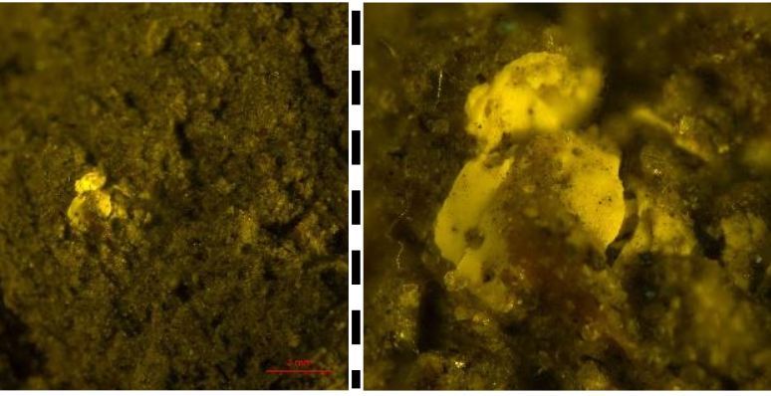
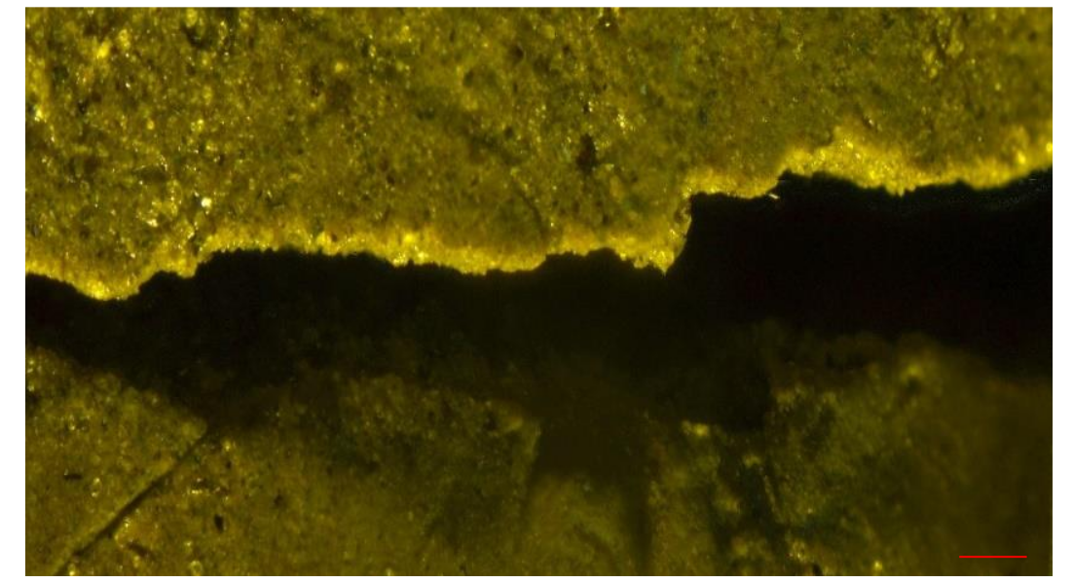
Core B003

Slide 12
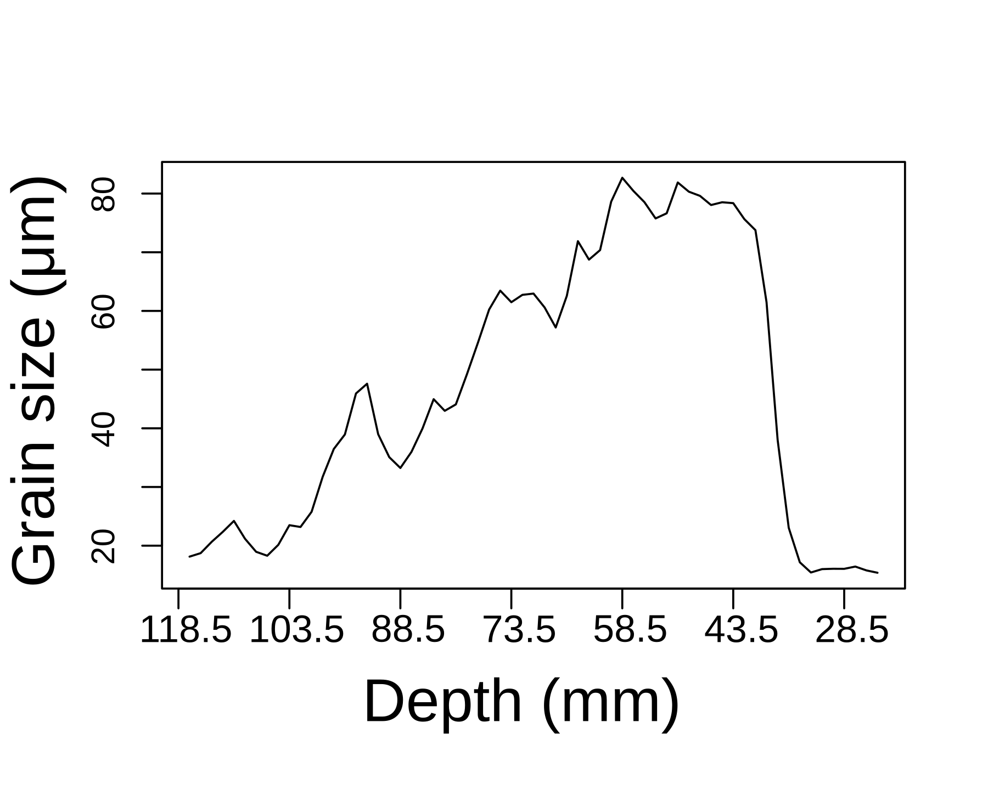
Core B003

Slide 13
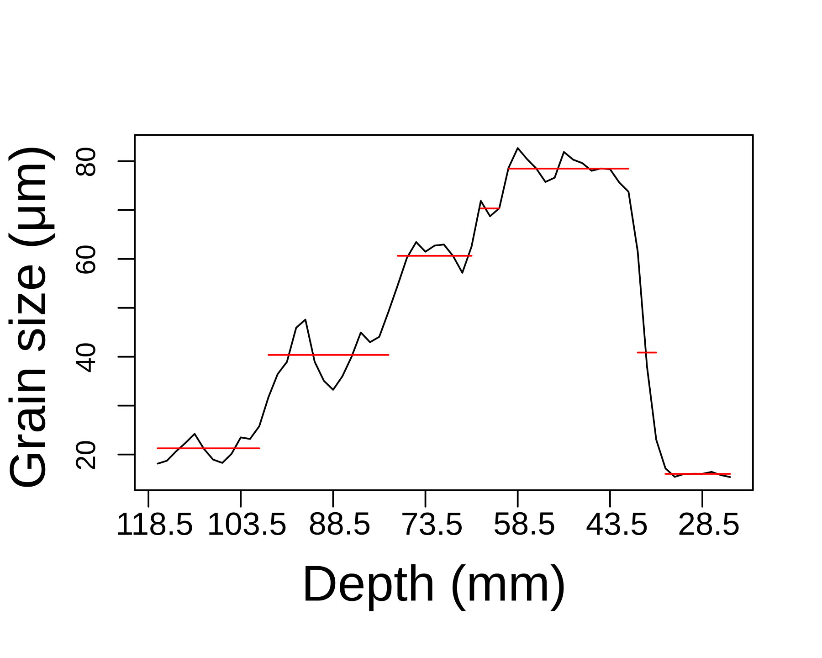
Core B003

Slide 14
Hill, J., et al.2014. Ocean Modelling 83 (0): 11–25.
https://fluidityproject.github.io/

Slide 15
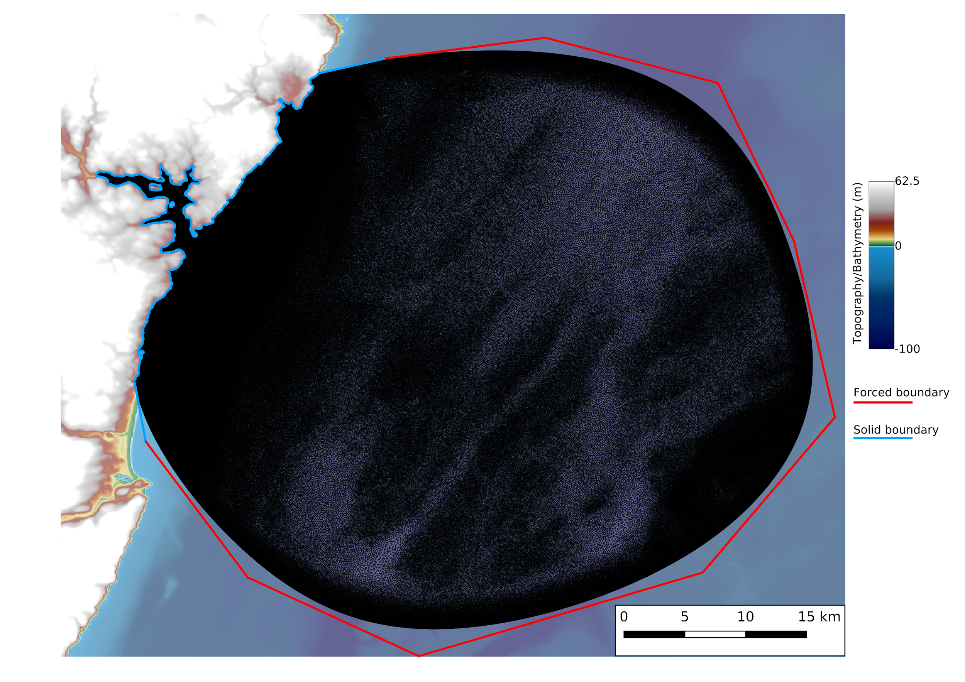
https://thetisproject.org/
github.com/EnvModellingGroup/hrds
Hill, 2019. 10.21105/joss.01112

Slide 17
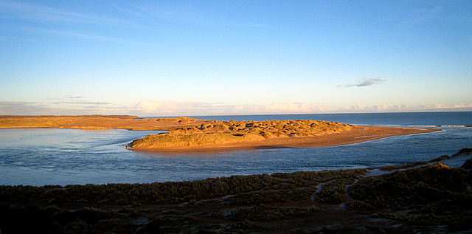
Palaeo-geomorphological reconstruction

Slide 19
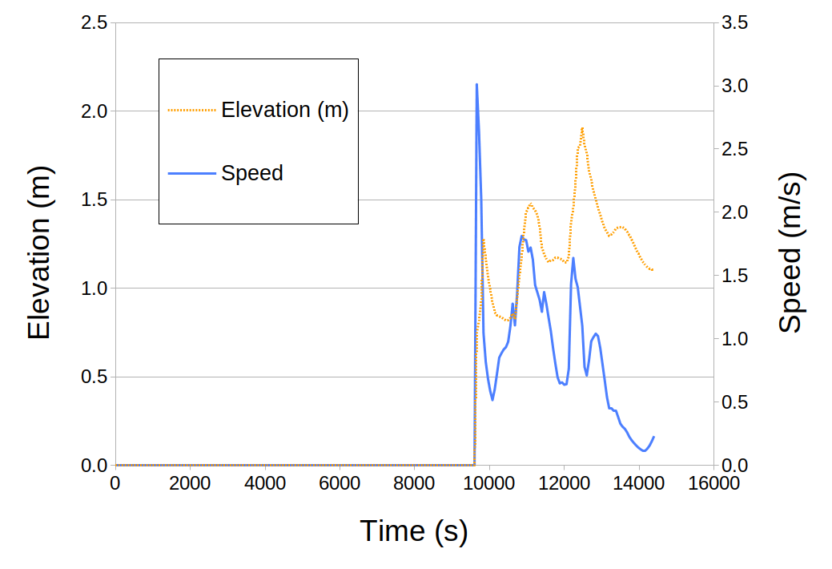

Slide 20
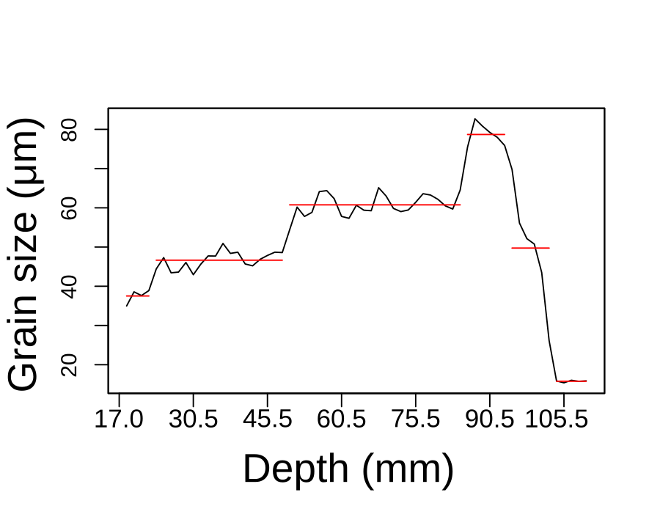

Slide 21
Summary
The sedimentological record is crucial to capture the extreme events
We can combine numerical modelling and sedimentology to gain insight into palaeo-extreme events
Work in the Ythan valley shows one large wave which consists of three pulses

