Slide 1
Open source tools to populate VIVO with Web of Science data
Benjamin Gross benjamin.gross@clarivate.com
September 2019

Slide 2
Agenda
1.
15’
Motivation
2.
15’
Web of Science Group Overview
3.
60’
Explore APIs and data - Postman
4.
30’
Break
5.
60’
Open source tools overview and examples – wos2vivo, incites2vivo, VIVO2MyOrg, and more
6.
30’
Times Cited Service Example

Slide 3
Better Data.
Better Decisions.
Better Outcomes.

Slide 4
Barriers to the Next Generation of Scientific Discovery
The Value of Good Data
Web of Science Group: A Unique Value Proposition
“Data quality is the biggest barrier to adoption and deployment of machine learning”
Our editorial process has selected the most relevant research dating as far back as 1864
“Unstructured Data, as well as data from alternative sources offers context and depth to analysis, but needs considerable work before it can be used for reliable insights”
We have created structured data for over 50 years utilizing millions of human hours
“There is a mismatch between the vision in the boardroom and the reality on the ground.”
We understand exactly what it takes to create data quality and analysis and have for over 50 years
Smarter Humans. Smarter Machines.
Insights from the Refinitiv 2019 Artificial Intelligence / Machine Learning Global Study
https://www.refinitiv.com/content/dam/marketing/en_us/documents/reports/refinitiv-ai-ml-survey-report.pdf

Slide 5
A reminder…

Slide 6
VIVO IS NOTHING WITHOUT DATA
VIVO IS NOTHING WITHOUT DATA
https://flic.kr/p/2v2xLD Some rights reserved

Slide 7
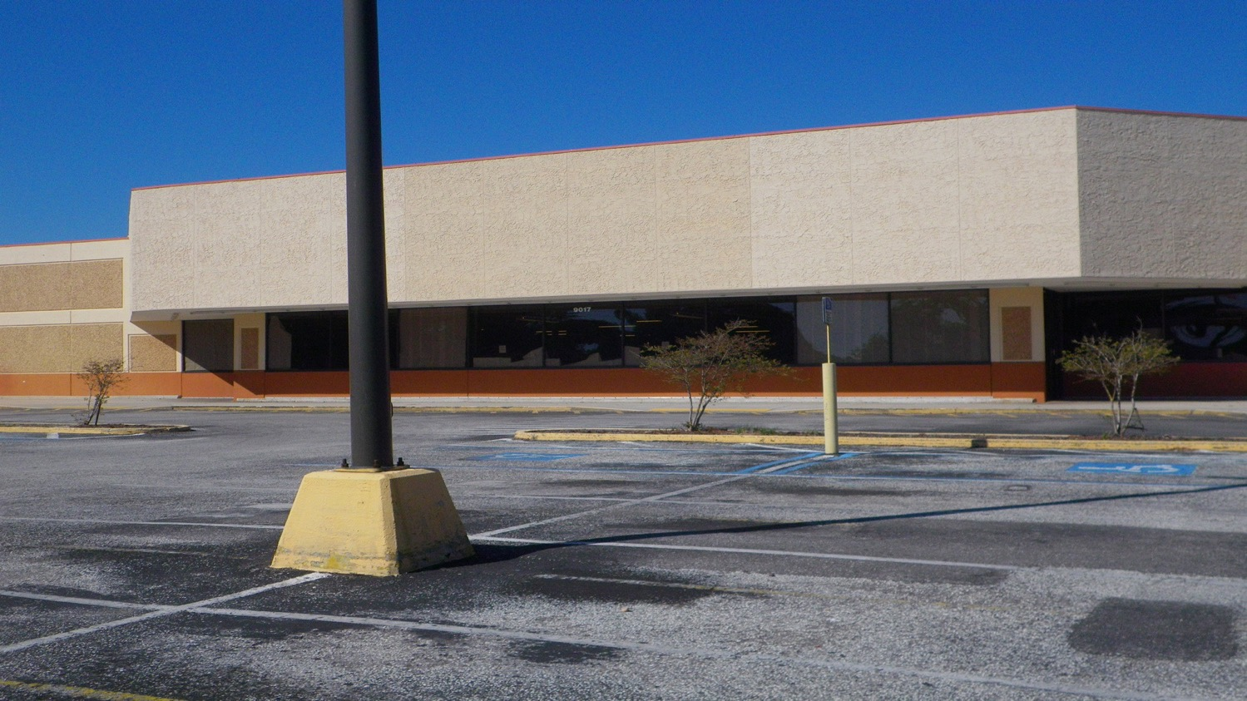
VIVO IS BORING WITHOUT DATA
https://flic.kr/p/gZMZhs Some rights reserved

Slide 8
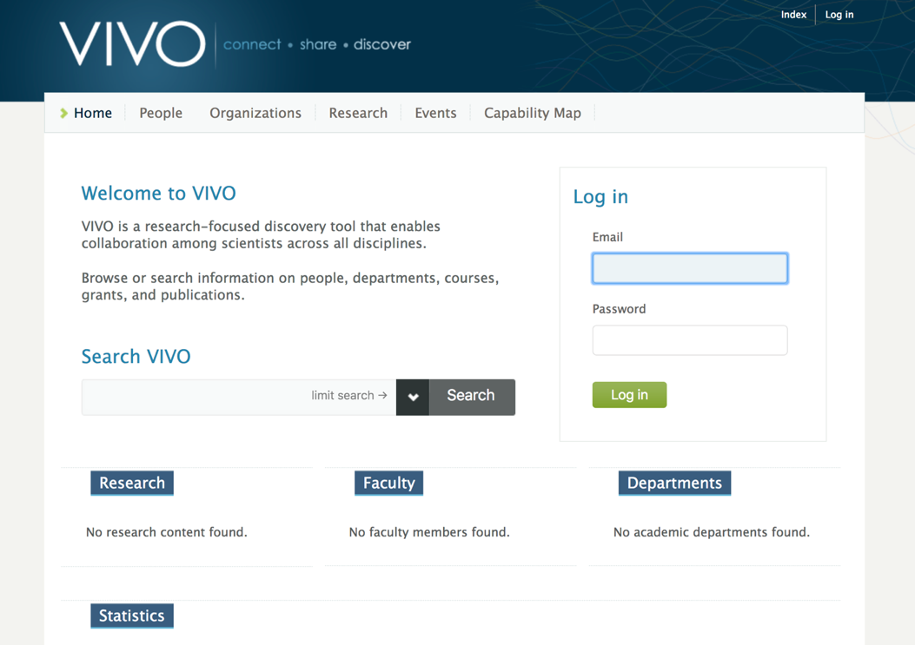
Empty default VIVO
😴
😱

Slide 9
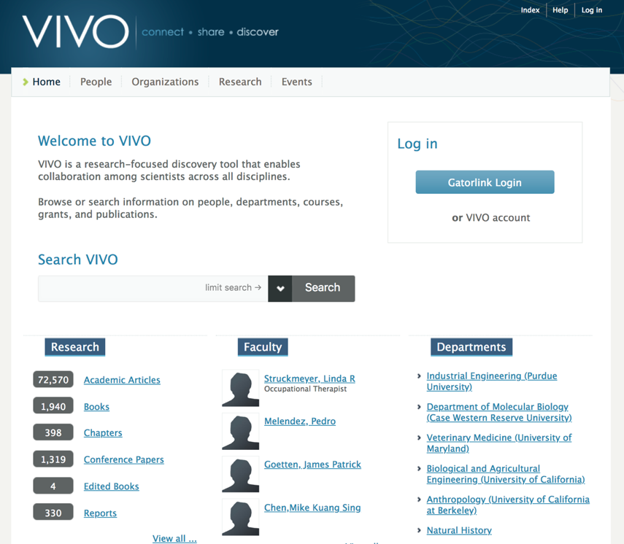
Default VIVO with lots of data - vivo.ufl.edu
😀
😁
😎

Slide 10
Why our data?

Slide 11
The Web of Science Data Difference:
Selectivity, Structure and Certainty
For over 50 years, the Web of Science has been the only publisher-independent citation index serving the research ecosystem. Through our unbiased, editorial selectivity, comprehensive, cover-cover indexing, enhanced curation for reliable citation connections, and consistent data structure Web of Science Data is the gold standard and trusted network the research community relies on for accuracy, analysis and impact.

Slide 12
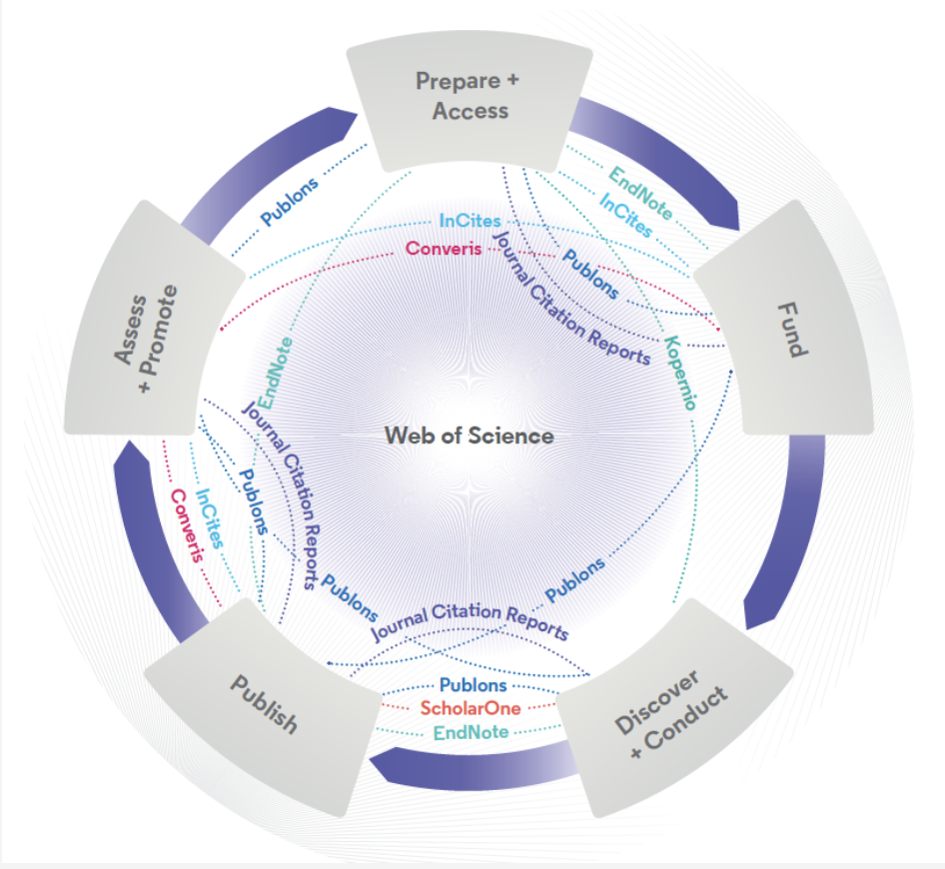
Web of Science Group Platform and Tools
Respected and innovative portfolio to accelerate research workflows
Web of Science The world’s largest and highest quality publisher-neutral citation index.
InCites Analyze institutional productivity and benchmark your output against peers worldwide.
ScholarOne Simplified submission workflows and peer review for scholarly publishers and societies.
Essential Science Indicators Reveals emerging science trends as well as influential individuals, institutions, papers, journals, and countries across 22 categories of research.
Journal Citation Reports The world’s most influential and trusted resource for evaluating peer-reviewed publications.
EndNote A smarter way to streamline references and write collaboratively.
Kopernio Fast, one-click access to millions of high-quality research papers.
Converis One flow to let institutions collect, manage, and report on all research activity, working seamlessly with an institutions existing systems.
Web of Science Author Connect Reach leading researchers in the sciences, social sciences, and arts and humanities.
Publons Supporting researchers through documenting their peer-review and journal editing contributions, providing guidance and best practice for the peer-review process, as well as increasing the overall visibility of their research and its impact.

Slide 13
Data as Service
Web of Science APIs are available for Web of Science customers who want to build out system integrations or otherwise leverage Web of Science data.
Our data can be accessed via:
AMR API
Web of Science Lite API
Web of Science Expanded API
Incites API
Plus APIs are available from:
Converis
Publons
Use Case
Capture & Manage the Publishing Activities of Your Organization:
Populate and institutional repository or conduct your own internal analysis
Available Fields from Web of Science
Article Title
Author Name(s)
Institution(s)
Journal Title
Publication Date
Page Range
Document Type
Keyword(s)
Times Cited (overall)
Monitor the Impact of Your Organization’s Publishing Efforts
Showcase the work of your researchers and feed internal research management systems
Based on either Web of Science or Essential Science Indicator Categories
Articles
Author Addresses (linked)
Authors
Author Keywords
Categories
Citations/Times Cited
Funding
To Understand the Citation Activity Across A Country or Region
Support National Excellence Frameworks and Reporting Requirements
Based on either Web of Science or Essential Science Indicator Categories
Articles
Author Addresses
Authors
Author Keywords
Categories
Citations/Times Cited
Funding
Key Data Fields

Slide 14
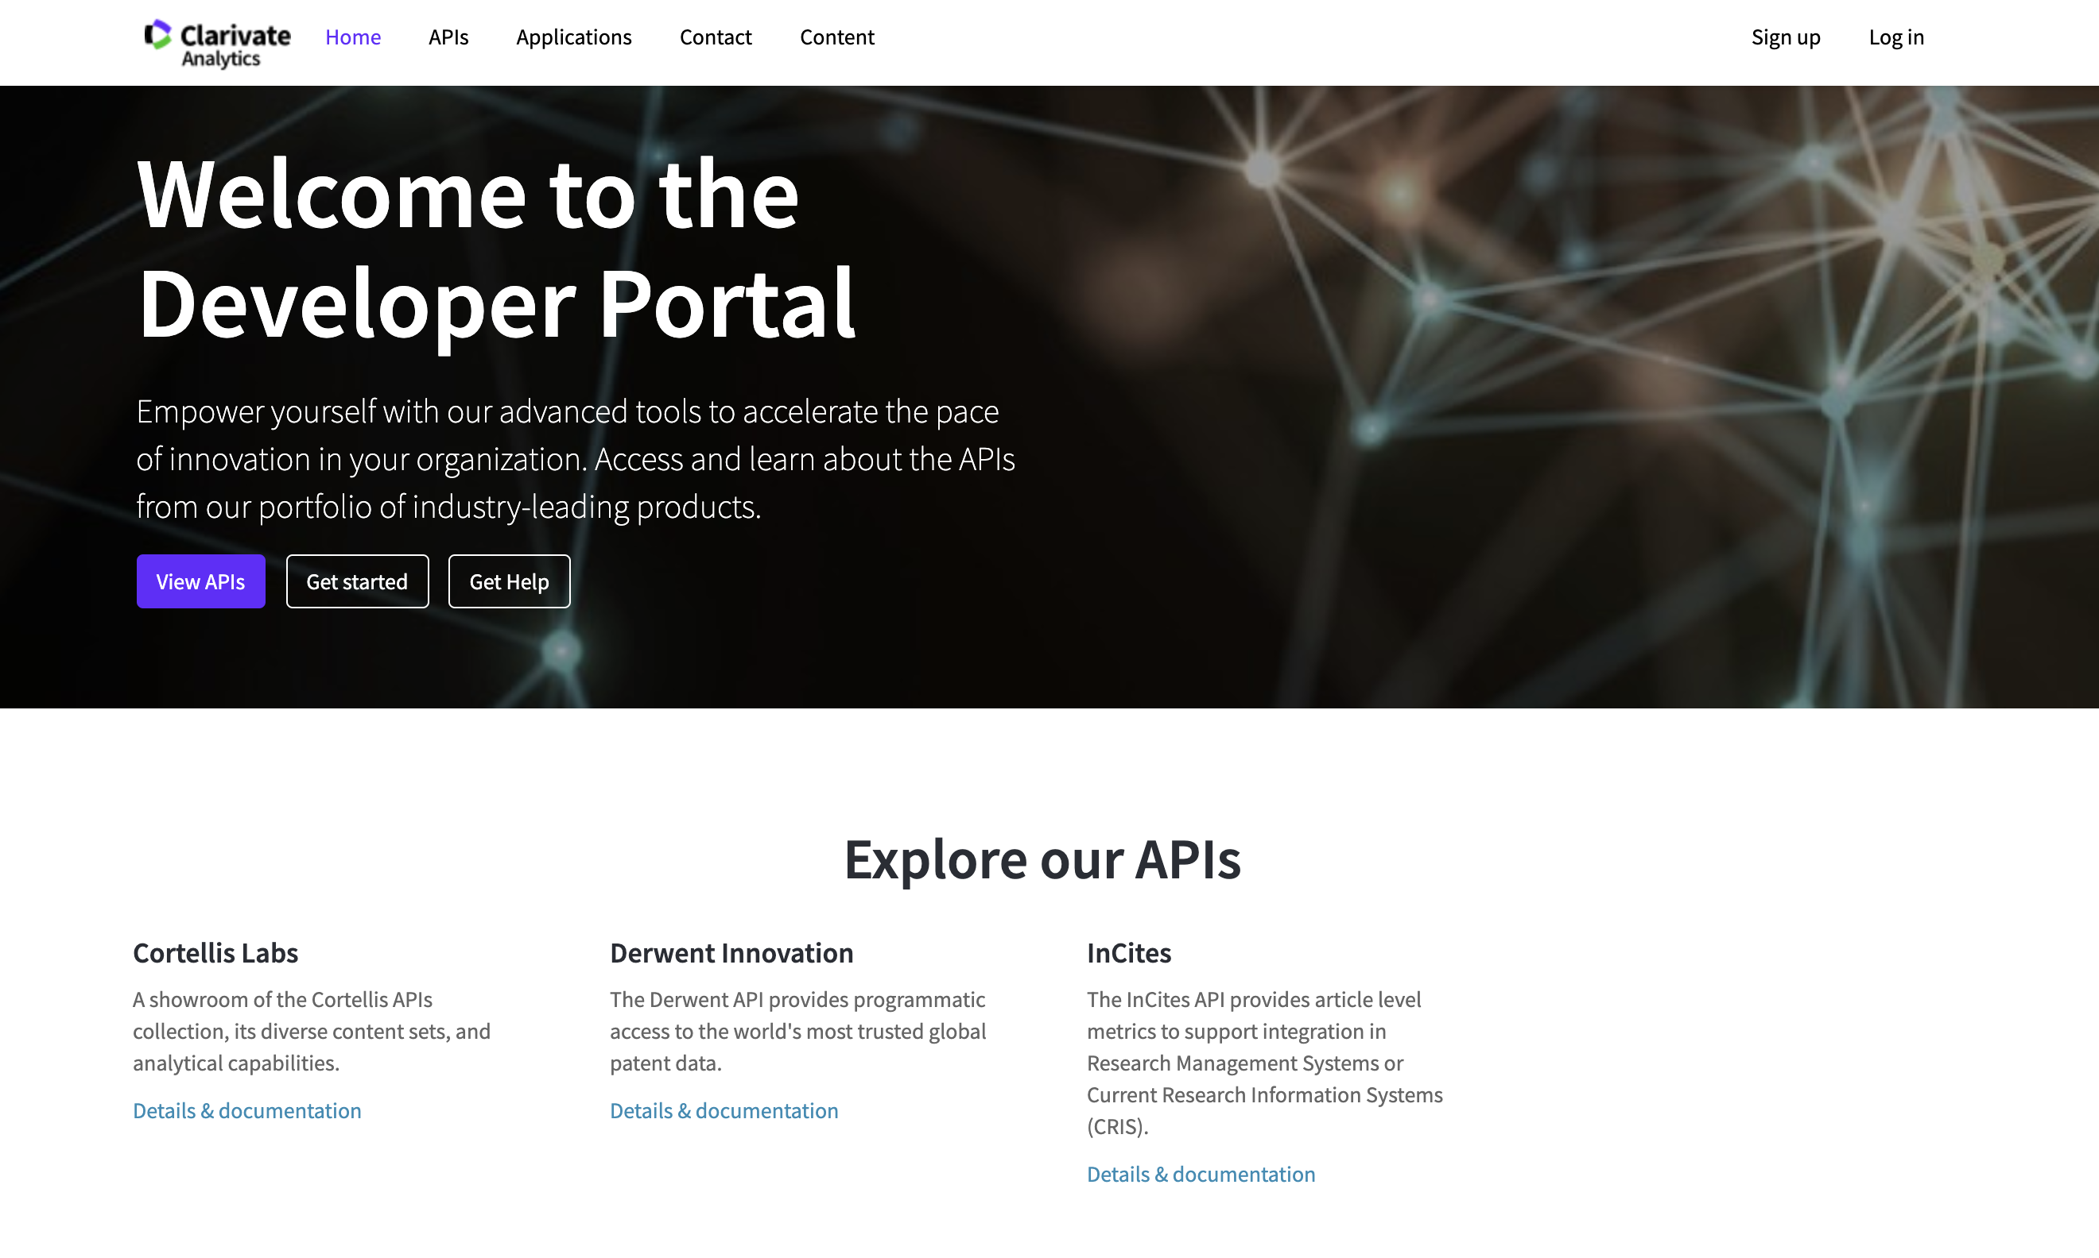
Clarivate Developer Portal
API information, documentation, and requests all in one place
Documentation in standard Swagger format
https://developer.clarivate.com/

Slide 15
Recent API enhancements
Web of Science Group API changes
Non-Portal enabled (SOAP) APIs
Older, outdated, and more cumbersome technology
Data returned in XML only which limits ease of integration
Consumers limited to mostly expert developers
Less visibility into user activity
No central API location for customers to find information and request access
Portal enabled (REST) APIs
Newer, widely adopted, more efficient technology
Ongoing API enhancements/developments
Data returned in JSON (or XML) which greatly enhances integration
Consumers can be both expert developers and novice users
Greater visibility into user activity

Slide 16
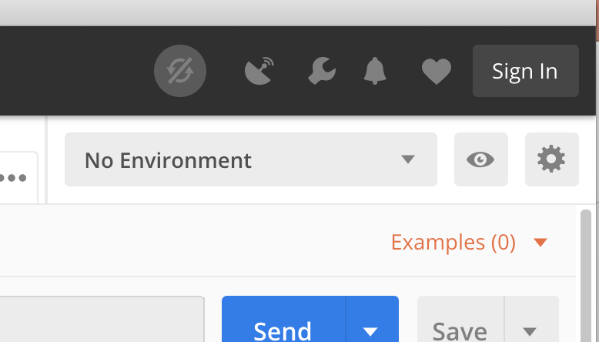
API Demos - Postman
Postman is a tool that provides a handy interface for working with APIs
Download Postman: https://www.getpostman.com/downloads/
Postman collection with examples: See link in email or contact benjamin.gross@clarivate.com
Tip: Easily manage credentials by creating an environment
For these demos, set variables as ‘restful_key’ and ‘incites_key’
Set initial value to the provided key values.

Slide 17
Web of Science Expanded API
The Web of Science Expanded API is a service that:
Supports 'search' and 'data integration' using Web of Science data returned as JSON or XML.
This API supports rich searching across the Web of Science to retrieve item-level metadata, including times cited counts and contributor addresses/affiliations.
Additional operations support the ability to discover related records as well as cited references and citing items.
WoSE is used for retrieving publication metadata
Documentation: https://developer.clarivate.com/apis/wos

Slide 18
Web of Science Expanded API
Building queries
AD=Address
AI=Author Identifiers (ResearcherID and ORCID)
AU=Author
CF=Conference
CI=City
CU=Country
DO=DOI
ED=Editor
FG=Grant Number
FO=Funding Agency
FT=Funding Text
GP=Group Author
IS=ISSN/ISBN
OG=Organization - Enhanced
OO=Organization
PS=Province/State
PY=Year Published
SA=Street Address
SG=Suborganization
SO=Publication Name
SU=Research Area
TI=Title
TS=Topic
UT=Accession Number
WC=Web of Science Category
ZP=Zip/Postal Code
Example: TS=particle swarm AND PY=(2007 OR 2008)

Slide 19
InCites API
The InCites API is a service that provides:
document level metrics to support integration in Research Management Systems or Current Research Information Systems (CRIS). InCites data is returned as JSON or XML.
data to analyze institutional productivity and benchmark output against peers and aspirational peers in a national or international context
For VIVO, we use the InCites API to retrieve ’indicator flags’ for Hot Papers, Industry Collaborations, International Collaborations, and Institutional Collaborations, and Open Access publications.
Documentation: https://developer.clarivate.com/apis/incites

Slide 20
Links AMR (Article Match Retrieval) API – demo only
Links Article Match Retrieval Service (Links AMR) is an API service that supplies:
article data from Web of Science™ Core Collection
article data from Data Citation Index
Journal Profile page from InCites™ Journal Citation Reports® or Journal Impact Factor five-year trend graph from Journal Citation Reports®
AMR is primarily used for retrieving Web of Science IDs (aka UTs) and times cited counts
Documentation: http://help.incites.clarivate.com/LAMRService/WebServicesOverviewGroup/overview.html?elqTrackId=f2caae2fa771479ab6b6654633a23cdf&elqaid=3746&elqat=2

Slide 21
Tool demos
Code is available at https://github.com/Clarivate-SAR
For convenience, also in the workshop Google Drive folder.
Tools available:
wos2vivo: Web of Science to VIVO
incites2vivo: Query VIVO for UTs, query InCites for metadata, and convert to RDF
wos-times-cited-service: Java web service for embedding Times Cited from the Web of Science.
Publons2VIVO: Python program to pull data from Publons API and convert to VIVO RDF
wos-amr: Utility scripts for using the Web of Science Links Article Match Retrieval Service (AMR) service.
incites-retrieve: Retrieve metrics from the InCites web service
VIVO2MyOrg

Slide 22
VIVO APIs – Interacting with VIVO as a developer
Public Services | available without restriction provide filtered results, allowing restrictions on data
Linked Open Data | Information about an individual, its types, its data values, incoming and outgoing links.
ListRDF | Lists of individuals that belong to a particular class in the ontology. For example, a list of all People, or all Organizations.
Access Controlled Services | require account credentials on each request credentials are for an internal VIVO with sufficient authorization results are not filtered, and may return data that should be kept private
SPARQL Query API | Submit a SPARQL query to get information from VIVO. Supports SELECT, ASK, CONSTRUCT, and DESCRIBE query types.
SPARQL Update API | Submit a SPARQL query to INSERT new triples or DELETE existing triples. Also, LOAD triples from a web-accessible file.
Search Indexing API | Submit a list of URIs that may have stale data in the search index. The search data for each of these URIs will be rebuilt.
Example linked open data request:
$ curl -i -L -H "Accept:text/turtle" http://localhost:8080/vivo/individual/n7403
Notes:
.

Slide 23
Benjamin Gross
benjamin.gross@clarivate.com

