Slide 1



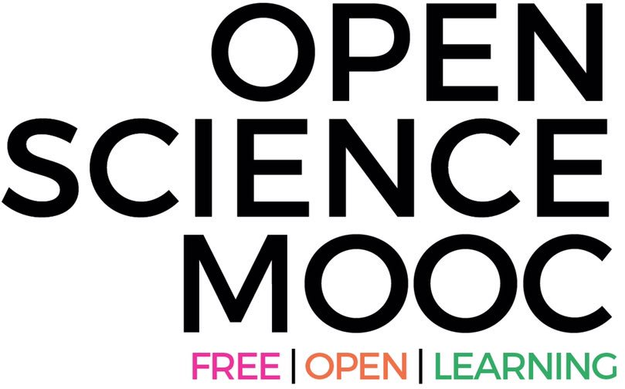

The global state of
Open Science
Dr. Jon Tennant
@protohedgehog
Lima, Peru Sept 11th, 2019
https://orcid.org/0000-0001-7794-0218

Slide 2
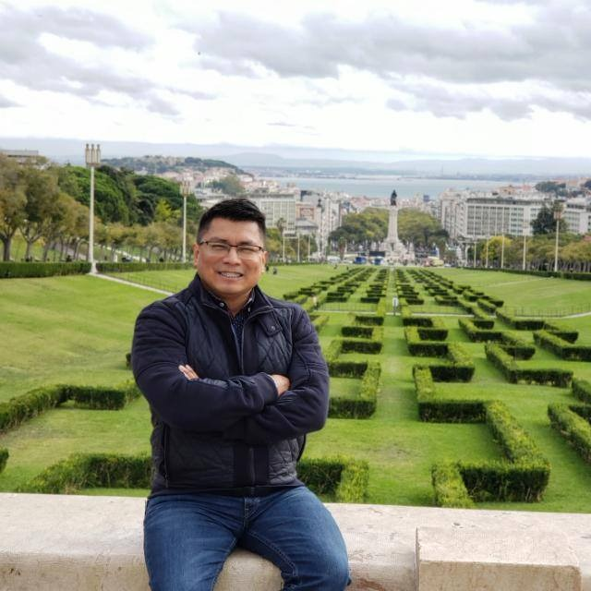
Thank you for inviting me to Peru
Notes:
I don‘t want to come here like a colonialist and pretend Europe has all the answers. Didn‘t work out so well in the past.
I also don‘t want to pretend everything is perfect in South and Latin America.
I also want to treat you with respect, and be honest about how I feel the situation is. This is a big opportunity for co-learning, and I‘m honoured and privileged to be here with you all.
I‘m also aware that Elsevier, one of the most anti-open ruthlessly capitalistic companies in the world is sponsoring this event. I am not going to go gentle on them because of this.

Slide 3
[Open] Science is a Human Right
Article 27
Everyone has the right freely to participate in the cultural life of the community, to enjoy the arts and to share in scientific advancement and its benefits.
Everyone has the right to the protection of the moral and material interests resulting from any scientific, literary or artistic production of which he is the author.
https://www.un.org/en/universal-declaration-human-rights/
@protohedgehog

Slide 4
We are in the middle of a global research [r]evolution
There are (at least) five major ‘crises’:
Access – Most research still paywalled to most people
Reproducibility – Much research fails basic reproducibility tests
Serials – The dramatic price increases of journals
Evaluation – The metric that shall not be named
Copyright – No longer serves researchers or creators
@protohedgehog

Slide 5
The way the current system works is a consistent violation of fundamental human rights.
This is why each of us has to fight to protect them. Today.
@protohedgehog

Slide 6
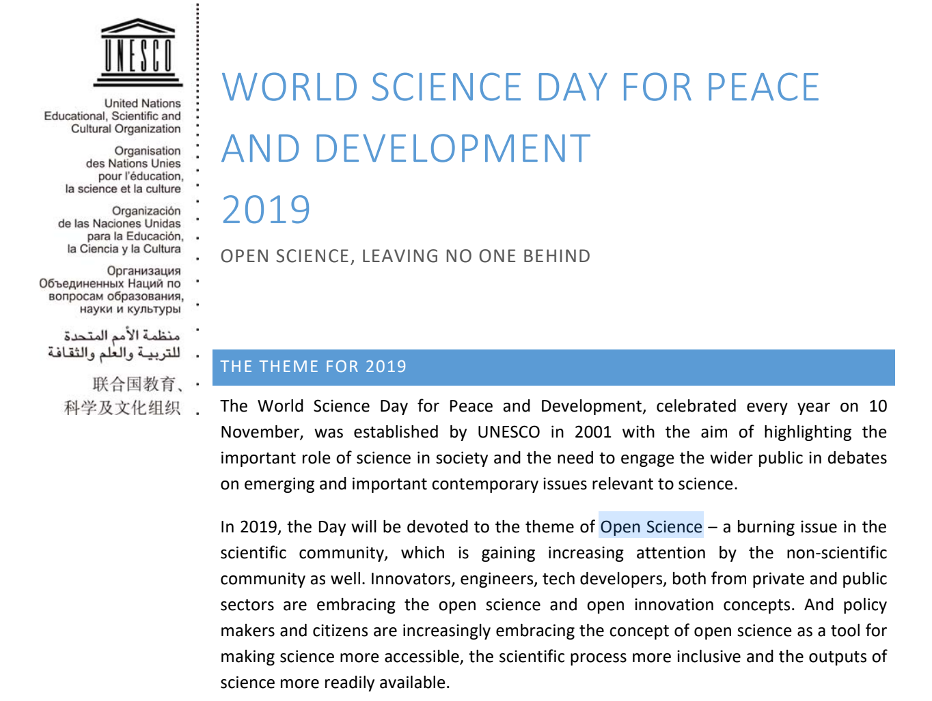
@protohedgehog

Slide 7
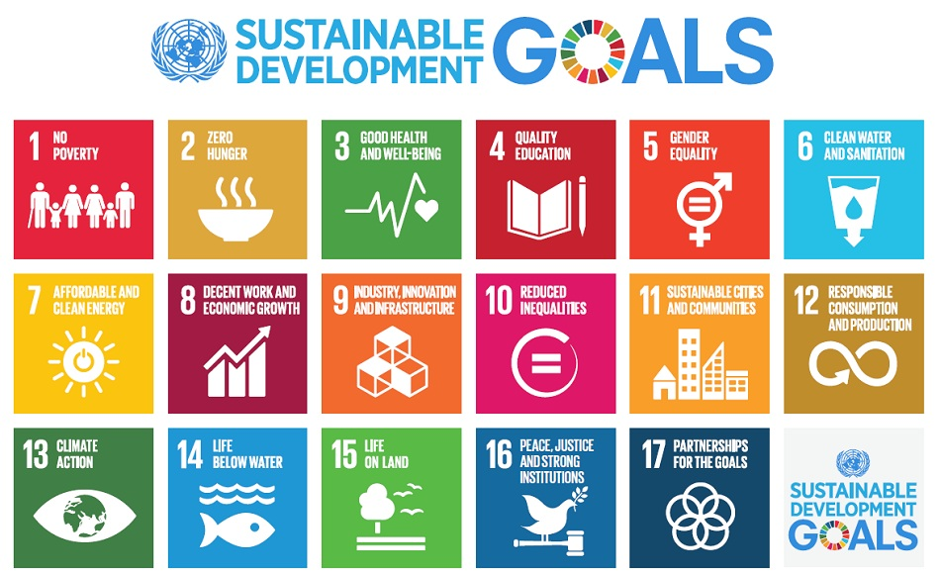
We need science to help solve the problems our global society faces.
http://www.who.int/mediacentre/events/meetings/2015/un-sustainable-development-summit/en
@protohedgehog

Slide 8
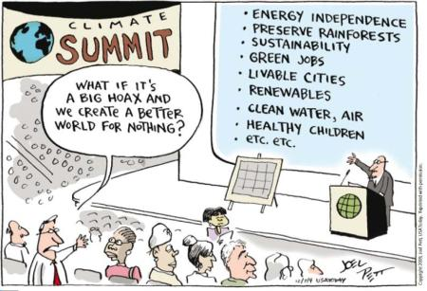
We must acknowledge that by preventing access to research, we are acting against meeting these goals.
And this is what many in the present scholarly publishing industry are doing. In exchange for vast sums of public money.
It’s not a bug. It‘s a feature.
@protohedgehog

Slide 9
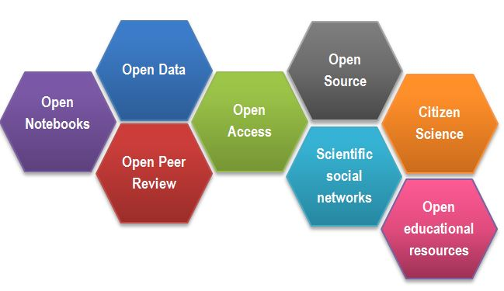
What is ‘Open Science’?
https://www.fosteropenscience.eu/content/what-open-science-introduction
@protohedgehog

Slide 10
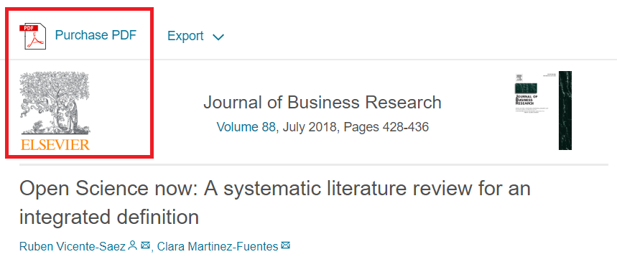
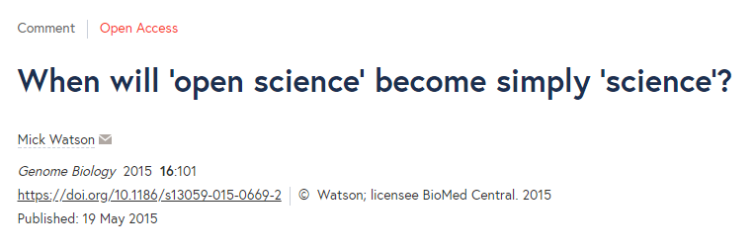
What is the difference between “Open Science” and good science?
“Open Science is transparent and accessible knowledge that is shared and developed through collaborative networks.”
“Open science describes the practice of carrying out scientific research in a completely transparent manner, and making the results of that research available to everyone. Isn’t that just ‘science’?”
https://genomebiology.biomedcentral.com/articles/10.1186/s13059-015-0669-2
https://www.sciencedirect.com/science/article/abs/pii/S0148296317305441
@protohedgehog

Slide 11
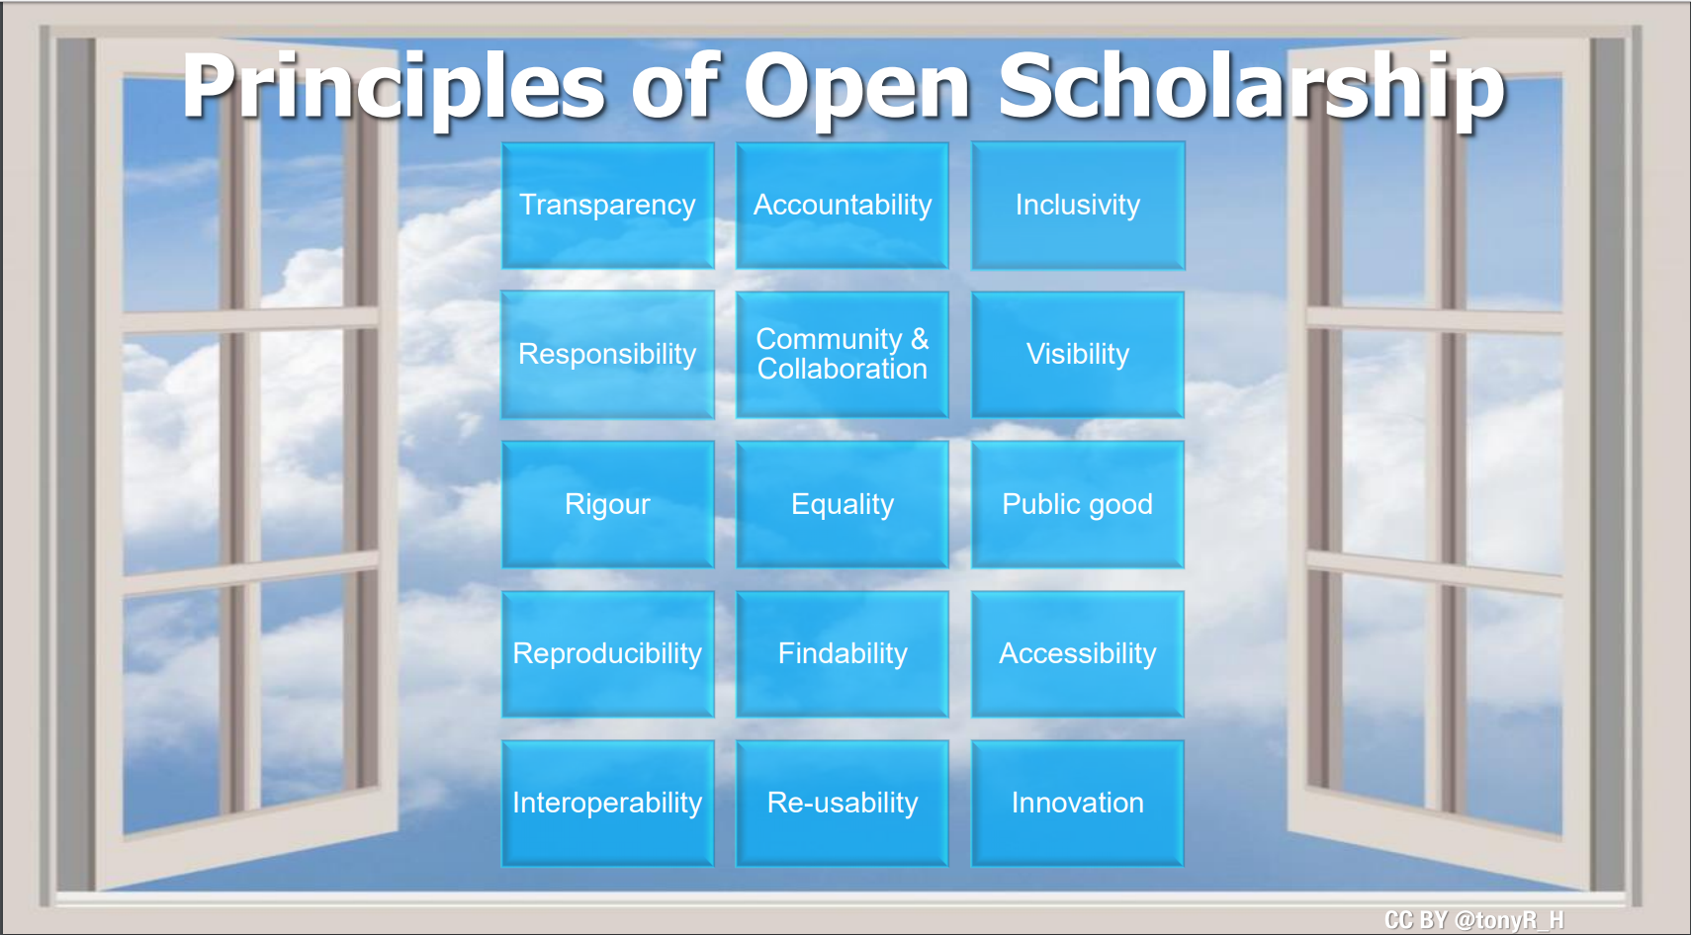
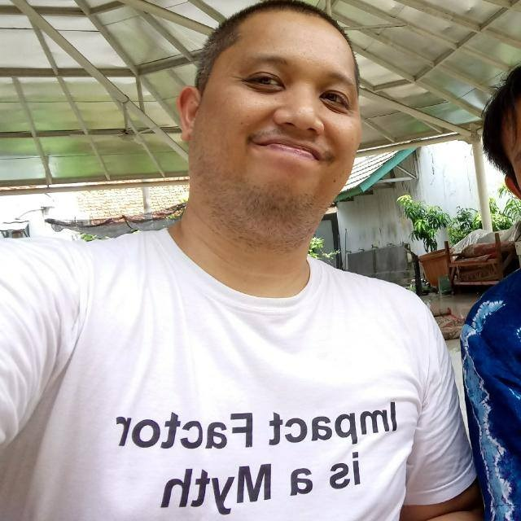
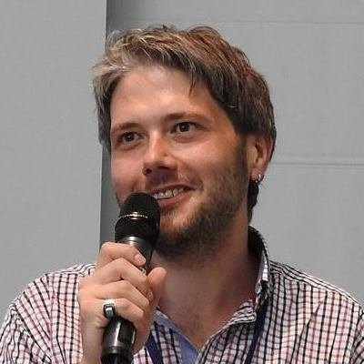
Freedom
Fairness
Justice
Truth
Liberty
Principles of Open Scholarship, by Tony Ross-Hellauer (Source, CC BY).

Slide 12
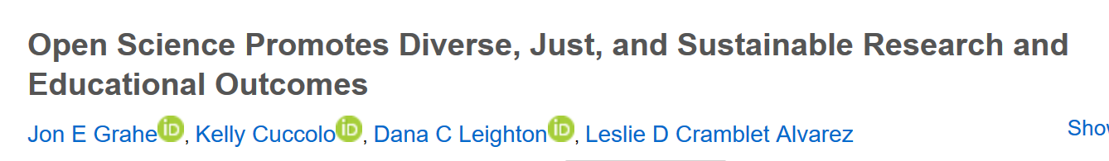
“Open science initiatives also promote diversity, justice, and sustainability through increased levels of inclusion and access, equitable distribution of opportunities and dissemination of knowledge, and increased sustainability stemming from increased generalizability.”
https://www.plu.edu/psychology/wp-content/uploads/sites/60/2019/08/grahe-paper.pdf
@protohedgehog

Slide 13

Melanie Imming, & Jon Tennant. (2018, June 8). Sticker open science: just science done right.
Zenodo. http://doi.org/10.5281/zenodo.128557
@protohedgehog

Slide 14
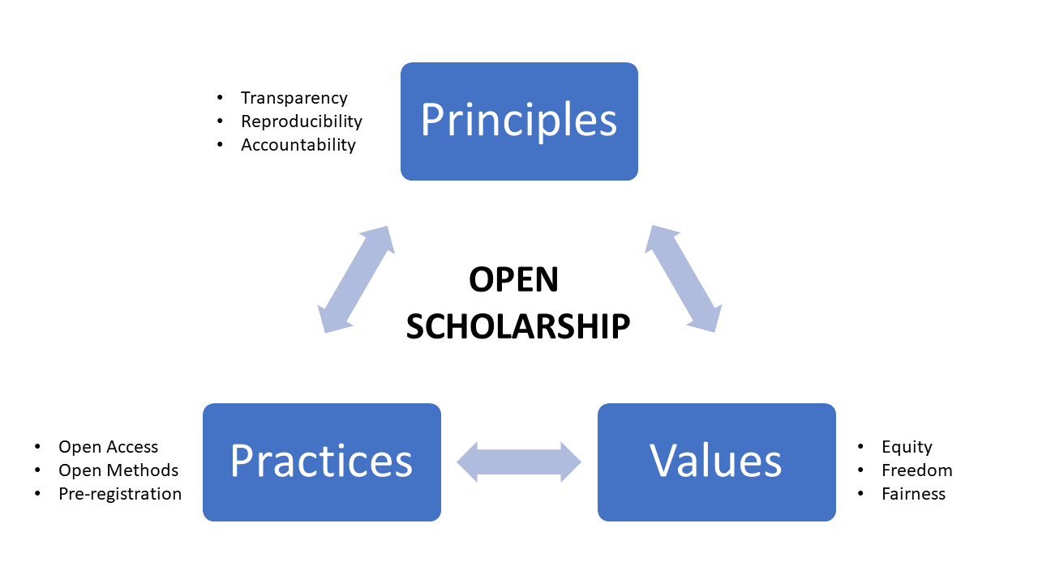
GOOD
SCIENCE
Thoughts in progress…
GOOD
PEOPLE
@protohedgehog

Slide 15
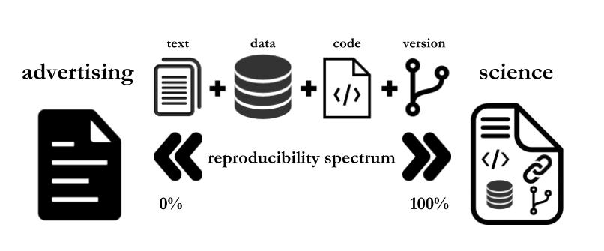
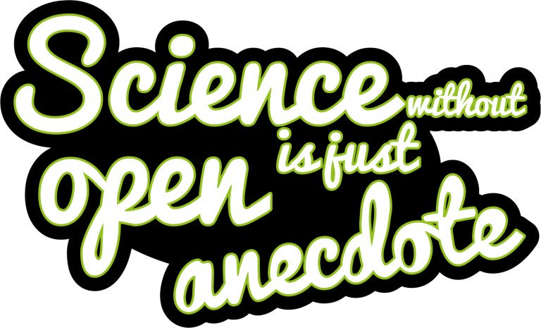
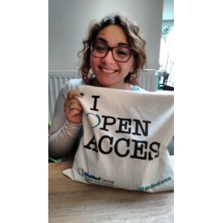
Paola Masuzzo, re-used with permission
Sticker by Melanie Imming
Notes:
15

Slide 16
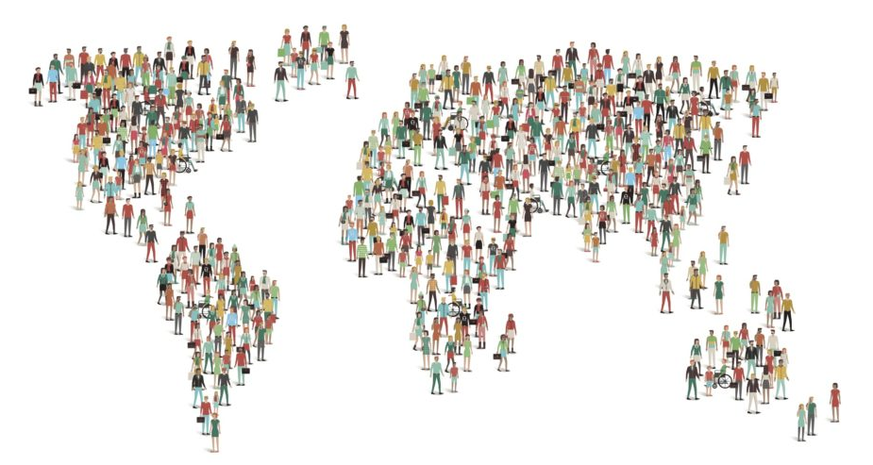
Open Science is global and affects all of us
@protohedgehog

Slide 17
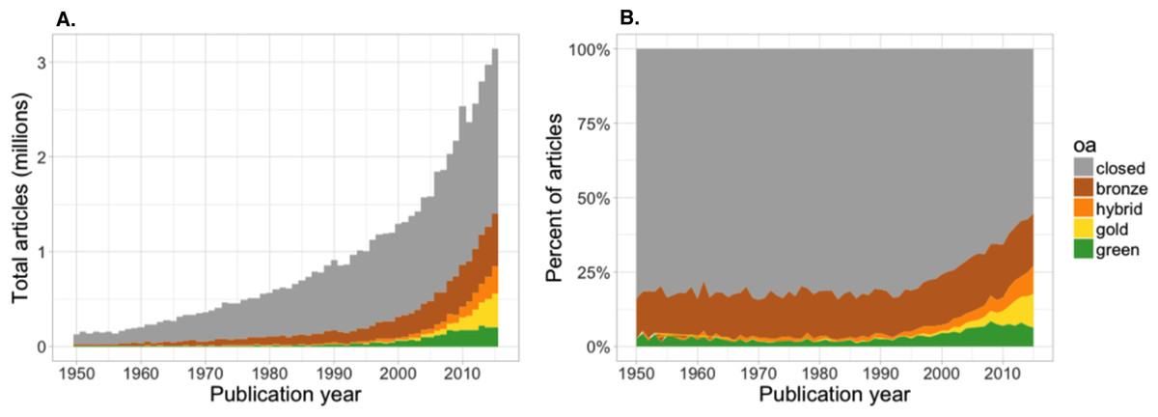
Painfully slow growth of Open Access?
“We estimate that at least 28% of the scholarly literature is OA (19M in total) and that this proportion is growing, driven particularly by growth in Gold and Hybrid.” – Piwowar et al., 2018.
https://peerj.com/articles/4375/
@protohedgehog

Slide 18
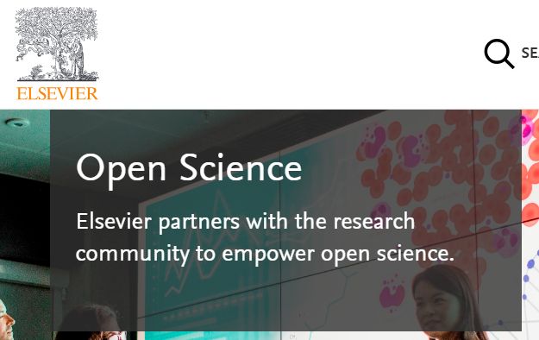
Mega-publishers are corrupting Open Science
Organisations stuck in a pre-digital mindset with a key product developed in the 17th Century.
Basically the reason why the Open Science ‘movement’ began.
Business models based on exclusion, exploitation of privilege, discrimination, extortion..
Who pay lip service to Open Science, while simultaneously subverting it to meet their own intentions.
We DO NOT share the same values and principles.
@protohedgehog

Slide 19
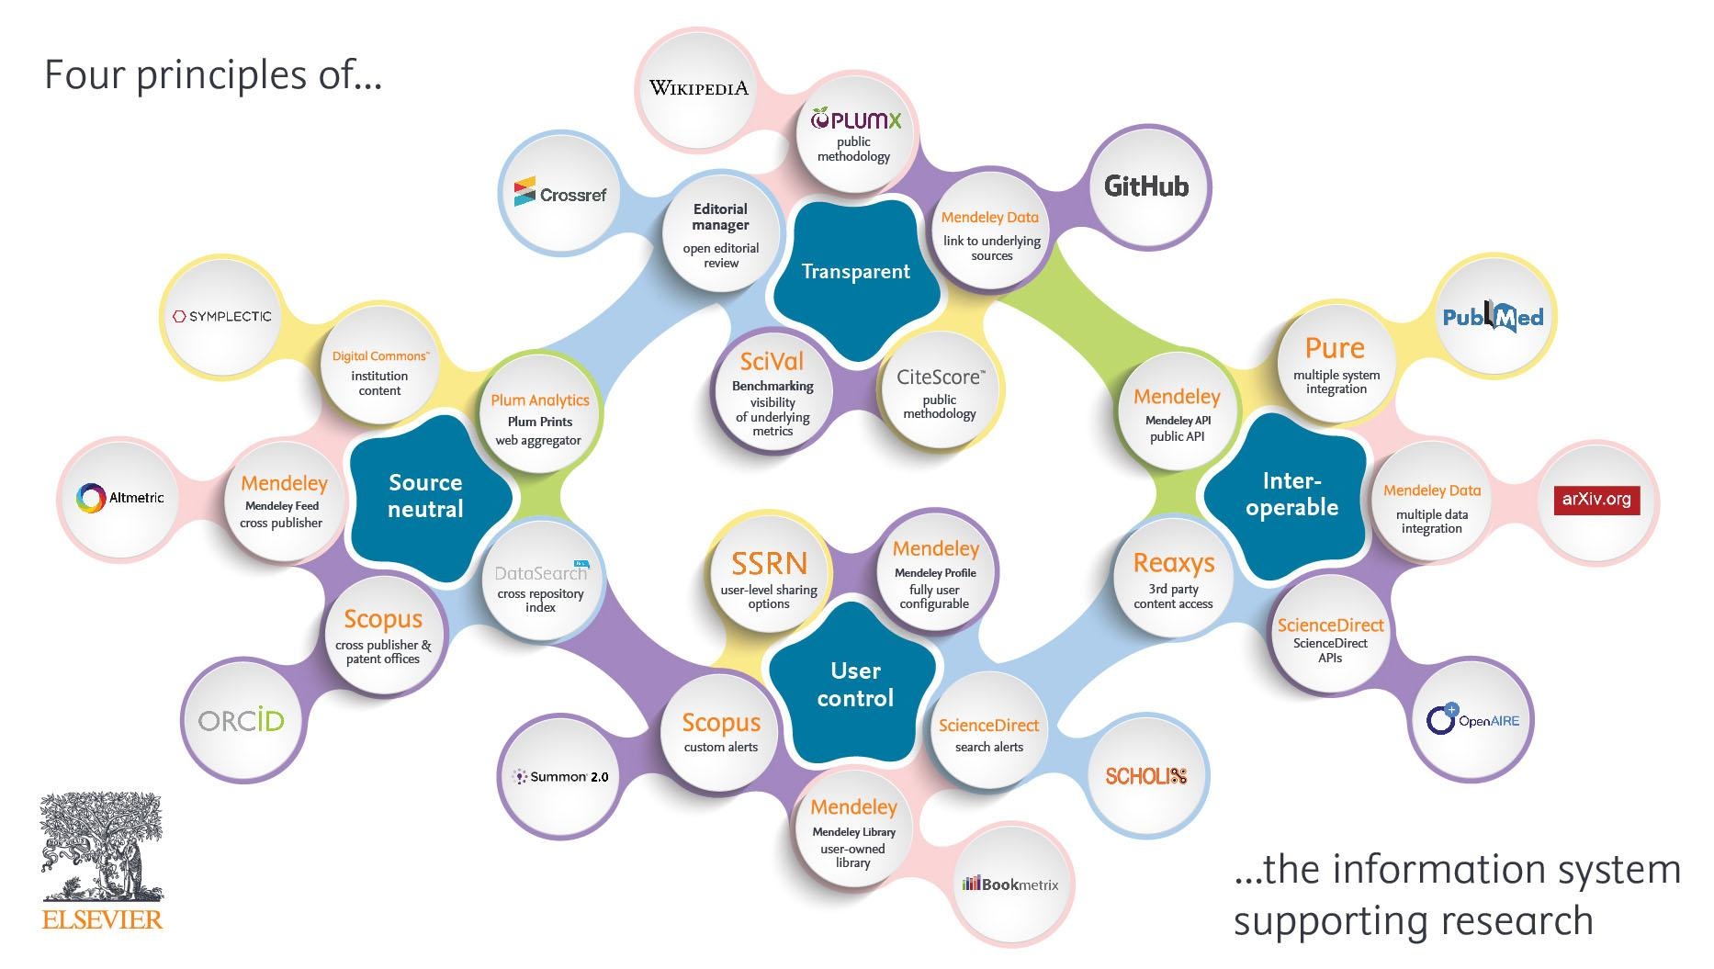

Slide 20
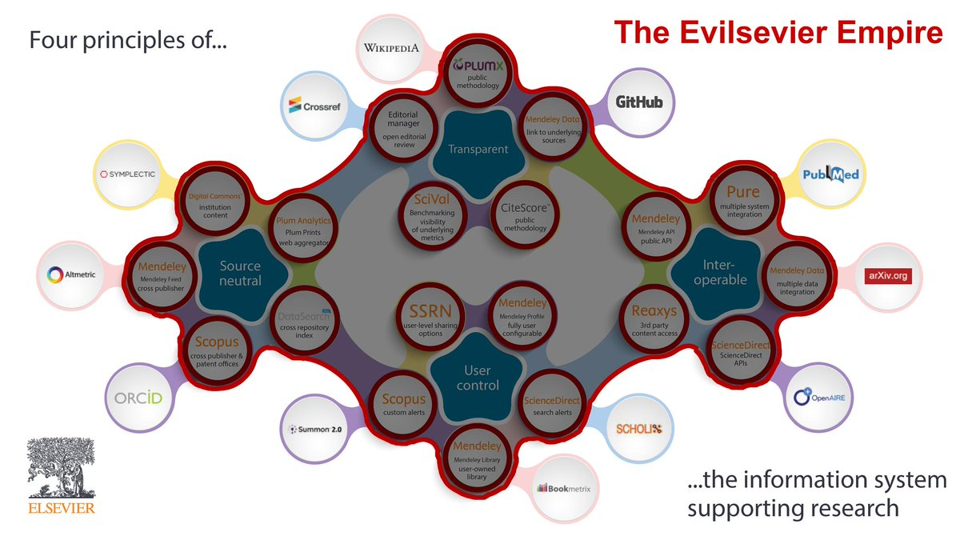
https://twitter.com/brembs/status/1100713883373838337

Slide 21
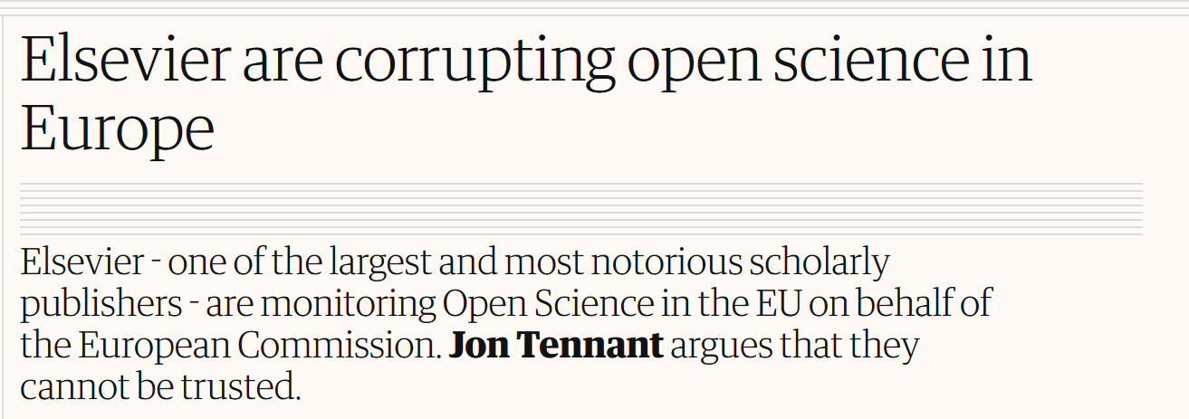
Things you can‘t even make up
https://www.theguardian.com/science/political-science/2018/jun/29/elsevier-are-corrupting-open-science-in-europe
https://zenodo.org/record/2565052#.XXL_7GZOnZs – Referring RELX to the EU Competition Authority
https://bit.ly/2PPjwRK – Democratising Knowledge, Education International
@protohedgehog

Slide 22
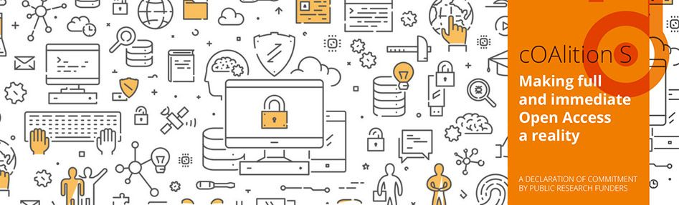
Plan S – the solution to all our problems?
Or a plaster for a much bigger wound?
https://www.coalition-s.org/
@protohedgehog

Slide 23
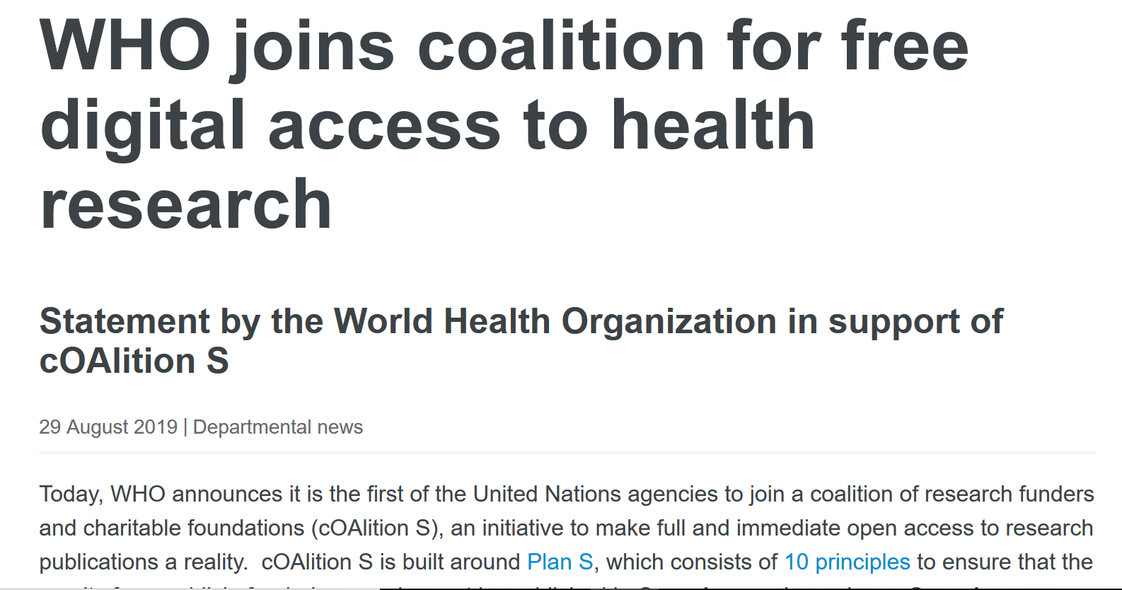
https://www.who.int/news-room/detail/29-08-2019-who-joins-coalition-for-free-digital-access-to-health-research
@protohedgehog

Slide 24
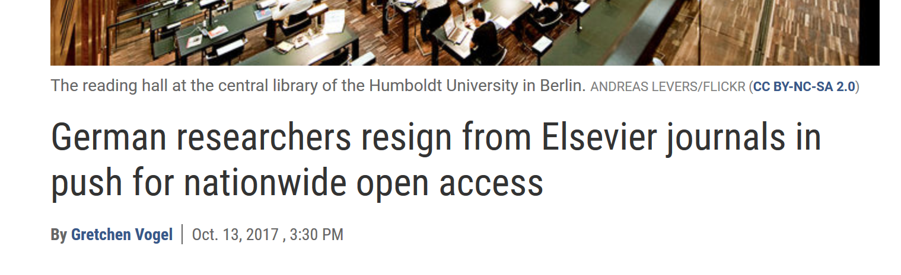
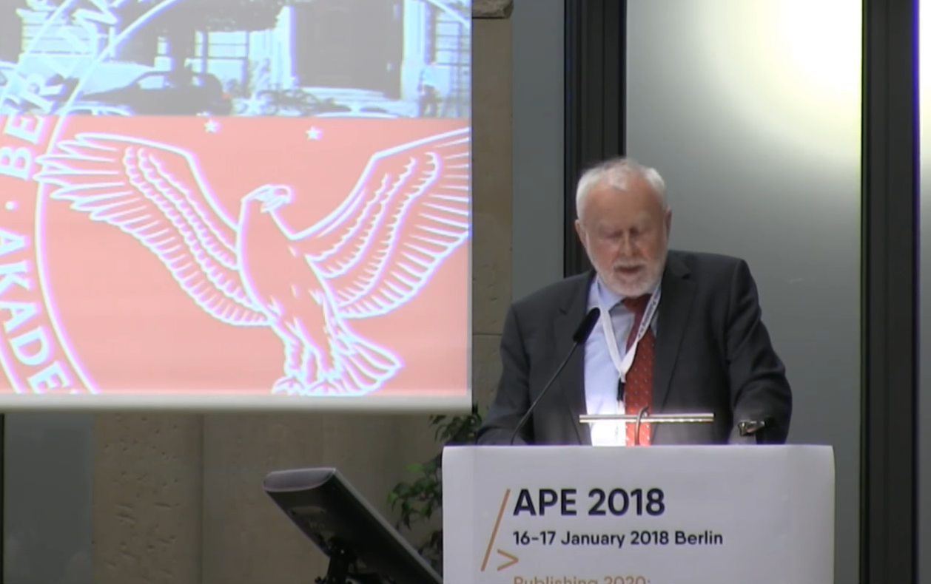
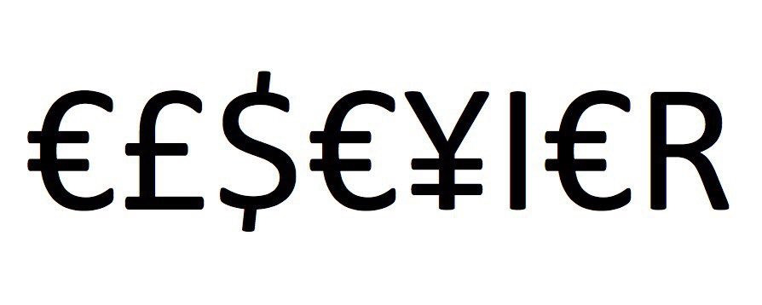
“One big publisher stated: if your country stops subscribing to our journals, science in your country will be set back significantly. I responded […] it is interesting to hear such a threat from a producer of envelopes who does not have any idea of the contents.”
Martin Grötschel, President of the Berlin-Brandenburg Academy of Sciences and Humanities
#HERO
#villain
@protohedgehog

Slide 25
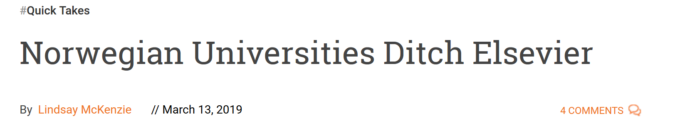
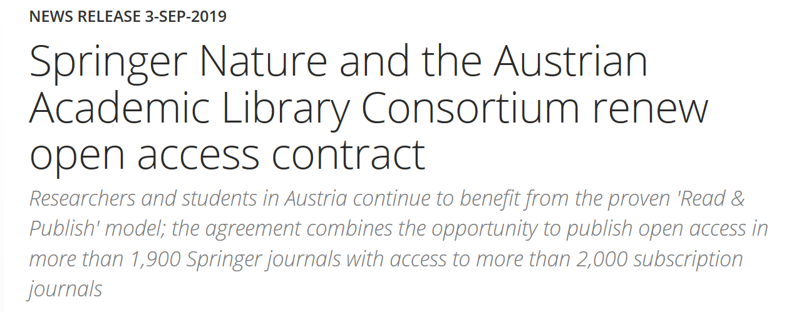
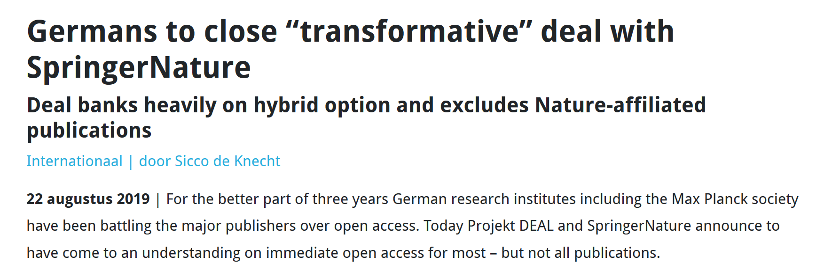
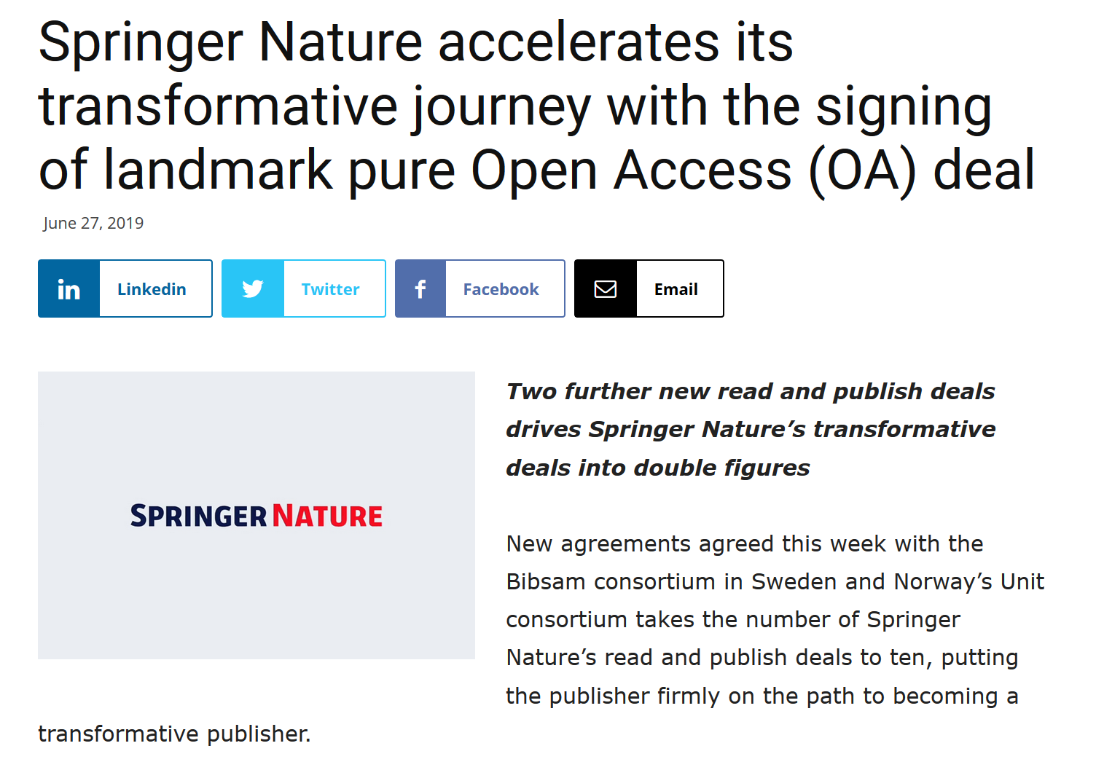
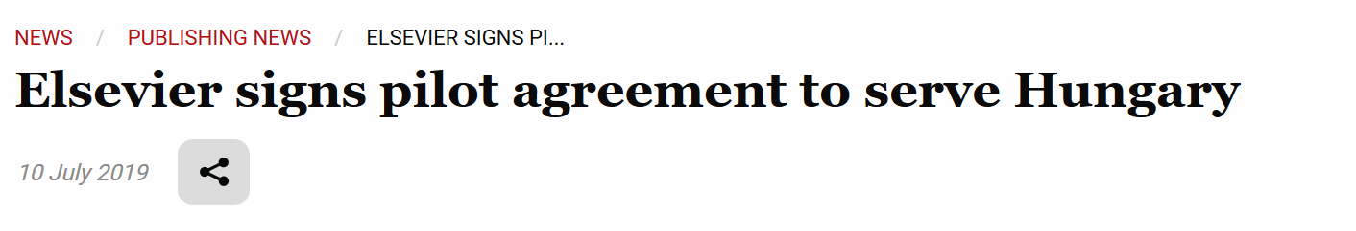
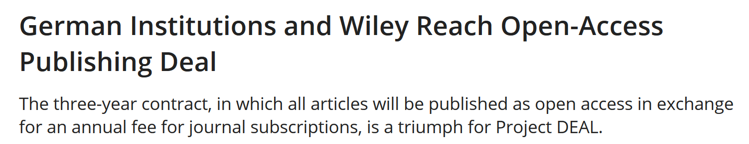
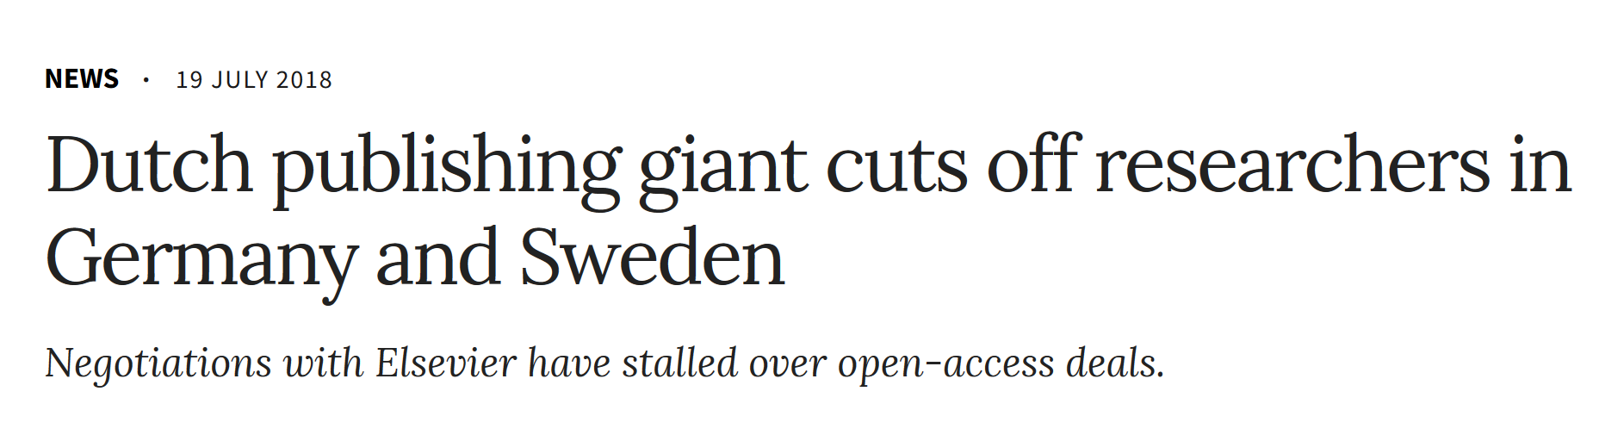
@protohedgehog

Slide 26
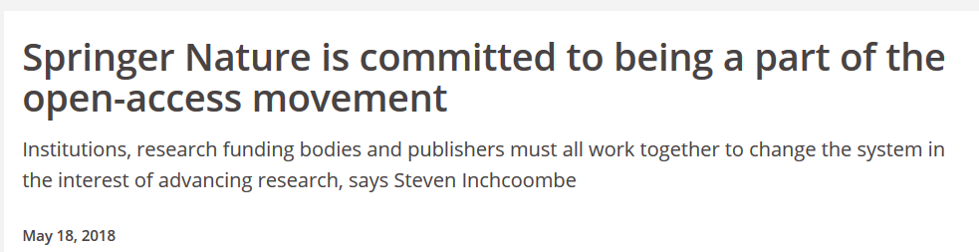
Springer Nature abusing power for profits
Page 99 of the Springer Nature IPO* prospectus:
“We also aim at increasing APCs by increasing the value we offer to authors through improving the impact factor and reputation of our existing journals.”
https://www.timeshighereducation.com/blog/springer-nature-committed-being-part-open-access-movement
https://www.timeshighereducation.com/blog/linking-impact-factor-open-access-charges-creates-more-inequality-academic-publishing
*failed…
@protohedgehog

Slide 27
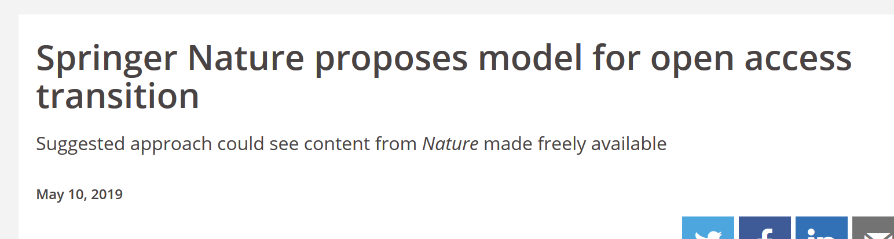
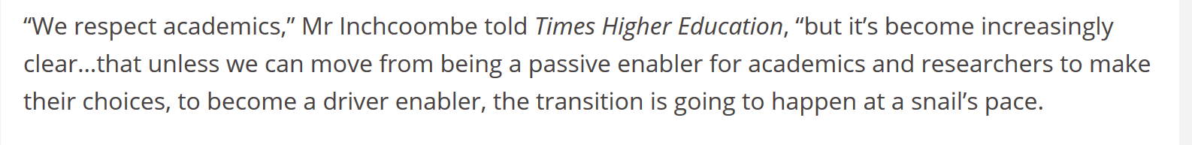
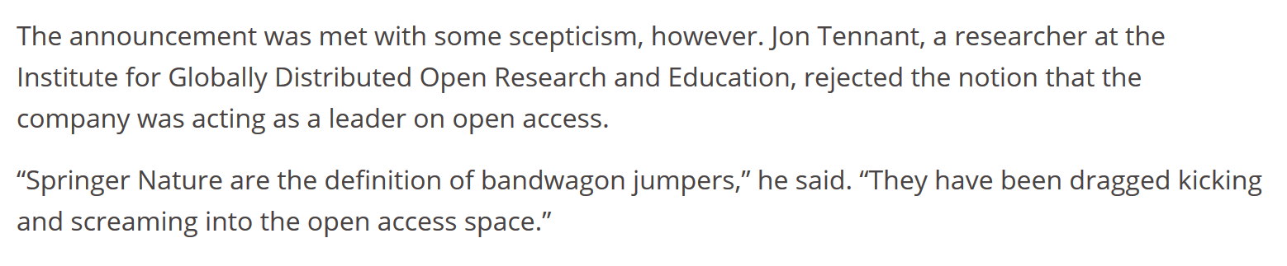
We have to combat their propoganda
https://www.timeshighereducation.com/news/springer-nature-proposes-model-open-access-transition
@protohedgehog

Slide 28
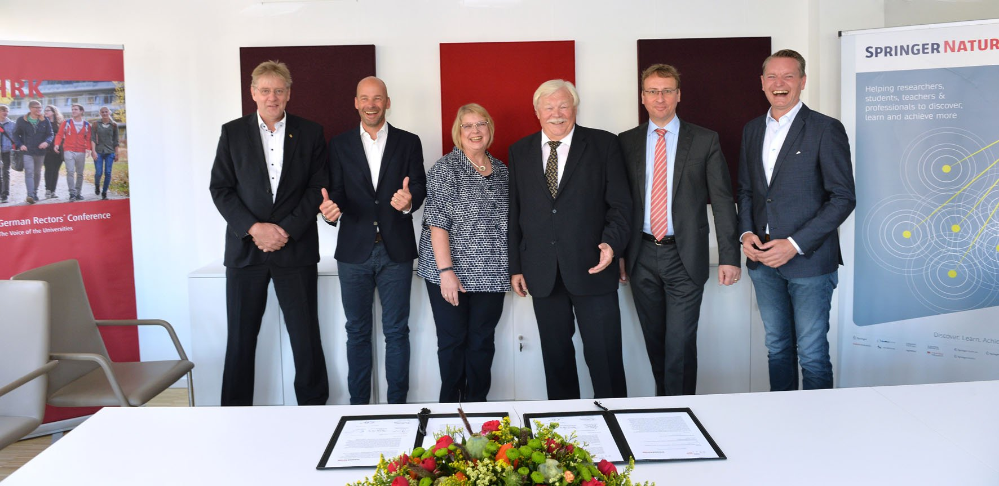
Better or worse?
https://www.hrk.de/press/press-releases/press-release/meldung/projekt-deal-and-springer-nature-reach-understanding-on-worlds-largest-transformative-open-access-a/
@protohedgehog

Slide 29
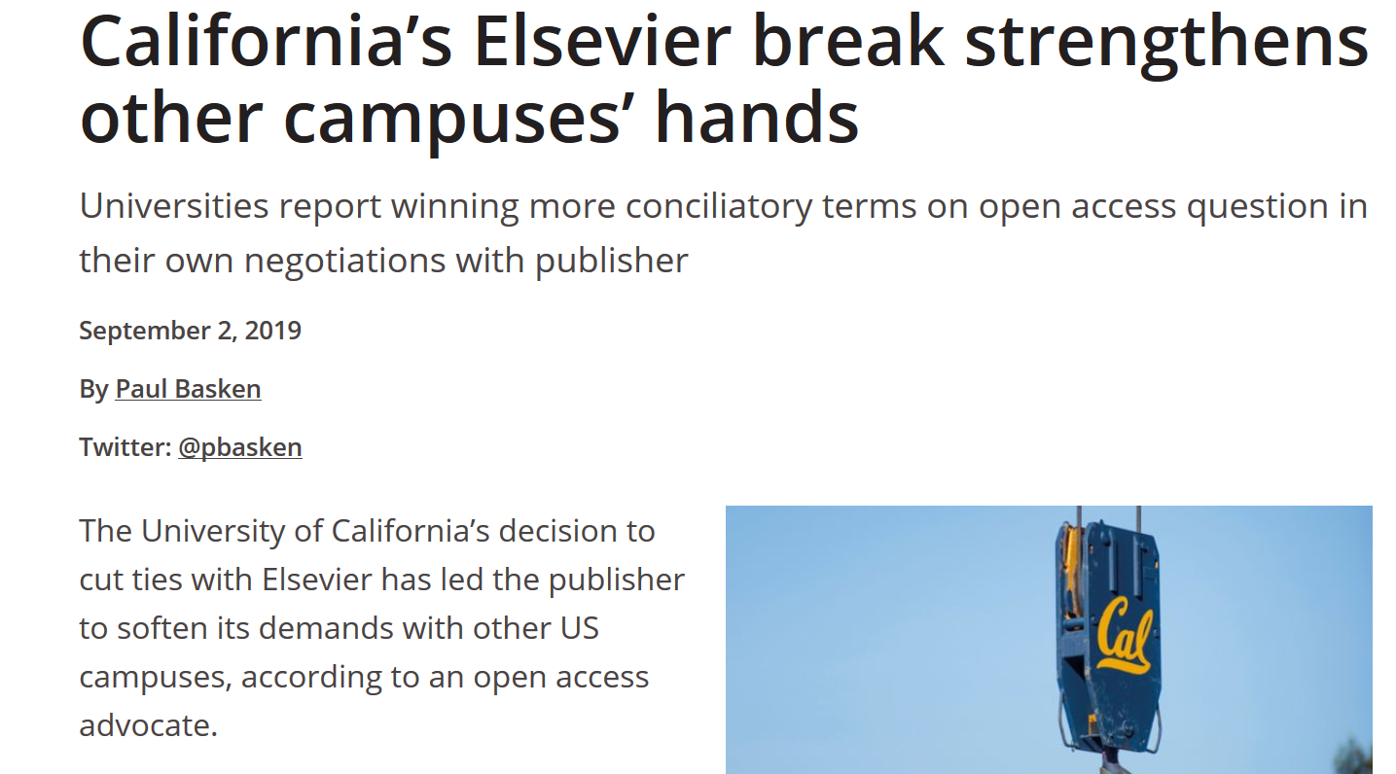
North America in transition?
https://osc.universityofcalifornia.edu/2019/08/fact-check-uc-and-elsevier/
@protohedgehog
https://www.timeshighereducation.com/news/californias-elsevier-break-strengthens-other-campuses-hands

Slide 30
We are running out of time
“The current model of scholarly publishing contains a disastrous blend of Stockholm Syndrome and cognitive dissonance. Researchers are helplessly locked into the system because of an over-reliance on journal brands for their evaluations.
Every time we sign one of these so-called transformative contracts, which often contain multi-year lock-ins, we lose the opportunity to create something more just, sustainable, efficient and effective. We actively work against efforts to return control of publishing to the academic community. It is time to take a step back and to think again about what we really want.”
https://www.timeshighereducation.com/opinion/transformative-open-access-publishing-deals-are-only-entrenching-commercial-power
@protohedgehog

Slide 31
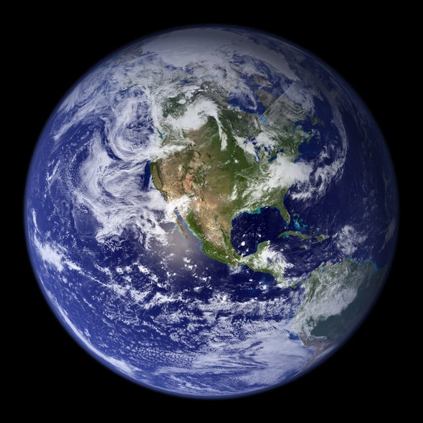
Bridging the North-South divide
What can we learn from the successes and failures of each other?
@protohedgehog

Slide 32
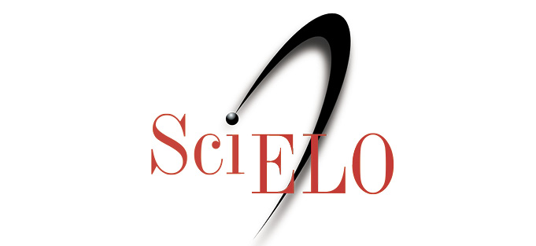
SciELO: the hero the world needs?
Covers Latin America, Iberian Peninsula, and South Africa (13 countries)
Around 750,000 published papers, 1,200 active journals – all OA!
20 years of free/low cost publishing for researchers
Production costs much lower than ‘western’ publishing houses
@protohedgehog

Slide 33

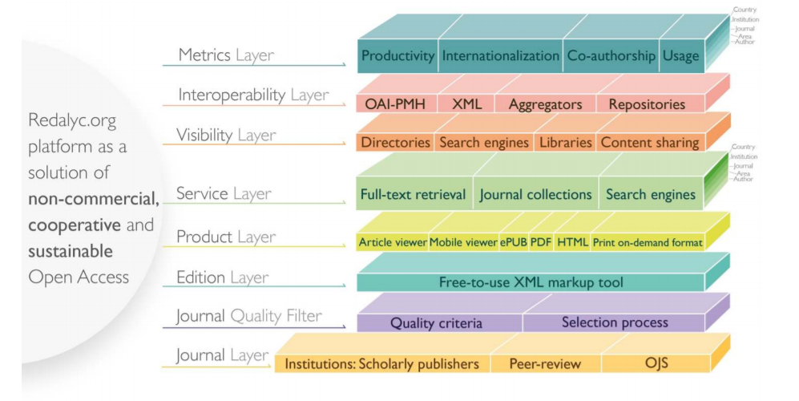
1,260 journals from 15 Iberoamerican countries
622 publishers
Half a million full text articles
Generates bibliometric indicators too
https://www.opencon2018.org/opencon_2018_latam
https://hal.archives-ouvertes.fr/hal-01816693/
@protohedgehog

Slide 34
Why are SciELO/REDALYC so effective?
Strong cultural commitment and sense of public mission among Latin American universities and researchers:
  “Iberoamérican scientists especially are committed to the movement as a way to ensure that society benefits from their research.” - Victoriano Colodrón.
Have we lost this idea around much of the rest of the world?
Or have the ‘western’ publishing houses corrupted the process?
https://www.timeshighereducation.com/blog/why-open-access-publishing-growing-latin-america
@protohedgehog

Slide 35
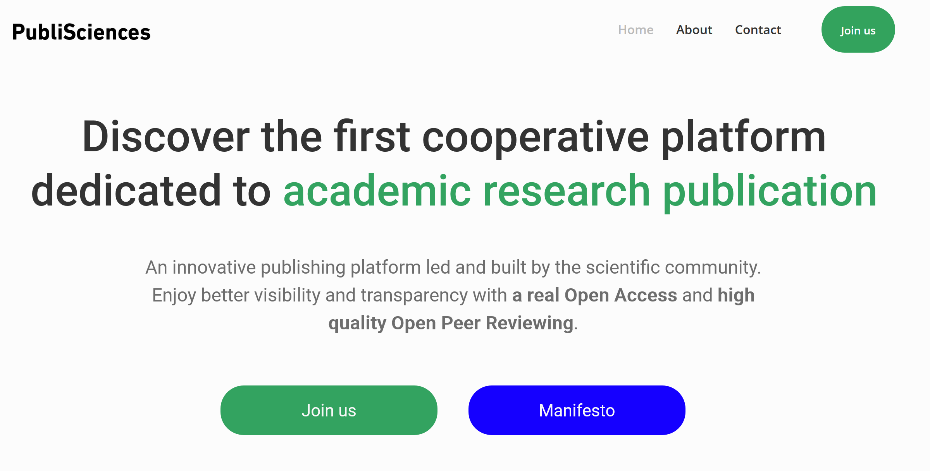
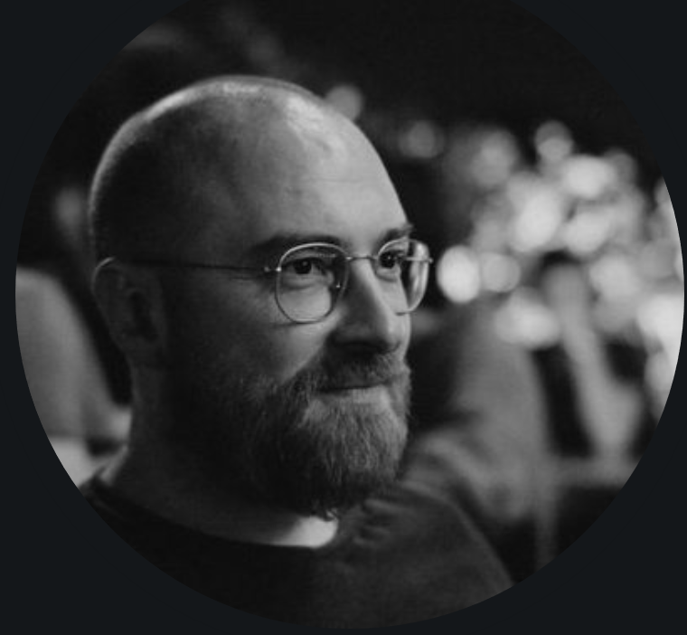
Vive la revolution?
https://twitter.com/michael__rera
https://publiscience.com/
@protohedgehog

Slide 36
Plan S has it backwards
Instead of Plan S trying to impose itself on the rest of the world (cough Neocolonialism cough), we should be asking how can we co-operate and learn from the huge successes of Latin America
Without continuing to funnel billions of taxpayers money into a corrupt, dysfunctional, profit-driven system
@protohedgehog

Slide 37
“From a geopolitical perspective, there are fundamental differences in the notion of scientific publishing and scholarly publications, which appear to be handled as a commodity prone to commercialization in Plan S guidelines.”
“We believe that the potential adhesion of Argentina and other countries from this region to Plan S ignores the reality of Latin America, and harms at a regional and global level the advancement of non-commercial Open Access initiatives.”
Humberto Debat​ and Dominique Babini: https://peerj.com/preprints/27834/
@protohedgehog

Slide 38
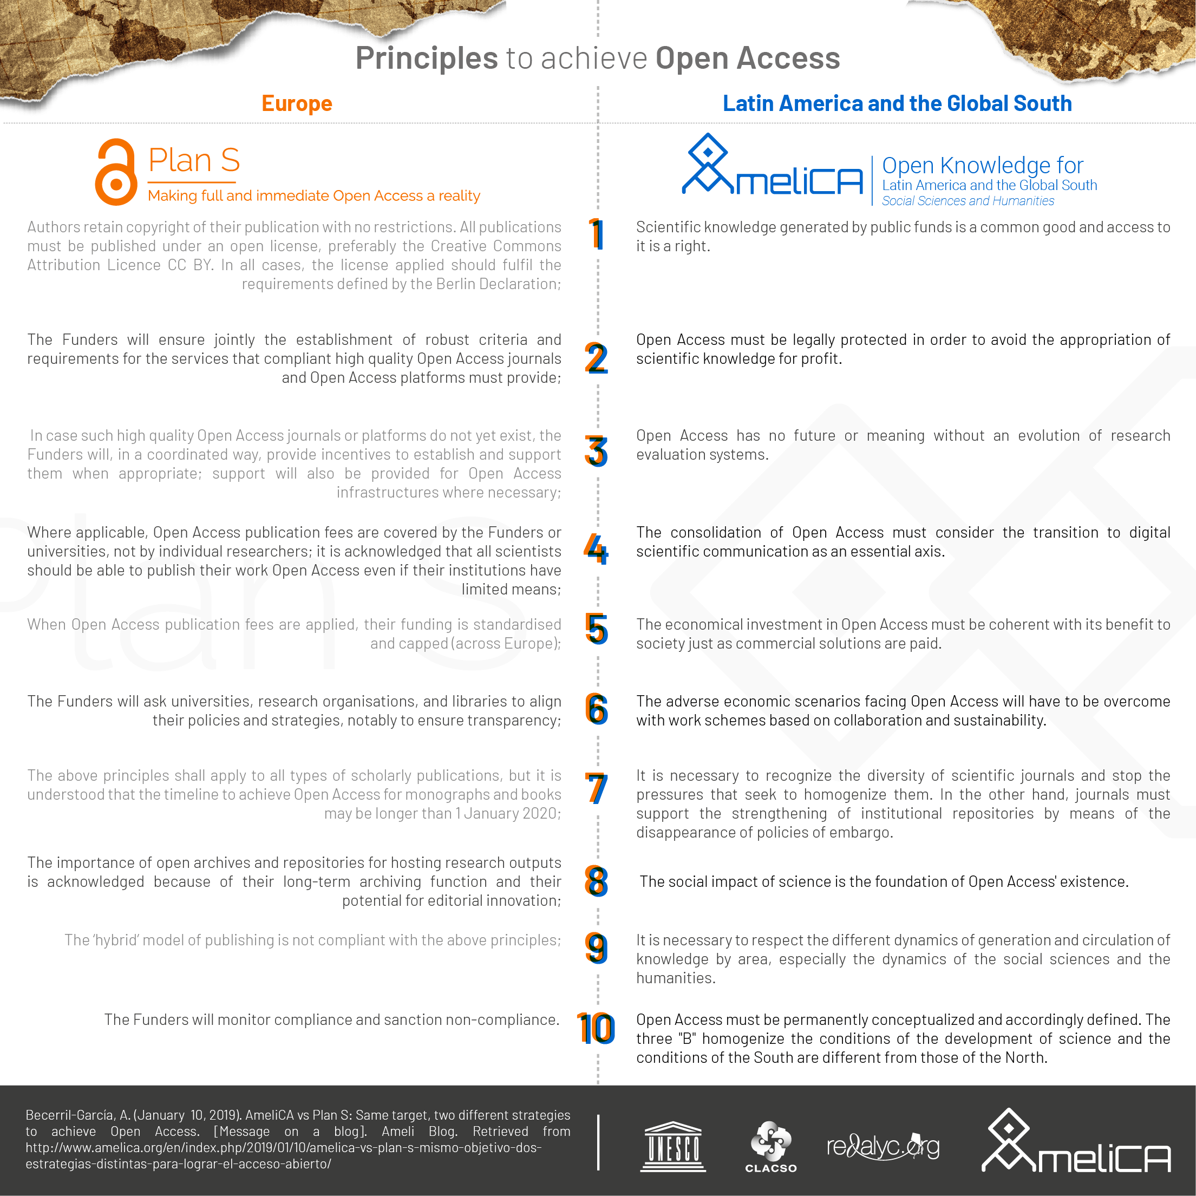
www.amelica.org/en/index.php/2019/01/10/amelica-vs-plan-s-mismo-objetivo-dos-estrategias-distintas-para-lograr-el-acceso-abierto/
@protohedgehog

Slide 39
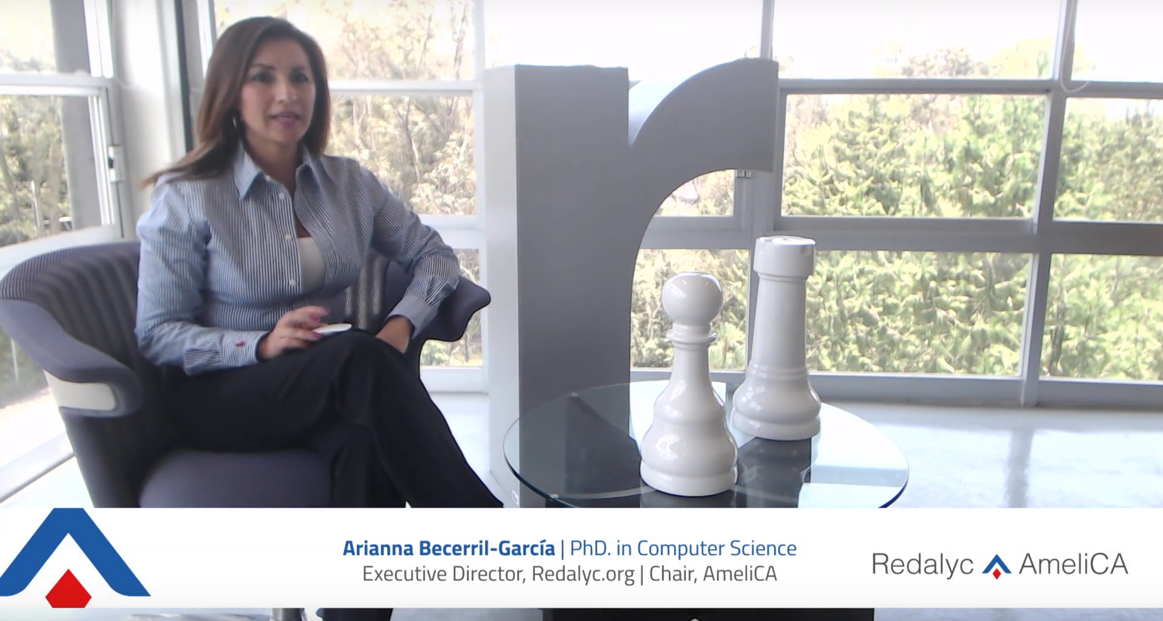
Arianna Becerril-García, chair of AmeliCA:
“The commercial strategies that for-profit publishers have adopted for open access are ravenous, exclusionary and unsustainable. This is entirely contrary to the vision of open access that AmeliCA supports.”
https://www.youtube.com/watch?v=yQDFHBJX7xI&feature=youtu.be
https://poynder.blogspot.com/2019/05/the-oa-interviews-arianna-becerril.html
@protohedgehog

Slide 40
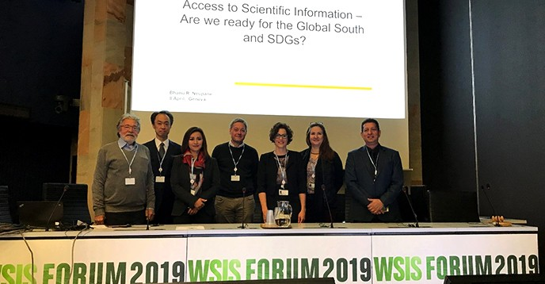
GLOALL: Global Alliance of Open Access Scholarly Communication
Taking back control of scientific publications by academics and institutions by investing the in development of a shared and open scholarly infrastructure.
AmeliCA, AJOL, Érudit, J-STAGE, OpenEdition, and SciELO
@protohedgehog

Slide 41
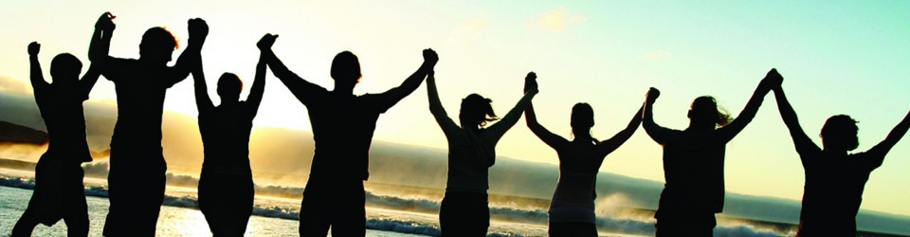
What can we all achieve if we stand together?
We need to stand together as a unified global community to make sure that we are acting in the best interests of the public, not corporate gains.
#PeopleNotProfits
https://letsallstandtogether.wordpress.com/
@protohedgehog

Slide 42
What do we need to change cultures?
Leadership from those who are less at risk
  They need to invest in our future
  Make sure that the system we are creating is in the best interests of future generations
For each of us to take small steps where we can
  Without putting ourselves at risk
  Be aware of the options available to us
And some times to be brave
  To stand up for what we believe in
  To ask the challenging questions
  To be deeply introspective of what we are doing and why
@protohedgehog

Slide 43
Welcome to the Open Science MOOC!
To help make ‘Open’ the default setting for all global research.
We want to help create a welcoming and supporting community, with good tools, teachers, and role-models, and built upon a solid values-based foundation of freedom and equitable access to research.
@protohedgehog

Slide 44
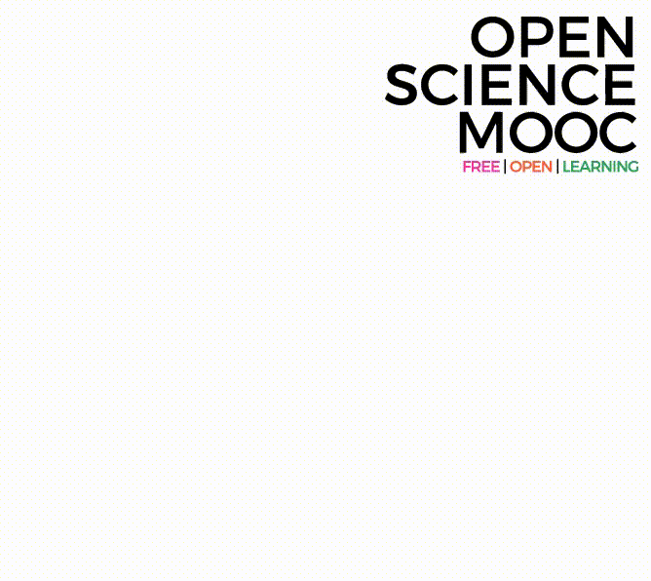
Can we break the inertia?
Education, training, support.
  Empowerment and leadership for the next generation.
    Shifting power dynamics to reduce bias and abuse.
      Building a global community based on strong values, sharing and collaboration.
        Massive-scale engagement to re-align Open Science with current incentive structures.
GitHub: https://github.com/OpenScienceMOOC
Website: https://opensciencemooc.eu
Twitter: @OpenScienceMOOC
Email: info@opensciencemooc.eu
@protohedgehog

Slide 45

Modular learning
@protohedgehog
Designed by: Mike Morrison

Slide 46

We are not alone

Slide 47
Status
In development
2 modules currently live, 1000 enrolled participants
860 Slack community members
7500 Twitter followers
150 strong GitHub development team
45 strategic partnerships
2 more modules in development
https://www.dataplanes.org/osmooc-dashboard/
@protohedgehog

Slide 48

I invite you all to join us!
https://github.com/lhehnke/opensciencemooc-followers
@protohedgehog

Slide 49

https://twitter.com/EPFLOpenScience/status/1170959367140777984?s=03
@protohedgehog

Slide 50
How do we get to where we want?
Imagine a future defined by the values and principles of Open Science:
        Freely available public good
        Rigorous and reproducible
        Open to ALL
        Isn’t that just GOOD science?
@protohedgehog

Slide 51
The ultimate goal
Pooling knowledge and resources to create a decentralised scholarly infrastructure, with communities as the focus.
Inclusivity
Equality
Accountability
Freedom
Fairness
Justice
Truth
Rigour
Transparency
Reproducibility
SCIENCE AS A PUBLIC GOOD FOR THE BETTERMENT OF SOCIETY
#PeopleNotProfits
http://elephantinthelab.org/do-we-need-an-open-science-coalition/
@protohedgehog

Slide 52

























Never doubt that a small group of thoughtful, committed citizens can change the world; indeed, it's the only thing that ever has.
Margaret Mead

