Slide 1
Like etlix but for iches
Modelling species, genes, (and movies) in the age of Big Data

Slide 2
Ecological Data - Presence
Species
 | wearable springtail | self conceited nuthatch | stoney freshwater eel | quasi- economic phoebe | pale island canary | mega indian ringneck parakeet | unlikely andean cat | bibliomaniacal egret | velveteen rhesus monkey
Butterland | 1 | 0 | 0 | 1 | 0 | 1 | 0 | 0 | 0
Edgewick | 1 | 1 | 0 | 0 | 0 | 1 | 0 | 0 | 0
Wildeland | 0 | 1 | 0 | 0 | 0 | 1 | 0 | 0 | 0
Byrock | 0 | 1 | 0 | 0 | 1 | 0 | 0 | 1 | 0
Dragonmere | 0 | 1 | 0 | 1 | 0 | 0 | 1 | 0 | 1
Orholt | 0 | 0 | 0 | 1 | 0 | 1 | 0 | 1 | 0
Lorston | 1 | 0 | 1 | 0 | 0 | 0 | 1 | 1 | 1
Wyvernshore | 0 | 0 | 1 | 1 | 0 | 0 | 1 | 0 | 0
Sagecoast | 0 | 0 | 0 | 0 | 0 | 0 | 1 | 0 | 0
Sites

Slide 3
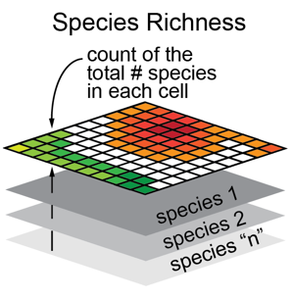
Stacked Species Distribution Models
Does not take into account covariance between species
Inference is not valid (assumes independence)
Predictions are poor
Image from http://seamap.env.duke.edu

Slide 4
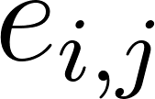
Joint Species Distribution Models
Fixed Environmental Effects
(regression coefficients)
Jointly models occurrence or abundance of species j in site i
Mean abundance or
probability of occurrence
Site-specific intercept
Species-specific intercept
Residual error
Residual Species Covariance Matrix
Warton et al. (2015)

Slide 5
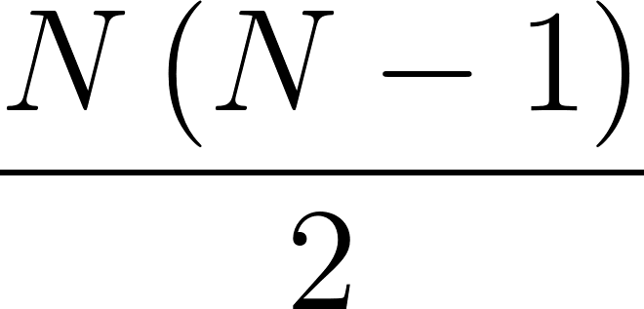
Modelling Full Covariance Matrix is Difficult
The number of covariance terms scales as:
320 Species
51,040 covariances
10 Species
45 covariances
20 Species
190 covariances
80 Species
3,160 covariances

Slide 6
Joint Species Distribution Models
Jointly models occurrence or abundance of species j in site i

Slide 7
Joint Species Distribution Models
Jointly models occurrence or abundance of species j in site i
Full residual covariance is replaced by lower rank approximation. E.g. Latent Variables
(or Matrix Factorization)
Latent Factor need contraining, most methods used by ecologists use Bayesian priors, and full MCMC

Slide 8
Joint Species Distribution Models
Jointly models occurrence or abundance of species j in site i
This is SLOW, and
DOES NOT SCALE
Full residual covariance is replaced by lower rank approximation. E.g. Latent Variables
(or Matrix Factorization)
Latent Factor need contraining, most methods used by ecologists use Bayesian priors, and full MCMC

Slide 9
Joint Species Distribution Models
Jointly models occurrence or abundance of species j in site i
This is SLOW, and
DOES NOT SCALE
What if we have millions of data points?
Full residual covariance is replaced by lower rank approximation. E.g. Latent Variables
(or Matrix Factorization)
Latent Factor need contraining, most methods used by ecologists use Bayesian priors, and full MCMC

Slide 10
Netflix Data - Liked
Movies
 | Fist of Trouble | Troll 2 | The Room | Lambast and Barter | Naked Brunch | Canteen 2 | Horse Pants | Nature, Nature, Nature | Bed, Bath, and Bed
Ji Fielder | 0 | 1 | 1 | 1 | 0 | 1 | 0 | 0 | 0
Glynis State | 1 | 1 | 1 | 1 | 0 | 1 | 0 | 0 | 0
Maryam Cav | 0 | 1 | 0 | 1 | 0 | 1 | 0 | 0 | 0
Brad Brown | 0 | 1 | 0 | 1 | 0 | 0 | 0 | 1 | 0
Al Broody | 0 | 1 | 0 | 0 | 0 | 0 | 1 | 0 | 1
Jay Henson | 0 | 1 | 0 | 0 | 0 | 1 | 0 | 1 | 0
Seth Sethko | 1 | 1 | 0 | 0 | 0 | 0 | 1 | 1 | 1
Shia Lebeau | 0 | 1 | 1 | 0 | 0 | 0 | 1 | 0 | 0
Krasmer Kai | 0 | 1 | 0 | 0 | 0 | 0 | 1 | 0 | 0
Users

Slide 11
Joint Species Distribution Models
Recommendation Models (used by Netflix, LinkedIn, etc.)
From paper published by LinkedIn (Zhang et al. 2016):

Slide 12
Joint Species Distribution Models
Jointly models occurrence or abundance of species j in site i
Jointly models interactions with job j by member m

Slide 13
Jointly models occurrence or abundance of species j in site i
Mean abundance or
probability of occurrence
Mean number of clicks
or probability of viewing
Site-specific intercept
Member-specific
regression coefficients
(could include intercept)
Species-specific intercept
Job-specific
regression coefficients
(could include intercept)
Jointly models interactions with job j by member m

Slide 14
Jointly models occurrence or abundance of species j in site i
Jointly models interactions with job j by member m

Slide 15
Models occurrence or abundance of species j in site i
Observed
Data
Fixed Effects
(a vector of regression
coefficients)
Latent
Factors
(for site or
member)
Latent
Factors
(for species
or job)
Jointly models interactions with job j by member m

Slide 16
Big Business has Big Data,
and uses Big Methods
We can apply methods developed for recommendation engines, used on Billions of data points, to Joint Species Distribution Models
Model Hundreds of Thousands of species?
If so, what about Joint Gene Distribution Models?
Models environmental associations of genes, while accounting for likely strong covariance between them

Slide 17
Big Business has Big Data,
and uses Big Methods
We can apply methods developed for recommendation engines, used on Billions of data points, to Joint Species Distribution Models
Model Hundreds of Thousands of species?
If so, what about Joint Gene Distribution Models?
Models environmental associations of genes, while accounting for likely strong covariance between them
We tested this out on a data set of over 12,000 genes in 375 Bradyrhizobium Genomes (in collaboration with Anna Simonsen)

Slide 18
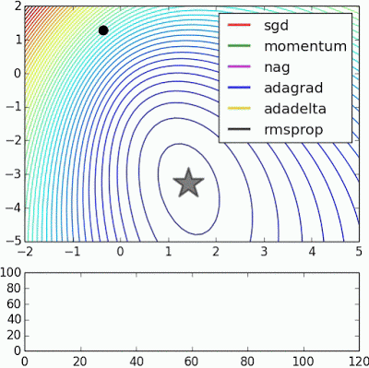
Method: Stochastic Gradient Descent
(with mini-batches)
Animation by Alec Radford

Slide 19
Method: Dataset Details
Number of Genes: 12,137
Number of Genomes: 375
Number of Data Points: 4,255,771
Number of Environmental Variables: 9
Number of Parameters Estimated: 747,354
Implemented model in Tensorflow
Ran for 300 Epochs
Final Accuracy on 200,000 held-out samples:
93%

Slide 20
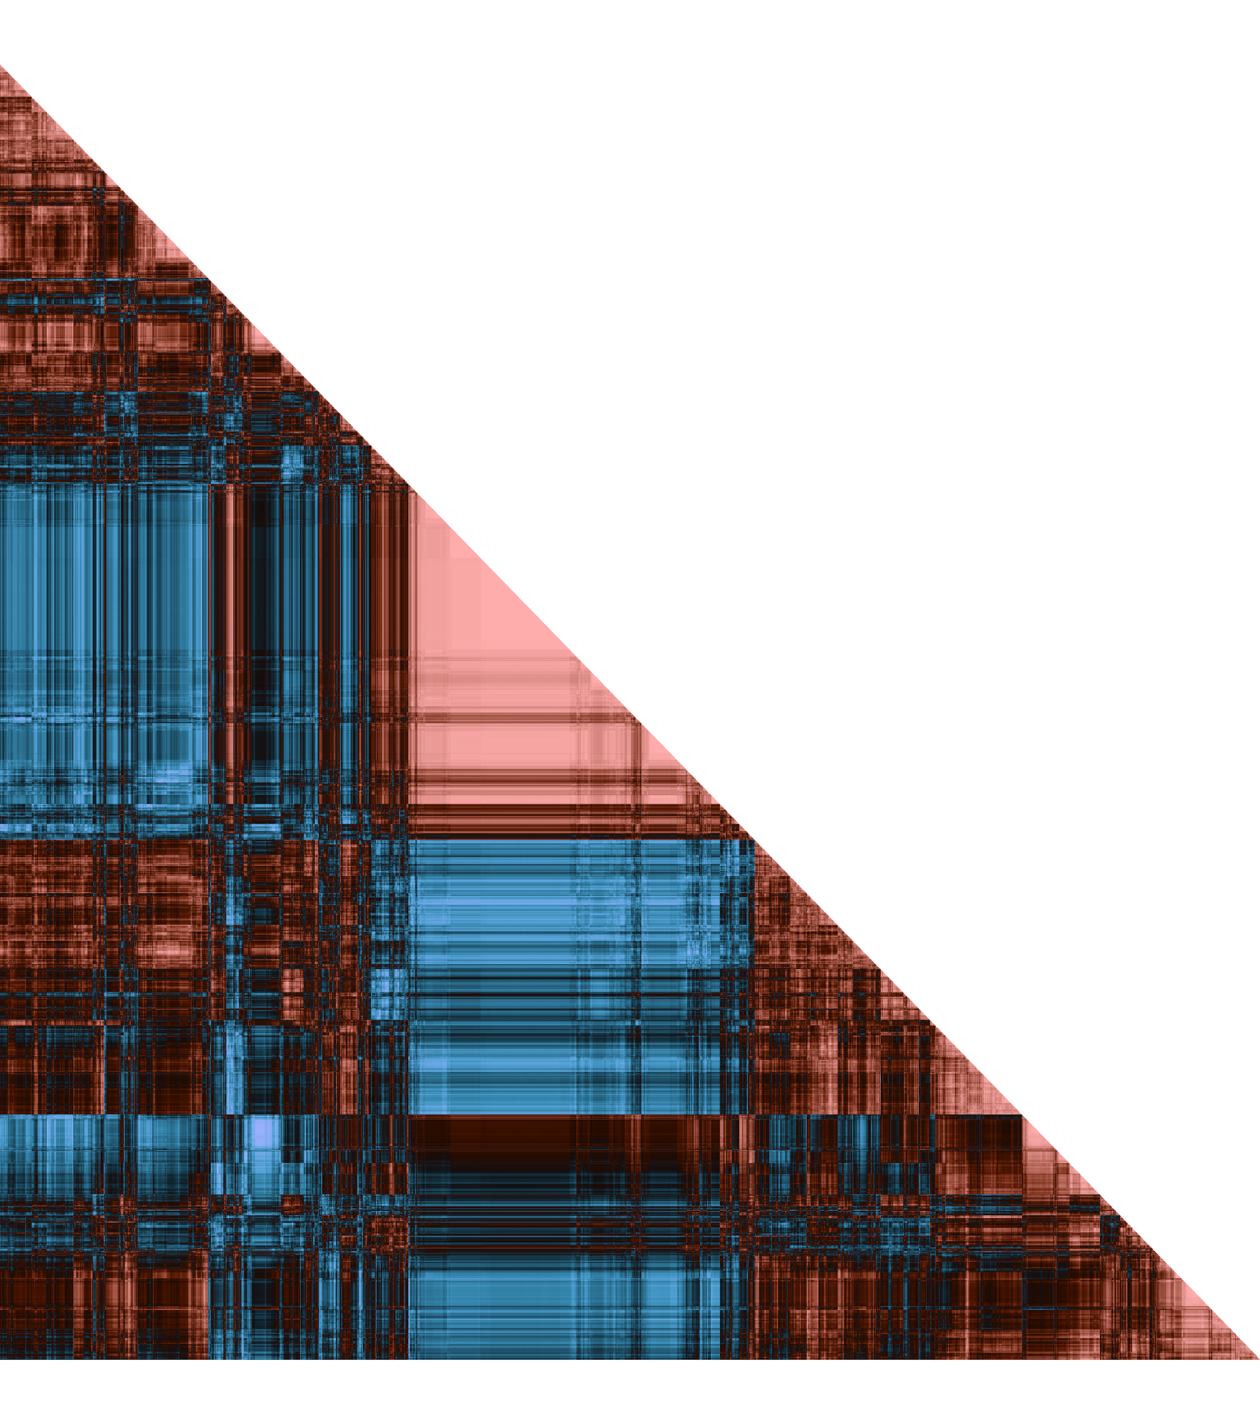
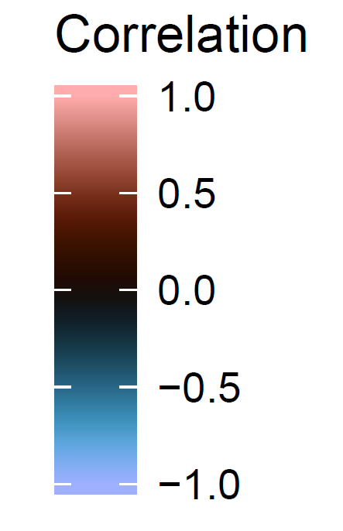
Residual Correlation

Slide 21
Residual Correlation

Slide 22
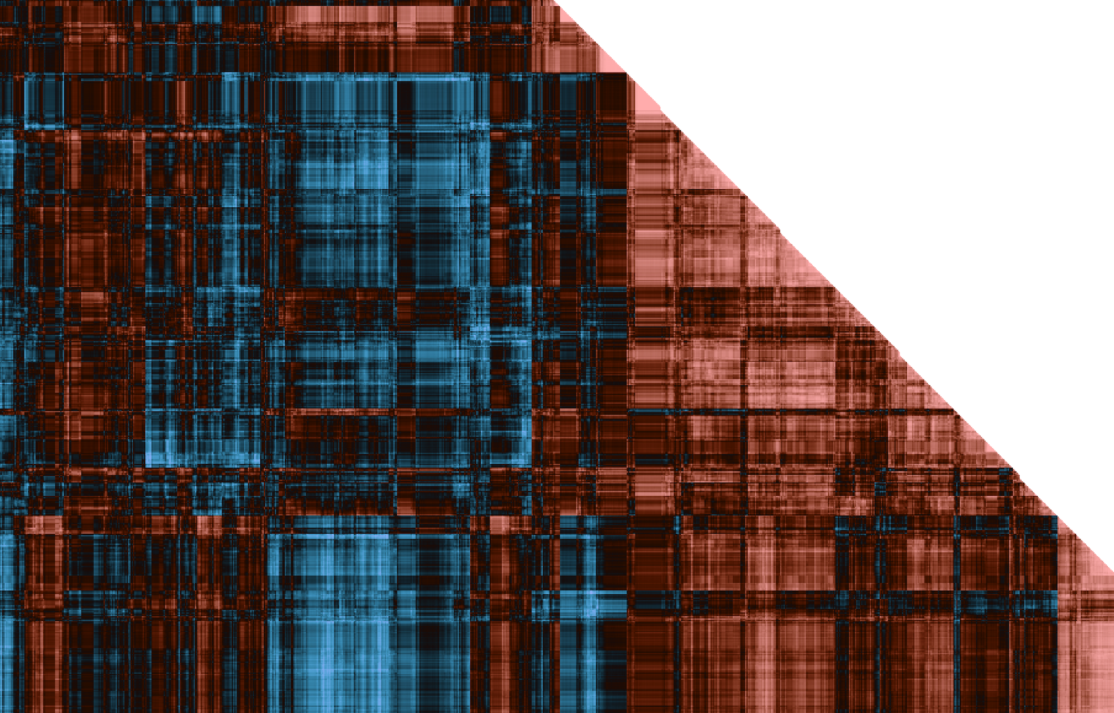

Slide 23
Residual Correlation

Slide 24
Eye of Sauron?

Slide 25
Is there a limit?
It appears entirely possible computationally to jointly model every species on Earth (for which we have data)
Currently not feasible (probably) for reasons unrelated to computation
Data Quality
Missing Data
Relevant environmental variables
Species traits
But, why not be ambitious?
Ecology is an important science, we need more large-scale global efforts
Collaborate with Big Business?

Slide 26
Next Steps - Deep Learning Model
Conditional Variational Auto-encoders (CVAEs)
Find a latent representation of the data, but can include predictors (the “conditional” part)
Originally developed for image analysis, which are extremely high dimensional data, so will scale well for ecological or genomic datasets
Allow probabilistic inference, so able to measure uncertainty efficiently
I am in the process of implementing this for Joint Species Distribution Models in Tensorflow

Slide 27
