Slide 1
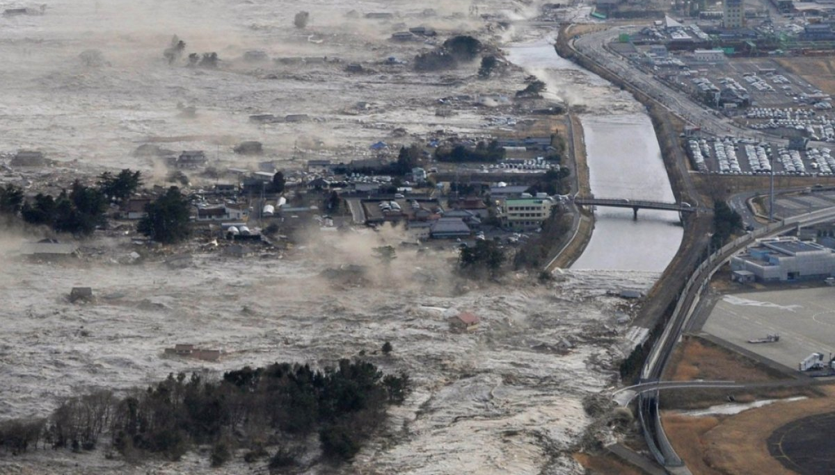
Resolving the tsunami wave: interpreting palaeotsunami deposits by integrating numerical modelling and sedimentology
Jon Hill
Graham Rush, Luke Hodson, Jeff Peakall, Natasha Barlow, Roland Gehrels, Dave Hodgson

Slide 2
Acknowledgements
Dr Sue Dawson
Prof Matt Piggott
Prof Alistair Dawson
Frances Taylor
Charlotte Desmond
Ashley Elliot
Jenna Mohan
Dr Lis Bowman
Dr Georges Kesserwani

Slide 3
Feel free to…
Tweet (@jonxhill)
Take picture/videos
More info:
10.6084/m9.figshare.9771917
https://envmodellinggroup.github.io/

Slide 4
Outline
The sedimentary record and the extreme event
How can we combine models and sedimentology?
Soregga as an example
The future

Slide 5
The sedimentary record and the extreme event

Slide 6
Japan, 2011
Notes:
Kuji port, north end of the main island. North of Sendai

Slide 7
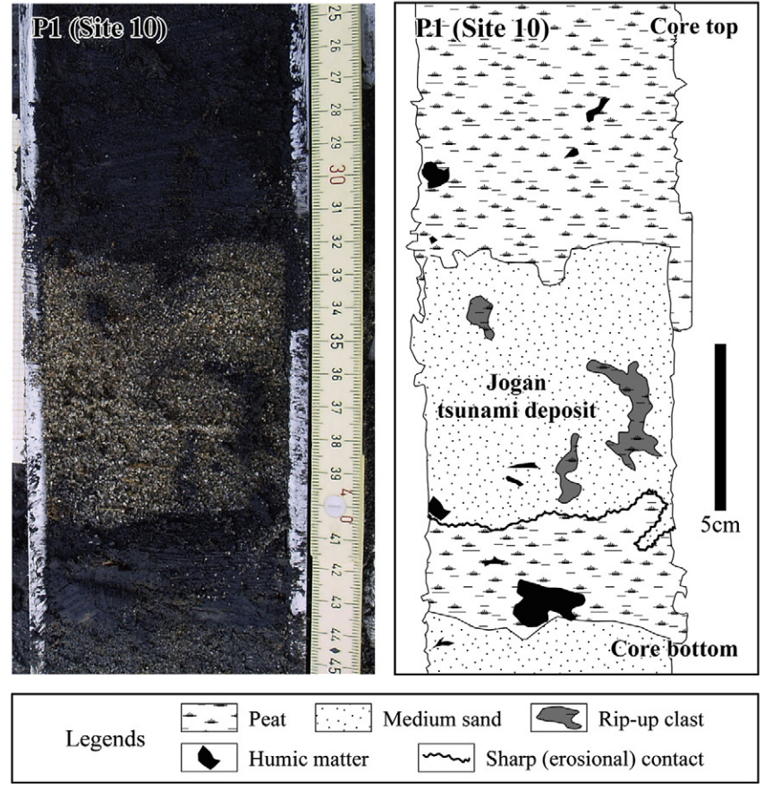
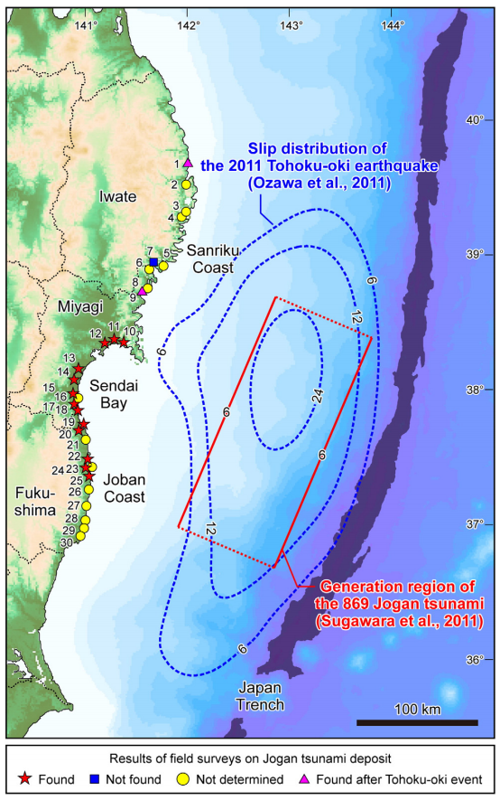
Jogan 869 AD
Sugawara, D., et al. 2012. Sediment. Geol. 282, 14–26.
Notes:
Jogan 869 as a precursor for the 2011 event

Slide 8
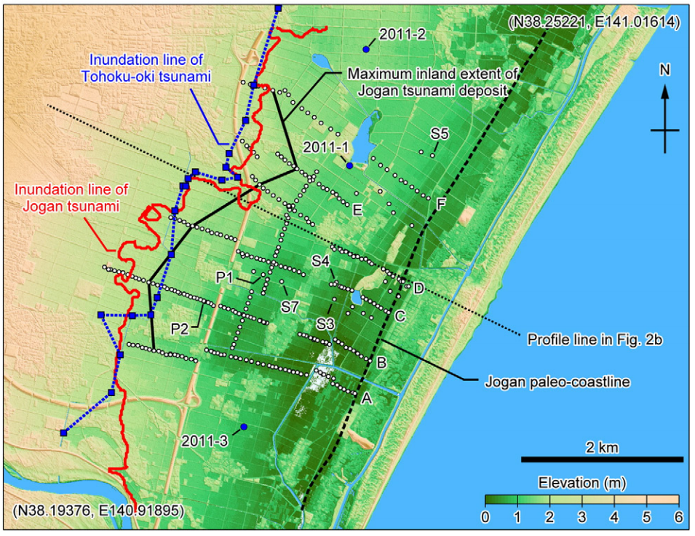
Jogan 869AD
Satake, K., et al., 2008. Ann. Rep. Active Fault Paleoearthquake Res 8, 71–89.
Sugawara, D., et al. 2012. Sediment. Geol. 282, 14–26.
Notes:
Cores and numerical models, Jogan. Make point - there’s no consideration of flow dynamics - just inundation distance

Slide 9
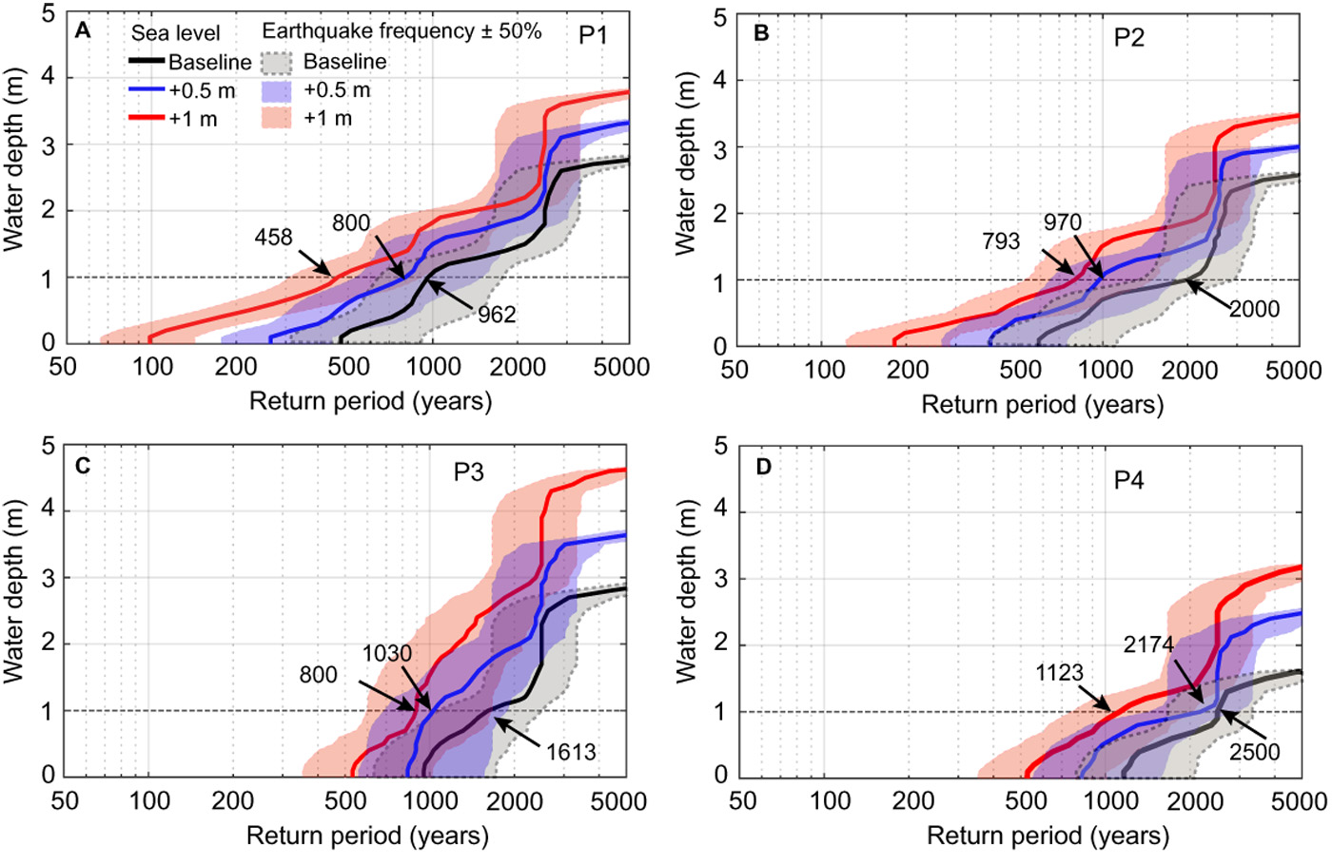
Li, L., et. al, 2018. Sci Adv 4, eaat1180.
Notes:
Rising sea levels will have overwhelmingly negative impacts on coastal communities globally. With previous research focused on how sea-level rise (SLR) affects storm-induced flooding, we show that SLR will also increase both the frequency and the intensity of tsunami-induced flooding, another significant coastal hazard associated with sea-level extremes. We developed probabilistic tsunami inundation maps for Macau, a densely populated coastal city located in the South China Sea, under current sea-level, 0.5-m SLR, and 1-m SLR conditions, using an extensive Monte Carlo tsunami inundation simulation. Our results indicate that conservative amounts of SLR of 0.5 m (by 2060) and 1 m (by 2100) would dramatically increase the frequency of tsunami-induced flooding incidences by a factor of 1.2 to 2.4 and 1.5 to 4.7, respectively.

Slide 10
How can we combine models and sedimentology?

Slide 11
Storegga as an example

Slide 12
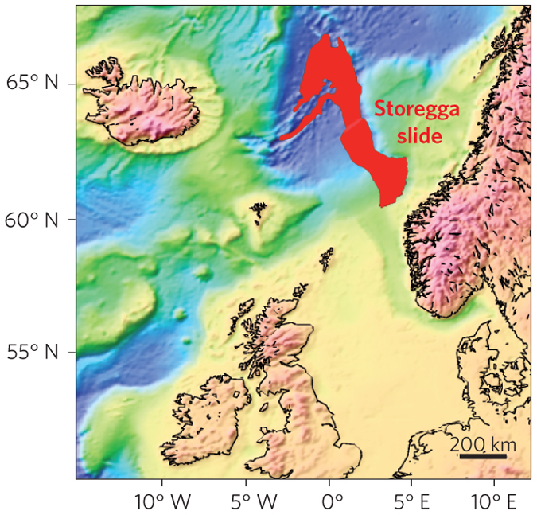
Storegga: largest tsunamigenic submarine slide
3000km³ of sediment.
1-2 degree slope.
Estimated run-ups of 20m in Norway, Faroes and Shetlands.
8150 yr (autumn)
Bondevik et al. (2005)

Slide 13
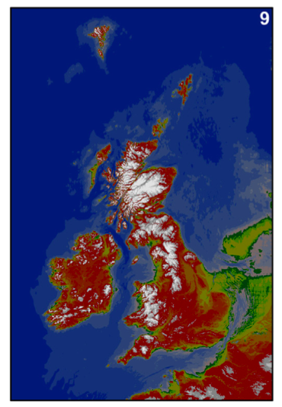
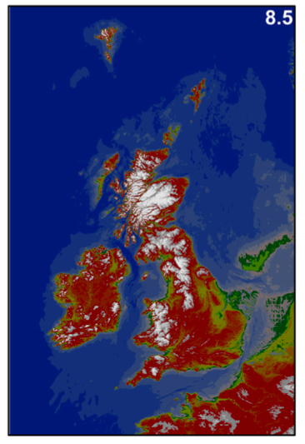
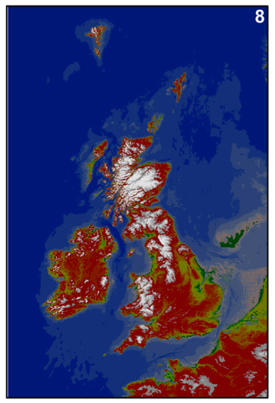
Palaeobathymetric changes
Sturt, F., et al., 2013. Journal of Archaeological Science, 40(11), pp.3963–3976.

Slide 14
Hill, J., et al.2014. Ocean Modelling 83 (0): 11–25.
https://fluidityproject.github.io/

Slide 15
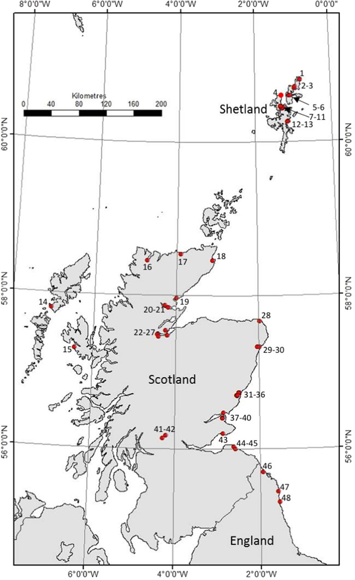
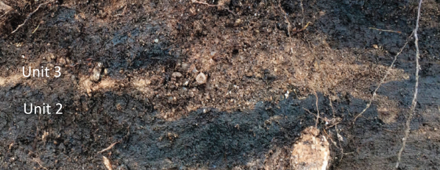
Storegga deposits
Long, A. J, et al. 2016. Journal of Quaternary Science 31 (3): 239–55.
Long, D., 2018. Geological Society, London, Special Publications 456, 143–165.

Slide 16
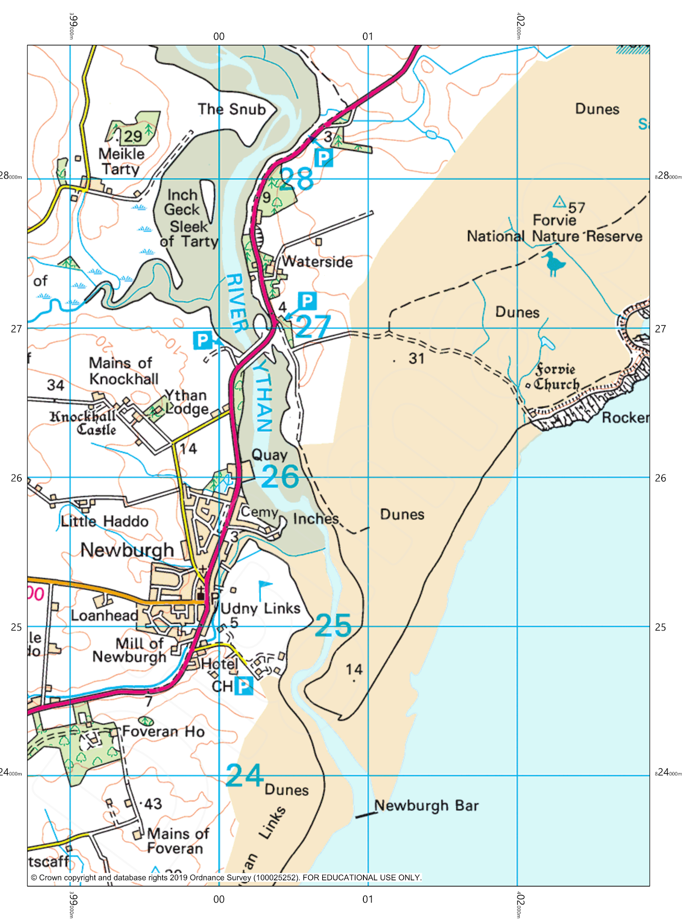
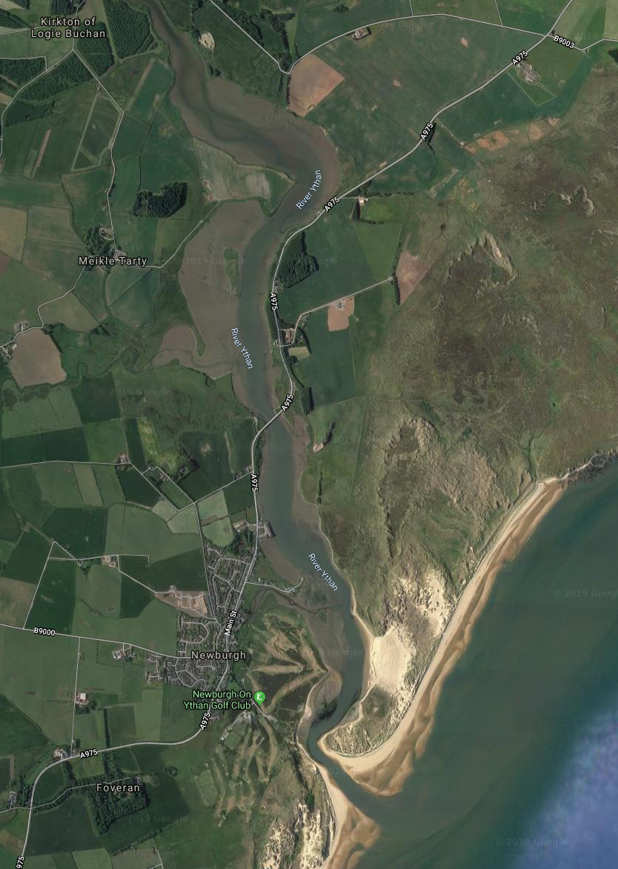
Ythan valley

Slide 17
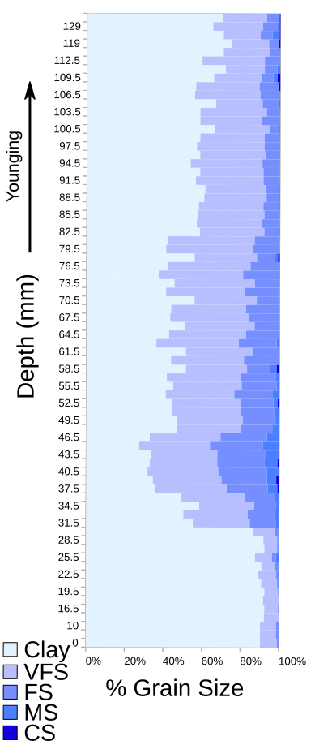
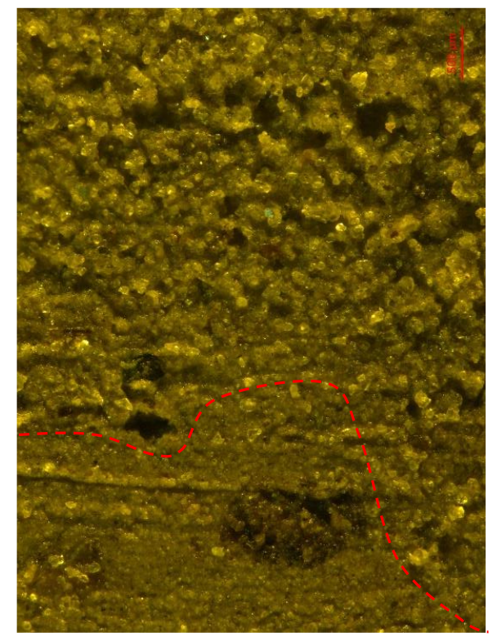
Core A004

Slide 18
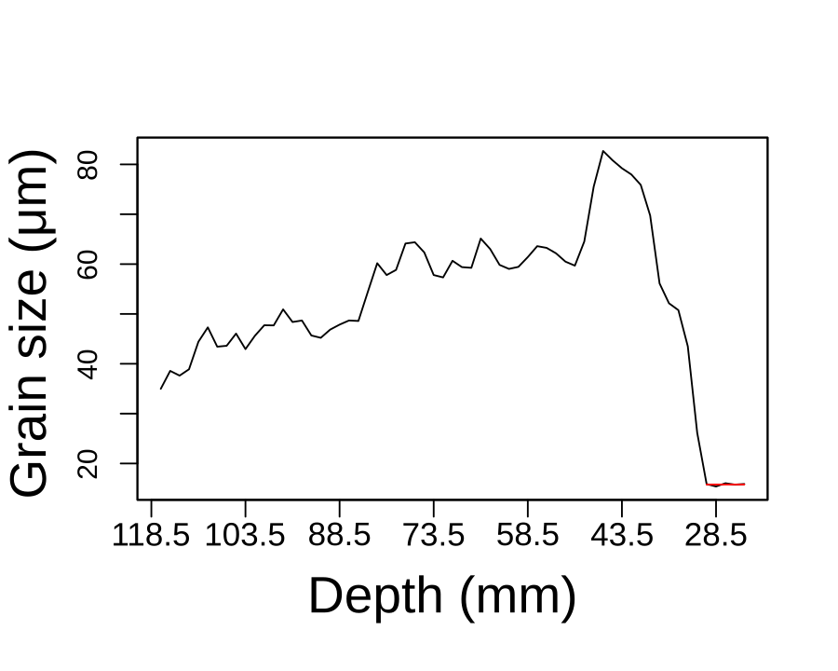
Core A004

Slide 19
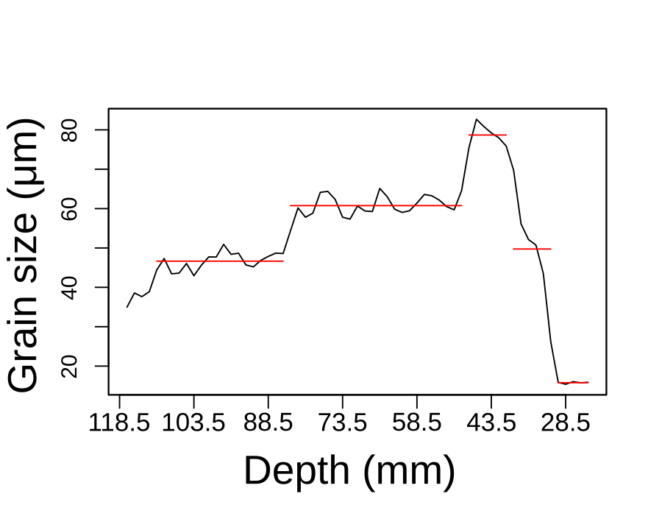
Core A004

Slide 20
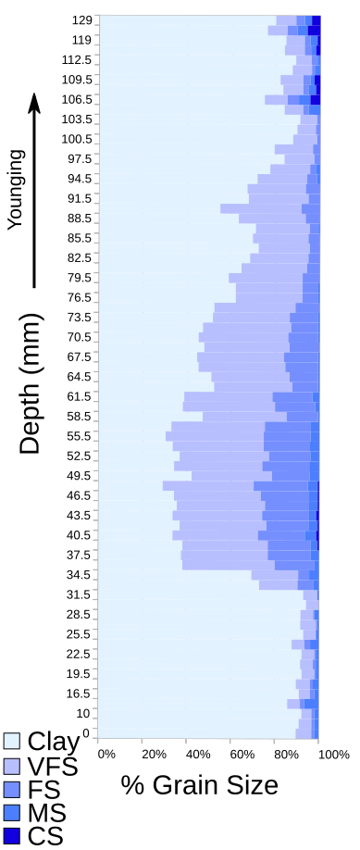
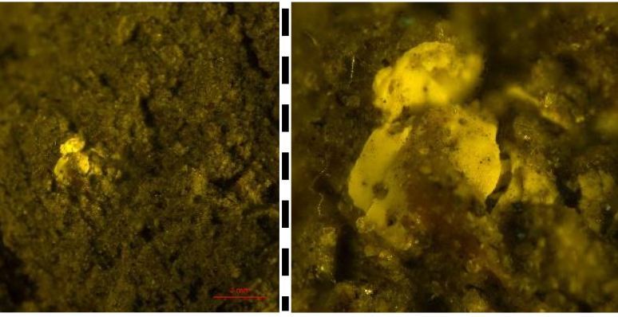
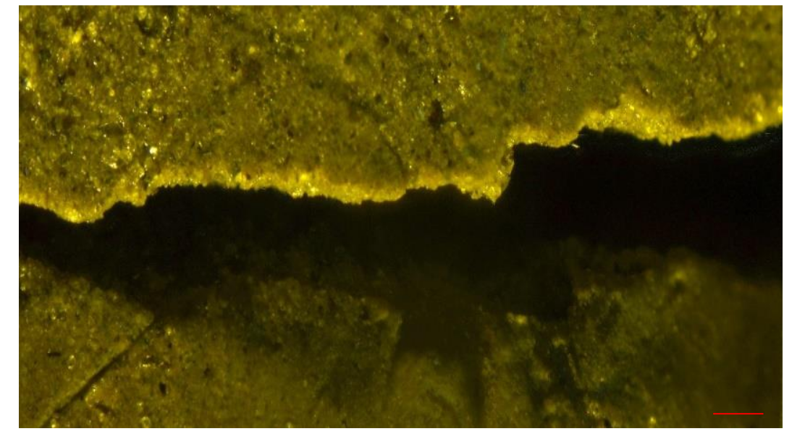
Core B003

Slide 21
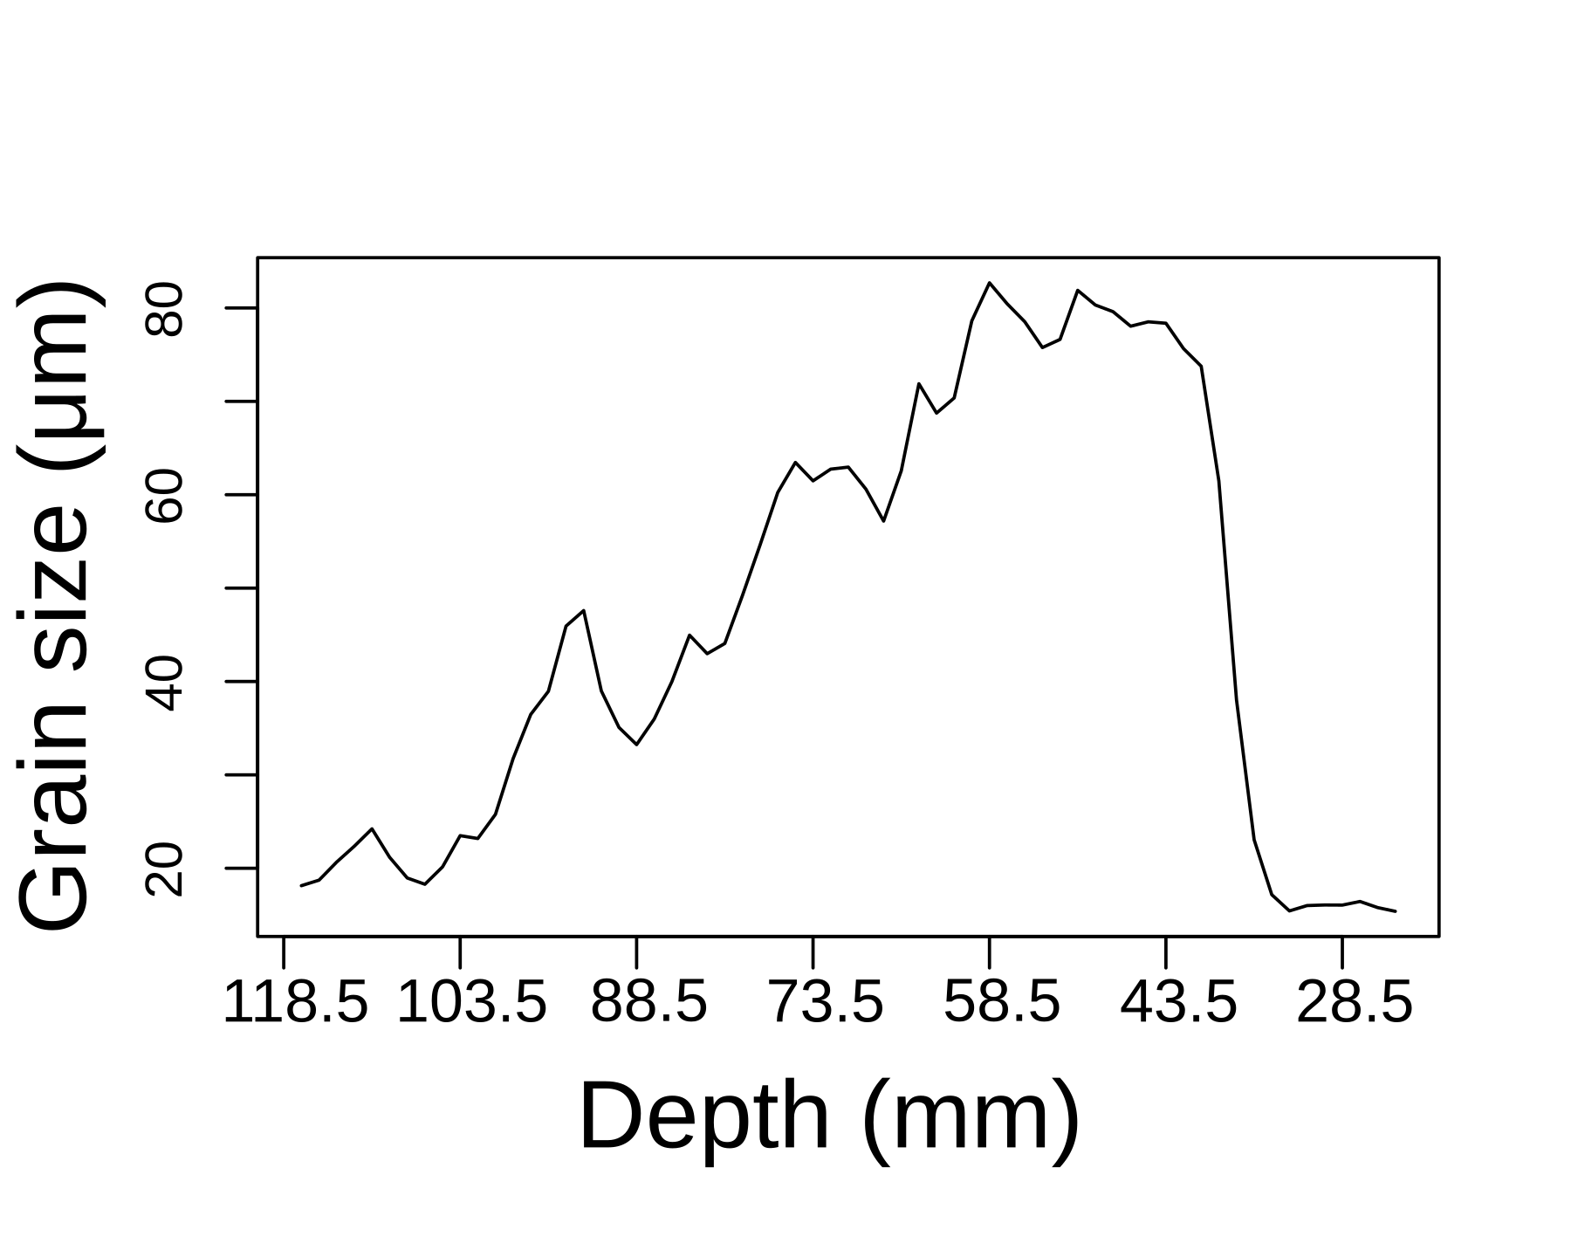
Core B003

Slide 22
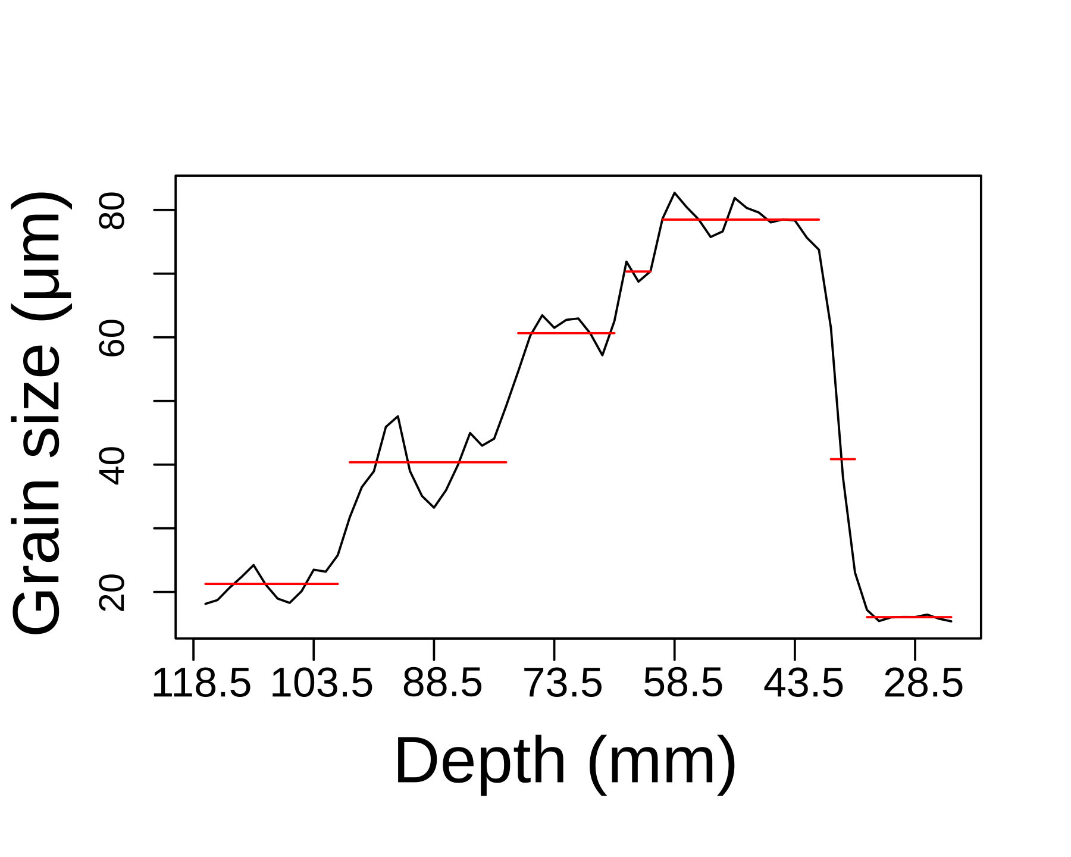
Core B003

Slide 23
Hill, J., et al.2014. Ocean Modelling 83 (0): 11–25.
https://fluidityproject.github.io/

Slide 24
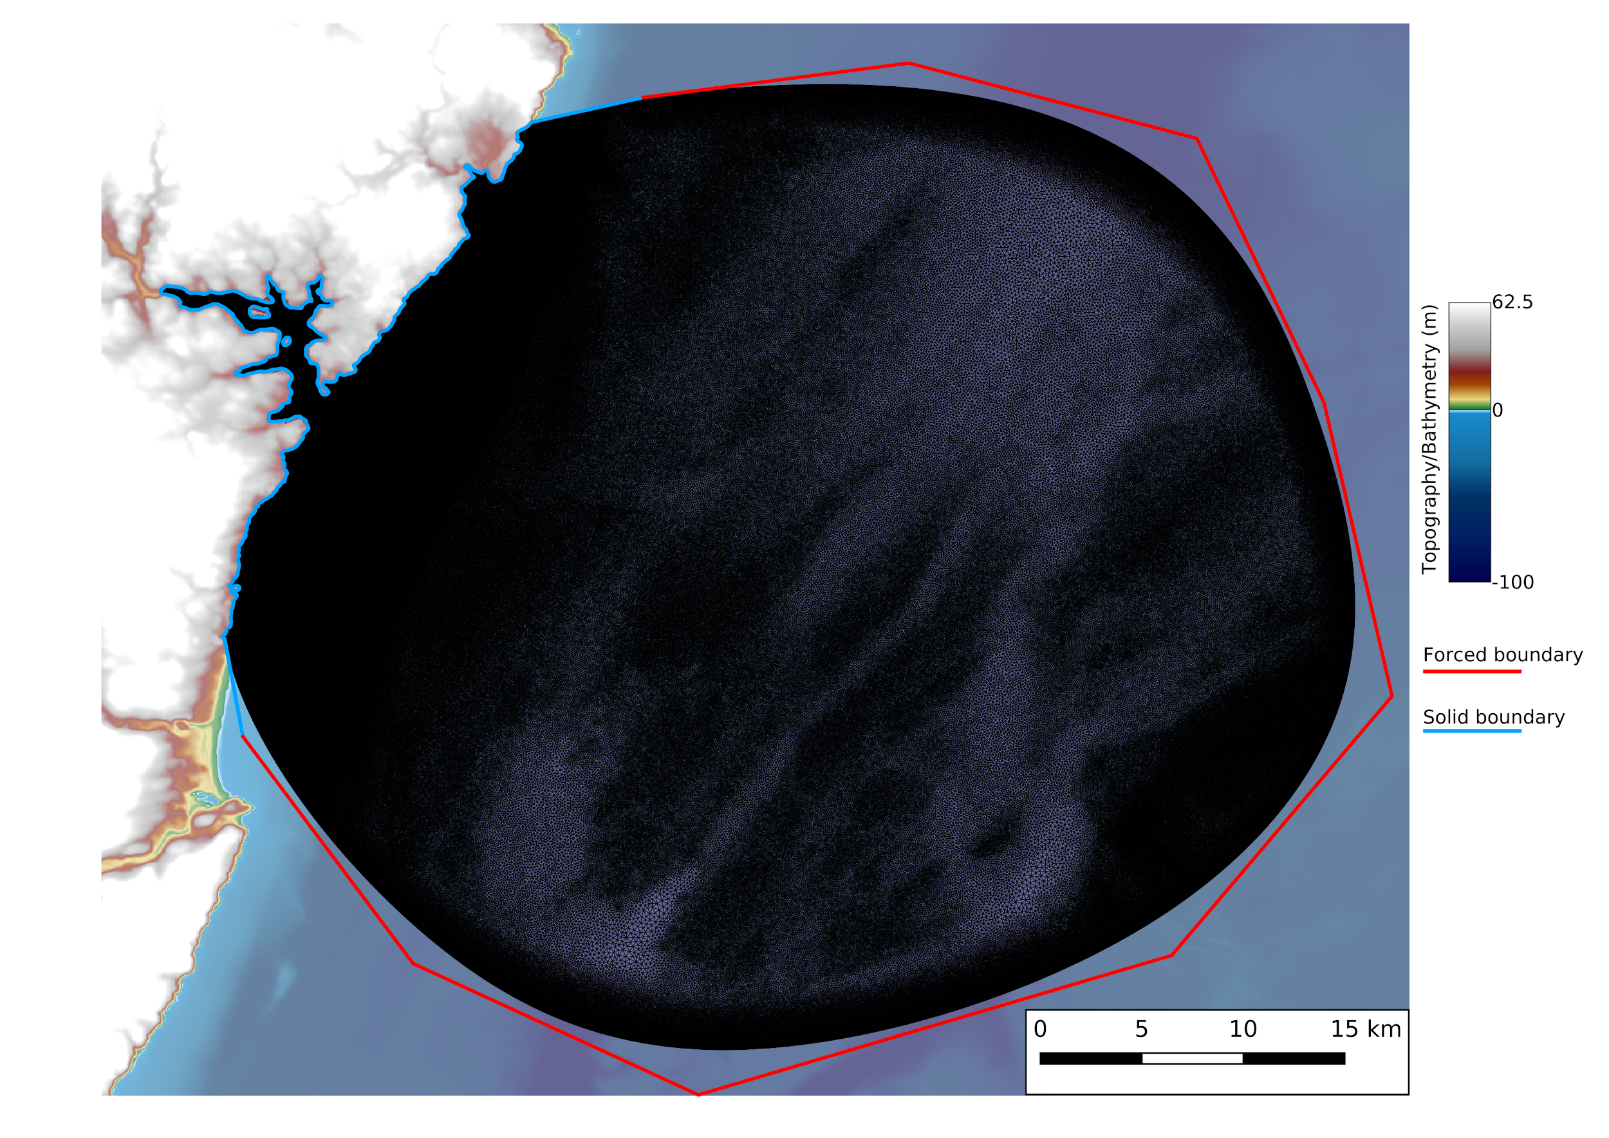
https://thetisproject.org/
github.com/EnvModellingGroup/hrds
Hill, 2019. 10.21105/joss.01112

Slide 26
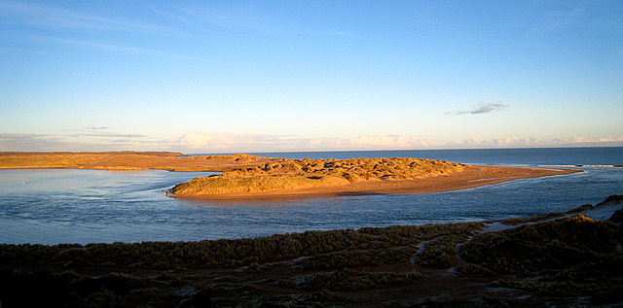
Palaeo-geomorphological reconstruction

Slide 27
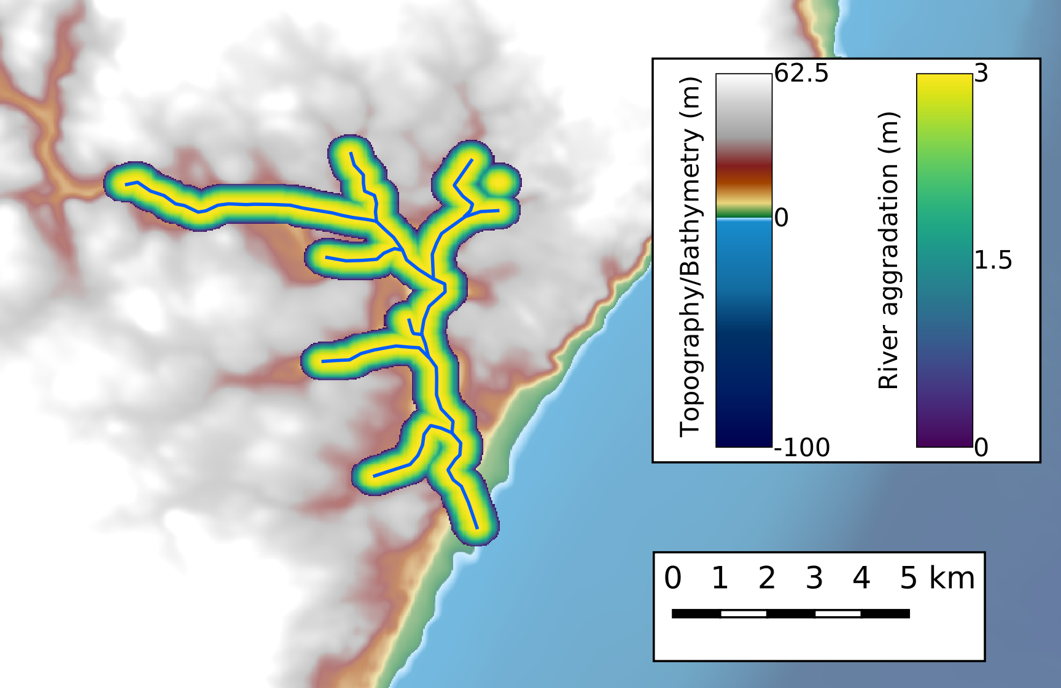
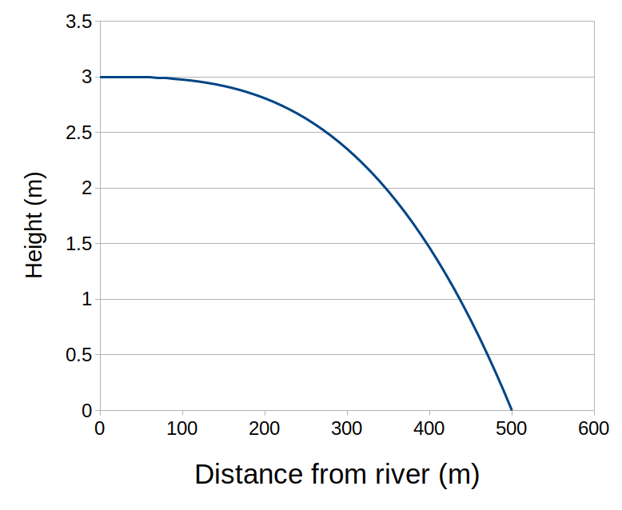
Palaeo-geomorphological reconstruction

Slide 28
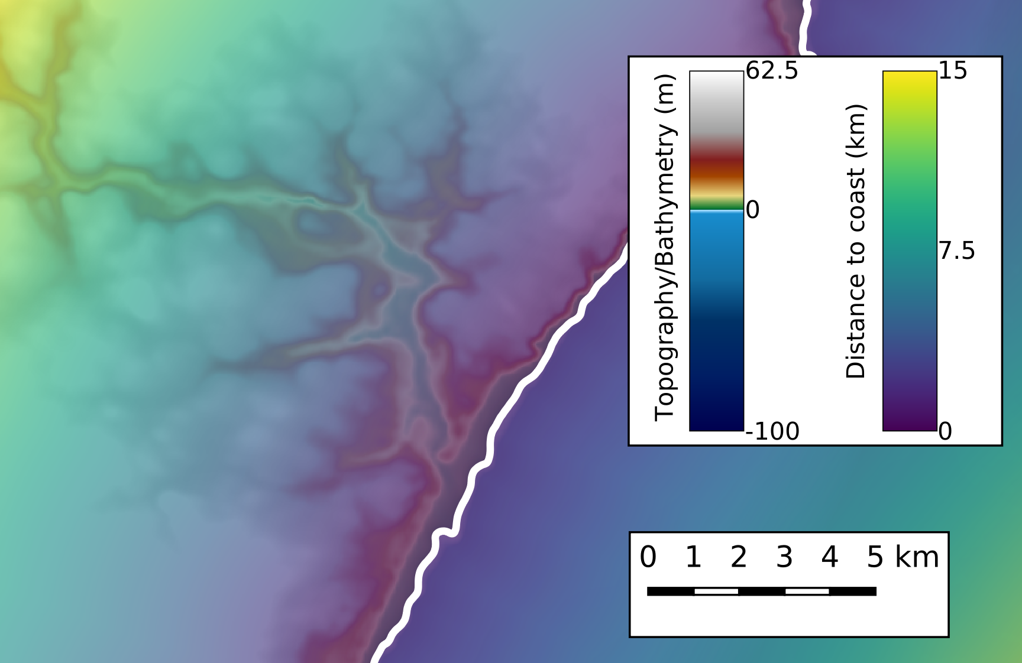
Palaeo-geomorphological reconstruction

Slide 29
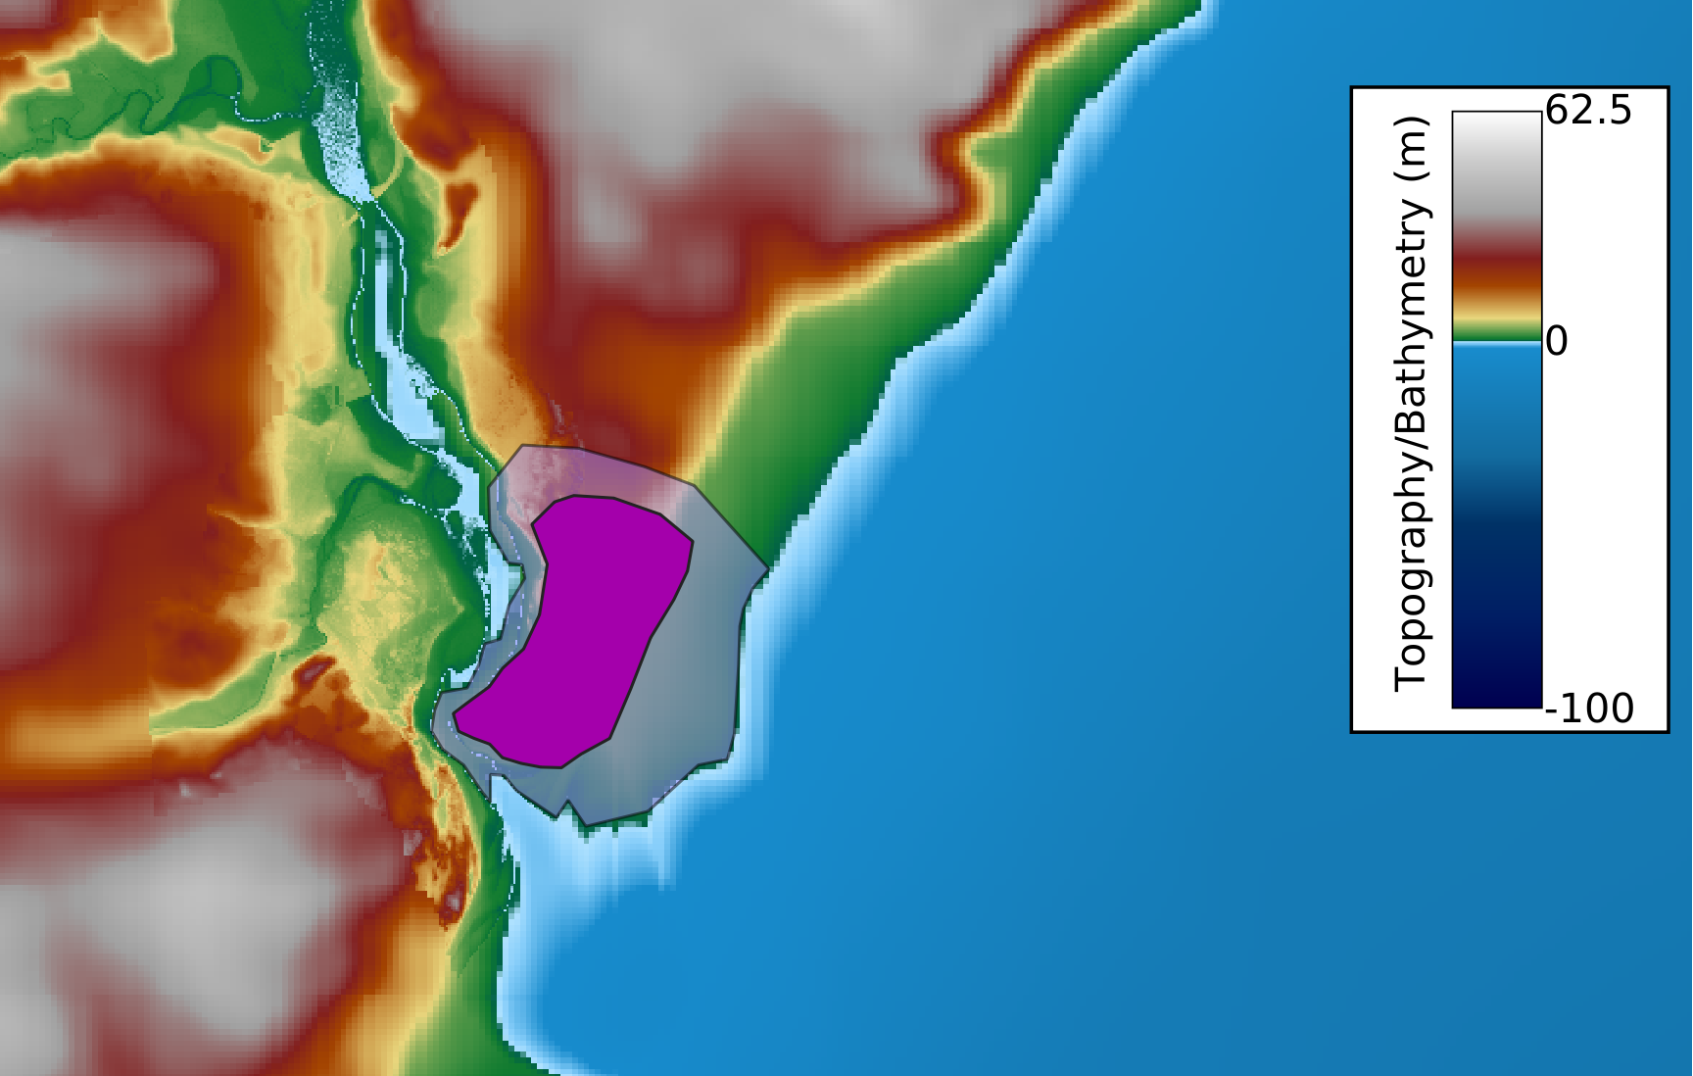
Palaeo-geomorphological reconstruction
Sands of Fovrie formed ~6 ka
Assume area was estuary 8 ka
Remove sands and smoothly blend to bathy/topo

Slide 30
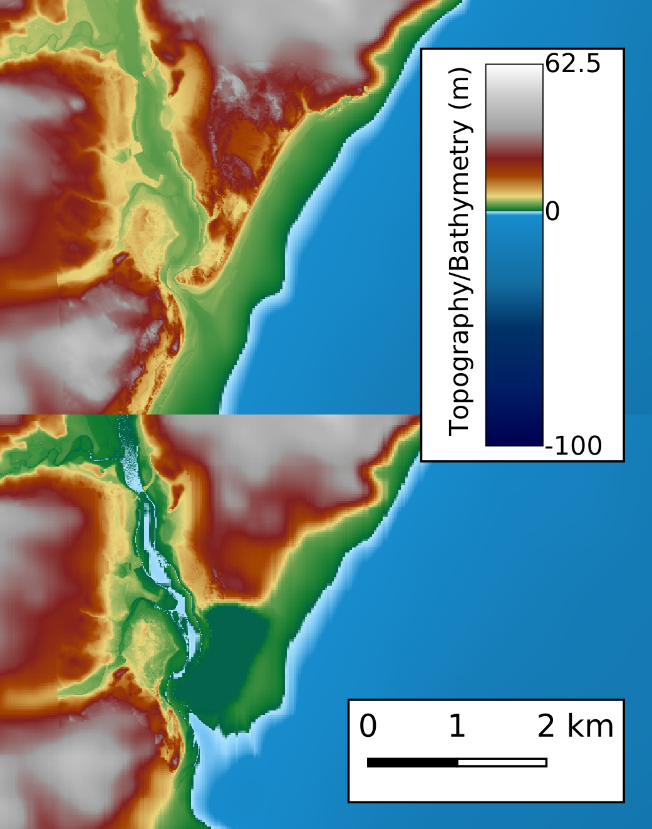
Remove river aggradation
Remove spit and sand dunes

Slide 32
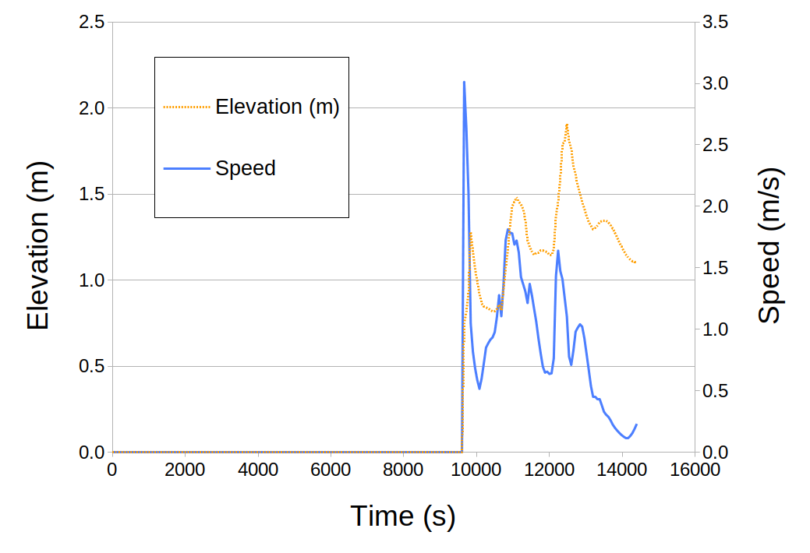

Slide 33
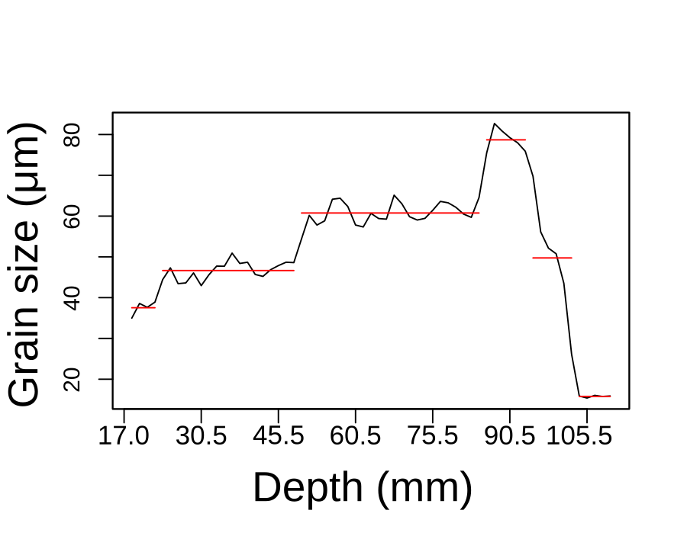

Slide 34
The future

Slide 35
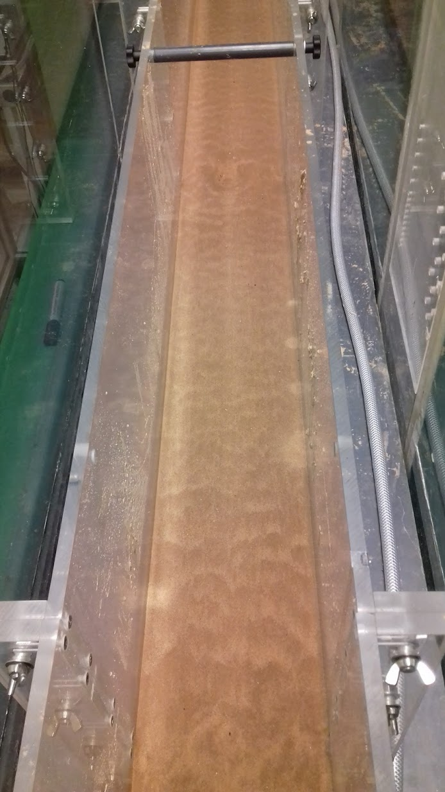
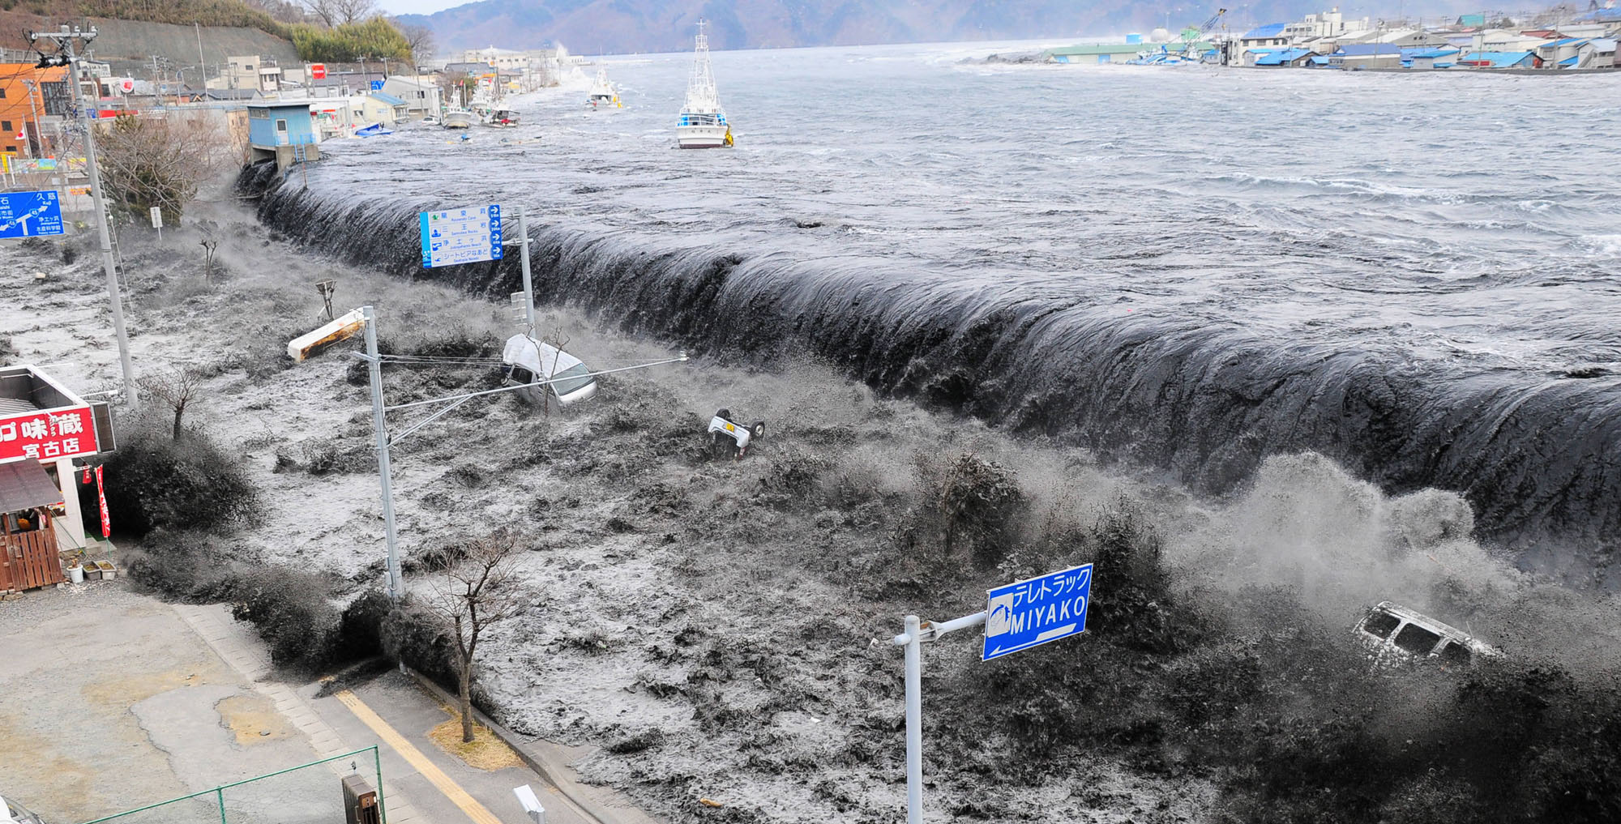
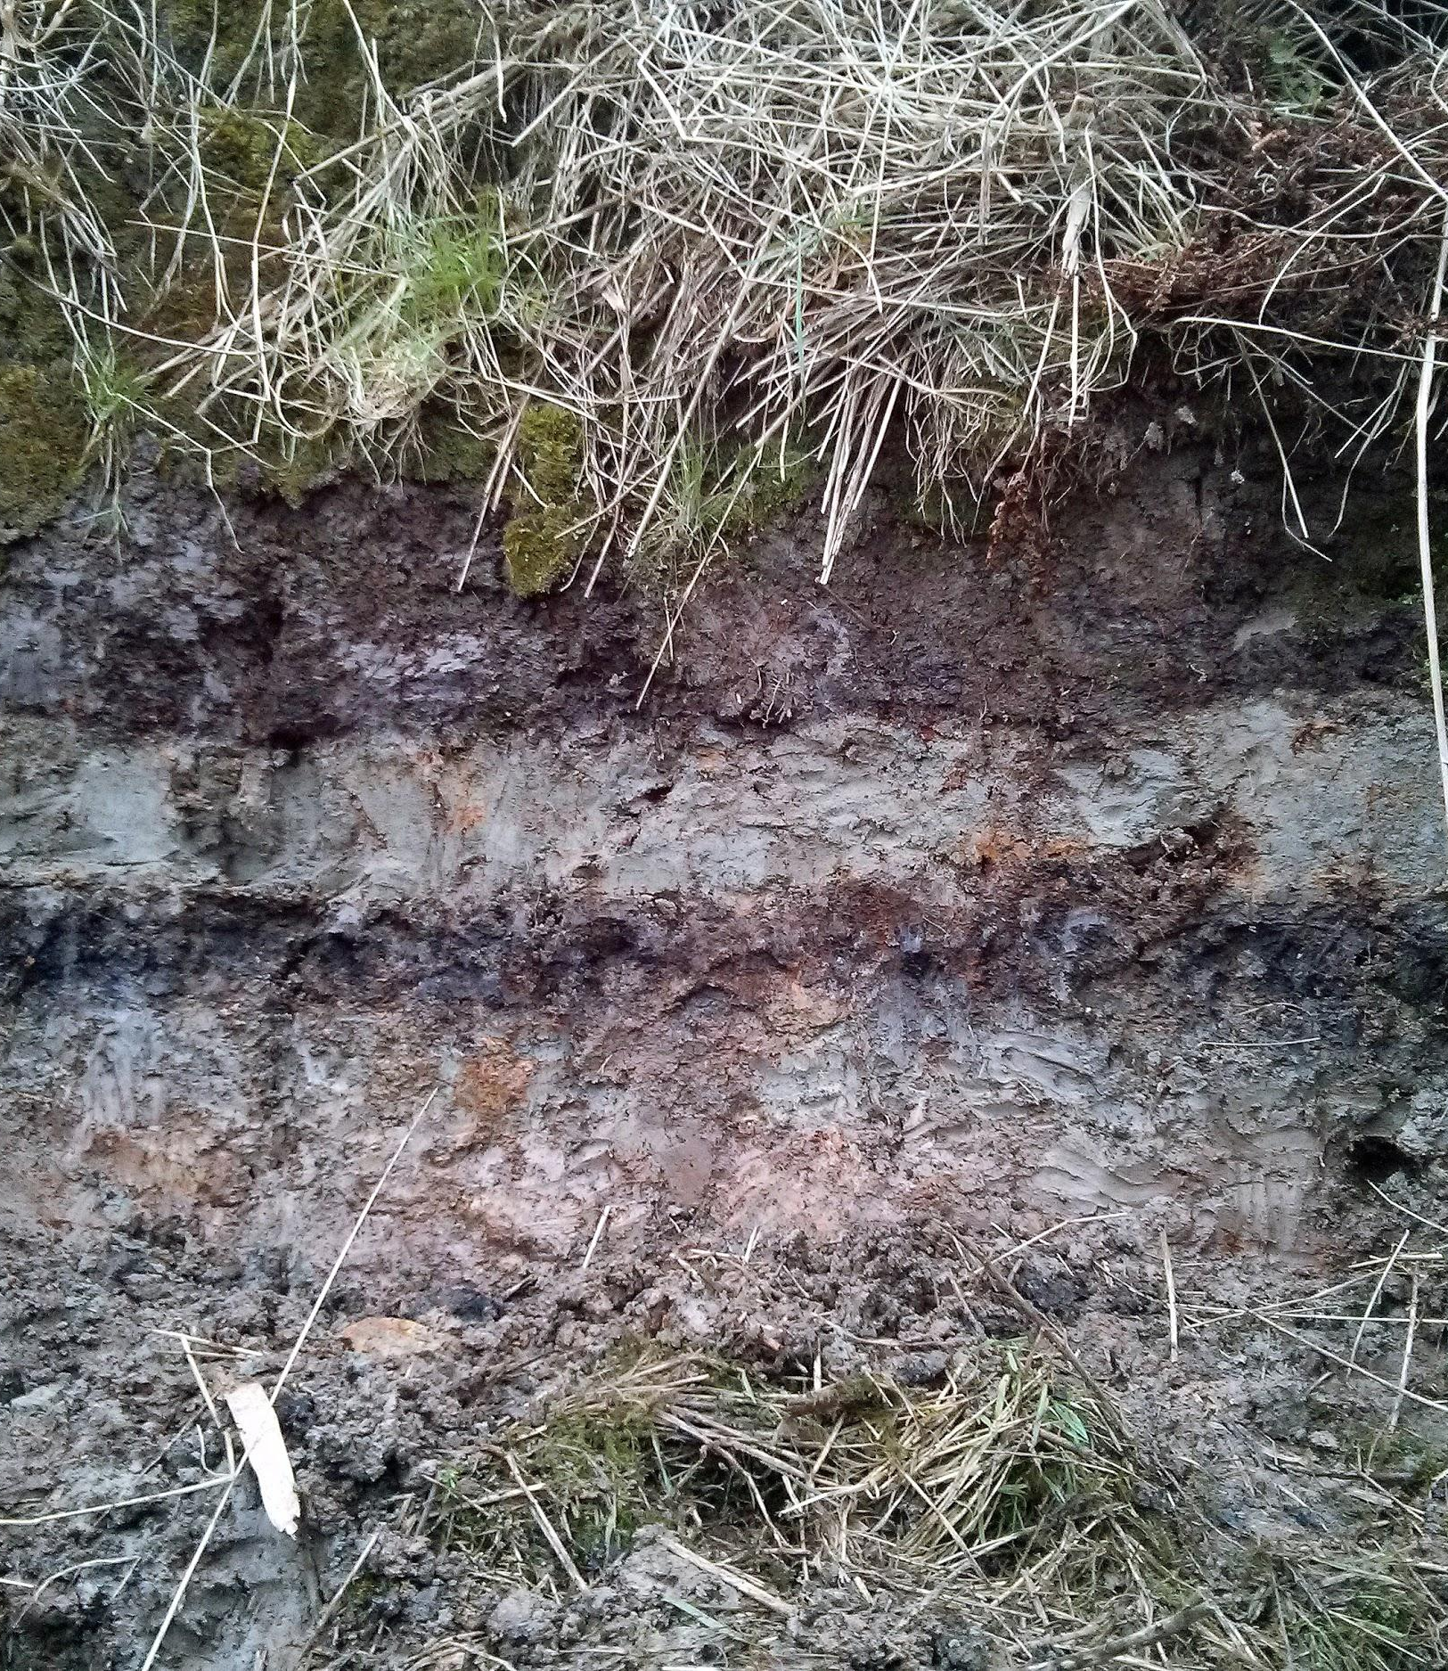
Joining forces
Lab
Lab-scale models
Field
Regional models
Machine learning

Slide 36
Joining forces
Lab
Lab-scale models
Field
Regional models

Slide 37
Joining forces
Machine learning
Lab
Lab-scale models
Field
Regional models
Machine learning
Notes:
Needs collaboration between social scientists interested in risk, mathematicians, sedimentologists, sea level change, coastal geomorphologist

Slide 38
Summary
The sedimentological record is crucial to capture the extreme events
We can combine numerical modelling and sedimentology to gain insight into palaeo-extreme events
Work in the Ythan valley shows one large wave which consists of three pulses
To move forward we need to work collaboratively, combining established methods with cutting-edge numerical technology

