Slide 1
VIVO Ontology Version 2
Michael Conlon, University of Florida, Violeta Ilik, Columbia University, Brian Lowe, Ontocale SRL, Christian Hauschke, Technische Informationsbibliothek (TIB), Marijane White, Oregon Health Science University,
Muhammad Javed, Mastercard Inc, Naomi Braun, University of Florida

Slide 2
Why? What? How?
Why
Improve representation of scholarship -- breadth, depth, consistency
Address technical debt, licensing, methodology, use of other ontologies
What
A new ontology, with related ontology modules, based on BFO and developed in accord with OBO principles
Tools, documents, and training to work with the new ontologies.
How
Open, multi-year effort to develop, test, and implement the new ontologies in the VIVO software, upgrade existing data, document, and train

Slide 3
Why now?
VIVO Development has a goal of “decoupling” various components of the VIVO environment. The current software is heavily dependent on the ontology. Future interface software will operate from a decoupled index easily populated from any ontology.
The VIVO Ontology Interest Group has been meeting for more than a year to identify issues related to the ontology. Implementing incremental changes to the ontology is difficult in the current VIVO environment. It was last attempted in 2013 with significant difficulties. A full scale version upgrade to the ontology can be planned years in advance to include all the change management required.
Ontological practice has matured significantly in the 12 years since the VIVO ontology was created. Best practices can be implemented to significantly improve the ontology and its related modules.

Slide 4
Adopting BFO and the OBO Foundry
The Basic Formal Ontology (BFO) is a small, upper level ontology that is designed for use in supporting information retrieval, analysis and integration in scientific and other domains.
VIVO mostly adopted BFO in 2012 and is listed as an ontology using BFO. Work remains on the subsumption hierarchy to fully adopt BFO.
VIVO is listed in the OBO Foundry, but does not comply with OBO standards, most notably full adoption of numbered class names.
VIVO uses the Ontology Development Kit and most notably robot, an ontology tool that provides templating, reasoning, SPARQL, term extraction, and other functions helpful in building consistent ontologies at scale.

Slide 5
Relation to other ontologies
Ontologies are based on different upper ontologies, introducing inconsistencies
Ontologies are often not well-maintained
Licenses for other ontologies may not be clear, or may restrict some use
Much great work has been done across many projects. VIVO needs a consistent, well-maintained set of ontologies to represent scholarship. VIVO intends to capitalize on this great work to build consistent, well-maintained ontologies to represent scholarship.
VIVO ontology 2 will contain assertions regarding the relationship between terms in the VIVO ontology and those in other ontologies.

Slide 6
Ontologies used, referenced, modules
Version 1
Used
bfo, ro, iao, ero, skos, bibo, vcard, event, vitro, geo, ocre, ocresd, ocres, ocresp, fabio, c4o, cito, DC terms, vann, vocab, swo, vivo-sr
Referenced
None
Modules
local
Version 2
Used
bfo, ro, iao, ero, obi, time, skos
Referenced
cro, swo, bibo, vivo 1, cito
Modules
local, org, lang, ado, fast, gaz, journal, rao

Slide 7
People
Version 1
foaf:Person
Many types
Version 2
Person is a Material Entity
No types
Many roles

Slide 8
Organizations
Version 1
foaf:Organization
21 types
Organization ontology in the VIVO ontology
No data provided
Version 2
Organization is a Material Entity
Few types
Roles, dispositions, functions
ORG ontology module distinct from VIVO
90,000 organizations provided based on GRID and ROR

Slide 9
Concepts
Version 1
skos:Concept
Some entities are concepts
No data provided
Version 2
skos:Concept
No entities are concepts
FAST vocabulary ready to use with VIVO

Slide 10
Scholarly Works
Version 1
Several types based on BIBO
Little to no coverage the arts
Authorship model with non-informative relationships
Version 2
Many types based from many ontologies
Arts and the Humanities
Improved representation of software, databases, protocols, ontologies, and other artifacts of scholarship
Contributorship model with roles and standard BFO relationships

Slide 11
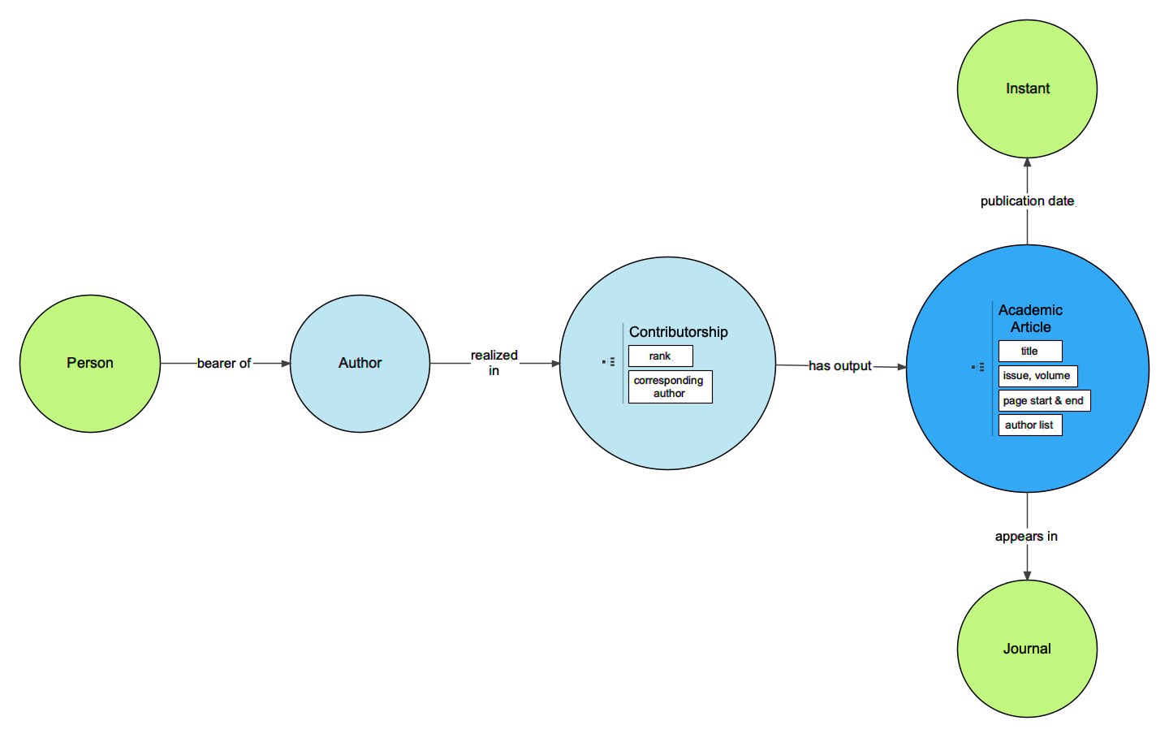
Simplified Representation of Scholarly Works

Slide 12
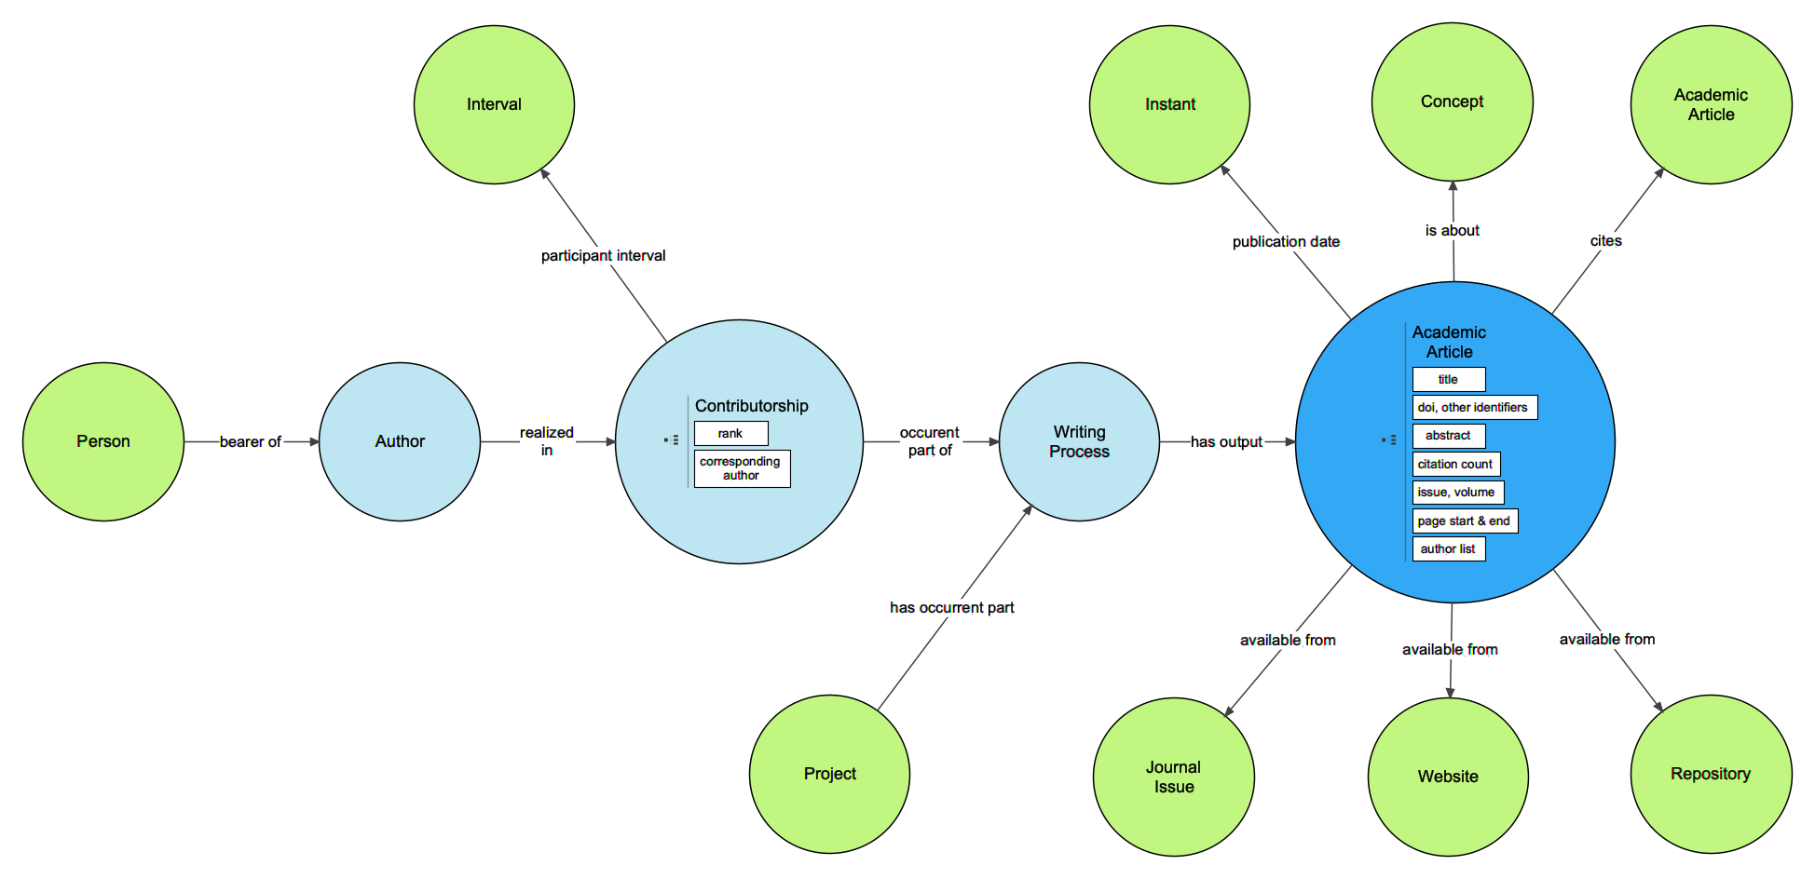
General Representation of Scholarly Works

Slide 13
Languages
Version 1
No languages
Version 2
LANG ontology based on ISO 639 and CEFR
Ability to represent language capabilities of people and organizations
Ability to represent translations
Ability to represent languages of works

Slide 14
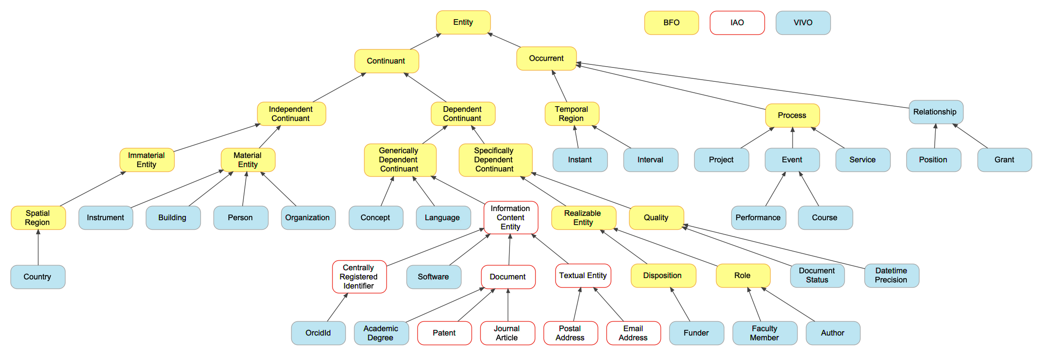
Subsumption Hierarchy

Slide 15
Additional areas of representation
Languages
Research Impact
Data and software
Attribution
Peer review and other services to the profession
Services beyond those to the profession
National modules
Learning objects
Corporate research
Grey literature
Social media
Academic degrees
Location
Collection and curation
Non-academic expertise

Slide 16
Work to Date
VIVO Ontology Version 2 white paper
Early Thoughts on Ontologies used in VIVO
Early Thoughts on Open Ontology Issues and Version 2
Early Thoughts on Related Domains
Early Thoughts on Representing Academic Degrees in VIVO
Early Thoughts on Representing Grants and Projects in VIVO
Early Thoughts on Representing Identifiers in VIVO
Early Thoughts on Representing Language Capabilities in VIVO
Early Thoughts on Representing Organizations in VIVO
Early Thoughts on Representing People in VIVO
Early Thoughts on Representing Roles and Relationships in VIVO
Early Thoughts on Representing Scholarly Works and Activities in VIVO
Early Thoughts on VIVO Subsumption Hierarchy
VIVO Community Ontology Development Repository

Slide 17
More Information
The VIVO Ontology Interest Group meets regularly to discuss the development of ontology for VIVO. See https://wiki.duraspace.org/display/VIVO/Ontology+Interest+Group
Development of the version 2.0 ontology happens here: http://github.com/vivo-community/ontology-dev
The current VIVO ontology can be found here: http://vivoweb.org/ontology/core
For additional references and background, see our poster.

