Slide 1
Troubleshooting Inadmissible & Problematic Solutions
HSE Psychometric School August 2019
Prof. dr. Gavin T. L. Brown
University of Auckland
Umeå University

Slide 2
Trouble-Shooting Summary
Estimation problems are quite common
  Small sample size
  Poor model specification
  Over-factored constructs
Solutions must fit and be theoretically sound
  Remove factors, items
  Use modification indices
Solutions need to be tested
  Alternative structures
  Invariance to other groups
And then we can address the substantive “So What?” question, with good measurements

Slide 3
Inadmissible solutions
Multiple causes of inadmissibility
  Gerbing, D. W., & Anderson, J. C. (1987). Improper solutions in the analysis of covariance structures: Their interpretability and a comparison of alternate respecifications. Psychometrika, 52(1), 99-111.
Causes:
  Specifying a sub-factor of items when participants do not actually make such fine-grained distinctions
    Chen, F., Bollen, K. A., Paxton, P., Curran, P. J., & Kirby, J. B. (2001). Improper solutions in structural equation models: Causes, consequences, and strategies. Sociological Methods & Research, 29(4), 468-508. doi:10.1177/0049124101029004003
  Not having enough items for the factor
    Marsh, H. W., Hau, K.-T., Balla, J. R., & Grayson, D. (1998). Is more ever too much? The number of indicators per factor in confirmatory factor analysis. Multivariate Behavioral Research, 33(2), 181-220. 10.1207/s15327906mbr3302_1
  Not having enough people to generate stable estimates (ideally n>400)
  Too much missing data that has been imputed
  Factors that are too highly inter-correlated

Slide 4
  Negative Error Variance
Also known as a Heywood case
  When the minimum of the discrepancy function is obtained with one or more negative values as estimates for the variance of the unique variables.
Explaining more than 100% of variance causes the error to be less than zero (negative). NOT logical or acceptable.
Solutions:
  Remove offending factor and have items predicted by higher-order factor
  Subordinate the factor to the other factor
  Fix value to small value >0.00 (e.g., .005) if 2*se includes 0.00

Slide 5
A Useful Application of CI logic: Negative error variance
What if a point estimate is negative when in reality it should be positive?
  If the residual is estimated to be -0.10 this is a violation of reality because we cannot explain more than 100% of variance
  But if the se is 0.06, then it is possible the TRUE value of the residual is NOT negative
    -.10 + (2*.06)=.02
    Hence, it is possible to overcome this problem by fixing the residual to a small positive value (e.g., .005)
    But do this only if other studies clearly indicate the value is not reported as negative

Slide 6
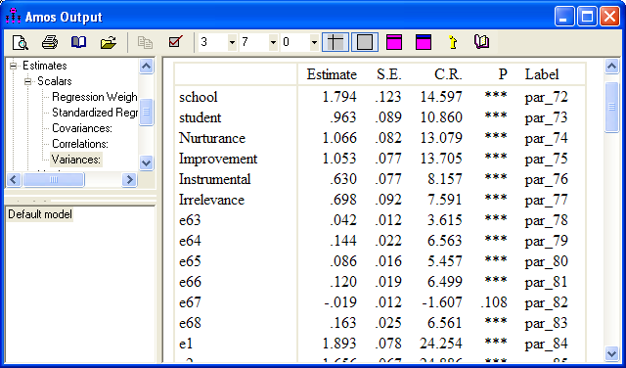
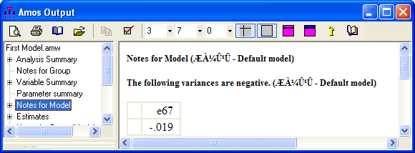
Fixing a negative error variance
  If 2 standard errors (se) are greater than observed value, it is highly likely (95% CI) that the TRUE value is not negative. Hence, it can be fixed to .005. If previous studies have shown that the value is normally >0.00
  Do structural causes explain why variance might be negative? Was it negative in other study conditions?

Slide 7
Error Variances Fixed @.005 ➔ Admissible Solution
NB. When only 1 predictor explained will be .995 (≈1.00)

Slide 8
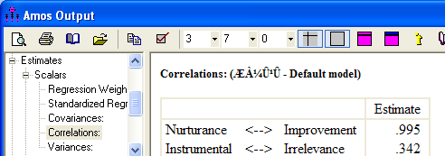
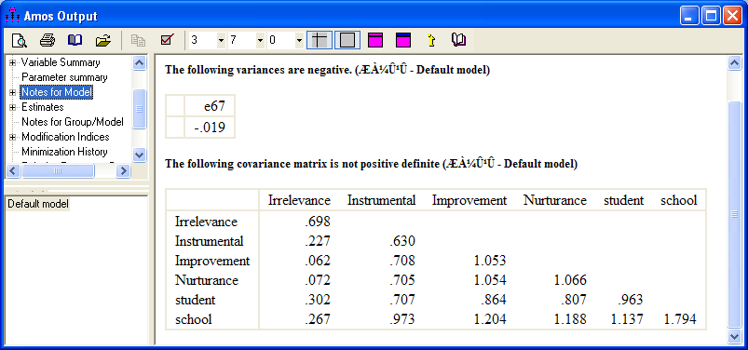
Not Positive Definite
When ALL eigenvalues (the diagonals) in a matrix are NOT >0
  At least 1 factor is linearly dependent on another (collinearity)
  This can be extremely difficult to identify and solve
  Here at least 2 causes exist: over-correlation of factors + negative error variance

Slide 9
Fixes for Nonpositive Definite Covariance Matrices
Goal:
  Keep the same theoretical framework so that the analysis tests your theory
  Not just dredging through data to discover fixes
    Too much chance in that process

Slide 10
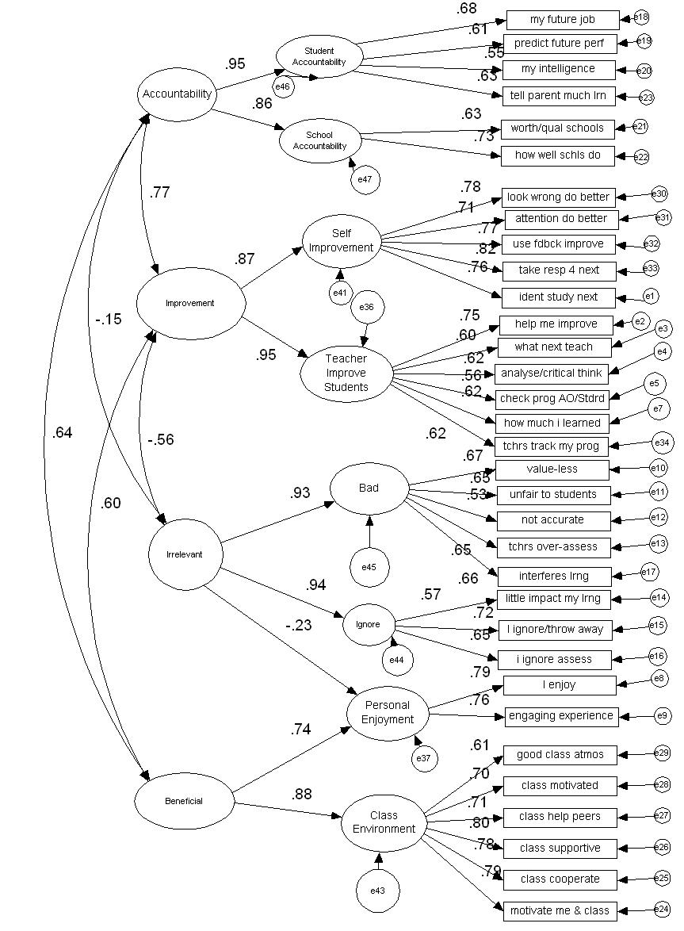
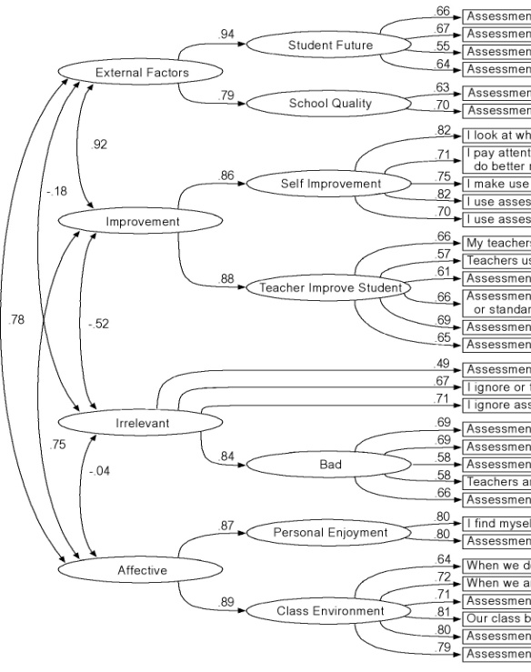
Resolving Inadmissible Solutions
Reduce the number of factors by joining the factors which are linearly dependent
  Remove a sub-factor and join the items to the first factor
    The meaning remains the same (just lose some precision)

Slide 11
Resolving Inadmissible Solutions
    Make an over-correlated factor into a sub-factor of the other
Before After
very high correlation a dependent regression

Slide 12
Resolving Inadmissible Solutions
Small Samples problematic
Admissible (N=82)
Remove sub-factors
Join highly correlated factors
Keeps interpretation similar
This approach necessary especially when N is low.
Inadmissible N=82
error variances <0.00 + correlations >1.00

Slide 13
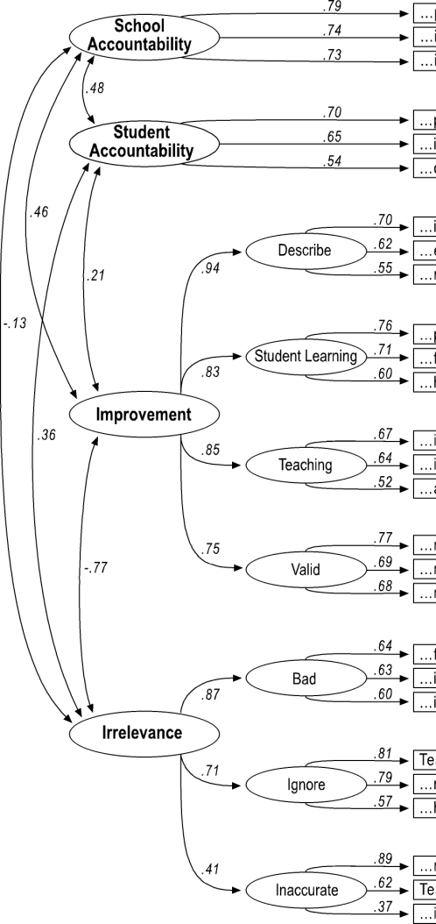
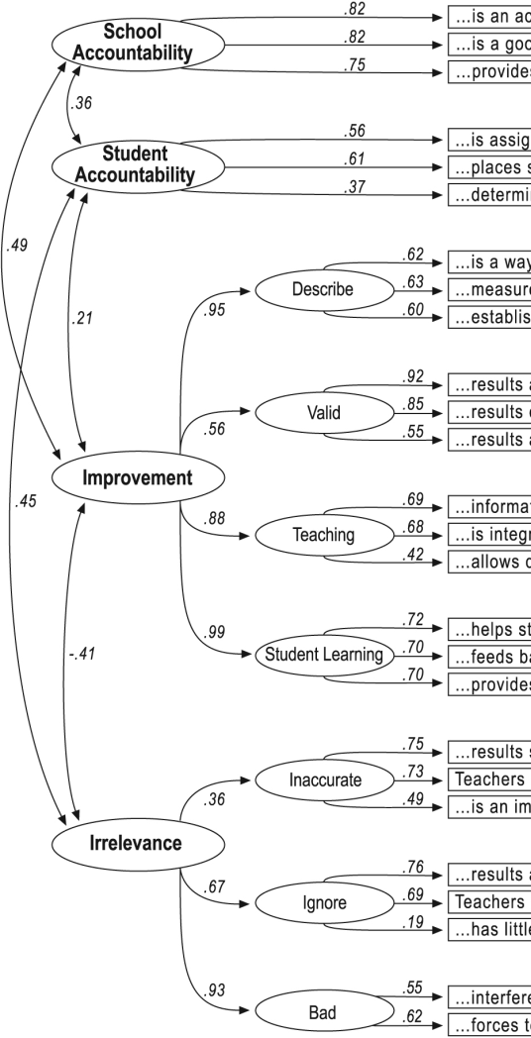
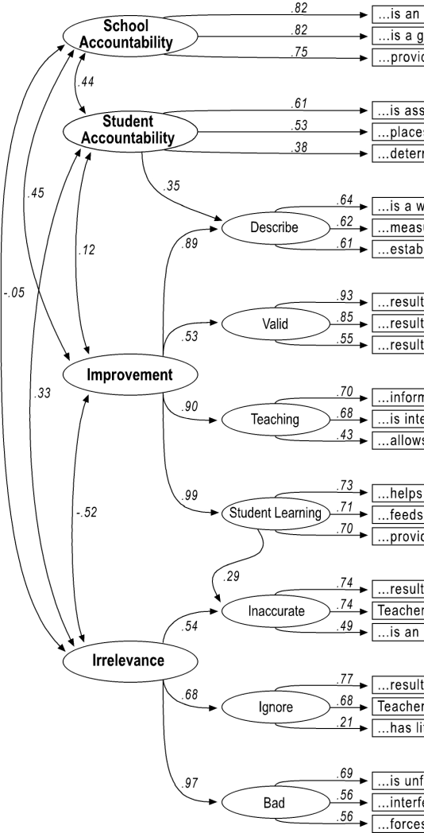
Resolving Inadmissible Solutions
Base Model
(did not fit a new group)
Alternate Model 1: Remove problematic item
Alternative Model 2: Add paths
PS. Both revisions worked

Slide 14
Resolving Inadmissible Solutions
Parcel factor into a single variable and pretend that it was measured directly
8 items, 2 factors becomes 2 correlated variables when n reduces from 86 to 20.
Note the similar correlation.

Slide 15
Improving Fit
If solution is recursive and admissible, but does not fit well, what to do?
  Remove paths and items that are not statistically significant
  Remove items that have high attraction to logically inappropriate factors (use the modification indices to identify those)
  Remove items with weak loadings on their respective factors
  Correlate all the factors with each other
  Collapse factors
  Parcel factors into scale scores

Slide 16
Modification index
Also known as Lagrange multiplier
  an estimated value in which the model’s χ² test statistic would decrease if a fixed parameter were added to the model and freely estimated
  Statistically significant at value of 3.84 which corresponds with 1 df at alpha=.05
  But generally values under 20 make almost no difference to fit indices
  Use the values to identify paths that could be added to make the fit better
    Alternately use the MI to identify paths or items that could be removed.
    Items with large attraction to factors that violate simple structure are candidates for removal
    Items with large attraction to other items within their own set are candidates for deletion
  Highly subjective in decision making: I tend to sum the MI for an item to see which are most problematic. Removing a few items in light of theoretical considerations is the goal

Slide 17
Expected parameter change
EPC indicates the estimated value of a fixed parameter if it were added to a model and freely estimated
  “a direct estimate of the size of the misspecification for the restricted parameters”
  fixed parameters associated with the largest EPC value indicate the most model misspecification
    Must be evaluated in terms of theoretical plausibility and could be freely estimated in the model.
standardized EPC
  invariant to the rescaling of observed and latent variables
  SEPC values for residual covariances between latent variables and between observed variables are standardized using their respective residual variances instead of their variances
  the SEPC tends to outperform the MI when arriving at the correct confirmatory model.

Slide 18
Tweaking models
What to look for?
  Items that have strong sum of MI/SEPC
    These are items that are most mis-specified
    Your theory does not match participant responses
  Items that are highly attracted to multiple factors
    These violate simple structure; Remove these IF and ONLY IF there are sufficient items in a factor to keep a valid factor
  Factors that want to be joined to other factors
    Consider this IF and ONLY IF the path makes some sort of theoretical sense—can you explain it? Make it dependent or correlated
Remember
  Change only if you can explain it with your theory
  Don’t delete items that would destroy a factor

Slide 19
Tweaking models
Model | # manifest variables | df | RMSEA | Gamma hat
Before 3 items removed | 33 | 474 | 0.066 | 0.889
After 3 items removed | 30 | 384 | 0.061 | 0.913
This change reduced the df considerably while increasing the RMSEA somewhat. Consequence is that the model fit for gamma hat is clearly acceptable. Fit is improved.
But does it still mean the same? What did I lose in gaining better fit?

Slide 20
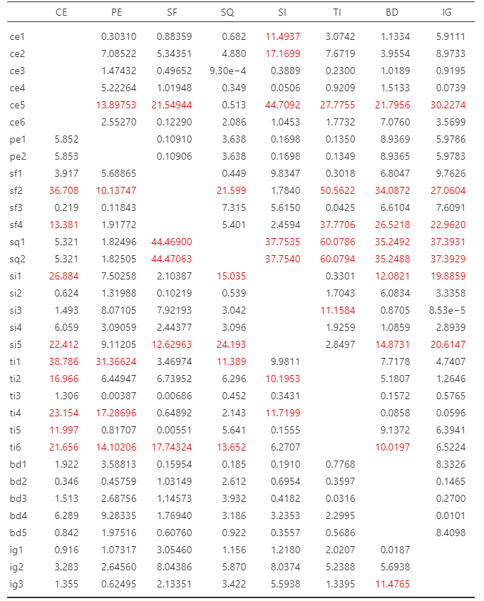
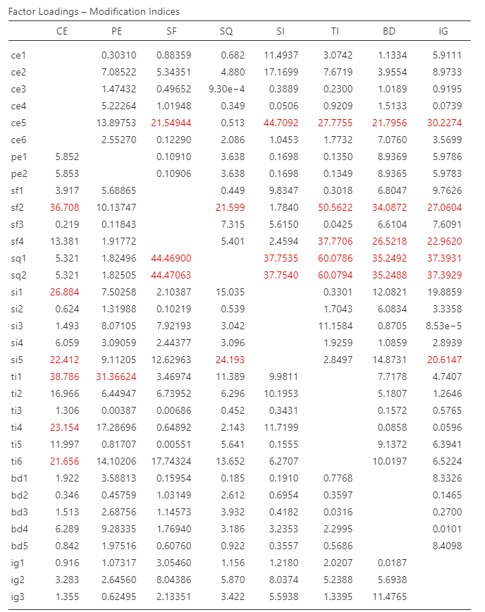
Jamovi: SCoA6
Modification Indices
Default display >10; change to >20 and you will more easily focus on items with big problems
  Examples:
    sq1, sq2 both want to go on lots of factors. It was designed to go with SF, but strongest on TI. So test the alternative models?
    ce5 wants to go with 5 other factors. There are 6 items in the set. Delete ce5? If so, what impact on fit AND meaning?
    sf2 also behaves like ce5. test?

Slide 21
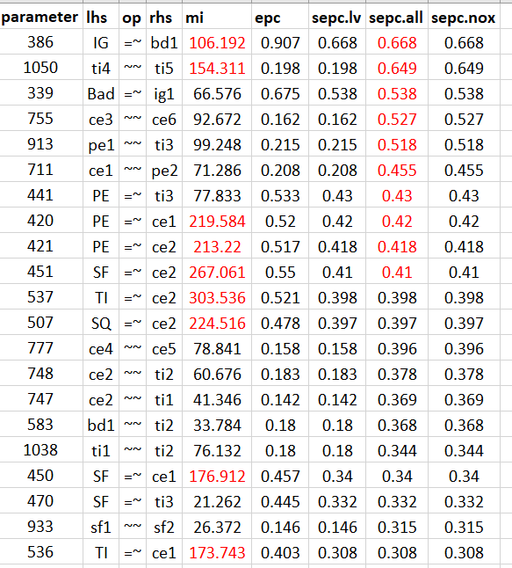
Lavaan MI
Syntax
#displays MI in decreasing order, and print only those that would substantially improve model fit i.e., changes in x2 square greater than 20.00 with df = 1)
  modind_scoawls <- modindices(SCoAwls_fit, sort. = TRUE)
  modind_scoawls[modind_scoawls$mi > 20.00 , ]
  NB: the sort is MI not SEPC, change $mi to $sepc.all
  I transferred data to Excel, highlighted MI down to 100, re-sorted on SEPC.all and highlighted down to .40
  Top problems:
    IG predicts bd1; bd1 violates simple structure
    ti4 correlates with ti5; ti4-5 one is redundant?
    pe1-2 want regress onto ce1-2; subordinate factor?
  Do 1 at a time; inspect impact

Slide 22

Improving Fit
What NOT to do
  Correlate residuals
    It will improve fit but what does it mean?
    Residuals are meant to be random in their patterns but when correlated…
    Everything I can’t explain is systematically related to everything I can’t explain and I can’t explain how or why it is related….
    Do you believe this?—if not don’t do it!
    Plausible in longitudinal studies though
If these do not produce acceptable fit, rethink your model and theory
  Use EFA to see how the items in this sample really do aggregate

Slide 23
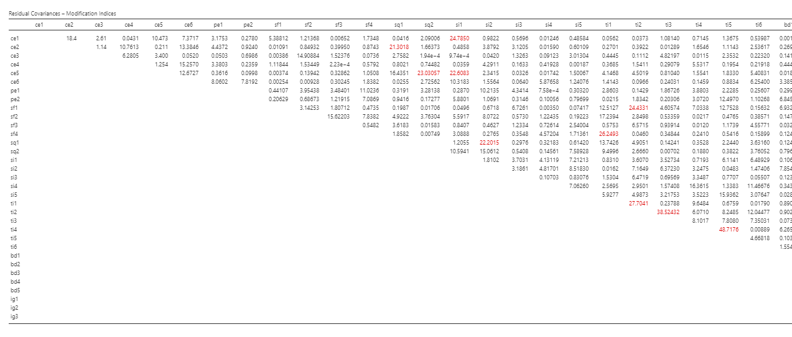
Jamovi: SCoA Residual MI
Yes, the info is here but if you cannot give a clear rationale for correlating residuals, please don’t do it.
It will inflate fit but it violates the assumptions we work with.
If items are within a factor, give serious consideration to deleting 1

Slide 24
Summary
Estimation problems are quite common
  Small sample size
  Poor model specification
  Over-factored constructs
Solutions must fit and be theoretically sound
  Remove factors, items
  Use modification indices and SEPC
Solutions need to be tested
  Alternative structures
  Invariance to other groups
And then we can address the substantive “So What?” question, with good measurements

