Slide 1
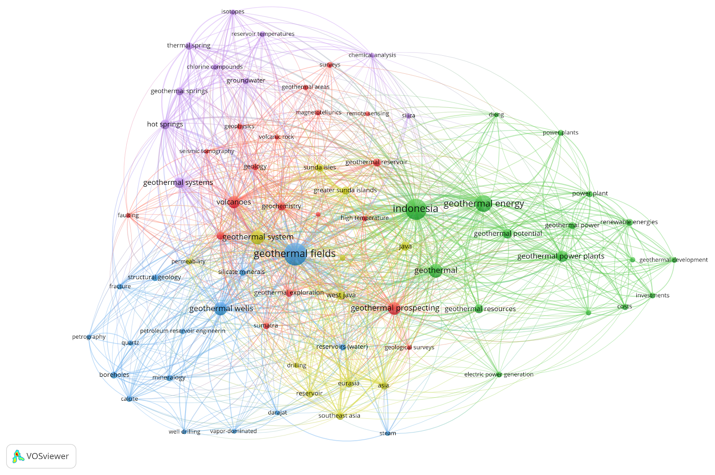
Fig. 1 The keywords connection from 218 papers taken from Scopus

Slide 2
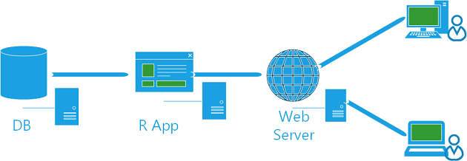
Fig. 2 The basic setup of data driven R Shiny app[12]
[12]"Creating a Business Intelligence Dashboard with R and ASP.NET MVC." 8 Jul. 2013, https://www.red-gate.com/simple- talk/dotnet/asp-net/creating-a-business-intelligence-dashboard-with- r-and-asp-net-mvc-part-1/. Accessed 16 Aug. 2019

Slide 3
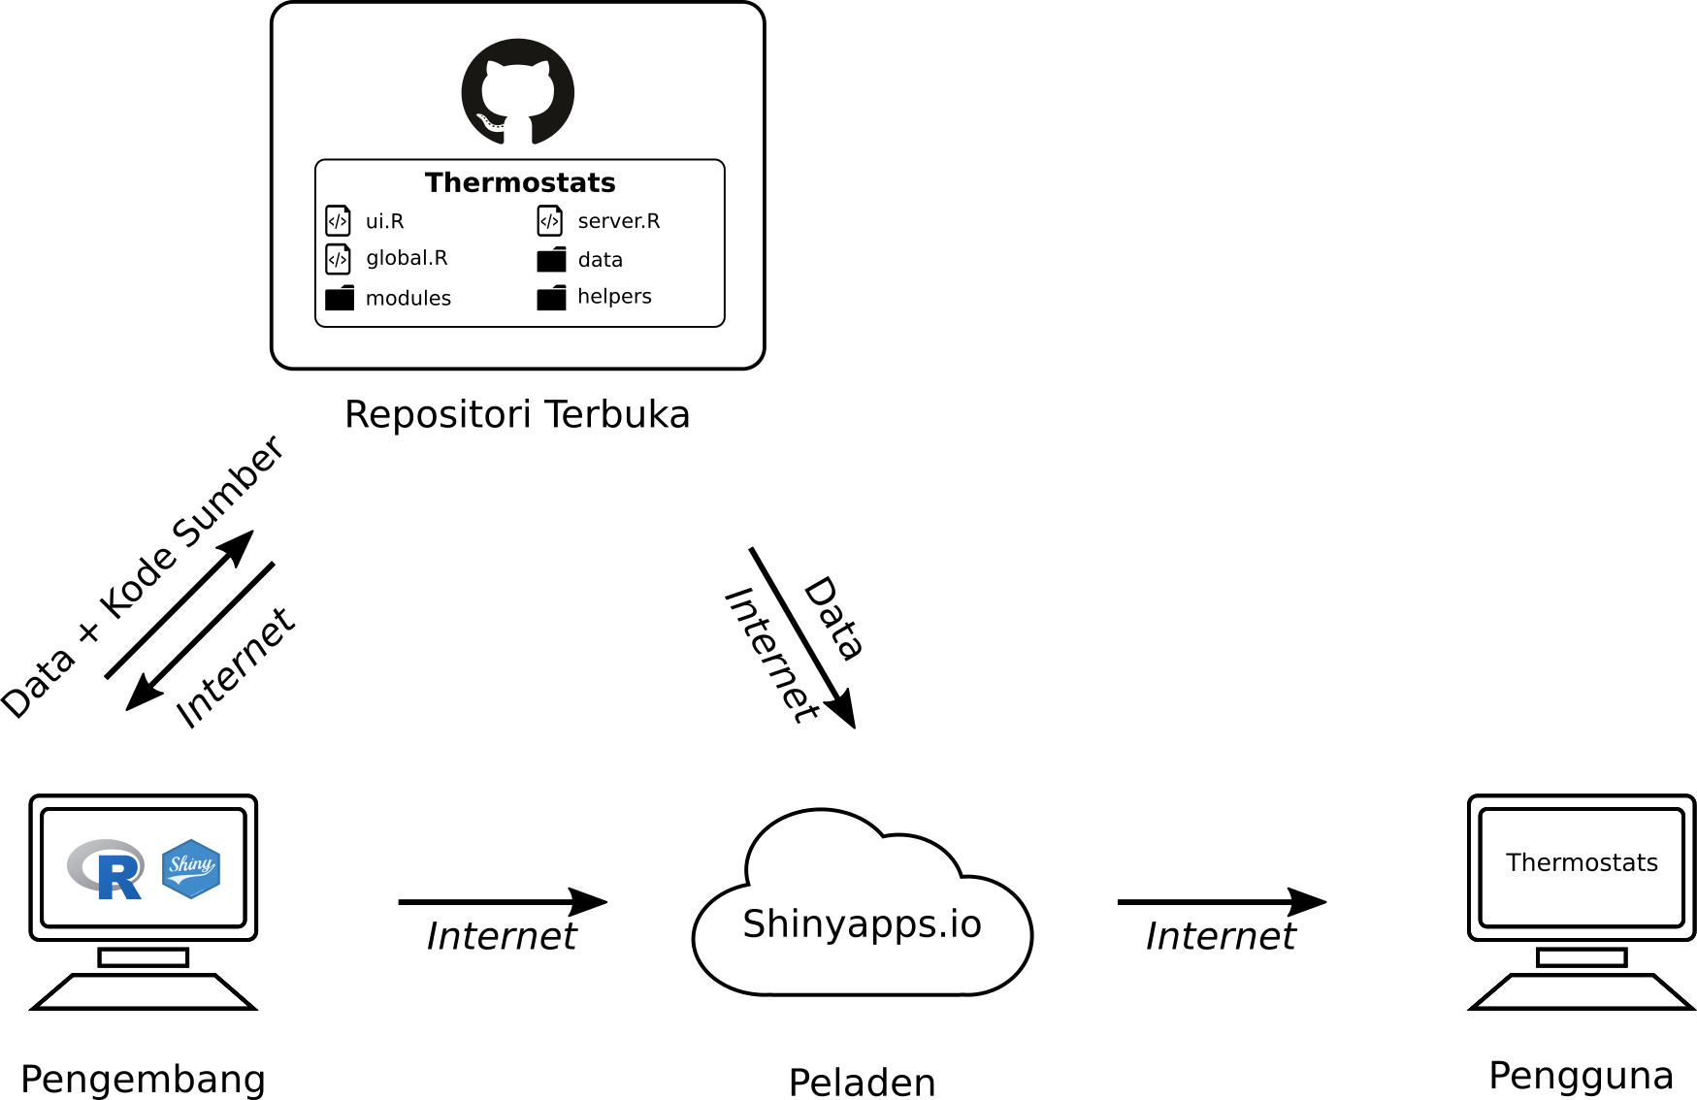
Open repository
Fig. 3 The setup of Thermostat Shiny app
Data + source code
Developers
Server
Users
Developers

Slide 4
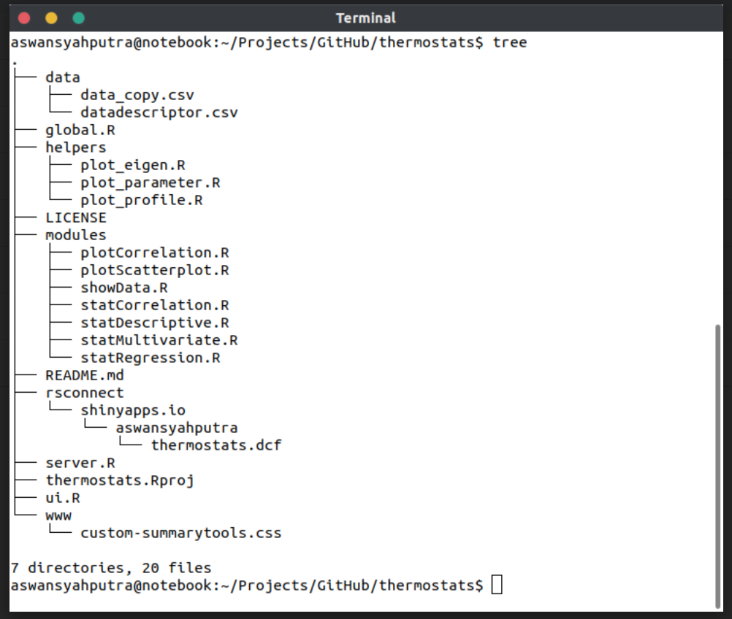
Fig. 4 The setup of Thermostat Shiny app

Slide 5
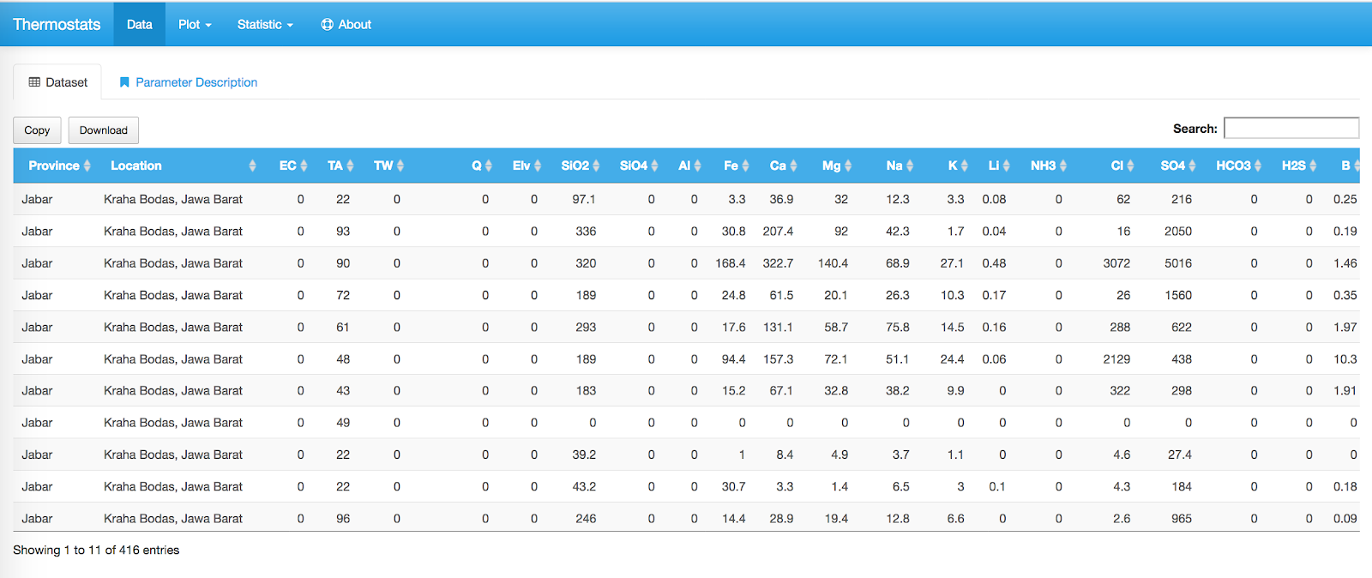
Fig. 5 The setup of Thermostat Shiny app

Slide 6
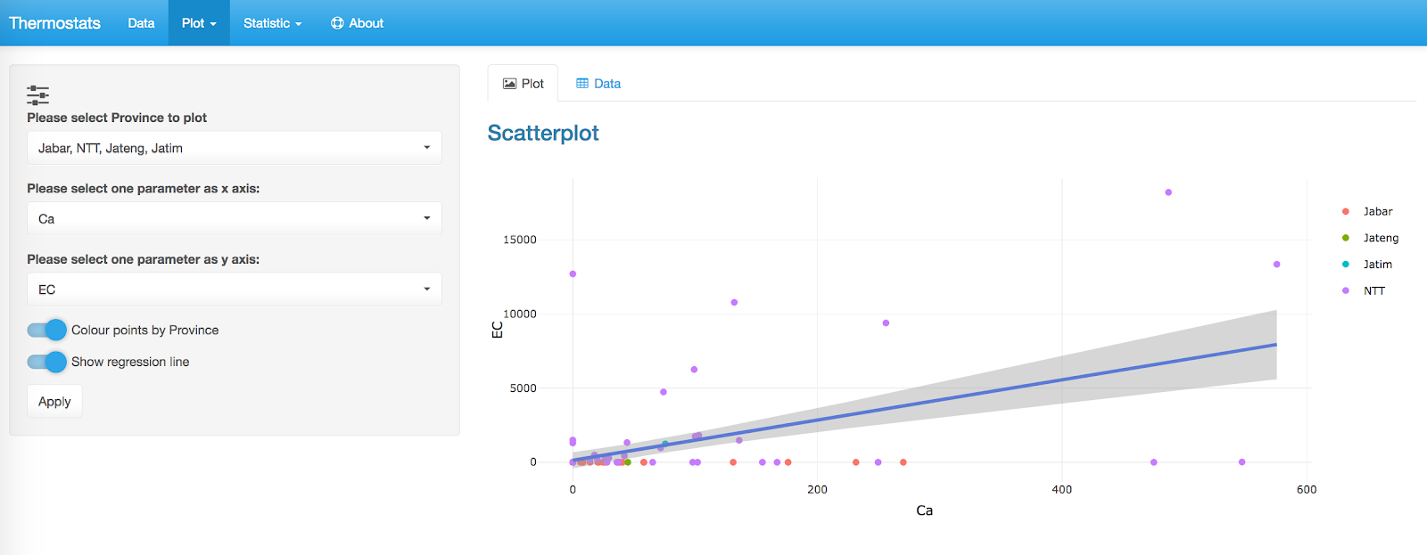
Fig. 6 Sample of scatter plot of EC and Ca for all province

Slide 7
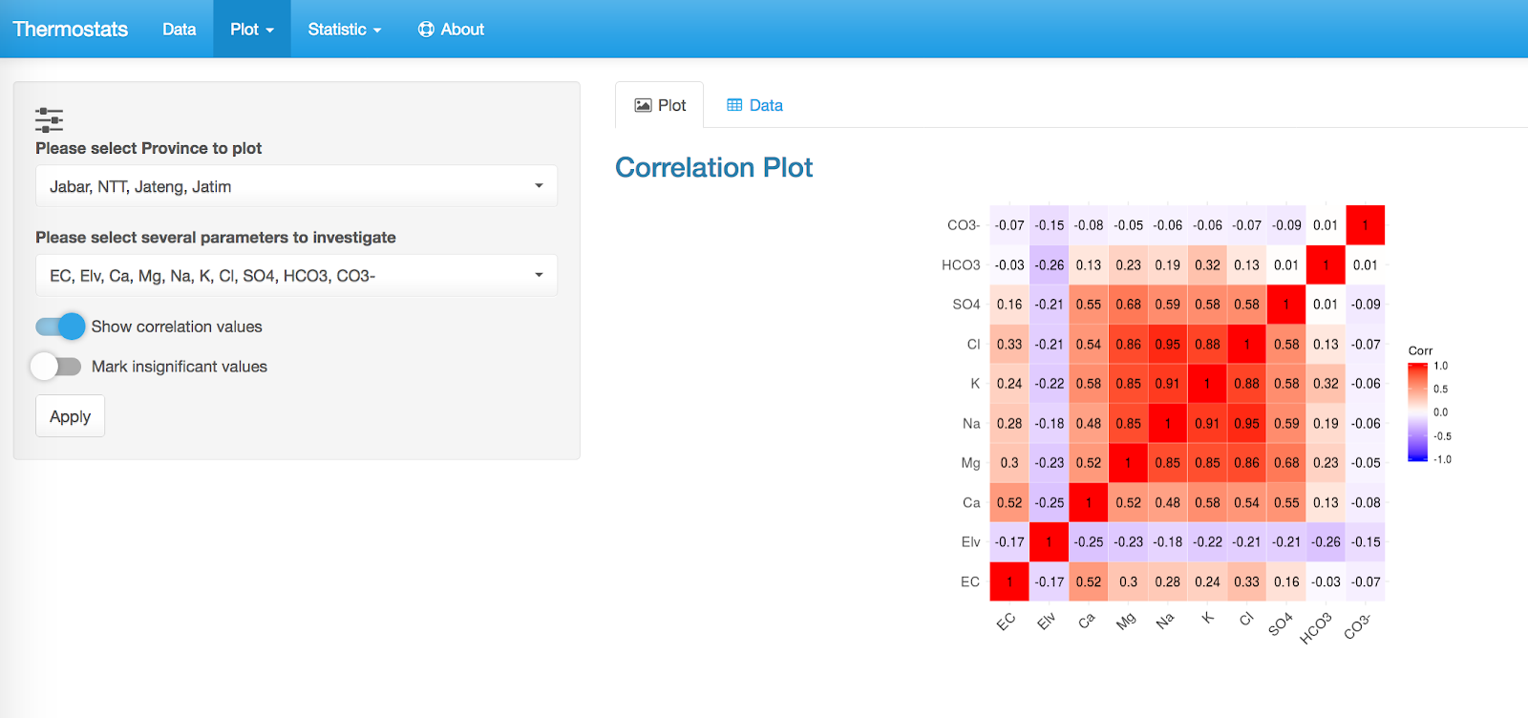
Fig. 7 Sample of correlation plot between variables and all province

Slide 8
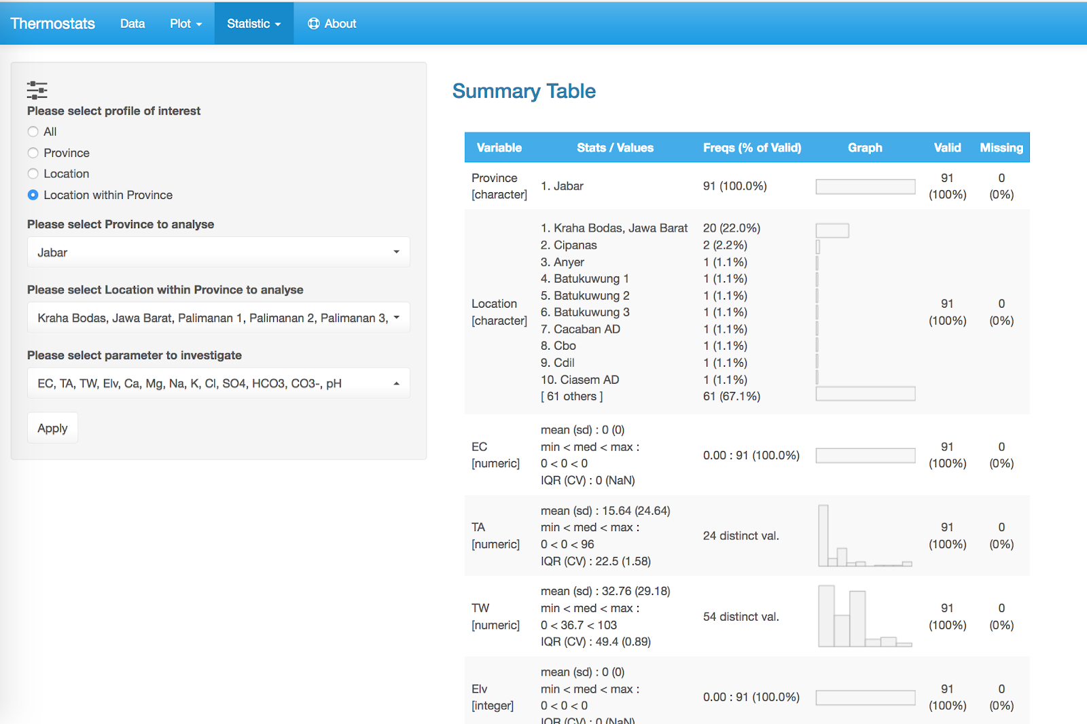
Fig. 8 Sample of descriptive statistic analysis from several major elements

Slide 9
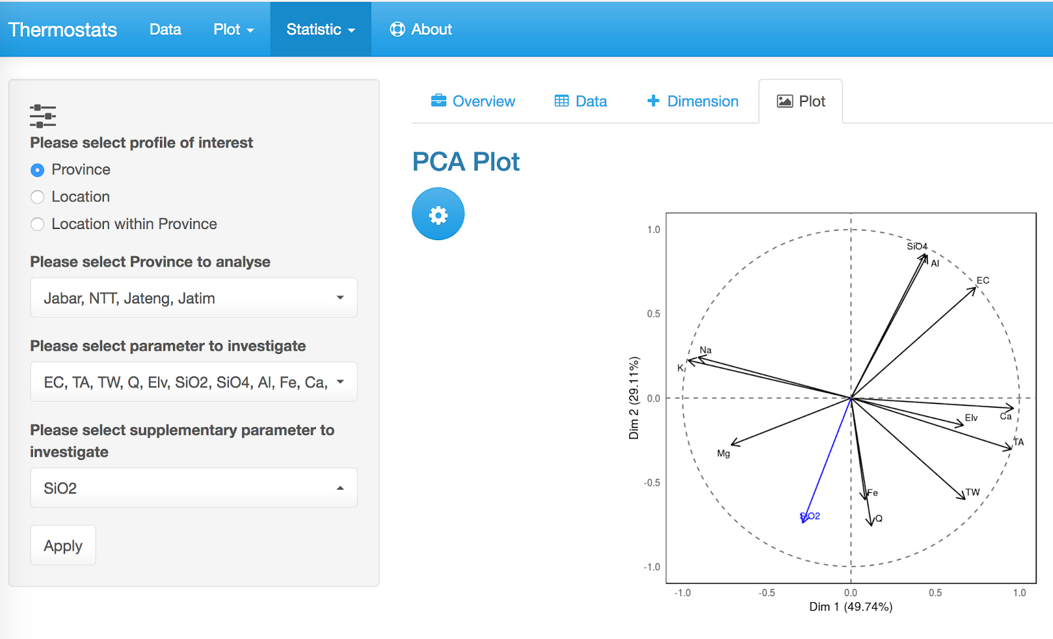
Fig. 9 Sample of PCA analysis to show grouping of parameters

Slide 10
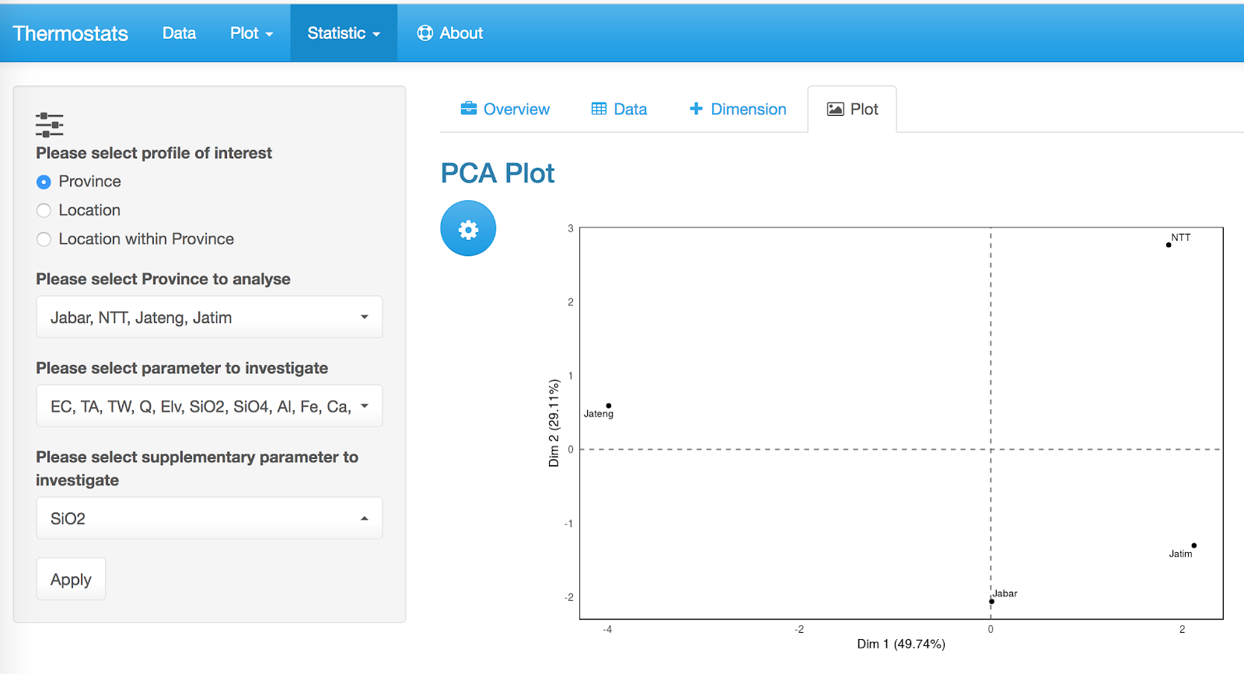
Fig. 10 Sample of PCA analysis to show grouping of locations

