Slide 1
Modelling epithelial transport
David P. Nickerson¹, Kirk L. Hamilton², Peter J. Hunter¹
¹Auckland Bioengineering Institute, Auckland, New Zealand
²Department of Physiology, University of Otago, New Zealand
(With help from Hugh Sorby¹)
Notes:
While this work is in the context of modelling epithelial transport, the underlying methods and technologies are applicable to much wider range of application, and this work can be viewed as a prototype for all the models being developed under the VPR project with the goal being able to automatically link them all together as required.

Slide 2
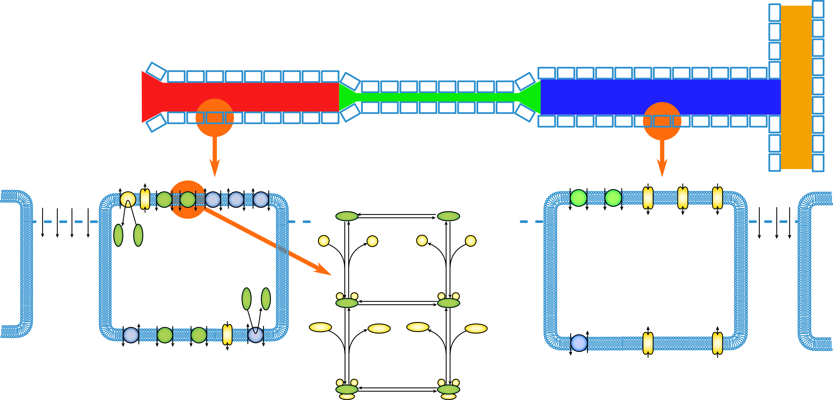
Notes:
Start off with a description of what we really want – a tool which lets users interact with, extend, modify, etc. a whole nephron model. A renal nephron has distinct functional regions, each with specialised cells, and we model this as a 1-d finite element model with epithelial cell models distributed along the length of the tubule. Each cell model can be parameterised as well as being able to distribute varying cell models.

Slide 3
Requirements for the work
Reproducible – requires an unambiguous description of what is done with which model, or set of models, in order to produce some output(s).
Reusable – requires a detailed description of the work:
physiology/anatomy being modelled;
simulation experiments being performed (numerical methods, pre-/post-processing, etc.);
cross-references/linked data;
provenance.
Accessible – non-specialists should be able to reproduce and reuse the work.
Notes:
In order for such models to be useful, and this holds for any model really, there are three main requirements (probably more, but can’t think of them at the moment).

Slide 4
Notes:
For the purpose of the current project, we limit the scope to just the cellular spatial scale and transport processes.

Slide 5
Requirements for the work
Reproducible
CellML (http://cellml.org)
SED-ML (http://sed-ml.org)
Reusable
RDF/XML, ontologies & knowledgebases
Semantic web technologies
RICORDO (http://www.ricordo.eu/)
Accessible
Web-based graphical interface
Notes:
With the scope limited in this way, we can make decisions on the specific technologies to achieve our requirements.

Slide 6
Objective
To provide a user-focused tool for investigations of epithelial transport from molecular mechanisms through to whole cell models.
Libraries of existing mathematical models and simulation experiments will be made available to users for the:
investigation/application of previous studies;
development of new studies based on previous work;
validation of new or existing work with new experimental data or computational tools.
Notes:
The objective for the current work is to…. (By user-focused I mean the tool must be easy for non-specialist users to take full advantage of the models/simulations).

Slide 9
Existing model library
The Physiome Repository contains several demonstrations of epithelial transport models encoded in CellML.
See http://models.physiomeproject.org/exposure/42 for some examples.
These, and other, models are being decomposed into re-usable modules that both use and help develop best-practice guidelines for the CellML community.
Notes:
We start with an existing library of models encoded in CellML in the Physiome Repository.

Slide 10
The GET framework
All code will be open-source and we currently have the following parts to the framework.
get-creator: a tool for assembling CellML models of epithelial transport based on biological annotations.
get-simulator: a SED-ML client tool for the simulation of epithelial cell models.
get-model-server: prototype web-services for GET.
get-web-application: the web-based graphical user interface.
GET model repository: test/demonstration models and simulation experiments.
CSim: a CellML simulation tool.
Notes:
The code is currently in private repositories available to the GET team. Anyone wanting access should drop me an email.

Slide 11
CSim
A CellML simulation tool with command-line client, library with C++ API, and a C# wrapper based on the Systems Biology Workbench.
http://cellml-simulator.googlecode.com
The simulation tool used for CellML models at the SED-ML web-tools, http://sysbioapps.dyndns.org/SED-ML Web Tools.
GET uses CSim to provide the simulation engine for models encoded in CellML.
Current status: relatively stable and in use by several external projects.

Slide 12
GET model repository
A convenient collection of CellML and “SED-ML” documents of models and simulation experiments across the spatial scales.
Separation of mathematical models, model parameterizations, biological concepts, and computational instantiation are key aspects of this repository.
Will provide the initial collection of re-usable models and simulation experiments in the epithelial transport library.
Notes:
Make it clear that this is just a convenience in terms of software development and this repository is just an alias for models that will all be available directly from the Physiome Repository in the future…

Slide 13
GET model repository
Current status:
models for dynamic molecular concentrations; membrane transport proteins, and prototype three compartment epithelial cell model.
prototype “SED-ML” description of a simulation experiment for a epithelial cell model.
Notes:
I say “SED-ML” because while the prototype is a valid SED-ML document, the interpretation of the encode simulation experiment requires special knowledge.

Slide 14
get-web-application
Javascript and HTML based web interface for the creation, editing, and simulation of epithelial transport models.
Provides access to the GET model repository and makes the library models available for use in novel ways.
Drag-and-drop model building framework under development.
Makes use of the web-services provided by the get-model-server to do the grunt work on the server.
Deployable to any web-enabled platform (PC, tablet, phone, TV, …).

Slide 15
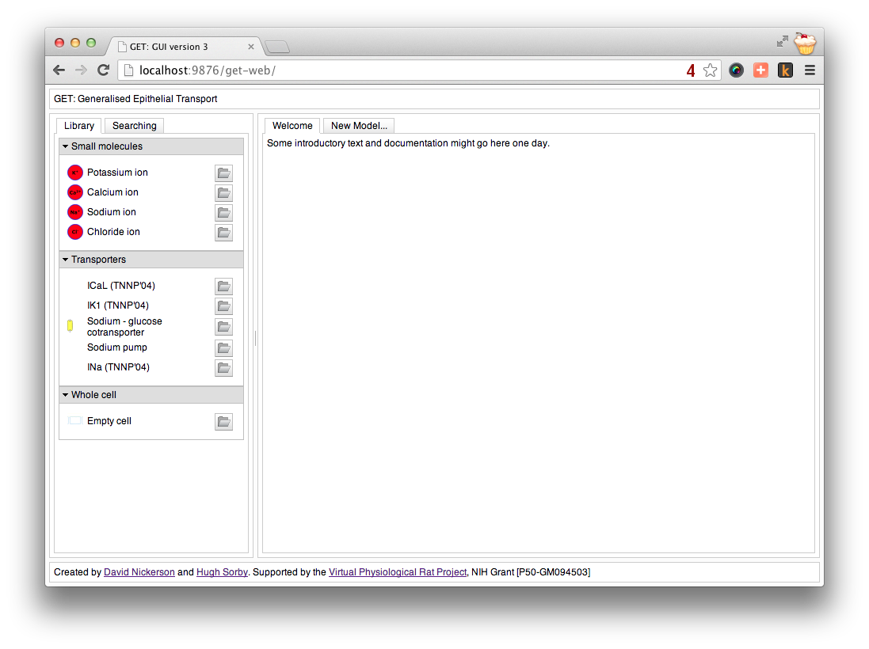
Notes:
The initial page in the GET web user interface. The panel on the left shows the current contents of the library (grouped according to model type: small molecules, transporters, and whole cell). You can also see the search tab on the left, which currently is non-functional. The large empty space used to display the content. The folder icon for each model in the library panel allows the user to “open” the model.

Slide 16
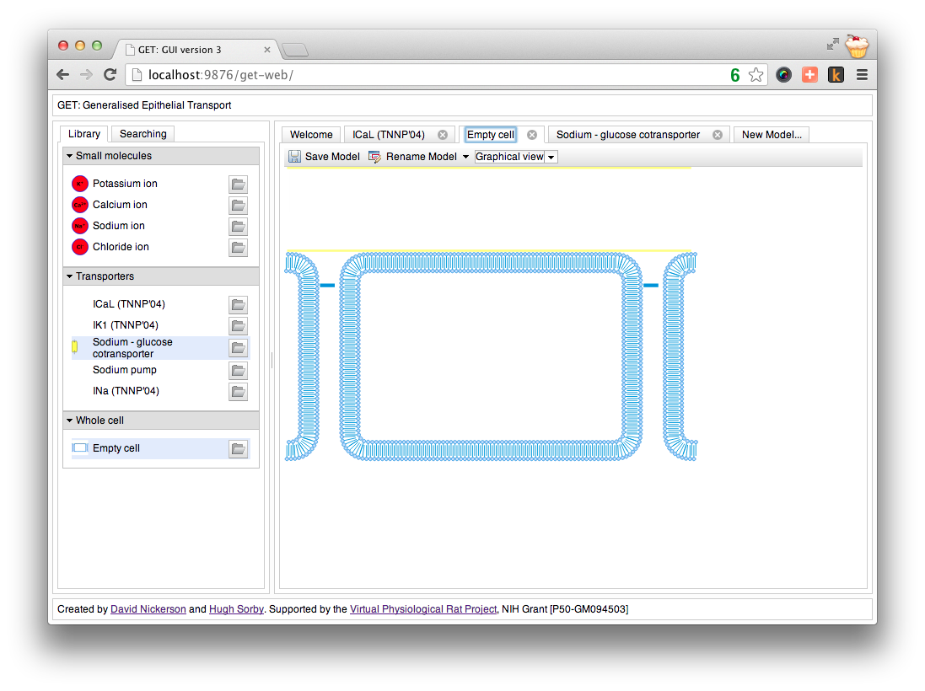
Notes:
Many models can be open simultaneously using a tab interface. Eventually the user interface will enable the user to access the various annotations associated with the displayed model (biological context, relevant literature citations, etc.). In this example we are showing the “empty cell” model, this is a template model designed as a starting point for developing a new epithelial cell model from scratch.

Slide 17
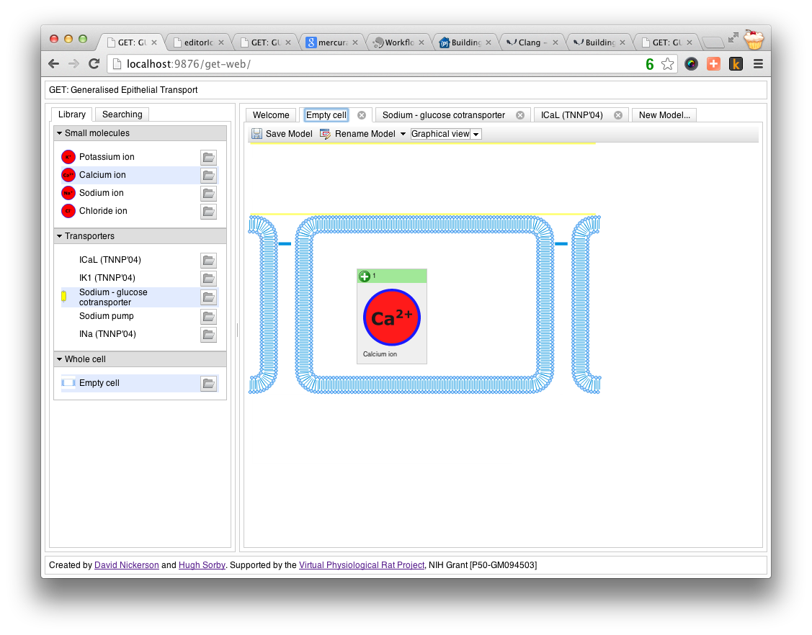
Notes:
Modules from the library can be “added” to the current model by dragging them from the library panel onto the current model. In this case we are dropping a dynamic calcium concentration model into the intracellular compartment of the empty cell model. The user is informed this is a valid action by the green “+” in the model’s avatar.

Slide 18
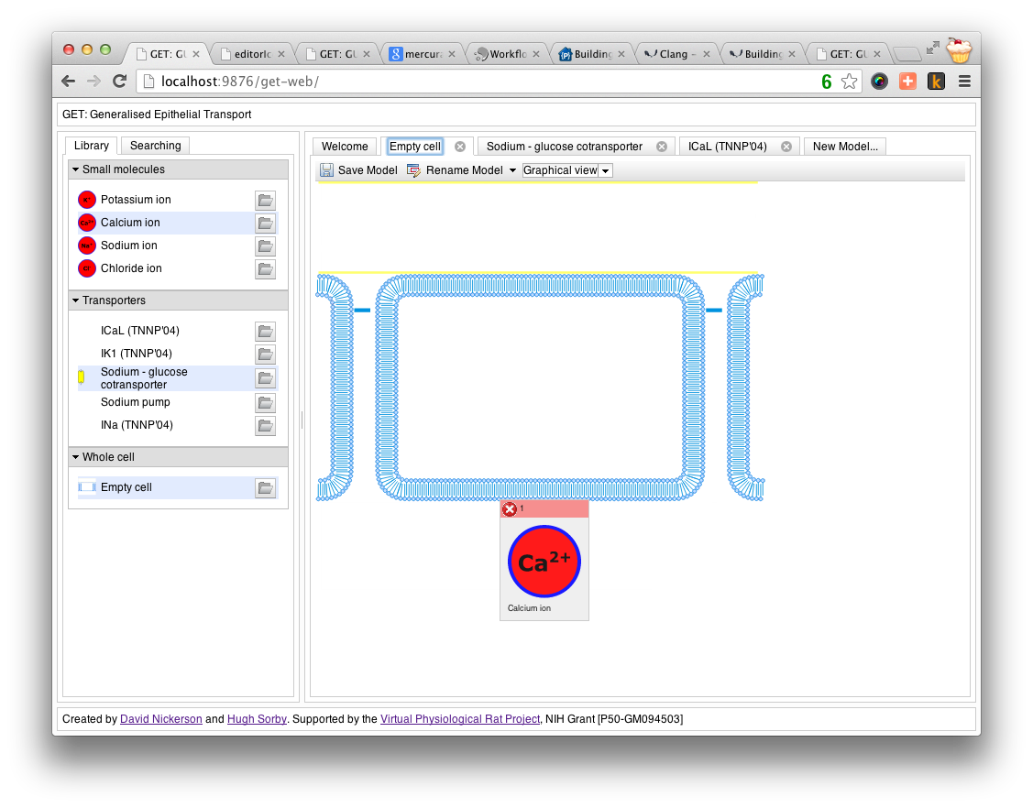
Notes:
Here the user is informed that dropping the calcium concentration model onto the basolateral membrane is an invalid action by the red “x” on the model’s avatar.

Slide 19
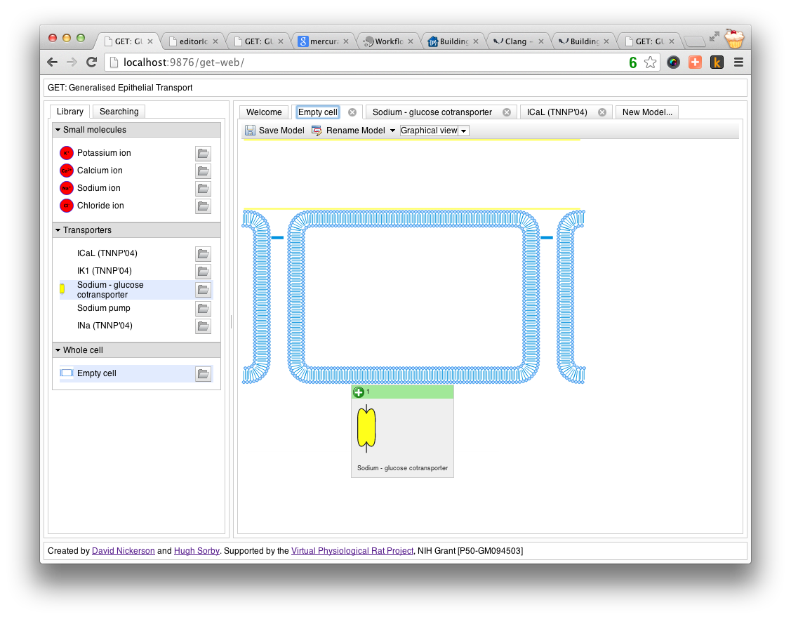
Notes:
and a final example showing that it is valid to drop the membrane transporter onto the basolateral membrane. The get-model-server provides the information that the user interface requires in order to determine acceptable drop regions in the graphical view of a model.

Slide 20
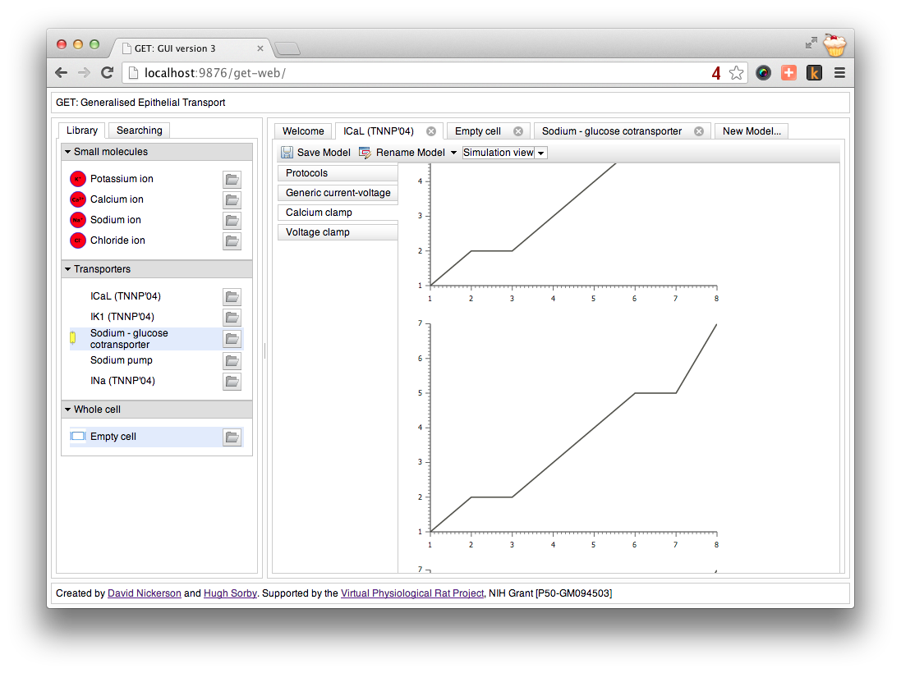
Notes:
In this example, you can see the “Simulation View” of the current model (a ICaL model in this example). Here you see all the simulation experiments relevant to this particular model. The dummy result graphs probably give away the fact that performing the actual simulation experiments is not yet implemented ☺

Slide 21
get-web-application
Current status:
communication between the web-interface and the model server well established and demonstrated.
the user-interface elements are all in place.
the drag-and-drop interface is working graphically, connection to the get-creator web-services needs to be implemented to actually create the underlying CellML models.
similarly, connection to simulation services is required to produce valid computational results.

Slide 22
get-model-server
A prototype web-server which provides access to the GET tools via web-services.
Allows computationally demanding tasks to be performed outside the web-browser.
Makes use of the JavaScript Object Notation (JSON) format to communicate data between the web-application and the C++ GET tools.
Current status:
provides web-services to all existing GET tools and the model library.
continuously developed as more functionality is required and available.
Notes:
The functionality provided by this prototype will eventually be integrated into the software used to provide the Physiome Repository.

Slide 23
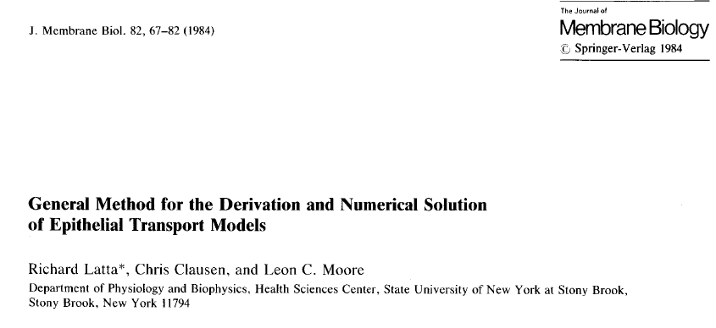
get-simulator
Simulation engine for whole cell epithelial transport.
Based on:

Slide 24
get-simulator
Notes:
The basic modelling framework used by get-simulator to simulate epithelial transport. The transport of the various solute species is modelled between the mucosal, intracellular, and serosal solution. Each of the total membrane and paracellular fluxes consists of passive transport (leaky membrane) and potentially active transport. We use CellML modules to define any active processes and to parameterise the passive cellular properties. This includes which molecular species to include in the model – and whether they should be considered dynamic or static variables in the model. Water transport is also considered and provides the driving force for cellular volume changes and passive transport of molecular species.

Slide 25
get-simulator
Notes:
Here we show the overall Latta et al simulation method. Within this, the Latta et al article describes two different modes in which the model can be solved. In the voltage clamp case the total membrane potential (E_t) is prescribed and the apical and basolateral membrane potentials are solved for such that the current into the cell equals the current out of the cell. Under the current clamp case, the total current is prescribed and the total membrane potential and the apical and basolateral membrane potentials are solved for. Both these simulation modes requires the integration of the active and passive transport mechanisms.

Slide 26
get-simulator
Implements the Latta et al method based on a CellML model describing the complete model – molecular species of interest, the collection of various active transport processes, and the parameterization of the passive cellular properties.
SED-ML is used to describe the specific simulation experiment to perform – e.g., voltage or current clamp
Such CellML models are completely valid and simulatable in any of the standard CellML tools, but get-simulator applies pre-defined interpretation of the model to update the “static” membrane potential values, as required.

Slide 27
get-simulator
Current status:
the Latta et al method and sodium model have been implemented and validated in C++.
migration to the CellML model-based cell configuration is almost complete (the GET model repository now has the passive cell model completely defined along with a simulation experiment in SED-ML).
integration with CSim and libSEDML is complete and a SED-ML based client is underway.

Slide 28
get-creator
Will create the epithelial cell model CellML document used by get-simulator.
Provides an API which is exposed to the get-web-application via web-services through the get-model-server.
Creates new CellML models by assembling existing modules from the library and collating the constituents appropriately (e.g., summing all sodium fluxes).
Generic SED-ML templates can also be customized to specific models.
Makes use of model annotations to automate the assembly process.

Slide 29
get-creator
Current status:
preliminary prototype written which allows the user to define the molecular species of interest and connect the flux differential equations to fluxes.
makes use of known CellML XML structure to automate model assembly.

Slide 30
Acknowledgements
National Institutes of Health grant [P50-GM094503].
d.nickerson@auckland.ac.nz
http://about.me/david.nickerson

