Slide 1
Why* open science? (* and why not) A primer on open science practices for graduate students and early career researchers
James Montilla Doble UNIVERSITY OF THE PHILIPPINES DILIMAN PHILIPPINE RESEARCHERS FOR OPEN SCIENCE (PROSCIENCE)
Link here
@lysanderjames
cmdoble@up.edu.ph

Slide 2
Why open science? The replication crisis in psychology The producibility crisis in Philippine psychology

Slide 3
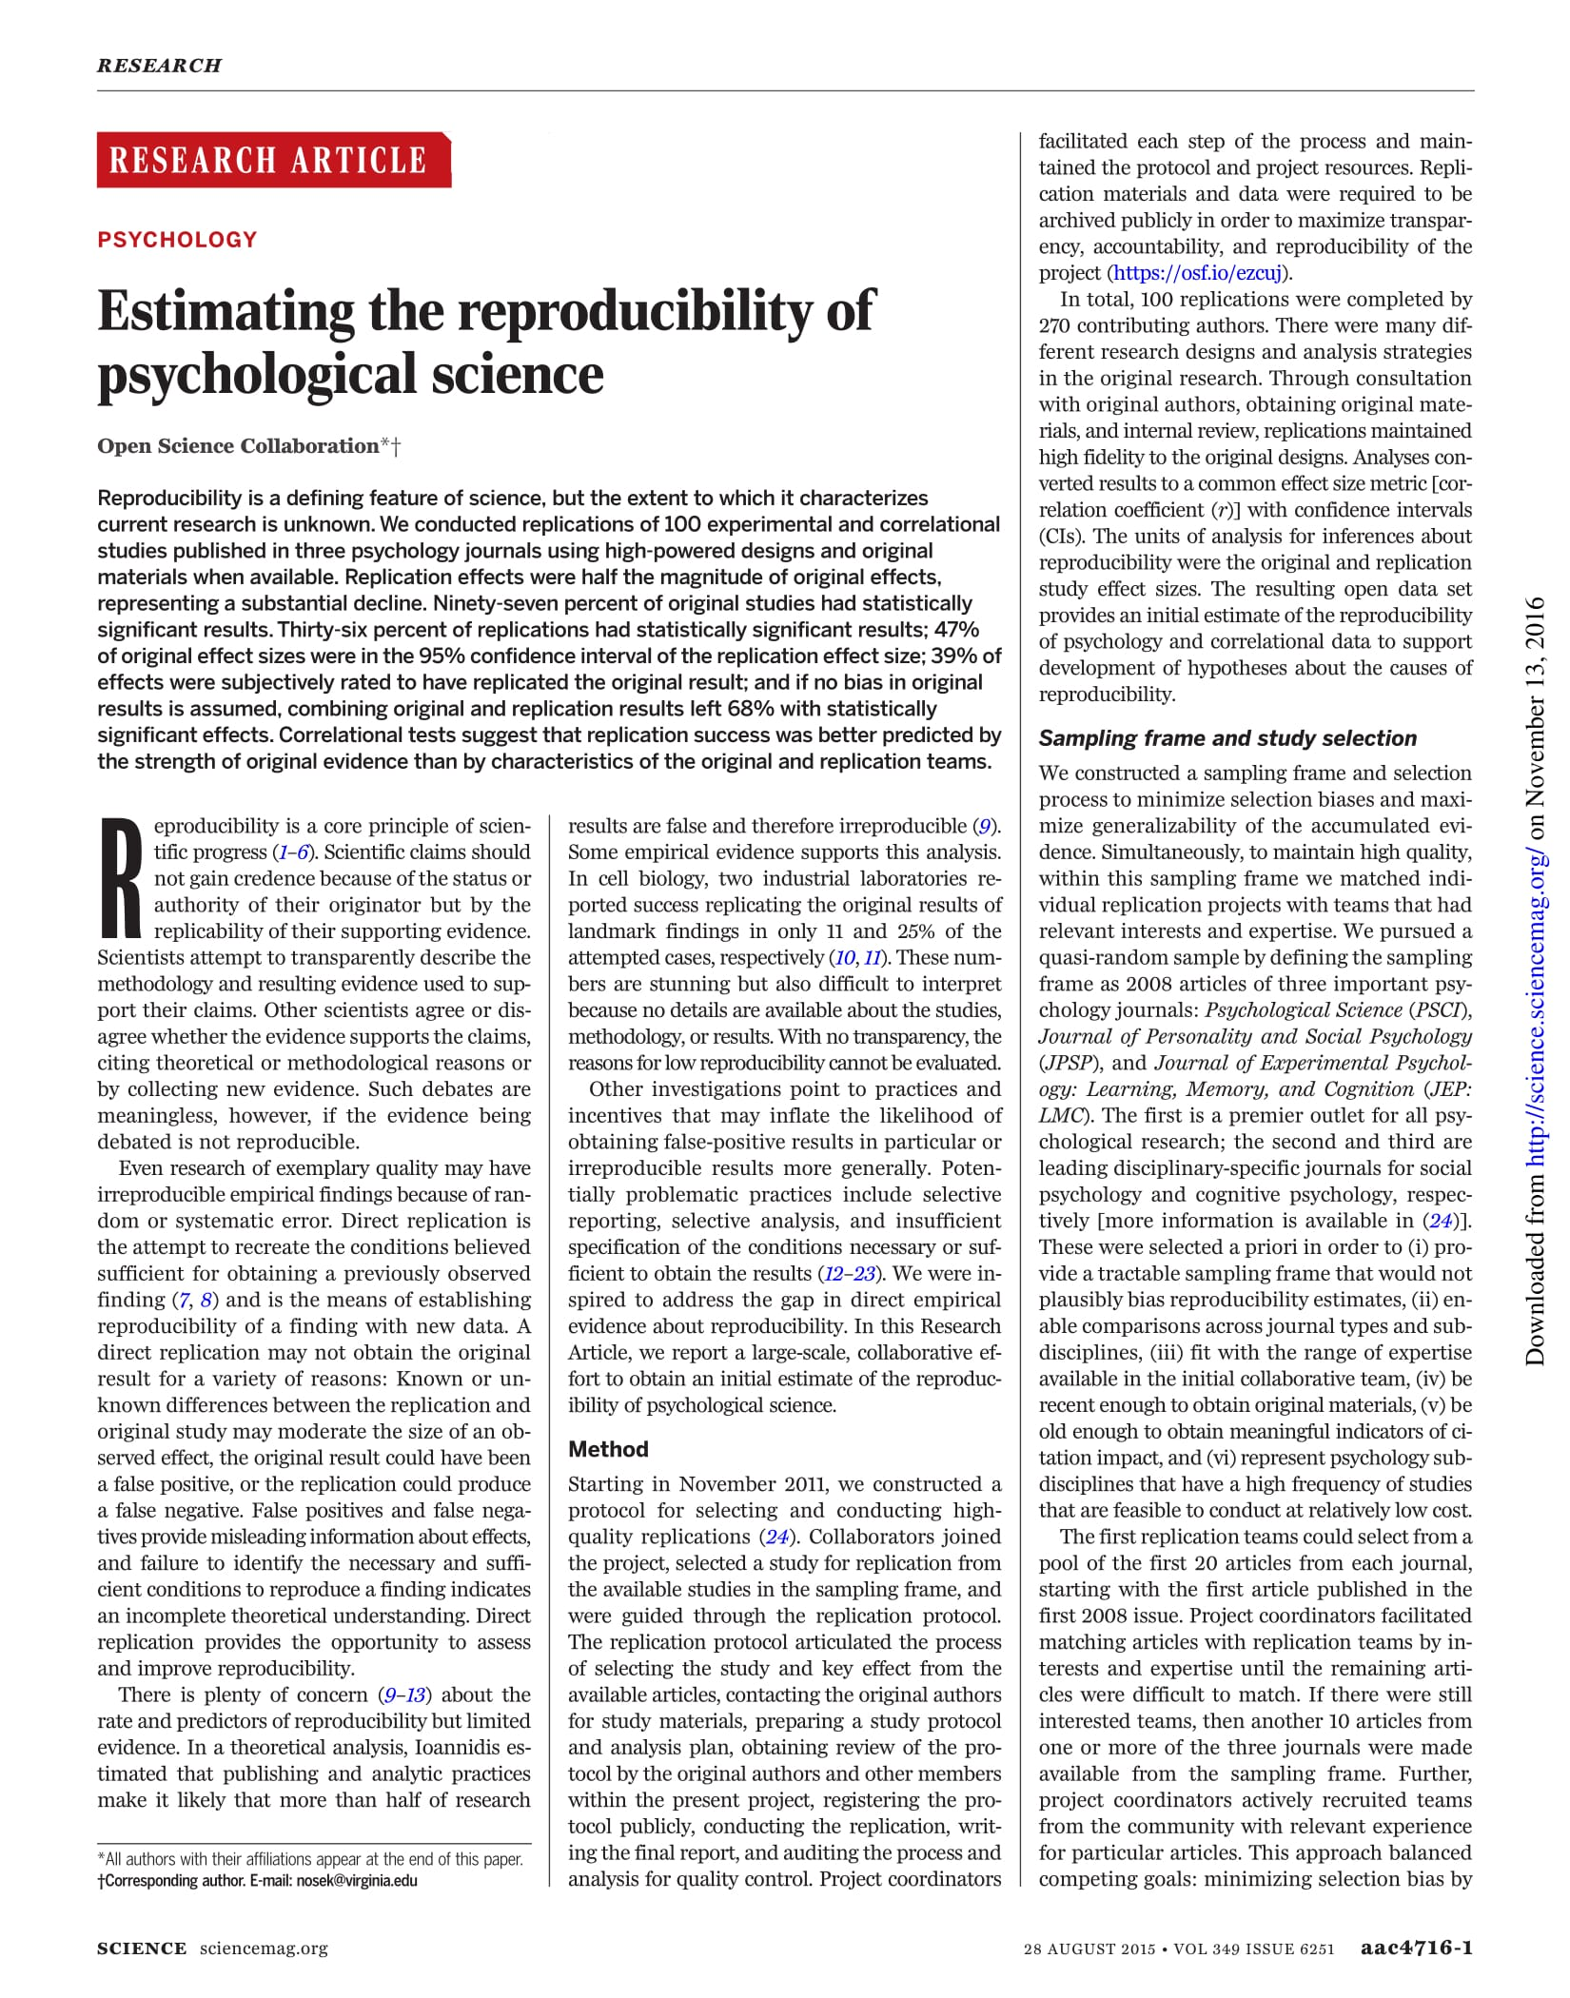
(OSC, 2015)

Slide 4
Notes:
Ask audience

Slide 5
Generate and specify hypothesis
Design study
Conduct study and collect data
Analyze data and test hypothesis
Publish and/or conduct next experiment
Integrate results
The scientific method
(Munafo et al., 2017)

Slide 6
Generate and specify hypothesis
Design study
Conduct study and collect data
Analyze data and test hypothesis
Publish and/or conduct next experiment
Integrate results
Lack of replications
Bias
Only reporting or publishing studies with “significant” results (file drawer effect, publication bias)
Small sample sizes
Changing hypotheses to match results (HARK-ing)
Threats to the scientific method
Poor quality control
Collecting and analyzing data until results are “significant” (cherry picking, p-hacking)
(Munafo et al., 2017)
Notes:
Lack of replications

Slide 7
Cumulative replication evidence
RP: Psychology (2015) 36 of 100 (36%)
Many Labs 1 (2014) 10 of 13 (77%)
Many Labs 2 (2018) 14 of 28 (50%)
Many Labs 3 (2016) 3 to 10 (30%)
Nature/Science (2018) 13 of 21 (62%)
Average replication rate of large-scale replication projects in psychology 76 of 172 (44%)
(COS)

Slide 8
Cumulative replication evidence
Economics (2015) 22 of 67 (33%)
Exp’l economics (2016) 11 of 18 (61%)
Exp’l philosophy (2018) 28 of 40 (70%)
Microarray gene expression analysis (2009) 8 of 18 (44%)
Oncology and cardiovascular medicine (2011) 14 of 67 (20%)
RP: Cancer Biology* (mixed results)
(COS)

Slide 9
Questionable research conduct
Low research competence and efficacy
Negative attitudes towards research
Lack of resources
Low research producibility
Misconceptions about science and research
(Montilla Doble et al., 2018)
Notes:
Is there a reproducibility crisis in psychology research in the Philippines?
What are the issues (in conducting psychological research) that psychologists and graduate students find most pressing?
Lack of resources: Time and manpower, funding, information, literature and measures
Low research competence and efficacy in all parts of the research process (hypothesis to publication)
Questionable research conduct in all parts of the research process
Negative attitudes towards research: Research = statistics, research as exclusive and inaccessible, research as a means to an end, research as irrelevant or unimportant
Misconceptions about research and science: Reproducibility as inessential to science; research, practice, and science as separable; Research should be innovative, novel (replications as unoriginal)

Slide 10
What is open science? Open science practices The open science umbrella

Slide 11
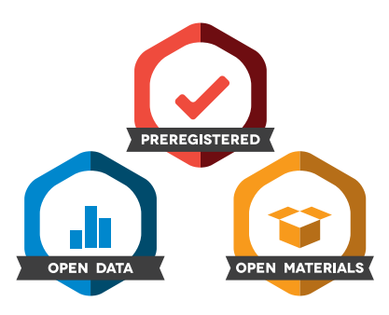
The Open Science™ brand

Slide 12
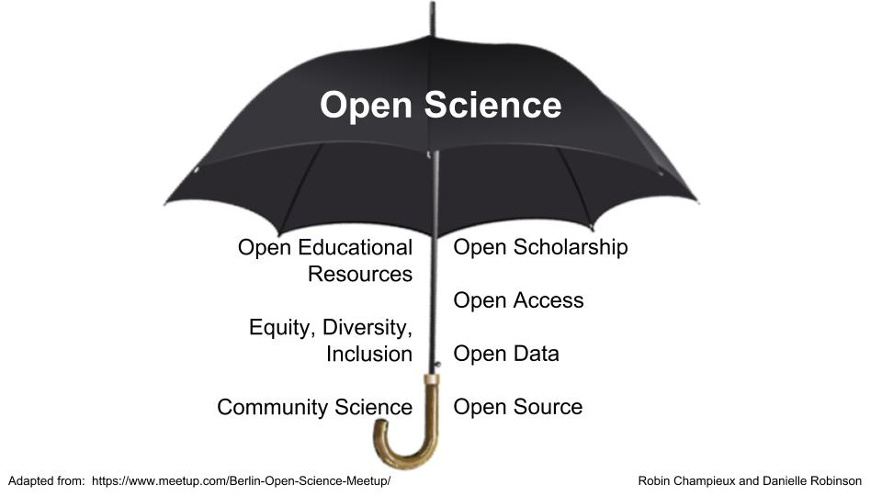
The open science umbrella (Robinson, 2018)

Slide 13
The rainbow of open science practices (Kramer & Bosman, 2018)

Slide 14
“Cherry-picking” open science practices
Share a preprint arxiv.org, PsyArXiv, SocArXiv, Thesis Commons, other preprint servers under the Open Science Framework (OSF)
Make your materials, data, and/or code available online Dataverse, Dryad, GitHub, OSF, Zenodo, etc.
Share your posters and presentations FigShare, OSF, social media (Facebook, Instagram, Twitter), etc.

Slide 15
“Cherry picking” open science practices
Communicate your research findings blogs, social media, etc.
Work with people outside your institution and/or field Psychological Science Accelerator

Slide 16
“Cherry picking” open science practices
Preregister your study and analysis plans (cos.io/prereg)
Publish in open access journals
Try the Registered Report format (cos.io/rr)
Find your open science community, whether offline or online

Slide 17
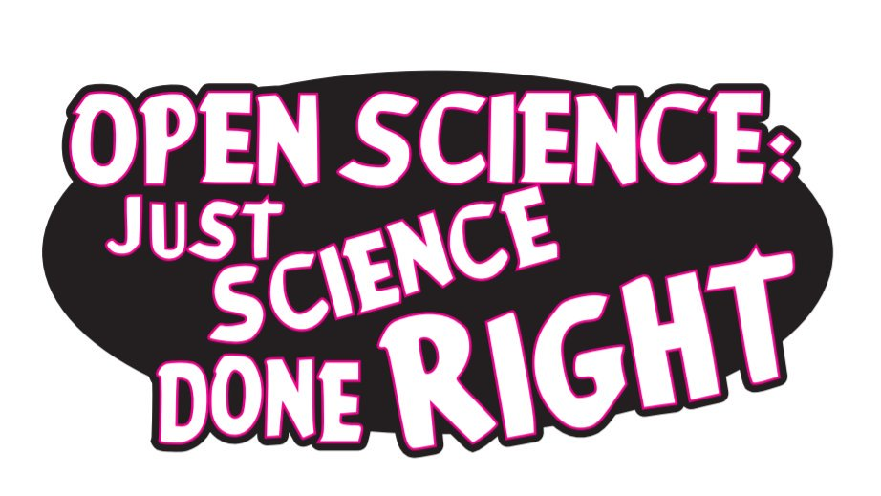
What’s in it for you?
Open access citation advantage
Closed science is the past Potential collaborators Job and funding opportunities

Slide 18
Generate and specify hypothesis
Design study
Conduct study and collect data
Analyze data and test hypothesis
Publish and/or conduct next experiment
Integrate results
Registering the study/analysis before data collection (pre-registration)
Pre-prints
Two-stage peer review (Registered reports)
Team and open science
Initiatives / possible solutions for reproducible science
Pre-registration
Pre-registration
Reporting and protocol checklists
Team and open science
Pre-registration
(Munafo et al., 2017)

Slide 19
Questionable research conduct
Open science practices
Low research competence and efficacy
Negative attitudes towards research
Collaborative laboratory networks
Pre-print sharing
Science communication
Open science practices
Lack of resources
Low research producibility
Misconceptions about science and research
Open access
Open materials, data, code
Collaborative laboratory networks
(Montilla Doble et al., 2018)

Slide 20
Why not open science? The limitations of open science practices Credibility as our shared goal The case for a critical and radical open science

Slide 21
Lack of resources
Low research competence and efficacy
Open science practices
Better consumption, production, and teaching of research
More credible psychological science
High research (re)producibility
Low research competence and efficacy
Questionable research conduct
Negative attitudes towards research
Misconceptions about science and research
(and more)

Slide 22
A critical and radical open science
Acknowledges that openness is never universally positive or neutral
Recognizes that openness is a mechanism to mobilize power
(Albornoz, 2018)

Slide 23
The open science umbrella (Robinson, 2018)

Slide 24
(Bahlai, et al., 2019)

Slide 25
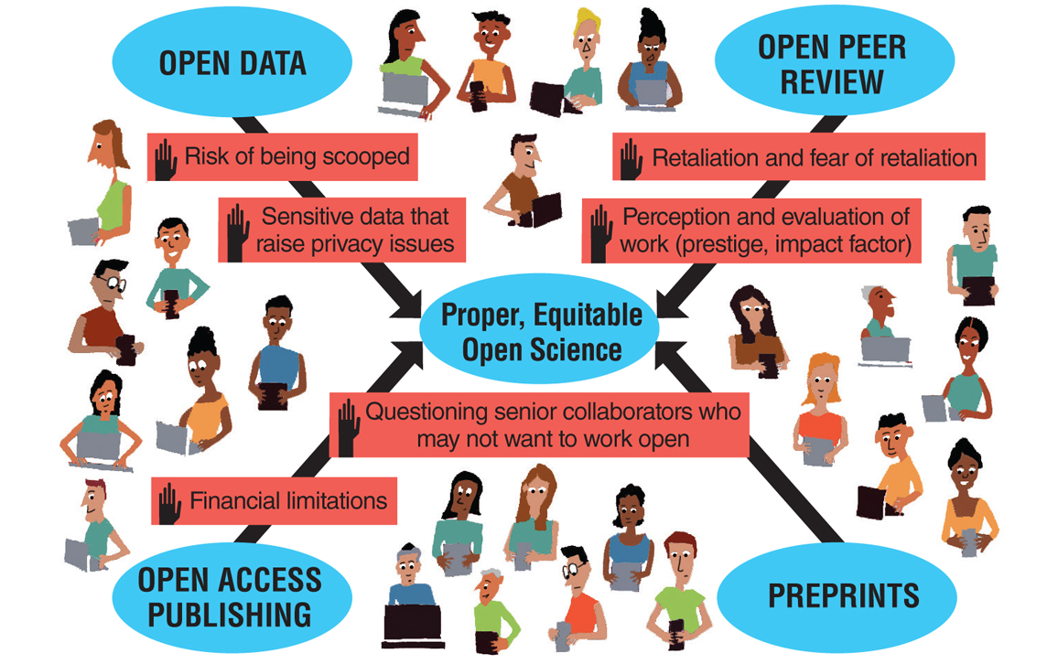
(Dunne, 2019)

Slide 26
Open science is built on the same foundation as science itself, and inherits many systematic barriers that already exist in mainstream science.
(Bahlai, et al., 2019)

Slide 27
Why* open science? (* and why not) A primer on open science practices for graduate students and early career researchers
James Montilla Doble UNIVERSITY OF THE PHILIPPINES DILIMAN PHILIPPINE RESEARCHERS FOR OPEN SCIENCE (PROSCIENCE)
Link here
@lysanderjames
cmdoble@up.edu.ph

