Slide 1
FAIRtool.org toward better Earth science data stewardship
Abdullah Alowairdhi (alow4530@vandals.uidaho.edu),
Dr. Xiaogang Ma (max@uidaho.edu)
Department of Computer Science, University of Idaho

Slide 2
Introduction
Good data stewardship is the key to knowledge discovery and scientific innovation
The ultimate goal of proper data stewardship of research output is: the data have to be Found, Accessed, Integrated, and Reused
A proposal to build a FAIR tool to produce FAIR metadata-(RDF) following The FAIR Guiding Principles for scientific data management and stewardship (Wilkinson et al, 2016)
FAIR is an acronym of Findable, Accessible, Interoperable, and Reusable

Slide 3
FAIR – Summary of 15 principles
Findable: Should have a globally-unique identifier, and that this identifier should be associated with contextual, searchable metadata.
Accessible: The globally-unique identifiers should all resolve to data or metadata using an open, standard protocol.
Interoperable: The data and metadata should use a formal, broadly applicable representation language, and utilize open and widely-accepted domain-relevant
vocabularies and ontologies.
Reusable: The data should be richly described with an abundance of cross-references, and with a clearly-defined mechanism for accessing provenance and license information.

Slide 4
Technical Challenges
The goal is to build a semantic web tool that will enable the community to produce metadata for their research output, the tool follows FAIR guiding principles
To build such a tool you need to:
Understand ontology engineering- logic and integration
Understand semantic web programming and developments
Understand Java Scripting, API integration, and SPARQL query
Understand Mysql, Vitro, Tomcat, ….
Struggle and frustration, putting everything working together, you have to be specific e.g. J Connector 5.1.30 won’t work with Mysql 8.0.16, etc …
Database crashes, rebuild the system again
A long learning curve in a short period of time

Slide 5
The Approach of Tackling Challenges
On class- Data Science and semantic web course 4 months
Online- Courses and tutorials- Protégé¹, Cmap, JS, API, SPARQL, Vitro², Mysql, Tomcat, Maven
Advice and consultation from my advisor Dr. Marshall Ma
Learning is still going on
First time FAIR Ontology was built, it does not work ☹, more learning and rebuilt, the Ontology is working ☺
1- Stanford University
2- Cornell University

Slide 6
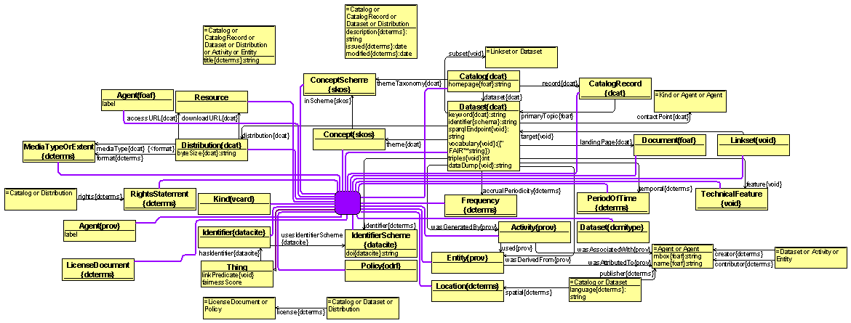
Result & Progress
The model integrates DCAT, DCT, VoID, Prov, FOAF, SKOS Schema.org,CompNet, and ODRL

Slide 7
Result & Progress (cont..)
Findable | Accessible | Interoperable | Reusable
F1 dct:identifier Schema:identifier | A1 dct:identifier Schema:identifier compNet:protocol | I1 void:TechnicalFeature void: feature | R1 void:vocablary
F2 void:vocablary | A1.1 compNet:protocol void:sparqlEndpoint | I2 void:vocabulary | R1.1 dct:LicenseDocument dct:license odrl:Policy
F3 dct:identifier schema:identifier | A1.2 dcterms:accessRights Dct:rights | I3 void:linkset void:subset | R1.2 prov:Activity prov:Agent prov:Entity prov:used prov:wasAssociatedWith prov:wasAttributedTo prov:wasDerivedFrom prov:wasGeneratedBy
F4 dcat:Catalog dcat:CatalogRecord | A2 dcat:Catalog dcat:CatalogRecord |  | R1.3 dcat:Distribution dct:format void:feature

Slide 8
Result & Progress (cont..)

Slide 9
Result & Progress (cont..)

Slide 10
Result & Progress (cont..)

Slide 11
Result & Progress (cont..)

Slide 12
Result & Progress (cont..)

Slide 13
Lessons learned
Do not think things will work from the first 10 times. Keep trying
Whatever you do things are not final, always there are improvements
Be patient and retry until you lose hope, then it will work
If you really want things to be done, it will be

Slide 14
Conclusion & future work
The tool needs some touches to be ready
To expedite going live I need help with:
CSS, JS, API, SPARQL QUERY, and Permanent Hosting
Beta version is ready in my laptop if anyone would like to try it
Fairness Scoring system. (15*6.667)/100 = %100
Or follow Hodson’s five star scale:

Slide 15
Conclusion & future work (cont..)

Slide 16
Thank You
If you would like to involve ask for access to web protégé and/or GitHub
Https://github.com/ESIPFed/FAIRTool
Https://webprotege.Stanford.edu
Abdullah Alowairdhi (alow4530@vandals.uidaho.edu)

