Slide 1
Sensors in Snowy Alpine Environments: Part II, Sensor Networks with LoRa
James Gallagher
OPeNDAP
<jgallagher@opendap.org>

Slide 2
Basic Design
Deploy sensors at research sites (initial site: Goat Flat, ~9,000 ft).
Sensor nodes should run on battery power for 2+ years.
Use LoRa radio to connect sensor nodes to a master node.
Use the master node to forward data to the Internet.
The master node will use cell phone technology for Internet uplink.
Subsequent implementations could use other techniques.
Data from the master node will be sent to an Application Server that can be accessed from browsers and analysis tools.
Locate and Tag sensor nodes using RFID.
The Master node can sense a wide(r) variety of conditions such as snow pack presence.
Calibration: use reference instruments including a portable soil temperature and moisture measurement device.

Slide 3
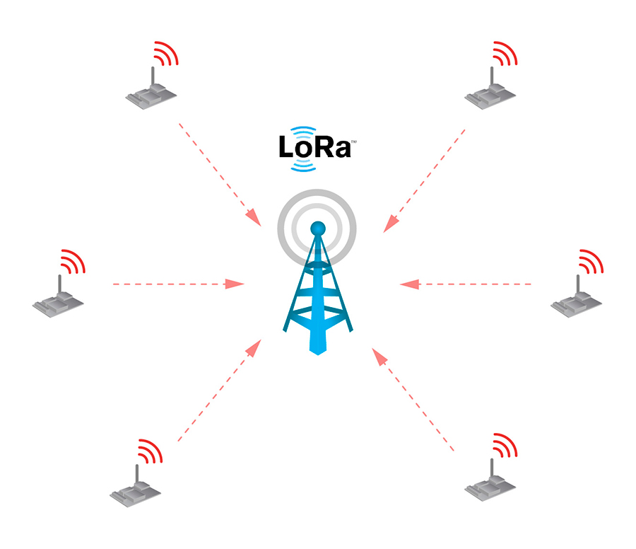
Sensor Network: Topology
Master/Sensor star topology
Sensor nodes
Collect data (temperature, soil moisture, etc.)
Use LoRa radio to send data to Master
Master
Receives data from sensors using LoRa
Forward data to ‘Application Server’ via Internet
Sensor node
Master node
Internet

Slide 4
Sensor Network: Operation
Sensors sleep most of the time to conserve power
Sensor node
Master node
Internet

Slide 5
Sensor Network: Operation
Sensors wake up and measure environmental parameters
Sensor node
Master node
Internet

Slide 6
Sensor Network: Operation
Sensors transmit data to the Master
Sensor node
Master node
Internet

Slide 7
Sensor Network: Operation
Sensors go back to sleep
Sensor node
Master node
Internet

Slide 8
Sensor Network: Operation
The Master node forwards the collected data to an Application Server in the Internet
Sensor node
Master node
Internet

Slide 9
Sensor Network: Operation
The Master returns to its nominal mode
Sensor node
Master node
Internet

Slide 10
LoRa Network Protocols How the Master and Sensor nodes communicate
LoRaWAN
Low power requirements
Reliable transmission; nodes are not responsible for error correction
Handles security
Ad Hoc protocol*
Leverage knowledge about the problem to further reduce power used
Error correction and security must be explicitly coded into the Sensor and Master nodes’ software
Less flexible than LoRaWAN
Notes:
* Often referred to as a ‘datagram protocol,’ however, that’s a misnomer –protocols like LoRaWAN also use datagrams.

Slide 11
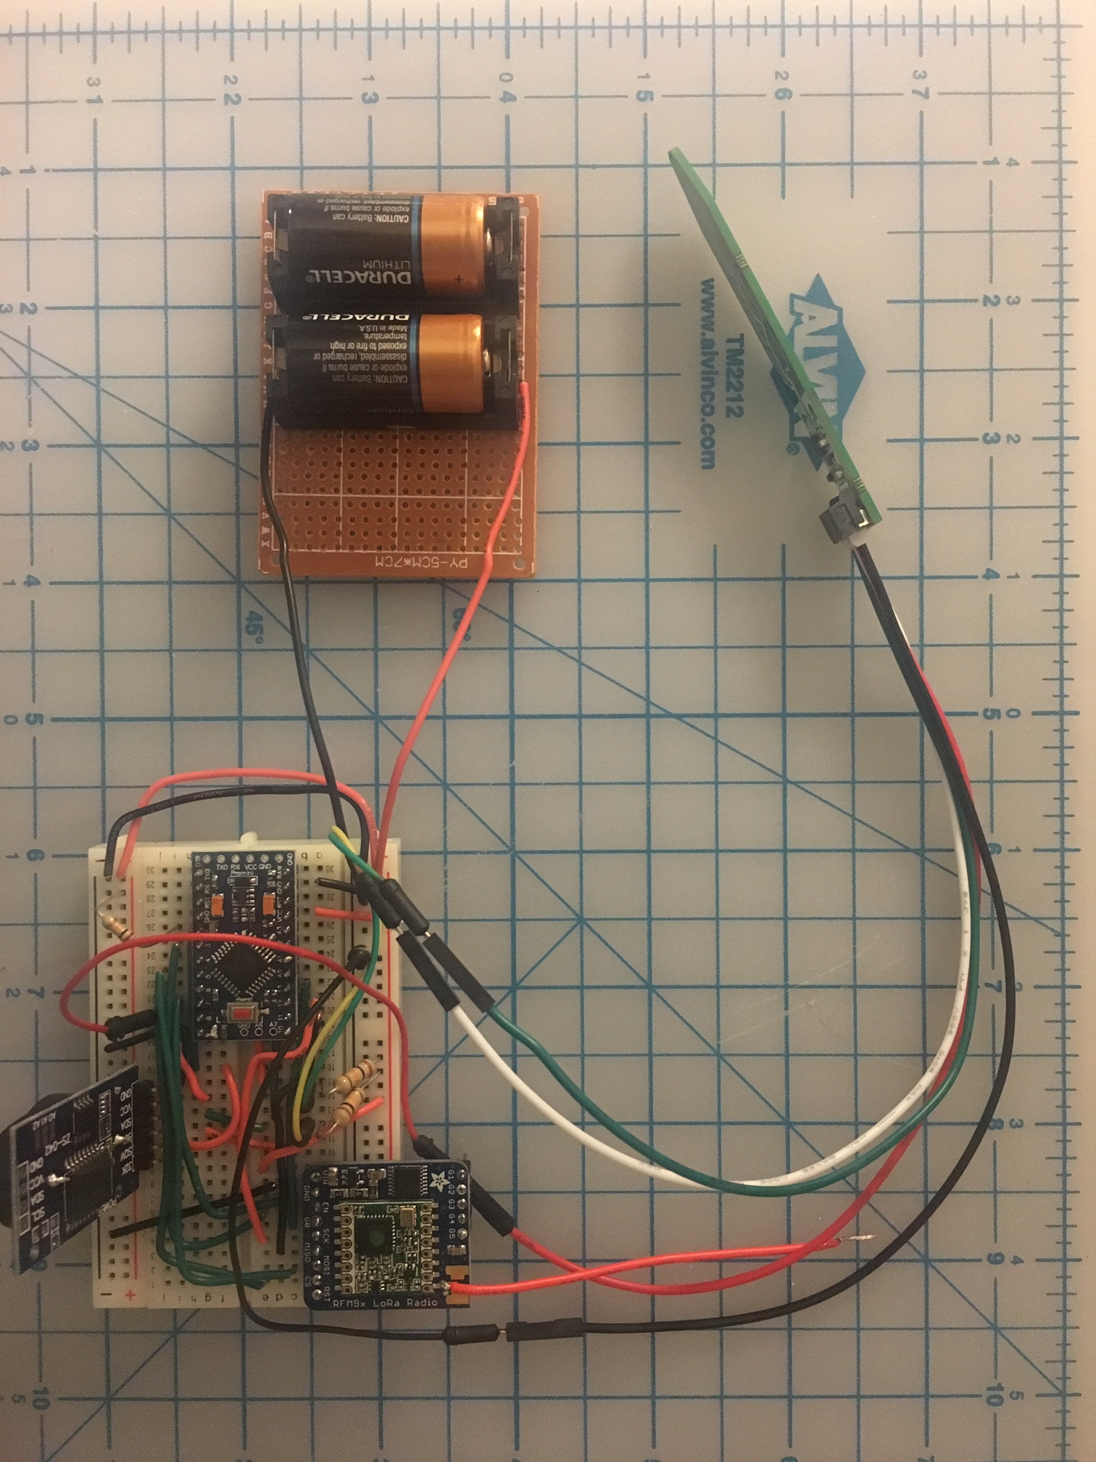
Test Implementation
Sensor node
LoRa + Arduino + Temperature and soil moisture sensor
Two LiMnO₂ batteries (-50° C)
Prototypes operated at -25°C and were run buried in both soil and snow as well as in open air
Total parts cost < $40; options exist to reduce that cost further
Master node
Dragino
Combination LoRa/Arduino and Yun single board Linux computer
Ethernet connectivity to a LAN and then to the Internet
Master/Sensor protocol
Ad Hoc
Application Server
CHORDS server running on provisioned Amazon Web Services EC2 instance
http://soil-sensor-prototype.opendap.org/data

Slide 12
Sample Data from Second Prototype Running in open air
Prototype was run from 3 to 28 Feb 2019
Sensed air temperature ranged from 0.8° C to -26.75° C

Slide 13
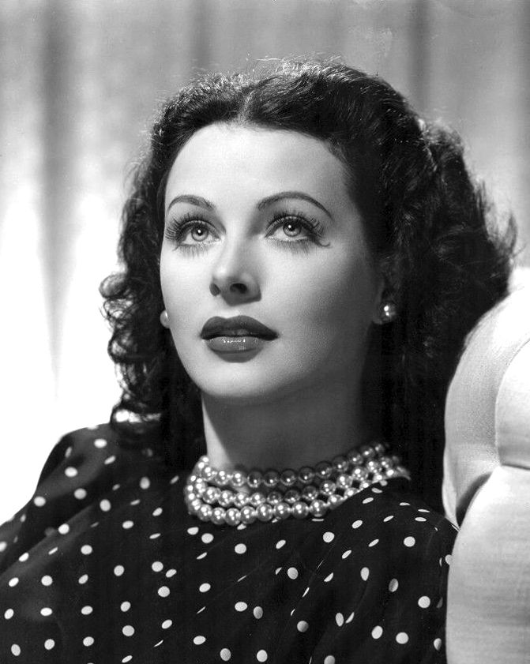
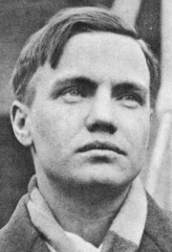
What is LoRa?
“LoRa (short for long range) is a spread spectrum modulation technique derived from chirp spread spectrum (CSS) technology.”*
Spread Spectrum: To spread an information signal over a (wide) band of radio frequencies.
Robust transmission technique; also used in WiFi, Cell phones, Bluetooth, etc.
Hedy Lamarr and George Antheil are credited with its invention
Lamarr¹
Antheil²
*https://www.semtech.com/lora/what-is-lora
Notes:
¹ By Unknown - eBay, Public Domain, https://commons.wikimedia.org/w/index.php?curid=47176716
² By unknown - picture found at http://www.schirmer.com/default.aspx?TabId=2419&State_2872=2&ComposerId_2872=35, Fair use, https://en.wikipedia.org/w/index.php?curid=23450183

Slide 14
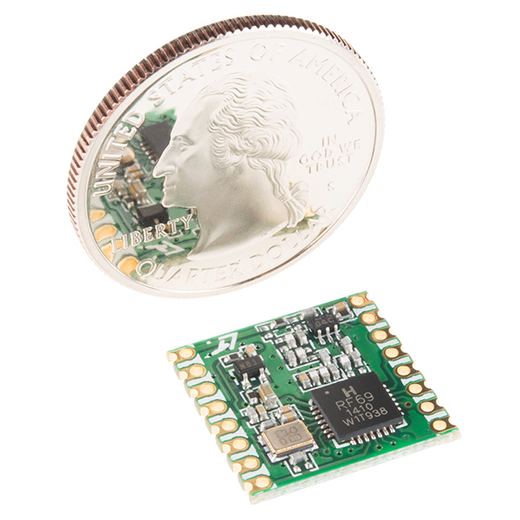
LoRa specifics
Widespread use by Internet of Things applications.
Inexpensive (~$5 eBay; $20 Adafruit/SparkFun)
Small (16mm x 16mm)
Range: 1–10km
Adjustable bit rate: 293 bps to 37.5 kbps
Adjustable error correction, etc., parameters
Works well with Arduino and similar MCUs
Good library support (e.g., RadioHead; TinyLora)
US/EU/AS frequency bands (915/868/430 MHz)
Low power – 20mA receive/100mA transmit
Image from the SparkFun website

Slide 15
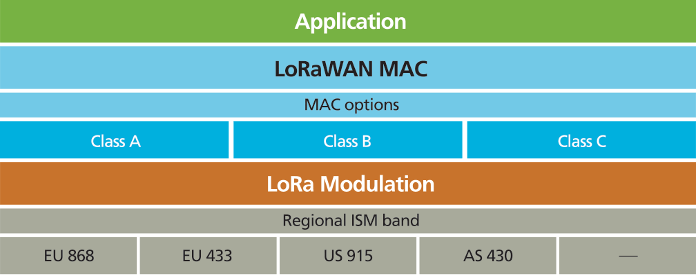
How LoRaWAN Relates to LoRa
Physical layer defined by the radio hardware
Network layer defined by the LoRa Alliance
Network Layer
Physical Layer

Slide 16
More information
What is LoRa, Semtech website: https://www.semtech.com/lora/what-is-lora
Comparison of LoRa with FSK (frequency Scaled Keying): Jesus Sanchez-Gomez, Ramon Sanchez-Iborra, and Antonio Skarmeta, Transmission Technologies Comparison for IoT Communications in Smart-Cities. 2017. DOI: 10.1109/GLOCOM.2017.8254530.
The Things Network (non-profit) : https://www.thethingsnetwork.org/
MathWorks ThingSpeak: https://thingspeak.com/
LoRa Alliance (non-profit) – LoRaWAN information source: https://lora-alliance.org/
LoRa Datagram open source implementation: https://www.airspayce.com/mikem/arduino/RadioHead/classRHReliableDatagram.html
LoRaWAN open source implementation: https://github.com/adafruit/TinyLoRa

Slide 17
Extra slides

Slide 18
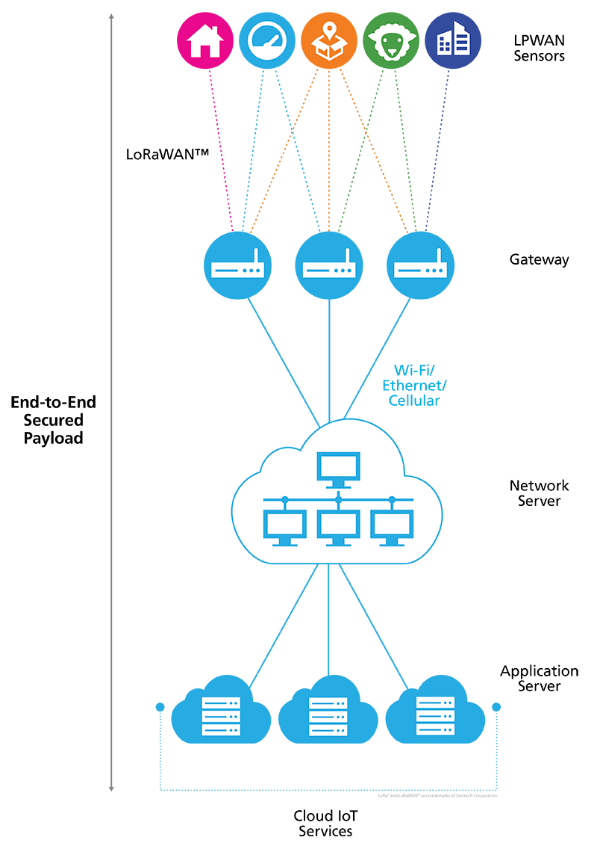
Generic IoT/LoRa Topology
Autonomous sensors communicate with LoRa Gateways
LoRa Gateways transfer information to the Internet
Once on the Internet the information can be routed to data servers, etc.
This can use LoRaWAN (a kind of Low Power Wide Area Network – LPWAN) or Datagrams
Picture: Semtech¹
Notes:
¹https://www.semtech.com/lora/what-is-lora

Slide 19
Sensor node
Sensor node
Sensor node
Sensor node
Master node
Sensor node
Internet
Master node
Sensor node
Internet

