Slide 1
Metadata and Dialect Evolution - Affiliations in the Dryad Data Repository
Daniella Lowenberg - California Digital Library
Ted Habermann - Metadata Game Changers

Slide 2
The Problem
We do not have reliable institutional affiliation information for 28,000 data publications at Dryad

Slide 3
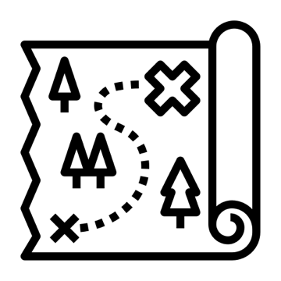
The Quest
Without this info, we cannot:
Report on deposits by institution
Evaluate usage and citations by institution
Send appropriate metadata or copies to institutions

Slide 4
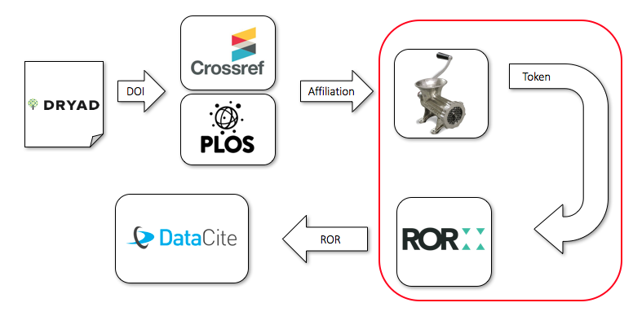
The Strategy

Slide 5
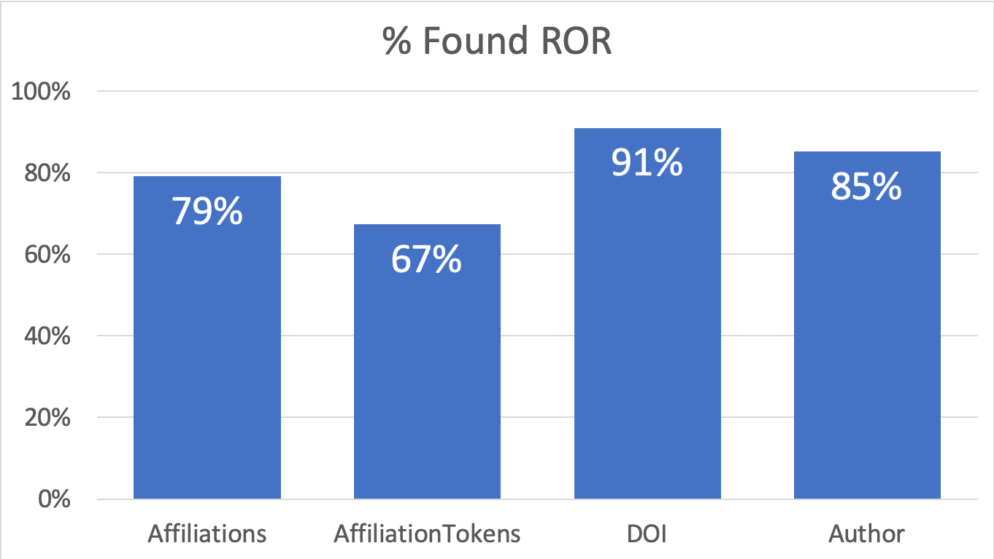
How well can we do finding RORs?

Slide 6
Metadata Evolution and Improvement
52,015 Affiliations
41,170 ROR’s
No Affiliation information
2018
2019

Slide 7
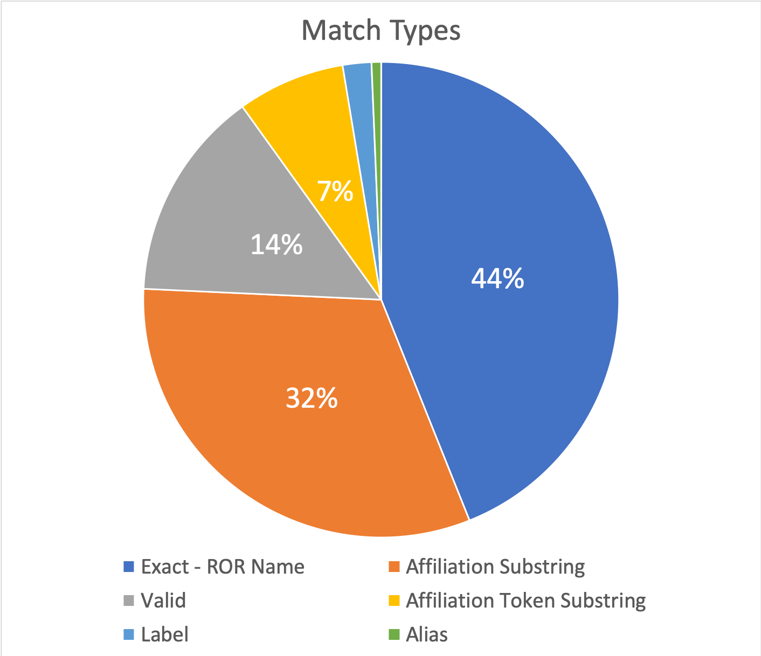
How well can we do matching RORs?
We have explored several approaches to identifying organization names in affiliation strings and identifying ROR’s for those organizations.
The most common matches are exact once tokens are extracted.

Slide 8
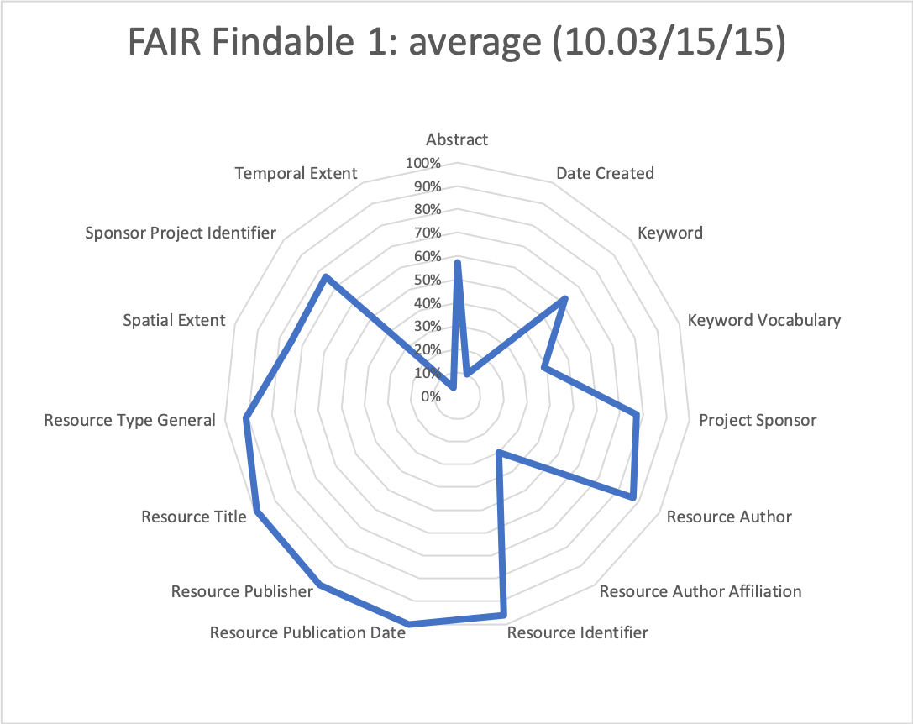
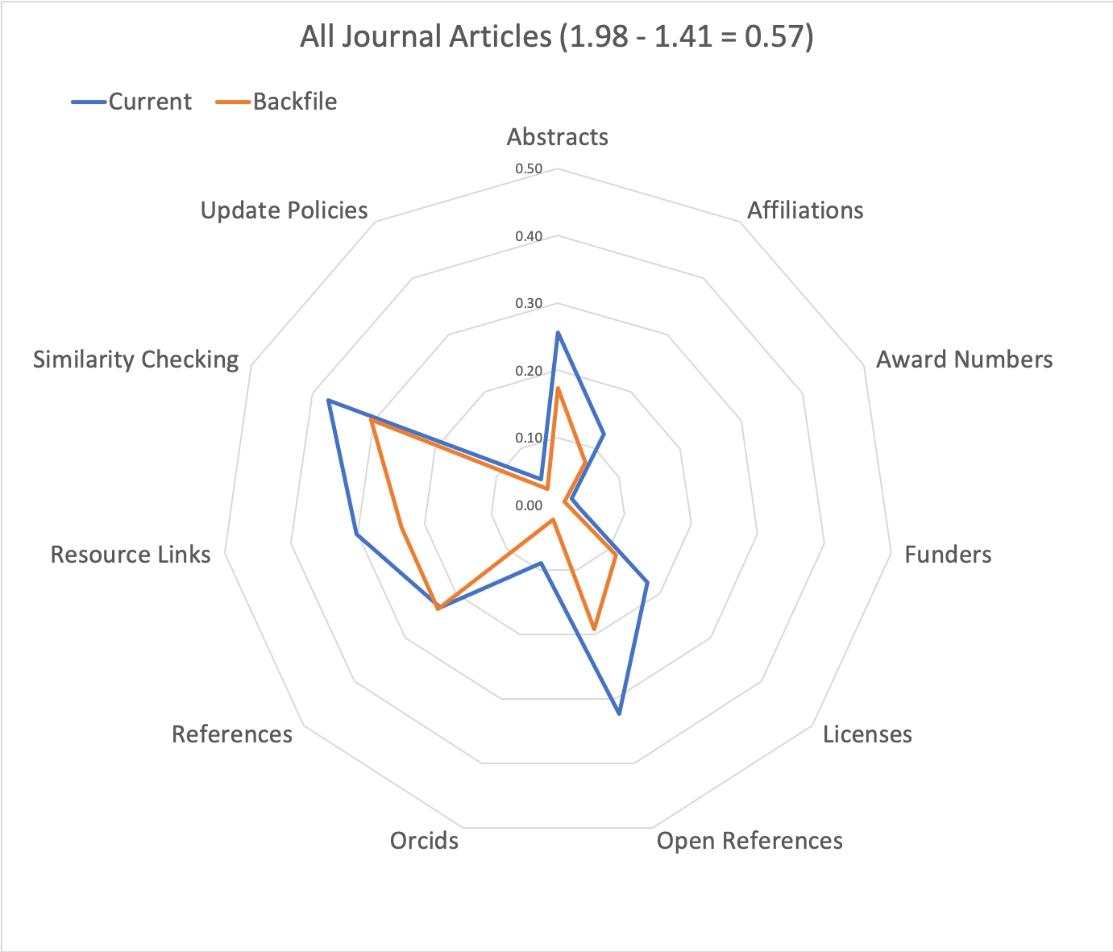
Other Collections - DataCite and Crossref
30%
5-11%

Slide 9
Challenges
Articles without accessible affiliations
Affiliations without organizations
Affiliations with unknown character sets
Organizations without RORs
Partners committed to evolving metadata content and repository tools

Slide 10
Repository Evolution
& Re-tooling

Slide 11
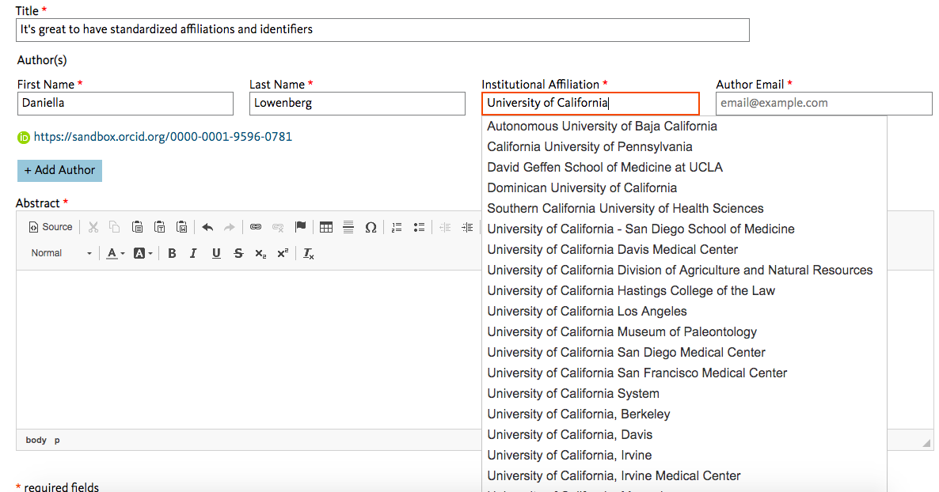

Slide 13
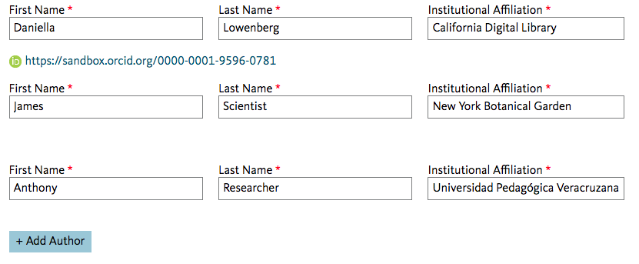

Slide 14
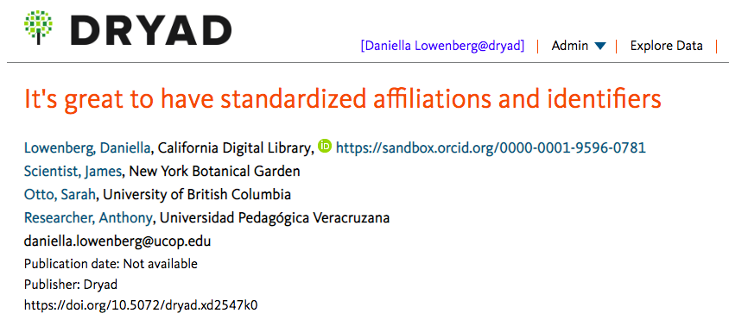

Slide 15
Questions?
Daniella Lowenberg - California Digital Library
Ted Habermann - Metadata Game Changers

