Slide 1
Rigorous scientific research in a neurodiversity framework: what, why, who, when, where & how?
Sue Fletcher-Watson
IoPPN, KCL
London, July 2019
@suereviews

Slide 2
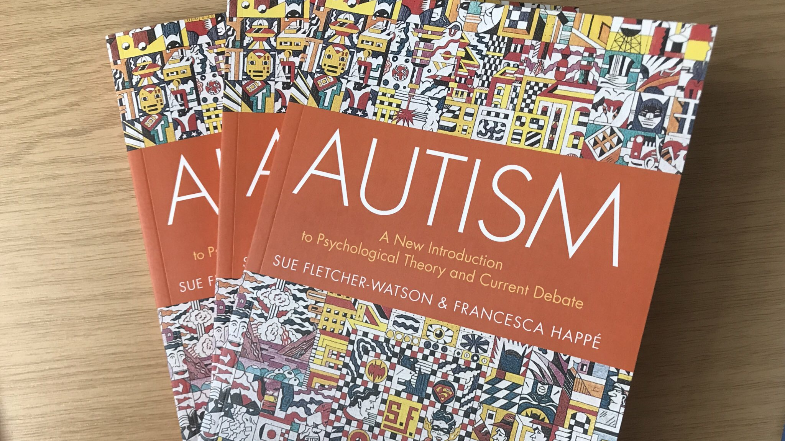
Thank you Franky
Notes:
Franky’s book an enormous influence on me = take nothing for granted in autism research. an intelligently critical take on evidence base - I hope we have continued through in the new book.
Current state of autism research – rather a mess. Pick a gene, brain region, cognitive domain and you can find evidence of something deficient or – more rarely – enhanced.
+ all we talk about in academia is pressure – short-term contracts & few jobs for ECRs, competition for funding + impossibility of managing time for established academics
In this context, what I’m going to talk about today could seem like yet more pressure – “I have do work with the community as well as EVERYTHING else?” But in fact it’s a pathway through the muddle. And in the context of limited resource, it is all the more important to ensure that our work MATTERS.

Slide 3
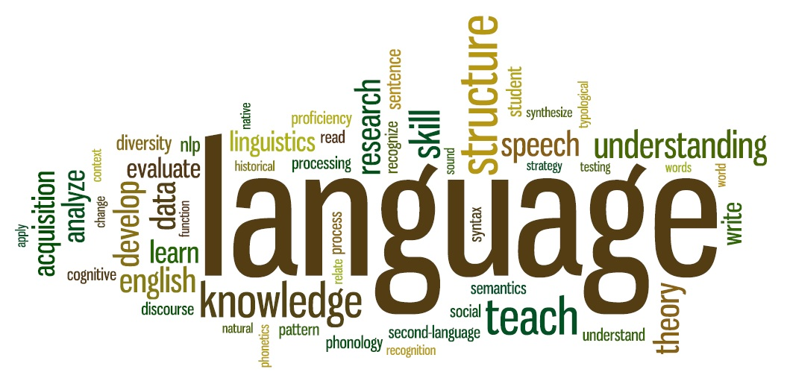
Outline
What neurodiversity is & what it is not
Why neurodiversity matters to science
Who is responsible?
When & where to think about participatory working
How to work in partnership
Visions for the future

Slide 4
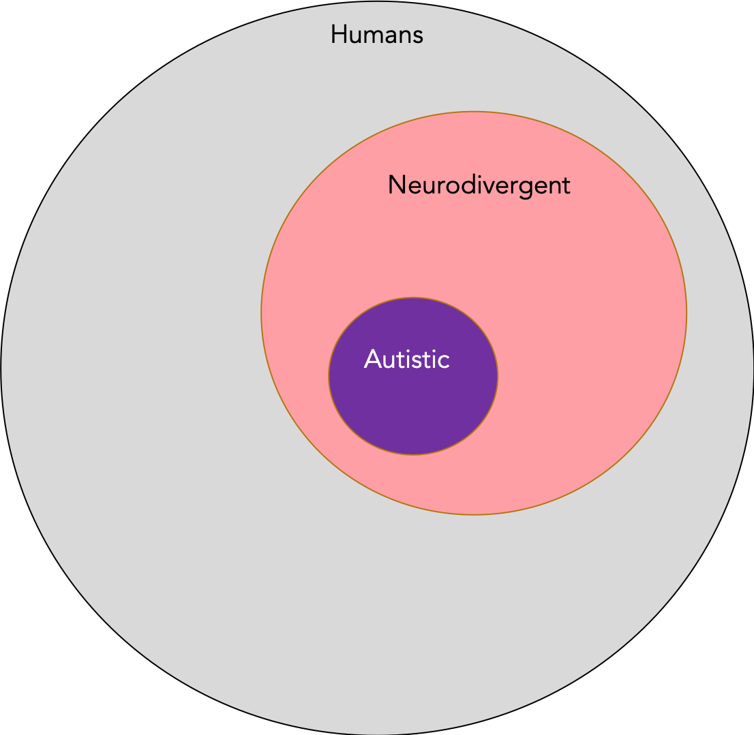
Neurodiversity: what?
Neurological = brain based
Diversity = differences / variation
Naturally occurring
Associated with
Disability rights
Social / post-social model of disability
Autism, but other neurodiversities too

Slide 5
@scrappapertiger

Slide 6
What it doesn’t mean
Denying disability or support
Focusing only on adult advocates
Excluding parents
Introducing bias
Forgetting about autistic researchers
Abandoning good science

Slide 7
Why: moral principles
Part of the Equality & Diversity agenda
Disability alongside ethnicity, sexual orientation, gender, religious belief
Accommodating learning disability = fundamentally anti-capitalist
Historic abuses and vulnerabilities
Not so historic
Autistic scholars and community leaders
Demand
Opportunity
#nothingaboutuswithoutus
Notes:
Part of the Equality & Diversity agenda – disability rights is like any other rights movement
Historic abuses and vulnerabilities – we have a lot to make up for (and it is still ongoing: cite electric shocks in USA)
Autistic scholars and community leaders – opportunity to work with people with unique combination of lived experience and professional skills

Slide 8
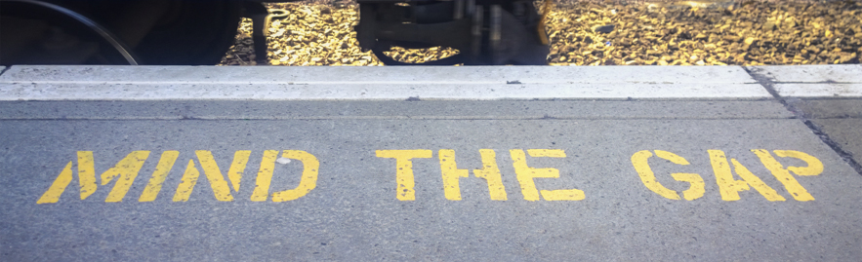
Why: scientific necessity
Insights into hard-to-reach populations
Minimizing research risks
Translation & implementation
Funder requirements
Notes:
Insights into hard-to-reach populations – very hard to understand autistic people who don’t speak, have intellectual disabilities
Minimizing research risks – recruitment, acceptability and feasibility
Translation & implementation – making your work relevant to the community (including far into the future e.g. biological sciences)
Funder requirements – increasing expectation of PPI and participatory working

Slide 9
What about ”wet lab” research?
Not relevant to the community
Lack of skilled partners
Hard to explain to people
Hyper-relevant due to timeline
Build a network, work with APOs
Work with experts, seize opportunities

Slide 10
Why are we here?

Slide 11
Why: scientific necessity
Insights into hard-to-reach populations
Minimizing research risks
Translation & implementation
Funder requirements
Latest evidence and theory

Slide 12
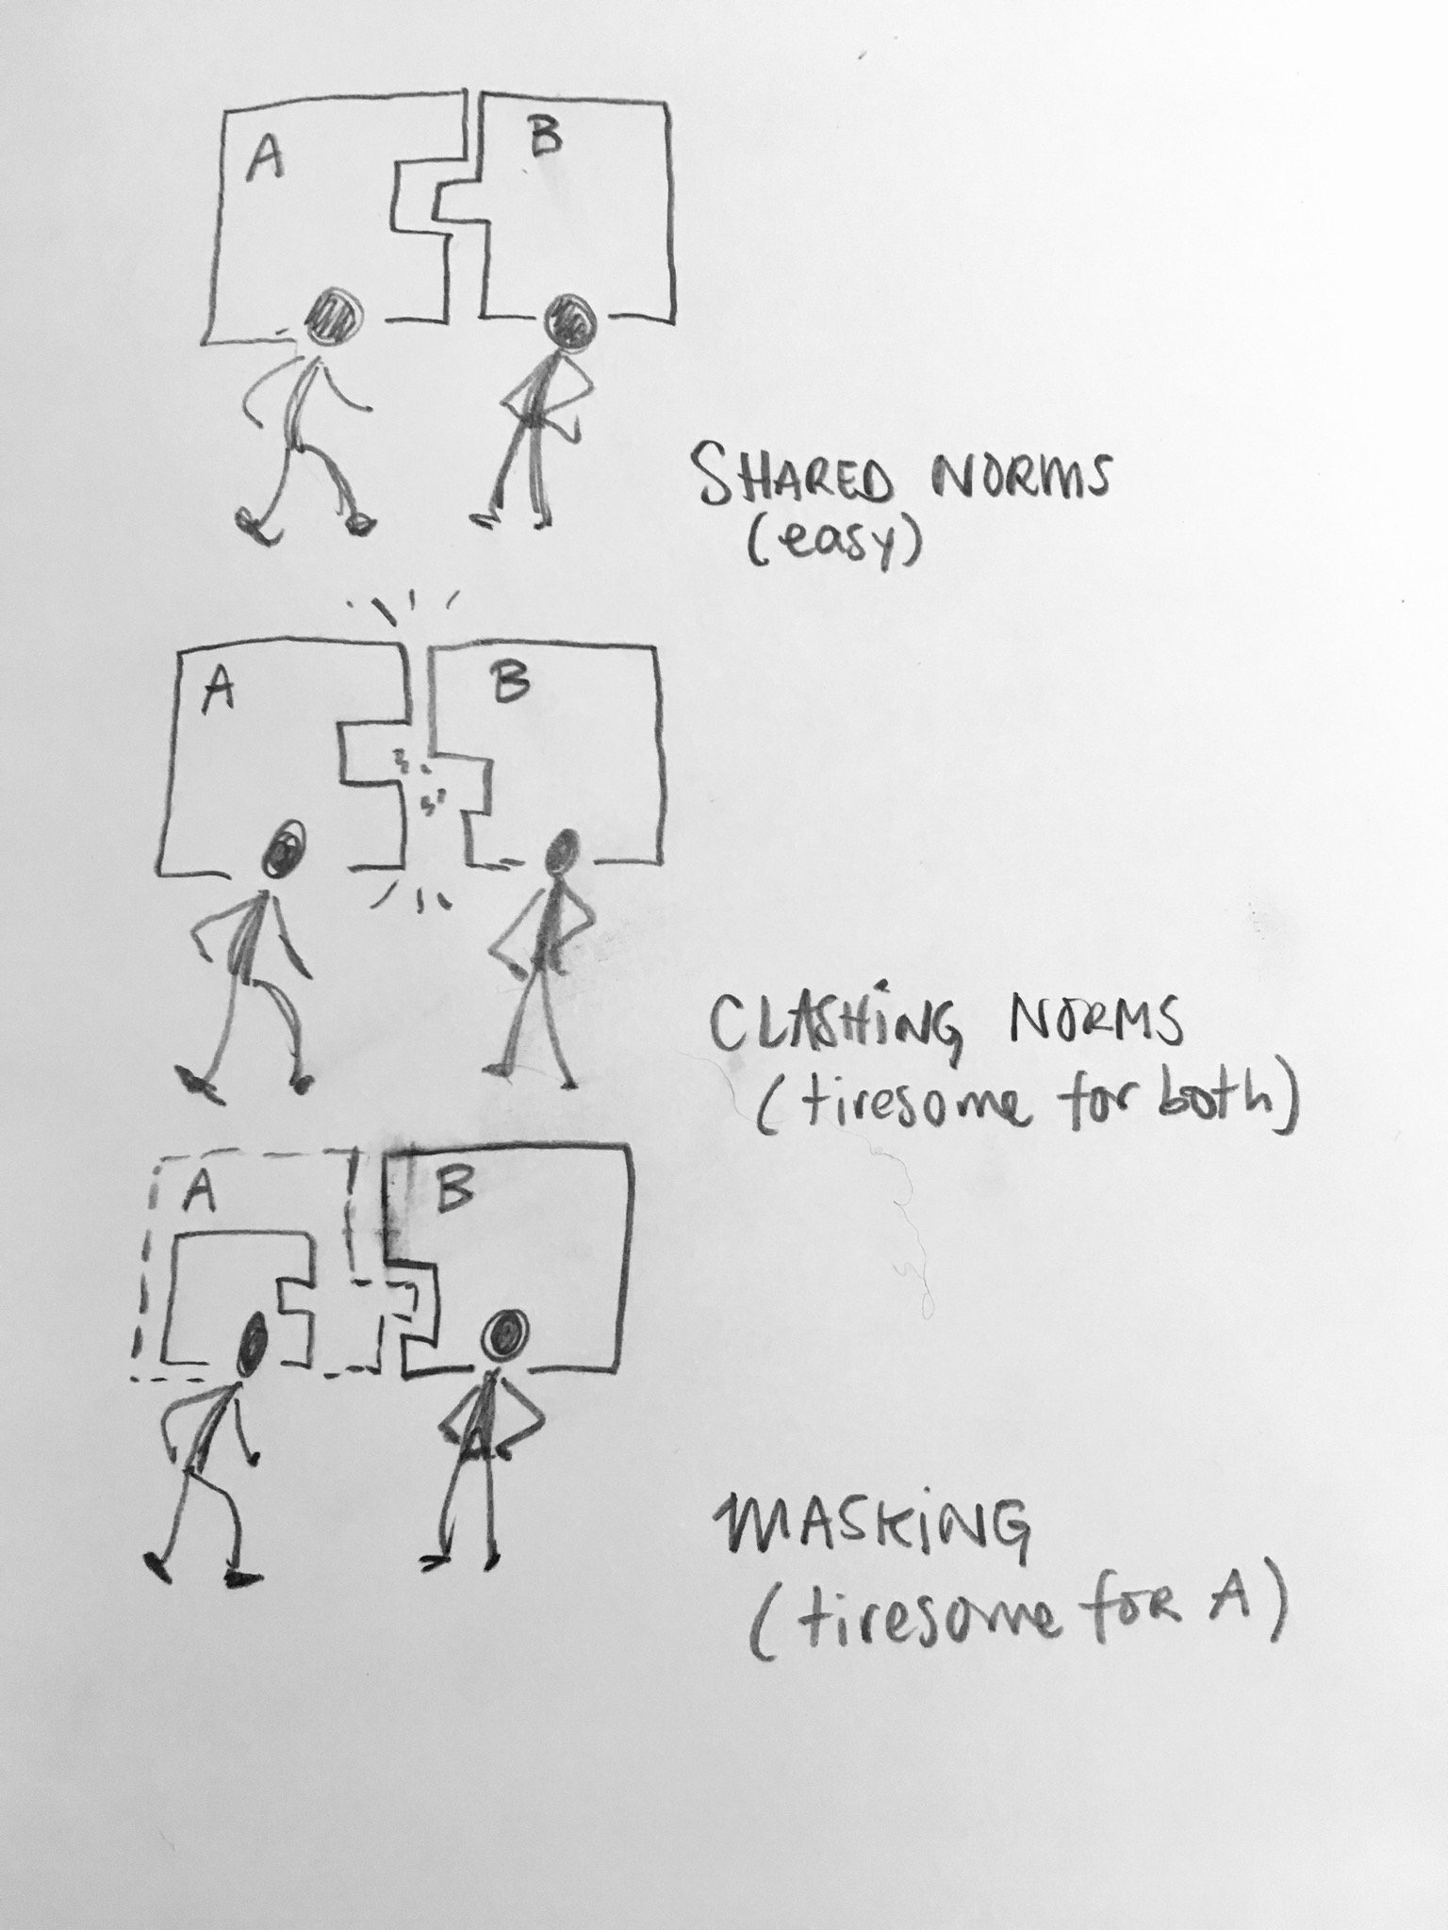
The Autistic / Neurotypical Divide
@theblub
Thin-slice judgements
AQ scores and in-group / out-group status
Judging emotional responses across diagnostic boundaries
Double-Empathy Problem
…but we don’t know much (empirically) about how autistic people interact with other autistic people.
Chevallier, 2014; Edey et al, 2016;
Gernsbacher et al, 2017; Milton, 2012; Sasson et al, 2017; Sheppard, 2016; Stagg et al, 2013

Slide 13
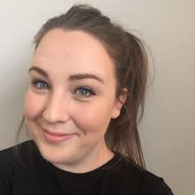
We set out to discover how autistic people relate to each other
Interviews
Diffusion chains
Paired conversations
Independent judgements
Rapport ratings
@cjcrompton

Slide 14
If I am surrounded by lots of neurotypical people I cant let all my autisticness out….
When I first self-diagnosed and I started finding blogs and autistic people on twitter, it blew my mind that there were all these people out there who just got me. I didn’t have to explain stuff, they just got it because they lived it too. I kept wanting to shout “I have found my people!”
Minority status
Cross-neurotype difficulties
I do like my neurotypical friends, but oh they make me tired, they don't understand me. Even if it's good it's exhausting.
Belonging

Slide 15
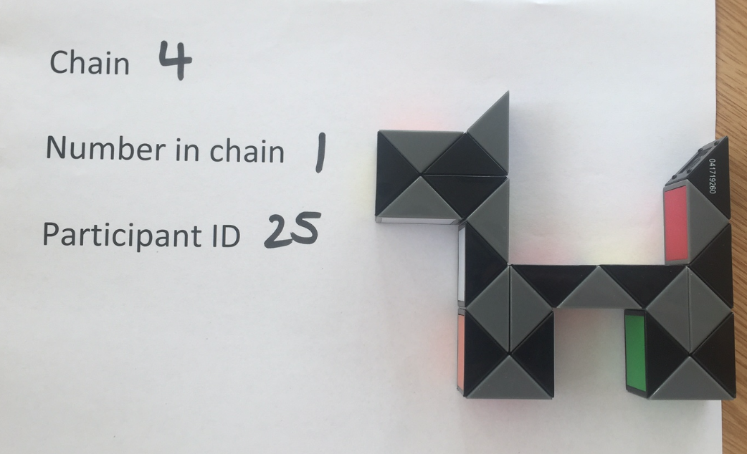
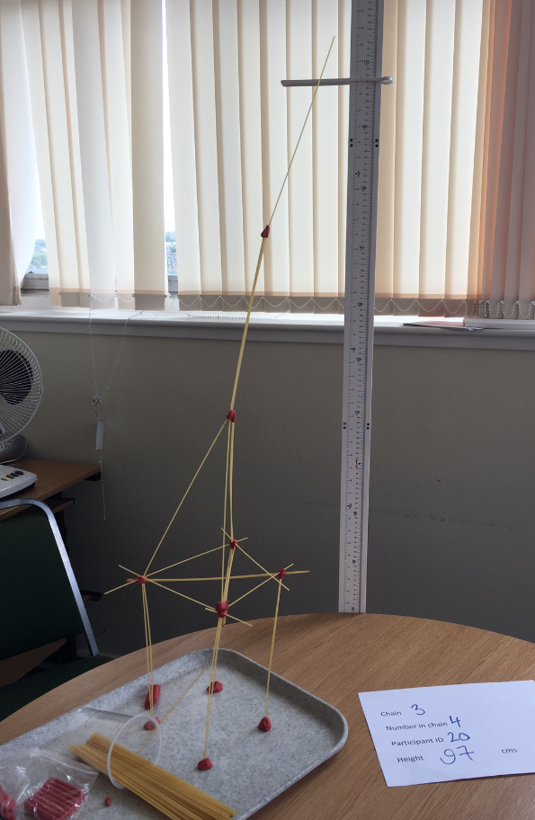
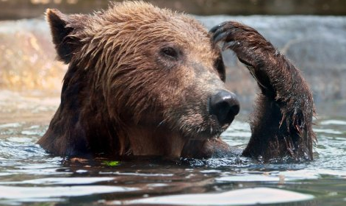
Diffusion chains
Exploring information sharing in a controlled way
Chains of 8 people (n = 72)
All autistic, all neurotypical, or alternating autistic and neurotypical

Slide 16
Story Recall
Autistic and non-autistic groups shared information similarly well
Alternating between autistic and non-autistic people meant less information was passed on.

Slide 17
Story Recall: the stats
 | Estimate | Std Error | t | p
Intercept (Neurotypical chains) | 22.10 | 0.94 | 23.61 | <0.0001*
Main effects
Group: Autistic chains | 0.13 | 1.32 | 0.09 | 0.9251
Group: Mixed chains | -6.04 | 1.32 | -4.56 | <0.0001*
Order in chain | -2.15 | 0.18 | -11.63 | <0.0001*
Interactions
Group: autistic * order in chain | 0.09 | 0.26 | 0.37 | 0.71
Group: mixed * order in chain | 0.57 | 0.26 | 2.17 | 0.03*
Residual standard error: 2.08 on 66 degrees of freedom. Multiple R-squared = 0.85; adjusted R-squared = 0.84. F statistic: 77.05 on 5 and 66 DF, p-value: < 2.2e-16

Slide 18
Key Findings
qualitative differences in real-world experiences of interaction
Autistic people share information effectively between each other
Information sharing selectively breaks down across neurotypes
Feelings of rapport accompany information-sharing benefits
External observers can detect the lack of rapport apparent in mixed interactions
External observers may mis-attribute the source of the social breakdown

Slide 19
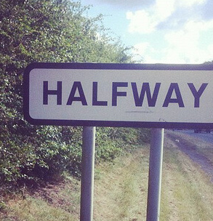
Outline
What neurodiversity is & what it is not
Why neurodiversity matters to science
Who is responsible?
When & where to think about participatory working
How to work in partnership
Visions for the future

Slide 20
Who
Us, we have the power
When
Now, all the time
Where
Everywhere
Giving opportunities means sacrificing privilege
Investing in expertise & connections for the future
Opening the door: as reviewers, employers, funders, advisors
From first concept to final implementation
Leading by example: inspiring policymakers and practitioners to do the same
On our taught and research courses
At academic events
In global research contexts

Slide 21
How to work in partnership
Working with neurodivergent people
Understanding their needs and priorities
Delivering meaningful research
Useful
Respectful
Kind

Slide 22
Participatory research as a framework
Research methods
qualitative
quantitative
Academic disciplines
psychology
biology
Public engagement
science communication
knowledge exchange
Participatory working
partnership
consultation
Notes:
Hum to vote for language

Slide 23
Types of participatory research
Consultation
Collaboration
Partnership
Citizen science
leadership

Slide 24
Getting the basics right
Principles of engagement
Trust
Mutual respect
Listening & learning
Practical considerations
Building personal relationships
Planning & preparation
Fair payment
Transparency, honesty
Willingness to change
www.shapingautismresearch.co.uk

Slide 25
Taking it up a level
Fletcher-Watson et al, 2019

Slide 26
Outline
What neurodiversity is & what it is not
Why neurodiversity matters to science
Who is responsible?
When & where to think about participatory working
How to work in partnership
Visions for the future

Slide 27
Consultation: Social media
Putting the advice of individual mentors / advisors in context
Following the latest debates
Understanding diversity within as well as between communities
Building a wide network of allies
Disseminating science direct to communities

Slide 28
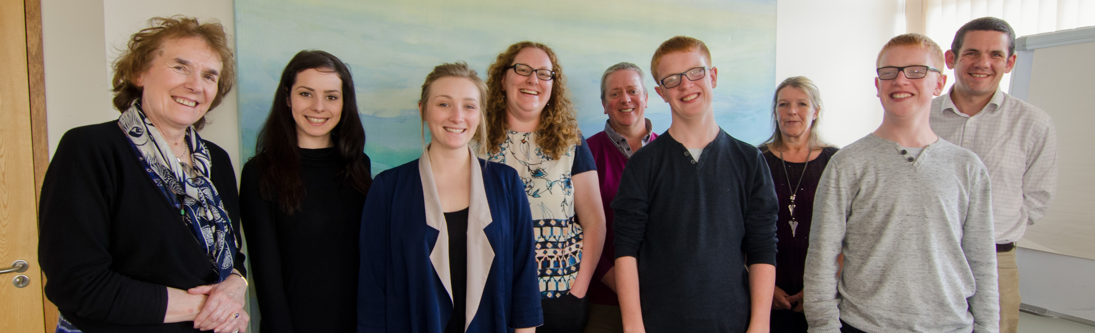
Collaboration: embedded experts
Consultation on trial design and materials
Sharing and interpreting results
Informed stakeholders for the advisory board
(in future) co-created outcome measures
→ lived experience roles within PhD programme

Slide 29
Partnership: mentors
Integrated from the earliest seed of an idea
Paid from core funding
can advise on student mini-projects & grants that don’t get funded
A chance to build a close working relationship
Problem solving and trouble-shooting
Equal power and partnership
→ Kabie Brook, Autistic Parenting Project
Notes:
Hum to vote for language

Slide 30
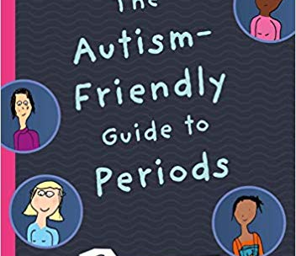
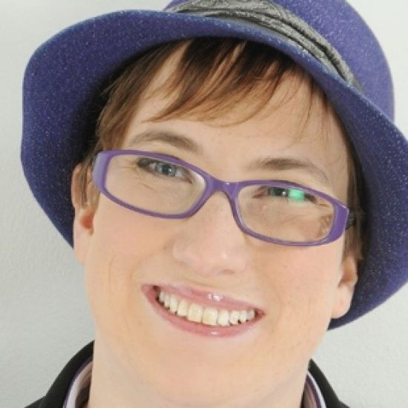
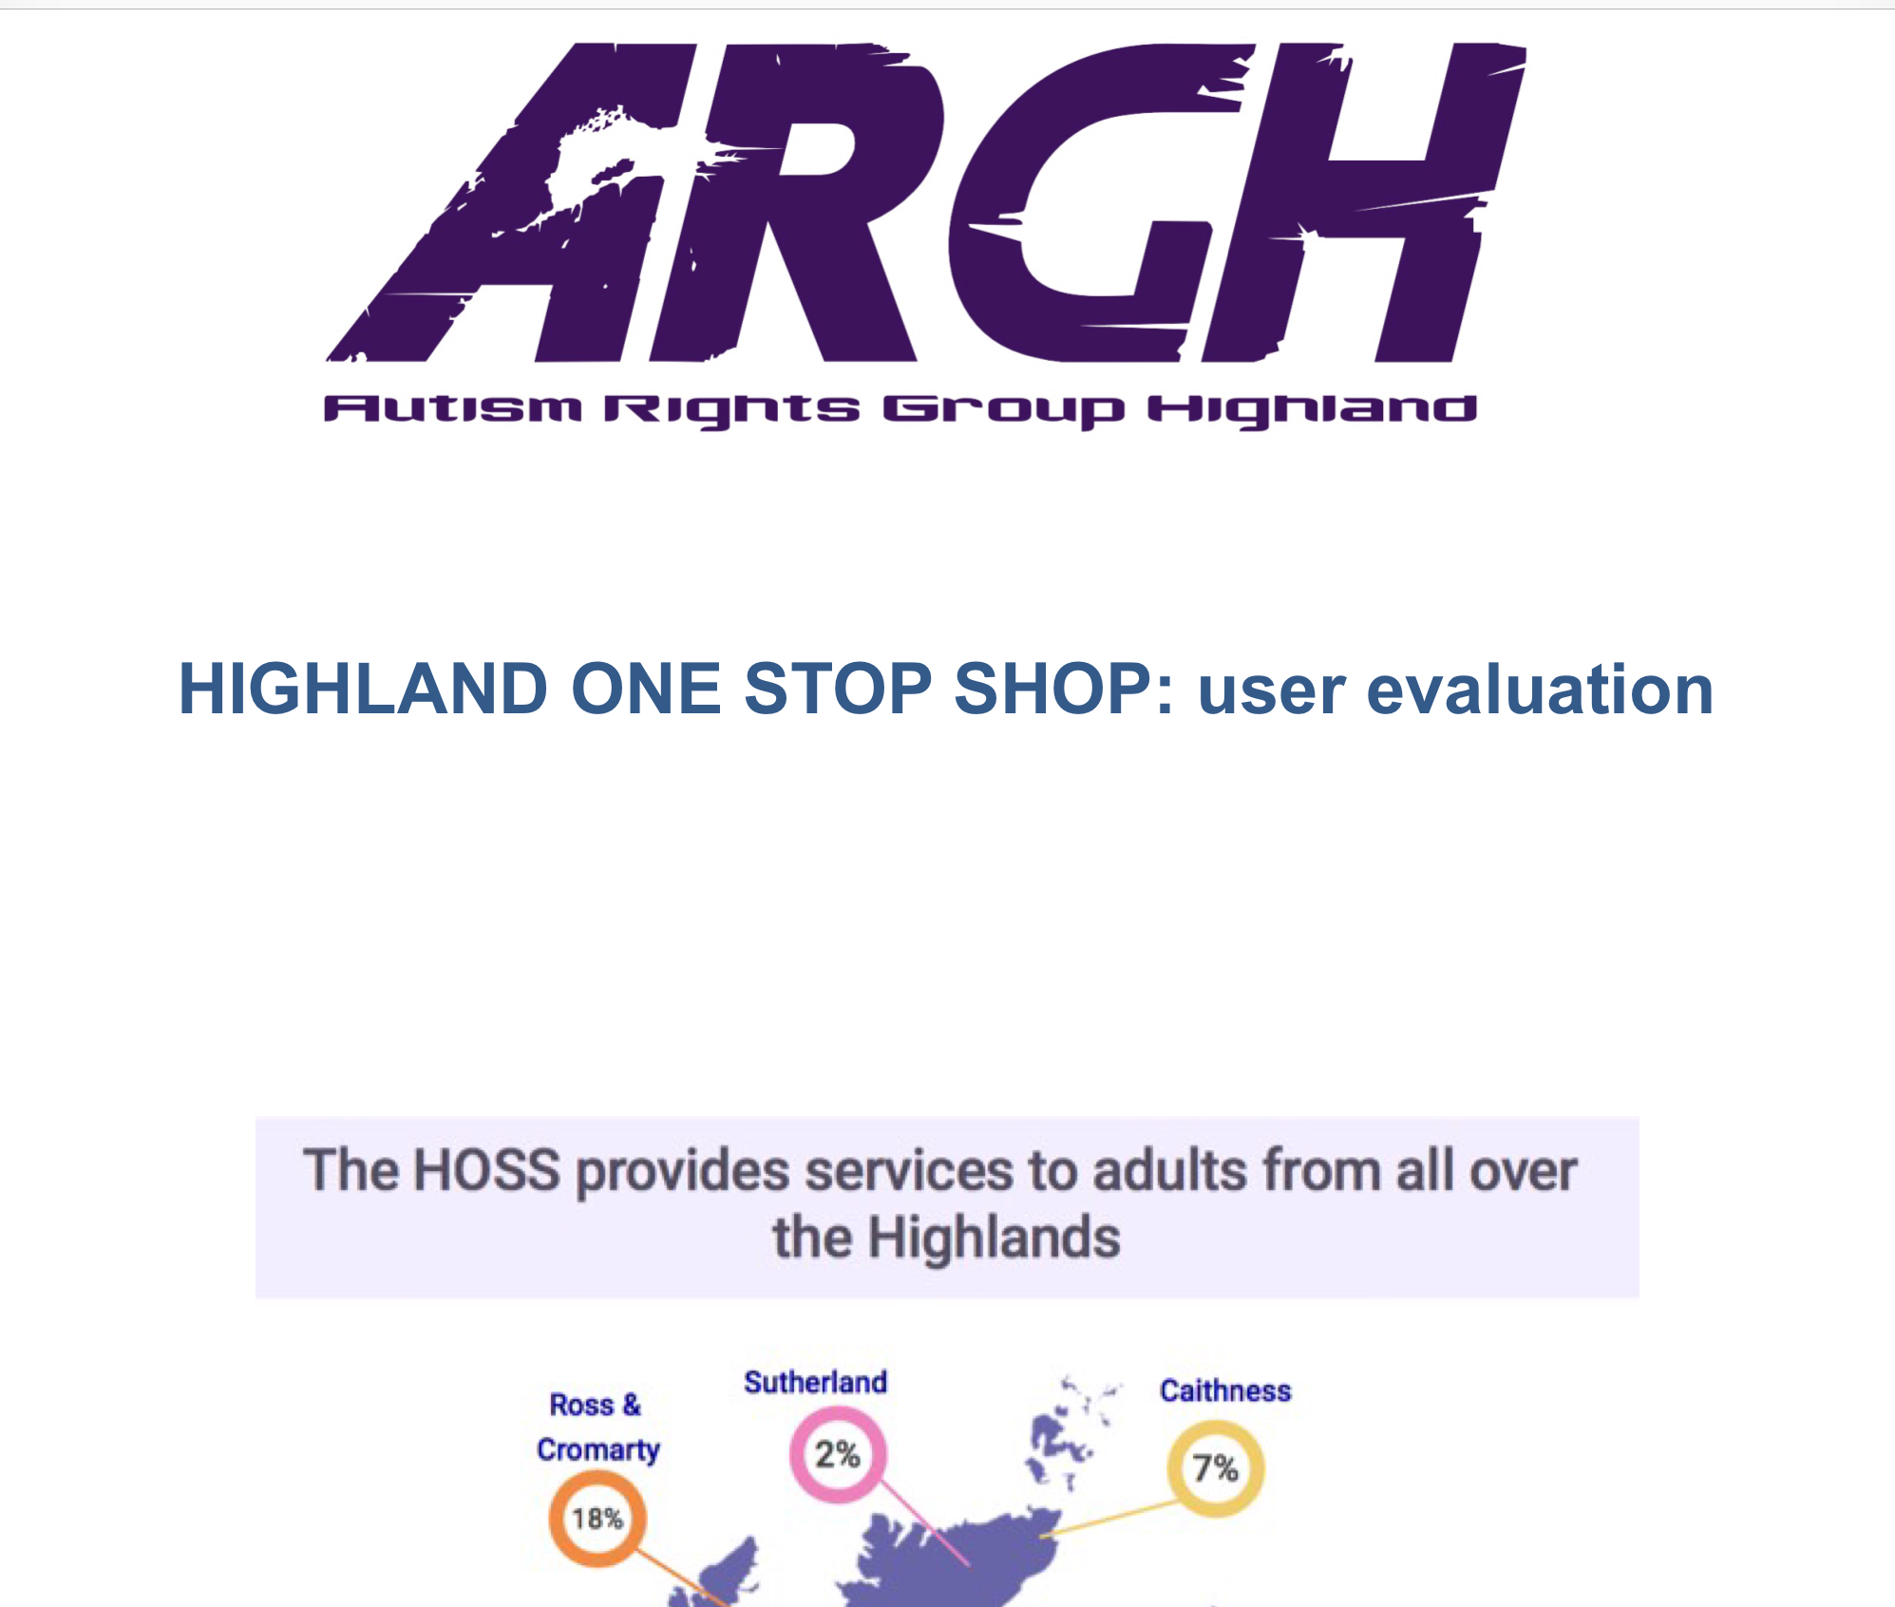
Leadership: Individuals and APOs
Working with Autistic Peoples Organisations to polish and disseminate their work
Providing support for governance, project management, policy & lobbying
Ensuring their presence at events and on committees
Responding in an open and timely manner to their queries

Slide 31
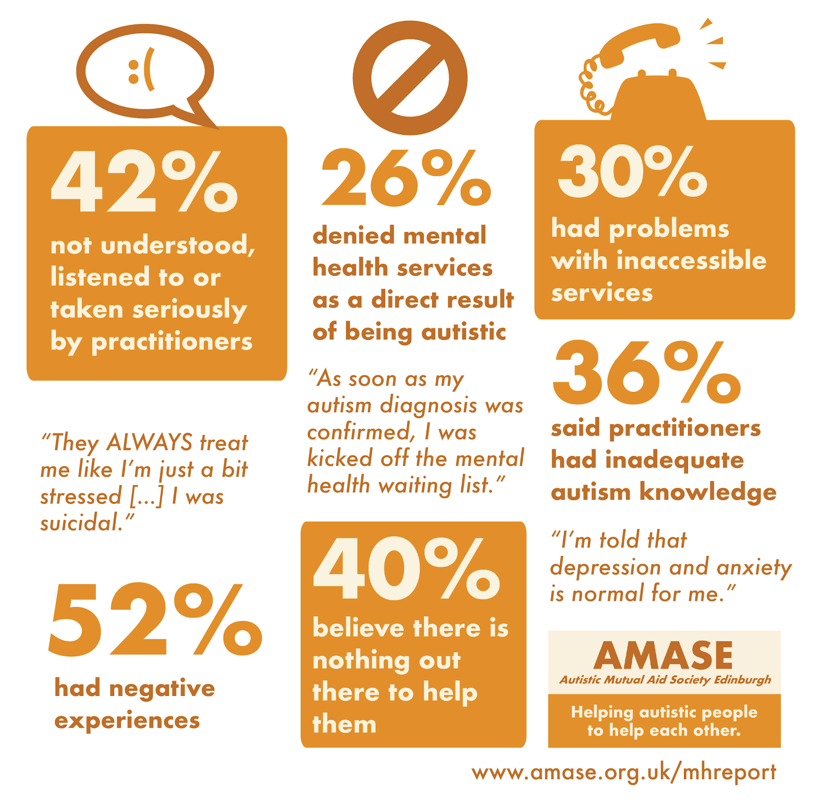
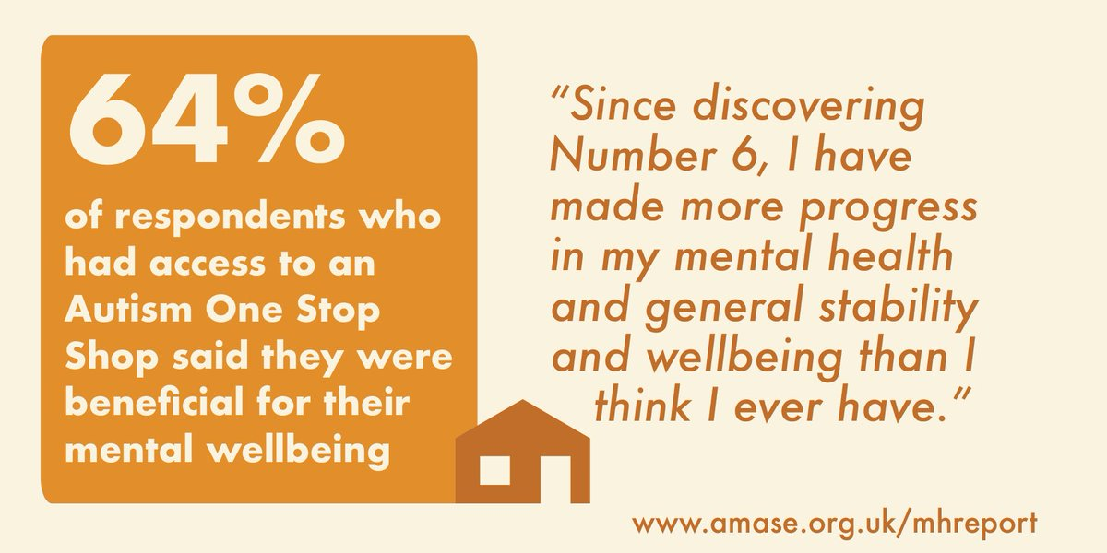
Citizen Science
Autistic Mutual Aid Society Edinburgh
Community survey on mental health: Too Complicated To Treat
Influence on Scottish government policy
Our role
Report design
Infographics
Signal boosting

Slide 32
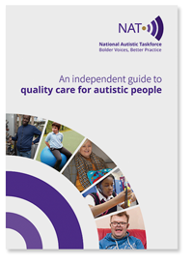
Citizen Science
National Autistic Taskforce
Our role
Consultation on building an evidence base
Signal boosting
Supporting staff recruitment

Slide 33
The end result
Empowered neurodivergent people
Supports that people want and use
Skilled and informed community collaborators
AND
Robust theory & methods
Evidence-based supports
High quality research

Slide 34
Outline
What neurodiversity is & what it is not
Why neurodiversity matters to science
Who is responsible?
When & where to think about participatory working
How to work in partnership
Visions for the future

Slide 35
What can we hope for?
Successful engagement with people with learning disabilities
Valuing people on a non-economic basis (while also paying them!)
Building autonomy rather than independence
Neurodivergent leadership is commonplace
Maturity and confidence in the disability rights movement
Partnership as a matter of course
Open science, good academic citizenship

Slide 36
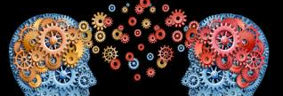
We can have it all
Neurodivergent people deserve the best
Awareness
Understanding
Support
Services
Neurodivergent people deserve the best
Theories
Questions
Methods
Measures
Data

Slide 37
Thank you
Autistic mentors: Kabie Brook, Fergus Murray
APOs: Autism Rights Group Highland, Autistic Mutual Aid Society Edinburgh, Participatory Autism Research Collective
Diverse Social Intelligence: Catherine Crompton, Claire Evans-Williams, Emma Flynn, Sonny, Hallett, Cos Michael, Dani Ropar
Family in Residence: Matthew, Stuart, Gillian & Craig McDonald
Shaping Autism Research: Jon Adams, Kabie Brook, Tony Charman, Laura Crane, James Cusack, Sue Leekam, Damian Milton, Jeremy Parr, Liz Pellicano + more….
www.dart.ed.ac.uk

