Slide 1
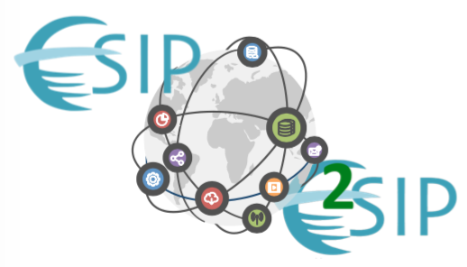
The Earth Science Information Partners:
Globally Connected Networks of Earth, Space and Environmental Science Data Practitioners Making Data Matter
Erin Robinson, Executive Director
ESIP
2019 ESIP Summer Meeting July 15, 2019 | Tacoma, WA
www.esipfed.org
@ESIPfed | #ESIPfed
ESIP is supported by
and 110+ member organizations

Slide 2
Making Data Matter
Old Way
Pre-Science
Find data
Retrieve high
volume data
Jan
Learn formats
and develop readers
Extract parameters
Perform spatial
and other subsetting
Mar
Identify quality and other
flags and constraints
Perform filtering/masking
Develop analysis
and visualization
Accept/discard/get more data
(sat, model, ground-based)
Jun
DO SCIENCE
Exploration
Initial Analysis
Sept
Use the best data for the final analysis
Derive conclusions
Write the paper
Dec
Adapted from Leptoukh, 2012
Present @ AGU
Notes:
The preprocessing and pre-science hurdles to find, access, understand and merge are well known, but increasingly discussed in a Sisyphean way. The user is forced to repeat these steps for each dataset they want to use.

Slide 3
Making Data Matter
Old Way
Pre-Science
Find data
Retrieve high
volume data
Jan
Learn formats
and develop readers
Extract parameters
Perform spatial
and other subsetting
Mar
Identify quality and other
flags and constraints
Perform filtering/masking
Develop analysis
and visualization
Accept/discard/get more data
(sat, model, ground-based)
Jun
DO SCIENCE
Exploration
Initial Analysis
Sept
Use the best data for the final analysis
Derive conclusions
Write the paper
Dec
Adapted from Leptoukh, 2012
Present @ AGU
Notes:
Often there are many users doing these same pre-science steps all in order to just do science. 20 years ago and even 8 years ago when this slide was developed we knew where we wanted to go but we didn’t know if it was possible. Recently, this picture has emerged in a different way – that we are all moving the ball forward together.

Slide 4
There is an urgent need to improve the infrastructure supporting the reuse of scholarly data.
- From The FAIR Guiding Principles for scientific data management and stewardship
Notes:
Brooks Hanson, AGU’s Sr. VP of Science wrote that there is an urgent need to improve the infrastructure supporting the reuse of scholarly data.

Slide 5
There is an urgent need to improve the [Global Collaborative] infrastructure supporting the (re)use of scholarly data.
- (Modified, Erin Robinson) From The FAIR Guiding Principles for scientific data management and stewardship
Notes:
I would actually modify to say that we are making great strides in the infrastructure, but what needs help is the Global collaborative Infrastructure for use and reuse. It is connecting people and organizations together that allow for us to all move the ball forward together. And at this point we are a bit fragmented.

Slide 6
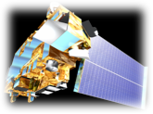
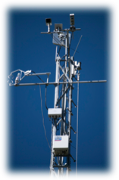
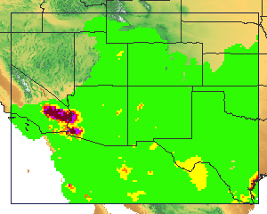
ESIP Vision
Leaders in promoting the collection, stewardship and (re)use
Of Earth science data, information and knowledge
that is responsive to societal needs.
Notes:
ESIP has a vision to bring distributed groups together across the data lifecycle from data providers, to researchers to application developers in order to promote the collection, stewardship use and reuse of earth science data and information. By bringing these people together they all become leaders across the field.

Slide 7
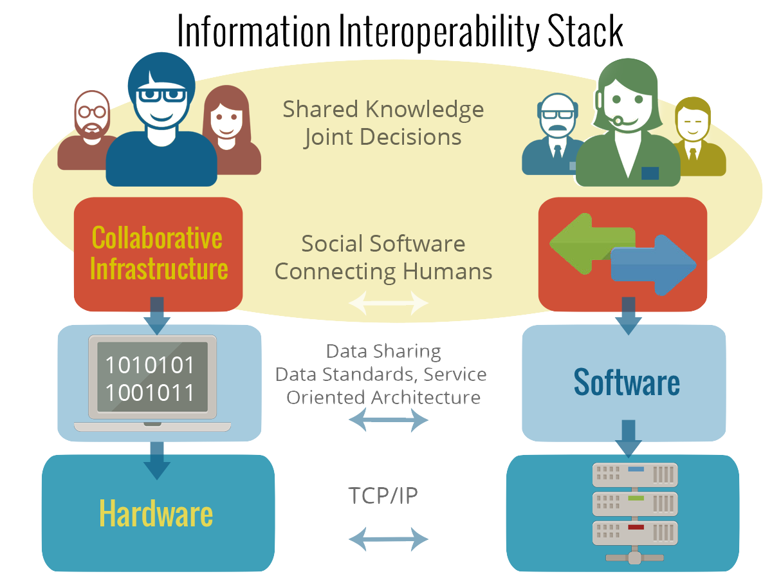
ESIP does:
Generate influential recommendations and work products
Have a lasting impact in the recommendation of standards.
ESIP does not:
Provide data
Sustain cyberinfrastructure
Compete with our members
Develop standards
Notes:
All of this together leads to an improved awareness at the individual and organizational level. Groups agree at ESIP on conventions or standards implementations or maybe feedback on a particular standard that can be taken to the standards organization and then go back to their home institution and actually implement. So ESIP does provide products like data citation guidelines that many organizations adopted as their own stricter directives. ESIP does not provide data infrastructure. We don’t sustain cyberinfrastructure, compete with our members or develop standards.

Slide 8
Three Approaches
In-Person Workshops & Meetings
Collaboration Areas | ESIP Lab
Notes:
ESIP takes three approaches to facilitating community interaction – In person meetings and workshops like E2SIP in May in Canberra, Australia and ESIP’s Summer Meeting in Tacoma, WA.Virutal collaboration areas that have distributed governance from loosely formed clusters to standing committees on key thematic areas like data stewardship, Education and Semantic Tech and clusters on emerging topics that include drones, envirosensing and machine learning (full list in ref slides). Finally, ESIP has a virtual Lab that allows our members to pilot high risk ideas in a low risk environment. Successful ideas coming out of the lab have often continued on to be funded at a larger scale by one of our partners like NASA or NSF. I will spend most of this talk focused on workshops, but if you are interested in collaboration areas or the Lab please see me after.

Slide 9
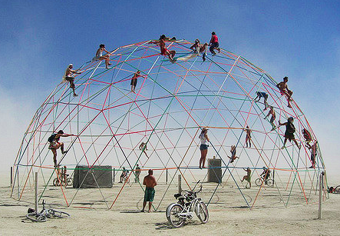
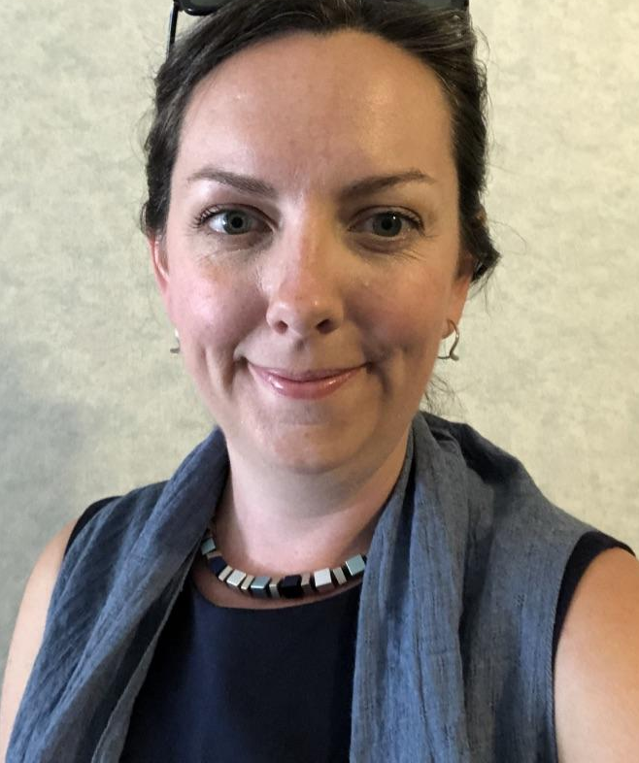
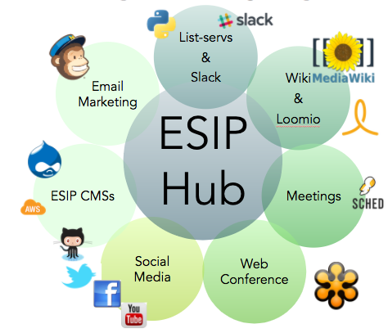
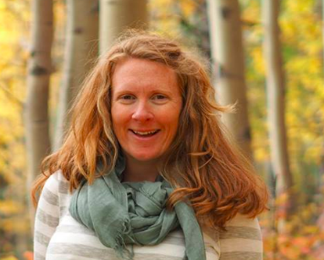
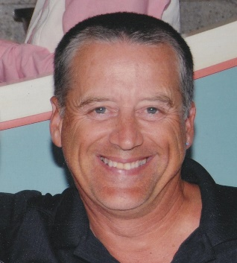
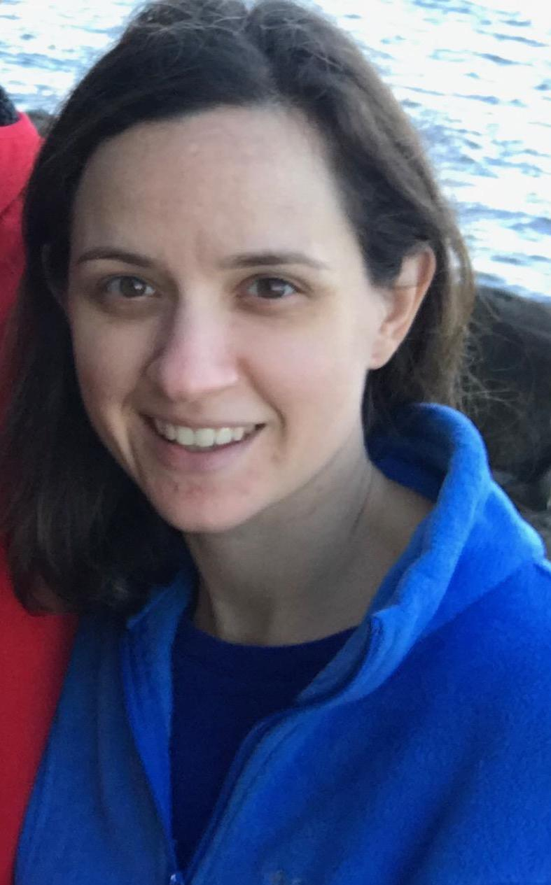
ESIP Backbone
Erin Robinson
Annie Burgess
Dan Keyes
20 years – Core funding through NASA, NOAA, USGS
Megan Carter
Notes:
ESIP Members and the three approaches are coordinated by a small staff team and a suite of collaborative services that are free for the entire community to use.
-----
ESIP provides community coordination to support interoperability at the data, systems, human and organizational levels. Virtual Elements (removes geographic, financial, temporal boundaries)
Social Media (Facebook, Twitter, LinkedIn, Vimeo)
Teleconferencing and web conference services (WebEx)
Content Management Systems (wikis, drupal)
List-servs
In Person Elements
Meetings January & July
Using social media to connect to outside communities

Slide 10
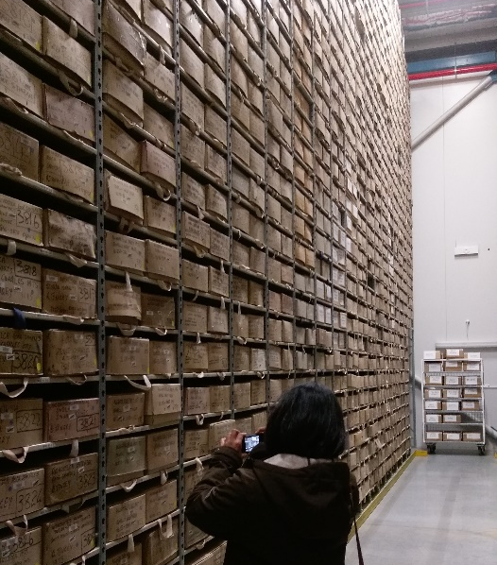
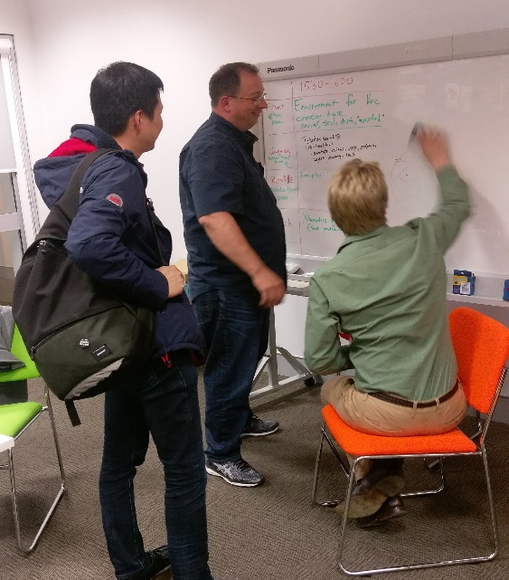
2017 Cutting edge science symposium – Linking environmental data & samples
Canberra, May 2017 – 3 days
~70 participants, 18 international, ESIP co-chair
Geoscience, marine, ecosystems, biodiversity, climate
Field trip, presentations, un-conference (breakouts), anti-conference, up-goer challenge
Notes:
In the last two years we begun exploring how to connect ESIP activities more globally. This started with a joint workshop in Australia on Linked Open Data and Samples. Erin Robinson, ESIP’s Executive Director, was included in the planning and steering committees that organized this group to leverage her expertise in running data community meetings effectively At the end of this week, Erin along with representatives from CSIRO, NCRIS Facilities, ANDS now ARDC, NCI and GA got together with ESIP ED and then President Peter Fox to discuss ESIP’s origin and method as well as the possibility of an ESIP down under.

Slide 11
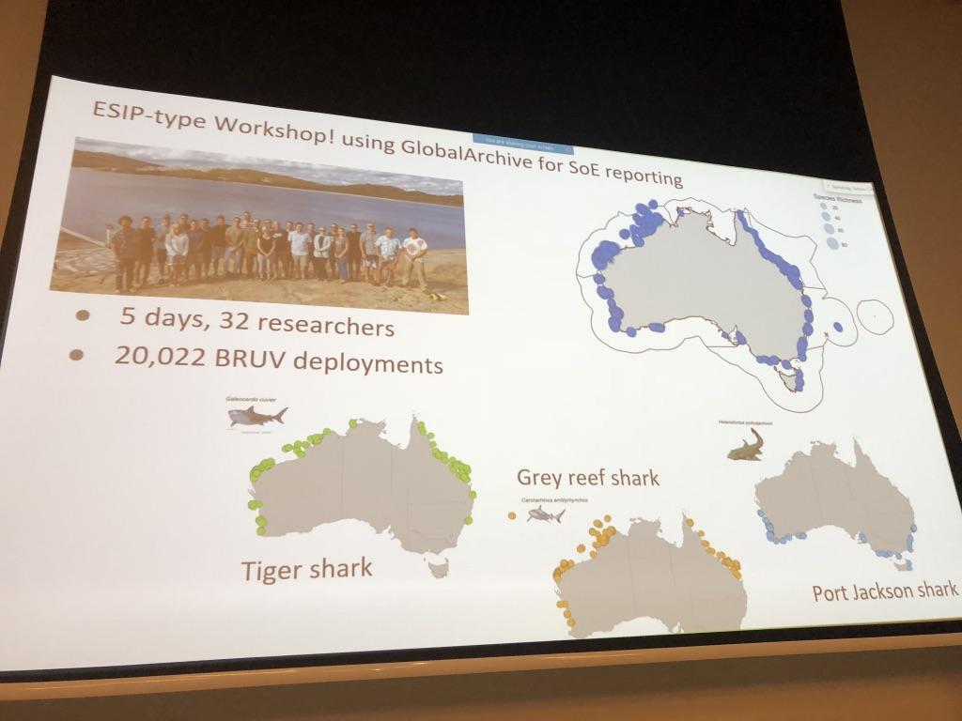
Notes:
One interesting note was that ESIP had come ahead of this E2SIP meeting. Roger Proctor, Director (now retired) of IMOS was the first Australian organization to join ESIP and had been following along completely remotely, but had adopted an ESIP type workshop approach for IMOS. This idea of taking what works and empowering the community to organically spread this collaborative layer is very exciting to us and one of the key ways that ESIP will be sustained and globalized.

Slide 12
ESIP Mission
To support the networking and data dissemination needs of our members and the
global Earth science data community
by linking the functional sectors of observation, research, application, education and use of Earth science.

Slide 13
ESIP Internationalization Strategy
Developed by ESIP Board following May 2017 Workshop
Four options:
Business as usual
Become an international organization
Be an international facilitator
A U.S. organization with strategic initiatives
ESIP has been exploring options 1, 3 & 4

Slide 14
ESIP Internationalization Strategy
Developed by ESIP Board following May 2017 Workshop
Four options:
Business as usual
Become an international organization
Be an international facilitator
A U.S. organization with strategic initiatives

Slide 15
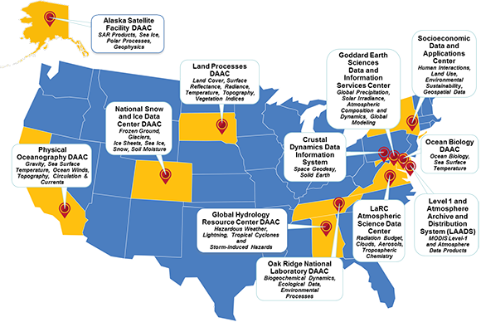
Types of ESIP Members
Type I: Data Centers
Type III: Application Developers
Type IV: Strategic Partners
Type II: Researchers and Tool Developers
And many more! ESIP has 110+ Members
Notes:
ESIP Is a membership organization of over 110 organizations and these are some of our members to give you an idea. Membership is free and provides organizations a voice in the topics of significant interest to the informatics community. ESIP is fortunate to be supported by NASA, NOAA and USGS through three cooperative agreements.

Slide 16
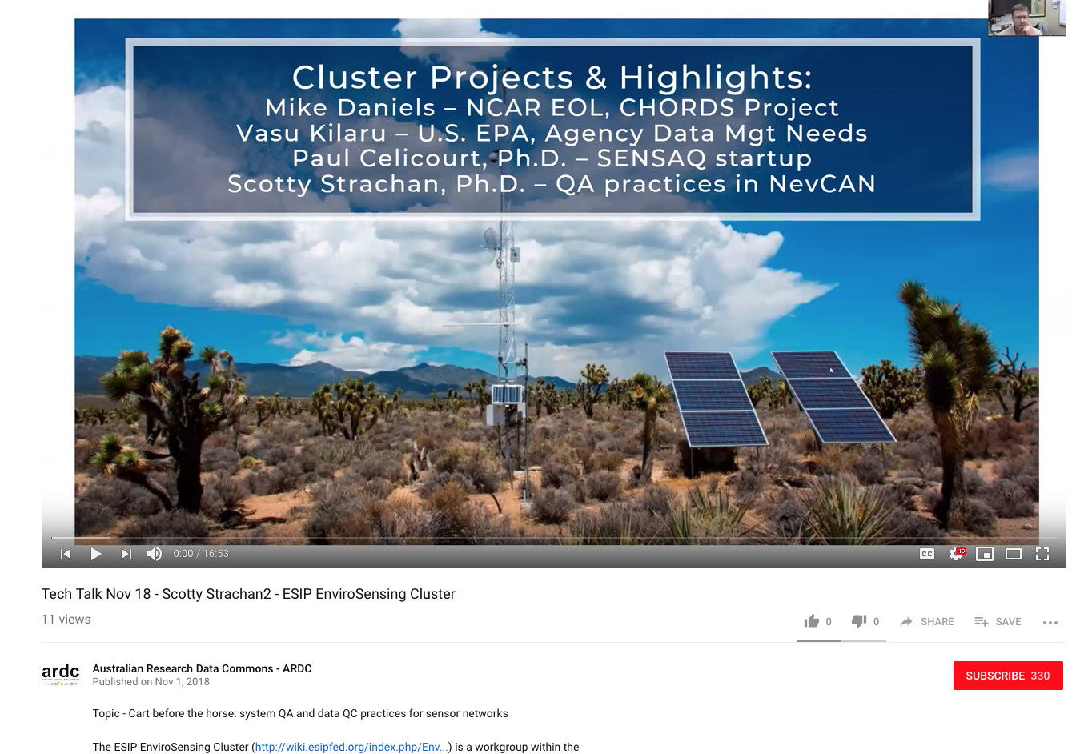
E2SIP Cluster & ARDC/ESIP Joint Telecons
March 2019 – Joint Information Quality Telecon

Slide 17
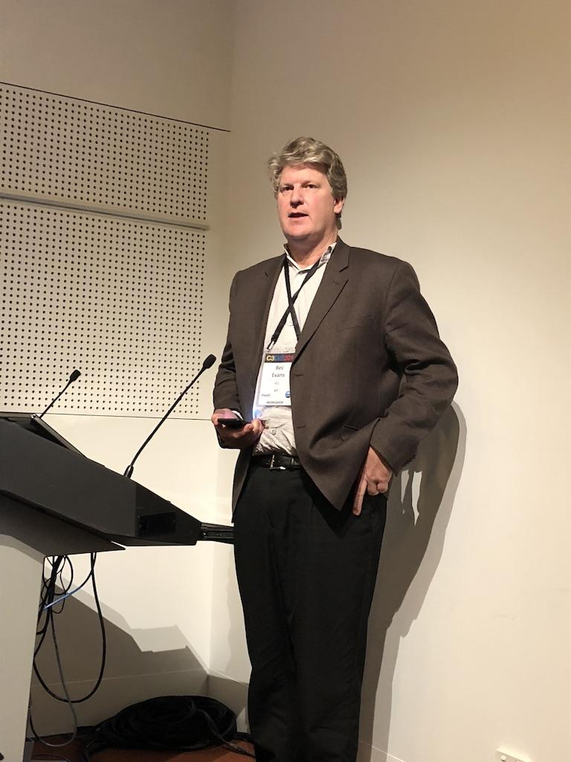
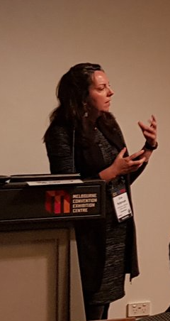
2018 & 2019 E2SIP @ C3DIS
Pre-conference workshop - http://www.c3dis.com/1725 - 09:00–18:00
~40 in the rooms (6 international), ~5 remote (2 international)
ESIP on organizing committee
6 NCRIS facilities + CSIRO + GA + CRCSI + 2 state govts + …
Notes:
In 2018, we worked with that core group to convene the first E2SIP meeting in Melbourne collocated with C3DIS, the CSIRO all-hands meeting. The meeting was a successe.

Slide 18
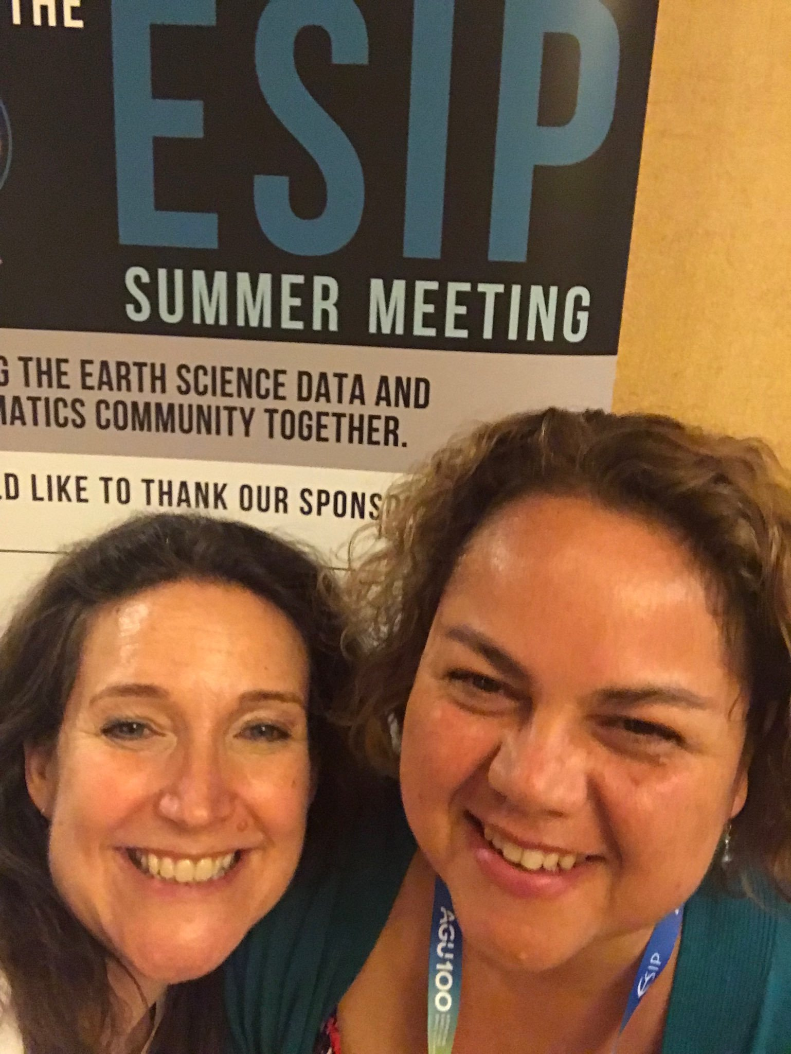
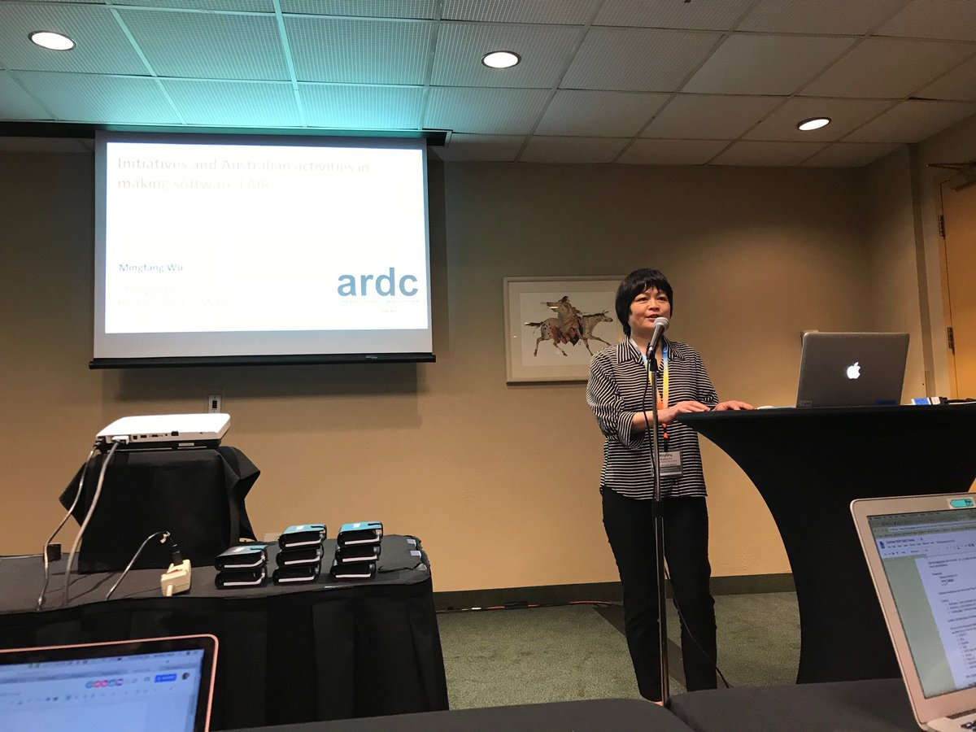
Following E2SIP 2018
We brought Lesley Wyborn to ESIP’s Winter Meeting and Natasha Simons & Mingfang Wu, ARDC to ESIP’s Summer Meeting to continue the exchange
ESIP formalize with an E2SIP representative on ESIP’s Board
Notes:
Following the first E2SIP meeting. We were intentional about creating an exchange between E2SIP and ESIP at both the ESIP winter and Summer Meetings and Lesley Wyborn was nominated and elected as an at-large board member for ESIP so there is now an Australian representative to the ESIP board. Australian organizations were encouraged to join ESIP as members as well.

Slide 19
A U.S. organization with strategic initiatives

Slide 20
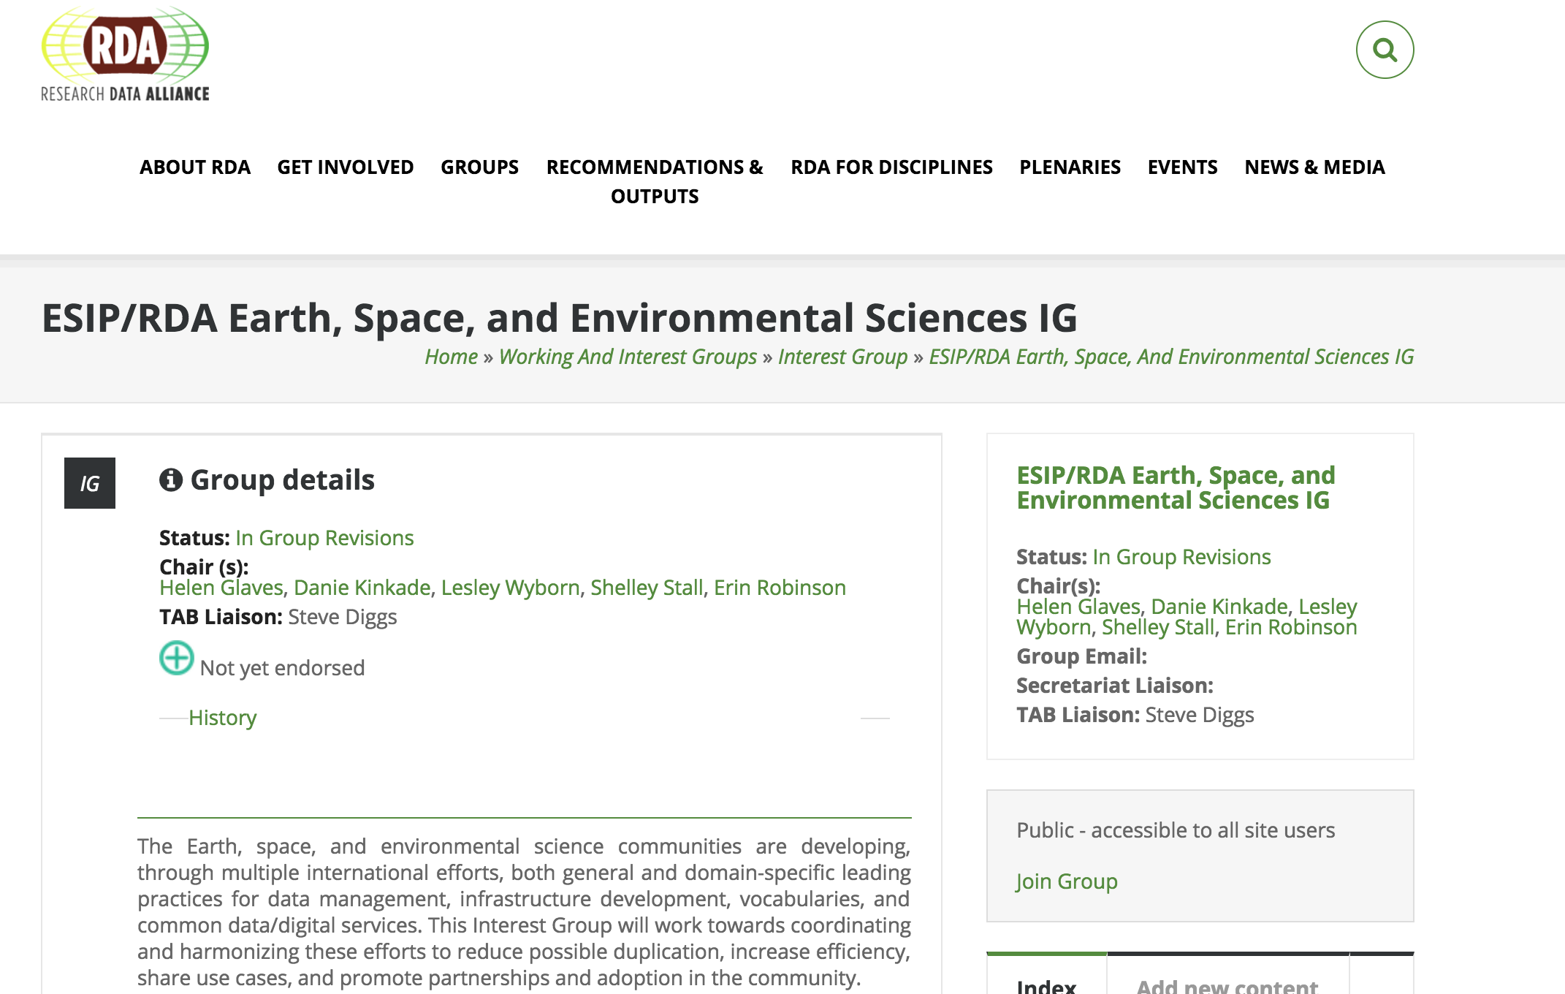

Slide 21
ESIP & the Group on Earth Observations (GEO)
ESIP is a Participating Organization of GEO
Kathy Fontaine serves as ESIP’s representative to the GEO Program Board

Slide 22
Next steps
3
Held Annual E2SIP workshop - alongside C3DIS
May 9, 2019 in Canberra, Australia
E2SIP is an ESIP Cluster
Leverage ESIP collaboration tools and logistics support
http://wiki.esipfed.org/index.php/ESIP-E2SIP
ARDC & ESIP finalized an MOU to provide local coordination support in May 2019
Exploring opportunities to strategically connect in Europe through collaborations with Envri & EGU ESSI
Holding our first E3SIP meeting as a side meeting at RDA P14 in October!
Notes:
In 2019, we have continued to bootstrap the process of building E2SIP. We are again planning a May workshop along with C3DIS. We are also planning activities in November along with the Group on Earth Observation plenary. I have mentioned E2SIP cluster, but we hope to identify a local chair and use it more. Finally, ARDC and ESIP are working on an MOU. This is an exciting opportunity for both the US and Australian communities to benefit from a joint, shared collaborative infrastructure. While this is still experimental, the in kind agreement is as important as a financial contribution because it will allow for ESIP to continue even if something was to happen in the U.S.

