Slide 1
Informatics, Data Science, and Artificial Intelligence :
Building the Educational Pipeline for the Future of Radiation Oncology
Developing Practical Informatics Approaches
Dave Fuller, MD, PhD cdfuller@mdanderson.org
@cd_fuller
Notes:
Default title slide layout for Basic presentations
Enter copy in the content placeholders (default formatting shown on example slide above)
Another image may be substituted
To change image:
Delete existing image
Drag a new image into the picture placeholder or select the image placeholder and under the Insert tab, select Pictures
Upload your photo

Slide 2
2016-19 Funders:
The Andrew Sabin Family Fellowship Program, through an endowment established by the Andrew Sabin Family Foundation
A direct gift from the Beach Family of Phoenix, AZ.
NIH Big Data to Knowledge (BD2K) Program of the National Cancer Institute (NCI) Early Stage Development of Technologies in Biomedical Computing, Informatics, and Big Data Science Award (1R01CA214825-01)
National Science Foundation, Division of Mathematical Sciences, Quantitative Approaches to Biomedical Big Data (QuBBD)/Big Data to Knowledge (BD2K) Program (NSF1557559;
National Cancer Institute Early Stage Development of Technologies in Biomedical Computing, Informatics, and Big Data Science (1 R01 CA214825-01)
National Institute of Dental and Craniofacial Research (NR56/R01 DE025248-01)
National Cancer Institute Grant MD Anderson Head and Neck Specialized Programs of Research Excellence (SPORE) Development Award (P50CA097007-10)
Elekta AB/MD Anderson MRI-LinAc Consortium Seed Grant*
Elekta AB Travel support &Honoraria*
#-Philantropic individuals/agencies/societies
*-Corporate/industry funders
+-Federal or state funding agencies

Slide 3
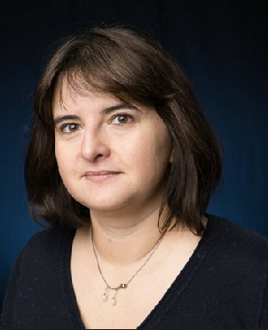
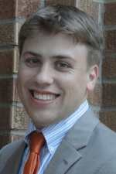
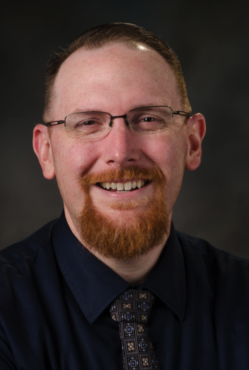
2014 Statistical and Applied Mathematical Sciences Institute (SAMSI) Innovation Lab "Interdisciplinary Approaches to Biomedical Data Science Challenges” Team
Liz Marai
PhD
Computer Science
U. Illinois-Chicago
David Vock
PhD
Biostatistics
U. Minnesota
Guadalupe Canahuate
PhD
Computer Science
U. Iowa
Dave Fuller
MD, PhD
Radiation Oncology
UT MD Anderson
-2016 Joint NIH/NSF Division of Mathematical Sciences Initiative on Quantitative Approaches to Biomedical Big Data (QuBBD) Grant, “Spatial-nonspatial Multidimensional Adaptive Radiotherapy Treatment” (NSF 1557679)
- 2017-2020 Early Stage Development of Technologies in Biomedical Computing, Informatics, and Big Data Science Grant, “SMART-ACT: Spatial Methodologic Approaches for Risk Assessment and Therapeutic Adaptation in Cancer Treatment” (R01 CA214825-01)

Slide 4
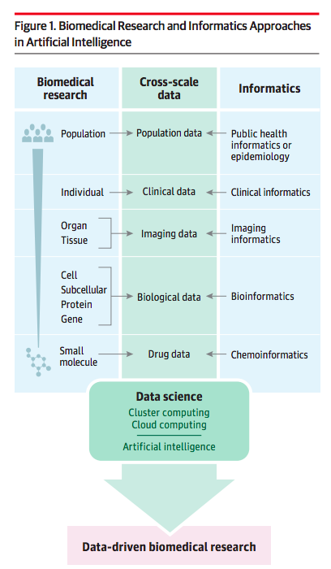
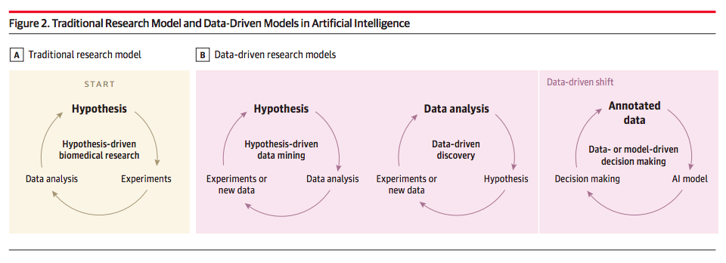

Slide 5
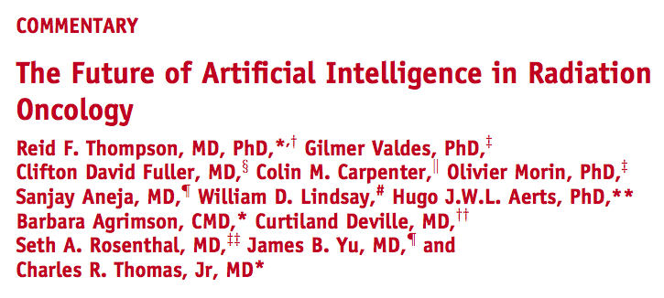

Slide 6
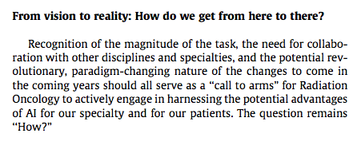

Slide 7
A few definitions…
Informatics [ The Discipline]
“Informatics is the science of processing data for storage and retrieval; information science as a field.”
Artificial intelligence [The Research domain]
"The theory and development of computer systems able to perform tasks that normally require human intelligence, such as visual perception, speech recognition, decision-making, and translation between languages."
”Big Data” [The Input]
"Big Data is high-volume, high-velocity and/or high-variety information assets that demand cost-effective, innovative forms of information processing that enable enhanced insight, decision making, and process automation.”- Gartner
Machine learning (“statistical learning”) [The Methodology]
“Machine learning explores the study and construction of algorithms that can learn from and make predictions on data – such algorithms overcome following strictly static program instructions by making data-driven predictions or decisions, through building a model from sample inputs.”
"The informatics lecturer at the AI conference gave a talk on what machine learning approaches to use for Big Data."

Slide 8
What is informatics as a discipline?
“ Medical informatics is the rapidly developing scientific field that deals with resources, devices and formalized methods for optimizing the storage, retrieval and management of biomedical information for problem solving and decision making”
Edward Shortliffe, MD, PhD
1995

Slide 9
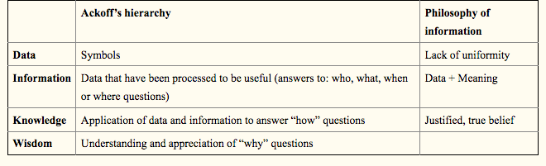
...informatics is the science of information, where information is defined as data + meaning."

Slide 10
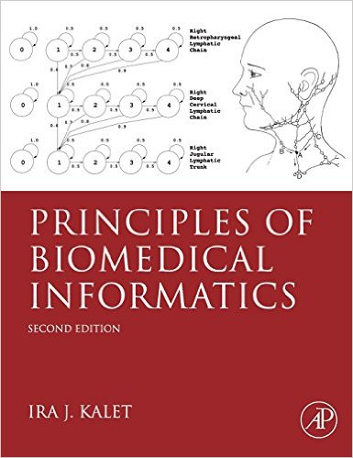
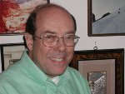
Ira Kalet, PhD

Slide 11
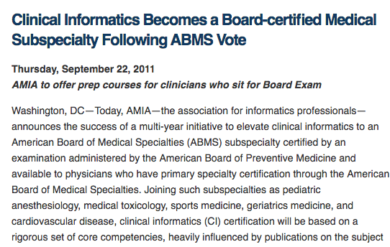

Slide 12
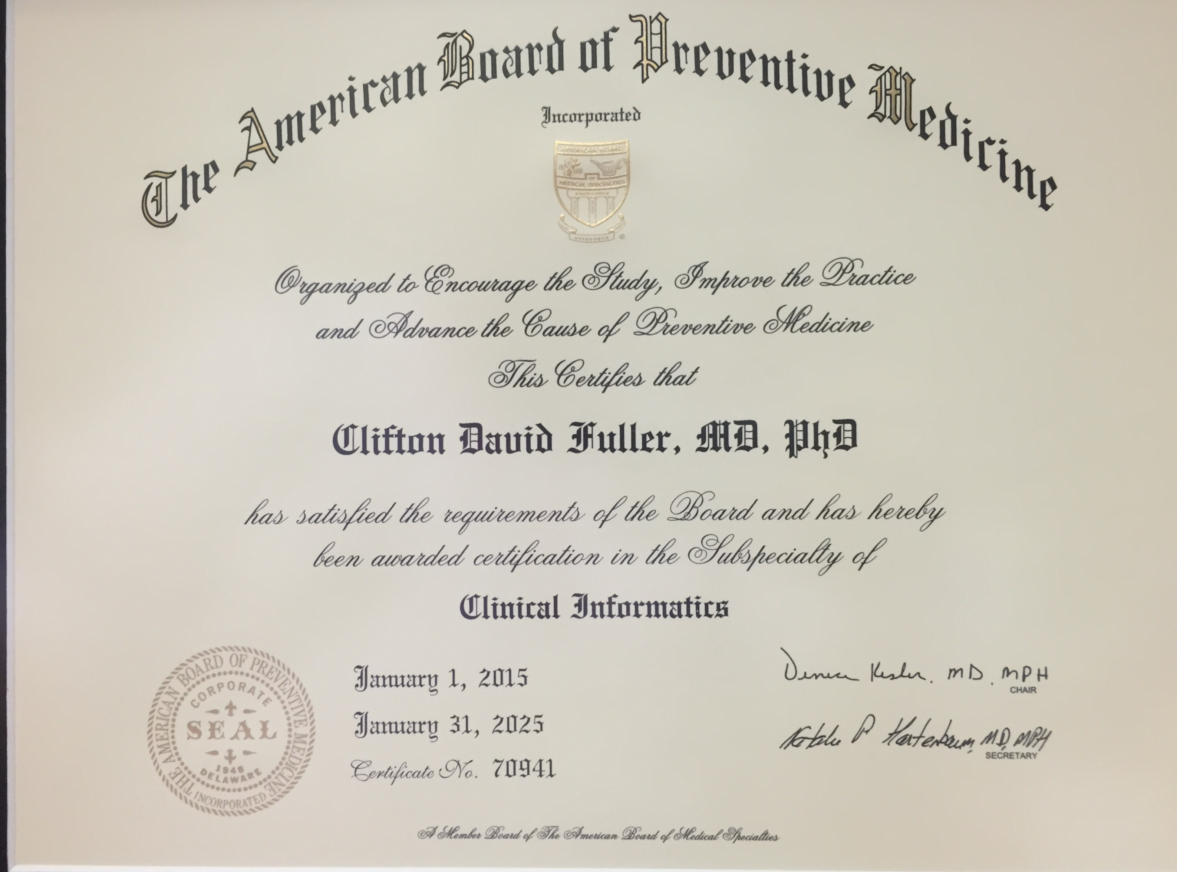
ABMS Informatics Sub-Specialty- Very Cool!!

Slide 13
Biomedical Informatics in Perspective
Basic Research
Biomedical Informatics Methods, Techniques, and Theories
Consumer Health
Pharmaco- genomics
Biomolecular
Imaging
Health Informatics
Bioinformatics
Imaging Informatics
Clinical Informatics
Public Health Informatics
Applied Research
And Practice
Molecular and
Cellular
Processes
Tissues and
Organs
Individuals
(Patients)
Populations
And Society
Continuum with “Fuzzy” Boundaries

Slide 14
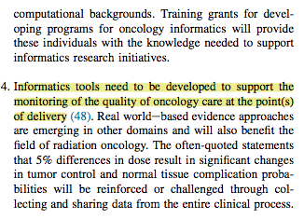

Slide 15
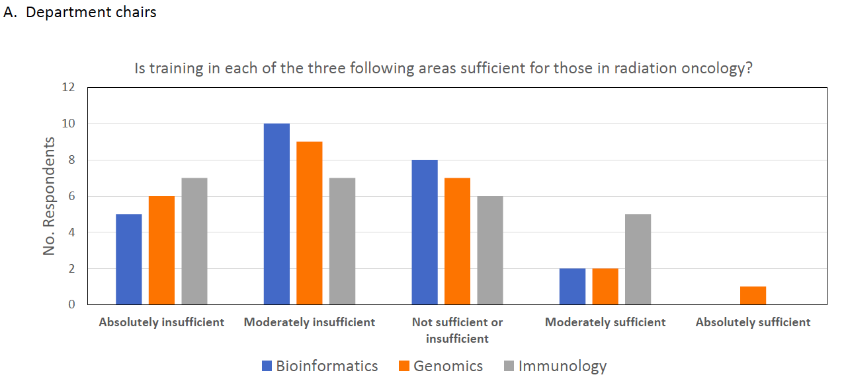

Slide 16
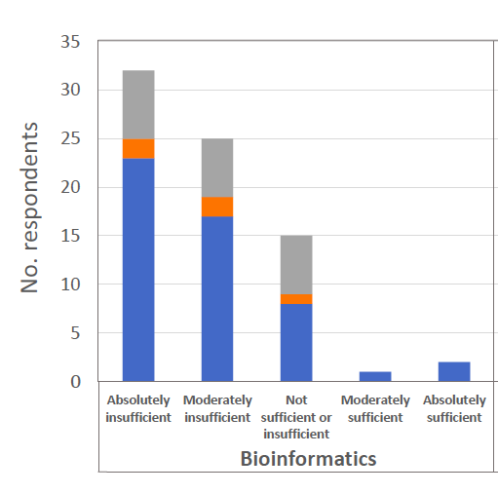

Slide 17
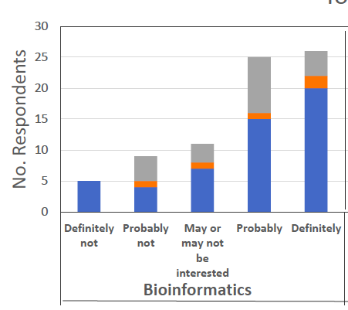

Slide 18
Example: Many #RadOnc residents have limited "Big Data" exposure/background
We informally polled trainees during the MD Anderson Annual RadBio/Physics course during their informatics lecture
In 2018, 0/21 participants had heard of "FAIR Guiding Principles"
4/21 could correctly map concepts of a "standard", "ontology", or "syntax"
4/21 had heard of SNO-MED
3/21 could correctly identify HL7 as a standards framework
20/21 could identifty DICOM, but most considered a filetype, not as an informatics satndard

Slide 19
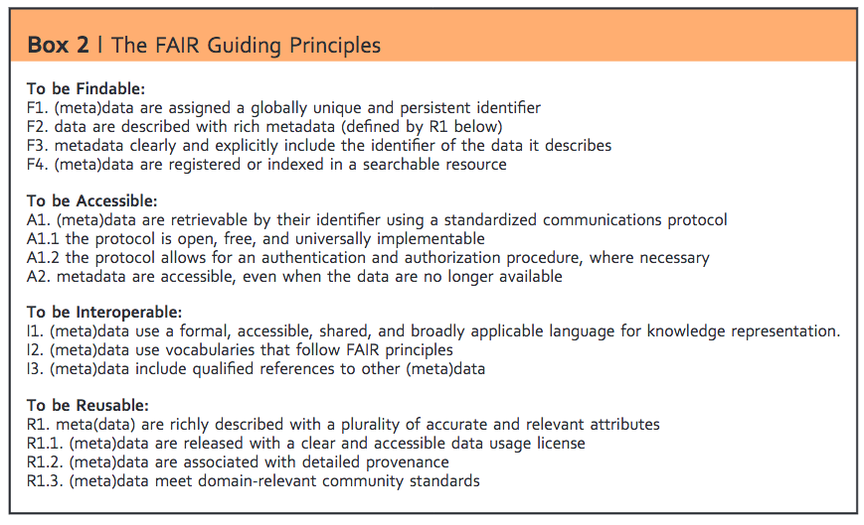
The Future is FAIR

Slide 20
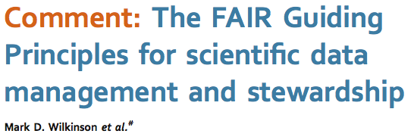
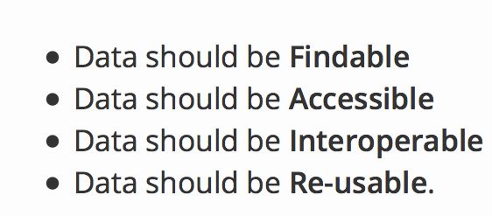

Slide 21
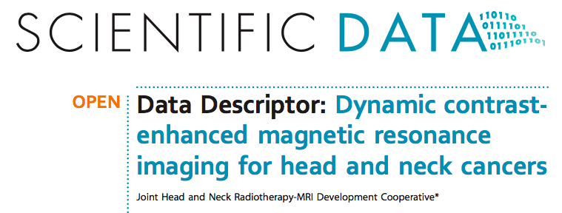

Slide 23
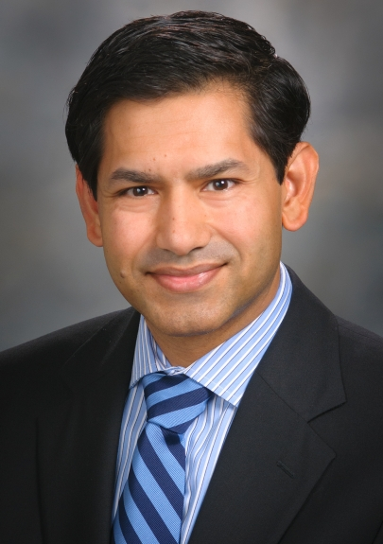
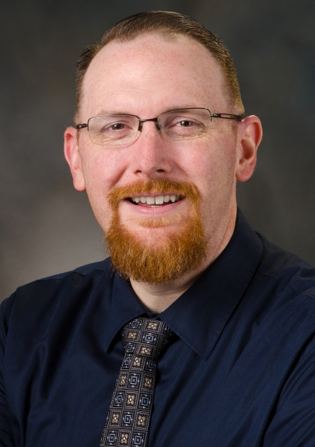
Fellow and Resident Radiation Oncology iNtensive Training in Imaging and Informatics to Empower Research Careers (FRONTI₂ER)
2 Residents/Fellows admitted annually NIBIB.
Trainees receive individualized training program.
Trainees receive Applicants up to $10,000 for research-related expenses,
All Trainees must commit to submit a K-level application.
Prajnan Das, M.D., M.S., M.P.H.
Professor, & Residency Director
co-PI
Dave Fuller, MD, PhD
Ass. Professor,
co-PI

Slide 24
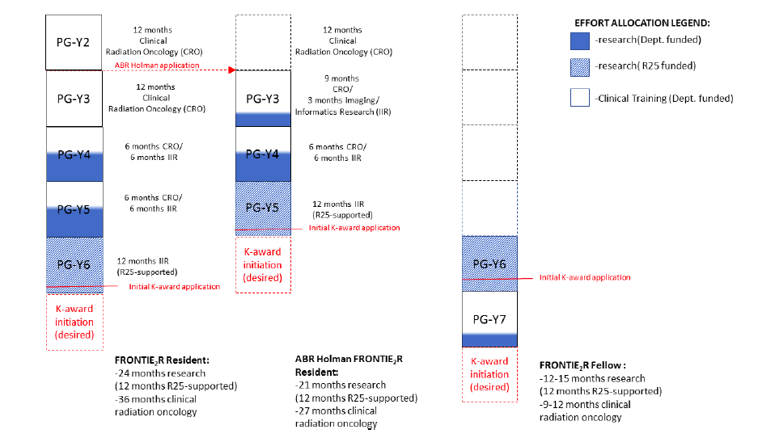

Slide 25
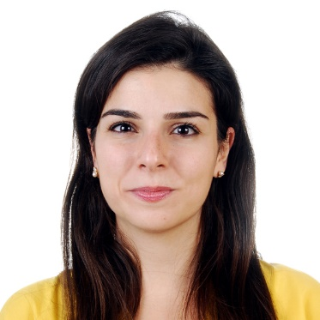
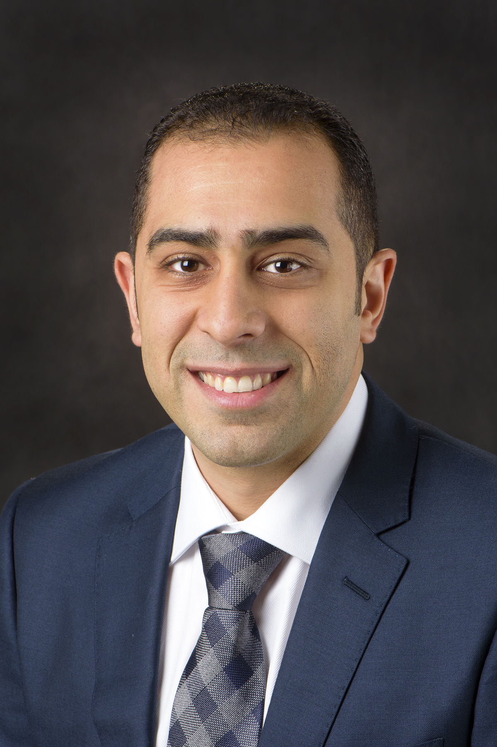
Awarded FY2019...so far, in Year 1:
2 trainees awarded cycle 1 (both are Clinical Fellows).
One trainee has imaging focus, the other informatics.
Resident applicants will begin matriculating year 2.
Expansion of the program with potential for increased non-NIH-funded trainees pending.
Karine
Al Feghali
MD
Baher Elgohari
MD

Slide 26
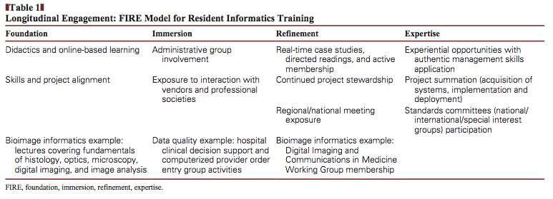

Slide 28
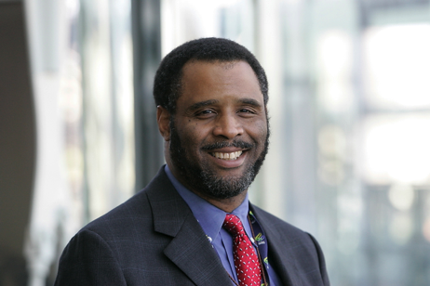
What about post-Rad Onc Training?
Charles R. Thomas, Jr., MD, Chair,

Slide 29
Unmet educational needs
Limited time for devoted machine learning/informatics training and lack of distributed expertise will necessitate online resources (MOOCS, modular courses) as a ROECSG-supported effort
Potential integration into current rad onc statistics education my be aided by modular exercises Greater support for specific "computational physician-scientist phenotype" by NCI/NLM/NIBIB through targeted training awards
Development of a core leaership cadre of "first wave" junior faculty physicians through avenues such as U. Michigan Practical Big Data Workshop, ACR Data Science Institute, NCI initiatives focused on physician-scientists.

Slide 30
Moving forward
How do we develop the pipeline of computational scientists who are also radiation oncologists?
Traditional MSTP programs train basic/translational "wet lab"scientists
Most Big Data expertise is ad hoc
Need earlier integration into training for maximum efficacy (even if at a limited number of training programs)

Slide 31
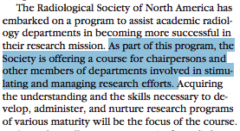

Slide 32
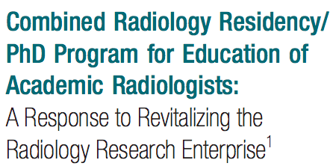
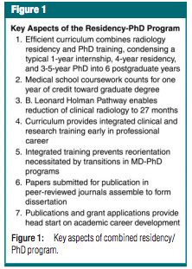
Can we develop Holman-pathway compatible AI-focused educational efforts leading to MS/PhD as part of residency for select trainees?
Could this be accomplished as a multi-site program ?
Can this be done through existing structures (e.g. Moffitt PSOC, CTSA programs, NLM training programs) or is NCI support vital?

Slide 33
Next steps
Development of a Rad Onc –focused "core curriculum" in informatics and machine learning (John Kang/Erin Gillespie) with possible ROECSG support.
Develop curriculum into a MOOC/modular course
Encourage AAPM TG particiaption by junior faculty recruitment to Big Data subcommittee (Chuck Mayo)
Identify additional stakeholders (ASTRO, NCI, AAPM, RSNA) to define coherent vision/pathway for training needs across programs.
IDEAS/SUGGESTIONS APPRECIATED!!

Slide 34
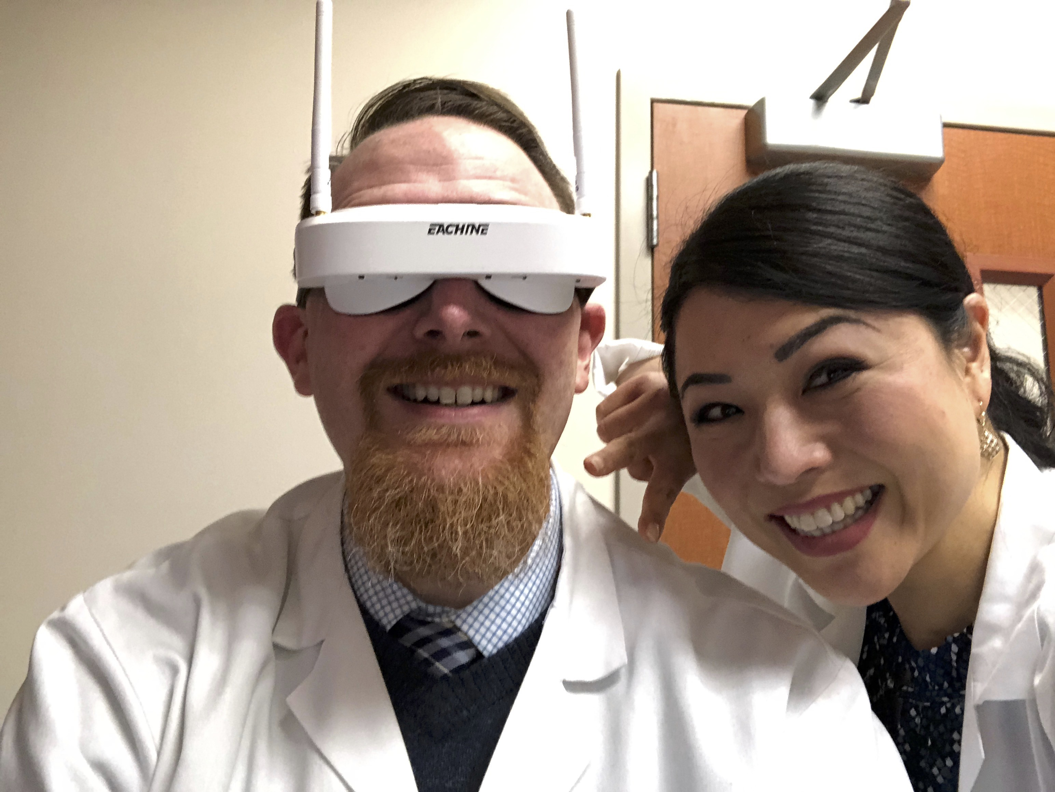
The future for enhanced performance looks good for advances in informatics, AI, and Big Data in #RadOnc, if we can build the necessary educational tools!
Please email/visit soon!
cdfuller@mdanderson.org
Caroline Chung, MD
Rad Onc MR Program Lead.

