Slide 1
Making research software visible: new models for sustaining development Slides: https://doi.org/10.6084/m9.figshare.8986499 24th July 2019, Collegeville Workshop on Sustainable Scientific Software (CW3S19) Neil Chue Hong (@npch), Software Sustainability Institute ORCID: 0000-0002-8876-7606 | N.ChueHong@software.ac.uk
Supported by:
Slides licensed under CC-BY where indicated:
Notes:
Introduction to software preservation
Why do we

Slide 2
SSI: software sustainability
“The software you use today will be available - and continue to be improved and supported - in the future”
Availability, extensibility, maintainability
The research community is able to continue to do their work, in new and better ways
Notes:
Maybe we defined ”software sustainability” with the wrong viewpoint. We’ve come to learn that sustainability is in the eye of the stakeholder.

Slide 3
Arguing for sustainability
The argument for contributing to open source is that it’s not a public good but a common-pool resource because it takes some effort to maintain the resource so everyone can benefit
Allison Randal
Ex-President, OSI
allisonrandal.com
https://www.rhyslindmark.com/club-goods-digital-infrastructure-and-blockchains
Photo by Ales Krivec on Unsplash
Notes:
Allison Randal: ex-president of Open Source Initiative
The argument for contributing to open source in companies is the same one as for any common-pool resource which requires some level of effort to ensure the resource is sustained, such as timber.

Slide 4
Software Sustainability △
PIs
Functionality/ Performance
Maintainability
Resources
Usability
Stakeholder labelling is provocative rather than accurate!
The challenge is the number of decision-makers, and each wants something different
Funding not the primary issue?
University Administration
Funders
Power users
Novice users
RSEs
Trainers
Infrastructure Providers
Notes:
Why is it harder to argue for sustainability for research software, particularly outside of industry.
Is there a systematic problem, caused by the way decisions are made – multiple stakeholders.
The argument has been made for commercial software: organisations will pay for licenses to Excel, Qualtrics, SPSS or Matlab.
Matlab: 3m+ (2015) researchers using it (via Total Academic Headcount, ~$100/academic)
Top Bioconductor packages downloaded by 25,000+ each month

Slide 5
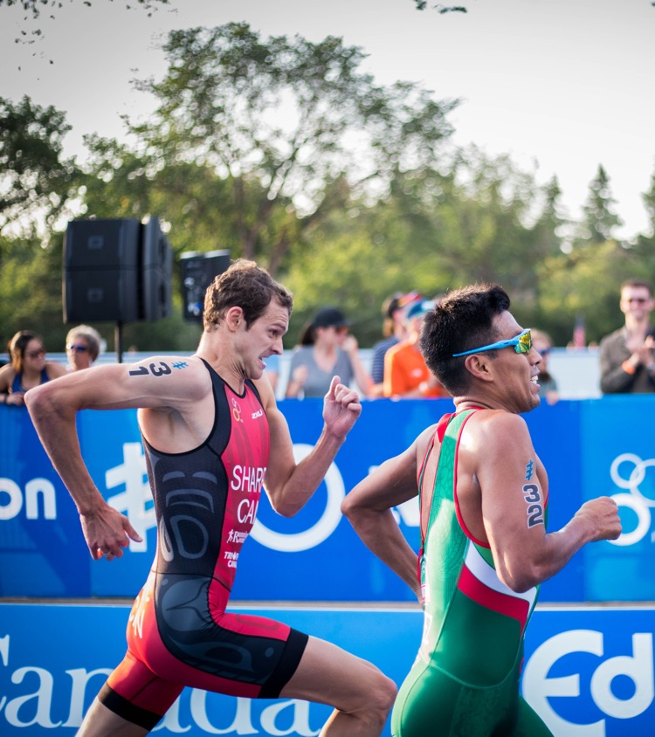
Competition vs Collaboration
Tension between what a software project needs to do versus what contributors want to do
Photo by Victoire Joncheray on Unsplash
Photo by NESA by Makers on Unsplash
Notes:
This takes many forms: competition for resources, for promotion, for users
However a significant tension is that in open source, and particularly research software, when people are willing to contribute, they’re only willing to do this for things they’re interested in. This means key maintenance tasks don’t benefit from contributions.

Slide 6
Undead software
Understanding when software should be “forcibly retired” – sadly no silver bullets
Sustainability is also about knowing when to stop development– resources are limited
https://collegeville.github.io/CW3S19/WorkshopResources/ WhitePapers/ChueHongSoftwareUndead.pdf
Photo by Daniel Jensen on Unsplash
Notes:
I’ve worked on – and with - a lot of research software projects over the last 20 years. So I’m very interested in why these software projects often live on for longer than they should.
But this is probably a better topic for discussion in the bar!

Slide 7
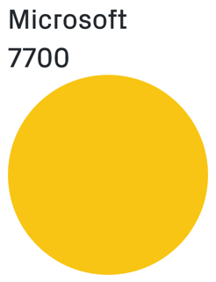
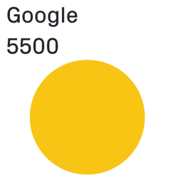
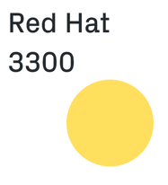
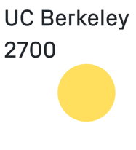
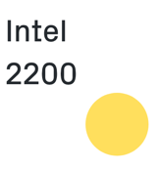
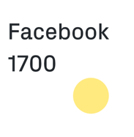
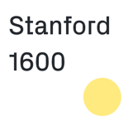
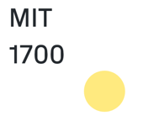
Contributing to OSS
Pytorch was the fastest growing software project
Universities were 5 of the top 10 contributing organisations
Literally billions of lines of code
1,000’s of contributions to top GitHub projects in 2018
https://octoverse.github.com/projects
Notes:
PyTorch
2002: Started as a research software project (Torch) out of Dalle Molle Institute for Artificial Intelligence Research, a public research institute associated with the University of Lugano, Switzerland
Picked up by Facebook AI Research, but also by several universities
Incorporates ideas by CMU (DyNet) and Preferred Networks (Chainer) [a spin out from University of Tokyo]
2016: PyTorch developed by a Research Intern at Facebook (Adam Paszke, still a student at the University of Warsaw)
2017: PyTorch released

Slide 8
Photo by André François McKenzie on Unsplash
Notes:
New models of funding open source development:
Fiscal sponsors (NumFOCUS, Code for Science and Society, Commons Conservancy)
Subscriptions (Tidelift)
Pay for expert support (RSE groups, QuanSight)
Tip Jar (GitHub Sponsors)
Can we agree a small number of models to improve traction?

Slide 9
Ideas to change the culture
Persuade your organisation to associate its brand with open source software (inc scientific software)
Promote working on existing OSS projects as part of UG and Masters programs, so it’s seen as valuable career development for students and staff
Notes:
Universities should seek to associate their brand with open source software more. Universities contribute significant amounts of effort already to leading open source projects, and yet it is often unrecognised.
Universities should promote working on open source projects as part of Undergraduate and Masters programmes, similar to doing internships, so it is seen as valuable career development for both students and faculty.

Slide 10
Ideas to change the culture
Agree a set %age of Research Software Engineering group time to contribute to OSS important to your organisation
Ask your information services (IT services, library) department to implement subscriptions to the most significant research software your organisation relies on
Notes:
3. As universities setup research software engineering groups, broker an agreement with RSE group leaders to set aside a set percentage of their time to contribute to open source software that is important to the organisation. For this to work, the way they use that time must be prioritised by the projects they are working on, based on what they are best placed to contribute to, not by their university (who only get to choose which software projects they are contributing to).
4. University libraries should consider subscription style donations to some of the most significant open source research software projects that they rely on, as determined by annual surveys.

Slide 11
Take home messages
Sustainability of research software should focus on research as the primary stakeholder, but…
Many decision-makers for research software so…
We need to shift the way that open source research software development is perceived
Celebrate OSS contributions
Recognise contributing to OSS as career development
Acceptance of new models to contribute to maintenance and support of software
Slides: https://doi.org/10.6084/m9.figshare.8986499

Slide 12
Additional References
Allison Randal - Open source influences on technology innovation: https://www.youtube.com/watch?v=f4nCMVfNqqM
Rhys Lindmark – Club Goods, Digital Infrastructure, and Blockchains: https://www.rhyslindmark.com/club-goods-digital-infrastructure-and-blockchains/
Juan Nunez-Iglesias – Why citations are not enough for open source software: https://ilovesymposia.com/2019/05/28/why-citations-are-not-enough-for-open-source-software/
Tidelift – 2018 Professional Open Source Survey https://tidelift.com/about/2018-Tidelift-professional-open-source-survey-results
Robert A Muenchen – The Popularity of Data Science Software: http://r4stats.com/articles/popularity/

Slide 13
Strategy & Business Design
Picture copyright: Daron G Green

Slide 14
Acknowledgements
The SSI team/alumni:
Aleksandra Nenadic
Aleksandra Pawlik
Alexander Hay
Arno Proeme
Carole Goble
Caroline Jay
Claire Wyatt
Clem Hadfield
Dave De Roure
Devasena Prasad
Giacomo Peru
Graeme Smith
Iain Emsley
James Graham
John Robinson
Les Carr
Malcolm Atkinson
Malcolm Illingworth
Mario Antonioletti
Mark Parsons
Mike Jackson
Olivier Philippe
Priyanka Singh
Raniere Silva
Rob Baxter
Robin Wilson
Shoaib Sufi
Simon Hettrick
Stephen Crouch
Tim Parkinson
Toni Collis
Plus the SSI Fellows and RSE community
Scientific software:
Dan Katz
Heather Piowowar
James Howison
Jeff Carver
Jennifer Schopf
Kaitlin Thaney
Martin Fenner
Victoria Stodden
WSSSPE community
The Carpentries:
Greg Wilson
Jonah Duckles
Tracy Teal
Instructor Community
Additional Input:
- Allison Randal
Supported by the UK Research Councils through grants EP/H043160/1, EP/N006410/1 and EP/S021779/1 . Additional project funding received from Jisc.

Slide 15
About the Institute

Slide 16
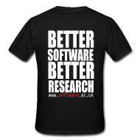
Software Sustainability Institute
A national facility for cultivating better, more sustainable, research software to enable world-class research
Software reaches boundaries in its development cycle that prevent improvement, growth and adoption
Providing the expertise and services needed to negotiate to the next stage
Developing the policy and tools to support the community developing and using research software
Supported by the UK Research Councils through grants EP/H043160/1, EP/N006410/1 and EP/S021779/1
Notes:
The Software Sustainability Institute can help with: software reviews and refactoring, collaborations to develop your project, guidance and best practice on software development, project management, community building, publicity and more…
Drawing on pool of specialists to drive the continued improvement and impact of research software developed by and for researchers
Providing services for research software users and developers
Developing research community interactions and capacity
Promoting research software best practice and capability

Slide 17
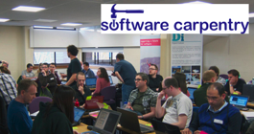
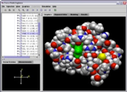
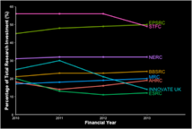
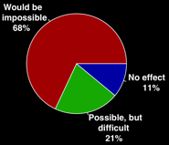
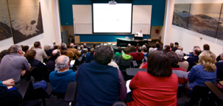
Software
Training
Helping the community to develop software that meets the needs of reliable, reproducible, and reusable research
Delivering essential software skills to researchers via CDTs, institutions & doctoral schools
Outreach
Exploiting our platform to enable engagement, delivery & uptake
Collecting evidence on the community’s software use & sharing with stakeholders
Bringing together the right people to understand and address topical issues
Policy
Community

Slide 18
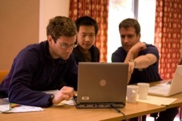
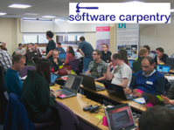
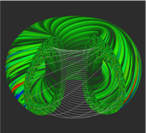
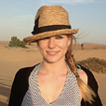
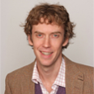
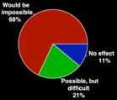
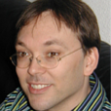
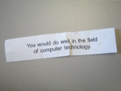
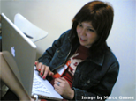
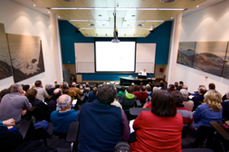
Software
Training
Advice
Courses
35+ UK SWC workshops
1000+ learners
Consultancy
50+ projects
130+ evaluations
4 surgeries
Guides
Outreach
80+ guides
50,000 readers
Website & blog
150+ contributed articles
20,000 unique visitors per month
3,000 Twitter followers
Research
740 researchers 50,000 grants analysed
Campaigns
Workshops
Fellowship
61 domain ambassadors
300+ RSEs engaged
2100 signatures
13 issues highlighted
Policy
Community
20+ workshops organised

