Slide 1
Location, Location, Location: Enabling Data Discovery by Place
John Porter & Kristen Vanderbilt

Slide 2
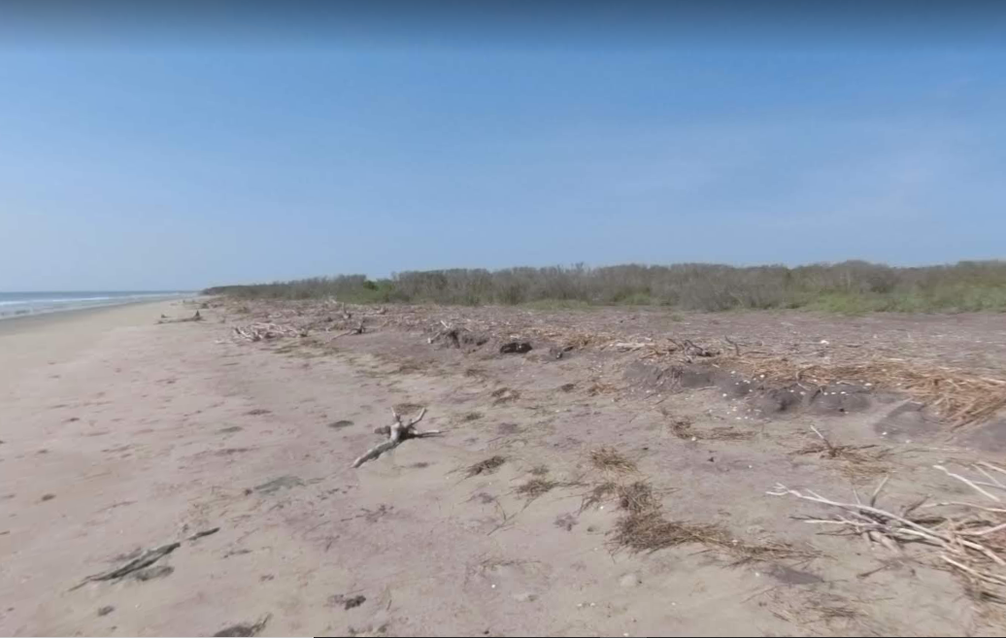
I want data about this place
Address? Here - Not Likely!
General Place Name – Hog Island, VA
Coordinates: 37.4588361,-75.6635331

Slide 3
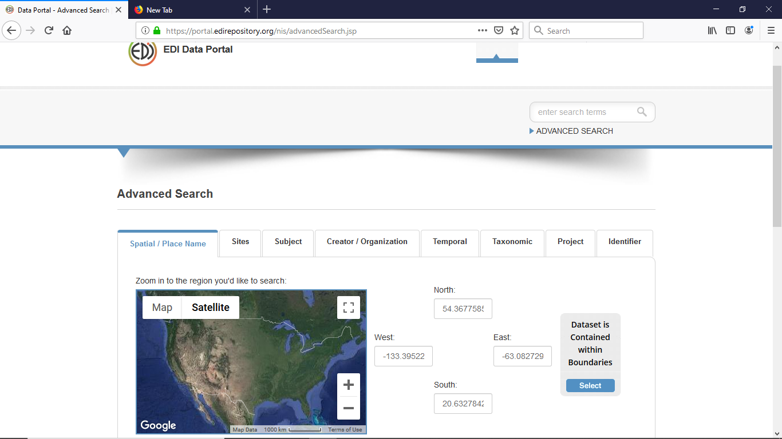
Why Kristen and I are Here
EDI Supports ADVANCED SEARCH
Based on Coordinates

Slide 4
Why Kristen and I are Here
But Most USERs use simple search:

Slide 5
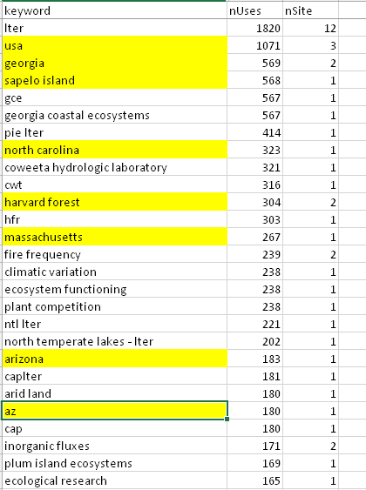
The Challenge
When we look at frequently-used terms drawn from LTER Metadata, Places are a major component
But they are not used consistently

Slide 6
Our Questions
How best to enable location-based data discovery?
What existing resources are available to help?
How can we evaluate resources?

Slide 7
You now know why WE are here. Why are YOU here? What interests you about geographical search?

Slide 8
Issues
SCALE
PRECISION
UNQUENESS

Slide 9
Issues
Geographic names are often inconsistently applied in metadata
Synonyms & Abbreviations (Arizona vs AZ)
Nearby places may be confounded
Even when coordinate data is available and searchable, many users don’t use “advanced” searches to use them
Local Names
A local problem or a community problem?

Slide 10
Geocoding
Geocoding
Address:
1500 Commerce St,
Tacoma, WA 98402
47.1507 N
122.2735 W
Place Name:
Hog Island, Northampton Co., Virginia, USA
Gazetteer
37.458 N
75.664 W

Slide 11
Best Practices?
Ideally place names would be drawn from standard references – Gazeteers
Using different levels of resolution e.g., Country, State, County, Place
Enable searches at all those levels
Naming conventions for “local” places

Slide 12
Which Gazeteer?
Gazetteers differ based on:
What spatial extent they address
What types of features they include
How accessible is the data?
Online forms
Downloadable tables
Queryable Web services

Slide 13
ColumbiaGazetter.org
Web site supports text and bounding-box searches
Advanced search function REST-based
Can return CSV or XML via additional clicks
Only 170,000 entities

Slide 14
U.S. Board on Geographic Names
U.S. Data Downloadable as a (big) delimited text file including names and coordinates
Ditto for Antarctic names
No non-U.S. names (see GeoNet)

Slide 15
NGA GeoNet Names
No US or Antarctic Locations
Over 7 million features (12M names)
Variety of OGC web services available
REST/JSON services available
Embeddable Widgets for Web Pages
Toponymic information is based on the Geographic Names Database, containing official standard names approved by the United States Board on Geographic Names and maintained by the National Geospatial-Intelligence Agency. More information is available at the Products and Services link at www.nga.mil. The National Geospatial-Intelligence Agency name, initials, and seal are protected by 10 United States Code Section 425.

Slide 16
Getty Thesaurus of Geographic Names ® Online
2.5M records
names, place types, coordinates, and descriptive notes, focusing on current and historical places and sites important for the study of art, architecture, conservation, and related disciplines
Hierarchical Organization
Available in many forms including
Web Services
Linked Open Data (SPARQL)
Database tables
CC-by license

Slide 17
GeoNames.org
Online name search capabilities
25 M names worldwide
Downloadable Data Tables
Names, Lat-Lon
Includes population and elevation data
Simplified boundary files also available
Web Services
Includes geographic-based searches
(up to 1,000 queries per hour)
CC-4-By License

Slide 18
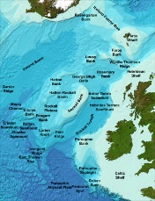
GEBCO Gazetteer of Geographic Names of Undersea Features
Ocean-focused (no terrestrial data)
Available for download in GIS formats

Slide 19
Gazetteer | Web Service API? | Raw Data? | Coord. Search? | Comments
ColumbiaGazetter.org | ? |  | X
US Board Geo. Names |  | X |  | US, Antarctica only
GeoNet Names Server | X | X |  | Non-US only
Getty Thesaurus | X
GeoNames.org | X | X | X | Hourly use limits
GEBCO Undersea Features |  | X |  | Marine only

Slide 20
Discussion Questions
What gazetteers have we missed?
How do you document locations? If you haven’t used a gazetteer, are inclined to use one now or is your approach sufficient?
How do the repositories you work with enable data discovery by location? How effective are they?
Do you prefer to search by coordinates or by named places? Or within a bounding box? What is most useful?
Do you use local names when specifying a location? If so, how do you document the local names and track any changes to those names over time?
Are there tools that you wish were available to help make use of gazetteers?
Any other questions to add to this list?

Slide 21
Case Study
For geographic feature names to be useful, they need to be within a reasonable distance of the actual data collection location
So, we compared EDI data package geographicCoverage elements with the U.S. Board on Geographical Names
Excluding Buildings, churches, cemeteries, schools, airports etc.

Slide 22
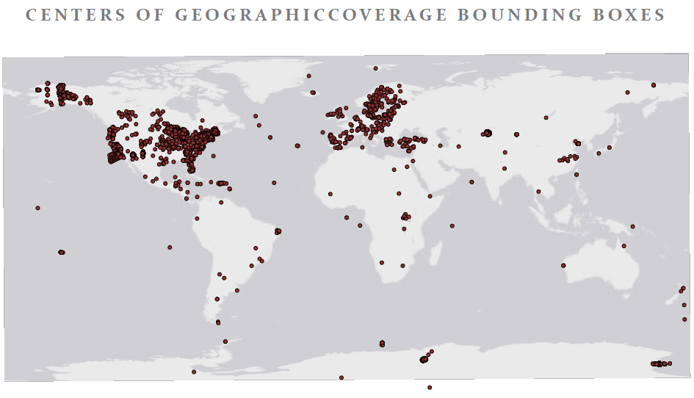
Locations from EDI Data
Over 17,902 distinct locations worldwide

Slide 23
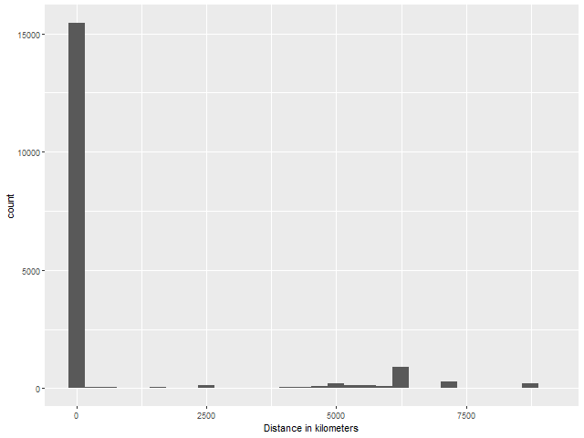
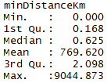
Using U.S. Board on Geographic Names
USA
South America
Europe
Asia

Slide 24
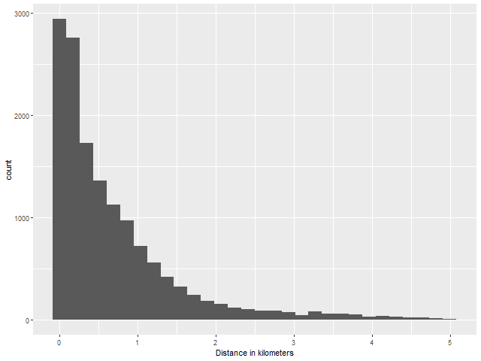
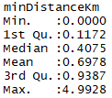
Features < 5 km
Median

Slide 25
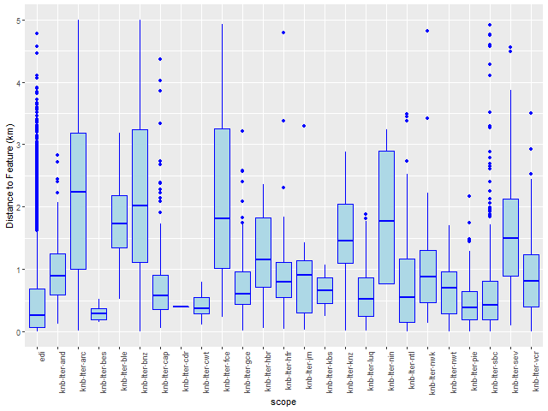
Variability Across Sites

Slide 26
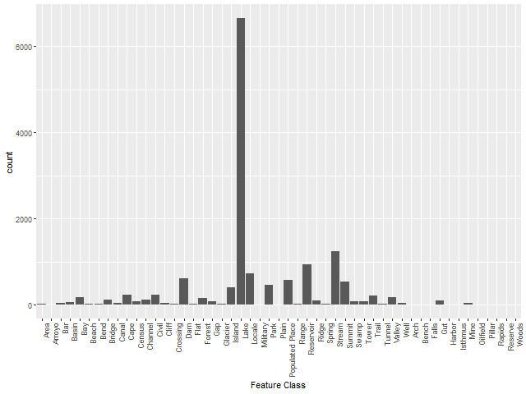
14,447 with distances < 5 km
Lakes are the most
common nearest feature
Dominated by edi.74.1
with 4,308 locations
Other information provided:
State
County
USGS Topo Map Name
Elevation

Slide 27
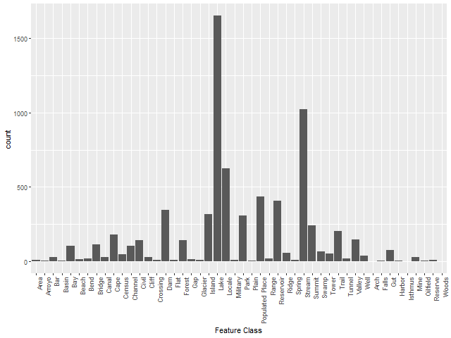
Even if EDI datasets with >1000 locations are excluded, Lakes are still the most common nearby feature

Slide 28
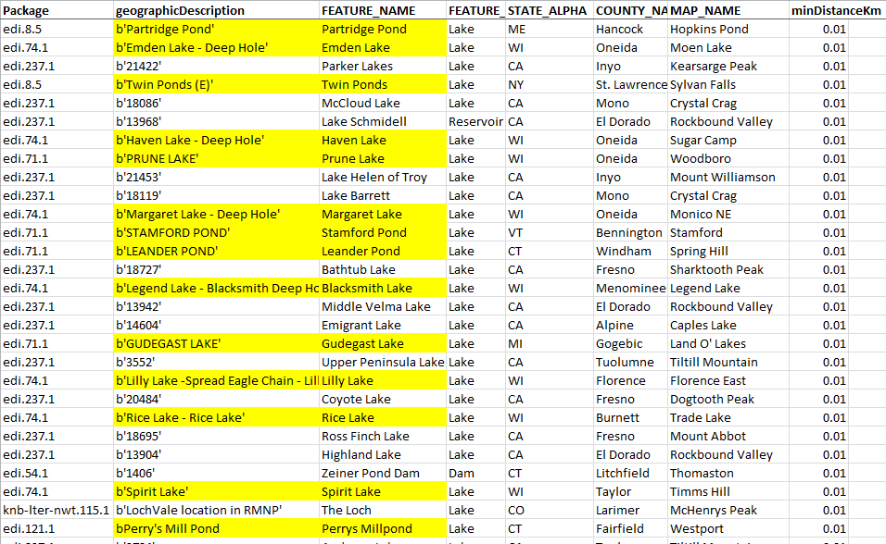
Lots of Exact Correspondence when distances are short ~ 10m
However, only 5%
of points are
within 10 meters

Slide 29
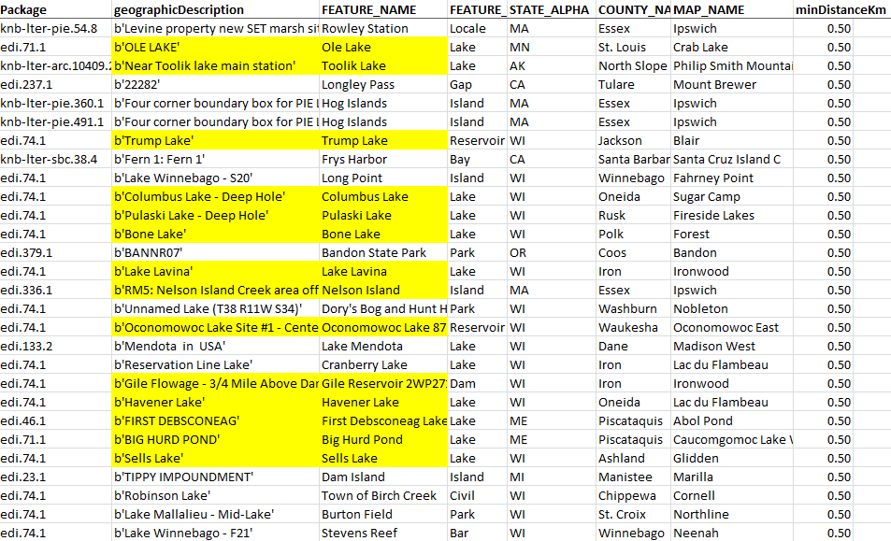
500 meters
45%
of points are
within 500 meters

Slide 30
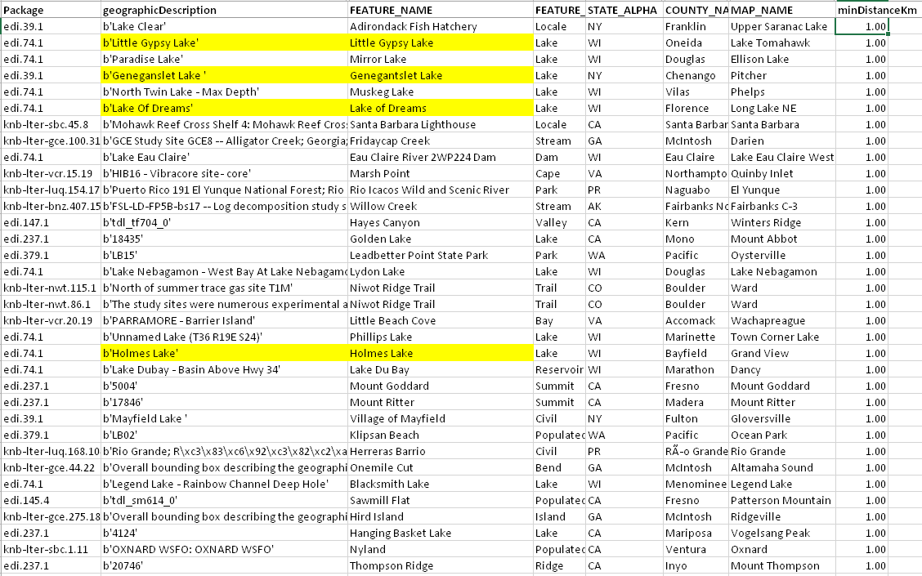
1 Kilometer
62%
of points are
within 1 kilometer

Slide 31
How good is good enough?
How automated can processing be?

