Slide 1
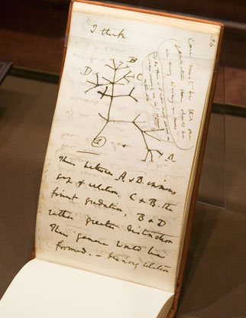
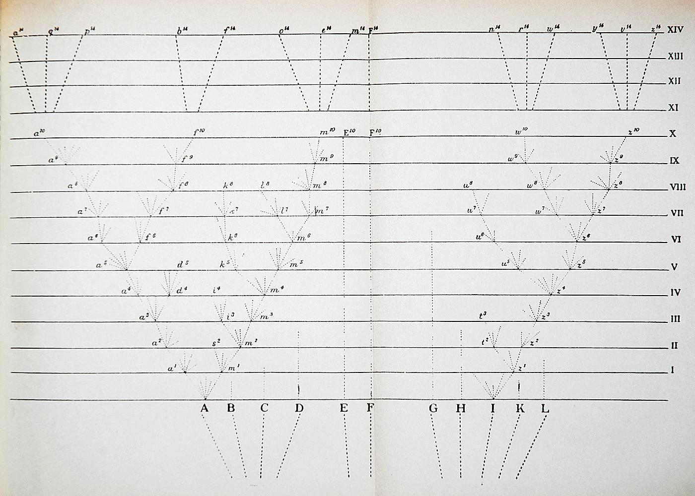
Phylogenetics
Brian O’Meara
brianomeara.info

Slide 2
Learning objectives
Why bother with phylogenies
Questions we can answer using these techniques

Slide 3
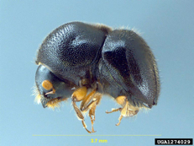
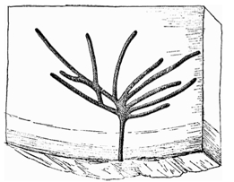
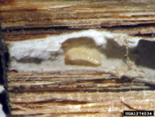
© Doug Stone
© Doug Stone

Slide 4
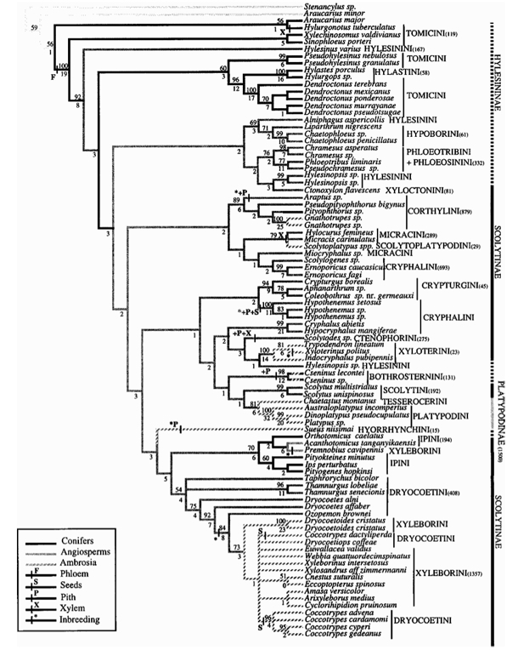
© Doug Stone
© Doug Stone

Slide 5
© Doug Stone
© Doug Stone

Slide 6
7 origins of agriculture
© Doug Stone
© Doug Stone

Slide 7
7 origins of agriculture
© Doug Stone
8 origins of inbreeding
© Doug Stone

Slide 8
7 origins of agriculture
© Doug Stone
Angiosperm | Conifer
5200 | 180
119 | 11
1500 | 195
8 origins of inbreeding
© Doug Stone

Slide 9
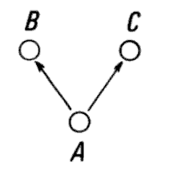
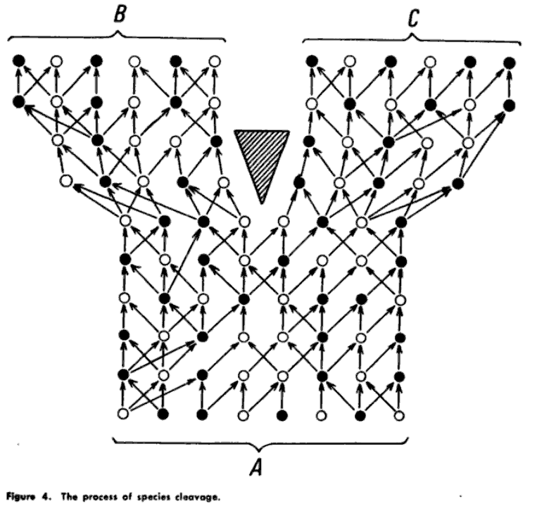

Willi Hennig, Phylogenetic Systematics, 1966. p. 19

Slide 10
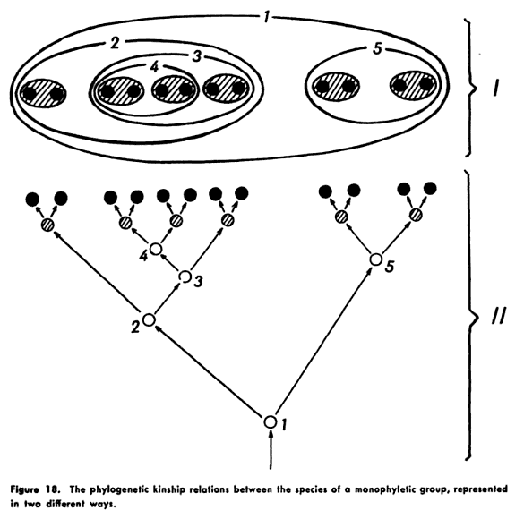
Willi Hennig, Phylogenetic Systematics, 1966. p. 71
Notes:
This history of splitting creates a series of nestings. We typically show this as a tree, but other ways of showing this nesting are possible.

Slide 11
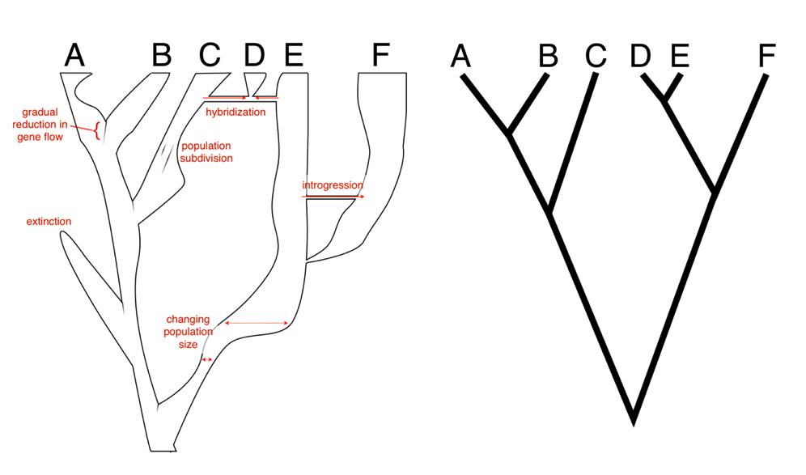

Slide 12
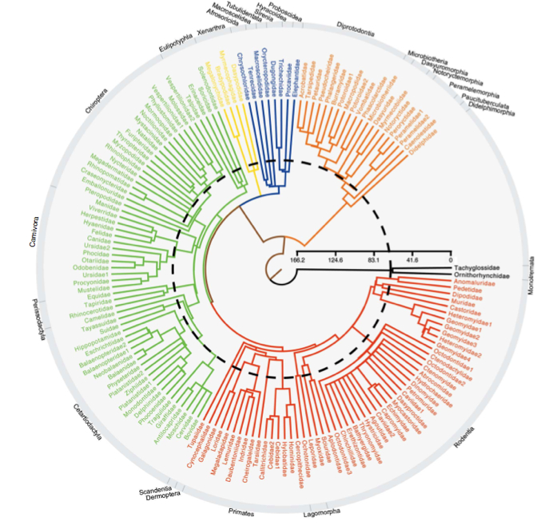
99% of mammal species (summary tree shown)
Bininda-Emonds et al. The delayed rise of present-day mammals. Nature (2007)

Slide 13
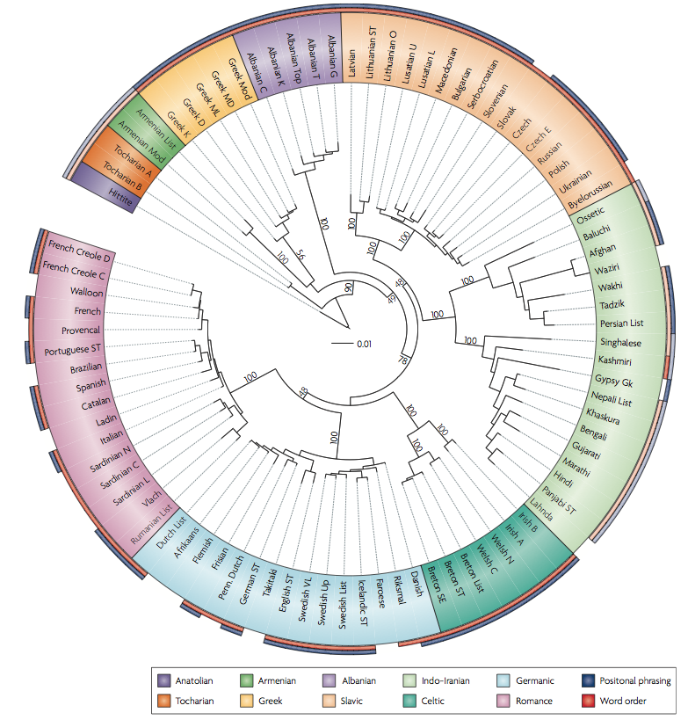
Pagel. Human language as a culturally transmitted replicator. Nature Reviews Genetics (2009) vol. 10 (6) pp. 405-415

Slide 14
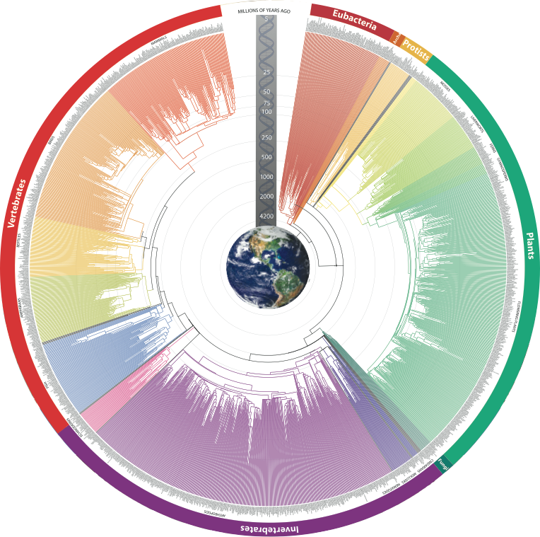
©2009 S. Blair Hedges & Sudhir Kumar (The TimeTree of Life)

Slide 15
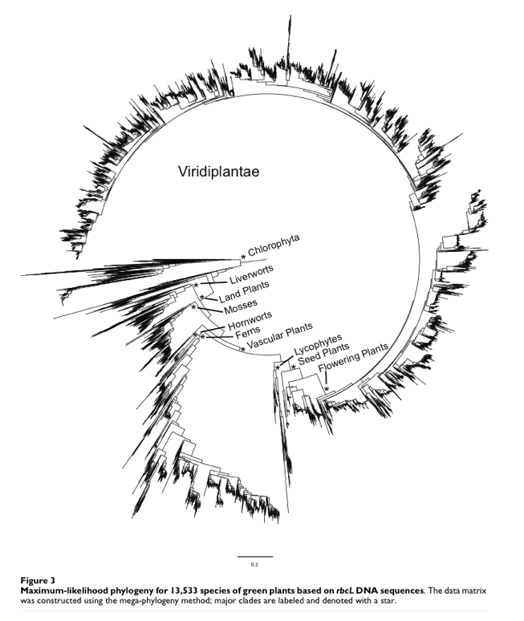
13,533 species
Needed 32 GB of RAM to run
Smith et al. 2009

Slide 16
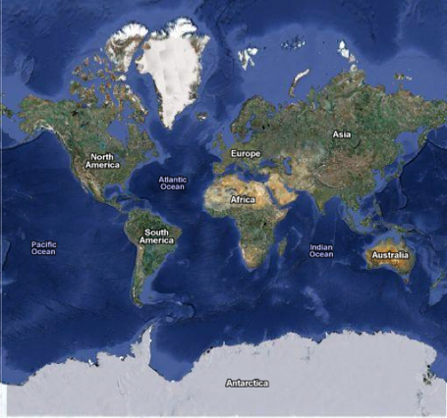
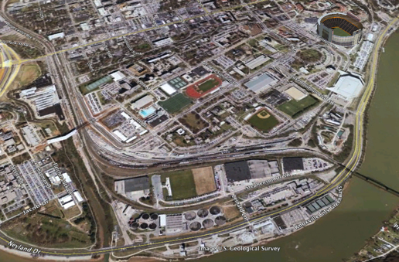
Number of atoms in the universe
N
N
Notes:
Remember this is a log scale, so the number of trees rises faster than exponentially with the number of taxa. This becomes a problem when searching for trees. Adding two more species to the 13,533 species dataset shown earlier means increasing the search space of possible topologies by 183 million-fold. This is the same magnitude of changing the search space for an object from “around campus” (about a square mile) to “anywhere on the planet” -- and it’s just adding two species.

Slide 17

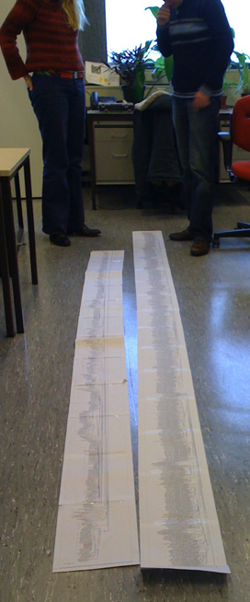
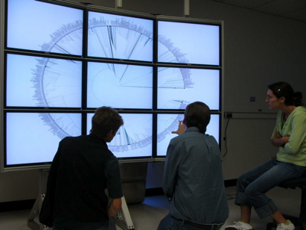
4K TV: 4096 × 2160
13,533 names
largest computer monitors: 3280×2048 (can be tiled)
Laser printer: effectively 3600 × 4725 (can be tiled)

Slide 18
5 fly species
Differ in body color
What is history of trait evolution?
The orange ones feed on oranges. Did they become orange to better feed on oranges (camouflage), or were they already that color?

Slide 19
Simple reconstruction: parsimony. Minimize changes.

Slide 20
Simple reconstruction: parsimony. Minimize changes.
One possible reconstruction:

Slide 21
Simple reconstruction: parsimony. Minimize changes.
One possible reconstruction:
2 changes (both orange to purple)

Slide 22
Simple reconstruction: parsimony. Minimize changes.
One possible reconstruction:
2 changes (both orange to purple)

Slide 23
Simple reconstruction: parsimony. Minimize changes.
A different reconstruction:
1 change (purple to orange)
More parsimonious

Slide 24
What is history of trait evolution?

Slide 25
5 fly species
Differ in body color
What is history of trait evolution?
The orange ones feed on oranges. Did they become orange to better feed on oranges (camouflage), or were they already that color?

Slide 26
Did they become orange to better feed on oranges, or were they already that color?

Slide 27
Did they become orange to better feed on oranges, or were they already that color?
Want tree is calibrated to time (chronogram)

Slide 28
Did they become orange to better feed on oranges, or were they already that color?
0
10
20
30
MYA
Want tree is calibrated to time (chronogram)

Slide 29

Did they become orange to better feed on oranges, or were they already that color?
0
10
Oranges evolve
20
30
MYA

Slide 30
Did they become orange to better feed on oranges, or were they already that color?
0
10
Oranges evolve
20
30
MYA
Orange color evolves AFTER orange fruit does. Consistent with hypothesis.

Slide 31
If different tree, different reconstruction
0
10
20
30
MYA

Slide 32
If different tree, different reconstruction
0
10
Oranges evolve
20
30
MYA

Slide 33
If different tree, different reconstruction
0
10
Oranges evolve
20
30
MYA
Orange color evolves BEFORE orange fruit does. Rejects hypothesis.

Slide 34
Amazing power of phylogenetics for trait evolution:
Once you have a tree...
And observations of extant organisms...
You can make inferences about processes happening millions of years ago.

Slide 35
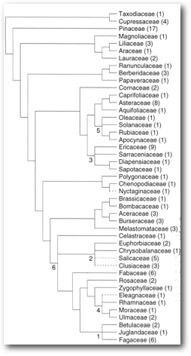
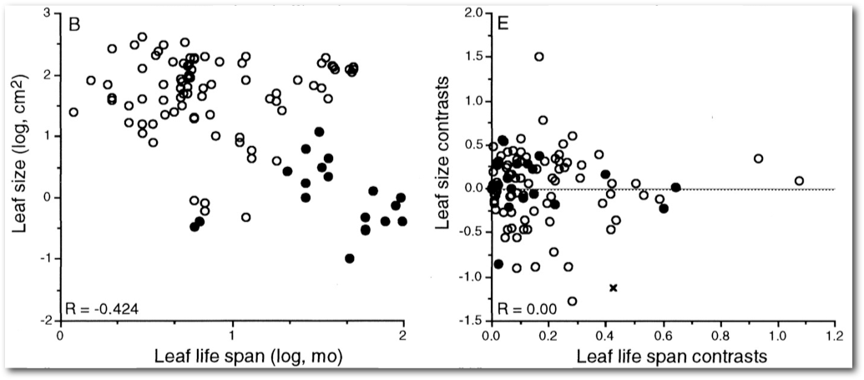
Ackerly and Reich. Convergence and correlations among leaf size and function in seed plants: a comparative test using independent contrasts. Am. J. Bot. (1999) vol. 86 (9) pp. 1272-1281
Notes:
First use for tree: species are not independent – tree helps you deal with that. Banal, but 1) important in getting right answer, 2) important in many fields

Slide 36
Ackerly and Reich. Convergence and correlations among leaf size and function in seed plants: a comparative test using independent contrasts. Am. J. Bot. (1999) vol. 86 (9) pp. 1272-1281
Notes:
First use for tree: species are not independent – tree helps you deal with that. Banal, but 1) important in getting right answer, 2) important in many fields

Slide 37
Small, long-lived
Big, short-lived
Ackerly and Reich. Convergence and correlations among leaf size and function in seed plants: a comparative test using independent contrasts. Am. J. Bot. (1999) vol. 86 (9) pp. 1272-1281
Notes:
First use for tree: species are not independent – tree helps you deal with that. Banal, but 1) important in getting right answer, 2) important in many fields

Slide 38
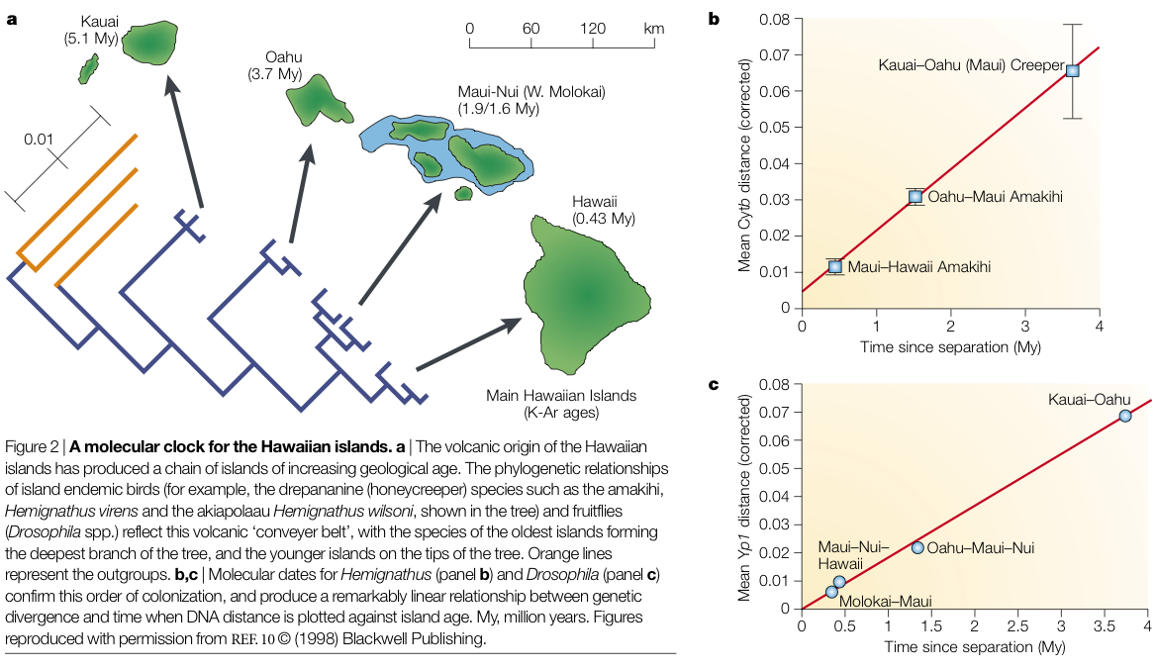
Bromham and Penny. The modern molecular clock. Nature Reviews Genetics (2003) vol. 4 (3) pp. 216-224. Figure after Fleisher et al. Evolution on a volcanic conveyor belt: using phylogeographic reconstructions and K-Ar based ages of the Hawaiian islands to estimate molecular evolutionary rates. Mol Ecol (1998)

Slide 39
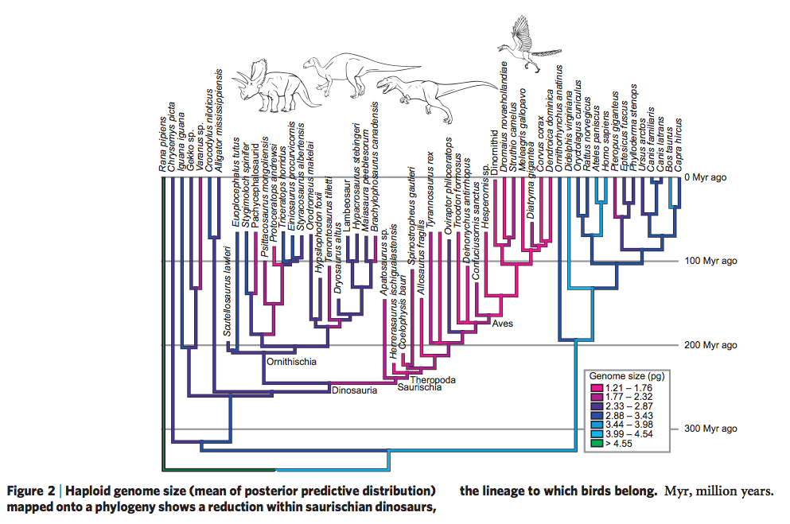
Here we use a novel bayesian comparative method to show that bone-cell size correlates well with genome size in extant vertebrates, and hence use this relationship to estimate the genome sizes of 31 species of extinct dinosaur, including several species of extinct birds. Our results indicate that the small genomes typically associated with avian flight evolved in the saurischian dinosaur lineage between 230 and 250 million years ago, long before this lineage gave rise to the first birds. By comparison, ornithischian dinosaurs are inferred to have had much larger genomes, which were probably typical for ancestral Dinosauria. Using comparative genomic data, we estimate that genome-wide interspersed mobile elements, a class of repetitive DNA, comprised 5-12% of the total genome size in the saurischian dinosaur lineage, but was 7-19% of total genome size in ornithischian dinosaurs, suggesting that repetitive elements became less active in the saurischian lineage.
Organ et al. Origin of avian genome size and structure in non-avian dinosaurs. Nature (2007) vol. 446 (7132) pp. 180-4

Slide 40
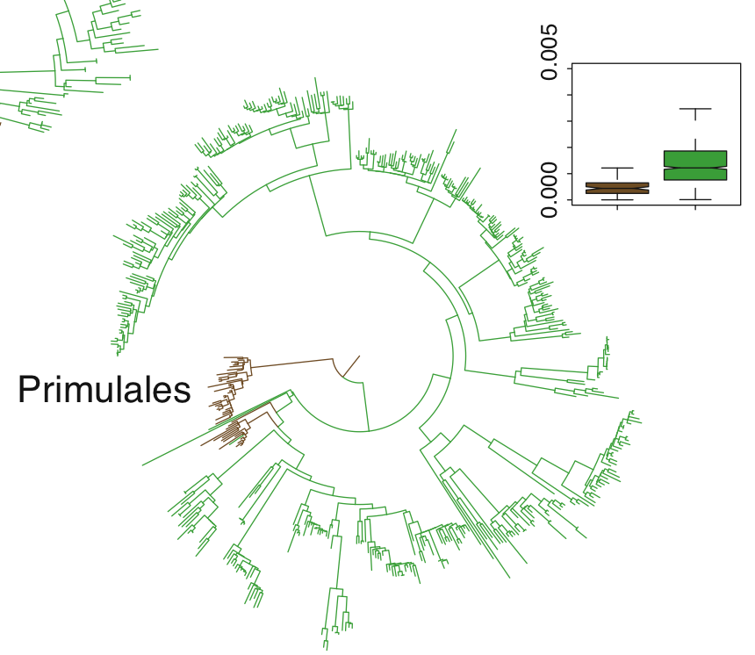
Substitutions/MY
Trees/shrubs
Herbs
Smith and Donoghue. Rates of Molecular Evolution Are Linked to Life History in Flowering Plants. Science (2008)

Slide 41
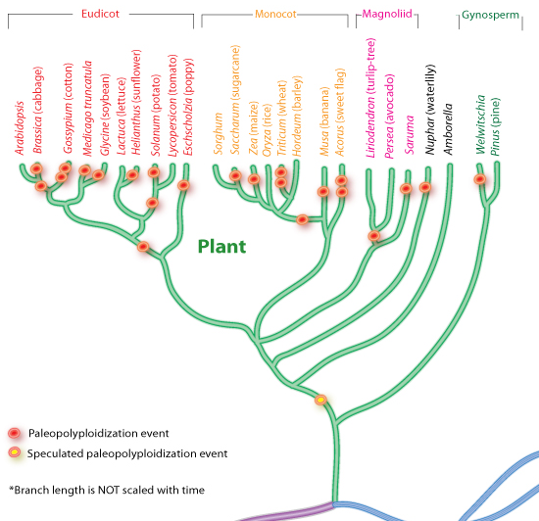
Peter Zhang after Adams & Wendel, 2005; Cui et. al, 2006; Wolfe, 2001.

Slide 42
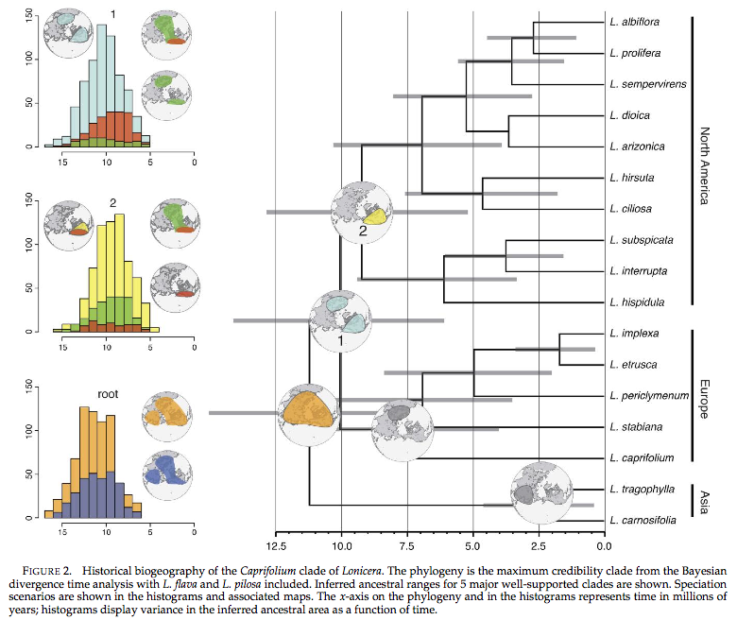
Smith and Donoghue. Combining Historical Biogeography with Niche Modeling in the Caprifolium Clade of Lonicera (Caprifoliaceae, Dipsacales). Syst Biol (2010) vol. 59 (3) pp. 322-341

Slide 43
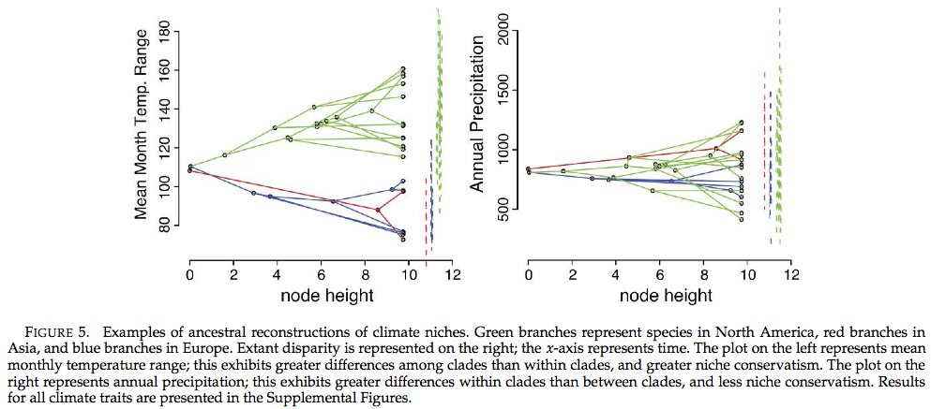
Smith and Donoghue. Combining Historical Biogeography with Niche Modeling in the Caprifolium Clade of Lonicera (Caprifoliaceae, Dipsacales). Syst Biol (2010) vol. 59 (3) pp. 322-341

Slide 44
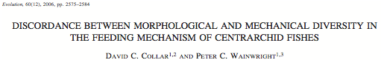
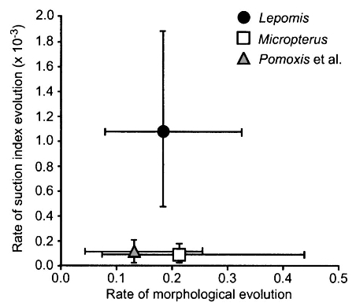
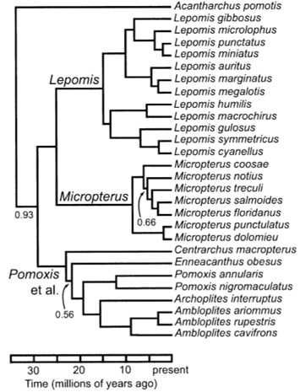
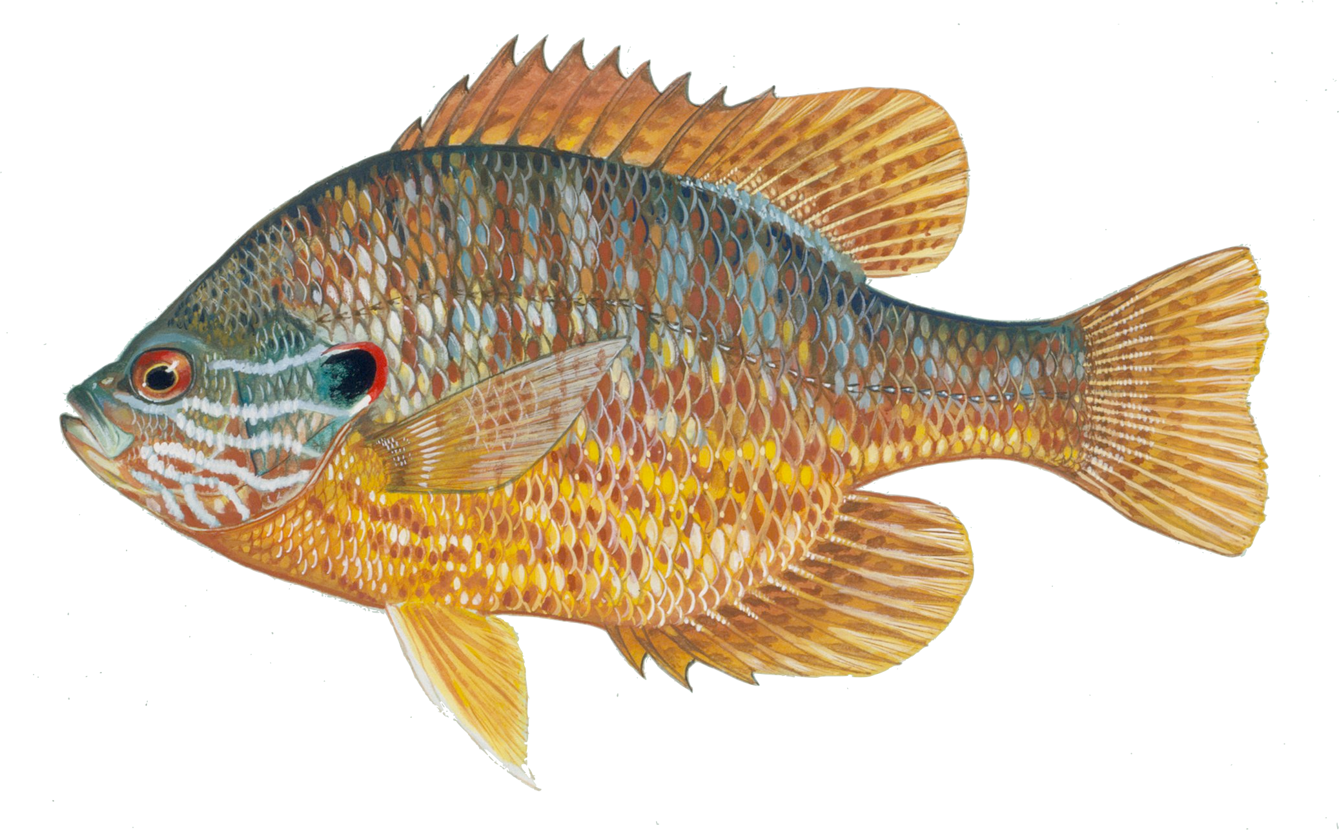
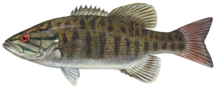
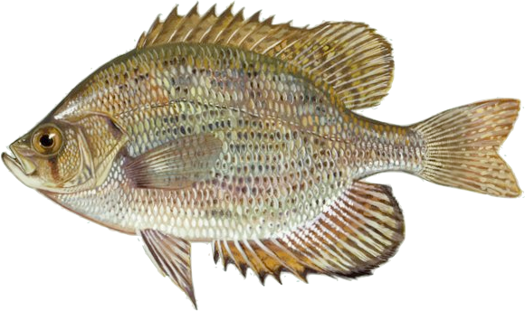
US FWS
Notes:
The censored approach has been used by Dave Collar (a Losos postdoc) to investigate morphological evolution. All three fish clades have similar rates of morphological evolution in general, but sunfishes have a much higher rate of evolution of their feeding apparatus (which is interesting, as they also have a greater diet diversity).

Slide 45
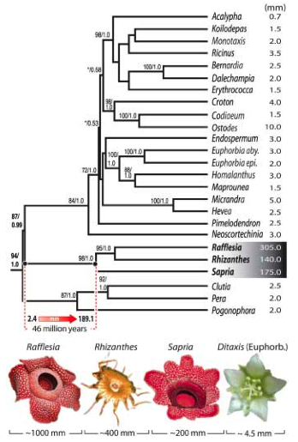
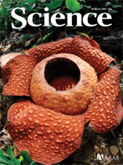
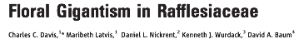
Estimate rates A, B, and C
Stretch tree based on these rates
Estimate states on stretched tree
Notes:
They used Brownie to get optimal rate estimates, then used these to scale the tree and then estimate ancestral flower sizes.

Slide 46
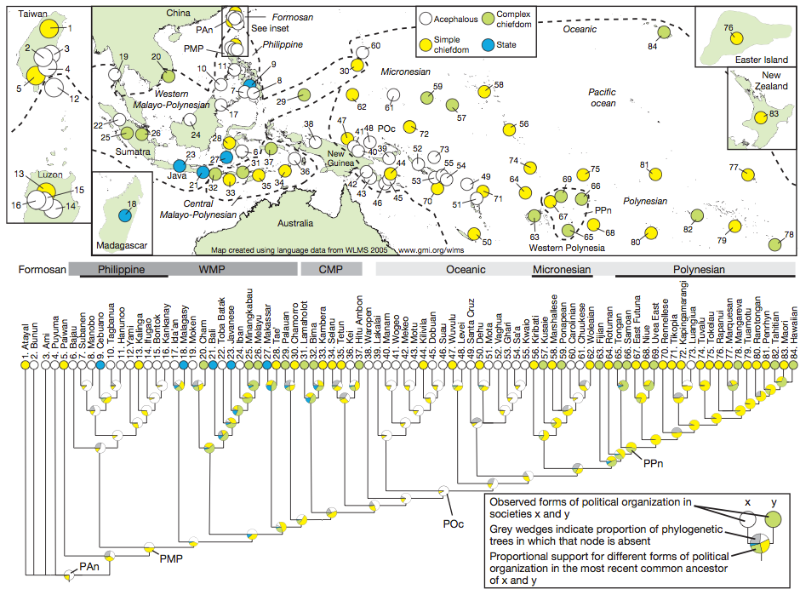
Currie et al. 2010 Nature

Slide 47
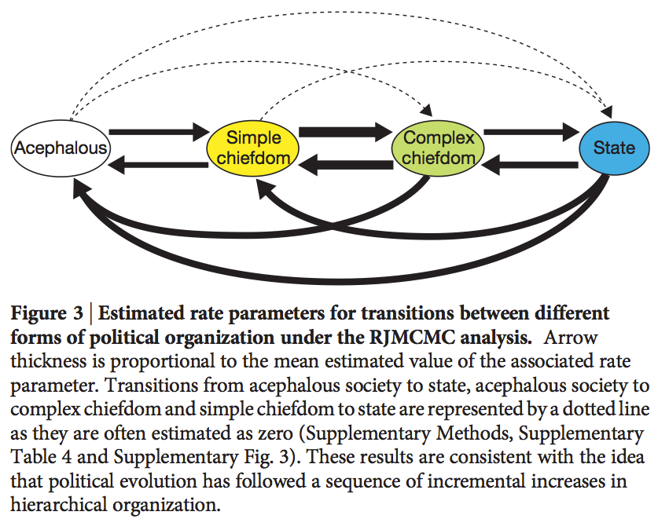
Currie et al. 2010 Nature
Notes:
And you get these rates.

Slide 48
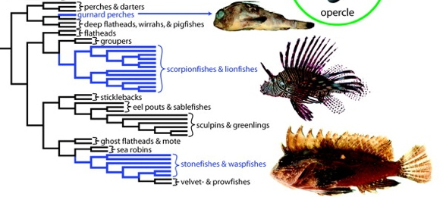
Smith &
Wheeler 2006

Slide 49
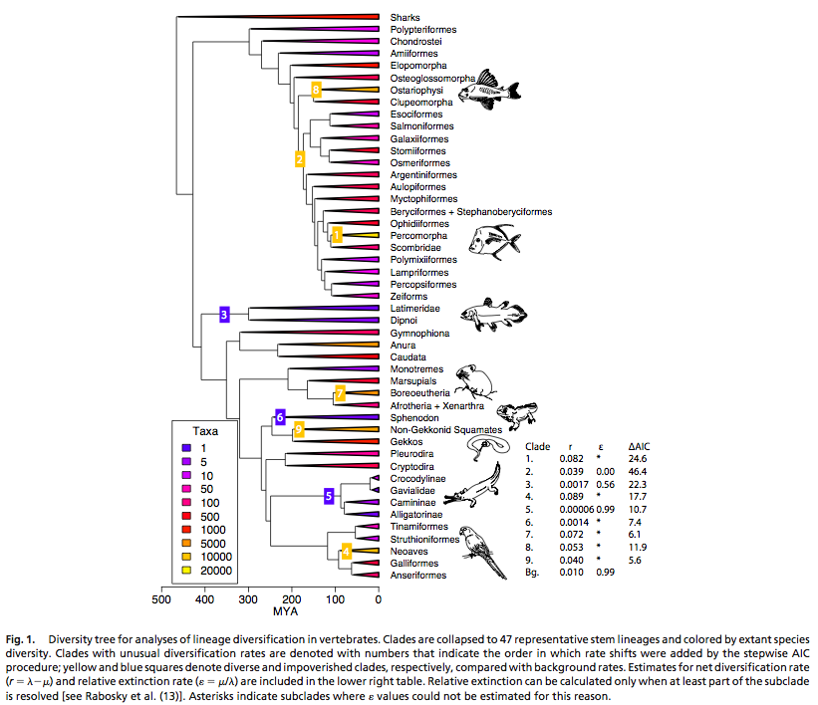
Alfaro et al. Nine exceptional radiations plus high turnover explain species diversity in jawed vertebrates. P Natl Acad Sci Usa (2009) vol. 106 (32) pp. 13410-13414

