Slide 1
5 in 10
5 Frontend Libraries For Visualizing Your Time-Series Data

Slide 2
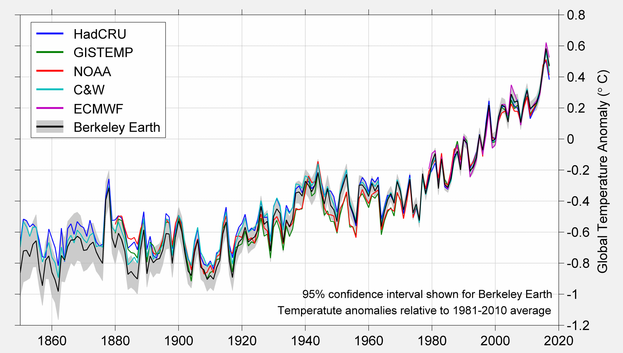
What’s the issue? - Time Series Data
Dense
Tens of thousands to Millions of Data Points
Meaningful Information on Axes
Scalability and Interactivity
Zoom and Panning
Accommodating granular metadata
Rendering multiple lines on one graph

Slide 3
D3.js
The king of frontend visualization libraries
Or at least one of the most ubiquitous
Used by hundreds companies
Square
New York Times
Plot.ly
Trifacta
Uses Native Functionality
HTML, CSS, JavaScript and SVG
Fundamental
Lightweight, Fully Customizable and Efficient

Slide 4
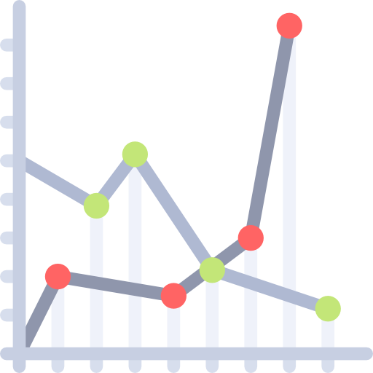
D3.js - Will it work for you?
Language: JavaScript
Vanilla Javascript
Fully Customizable
Have to rebuild the basic parts again and again
No templates for common graphs
Requires an Understanding of the DOM
Document Object Model
Non responsive
-ish

Slide 5
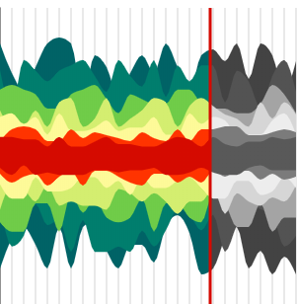
Victory
A Charting Library for React
Simple & Easy to Set Up
Pre-constructed React Components
Abstracts away the tedium of D3.js
Customizable
Components are easily modified with no need for hacky workarounds
Used by:
FiveThirtyEight, AirBnB, Viacom, Zillow

Slide 6
Victory - Will it work for you?
Language: JavaScript/TypeScript with React
Node JS
Frontend dependency hell
Specific Documentation for Handling Time Series Data
Not Optimized for Large Datasets
Native downsampling/upsampling can be laggy
Especially when combined with Zooming and Panning
Basic Design is a Little Lacking
Responsive!

Slide 7
Bokeh
Interactive Python-based Visualization Library
Provides “high-performance interactivity over very large or streaming datasets.”
Backend-Frontend
Generates Interactive .html files as Bokeh-apps
Can be served down statically
Provides tools for embedding graphs in existing web pages
Bokeh Json
Bokeh Server
Works well with commonly used Flask Microservice Library
Efficient
Visualizations are processed on the backend

Slide 8
Bokeh - Will it work for you?
Language: Python and Javascript
Jinja Syntax is a plus
Simple and Beautiful Plot Creation
Most plots can be created with a single function
Relatively Complex Architecture
Extensive documentation is provided
An advanced knowledge of client-server architecture helps
The power of Python
SciPy
NumPy
Pandas

Slide 9
Shiny
R Studio Library for Making Interactive Web Apps
Visualizations & Full Dashboards
Shiny Provides Tools for Creating Complex Dashboards
Complete applications with a variety of functionality
Out of the Box Functionality
Utilize Predefined UI Widgets
Manipulate, Search, Reduce, and Alter Your Data
Provides a Wide Variety of Chart Types
Designed for interactivity
Similar to Bokeh
Frontend-Backend

Slide 10
Shiny - Will will it work for you?
Language: R
Great for scientists
R is a commonly used language
Easy to integrate with existing research using R for data analysis
R and R ecosystem of products are free to use
R Commitment
Serving
Embedding
Maintenance and Evolution
May pose problems if the ownership of a project moves to a full-stack developer who does not know R

Slide 11
Crossfilter
Not a Visualization Library
Useful in Optimizing Javascript Based Visualizations
Frontend APIs
Rapid Filtering, Mapping, & Reducing client side datasets.
Up to millions of data points
Optimization
Aids libraries like Victory, D3.js, Chart.js
Mitigates client side lag
Not the only option for optimization, but a good first step

Slide 12
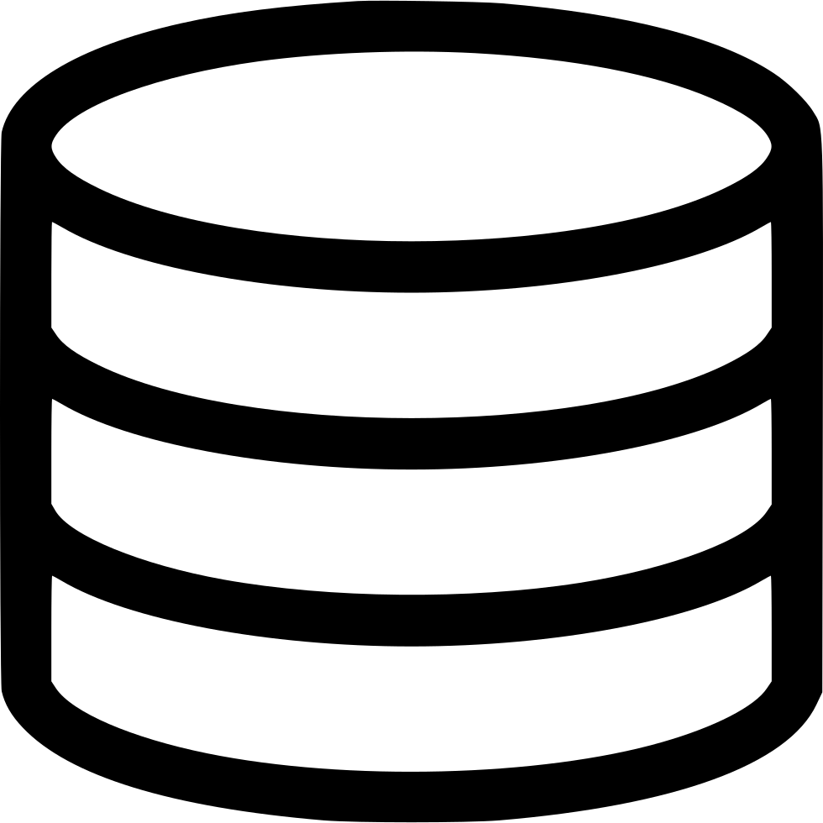
Crossfilter - Will it work for you?
Working with a Javascript Vis Library?
Not only helpful but borderline necessary
Crucial for optimal user experience
Working with R Shiny or Bokeh?
Bokeh?
Some Javascript-based functionality that can be optimized
Mostly unnecessary with Bokeh Server
R Shiny?
Pretty self contained
Mostly unnecessary

Slide 13
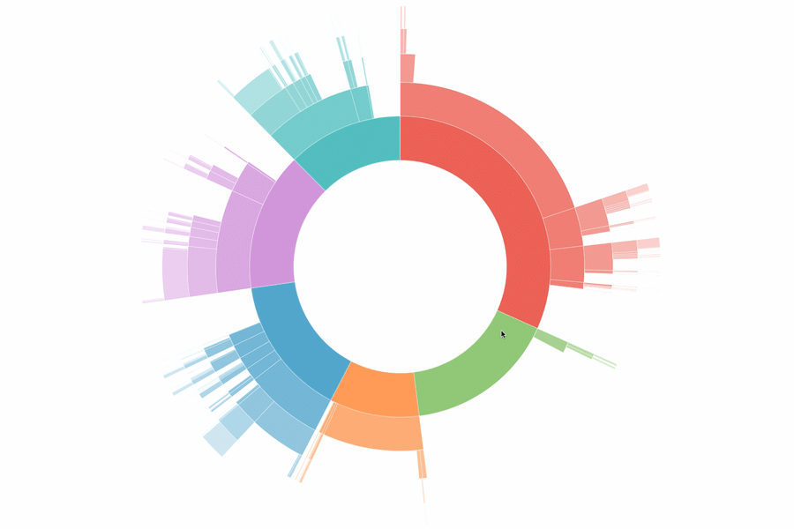
Thank You
Thoughts? Comments? Questions?

Slide 14
https://medium.com/@Elijah_Meeks/d3-is-not-a-data-visualization-library-67ba549e8520
https://stackshare.io/d3 - who uses d3

