Slide 1
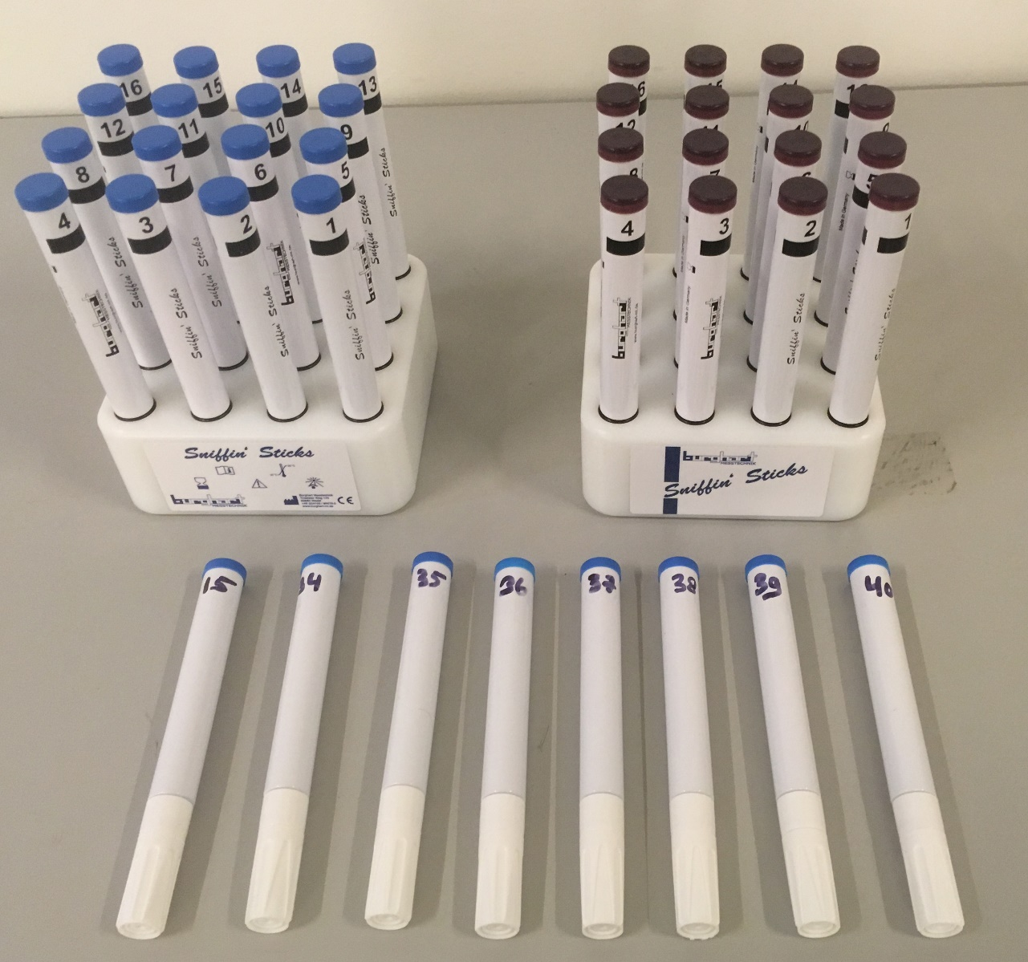
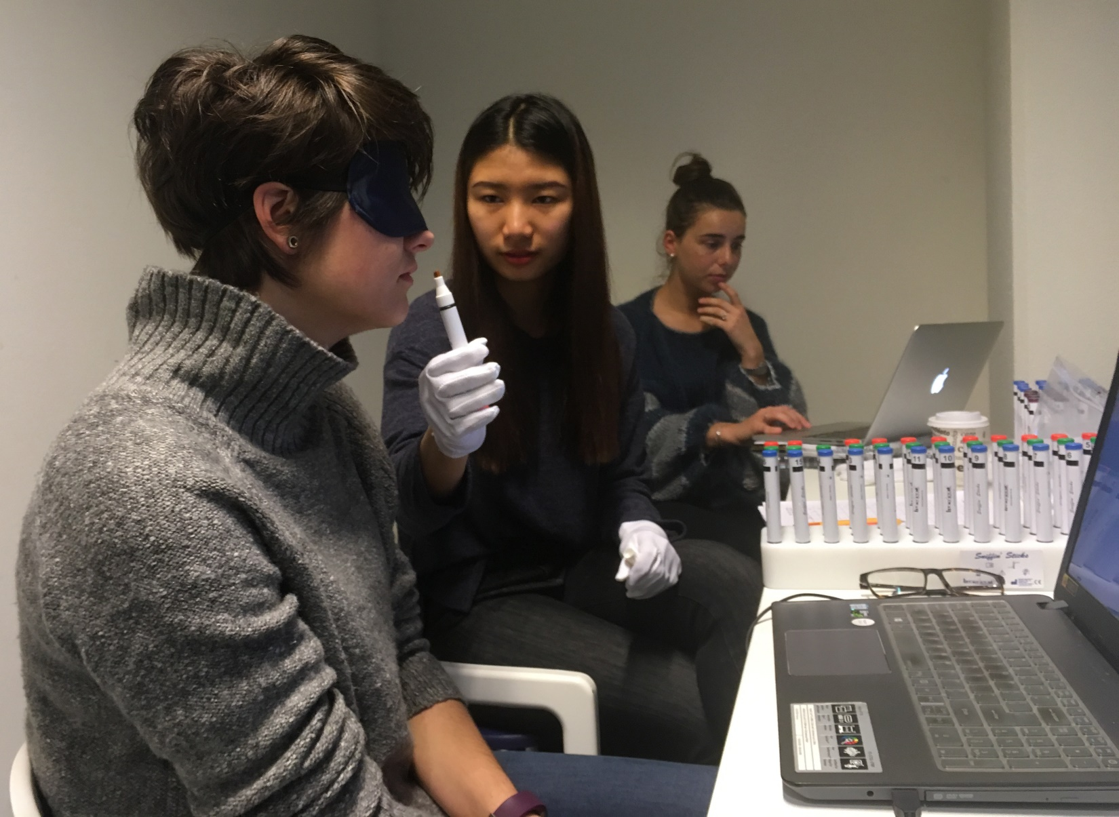
Assessment of Odor Evoked Emotions using the EmojiGrid
Alexander Toet¹, Sophia Eijsman^{1,2}, Yingxuan Liu^{1,2}, Stella Donker², Daisuke Kaneko^{1, 3}, Anne-Marie Brouwer¹, Jan van Erp^{1,4}
¹ TNO, The Netherlands, ² Utrecht Univ, The Netherlands, ³ Kikkoman Europe R&D Lab. B.V., The Netherlands, ⁴ Twente Univ., The Netherlands
Introduction
Odors are increasingly used to induce various emotional states (e.g. in retail, entertainment, public environments)
This is reflected in an increasing availability of digital scent delivery and communication systems
Efficient and intuitive self-report tools are needed to assess whether the desired emotions have been evoked.
Current affective measurement tools are language-dependent.
The EmojiGrid however is an intuitive graphical (language-independent) emotional self-report tool.
The EmojiGrid
The emoji-labels express different degrees of valence (horizontal axis) and arousal (vertical axis).
This study was performed to evaluate the EmojiGrid as a self-report tool for the assessment odor-evoked emotions.
Results
The odors successfully elicited a wide range of different emotions.
Fruit (e.g., peach, raspberry, banana) typically yields the highest positive mean valence ratings, while fish, garlic and onion give the most negative mean valence ratings.
Mean valence and arousal ratings agree with those from previous studies.
The relation between mean valence and arousal shows the typical U-shaped relation that is also found for affective stimuli in other sensory modalities (e.g., music, paintings, food).
Methods & Procedure
Participants (N=56, 24 males, mean age=24.3±4.6 years) briefly (about 5s) smelled 40 odors, presented in random order.
The odors ranged from very unpleasant (e.g., feces, fish) to very pleasant (e.g., peach, caramel).
At the start of the experiment participants inspected the EmojiGrid without any further instructions.
After smelling each odor participants reported their emotional response by a single click on the EmojiGrid.
-Subjective valence: ‘disgusting’, ‘funny’, ‘I am expected to dislike this’
-EEG asymmetry: ‘avoid’, ‘approach’
-Skin potential: ‘system activation’
The link to subsequent behavior is of special interest and topic of future study.
Discussion
The EmojiGrid is a valid affective self-report tool for the assessment of odor evoked emotions.
Participants were able to use the EmojiGrid without verbal instructions.
This makes the EmojiGrid a valuable instrument for cross-cultural research.
References
Kaneko e.a. (2018). EmojiGrid: a 2D pictorial scale for cross-cultural emotion assessment of
negatively and positively valenced food. Food Res. Int. 115, p. 541-551.
Toet e.a. (2018). EmojiGrid: A 2D pictorial scale for the assessment of food elicited emotions.
Frontiers in Psychol. 9, # 2396.
Other authors:
Bensafi e.a. (2002) Autonomic nervous system responses to odours: the role of pleasantness and arousal. Chem Senses 27: 703-709.
Bestgen e.a. (2015) Odor emotional quality predicts odor identification. Chem Senses 40: 517-523.
Herz & Cupchik (1992) An experimental characterization of odor-evoked memories in humans. Chem Senses 17: 519-528.
- -Skin potential: ‘system activation’
The link to subsequent behavior is of special interest and topic of future study.
Acknowledgements
We thank Jos van den Enden (Retroscent, https://retroscent.com) for kindly providing us with additional odor samples. This work was supported by Kikkoman Europe R&D Laboratory B.V.
Stimuli Stimulus presentation

