Slide 1
Big Gridded Data
The transition from legacy to next generation.
ESIP Summer Meeting: July 16, 2019

Slide 2
NetCDF and OPeNDAP clients: then and now.
How the ecosystem of data server, web service, process client, and environmental modeling has changed over the last decade.
Presented by David Blodgett <dblodgett@usgs.gov>
Tuesday, July 16th 2019

Slide 3
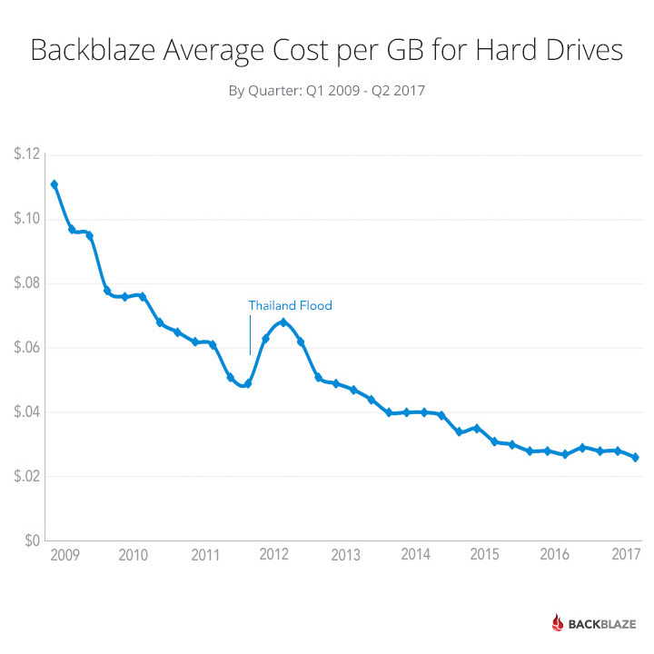
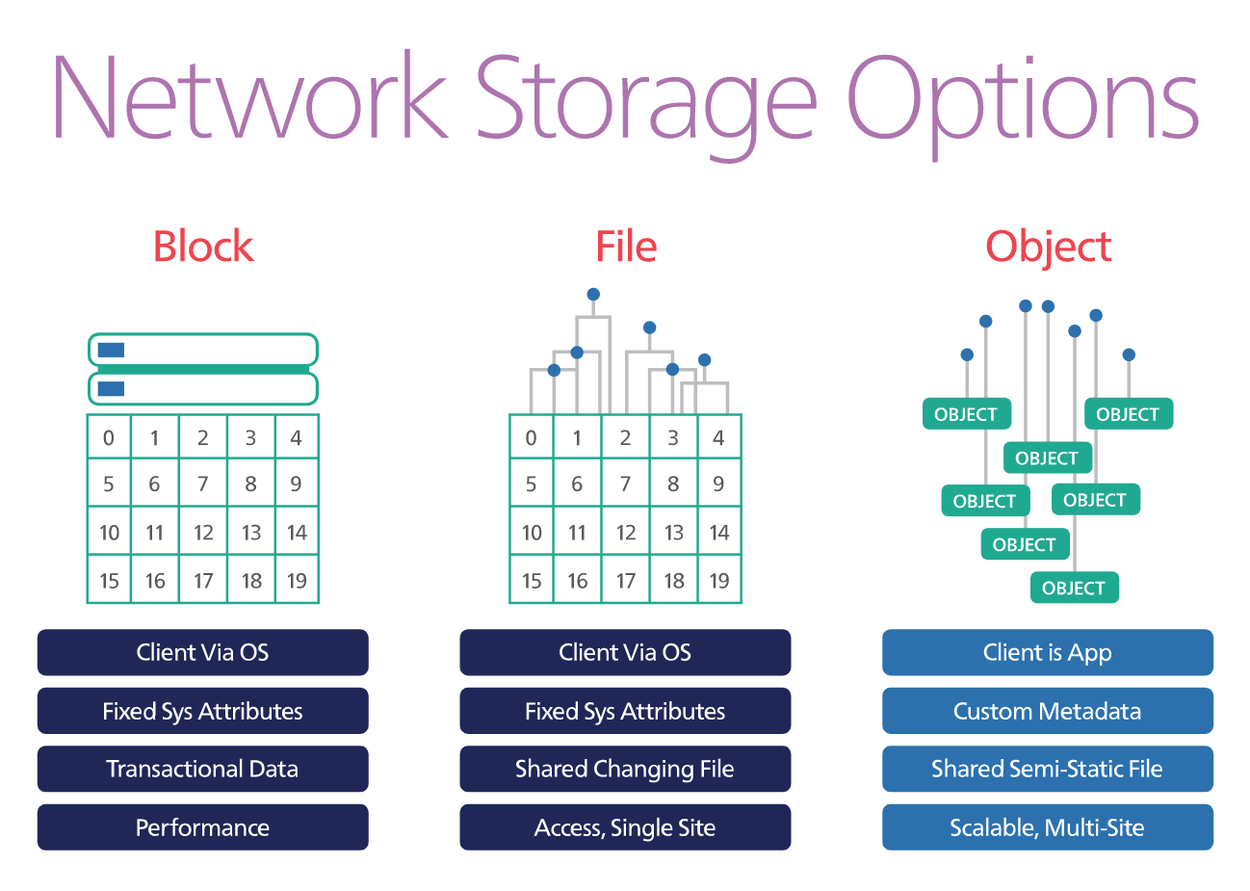
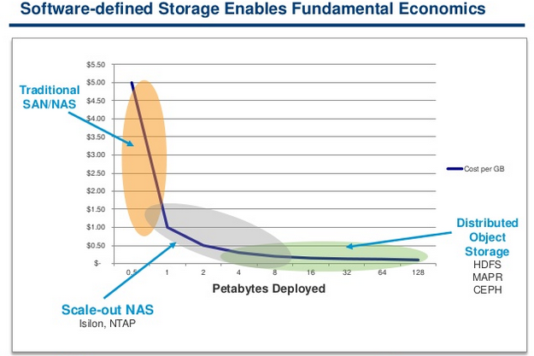
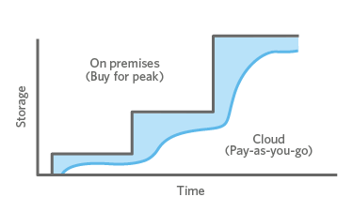
Storage
Cheaper
+
Faster
Notes:
Storage has become cheaper. Economics have become more linear. We have object storage in addition to database and file system. Object storage has completely changed the calculus when it comes to massive data storage and access.

Slide 4
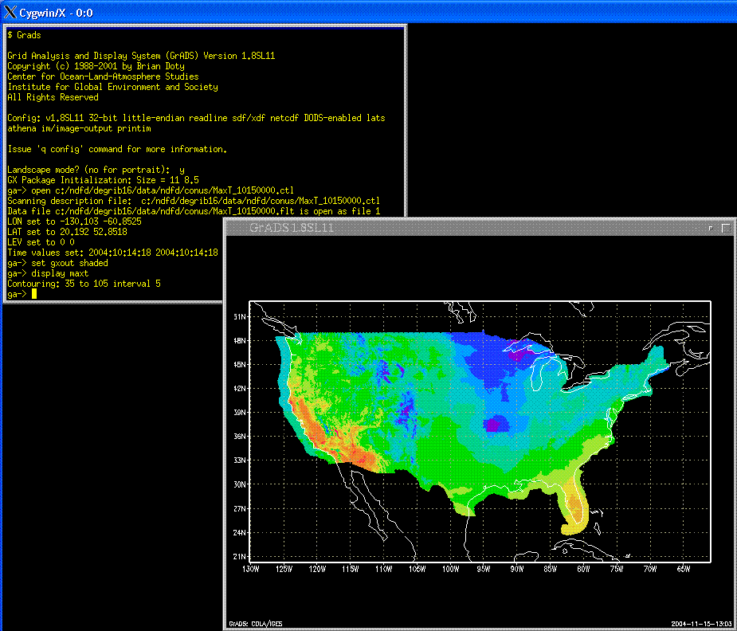
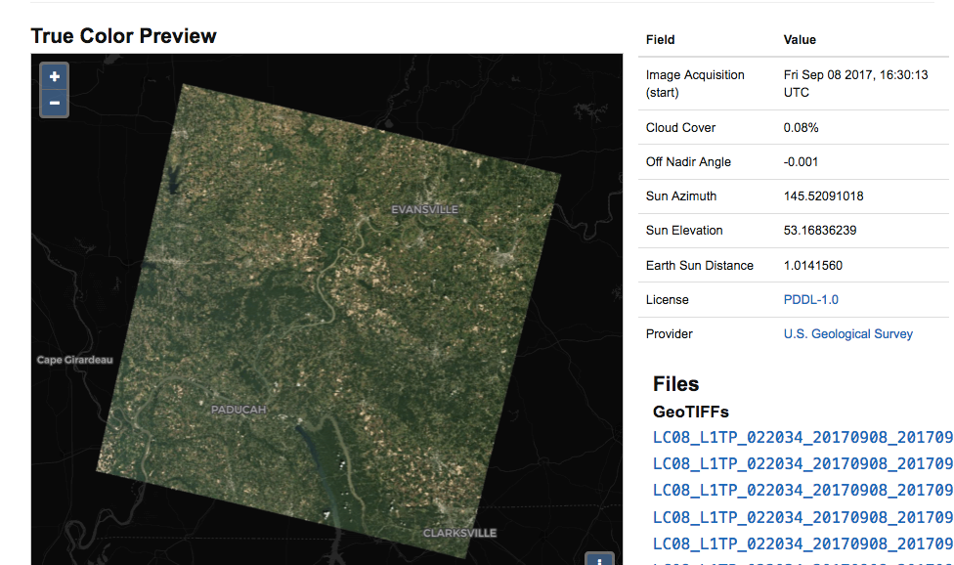
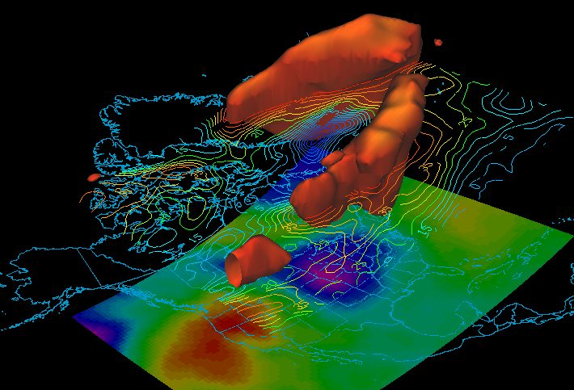
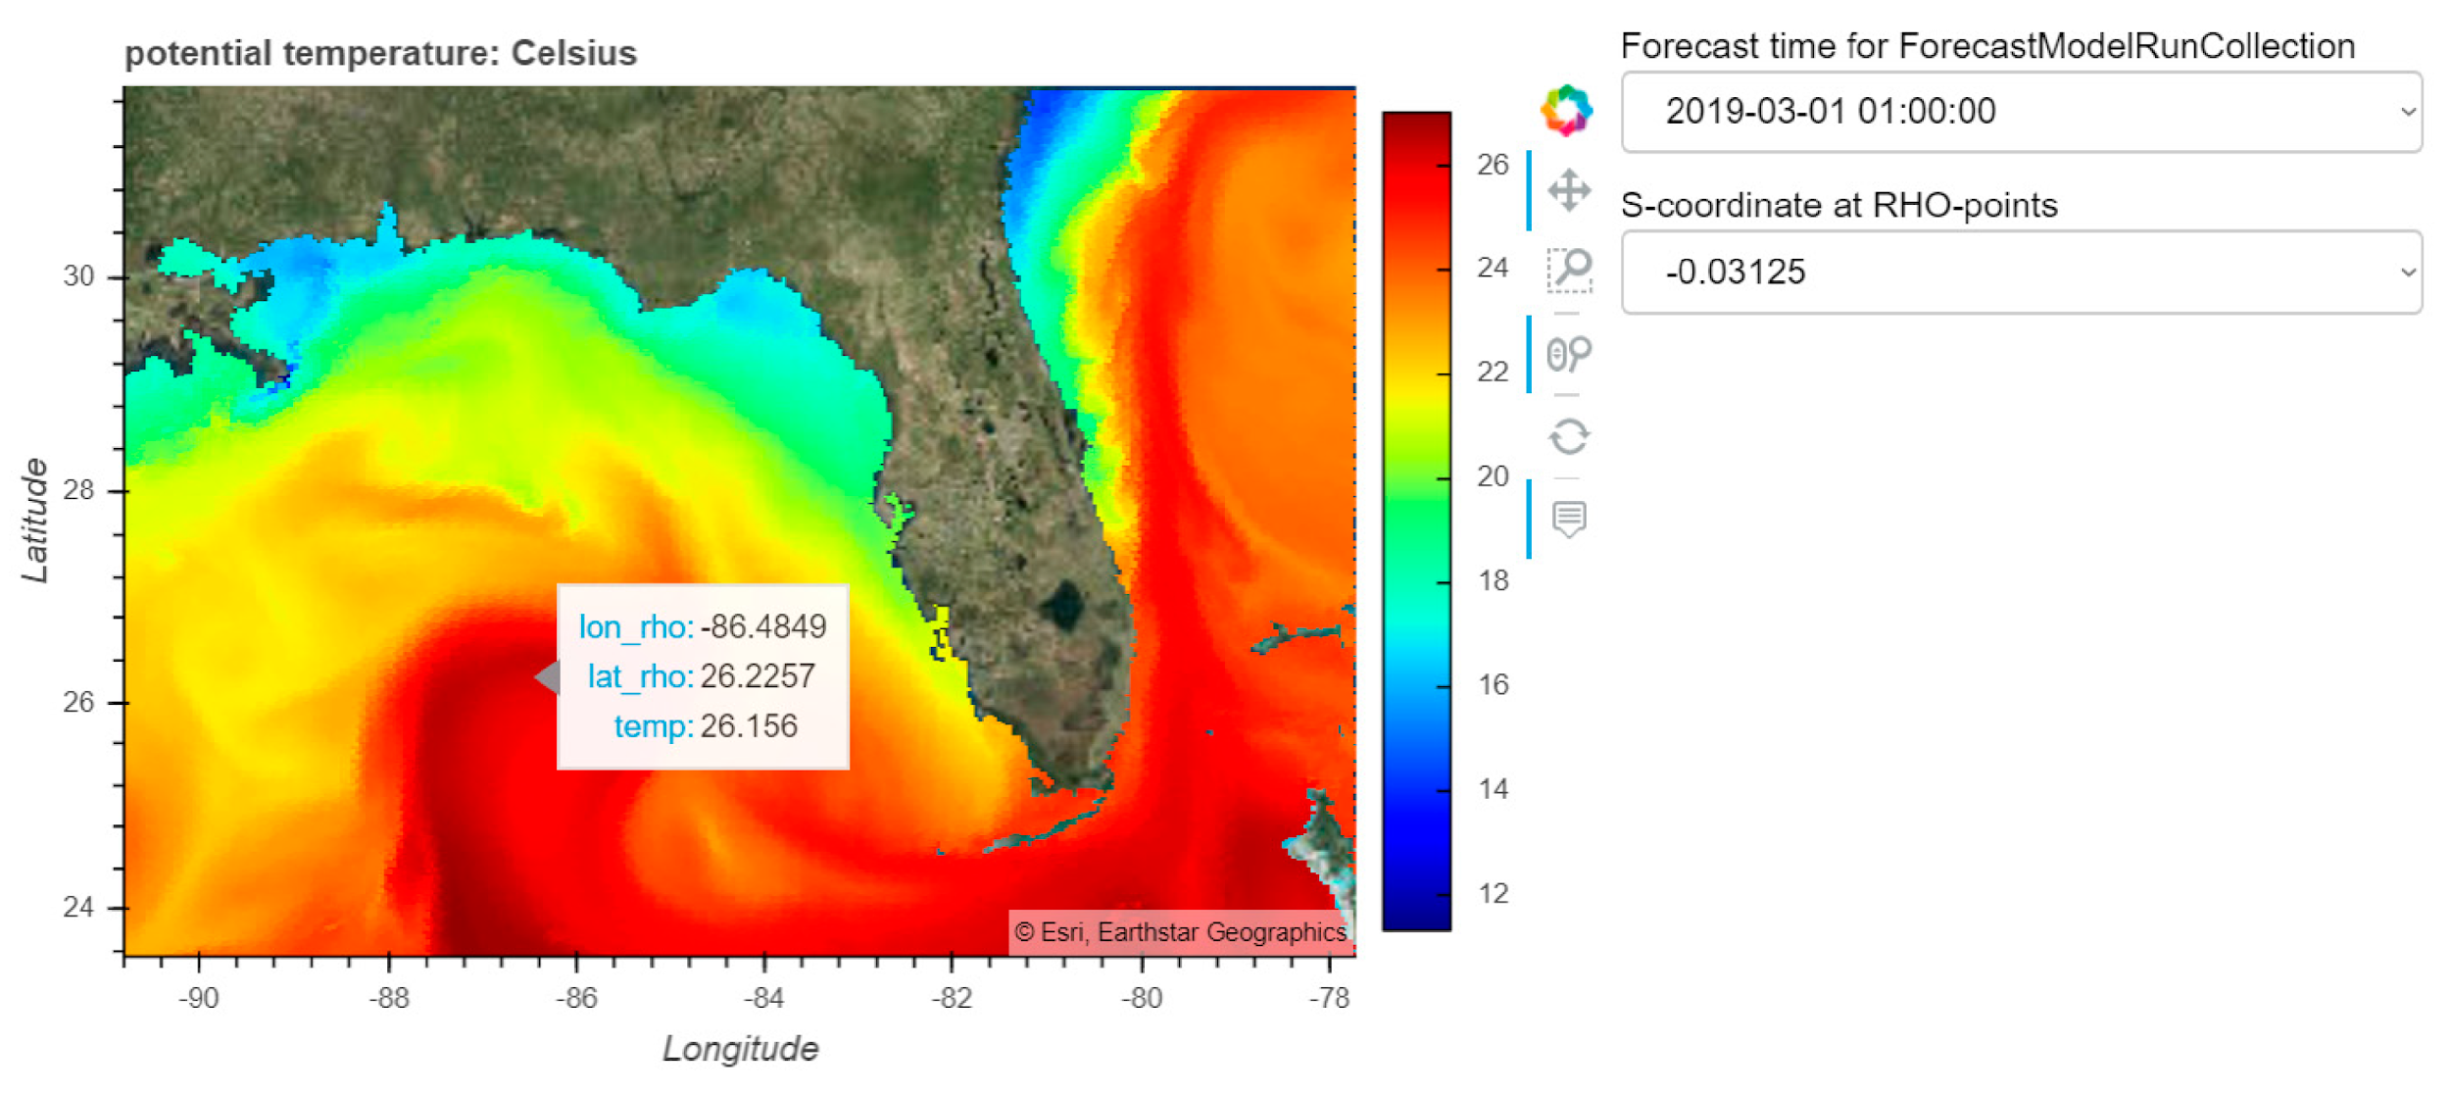
Server -> Serverless
STAC
GrADS
ZARR
THREDDS
Notes:
From the days of GRIB, NetCDF-Java files, and big arrays of SAN storage with bare metal sub-setting and rendering capabilities, we’ve moved to era of cacheable/cached, parallel-io capable, object store solutions. The new solutions are less flexible in some ways but leverage other technologies to give flexibility to users who can afford it.

Slide 5
Service Client
Notes:
Server-side service “clients” such as Giovanni and the Geo Data Portal use a suite of file-access and web-service mechanisms to provide meaningful subsets and lightly processed data sets. These kinds of clients put all the onus on the service developer to know what the end user wants but can make it very easy for end users – if the service fits their needs. In recent years, we’ve seen the advent of service clients that reside “in the cloud” such as Jupyter-Hub, Google Earth Engine, and ArcGIS Online. Google Earth Engine, ArcGIS Online, and the Pangeo project even leverage special storage capabilities of their cloud deployment environments to bring high-throughput and high-performance computing to their users through simple and flexible script interfaces. 10 years ago, we could only dream of the potential that these server-side client applications provide.

Slide 6
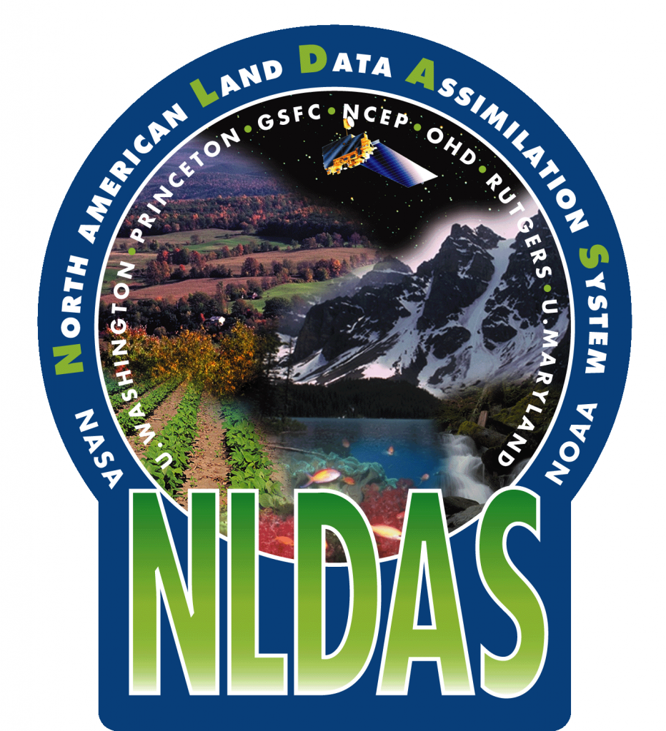
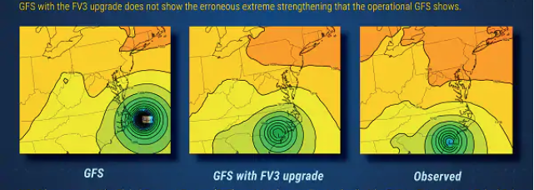
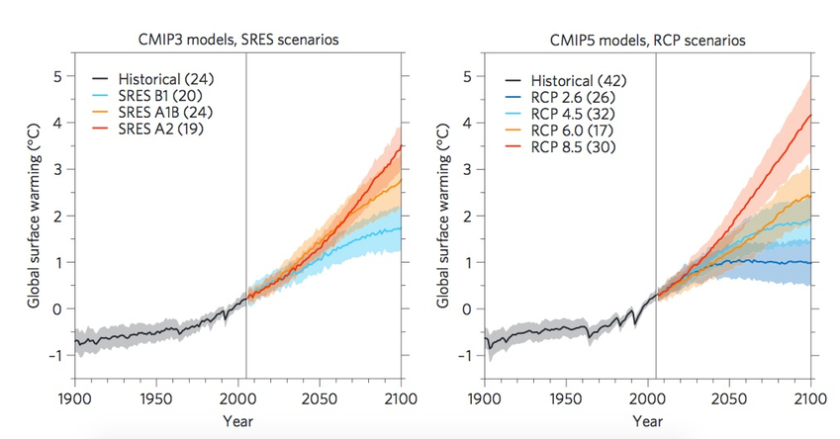
Modeling
Notes:
As an end-user of some of the advances in information management, environmental modeling is poised to make great strides based on the recent transition to object-store and containerized architectures. Legacy systems such as NLDAS and the CMIP modelling activities have typically run on supercomputers using software that is decades old. In the last few years, we’ve seen a new (FV3) dynamical core deployed (new code?!?) to the Global Forecast System as well as Version 2 of the National Water Model. These and many other models are poised to shift to containerized, cloud-based deployments that have both performance (read more ensemble members etc.) and accessibility (read data natively in the cloud for users) implications.

Slide 7
What’s next?!?
Labeled Property Graphs?
Haven’t penetrated earth systems modeling... yet.
Unprecedented Integrations?
W3C DWBP & STAC etc. are just getting started!
Distributed “edge” Sensor / Model systems?
Imagery from drones, processed into model inputs on the edge, fed into hyper-resolution predictive model “cores”?!?!

Slide 9
NCEI Service of Big Gridded Data Now
Technologies
THREDDS for both aggregations single files, ERDDAP for THREDDS aggregations.
Web Accessible Folders and FTP
Custom web applications that use THREDDS or ERDDAP as a source
Need for Change
NESDIS is planning to move services to the cloud
On the cloud, object storage such as Amazon S3 is far cheaper than traditional block storage
For on-premises storage, object storage is far easier to scale for large loads than block storage
NCEI data management and server code mostly uses block storage
Services like THREDDS and ERDDAP can allow users to cause our servers to do heavy processing
Possible Solutions
Some services such as THREDDS may be modified by their developers to use object storage
NCEI could publish data in object-storage friendly formats that allow client libraries to easily subset data, such as ZARR, N5, or Cloud-Optimized GeoTiff
Use of cloud-capable workflow management software like Apache NiFi and Kafka for data/metadata management
Notes:
Setting up and updating THREDDS aggregations can impose a heavy processing load on our systems as new data arrives, especially for GRIB.
NCEI already has an on-premises object store in testing.
ZARR, N5, and Cloud-Optimized GeoTIFF allow clients to do the work of subsetting data while NCEI systems act as simple HTTP servers.
Apache NiFi is being used for some preliminary data management tests; Kafka will be the basis of NCEI’s Inventory Manager, which will keep track of our data sets and their documentation. NiFi and Kafka integrate easily.
We have converted NCEI’s NOAA Global Surface Temperature

Slide 10
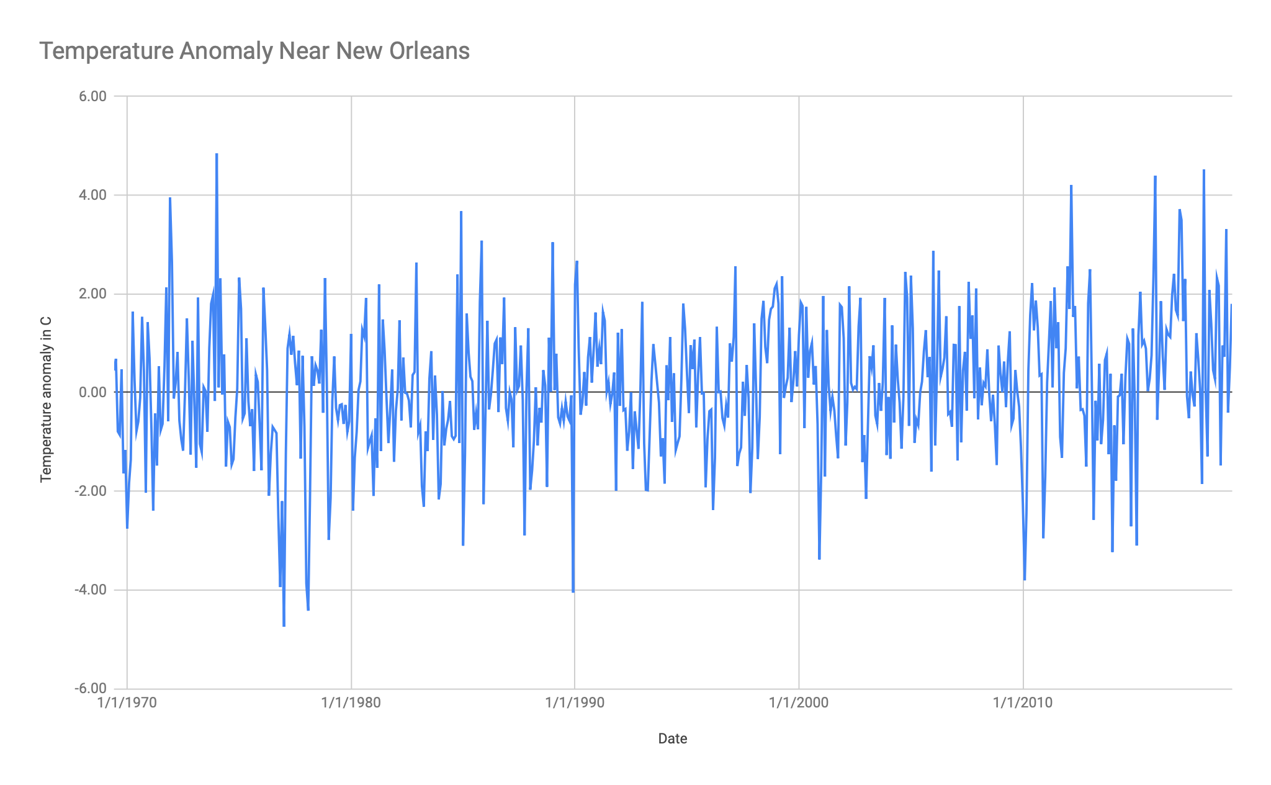
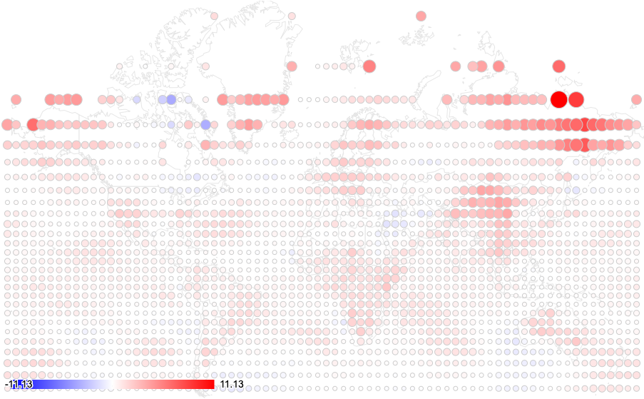
NCEI Data as Zarr
NCEI’s NOAA Global Surface Temperature dataset has been converted into Zarr. The ZarrDAP demo server allows selective access to it as JSON. The ZarrDAP Google Apps client library allows Google Sheets to get the data for graphing and analysis.
Line Graph from ZarrDAP Data
Temperature Anomaly Map from ZarrDAP Data
Notes:
For NCEI-generated data, we could generate the data as Zarr in the first place either instead of or alongside NetCDF.
When the data is put on a public object store, users could use the Zarr library to directly use the data.
The ZarrDAP JSON server is easy for users who don’t have a Zarr library. It could be used to support custom apps like Climate at a Glance which are in a language without a Zarr library.
The ZarrDAP Google Apps library will allow users of Google Sheets to put its functions into spreadsheet cells to get data from the ZarrDAP JSON server. Too bad Google Apps Script does not have a Zarr library.
The ZarrDAP server could be modified to create CSV directly to make it even easier for spreadsheet users.

Slide 12
A tiled storage technology for ocean data access and analytics
Edward Armstrong, Thomas Huang in conjunction with PO.DAAC and Oceanworks development team
© 2019 California Institute of Technology. Government sponsorship acknowledged.

Slide 13
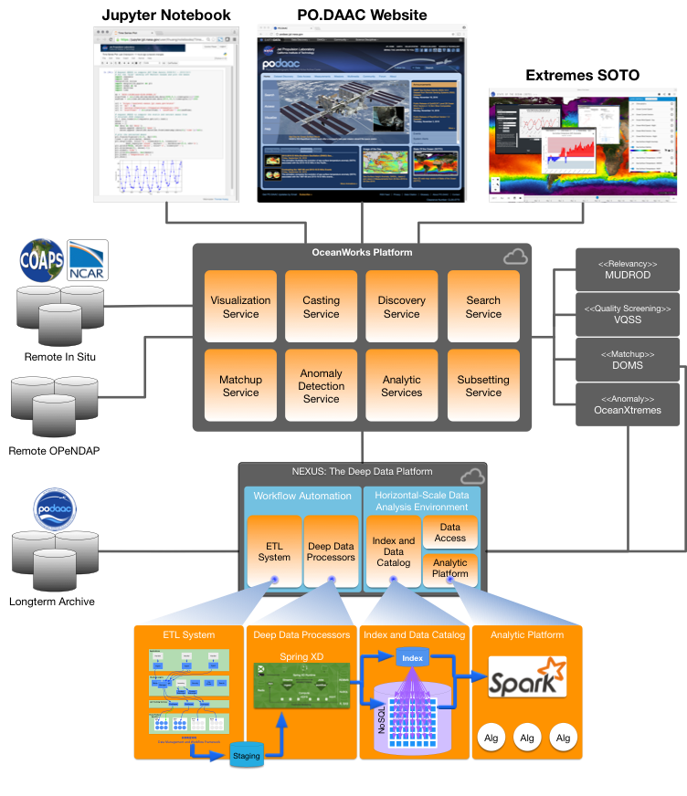
Oceanworks -- NASA AIST
Enabling Next Generation of Ocean Science Tools and Services with data analytics and services for
Oceanographic anomaly detection
Sea level rise and variation
Hydrological mass change
In situ to satellite matchups
Ocean models (in progress)
The engine behind this capability is Nexus
A tiled storage system based on Casandra and Solr
Data analytics by Apache Spark
The entire software stack is an Apache Open Source project:
Integrated Ocean Science Data Analytics Platform (SDAP)
Capabilities accessible (e.g. in a Jupyter notebook) via RESTful APIs
Key message: harmonize data, tools, services and computation resources so the scientist can concentrated on results and not on data conditioning or preparation
NASA AIST OceanWorks
© 2019 California Institute of Technology. Government sponsorship acknowledged.

Slide 14
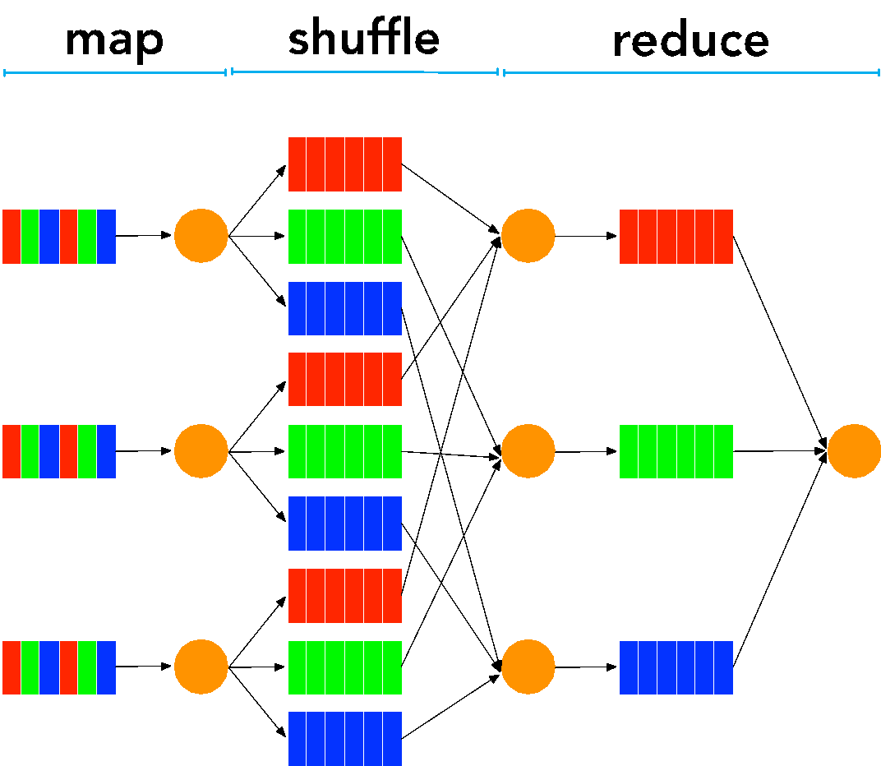
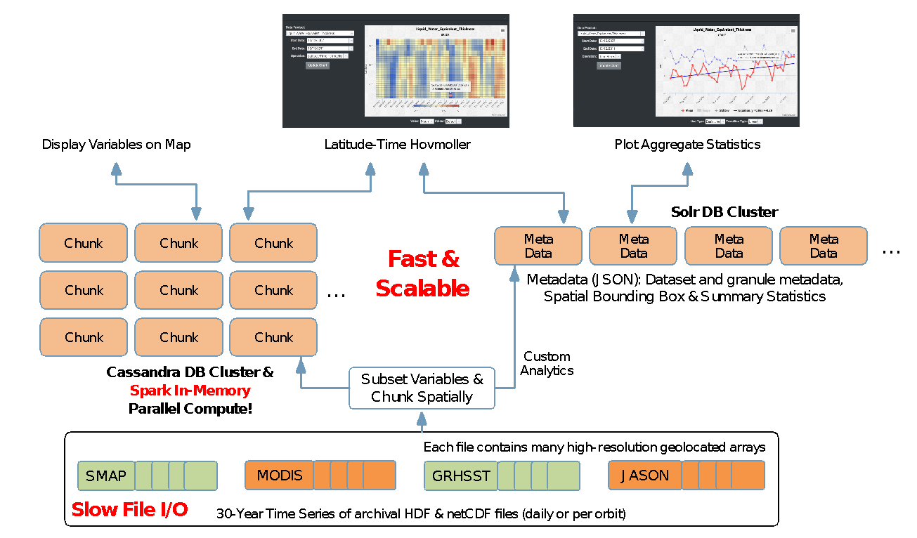
Scalable Data Analytic Solution
MapReduce: A programming model for expressing distributed computations on massive amount of data and an execution framework for large-scale data processing on clusters of commodity servers. - J. Lin and C. Dyer, “Data-Intensive Text Processing with MapReduce”
Map: splits processing across cluster of machines in parallel, each is responsible for a record of data
Reduce: combines the results from Map processes
SDAP’s NEXUS is a data-intensive analysis solution using a new approach for handling science data to enable large-scale data analysis
Streaming architecture for horizontal scale data ingestion
Scales horizontally to handle massive amount of data in parallel
Provides high-performance geospatial and indexed search solution
Provides tiled data storage architecture to eliminate file I/O overhead
A growing collection of science analysis webservices
MapReduce Model
Two-Database Architecture
© 2019 California Institute of Technology. Government sponsorship acknowledged.

Slide 15
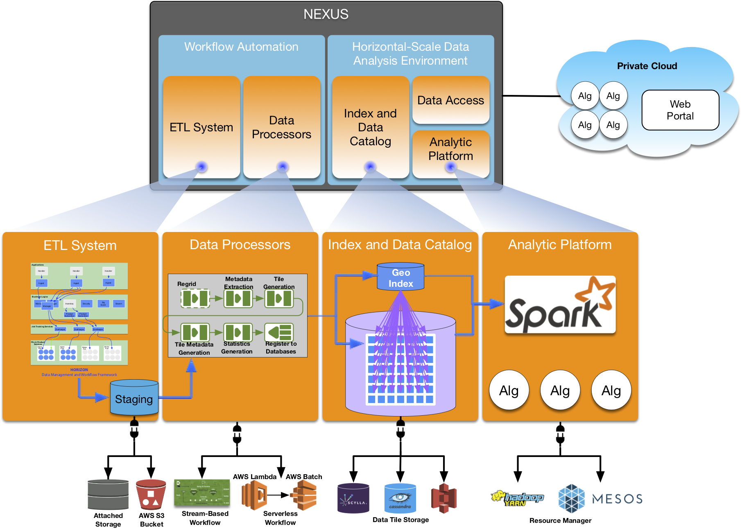
NEXUS’ Pluggable Architecture
Several container-based deployment options
Local on-premise cluster
Private Cloud (OpenStack)
Amazon Web Service
Automate Data Ingestion with Image Generation
Cluster based
Serverless (Amazon Lambda and Batch)
Data Store Options
Apache Cassandra
ScyllaDB
Amazon Simple Storage Service (S3)
Resource Management Options
Apache YARN
Apache MESOS
Analytic Engine Options
Custom Apache Spark Cluster
Amazon Elastic MapReduce (EMR)
Amazon Athena (work-in-progress)
Apache SDAP’s NEXUS supports
public/private Cloud and local cluster
deployments
© 2019 California Institute of Technology. Government sponsorship acknowledged.

Slide 16
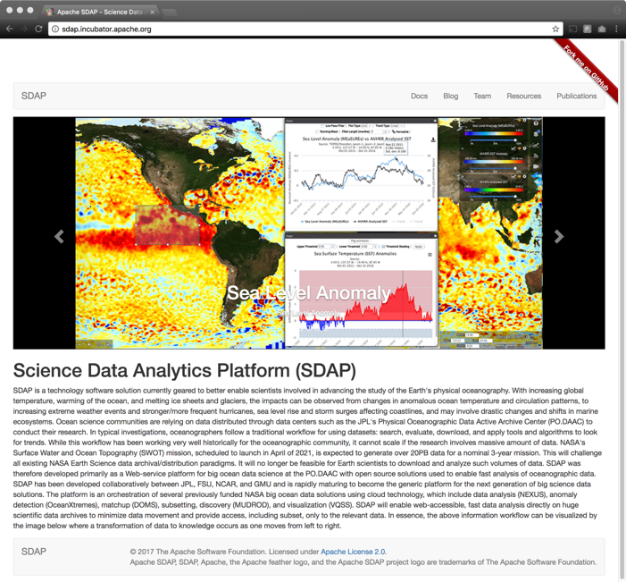
Free and Open Source Software
http://sdap.apache.org
After more than two years of active development, on October 2017 we established Apache Software Foundation and established the Science Data Analytics Platform (SDAP) in the Apache Incubator
Technology sharing through Free and Open Source Software (FOSS)
Why? Further technology evolution that is restricted by projects / missions
It is more than GitHub
Quarterly reporting
Reports are open for community review by over 6000 committers
SDAP has a group of appointed international mentors
SDAP and many of its affiliated projects are now being developed in the open
Support local cluster and cloud computing platform support
Fully containerized using Docker and Kubernetes
Infrastructure orchestration using Amazon CloudFormation
Satellite and model data analysis: time series, correlation map,
In situ data analysis and collocation with satellite measurements
Fast data subsetting
Upload and execute custom parallel analytic algorithms
Data services integration architecture
OpenSearch and dynamic metadata translation
Mining of user interaction and data to enable discovery and recommendations
Come see us at ApacheCon North America
Las Vegas, Sept 9-12, 2019
© 2019 California Institute of Technology. Government sponsorship acknowledged.

Slide 17
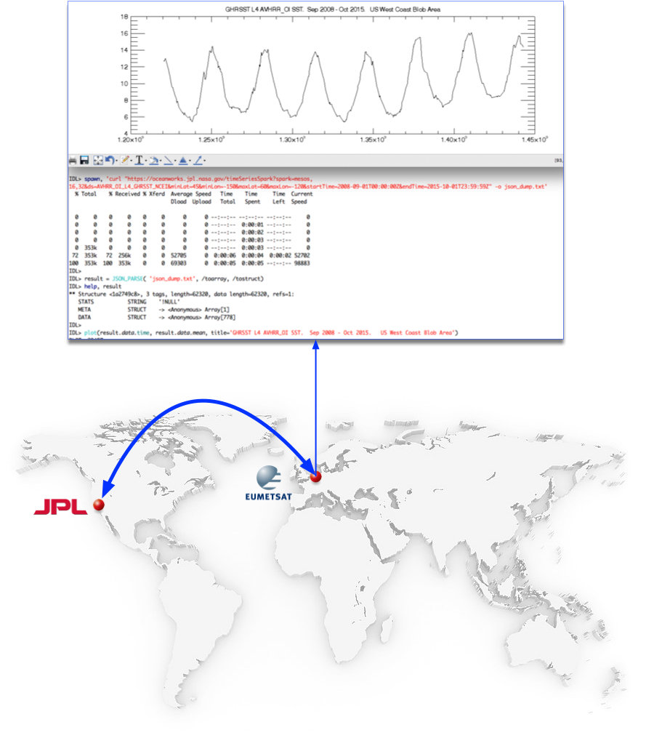
Interact with NEXUS using any Programming Language
IDL> spawn, 'curl "https://oceanworks.jpl.nasa.gov/timeSeriesSpark?spark=mesos,16,32&ds=AVHRR_OI_L4_GHRSST_NCEI&minLat=45&minLon=-150&maxLat=60&maxLon=-120&startTime=2008-09-01T00:00:00Z&endTime=2015-10-01T23:59:59Z" -o json_dump.txt'
% Total % Received % Xferd Average Speed Time Time Time Current
Dload Upload Total Spent Left Speed
0 0 0 0 0 0 0 0 --:--:-- --:--:-- --:--:-- 0
0 0 0 0 0 0 0 0 --:--:-- 0:00:01 --:--:-- 0
0 0 0 0 0 0 0 0 --:--:-- 0:00:02 --:--:-- 0
0 0 0 0 0 0 0 0 --:--:-- 0:00:03 --:--:-- 0
0 353k 0 0 0 0 0 0 --:--:-- 0:00:03 --:--:-- 0
72 353k 72 256k 0 0 52705 0 0:00:06 0:00:04 0:00:02 52702
100 353k 100 353k 0 0 69303 0 0:00:05 0:00:05 --:--:-- 98883
IDL>
IDL> result = JSON_PARSE( 'json_dump.txt', /toarray, /tostruct)
IDL> help, result
** Structure <1a2749c8>, 3 tags, length=62320, data length=62320, refs=1:
STATS STRING '!NULL'
META STRUCT -> <Anonymous> Array[1]
DATA STRUCT -> <Anonymous> Array[778]
IDL>
IDL> plot(result.data.time, result.data.mean, title='GHRSST L4 AVHRR_OI SST. Sep 2008 - Oct 2015. US West Coast Blob Area')
PLOT <29457>
Credit: Ed Armstrong
Jun. 05, 2018
© 2019 California Institute of Technology. Government sponsorship acknowledged.

Slide 18
NEXUS integration points
JPL Oceanworks portal
https://oceanworks.jpl.nasa.gov
Satellite data analysis and in situ matchup
NASA Sea Level portal
https://sealevel.nasa.gov/data/data-analysis-tool
Altimeter sea level rise and variation
NASA GRACE portal
https://grace.jpl.nasa.gov/data/data-analysis-tool/
Mass change analysis
Others in progress……...
© 2019 California Institute of Technology. Government sponsorship acknowledged.

Slide 19
NEXUS roadmap into a visualization service
Integration in the PO.DAAC State Of The Ocean (SOTO) visualization service
https://podaac-tools.jpl.nasa.gov/
SOTO presents long time series global images of ocean temperature, wind, topography, salinity, color, currents and much more
But no capability of time series analysis
NEXUS integration as the backend of SOTO version 5 provides this capability
Currently in a test-user acceptance phase
Let's look at some of its functionality…….
© 2019 California Institute of Technology. Government sponsorship acknowledged.

Slide 20
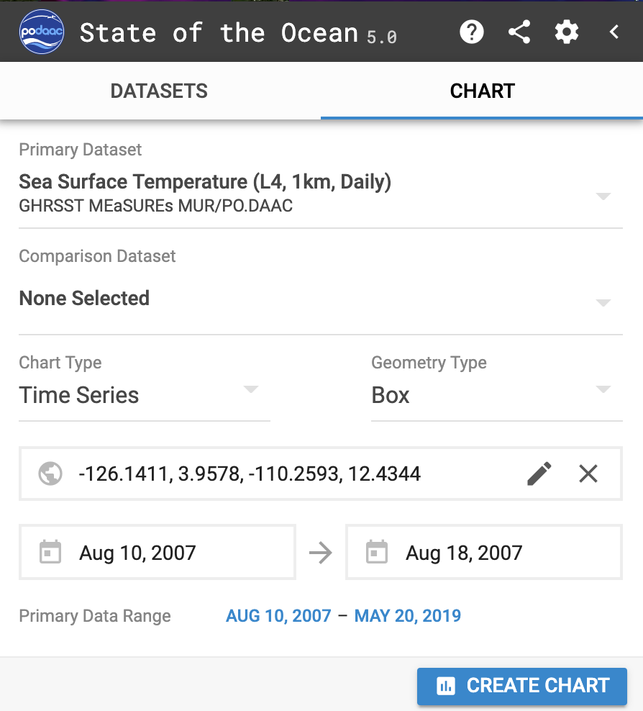
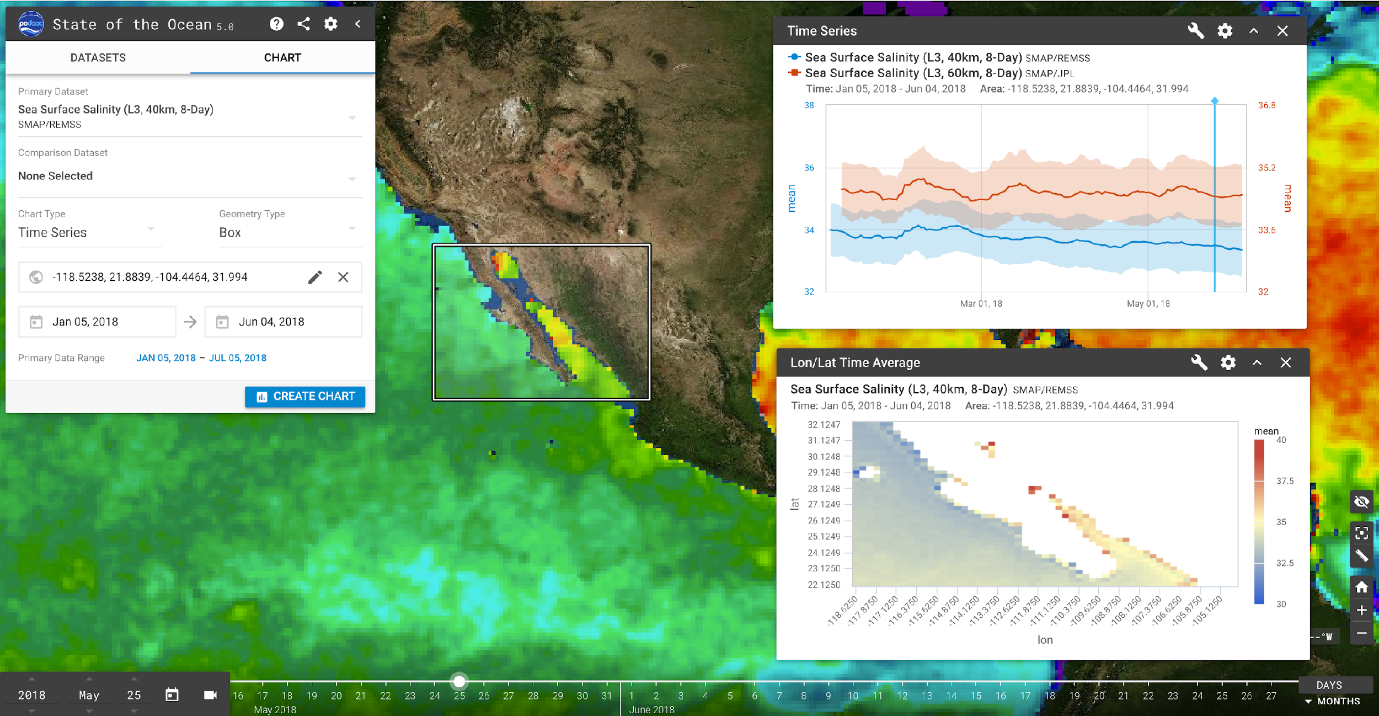
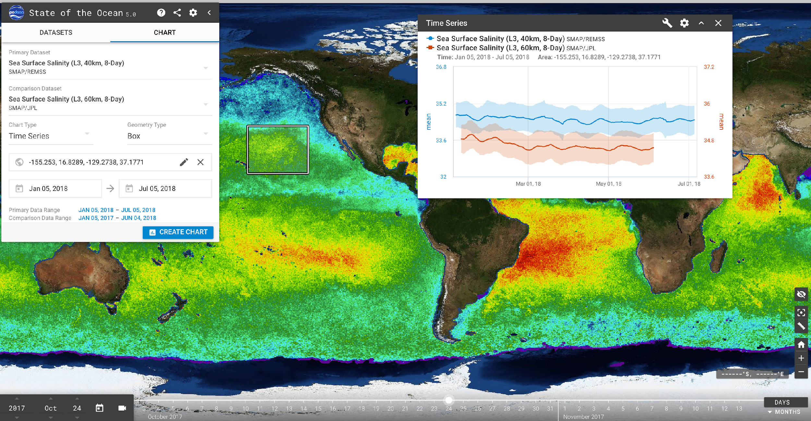
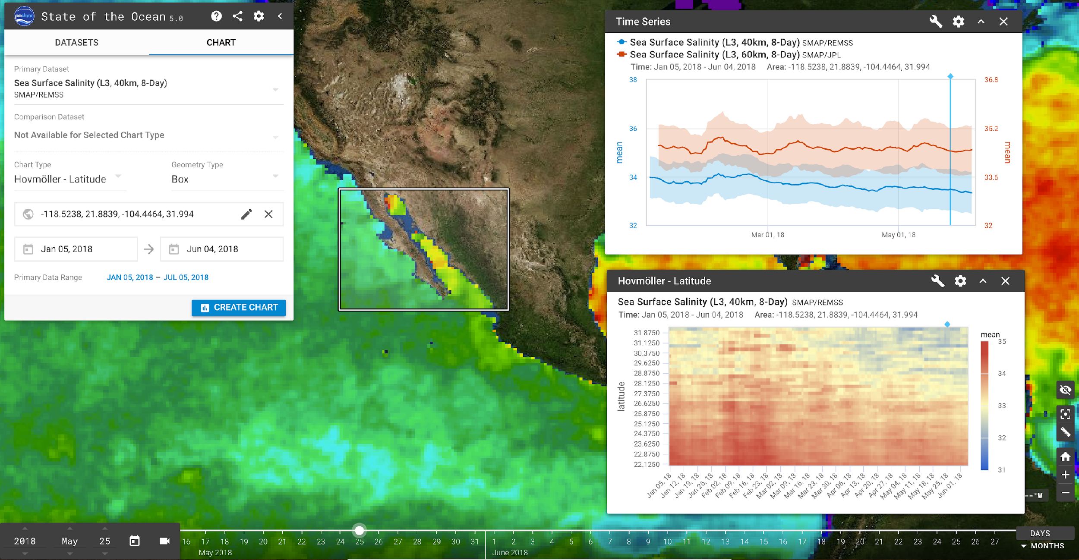
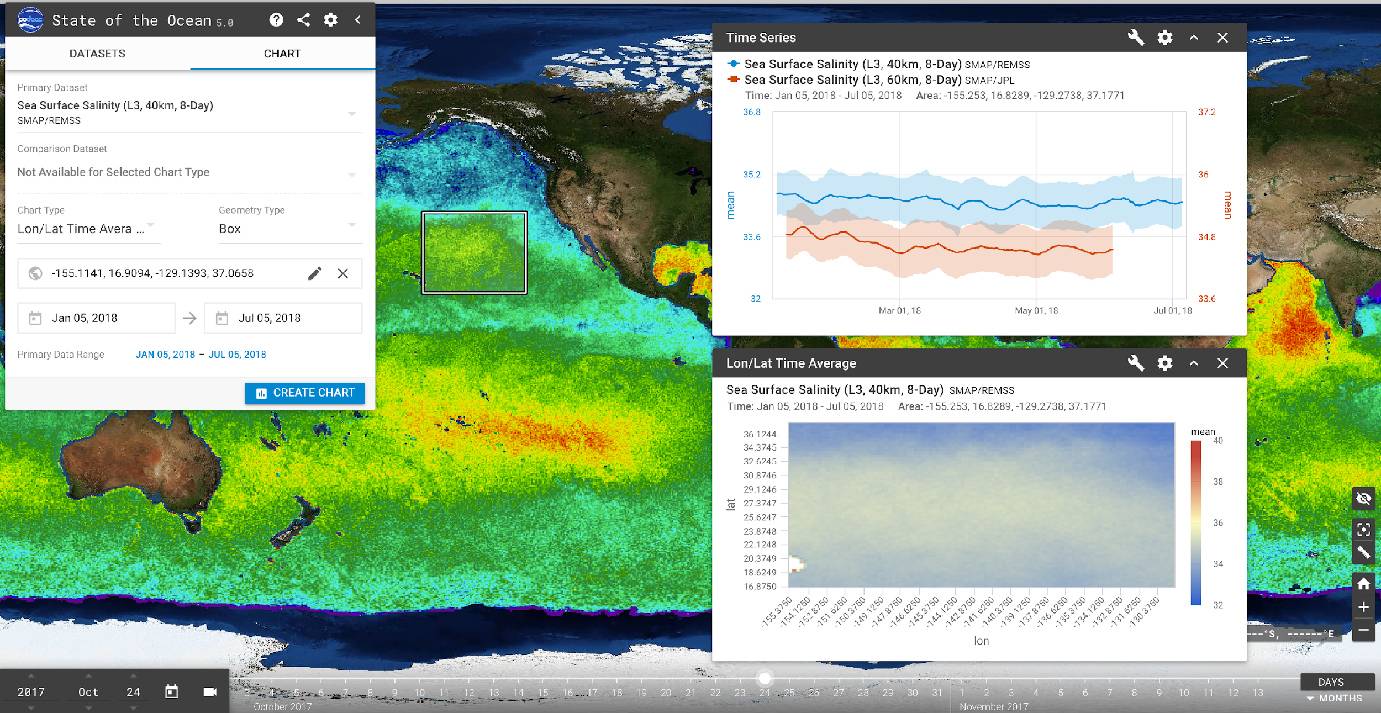
SOTO 5.0 Analytics Capability
© 2019 California Institute of Technology. Government sponsorship acknowledged.

Slide 21
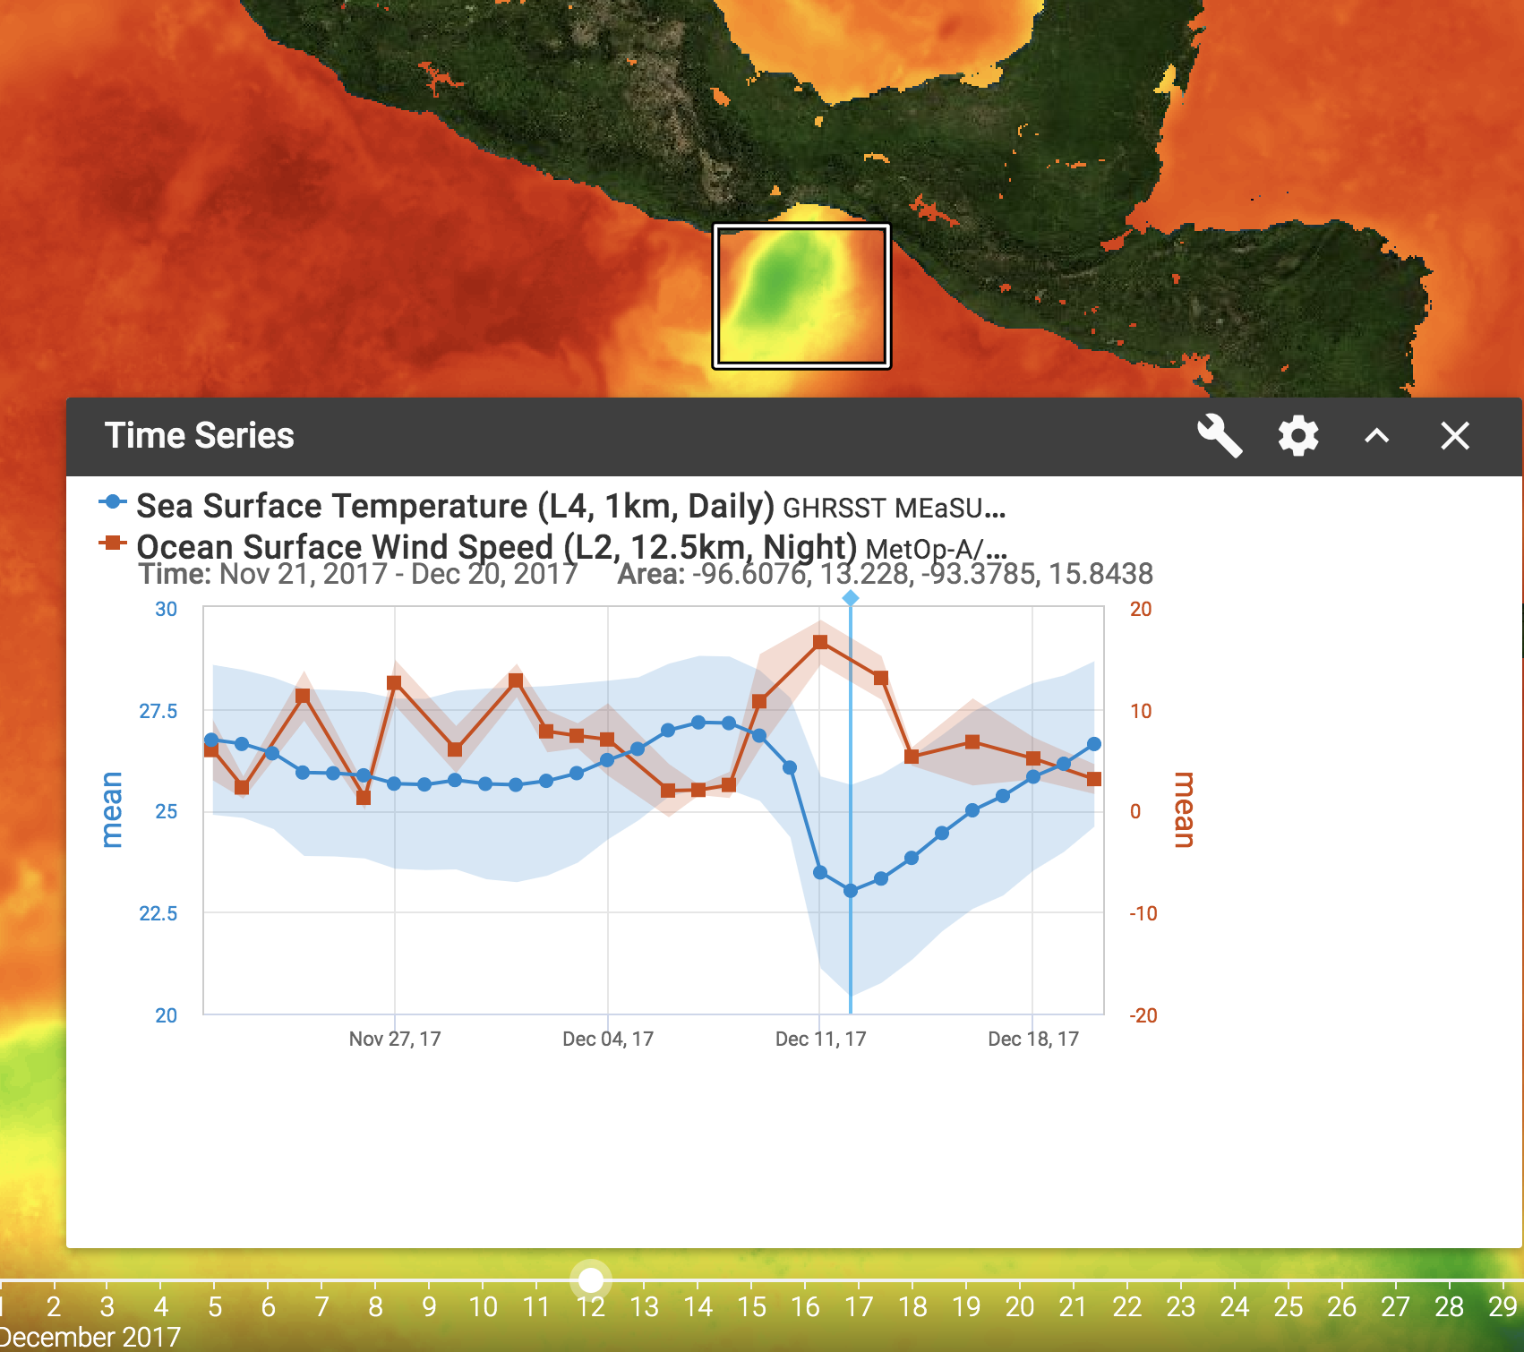
Plots: Time Series
Use Case #1: Tehuantepecers
Geometry Types:
Box
Point
Chart Options:
Variables:
Min
Max
Mean
Cnt
Std
Time
Display Options
Lines and Dots
Dots Only
Bars
Notes:
https://podaac-uat.jpl.nasa.gov/soto/#b=BlueMarble_ShadedRelief_Bathymetry&l=SMAP_L3_Sea_Surface_Salinity_REMSS_8Day_RunningMean(la=true),GHRSST_L4_MUR_Sea_Surface_Temperature(la=true),GHRSST_L4_AVHRR-OI_Sea_Surface_Temperature,ascata_l2_coastal___wind_speed___2880_x_1440___night(lo=0.25),MODIS_Aqua_CorrectedReflectance_TrueColor,MODIS_Aqua_Chlorophyll_A,jpl_l4_mur_ssta___ssta___36000_x_18000___daynight&ve=-128.86742378908403,-5.379700283342503,-72.61752688533322,21.908196131274707&pl=false&pb=false&d=2017-12-12&ao=false&as=2019-06-09&ae=2019-06-16&asz=1/day&afr=500&tlr=days&cpd=GHRSST_L4_MUR_Sea_Surface_Temperature&csd=ascata_l2_coastal___wind_speed___2880_x_1440___night&cct=timeSeriesSpark&cgt=Box&csa=-96.6076,13.228,-93.3785,15.8438&cst=2017-11-21&cet=2017-12-20

Slide 22
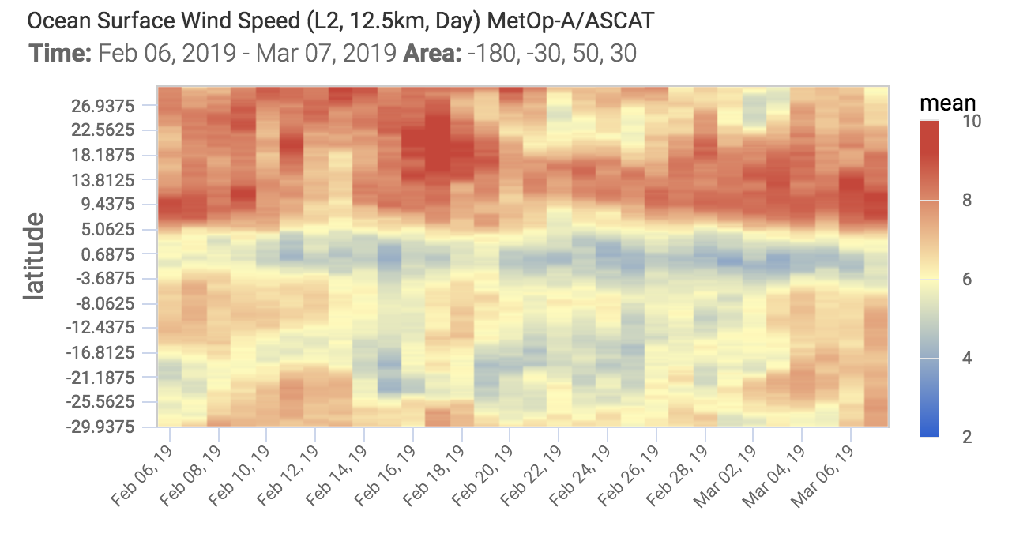
Plots: Hovmoller - Latitude
Geometry Types:
Box
Point
Chart Options:
Variables:
Min
Max
Mean
Cnt
Std
Latitude
Display Options
Invert X/Y
Use Case #1 - Trade Winds

Slide 23
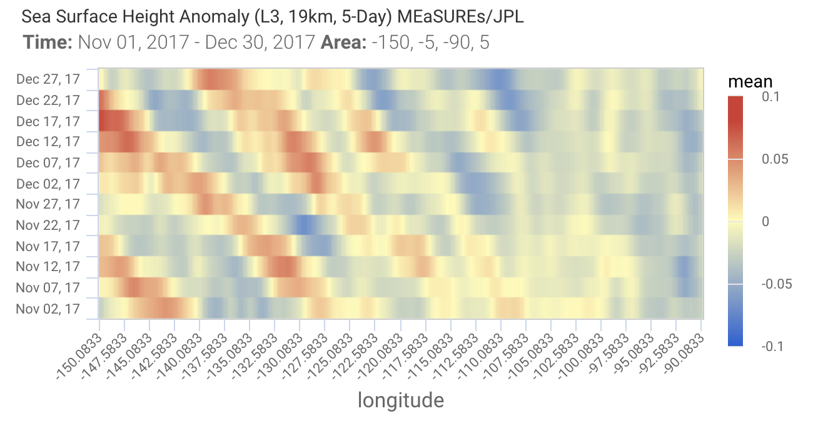
Plots: Hovmoller - Longitude
Geometry Types:
Box
Point
Chart Options:
Variables:
Min
Max
Mean
Cnt
Std
Longitude
Display Options
Invert X/Y
Use Case #1: El Nino 3 Box

Slide 24
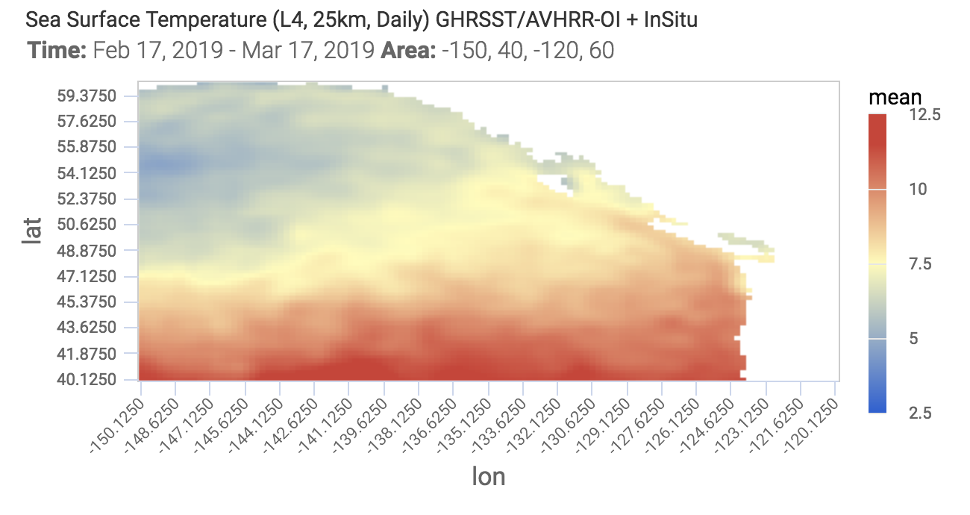
Plots: Time-Average (Lat/Lon)
Geometry Types:
Box
Point
Chart Options:
Variables:
Min
Max
Mean
Cnt
Std
Longitude
Display Options
Invert X/Y
Use Case #1 - The Blob

Slide 25
Summary
Increasingly Big Data (gridded and ungridded) will require technologies that harmonize data, tools, services and computation resources so the scientist can concentrated on results and not on data conditioning or preparation
There are a number of technologies including NEXUS to meet this challenge
NEXUS has demonstrated a successful deployment in the NASA Sea Level and GRACE portals
Ongoing roadmap to deployment as the SOTO visualization backend
Beta testers will be welcomed
Thanks !

Slide 27
Making Big Gridded Data FAIR: The IOOS Approach
Rich Signell USGS Coastal and Marine Geology Program Woods Hole, MA
ESIP Summer Meeting 2019, Tacoma WA

Slide 28
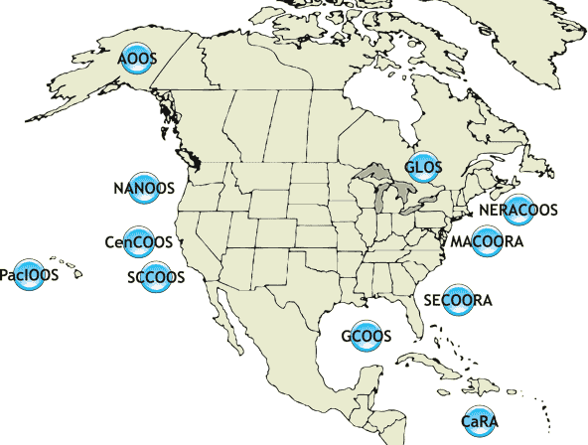
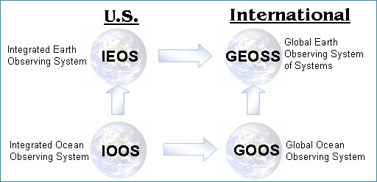
US Integrated Ocean Observing System (IOOS)
11 Regional Associations
17 Federal Agencies

Slide 29
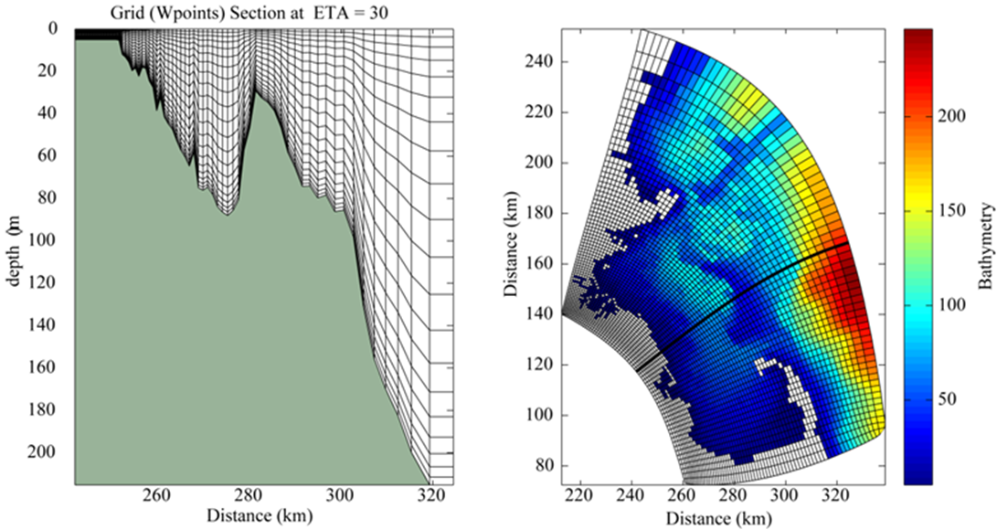
IOOS Big Gridded Model Data

Slide 30
CF Conventions makes data Interoperable
float temp (ocean_time, s_rho, eta_rho, xi_rho) ;
temp: standard_name = “sea_water_potential_temperature" ;
temp: units = "Celsius" ;
temp: coordinates = "lon_rho lat_rho s_rho ocean_time" ;
double s_rho (s_rho) ;
s_rho: long_name = "S-coordinate at RHO-points" ;
s_rho: standard_name = "ocean_s_coordinate_g1" ;
s_rho: formula_terms = "s: s_rho C: Cs_r eta: zeta depth: h depth_c: hc" ;
s_rho: positive = "up" ;
cfconventions.org

Slide 31
Web services make data Interoperable
Nonstandard Model Output Data Files
THREDDS Data Server
Standardized (CF-1.6, UGRID-1.0) Virtual Datasets
Library or Broker
Clients
ROMS
Web Services
Matlab
NetCDF-Java
NCOM
NcML
OPeNDAP+CF
IDV
NcML
Common Data Model
WCS
Panoply
HYCOM
NetCDF4-Python
NcML
SOS
ArcGIS
SELFE
Grid Ugrid TimeSeries Profile Trajectory TimeSeriesProfile
Python
NcML
WMS
ERDDAP
ADCIRC
NcML
NetCDF Subset
Godiva2
FVCOM
NcML
ncISO
CKAN-pycsw
Observed data (buoy, gauge, ADCP, glider)
Geoportal Server
Nonstandard Data Files
Catalog Services
GeoNetwork

Slide 32
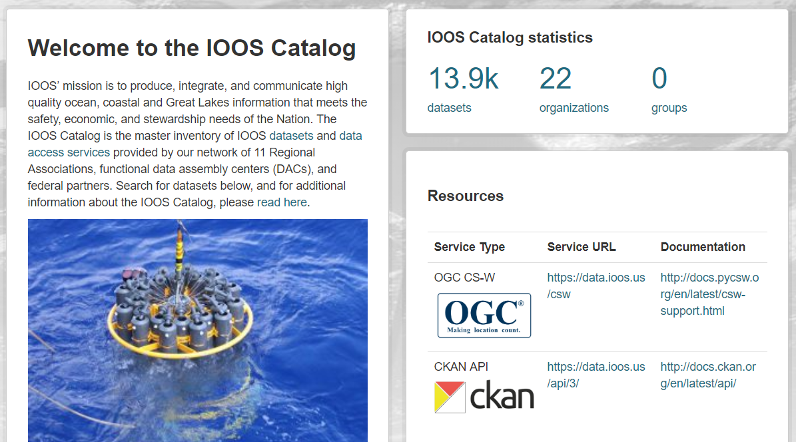
ISO metadata makes data Findable

Slide 33
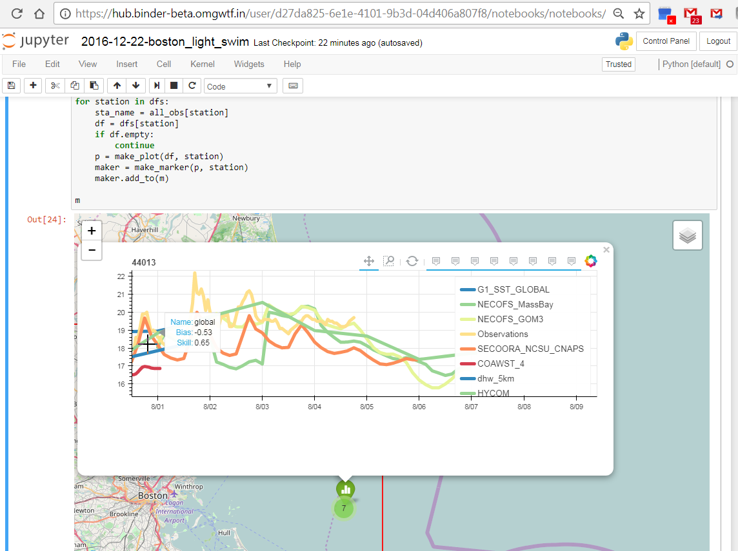
Binder Notebooks make workflows Reusable

Slide 34
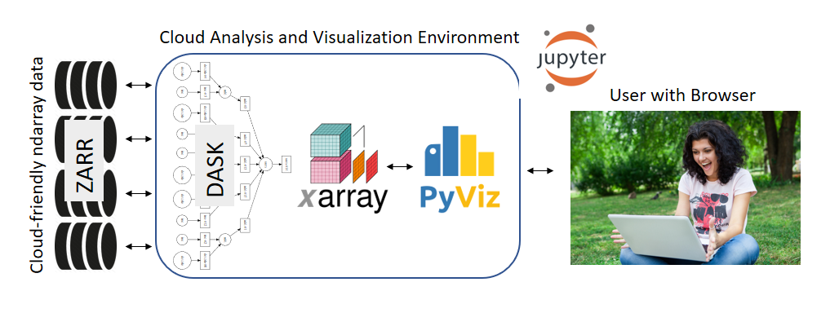
Pangeo Architecture

Slide 35
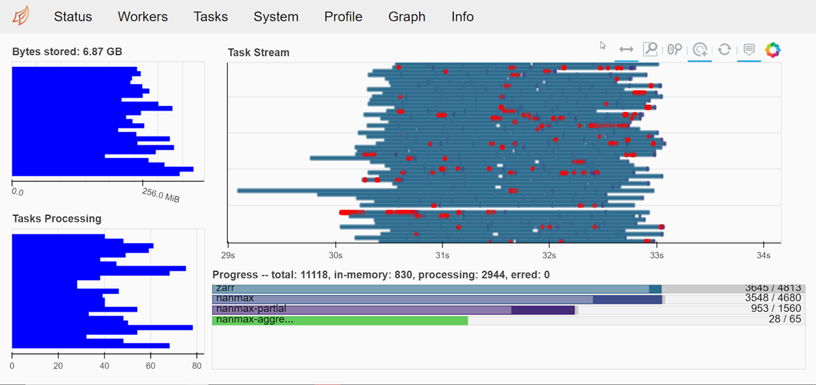
FAIR Big Gridded Data in the Cloud
https://github.com/reproducible-notebooks

Slide 36
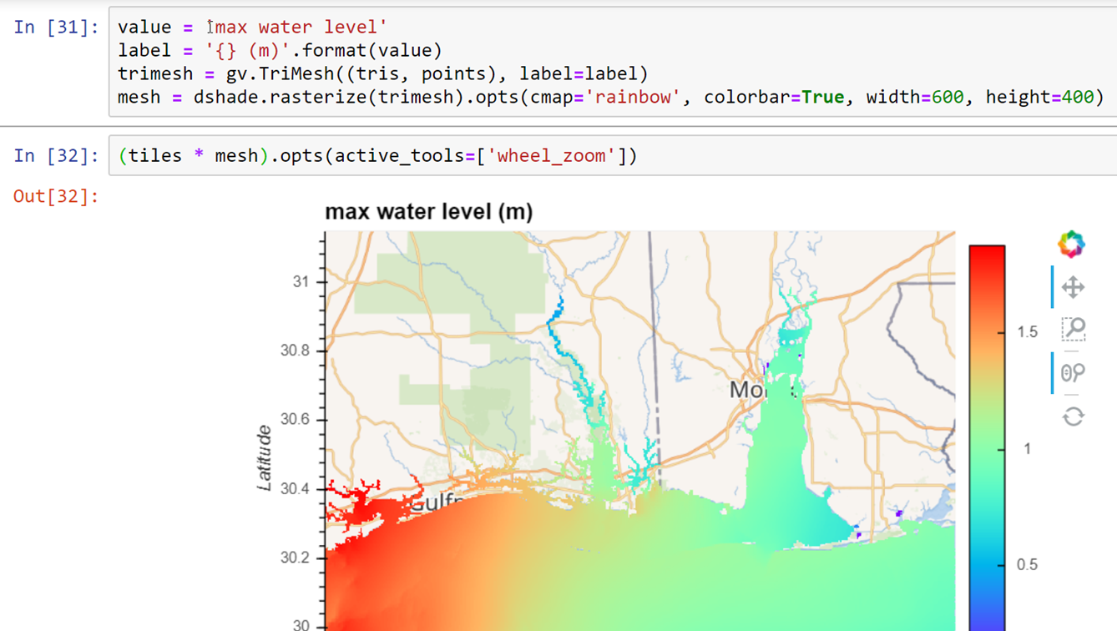

Slide 37
The Future: All data proximate “in the I2 Sense”
Amazon
Google
I2
I2
I2
XSEDE JetStream
Microsoft
I2

Slide 38
The Cloud can make this all work better
Can use S3 direct access instead of data services
“Cloud Data Optimation” sessions this afternoon
Datasets need to be standardized at the S3 level
“NetCDF-CF Workshop” sessions this afternoon and tomorrow morning
Standardized ISO records needed for S3 items
Move data and workflows to the Cloud!
“Using Pangeo JupyterHubs” session after lunch
“Scalable, Data-Proximate Computing” session tomorrow afternoon

Slide 40
STARE Compatibility
Mike Rilee, RST LLC
Kwo-Sen Kuo, Bayesics LLC
James Frew, Niklas Griessenbaum, UCSB
James Gallagher, Kodi Neumiller, OPeNDAP, Inc.
‹#›

Slide 41
The Problem
Dissociation between array indices and geo-spatiotemporal reference
severely impedes interoperability

Slide 42
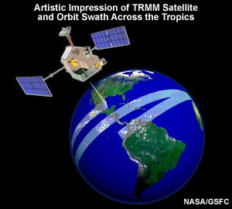
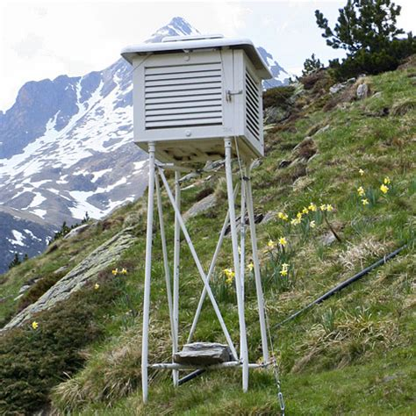
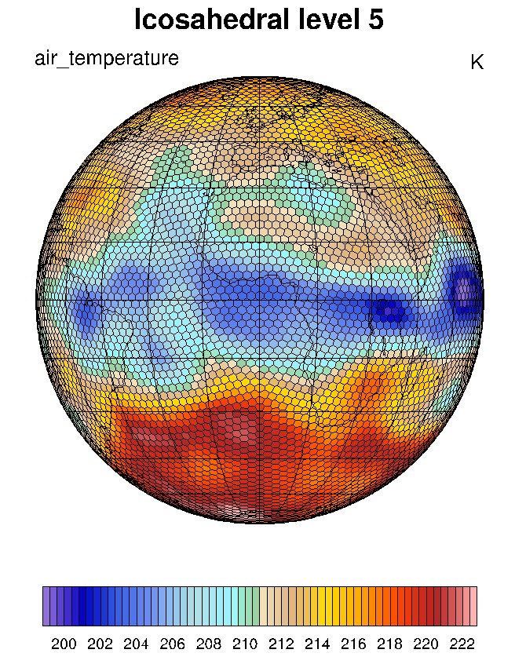
There’s more than just one data array…
SWATH
GRID
POINT
SIMULATION
GRID
We need a universal framework.

Slide 43
EOSDIS: Grid, Swath, & Point Data
How to compare?
“Regrid” to common grid?
Satellite instrument instantaneous field of view (IFOV)
In situ observation station
m
j
Point
Grid
l
Swath
i
Notes:
Different data models create problem. Different resolutions (and geometric characteristics) add more diversity!

Slide 44
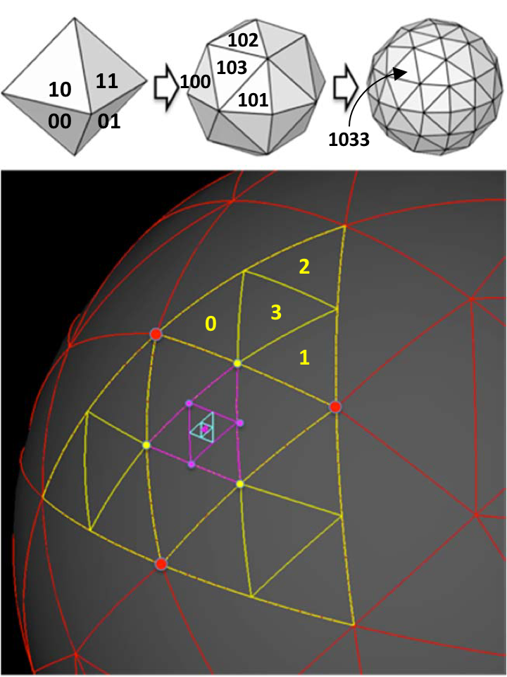
A scalable indexing unifying diverse big Earth Science data
SpatioTemporal Adaptive Resolution Encoding (STARE)
Left-justified HTM Encoding
Quadtree hierarchy
Indexes geolocation – a substitute for lat-lon
Contains approximate data resolution
Efficient on distributed compute/storage resources
The bit format of the STARE spatial index including geo-position and resolution.
Notes:
Make sure we mention that this is only the Spatial element of STARE

Slide 45
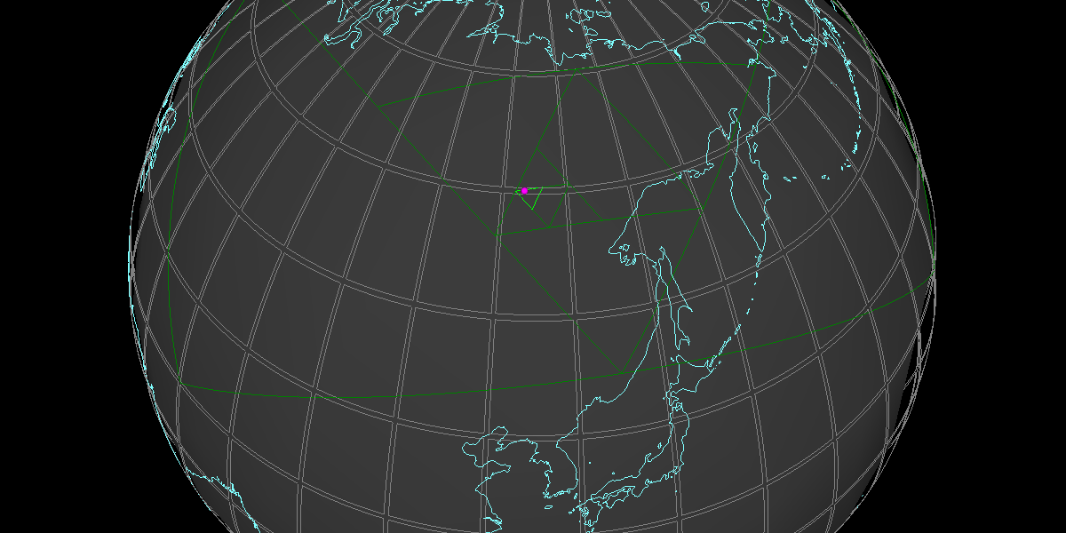
STARE vs Floating-Point Encoding
 | Longitude | Latitude
Human readable | +123.4° | 60°
Single-precision floating-point | 0x42f6cccd | 0x42700000
STARE spatial id* | 0x36ee9398f7210f34
*STARE id also includes resolution information. In this case, it points to quadfurcation level 20, i.e. ≲ 10-m
The smallest triangle in the figure is at quadfurcation level 6.

Slide 46
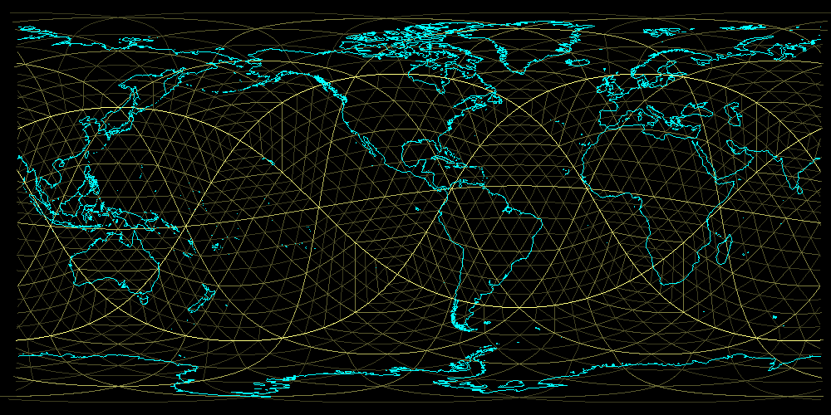
Notes:
Triangles at multiple levels. Levels 0-4.

Slide 47
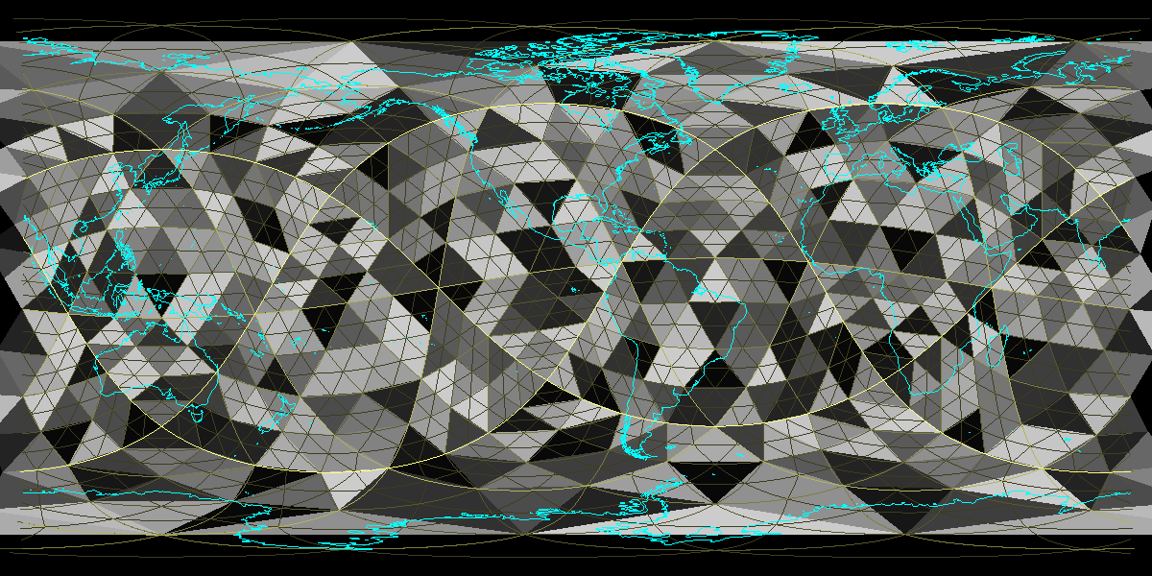
Notes:
2019-0407-152745 Equirectangular - Level 3 chunks uniformly distributed across 16 “nodes”
Chunk1 Start
ncolor = 16
chunkLevel = 3
chunkTransparency = 0
chunk color_scale = 1
Drawing faces with ncolors bin colors
chunks randomized: uniformDouble
Drawing trixels at various levels
nbins is the number of bins into which to put trixels
nlevels is the number of levels to draw. levels=[0,1,2,...,nlevels-1]
nbins = 1
nlevels = 5
Chunk1 End

Slide 48
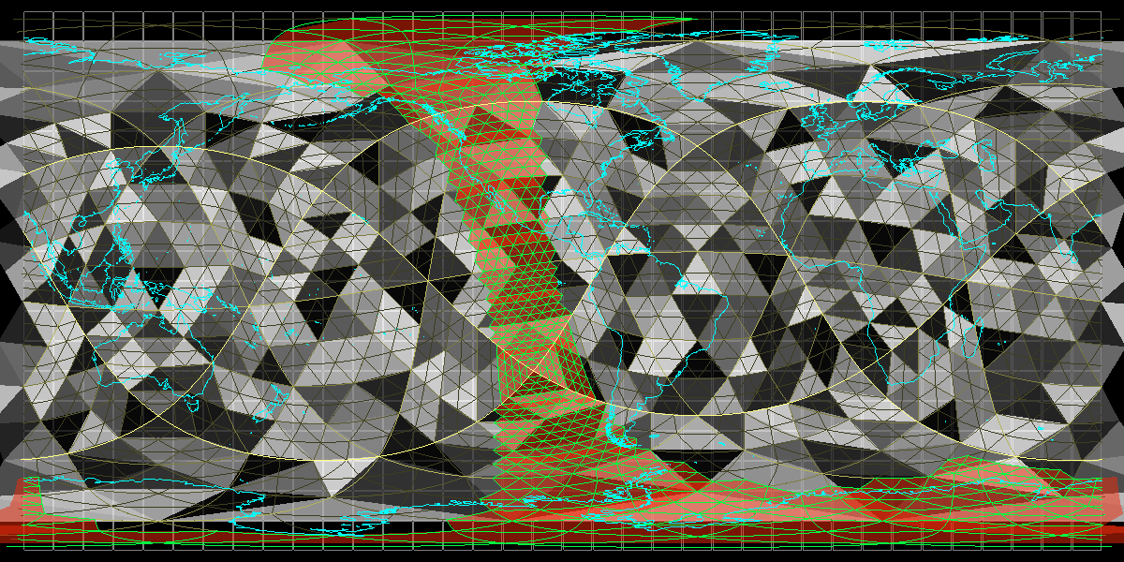
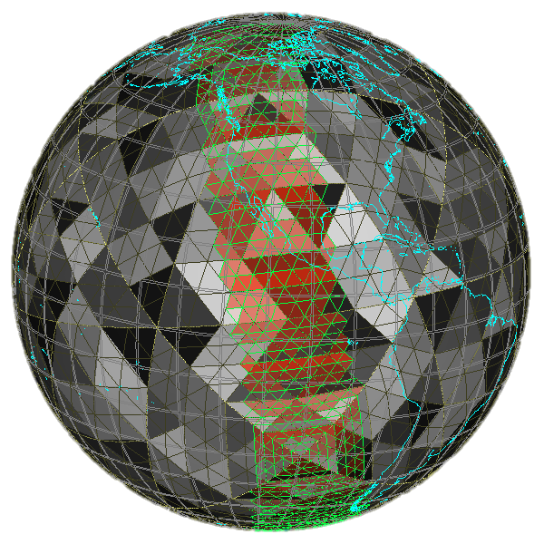
Notes:
chunkLevel=3 (nodes). TrixelGrid=0,1,2,3,4 (yellows getting darker). Swath, resolution level=5 (green).

Slide 49
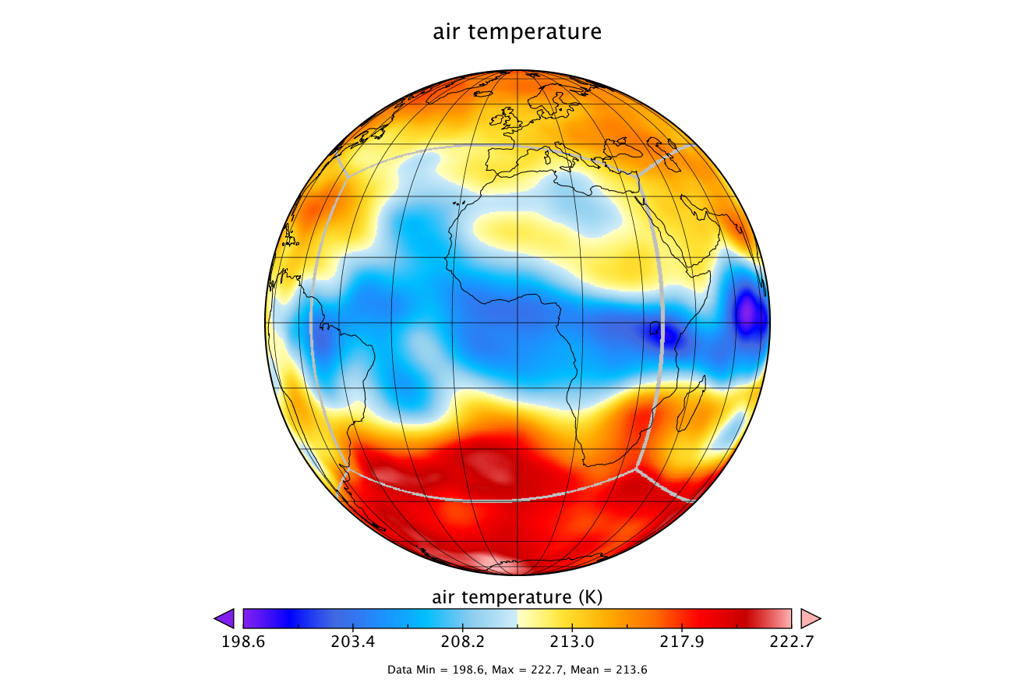
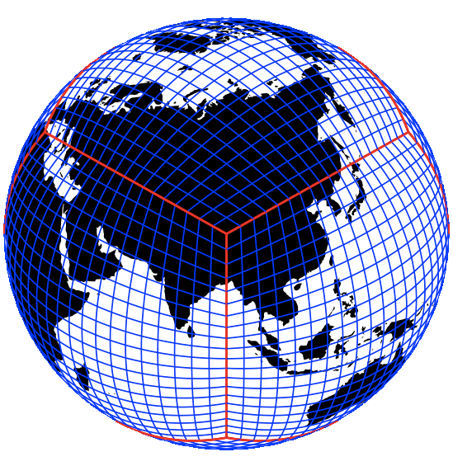
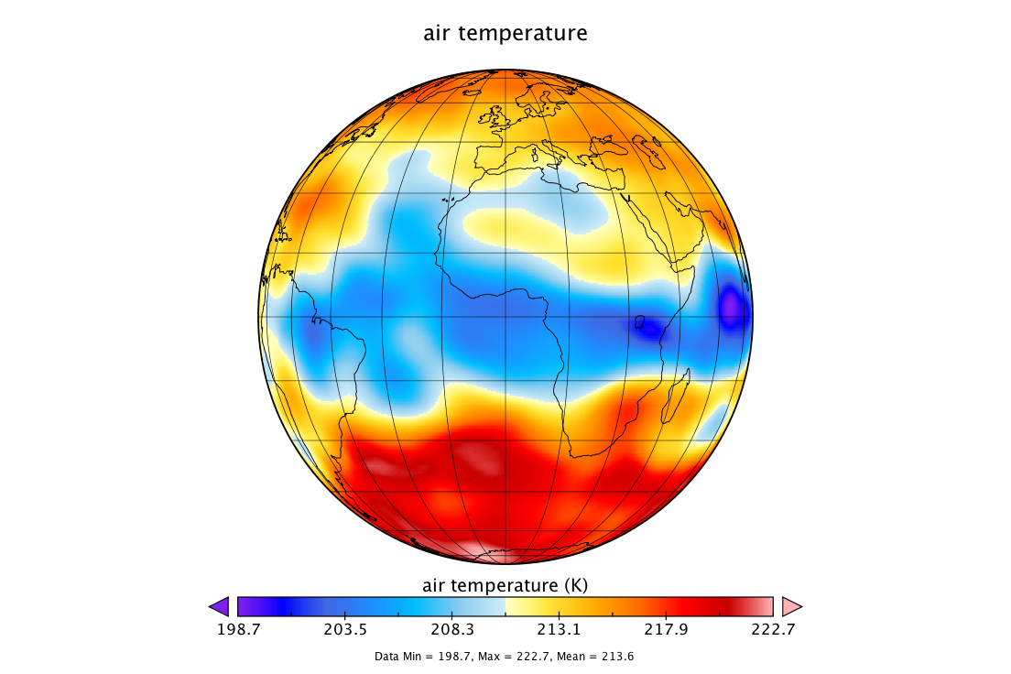
Next-generation global grids
Cubed-Sphere
REGRID
REGRID
LatLon
NOGGIn

Slide 50
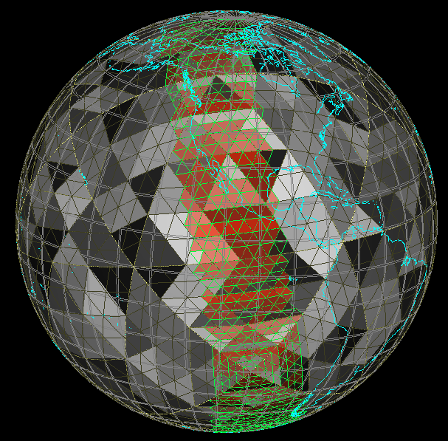
Next-generation global grids
Cubed-Sphere
REGRID
REGRID
LatLon
NOGGIn

Slide 51
Next-generation global grids
Cubed-Sphere
INDEX
INDEX
REGRID
INDEX
REGRID
LatLon
NOGGIn

Slide 52
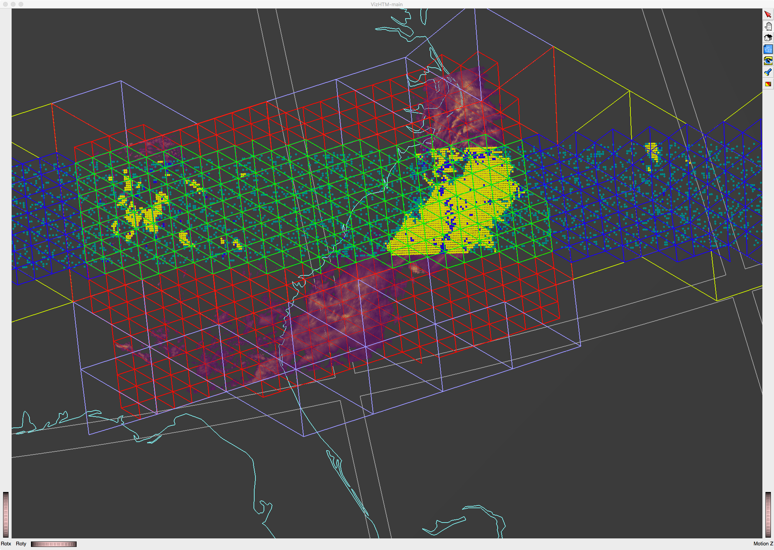
Notes:
05-2016-1108-Intersection-TRMM+NMQ-htm+data-2.tiff
Zoom in of the preceding for detail & clarity.

Slide 53
NMQ data conditionally selected on TRMM
Notes:
06-2016-1108-ConditionalQuery-TRMM+NMQ-NMQSelectedWhereTRMMIndicatesPositive-1.tiff
Conditional subsetting as we’ve discussed previously. Data from one set is selected according to data in another, where the geometries of both data sets are dramatically different.

Slide 54
STARE Updates
New Simplified API
Temporal Indexing (Hierarchical Calendrical)
Astronomical standards, providing UTC and TAI
Python interface
Baby steps with OPeNDAP
Next steps
Build out functionality & work with partners, community
Current support for STARE development is provided by the NASA ACCESS program. Award ID no. 80NSSC18M0118.

Slide 56
L34RS: Level 3 and 4 Regridder & Subsetter for Gridded Data
Big Gridded Data: The transition from legacy to next generation
ESIP Summer 2019
Jay Su^{1,2}, Binita KC^{1,2}, Carlee Loeser^{1,2},
Hualan Rui^{1,2}, Suhung Shen^{1,3}, Dana Ostrenga^{1,2}
¹NASA Goddard Space Flight Center, GES DISC
²ADNET Systems
³George Mason University
<jian.su@nasa.gov>
Notes:
As you can see we have a strong team of scientists and engineers.

Slide 57
LDAS
Notes:
The Subsetter/Regridder is very useful/helpful for LDAS users. The NLDAS data are in GRIB files, with hourly temporal resolution. Many users have difficulty to handle GRIB formatted data. The Subsetter/Regridder enables the users to get variable and spatial subsetted data in NetCDF files, which is a big step for making NLDAS data to be Analysis Ready Data (ARD).

Slide 58
MERRA-2: 30M files & save 95%

Slide 59
Products
MERRA
MERRA-2
FLDAS
GLDAS
NLDAS
NCA-LDAS
OMI
GPM
…
Notes:
Service side

Slide 60
Highlights
User-friendly Lat/Lon input
Spatial/Temporal/Level/Variable subsetting
Point selection
Various interpolants and output grids
Customized metadata modification
Powerful data handling of inputs and outputs

Slide 61
https://disc.gsfc.nasa.gov/
Notes:
OMI?

Slide 62
Highlights
User-friendly Lat/Lon input
Spatial/Temporal/Level/Variable subsetting
Point selection
Various interpolants and output grids
Customized metadata modification
Powerful data handling of inputs and outputs

Slide 63
Highlights
User-friendly Lat/Lon input
Spatial/Temporal/Level/Variable subsetting
Point selection
Various interpolants and output grids
Customized metadata modification
Powerful data handling of inputs and outputs

Slide 64
Interpolations
nn: nearest neighbor
dis: distance-weighted average
bil: bilinear
bic: bicubic
con: first order conservative
con2: second order conservative
laf: largest area fraction

Slide 65
Grids
JRA-55 | 20cr2x2 | MERRA0.5 | MERRA1.25 | gpcp2.5 | cfsr0.5a
cfsr0.5b | cfsr1.0 | cfsr2.5 | ncepncar2.5 | geos1x125 | geos1x1
geos4x5 | geos2x25 | geos0.25 | geos0.5 | fv1x125 | fv2x25
fv4x5 | ERA-40 | ERA2.5 | ERA-I | ERA1.5 | ERA.75
GPCC2.5 | GPCC1.0 | GPCC0.5 | CMORPH0.25 | NLDAS-2 | GLDAS-2_0.25
GLDAS-2_1 | NCA-LDAS | GFDL
Notes:
GFDL grid was requested by a NOAA team. They were especially interested in comparing MERRA2 with GFDL.

Slide 66
OMI Sulfur Dioxide (SO2) Total Column
Notes:
As an example, users can select output grid same as MERRA2

Slide 67
MERRA-2: dust scattering AOT [550 nm] - PM 1.0 um (M2T1NXADG)
Notes:
Users can also select daily mean of MERRA2 data, then compare them with the regridded OMI data.

Slide 68
Highlights
User-friendly Lat/Lon input
Spatial/Temporal/Level/Variable subsetting
Point selection
Various interpolants and output grids
Customized metadata modification
Powerful data handling of inputs and outputs

Slide 69
Filetypes
netCDF
HDF-EOS2
HDF-EOS5
HDF5
GRIB
ASCII
COG (Cloud Optimized GeoTIFF)
Zarr
…
Notes:
It might take a little while for GES DISC to put the service in cloud, but we will soon provide cloud-friendly data for the users, eg, COG.

